Slide 1

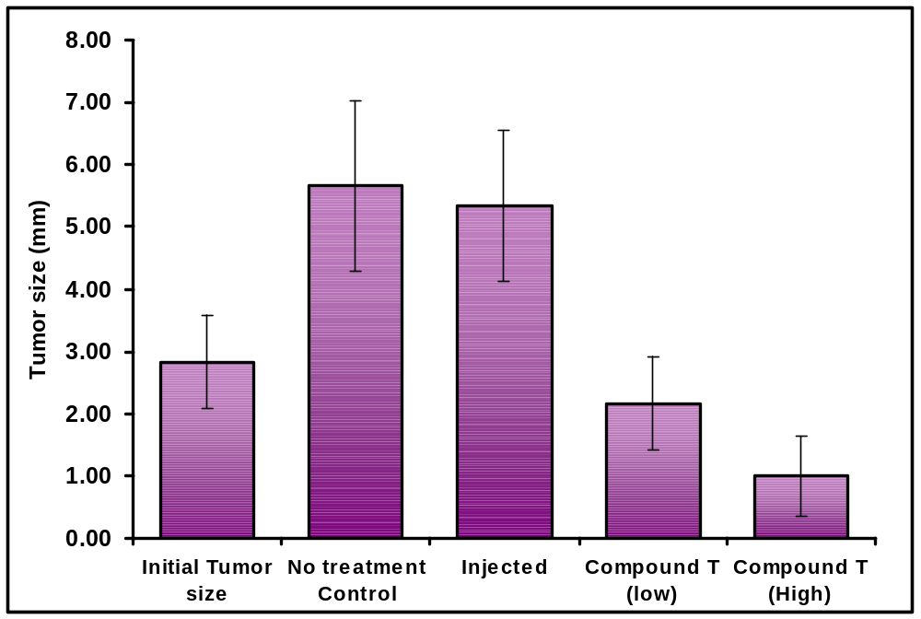
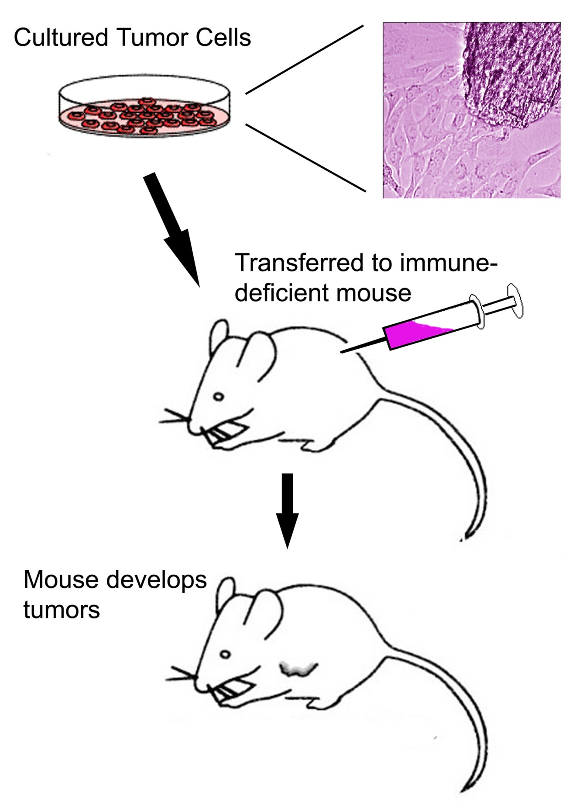
Title: Descriptive, No too long, 80 point, Shadow, white.
Some conferences require email and phone number.
G.P. Taylor and R.J. Norvegicus (Names ~72 pt)
The University of Texas at San Antonio, San Antonio TX, 78249
Gail.taylor@utsa.edu
(210) 458-5761
Abstract
Methods
Results - con’t
Insert Text Boxes. You can do many things to text boxes. Then paste abstract text into here. Resize it until it looks good. Use 36-30 point font. Abstract may or may not be required. Preferably that turned in for abstract book. Will provide redundant information. Preferably 150 words (up to 250). If space is needed, the abstract can also be reduced in size…along with the references and acknowledgements.
Can include summary figure; flow chart, image, photographs. Can bullet to shorten. Few words if possible. Be sure to include subjects, experimental design, statistical methods, drugs and equipment used.
Compound X Decreased Tumor Size
Photographs and tables will look best on gray, cream or light-colored complimentary background.
Figure 1. Protocol. Tumor cells were obtained from ______________ and cultured. 1 million cells were injected IP into an immune deficient mouse (which). After __________
Introduction (or Background)
Make very brief. Foundation for your work. Broad intro to the gap in literature that your work is filling. Why you chose to study.
Equivalent of 1 double spaced 81/2x11. Separate into easy to read paragraphs.
All body text 24-30 pts (28 here). I prefer Ariel or Verdana. Nice dark color (blue or black). No yellow. No red or yellow on a blue background.
Hint 1. To make the objects in one area move as a group, highlight them all by holding down the shift key and clicking on them consecutively. Then go to the drawing tools and choose group. They should now move together. If you have images on a background, do not resize by stretching the whole item; ungroup first and resize the background.
Hint 2. When you want to move something, but want to maintain either its horizontal or vertical position (ex., moving down one of the heading boxes), hold down the shift key, click on the item and drag it. The first direction you move (horiz. or vert.) will be the only way that it can go…no diagonal.
Hint 3. Make slight changes in font size or spacing to fill columns.
When you use one effect (outlined text boxes, for example) then use them consistently throughout.
Figure 2. Compound X significantly (p<0.01) shrank osteosarcoma tumors in nude mice, during 1 mo. of treatment. Tumors in carrier-injected controls significantly increased in size over the same time (p<0.01). No behavioral effects or significant weight loss were observed in treated mice during this time. n = 5 at all time points.
Expand and contract components until gaps are minimalized
Results
Conclusions (Disc. or Summary)
Figure Based but with enough words to be stand alone. Text can be exclusively in Figure captions.
Try to manipulate most of images/photographs outside of PowerPoint (Photoshop, etc). Photos should be 300 dots per inch to start with. They should be .jpg, .bmp, .tif, or .gif format. If you click on their corner then hold down the shift key, you will increase them proportionally, and not get odd-looking skinny or squashed lettering.
Excel graphs can be copied from within Excel and dropped into place. They can be stretched and reshaped with no trouble from within PowerPoint. Click once on them to manipulate or format them (if you click twice, you get a spread sheet). Tables from Excel or Word can also be manipulated.
Gifs and images from clipart in PowerPoint should also look good when inserted directly.
Bullets to stress.
Few words. Can be larger. Some people read only this.
Summarize results, implications (Refer to hypothesis), tie back to real world problem, tell about future directions.
References
Purpose (or Objective, Goal)
Quigley HA, Nickells RW, Kerrigan LA, Pease ME, Thibault DJ, Zack DJ. Retinal ganglion cell death in experimental glaucoma and after axotomy occurs by apoptosis. Invest Ophthalmol Vis Sci 1995;36:774-86
Can make smaller if needed for space. Can leave out titles if need space.
Purpose, Objective, Aim, Goal: Your hypothesis can go here as well, or in your introduction, bolded.
Acknowledgements
Give all Textboxes identical width, keeping margins in mind. They will have variable height.
0.2 internal LR margins
0.05 internal top/bottom margins
Funding Organization/Agency/Source & Acknowledgements, possible conflicts of interest - usually placed at the bottom right of the poster. One paragraph (short). Can make smaller if needed.
Partially funded by NIH/NIGMS MARC U*STAR GM07717
Partially funded by NIH/NIGMS RISE GM60655

