Slide 1
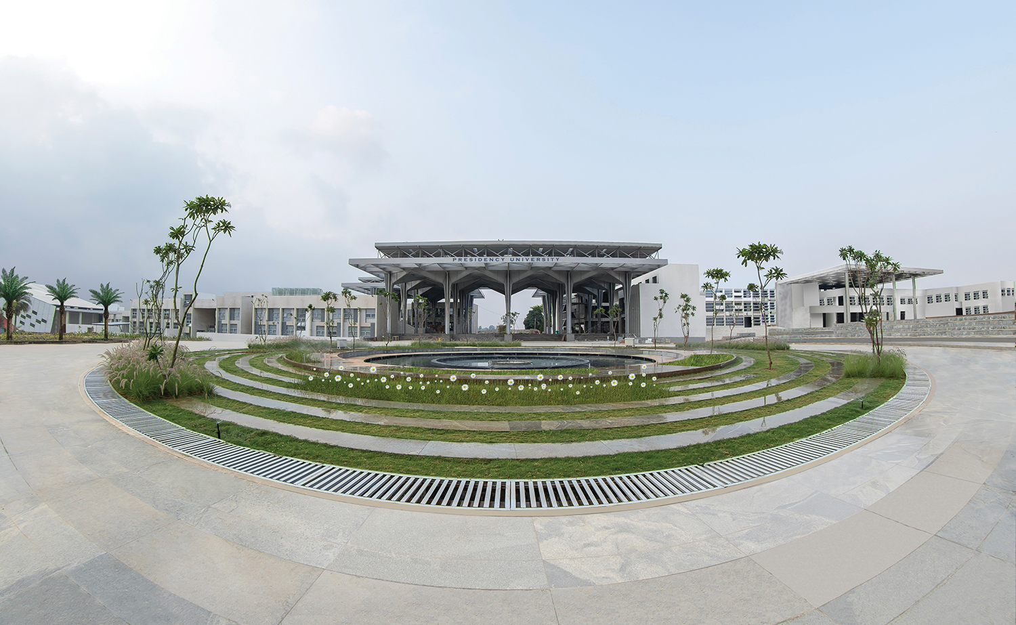

CLOUD COMPUTING FOR IOT-CIT3406
Department of Computer Science Engineering
School of Engineering

Slide 2
Module 3: Cloud Computing
Presented by,
Sharanya S
Assistant Professor

Slide 3
Contents
Introduction to Cloud Computing
Cloud Management
Cloud Storage
Cloud Data Processing .
On-demand IT Resources .
Cloud Service Providers.
Introduction to Google Cloud Platform

Slide 4
Introduction to Cloud Computing
Definition: Cloud Computing is the delivery of computing services such as servers, databases, networking, software, and analytics through the Internet (“the cloud”).
Instead of maintaining local servers, companies use remote data centers managed by cloud providers.
Example:
  When you store files in Google Drive, you are using cloud storage.
  When IoT data from sensors is stored and processed on AWS, that’s cloud computing.
Key Benefits:
✅ Cost-effective (no need for expensive hardware)
✅ Accessible anywhere
✅ Flexible and scalable

Slide 5
Cloud Computing and IoT
IoT devices continuously generate massive amounts of data (temperature, humidity, traffic, etc.).
Storing and processing all this data locally is difficult — cloud platforms solve this.
Cloud provides:
  Data storage: Keep sensor readings safely.
  Data processing: Analyze and interpret data in real-time.
  Connectivity: Devices connect easily to servers via the internet.
Example: A smart home uses cloud computing to collect data from sensors and automate lights, fans, or alarms based on user preferences.

Slide 6
Characteristics of Cloud Computing
Feature | Description | Example
On-demand self-service | Access computing resources as needed without human help | Creating a virtual machine anytime
Broad network access | Services available over the Internet from anywhere | Accessing AWS or Google Cloud from any device
Resource pooling | Multiple customers share a pool of resources | Shared servers and storage
Scalability & Elasticity | Resources can be increased or decreased automatically | Auto scaling in AWS
Measured service (Pay-as-you-go) | Pay only for what you use | Cloud bills like electricity usage

Slide 7
Cloud Management
Cloud Management involves handling and controlling computing resources on cloud platforms.
Includes:
  Provisioning: Allocating resources such as storage or compute power.
  Monitoring: Keeping track of usage, cost, and performance.
  Automation: Using scripts or tools to automatically start or stop services.
  Security management: Protecting data and managing access controls.
Example Tools:
AWS Management Console
Microsoft Azure Portal
Google Cloud Console
These tools allow developers to monitor and manage their IoT applications from a single dashboard.

Slide 8
Cloud Storage
Cloud storage means saving data on the Internet instead of on local drives.
It ensures data safety, backup, and easy access from anywhere.
Types of Cloud Storage:
Object Storage: Stores unstructured data (e.g., images, videos, sensor logs) – Example: AWS S3.
File Storage: Used for files and folders that multiple systems can share – Example: Azure Files, Google Filestore.
Block Storage: Used for databases or high-speed operations – Example: AWS EBS.
Advantages:
Scalable storage space
Data redundancy (backups on multiple servers)
Easy integration with IoT analytics tools

Slide 9
Data Processing in Cloud
Once IoT devices send raw data to the cloud, it must be processed and analyzed.
Cloud computing offers high-speed CPUs and distributed systems to handle this.
Types of Processing:
Batch Processing: Large data sets processed at once (e.g., analyzing daily sensor data).
Stream Processing: Real-time analysis of continuous data (e.g., live vehicle tracking).
Examples:
AWS Lambda – processes data when triggered (serverless).
Azure Stream Analytics – analyzes real-time IoT streams.
Google Dataflow – processes large-scale data pipelines.
Use Case: In a smart city, live traffic sensor data is analyzed in the cloud to control signal timings dynamically.

Slide 10
Cloud data processing means handling and analyzing large sets of data using cloud-based tools.
Phases of Cloud Data Processing
Data Collection: IoT devices or applications send data to the cloud.
Data Storage: Data is stored in cloud databases or data lakes.
Data Analysis: Cloud services (like AWS Lambda, Azure Machine Learning) process data.
Data Visualization: Tools like AWS QuickSight or Google Data Studio visualize the results.
Example:
An IoT-based smart home system sends temperature data to AWS Cloud, which processes and analyzes it to automatically adjust the AC.

Slide 11
Basic Working Principle of a Sensor:
Sensing Element – detects physical change (light, heat, motion).
Transducer – converts it into an electrical signal (voltage or current).
Signal Conditioning – amplifies or filters the signal for better accuracy.
Microcontroller Interface – Arduino reads the sensor’s output and processes it.

Slide 12
On-Demand IT Resources
Cloud computing provides on-demand access to computing resources such as servers, storage, databases, networking, and software — all delivered over the Internet.
The term “on-demand” means you can provision and release resources whenever required, without manual setup or large upfront costs.
Example:
When an IoT application suddenly gets more users, you can instantly add more virtual servers (EC2 instances in AWS) and shut them down when demand falls — paying only for the time used.

Slide 13
Core Concept – Virtualization
On-demand delivery is made possible through virtualization.
Virtualization allows one physical server to run multiple virtual machines (VMs), each acting as an independent system.
Types of Virtualization
Server Virtualization: Divides one physical server into several virtual ones.
Storage Virtualization: Combines multiple storage devices into one logical unit.
Network Virtualization: Creates virtual networks using software rather than hardware.
Hypervisors (like VMware ESXi, KVM, or Hyper-V) manage these VMs and allocate CPU, memory, and storage dynamically.

Slide 14
Resource Provisioning Models
Provisioning means allocating and configuring the needed cloud resources.
Type | Description | Example
Manual Provisioning | Administrator creates VMs or storage manually. | Launching an EC2 instance through AWS Console
Automated Provisioning | Resources are created automatically based on conditions. | Auto Scaling in AWS adds servers when CPU > 80 %
Dynamic Provisioning | Resources are adjusted in real-time according to workload. | Serverless model like AWS Lambda

Slide 15
Characteristics of On-Demand IT Resources
Elasticity & Scalability – Easily scale resources up/down.
Pay-as-you-go – Pay only for what you use.
Global Accessibility – Available anywhere through the Internet.
Self-Service Provisioning – Users create or remove resources without human support.
Rapid Elasticity – Immediate response to changing demand.

Slide 16
Cloud Service Models
Layer | Description | Example Services
IaaS (Infrastructure as a Service) | Provides virtualized hardware — servers, networks, storage. Users install OS and apps. | AWS EC2, Google Compute Engine, Azure VMs
PaaS (Platform as a Service) | Provides a ready-made platform for developers — includes OS, runtime, and tools. | AWS Elastic Beanstalk, Google App Engine, Azure App Service
SaaS (Software as a Service) | Provides complete software applications accessible through the web. | Gmail, Microsoft 365, Salesforce
IoT Example:
A smart-home system might use
IaaS for storing sensor data,
PaaS for running analytics,
SaaS for visual dashboards.

Slide 17
Major Cloud Service Providers
1. Amazon Web Services (AWS)
Compute: EC2 (Virtual Servers), Lambda (Serverless)
Storage: S3 (Object Storage), EBS (Block Storage).
Database: DynamoDB, RDS
Networking: VPC, CloudFront
IoT Integration: AWS IoT Core connects devices and processes data in real-time.
2. Microsoft Azure
Compute: Virtual Machines, App Services
Storage: Blob, File, Queue Storage
Database: SQL Database, Cosmos DB
Analytics: Power BI, Azure Machine Learning
IoT Integration: Azure IoT Hub + IoT Central provide device management and data analytics.

Slide 18
3. Google Cloud Platform (GCP)
Compute: Compute Engine (VMs), Cloud Functions (Serverless)
Storage: Cloud Storage (Buckets)
IoT Integration: Google Cloud IoT Core + BigQuery handle high-volume sensor data analysis.

Slide 19
Cloud Integration with IoT
IoT devices generate massive streams of data that need to be:
Collected from sensors.
Sent securely to the cloud.
Processed and analyzed for decision-making.
Visualized through dashboards or applications.
Example Workflow:
Smart sensor → sends temperature data via MQTT.
Cloud gateway (AWS IoT Core) receives it.
Data stored in Amazon S3 and processed by AWS Lambda.
Results visualized in QuickSight dashboard.
This shows how on-demand computing and storage power enable scalable IoT solutions.

Slide 20
Comparison of AWS, Azure, and GCP
Feature | AWS | Microsoft Azure | Google Cloud
Launch Year | 2006 | 2010 | 2011
Parent Company | Amazon | Microsoft | Google
Market Share (2025 est.) | ~34% | ~24% | ~11%
Strength | Broadest service range, IoT, global presence | Enterprise integration, hybrid cloud | AI/ML, analytics, data handling
Compute Service | EC2 | Virtual Machines | Compute Engine
Storage Service | S3 | Blob Storage | Cloud Storage
IoT Service | AWS IoT Core | Azure IoT Hub | Cloud IoT Core
Machine Learning | SageMaker | Azure ML | Vertex AI
Serverless | Lambda | Azure Functions | Cloud Functions
Pricing Model | Pay-as-you-go | Pay-as-you-go | Pay-as-you-go
Best For | Startups, large-scale IoT apps | Enterprises, Windows users | Data analytics, ML-driven apps

Slide 21
Case Study Topics:
Case Study 1: How Netflix Uses Cloud Computing to Stream Content Worldwide
→ Focus on scalability, global access, and cost-effectiveness.
Case Study 2: Dropbox: Moving from Data Centers to the Cloud
→ Discuss how Dropbox shifted to cloud architecture for file sharing.
Case Study 3: How YouTube Uses Cloud Data Processing for Video Recommendations
→ Analyze data flow, processing, and personalization.

