Slide 1
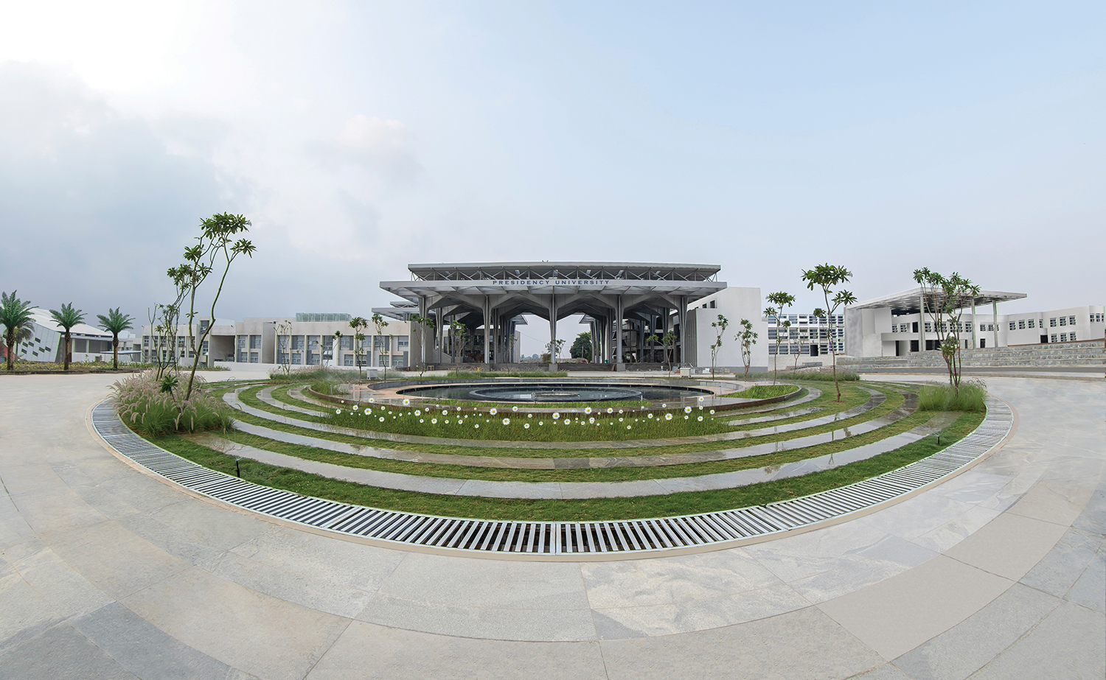

CLOUD COMPUTING FOR IOT-CIT3406
Department of Computer Science Engineering
School of Engineering

Slide 2
Module 1: Introduction to IoT
Presented by,
Sharanya S
Assistant Professor

Slide 3
Contents
Introduction to IoT.
Understanding IoT fundamentals.
Arduino Simulation Environment.
Arduino Uno Architecture.
Sensor & Actuators with Arduino.
Overview of Sensors working.

Slide 4
Introduction
Introduction to IoT (Internet of Things)
The Internet of Things (IoT) refers to the network of interconnected physical devices — such as sensors, machines, vehicles, appliances, and other objects — that collect, share, and exchange data over the Internet.
These devices are equipped with sensors, software, and connectivity, enabling them to interact with each other and with centralized systems to make smart decisions.

Slide 5
Understanding IoT Fundamentals
Devices/Sensors:
Collect real-time data from the environment (e.g., temperature, humidity, motion).
Example: DHT11 sensor for temperature and humidity.
Connectivity:
Devices send data to other devices or cloud platforms using communication technologies such as Wi-Fi, Bluetooth, Zigbee, LoRa, or cellular (4G/5G).
Data Processing:
The collected data is processed using microcontrollers, microprocessors, or cloud servers to extract meaningful information.
User Interface:
Users interact with the system through mobile apps, web dashboards, or alerts.
Cloud and Analytics:
Data is stored and analysed on cloud platforms (like AWS IoT, Google Cloud IoT) for better decision-making and automation.

Slide 6
Arduino Simulation Environment
What is the Arduino IDE (and related tools)?
Arduino IDE is the software environment used to write, compile, and upload programs (sketches) to Arduino and Arduino-compatible microcontroller boards. There are several related tools in the Arduino ecosystem:
Classic Arduino IDE (1.x) — simple, lightweight editor and uploader.
Arduino IDE 2.x — modernized editor with autocomplete, a better debugger integration (for supported cores), board/port selection UI improvements, and an integrated serial plotter/monitor.
Arduino CLI — command-line tool for automation, CI pipelines, and scriptable builds.
Third-party editors (VS Code + PlatformIO, Eclipse) — used for advanced projects and professional workflows.

Slide 7
Popular Arduino Simulators:
Tinkercad Circuits (by Autodesk) – simple drag-and-drop circuit building and coding online.
Proteus Design Suite – professional simulation of circuits and sensors.
Fritzing – helps visualize circuit layouts.
Wokwi – web-based simulator supporting sensors, ESP32, Raspberry Pi, etc.
Purpose of Simulation:
Test Arduino codes virtually.
Visualize sensor and actuator operations.
Debug programs before using actual components.
Save cost and time in project development.

Slide 8
Arduino Uno Architecture
Arduino Uno is one of the most popular microcontroller boards used for IoT and embedded system projects.
It is based on the ATmega328P microcontroller and is used to control sensors, actuators, and IoT devices.

Slide 9
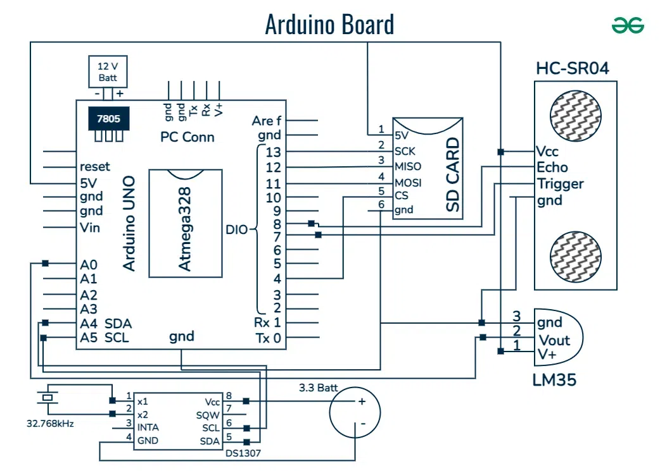
Arduino Uno Architecture

Slide 10
Components | Description / Function
Microcontroller (ATmega328P) | The “brain” of the board – executes the program.
Digital I/O Pins (0–13) | Used to read or send digital signals (HIGH/LOW).
Analog Input Pins (A0–A5) | Used to read analog signals (e.g., sensor values).
PWM Pins (3,5,6,9,10,11) | Provide variable voltage output – control motors or LEDs brightness.
Power Pins (3.3V, 5V, GND, VIN) | Provide power to sensors and modules.
USB Port | Used for uploading code and power supply.
Crystal Oscillator (16 MHz) | Provides timing to the microcontroller.
Reset Button | Restarts the program running on the Arduino.
ICSP Header | Used for firmware uploading and advanced programming.

Slide 11
Sensors and Actuators with Arduino
Types of Sensors used with Arduino:
Type | Example | Function
Temperature Sensor | DHT11, LM35 | Measures temperature.
Ultrasonic Sensor | HC-SR04 | Measures distance using sound waves.
Motion Sensor | PIR sensor | Detects motion or movement.
Light Sensor | LDR | Detects light intensity.
Gas Sensor | MQ2 | Detects gases like CO₂, LPG, smoke.
Humidity Sensor | DHT11 | Measures air moisture.

Slide 12
Actuators:
Type | Example | Function
Motor | DC Motor, Servo | Rotates or moves mechanical parts.
LEDs | Light indicators | Show output signals or alerts.
Buzzer | Sound actuator | Produces alert sounds.
Relay | Switch actuator | Controls high-voltage devices (fans, lamps).

Slide 13
Working Flow of Sensors & Actuators with Arduino:
Sensor senses environmental data (like temperature).
Arduino processes the signal using its microcontroller.
Actuator performs an action (e.g., turns on fan if temperature > threshold).
Example:
If DHT11 sensor detects temperature > 30°C, Arduino sends a signal to turn ON the fan using a relay actuator.

Slide 14
Overview of Sensor Working
Basic Working Principle of a Sensor:
Sensing Element – detects physical change (light, heat, motion).
Transducer – converts it into an electrical signal (voltage or current).
Signal Conditioning – amplifies or filters the signal for better accuracy.
Microcontroller Interface – Arduino reads the sensor’s output and processes it.

