Slide 1
Module-2
Finite Automata

Slide 2
Language Recognizers : An example of Finite Automata
An automaton is an abstract model of a digital computer.
Finite Automata(FA) is the simplest machine to recognize patterns.

Slide 3
Finite Automaton
Input
String
Output
“Accept”
or
“Reject”
Finite
Automaton

Slide 4
Representation of Finite Automata
Finite Automata is represented by –
      Transition Graph
      Transition Table
      Regular Expression

Slide 5
Transition Graph
initial
state
accepting
state
state
transition

Slide 6
Initial Configuration
Input String

Slide 7
Reading the Input

Slide 11
Input finished
accept

Slide 12
Rejection

Slide 16
Input finished
reject

Slide 17
Another Rejection

Slide 18
reject

Slide 19
Another Example

Slide 23
Input finished
accept

Slide 24
Rejection Example

Slide 28
Input finished
reject

Slide 29
Languages Accepted by FAs
Definition:
  The language contains
  all input strings accepted by
  = { strings that bring
  to an accepting state}

Slide 30
Example
accept

Slide 31
Example
accept
accept
accept

Slide 32
Example
trap state/
dead state
accept

Slide 33
Formal Definition
Finite Automaton (FA)
: set of states
: input alphabet
: transition function
: initial state
: set of accepting states

Slide 34
Input Alphabet

Slide 35
Set of States

Slide 36
Initial State

Slide 37
Set of Accepting States

Slide 38
Transition Function

Slide 42


Transition Table
$${∗q}_{4}$$
$$q_{5}$$

Slide 43
Extended Transition Function

Slide 47
Observation: if there is a walk from to
with label then

Slide 48
Example: There is a walk from to
with label

Slide 49
Recursive Definition

Slide 51
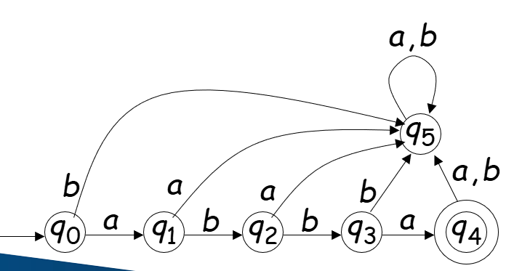
Check the string acceptance of abba
δ*(qo,abba)= δ(δ*(q0,abb) , a)
= δ(δ (δ*(q0,ab),b) , a)
= δ(δ (δ (δ*(q0,a),b),b) , a)
= δ(δ (δ (δ (δ*(q0,λ),a),b),b) , a)
= δ(δ (δ (δ (q0,a),b),b) , a)
=δ(δ (δ (q1,b),b) , a)
=δ(δ (q2,b) , a)
=δ(q3, a)
=q4 Є F
String abba is accepted as q4 is a final state

Slide 52
Language Accepted by FAs
For a FA
Language accepted by :

Slide 53
Example
= { all strings with prefix }
accept

Slide 54
L=strings with substring ‘101’ over {0, 1}

Slide 55
Example
= { all strings without
substring }

Slide 56
Example

Slide 57
Regular Languages
Definition:
A language is regular if there is
FA such that
Observation:
All languages accepted by FAs
form the family of regular languages

Slide 58
Examples of regular languages:
{ all strings with prefix }
{ all strings without substring }
There exist automata that accept these
Languages

Slide 59
There exist languages which are not Regular:
Example:
There is no FA that accepts such a language
(we will prove this later in the class)

Slide 60
Deterministic Finite Automata
Every State should have transition over every input symbol
There should be only One next state for each transition
DFA is defined as

Slide 61
DFA Example
Design DFA that accepts language L= { w : |w| mod 3 = 0 }
over ∑ = {a, b}
Solution
Strings accepted= {ϵ, aaa, bbb, aba, aab, bab, aaabbb, ababab, …}
Strings rejected= {a, b, ab, ba, abab, baba, bbaa, aaabb, …}
Transition Diagram

Slide 62
DFA Example
Consider Sample String : a a b

Slide 63
DFA Example
Consider Sample String : a a b

Slide 64
DFA Example
Consider Sample String : a a b

Slide 65
DFA Example
Consider Sample String : a a b
String is accepted
Acceptance State

Slide 66
DFA Example
Consider Another Sample String : b a b a

Slide 67
DFA Example
Consider Another Sample String : b a b a

Slide 68
DFA Example
Consider Another Sample String : b a b a

Slide 69
DFA Example
Consider Another Sample String : b a b a

Slide 70
DFA Example
Consider Another Sample String : b a b a
String is rejected
Rejection State

Slide 71
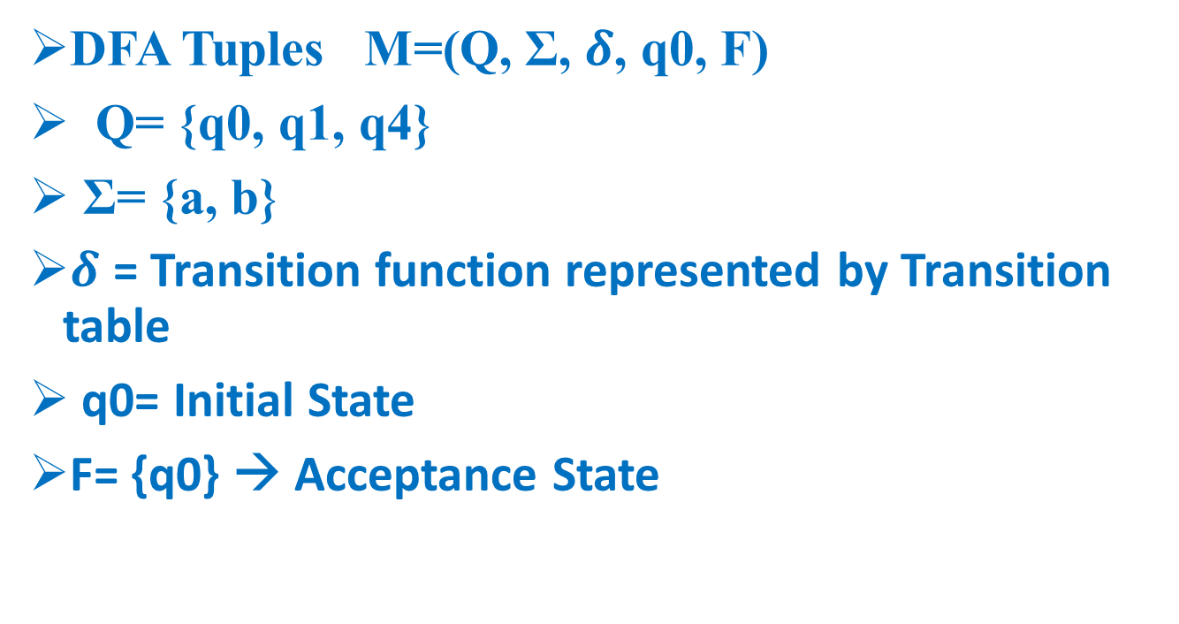
DFA Example
DFA Tuples M=(Q, Σ, $δ$, q0, F)
Q= {q0, q1, q4}
Σ= {a, b}
$δ$ = Transition function represented by Transition table
q0= Initial State
F= {q0} → Acceptance State

Slide 72
DFA Example
Transition Table
Σ Q | a | b
*q0 | q1 | q1
q1 | q4 | q4
q4 | q0* | q0*

Slide 73
DFA Examples to be covered

Slide 74
DFA - Starts with a , ∑={a,b}
L= { a,aa,ab,aaa,aab,aba,….}
a,b
a
q0
q1
b
q2
a,b

Slide 75
DFA - Starts with ab , ∑={a,b}
L= { ab,aba,abb,….}
a,b
a
b
q0
q1
q2
b
a
q3
a,b

Slide 76
DFA - Starts with aa , ∑={a,b}
L = { aa,aab,aaba,….}
a,b
a
a
q1
q2
q0
b
b
q3
a,b

Slide 77
DFA - Starts with aba , ∑={a,b}
L={ aba,abaa,abab,abaaa,…}
a,b
a
b
a
q0
q1
q2
q3
a
b
b
q4
a,b

Slide 78
DFA - Starts with 101 , ∑={0,1}
L={ 101,1010,1011,101101,…}
0,1
1
1
q0
q1
q2
q3
1
0
0
q4
0,1
78

Slide 79
Ends with a
L={a,aa,ba,aaa,aba,…}
b
a
a
q0
q1
b

Slide 80

L={ 1,01,11,…}
0
1
1
q0
q1
0

Slide 81
Ends with ab
L={ab,aab,bab,aaab,bbbbab,abab,…}
b
a
a
b
a
q2
q0
q1
a
b

Slide 82
Ending with bab
b
a
b
b
a
b
q0
a
q3
q1
q2
a
a
82

Slide 83
DFA – Ends with 101, ∑={ 0,1}
L={ 101,0101,1101,000101,111101,…}
1
0
1
0
0
1
1
q1
q2
q3
q0
0

Slide 84
DFA – Ends with 111 , ∑={ 0,1}
L= { 111,0111,11111,…}
0
0
1
1
1
1
q1
q0
q2
q3
0
0

Slide 85
DfA – Substring 101
L={ 101,0101,1101,1010,1011,00010111,…}
0
1
0,1
1
0
1
q1
q2
q3
q0
0

Slide 86
DFA- Contains 111
L={ 111,0111,1111,000111000,11111000,..}
0
0,1
1
1
1
q0
q1
q2
q3
0
0

Slide 87
DFA – Contains 1011
L= { 1011,01011,11011,00010111,..}
0
1
0,1
1
0
1
1
q0
0
0

Slide 88
DFA- Even no of 0s, ∑={ 0,1} or n0(w)mod2=0
L={ λ, 1,1111,00,0000,11100,1110000,0000111,..}
1
1
0
q0
q1
Transition | o | 1
*->q0 | q1 | q0
q1 | qo | q1
0

Slide 89
DFA – Odd no of 0’s , ∑={ 0,1} or n0(w)mod2=1
L={ 0,01,1110,000,000001111,…}
1
1
0
q1
q0
0

Slide 90
DFA - na(w)mod3=0, ∑={ a,b}
L={ λ,bbbb,aaabbb,aaaaaabbb,….}
b
b
b
a
a
a

Slide 91
DFA- nb(w)mod4=1, ∑={ a,b}
a
a
a
a
b
b
b
b

Slide 92
DfA – n1(w)mod3=2, ∑={ 0,1}
0
0
0
1
1
1

Slide 93
Dfa –lwlmod2=0,
a,b
a,b

Slide 94
DfA – lwlmod2=1
L={a,b,aaa,aba,aab,baa,bbb,baba,bba,….
a,b
a,b

Slide 95
DFA –lwlmod3=0, ∑={ 0,1}
a,b
a,b
a,b

Slide 96
No of a’s is even and no of b’s odd-eo
a
oe
ee
a
b
b
b
b
a
eo
oo
a

Slide 97
No of a’s is odd and no of b’s even=oe
a
oe
ee
a
b
b
b
b
a
eo
oo
a

Slide 98
No of a’s is odd and no of b’s odd-oo
a
oe
ee
a
b
b
b
b
a
eo
oo
a

Slide 99
No of a’s is even and no of b’s even-ee
a
ee
oe
a
b
b
b
b
a
eo
oo
a

Slide 100
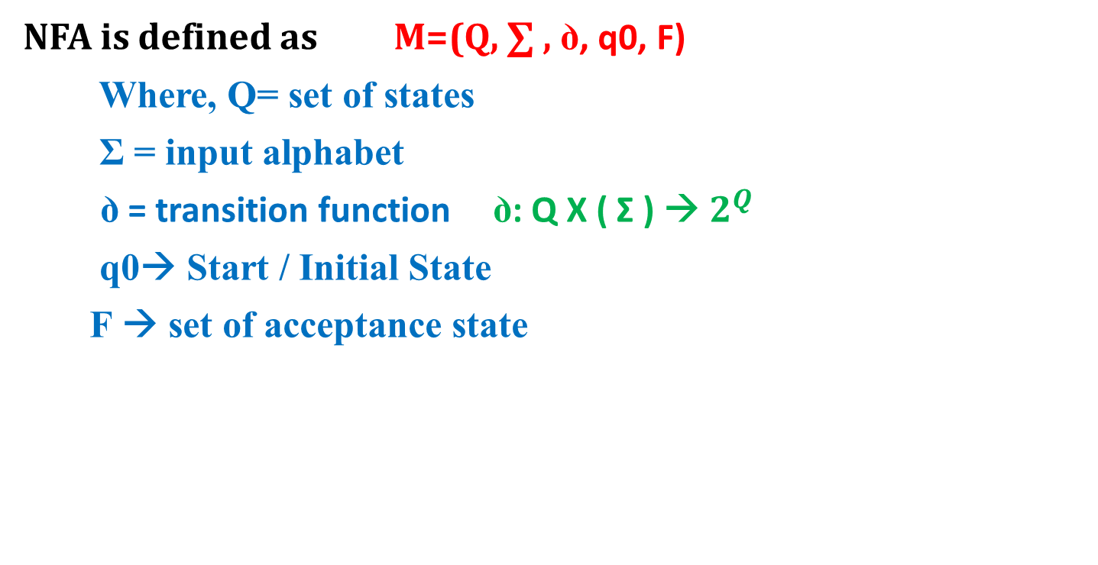
NFA Definition
NFA is defined as M=(Q, ∑ , ꝺ, q0, F)
Where, Q= set of states
Σ = input alphabet
ꝺ = transition function ꝺ: Q X ( Σ ) → $2^{Q}$
q0→ Start / Initial State
F → set of acceptance state

Slide 101
NFA Example
Design NFA that accepts language of strings ending with ab/ba over ∑ = {a, b}
Solution
Strings accepted= {ab, ba, abab, baba, bbab, aaaba, …}
Strings rejected= {ϵ, a, b, aa, bb, aaa, abb, aaabbb, …}
Transition Diagram

Slide 102
NFA to DFA Conversion Example
Convert NFA to DFA that accepts language of strings ending with ab/ba over ∑ = {a, b}
Solution
Draw NFA for given language
Convert that NFA into DFA using subset construction method

Slide 103
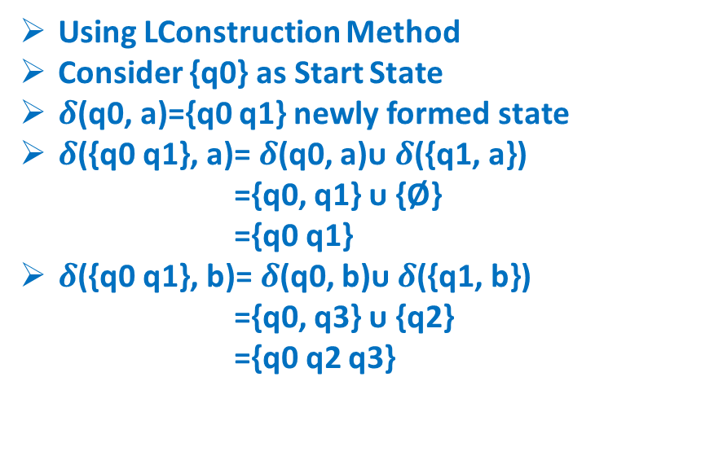
NFA to DFA Conversion Example
Using LConstruction Method
Consider {q0} as Start State
$δ$(q0, a)={q0 q1} newly formed state
$δ$({q0 q1}, a)= $δ$(q0, a)ᴜ $δ$({q1, a})
={q0, q1} ᴜ {Ø}
={q0 q1}
$δ$({q0 q1}, b)= $δ$(q0, b)ᴜ $δ$({q1, b})
={q0, q3} ᴜ {q2}
={q0 q2 q3}
NFA | a | b
q0 | {q0, q1} | {q0, q3}
q1 | - | {q2}
q2 | - | -
q3 | {q4} | -
q4 | - | -
DFA | a | b
q0 | {q0 q1} | {q0 q3}
{q0 q1} | {q0 q1} | {q0 q2 q3}

Slide 104
NFA to DFA Conversion Example
Using Lazy Evaluation Method
Consider {q0} as Start State
𝜹(q0, a)={q0 q1} newly formed state
𝜹({q0 q1}, a)= 𝜹(q0, a)ᴜ 𝜹({q1, a})
={q0, q1} ᴜ {Ø}
={q0 q1}
𝜹({q0 q1}, b)= 𝜹(q0, b)ᴜ 𝜹({q1, b})
={q0, q3} ᴜ {q2}
={q0 q2 q3}
{q0 q2 q3} is newly formed state
𝜹({q0 q2 q3}, a)= 𝜹(q0, a) ᴜ 𝜹({q2, a}) ᴜ 𝜹({q3, a})
={q0, q1} ᴜ {Ø} ᴜ {q4}
={q0 q1 q4}
𝜹({q0 q2 q3}, b)= 𝜹(q0, b)ᴜ 𝜹({q2, b}) ᴜ 𝜹({q3, b})
={q0, q3} ᴜ {Ø} ᴜ {Ø} ={q0 q3}
NFA | a | b
q0 | {q0, q1} | {q0, q3}
q1 | - | {q2}
q2 | - | -
q3 | {q4} | -
q4 | - | -
DFA | a | b
q0 | {q0 q1} | {q0 q3}
{q0 q1} | {q0 q1} | {q0 q2 q3}
{q0 q2 q3) | {q0 q1 q4} | {q0 q3}

Slide 105
NFA to DFA Conversion Example
{q0 q3} is newly formed state
𝜹({q0 q3}, a)= 𝜹(q0, a)ᴜ 𝜹({q3, a})
={q0, q1} ᴜ {q4}
={q0 q1 q4}
𝜹({q0 q3}, b)= 𝜹(q0, b)ᴜ 𝜹({q3, b})
={q0, q3} ᴜ {Ø}
={q0 q3}
NFA | a | b
q0 | {q0, q1} | {q0, q3}
q1 | - | {q2}
q2 | - | -
q3 | {q4} | -
q4 | - | -
DFA | a | b
q0 | {q0 q1} | {q0 q3}
{q0 q1} | {q0 q1} | {q0 q2 q3}
{q0 q2 q3) | {q0 q1 q4} | {q0 q3}
{q0 q3} | {q0 q1 q4} | {q0 q3}

Slide 106
NFA to DFA Conversion Example
{q0 q3} is newly formed state
𝜹({q0 q3}, a)= 𝜹(q0, a)ᴜ 𝜹({q3, a})
={q0, q1} ᴜ {q4}
={q0 q1 q4}
𝜹({q0 q3}, b)= 𝜹(q0, b)ᴜ 𝜹({q3, b})
={q0, q3} ᴜ {Ø}
={q0 q3}
{q0 q1 q4} is newly formed state
𝜹({q0 q1 q4}, a)= 𝜹(q0, a) ᴜ 𝜹({q1, a}) ᴜ 𝜹({q4, a})
={q0, q1} ᴜ {Ø} ᴜ {Ø}
={q0 q1}
𝜹({q0 q1 q4}, b)= 𝜹(q0, b)ᴜ 𝜹({q1, b}) ᴜ 𝜹({q4, b})
={q0, q3} ᴜ {q2} ᴜ {Ø}
={q0 q2 q3}
NFA | a | b
q0 | {q0, q1} | {q0, q3}
q1 | - | {q2}
q2 | - | -
q3 | {q4} | -
q4 | - | -
DFA | a | b
q0 | {q0 q1} | {q0 q3}
{q0 q1} | {q0 q1} | {q0 q2 q3}
{q0 q2 q3) | {q0 q1 q4} | {q0 q3}
{q0 q3} | {q0 q1 q4} | {q0 q3}
{q0 q1 q4} | {q0 q1} | {q0 q2 q3}

Slide 107
NFA to DFA Conversion Example
DFA | a | b
q0 | {q0 q1} | {q0 q3}
{q0 q1} | {q0 q1} | {q0 q2 q3}
{q0 q2 q3) | {q0 q1 q4} | {q0 q3}
{q0 q3} | {q0 q1 q4} | {q0 q3}
{q0 q1 q4} | {q0 q1} | {q0 q2 q3}

Slide 108
Minimization of DFA Example
Minimize the following DFA
DFA | 0 | 1
A | B | C
B | B | D
C | B | C
D | B | E
E* | B | C

Slide 109
Minimization of DFA Example
Minimize the following DFA
Use State Equivalence Method
Write 0’Equivalence as
{A, B, C, D} {E}
Write 1’Equivalence
{A, B, C} {D} {E}
Write 2’Equivalence
{A, C} {B} {D} {E}
Write 3’Equivalence
{A, C} {B} {D} {E}
DFA | 0 | 1
A | B | C
B | B | D
C | B | C
D | B | E
E* | B | C

Slide 110
Minimization of DFA Example
Minimize the following DFA
Use State Equivalence Method
Write 0’Equivalence as
{A, B, C, D} {E}
Write 1’Equivalence
{A, B, C} {D} {E}
Write 2’Equivalence
{A, C} {B} {D} {E}
Write 3’Equivalence
{A, C} {B} {D} {E}
DFA | 0 | 1
A,C | B | C
B | B | D
D | B | E
E* | B | C

