Slide 1
Impact of positron range on image reconstruction in ¹⁸F and ⁴⁴Sc PET imaging
Anna Giebułtowska

Slide 2
Agenda
Motivation
Current stage of work
Summary
Future reaserch

Slide 3
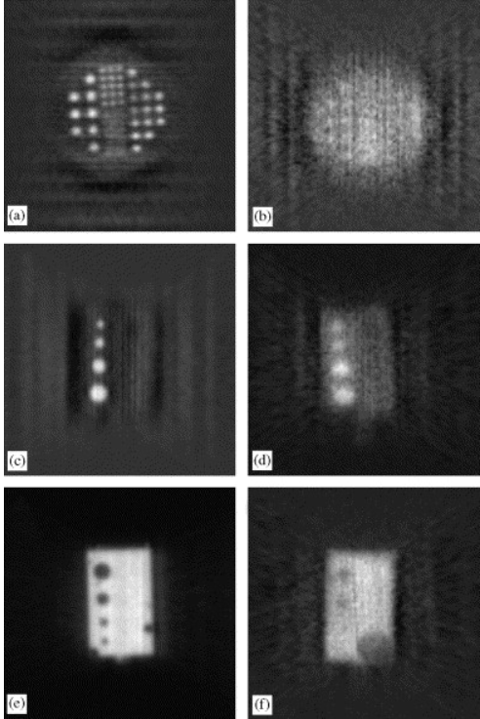

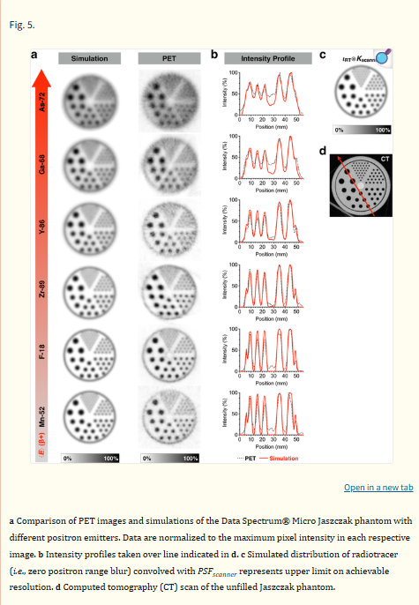
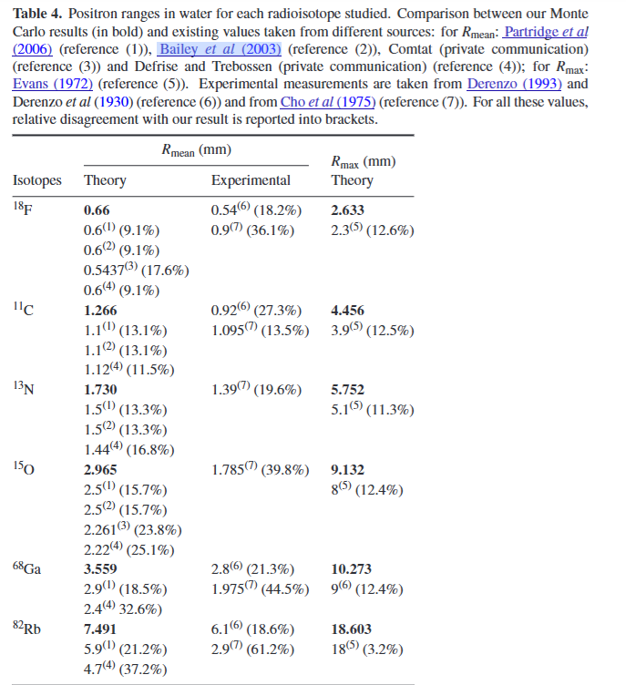
Motivation
Champion: https://iopscience.iop.org/article/10.1088/0031-9155/52/22/004/pdf
Partige: https://www.sciencedirect.com/science/article/pii/S0168900206016640
Carter: https://pmc.ncbi.nlm.nih.gov/articles/PMC6805144/#TFN1

Slide 4
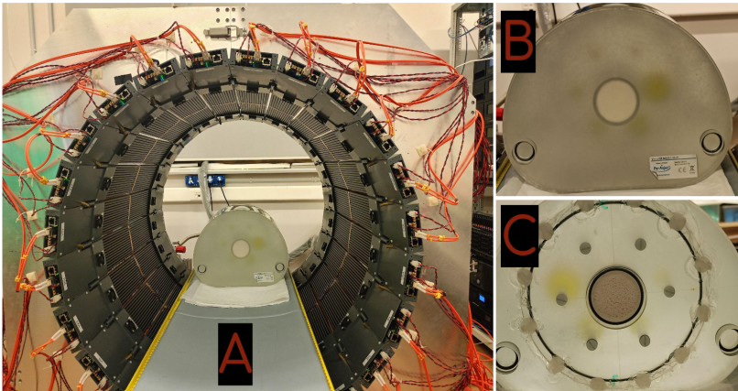
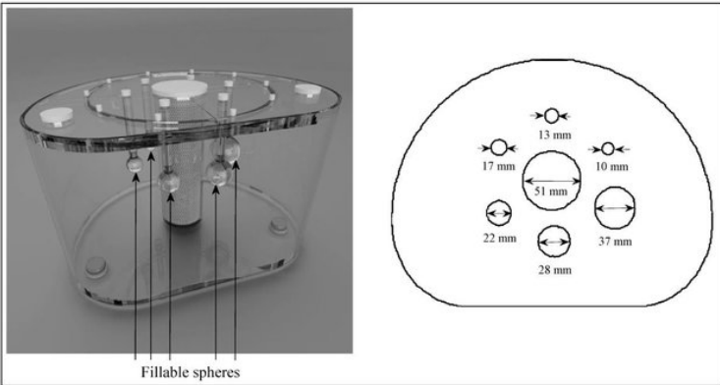
Coś w środku
JPET Raport

Slide 5
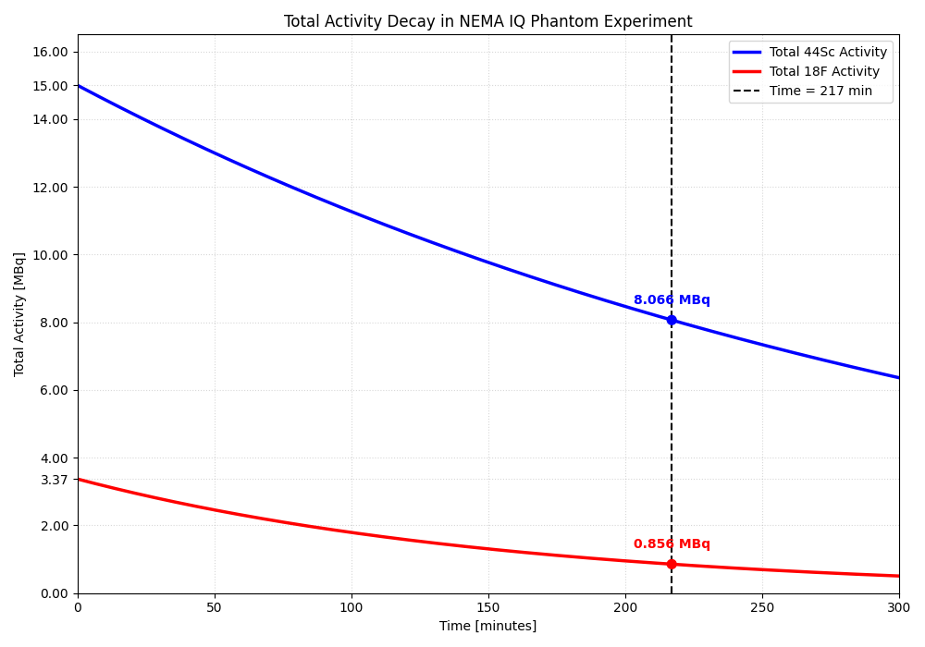
Wykres zanikanie aktywności Sc i F w czasie

Slide 6
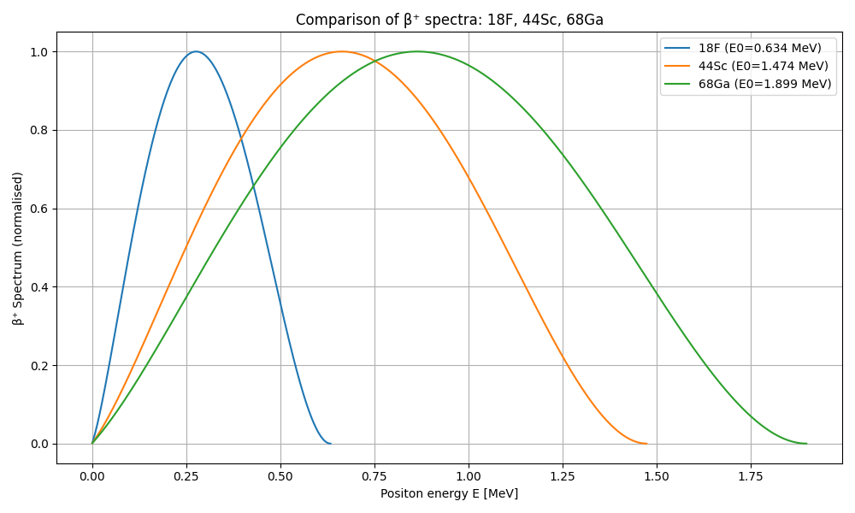

Energy spectrum
Levin CS, Hoffman EJ. Calculation of positron range and its effect on PET resolution. Phys Med Biol.

Slide 7
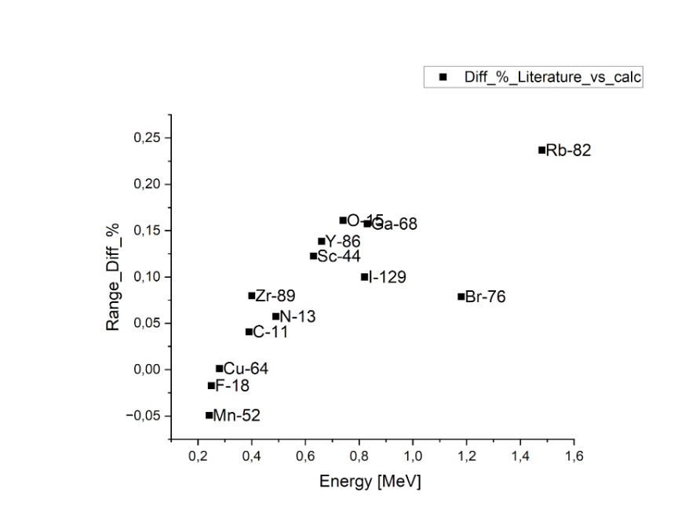
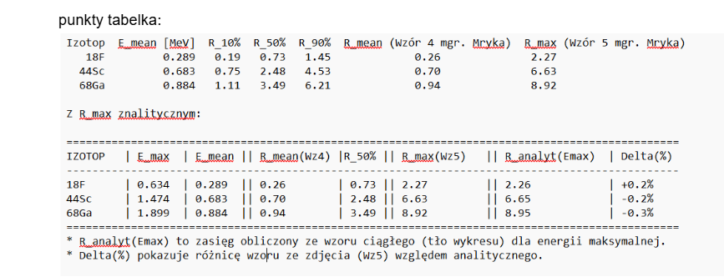
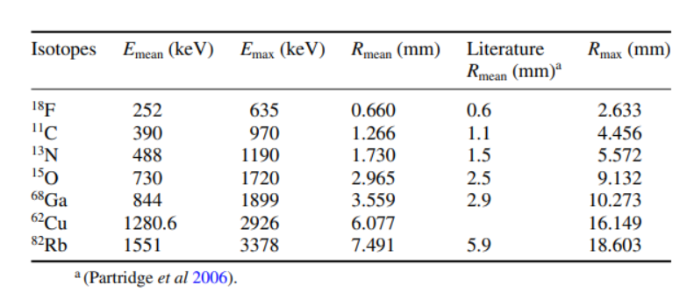
Wykres/tabela z zasięgów obliczonych vs literaturowe vs energia

Slide 8
Summary

Slide 9
Future reaserch

Slide 10
Thank You for Your attention

