Slide 1
Getting Started with Tableau
Notes:
Thank you for coming to attend this introductory Tableau workshop! Here, you will learn the advantages of the data visualization tool Tableau public and important concepts and techniques needed to display and analyze data. You’ll learn to make and convey data-driven decisions or recommendations for your work through hands-on activities.
Event details: Tuesday, March 10, 2020 from 1:00 pm to 3:00 pm at Gelman Library 219
Page: https://library.gwu.edu/news-events/events/getting-started-tableau
Source: https://www.slidescarnival.com/ely-free-presentation-template/4761
Presentation template by SlidesCarnival, Photographs by Unsplash

Slide 2
Hello!
I am Nopphiphat Suraminitkul (Nopi)
Graduate student in Computer Science
Statistical consultant
Notes:
Hi, my name is Nopphiphat Suraminitkul (or you can call me by Nopi). I am a graduate student pursuing my degree in Computer Science, and my role in the Gelman library is statistical consultant.

Slide 3
Overview
Learning Objectives
Introduction
Why Tableau?
Workshop Materials
Data Visualization Process
Practice
Notes:
So, let’s begin with the flow of the workshop. We will start with what are we going to accomplish by the end of the workshop, basic introduction to data visualization, reason for us to use Tableau, materials we will be working with, data visualization process walk-through, and ends with some practices

Slide 4
1. Learning Objectives

Slide 5
Learning Objectives
You should leave with:
Understanding on ways to handle different data types
Methods for building good visualizations
Hands-on experience with Tableau Public
Notes:
The goal for the end of today’s session is that you should be able to understand different ways to handle different data types, methods for creating good visualizations, and gain some hands-on experience with Tableau Public

Slide 6
2. Introduction to Data Visualization

Slide 7
Introduction
Data visualization is the pictorial representation of dataset(s) and information using visual elements to give us a framework to make sense of masses of information, see and understand trends, detect hidden patterns, identify outliers, and develop new insights in data, which can then be used to make data driven decision.
Less Accurate
More Accurate
Texture
Tone
Volume
Surface
Orientation
Length
Position
Shape
Color
Size
Lines
Space
Notes:
What is data visualization? It is the pictorial representation of dataset(s) and information using visual elements like line, shape, color to give us a framework to make sense of masses of information, see and understand trends, detect hidden patterns, identify outliers, and develop new insights in data, which can then be used to make data driven decision. These are the basic visual elements which can be combined to make complex visualizations like graphs, charts, and maps to show relationships between variables
Graphs are mostly a numerical representation of raw data that shows the relation of change in numbers that how one number is affecting or changing another, or basically the relationship between data through a line, curve, etc.
Charts are the visual representation of large set of data which makes the user understands the similar things in a better manner, which may helps in the prediction of existing data and forecast future data based on the present data pattern.
Source:
1) https://www.interaction-design.org/literature/article/visual-mapping-the-elements-of-information-visualization
2) https://www.occreates.com/guide-to-visual-elements-a-series/

Slide 8
Why Tableau?
Advantages:
Superior Visualization Quality with Powerful Computation
Multiple Data Source Connections
Easy to Learn and Use
User-friendly Interface
Notes:
Tableau is one of the visualization tools that allows anyone to quickly learn and make beautiful visualization using drag-and-drop method on large data files of most file types, e.g. Excel, CSV, PDF, and SQL to name a few
Tableau offers superior visualization quality as compared to their competitors. It is able to convert unstructured statistical information into comprehensive logical results, which are fully functional, interactive, and appealing dashboards. It is also able to maintain high visualization functionality even when working with big data. Also, it is able to connect to data in Excel, PDF, Database, and more. Last but not least, it has user-friendly interface that allows non-developer users to quickly learn and utilize the basic application’s functionality to the fullest.
Source: https://www.sam-solutions.com/blog/tableau-software-review-pros-and-cons-of-a-bi-solution-for-data-visualization/

Slide 9
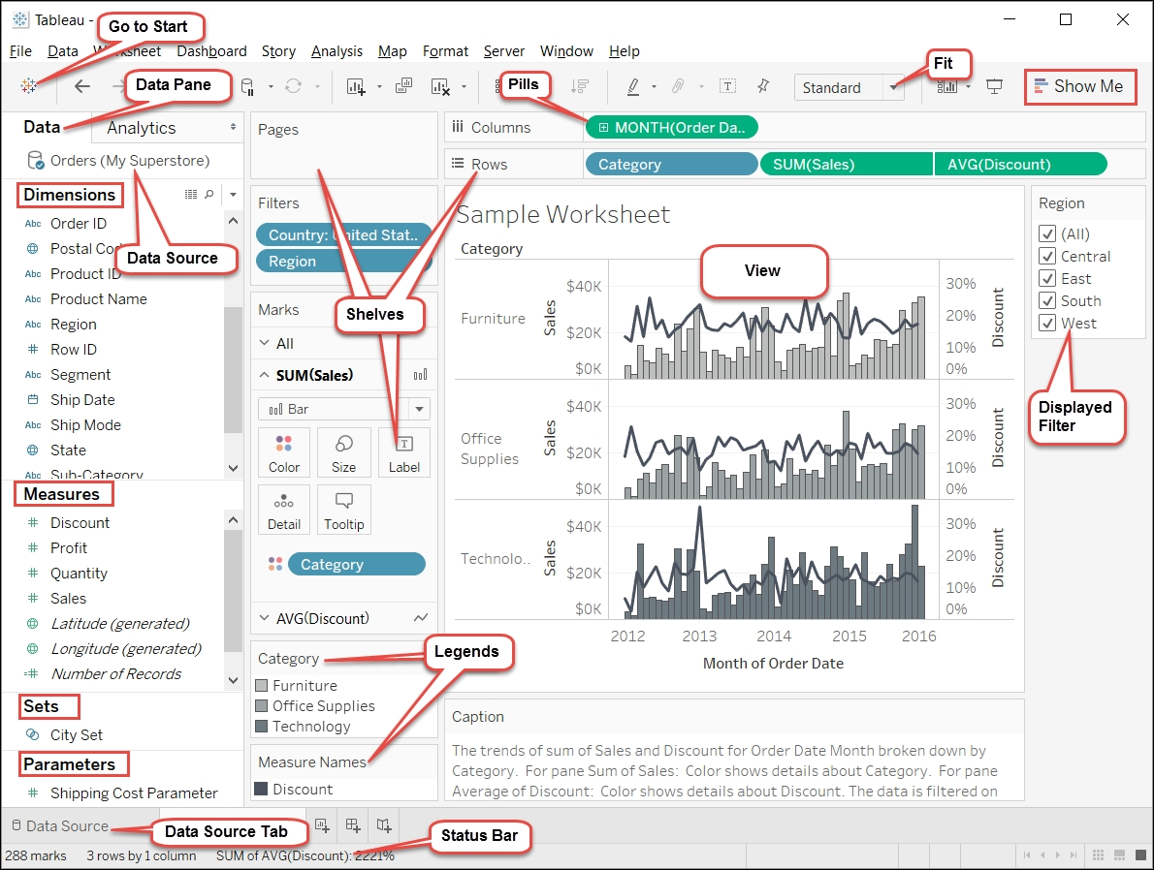
Tableau Interface
Notes:
The drag-and-drop method just means that you can just drag any elements from dimensions and measures under data pane and put them into the columns, rows, marks, and views to create visualizations within minutes. Just to answer what you guys may be wondering, dimensions contain qualitative values, such as names, dates, or geographical data, which can be used to categorize, segment, and reveal the details in your data. It affects the level of detail in the view, where as measures contain numeric, quantitative values that you can measure. By default, when measure is dragged into the view, Tableau applies an aggregation to that measure.
Source: https://subscription.packtpub.com/book/big_data_and_business_intelligence/9781784397692/1/ch01lvl1sec8/understanding-the-tableau-interface-and-basic-terminology

Slide 10
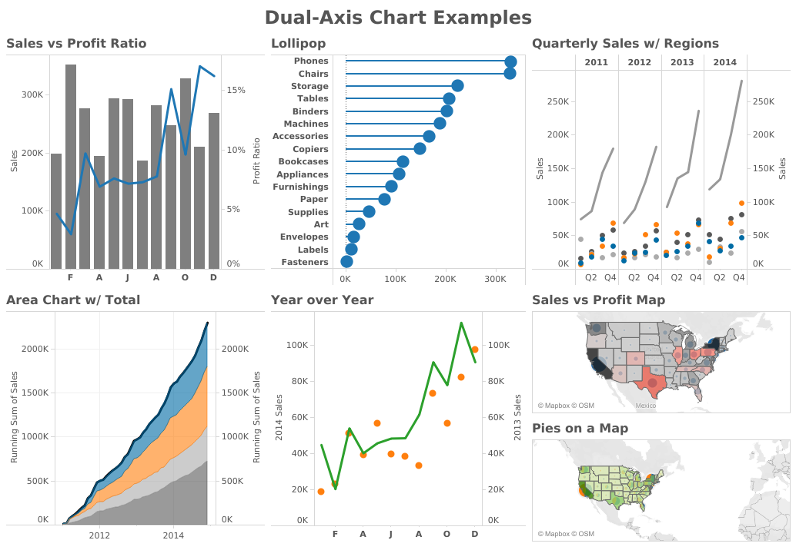
Types of Visualization
Vertical Bar Chart
Horizontal Bar Chart
Time Series
Stacked Area Chart
Scatter Plot
Density Map
Notes:
These are some type of the visualizations that can be created using Tableau, dual-axis bar charts, time series, scatter plot, and density maps.
Bar Chart – Compare and highlight differences; Reveal trends “max-min” and outliers
Line Chart – Present continuous evolution of data; Show trends
Pie Chart – Add details to other visualization
Maps - Present location information, such as zip code, state, country, longitude etc.
Density Maps (Present relative concentrations to location)
Scatter Plot (Show relationship between variables; Identify clusters of distinct points)
Bubble Chart (Present large volume of data at once; Add detail to scatter plots or maps)
Treemap (Relate different segments of data to whole)
Word Cloud (Frequencies of variables)
Source: http://www.vizwiz.com/2015/12/dual-axis.html

Slide 11
3. Workshop Materials

Slide 12
Workshop Material: Tableau Public
Installation of Tableau Public
Access https://public.tableau.com/en-us/s/download
Enter your email to download the software
(TIP) Making your work less public*
Register and sign in to the Tableau website
Profile icon on top-right -> click “Settings”
Tick:
“Allow viz data to be downloaded”
“Set my vizzes to hidden”
Notes:
Just a show of hands, who haven’t installed this software? For those who raised their hands, please navigate to this link, enter your email, and install the software. While your software is being installed, on the same website, sign up for an account on Tableau Public. For those who have already signed up, hover your mouse on the profile icon on top-right icon and click “Settings”, and ensure that both “Allow viz data to be downloaded” and “Set my vizzes to be hidden” are ticked.
Source: https://www.olgatsubiks.com/single-post/2017/03/20/How-to-save-Tableau-Public-workbooks-privately-on-your-computer

Slide 13
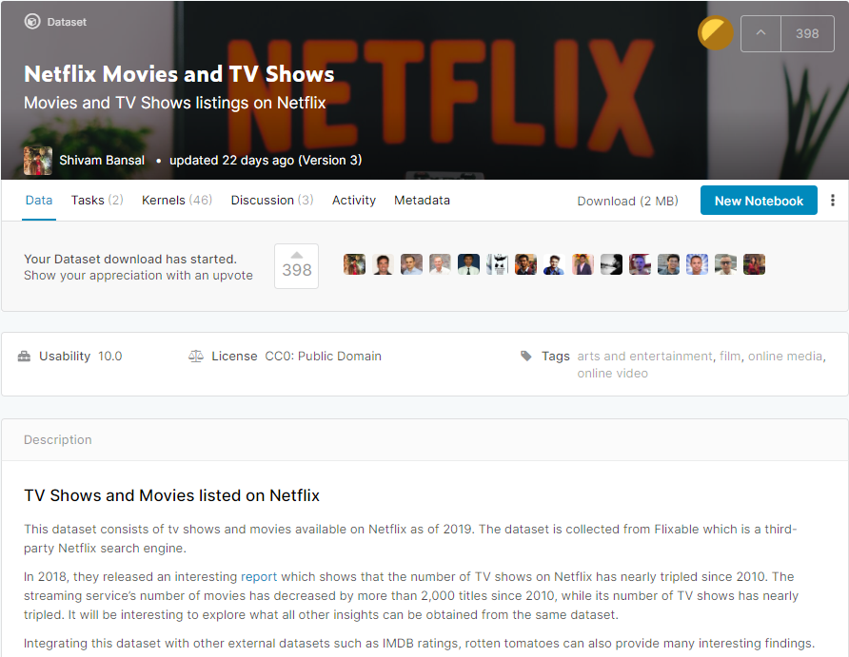
Workshop Material: Datasets
Access: https://www.kaggle.com/shivamb/netflix-shows
Dataset: Netflix Movies and TV Shows
Click “Download” and unzip the file to your desktop
Notes:
Source:
1) https://www.kaggle.com/shivamb/netflix-shows
2) https://www.kaggle.com/shivamb/netflix-shows-and-movies-exploratory-analysis/data
3) https://www.kaggle.com/subinium/storytelling-with-data-netflix-ver
4) https://www.kaggle.com/vikassingh1996/netflix-movies-and-shows-plotly-recommender-sys

Slide 14
4. Data Visualization

Slide 15
Data Visualization Process
Loading your data
Knowing your data: understand data definition
Determining what to visualize: what are you looking for
Pre-processing your data: ensure data is in correct format
Visualizing your data
Exporting your data
Notes:
Now, the main content, the data visualization process. For every data visualization, we will go through these steps, loading your data, knowing your data, determining your data, pre-processing your data, visualizing your data, and exporting your data

Slide 16
END
Bring the attention of your audience over a key concept using icons or illustrations

Slide 17
References
Garrett, J., Blaine, A., & Schechter, G. (2020, January 31). Getting Started with Data Visualization. Retrieved from osf.io/s4w5b
https://www.youtube.com/playlist?list=PLWPirh4EWFpGXTBu8ldLZGJCUeTMBpJFK

Slide 18
Step 1: Loading your data
Open Tableau Public
Click on “File” -> “Open…”
Navigate to the location of the file (e.g. Desktop)
“Select” the file
(Optional) Under “Files” in the left column,
[Tick] Cleaned with Data Interpreter, which is designed to help take care of cleaning and transforming the data into the proper format for analysis in Tableau.
Notes:
Click the right icon when hovering mouse over one of the sheets to view data
Sort data

Slide 19
Step 2: Knowing your data
What you do know / What is being measured ?
show_id: Unique ID for every movie or tv show
type: Identifier – a movie or tv show
title: Title of the movie or tv show
country: Country where the movie or show was produced
date_added: Date it was added on Netflix
release_year: Actual release year of the movie or show
rating: TV rating of the movie / show
duration: Total duration – in minutes or number of seasons
listed_in: Genre
Notes:
(Script)
What do you not know?

Slide 20
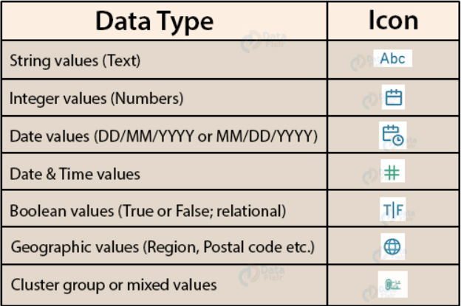
Step 2: Knowing your data
What data types are we dealing with ?
Notes:
6 Data Types
Hash – number
Abc – string
Calendar – date
Globe – geographic
T|F – Boolean
Etc.
Modifying data types

Slide 21
Step 3: Determining what to visualize
What do you not know ?
Quick overview of data
Can the information be represented without visualization?
*Not all data needs to be visualized*
Does audience needs to see pattern to understand data?
Preferences over time
Notes:
Modifying your data
Show example of messy data
Cleaning up (Preprocessing) might be beyond the scope of this workshop.

Slide 22
Step 4: Modification
Other library workshop
Notes:
Renaming column
Double click the column, and change the name
Splitting column
Split by delimiter

Slide 23
Step 5: Visualization
Content Type on Netflix
Content added over year by Type

Slide 24
Pie: Content Type on Netflix
Drag “Type” under Dimensions to “Rows”
Drag “Measure Values” to “Text” under Marks
Select display “Entire View”
From the Marks card drop-down menu, select “Pie”
Drag “Type” to “Label” under Marks
Drag “Measure Values” to “Label” under Marks
Click on the inverted triangle icon on the green pill under “Measure Values” and click “Quick Table Calculation” and select “Percent of the total”

Slide 25
Line: Content added over year
Drag “Date Added” under Dimensions to “Columns”
Drag “Type” under Dimensions to “Rows”
Drag “Number of Records” to “Text”
From the Marks card drop-down menu, select “Line”
Drag “Type” to “Color”
Drag “Number of Records” to “Label”
Click on “Label” and click “Select” under “Marks to Label”
Right-click on the points you want to show label, and “Mark Label” and “Always Show”
Notes:
Reference lines
Read on Netflix data, mention that the source weren’t doing great with data streaming as such only limited number of data points are being collected.

Slide 26
Map: Content by Different Countries
Drag “Country” to the view
Drag “Number of Records” to “Color”
Drag “Country” to “Label”
Click on “Label” and select “Selected” under “Marks to Label”
Right-click the country with darker color, and select “Always Show” under “Mark Label”

Slide 27
Bar Chart
Simple Bar Chart (Vertical vs Horizontal): rectangular column with size as data in measures
Ctrl + W or Swap Icon
Raw Data Drill Down (Sub-Category drag on another dimension)
Group by Header (Select headers and Group)
Colored Bar Chart
1 Blue pill in column + 1 green pills in rows + 1 measure to color
Create set (Top 5) and color the bars by set
Stacked Bar Chart
1 Blue pill in column + 1 Green pill in rows + 1 dimension to color
Leveled Bar Chart
Two blue pills in columns + 1 green pills in rows
Interactive Bar Chart
Insert Filters

Slide 28
Line Chart
Line Chart
A measure and a dimension are taken along the two axes of the chart area
The pair of values for each observation becomes a point and the joining of all these points create a line showing the variation or relationship between the dimensions and measures chosen. -> Show Caption
Date Line Chart
(Date Icon) “DATE” to columns and measures to rows
Date Line Details
Dimension “Category” to Color
Measure to Label (Show maximum)
Continuous (GREEN) vs Discrete (BLUE)
Modify the type of dates
Which year, which month, which date has highest value (continuous)
Notes:
Line Chart
A measure and a dimension are taken along the two axes of the chart area
The pair of values for each observation becomes a point and the joining of all these points create a line showing the variation or relationship between the dimensions and measures chosen. -> Show Caption
Date Line Chart
(Date Icon) “DATE” to columns and measures to rows
Date Line Details
Dimension “Category” to Color
Measure to Label (Show maximum)
Continuous (GREEN) vs Discrete (BLUE)
Modify the type of dates
Which year, which month, which date has highest value (continuous)

Slide 29
Scatter Plots
Scatter Chart
2 Measures in columns and rows
For category wise, drop the category into Shape/Color (Modify size)
Interactive Scatter Chart
Filters
Drop Lines
Click the point + Drop line (Edit Drop line, labels “automatic”, drop when “always”)
Notes:
Scatter Chart
2 Measures in columns and rows
For category wise, drop the category into Shape/Color (Modify size)
Interactive Scatter Chart
Filters
Drop Lines
Click the point + Drop line (Edit Drop line, labels “automatic”, drop when “always”)

Slide 30
Word Maps
Drag text dimension to “Text”, Drag measure to “Size”, Set the Drop down to text
Coloring, Bold
Interactive Word Map
Notes:
Drag text dimension to “Text”, Drag measure to “Size”, Set the Drop down to text
Coloring, Bold
Interactive Word Map

