Slide 1
Manual and Automatic Annotation of Meeting Reports with Young Offenders
for Quality Assessment of Interventions
Pierre André Ménard
Sylvie Ratté
Geneviève Parent
Franck barbedor
Annotation in digital humanities Workshop
ESSLI 2018, Sofia
August 9th, 2018
August 9, 2018

Slide 2
overview
Project’s context
Manual annotations
Task
Tool
Outcome
Automatic annotations
Next steps

Slide 3





Project’s context
YLS/CMI
Report
Report
Report
Report
Offense
Sentence
Risk
profile
Interventions
End of
sentence

Slide 4
Project’s context
Risks exemples
Antisocial personality
Delinquent peers
Family conflicts
Poor performance at school or at work
Drug abuse

Slide 5
Project’s context
Risk profile
Find the root causes of the delinquency
Reports
Detail of the interventions, what’s being talked about, etc.
Noisy, abbreviations, typos, various language level, 1 sentence to multiple paragraphs
Goals (criminology)
Are the interventions aligned with the risk profile?
What are the unaligned interventions?
What kind of interventions are they choosing over others?

Slide 6

Manual annotation : task
process
Youth protection
organism
Data
acquisition
~300k
Cleanup, filter,
Preprocess, import
Protocol tune-up (x 5)
Annotators
Training
Designed schema
Batch distribution
Project creation
Evaluation
Curator
~500 reports

Slide 7
Manual annotation : task
Administrative* (conditions, community work, help, intervention plan)
Antecedents (reinforce, alternative)
Attitude (motivation, prosocial institution valorisation and value restructuration)
Consumption (solution, reduction)
Family/Couple (relationship, supervision, couple)
Hobbies (sports, gym, extracurricular, religious activities)
Peers (reduction, valorisation)
Personality (anger management, improving problem, resolution skills, discourage manipulation of others or egocentrism)
Occupational school/work (help, participation, engagement. satisfaction, relationship)

Slide 8
Manual annotation : tool
PACTE platform (http://pacte.crim.ca)
Flexible schema design
Corpus creation
Multisteps project management
Other modules
Lexicon
User rights management
Resource sharing
Automated annotation services
User interface
Web
API
Corpus
Manual
annotations
Automatic
annotations
ML
model

Slide 9
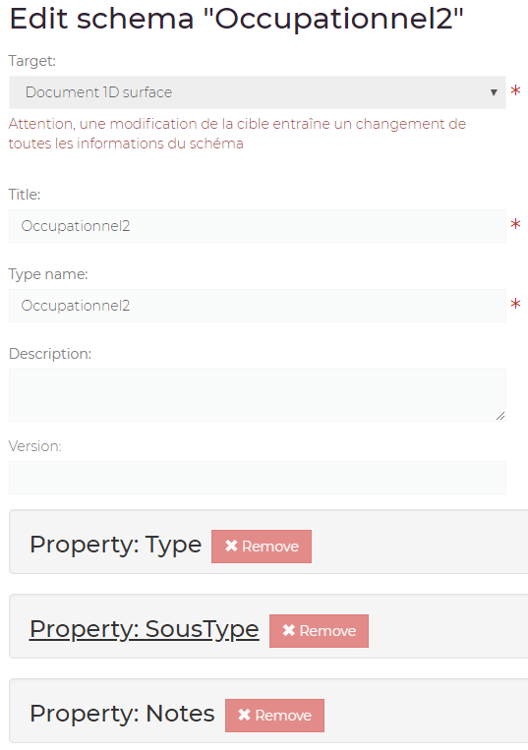
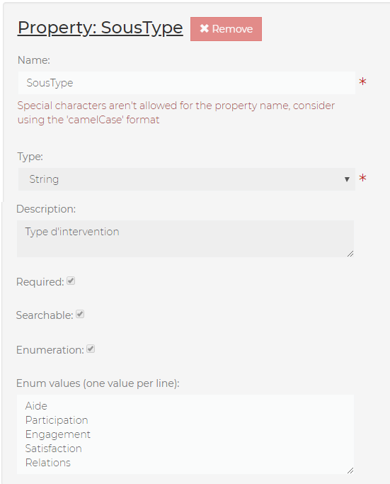

Slide 10
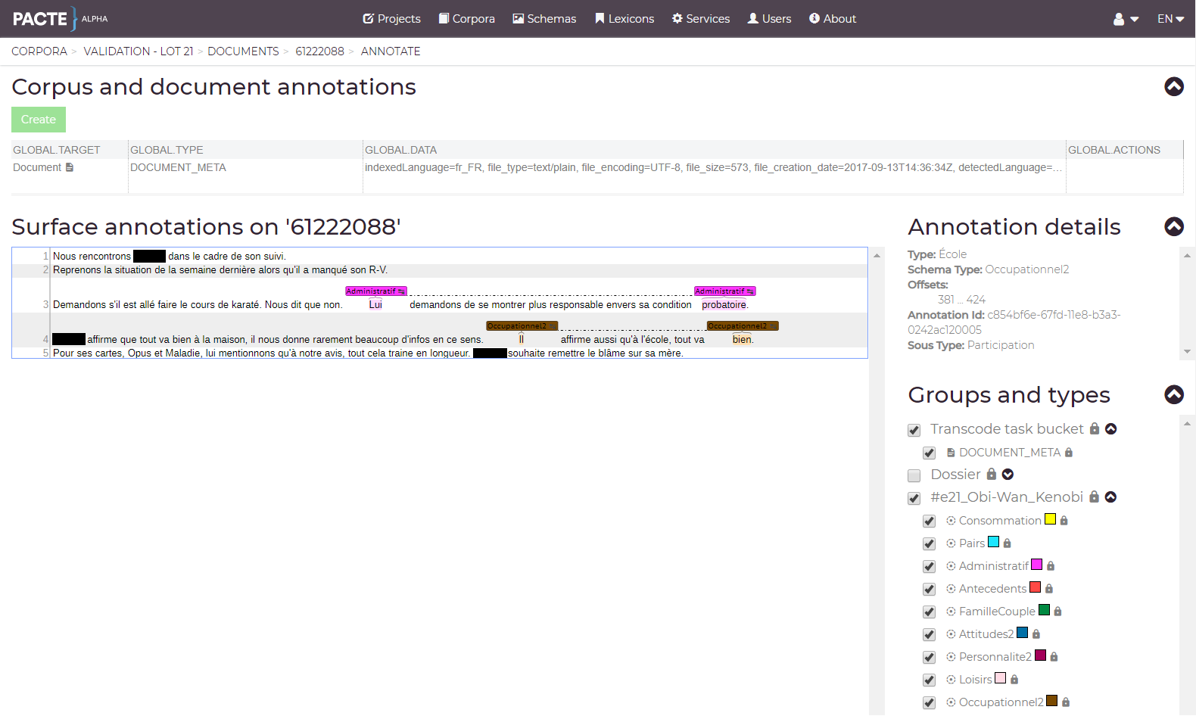

Slide 11
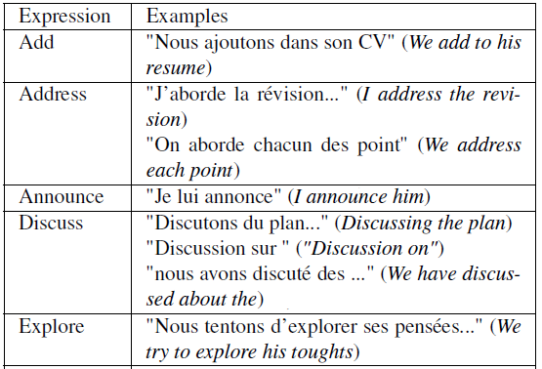
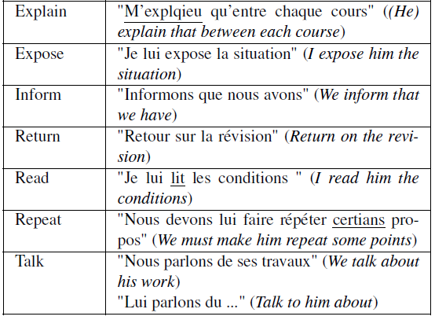
Manual annotation : outcome
Speech acts (Searle 1969)
Constative

Slide 12
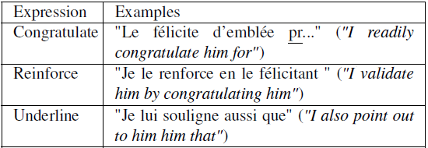
Manual annotation : outcome
Reinforcement

Slide 13

Manual annotation : outcome
Commissive

Slide 14
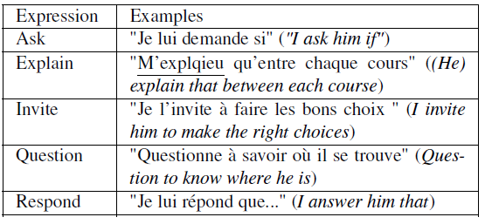
Manual annotation : outcome
Directive

Slide 15
Manual annotation : outcome
Some observations
Constative : found in all categories
Reinforcement and commissive
Absent in Antecedent and Family/Couple
More frequently in Personality and Consumption
Directive
High frequency in Administrative and Occupational

Slide 16
Automatic annotation
Using the training dataset
First level categorisation task on annotations (9 categories)
BOW features
Noisy stemming
Multilabel report annotation (inconclusive)
Performances on sentence classification
Rappel : 0.8160
Precision : 0.6301
F1-Mesure : 0.7116

Slide 17
Next steps
Sequence identification
Integrate speech acts as features
Provide annotated corpora for quality assessment
Further analyse the data from linguistic point-of-view
Develop other related automatic annotation services

Slide 18

Pierre André Ménard, eng., Ph. D. NLP Researcher
Speech and Text group
Computer Research Institute of Montréal
menardpa@ crim.ca
PACTE annotation platform (free for academic projects) :
http://pacte.crim.ca
Tous droits réservés © 2018 CRIM – Centre de recherche informatique de Montréal
101 - 405, avenue Ogilvy, Montréal (Québec) H3N 1M3 514 840-1234 / 1 877 840-2746

