Slide 1
Robust Resource Allocation Using Edge Computing for Smart Oil Fields
In proceeding of 24th Int'l Conf on Parallel and Distributed Processing Techniques and Applications (PDPTA'18)
Presenter : Anna Kovalenko
High Performance Cloud Computing Lab (HPCC)
School of Computing and Informatics
University of Louisiana Lafayette

Slide 2
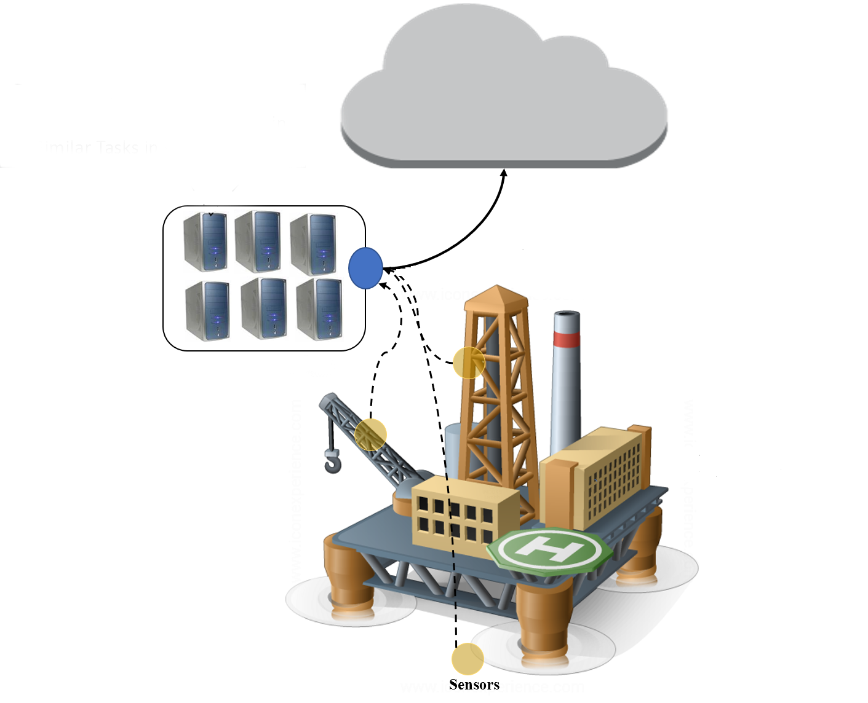
Introduction
High demands for petroleum creates scarcity of natural resources and Oil & Gas (O&G) companies move extraction sites to remote offshore places.
Achieving efficient and safe petroleum extraction is challenging due to it’s fault-intolerant nature.
Existing smart oil fields includes
various sensors (e.g., gas density, pipeline
pressure, Temperature) that collectively
generate terabytes of data per day.
Sensors generated data needs to be analyzed
in real-time for safety and decision making
purpose.
Cloud Datacenter
Edge Nodes
Smart Oil-field

Slide 3
Introduction (Cont.)
Cloud Datacenter with satellite communication in existing smart oil-field imposes a significant latency.
This latency is not acceptable to many real-time services needed in oil fields.
Consider the example of H2S gas leakage: it has to be identified and reacted in less than 5 seconds!
Edge computing can be instrumental in providing the real-time processing required in remote smart oil fields.
However, edge computing resources are generally insufficient for demands of oil fields
To have a robust smart oil field, we need a system to allocate arriving requests to edge OR cloud resources
Notes:
to satisfy the real-time constraint of application.

Slide 4
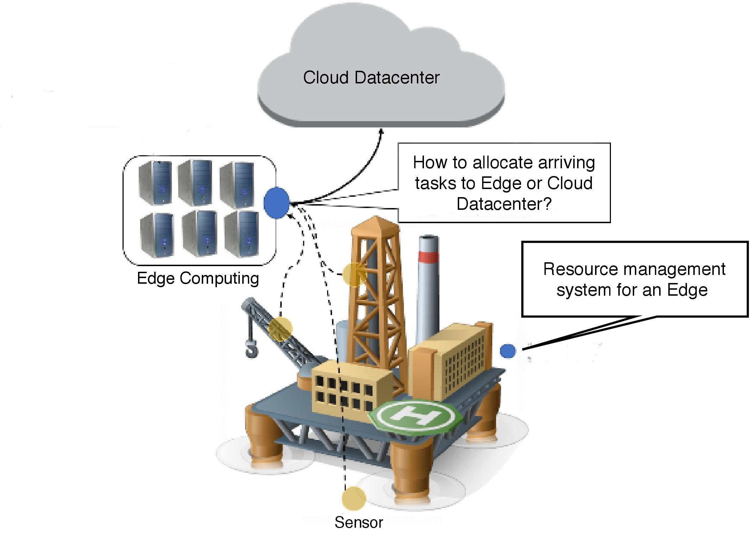
Problem Definition
The specific problem definition in this research can be stated as :
“How to allocate arriving tasks to an Edge resource or in Cloud Datacenter to achieve robustness?”
Robustness is defined as maximizing the number of tasks meeting their individual deadlines.
Our objective is to make the oil-field robust against
uncertainties in (a) Task arrival
(b) Communication delay

Slide 5
Contributions
We propose a resource allocation model to efficiently use limited computational resources of Edge and minimizes reliance on onshore cloud resources.
Developing a coordinator heuristic that provides robust task assignment for real-time monitoring and decision making.
Analyzing the performance of the proposed heuristic under various workload conditions.

Slide 6
System Model : Assumptions
Edge machines have constrained computational capacity and wireless communication capability.
Different sensors (e.g., pipeline pressure, cathodic protection, flow monitoring) of smart oil-field produce various types of data (e.g., numeric, image, video).
We define task types to represent the variety of applications ( e.g., disaster management and remote monitoring) that utilize the sensor generated data.

Slide 7
System Model : Assumptions
According to nature of tasks they are considered as
Delay-intolerant or urgent (pipeline pressure, oil spill monitoring, temperature monitoring)
Delay-tolerant (cost efficient drilling strategy, compressing and archiving captured video.)
Arrival rate of tasks to the system is unknown.
Receiving computing unit is oversubscribed.
The arriving tasks of delay-intolerant nature that miss their deadlines are considered to be dropped.
Notes:
which means it receives tasks beyond its capacity.

Slide 8
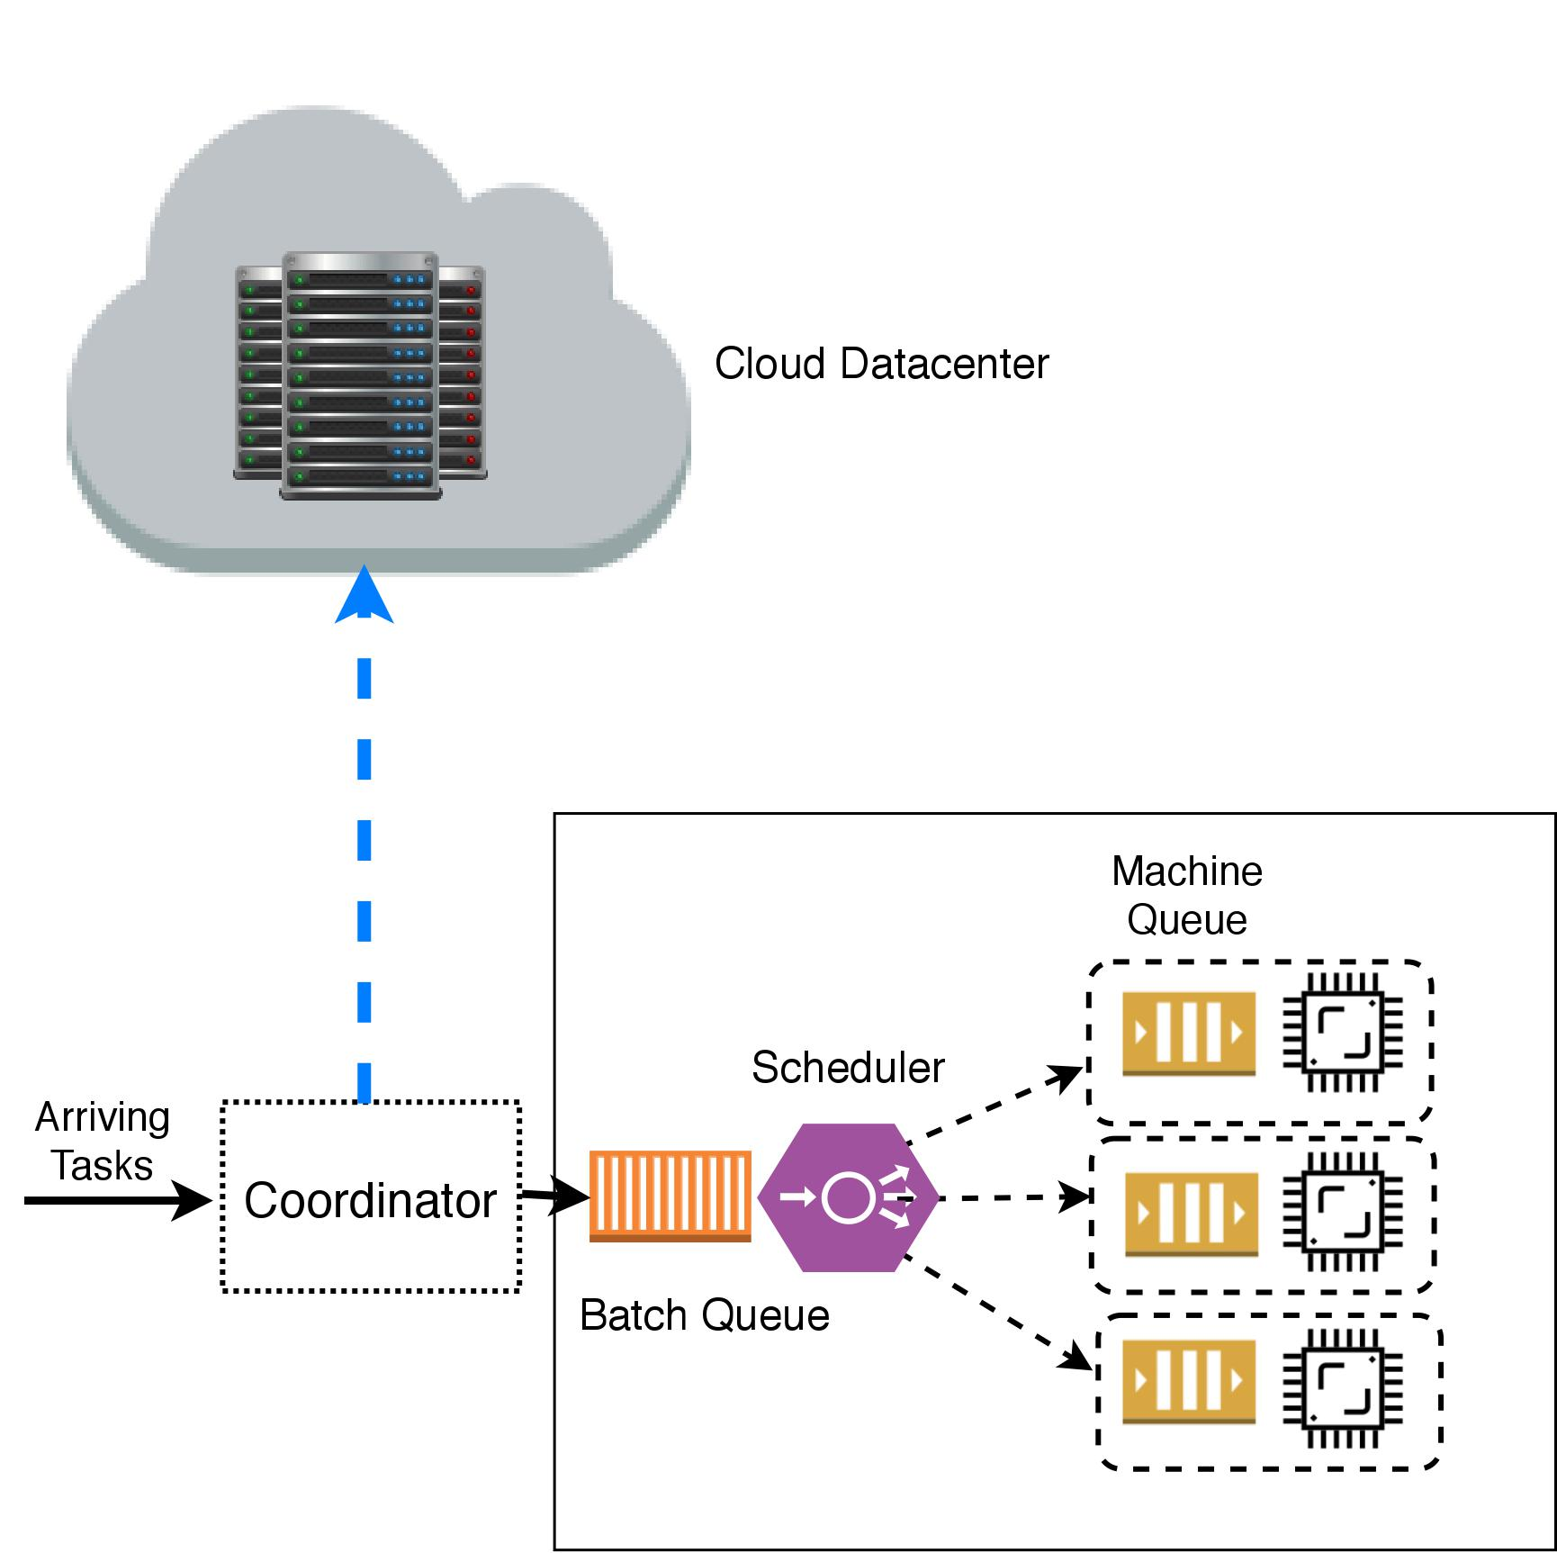
System Model : Scenario
Arrival of task until its processing completion is defined as computational delay
Appropriateness is defined as the computing unit that maximizes the likelihood of the task meeting task deadline
Edge Computing
Coordinator assign task to appropriate computing unit (edge or cloud).
Notes:
The assigned task then
enters the batch queue of
the computing unit to be
assigned (or mapped) to a
machine by scheduler.
The time passed from

Slide 9
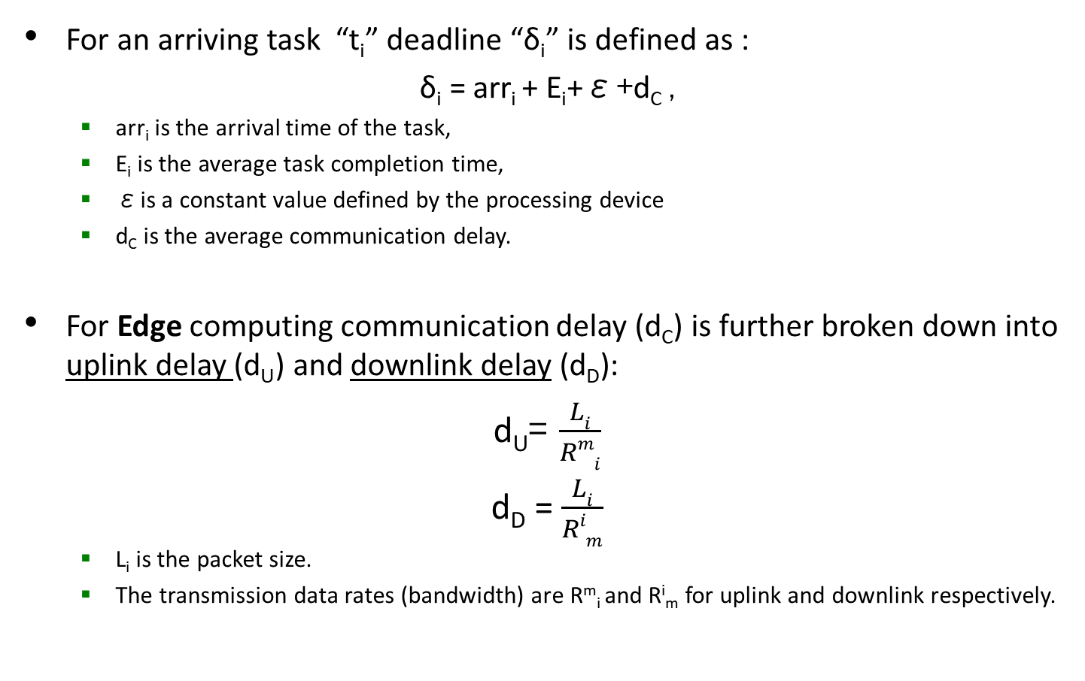
On-Time Completion Certainty of a Task on a Computing Unit : End-to-End Delay Calculation
For an arriving task “t_{i}” deadline “δ_{i}” is defined as :
δ_{i} = arr_{i} + E_{i}+ε+d_{C} ,
arr_{i} is the arrival time of the task,
E_{i} is the average task completion time,
εis a constant value defined by the processing device
d_{C} is the average communication delay.
For Edge computing communication delay (d_{C}) is further broken down into uplink delay (d_{U}) and downlink delay (d_{D}):
d_{U}= $\frac{Li}{Rmi}$
d_{D} = $\frac{Li}{Rim}$
L_{i} is the packet size.
The transmission data rates (bandwidth) are R^{m}_{i} and R^{i}_{m} for uplink and downlink respectively.

Slide 10
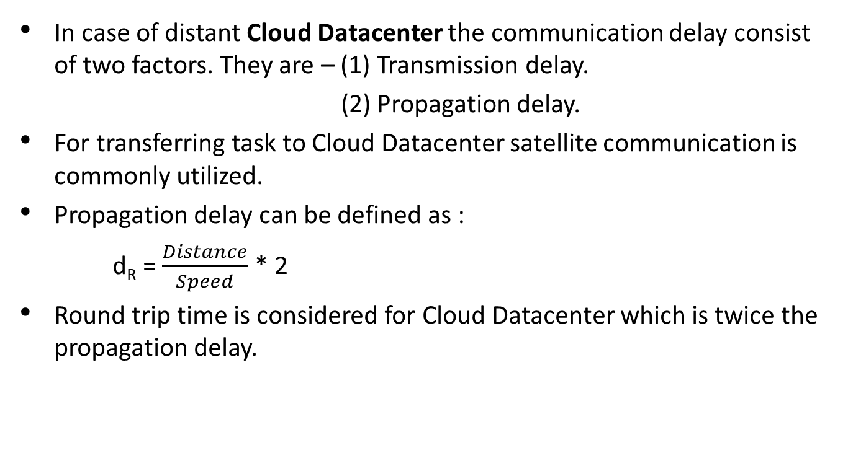
On-Time Completion Certainty of a Task on a Computing Unit : End-to-End Delay Calculation
In case of distant Cloud Datacenter the communication delay consist of two factors. They are – (1) Transmission delay.
(2) Propagation delay.
For transferring task to Cloud Datacenter satellite communication is commonly utilized.
Propagation delay can be defined as :
d_{R} = $\frac{Distance}{Speed}$ * 2
Round trip time is considered for Cloud Datacenter which is twice the propagation delay.

Slide 11
On-Time Completion Certainty of a Task on a Computing Unit : Completion Time Certainty
We assume the mean completion time of task i on machine j (denoted E_{ij}) obtained from historic completion time information.
We define on-time completion certainty C_{j}(t_{i}) as:
C_{j}(t_{i}) = δ_{i} - E_{ij}
Coordinator assigns tasks to the computing unit (i.e., Edge or Cloud) that provides highest certainty to complete the task on time

Slide 12
Coordinator vs Scheduler
The Coordinator makes an efficient resource allocation decision for processing each task within its deadline.
After resource allocation, scheduler of computing unit maps tasks to its VMs.
In this research two different commonly used scheduling policies are considered. They are –
First Come First Serve (FCFS) : This policy schedule tasks first that arrive earlier to scheduler.
Shortest Job First (SJF) : SJF schedule the tasks according to its execution time in ascending order. Therefore, shortest job scheduled first.

Slide 13
Resource Allocation Heuristics
Resource allocation decision in coordinator is based on 3 heuristics. They are –
Baseline Heuristic : The baseline heuristic naively allocates every task to the onshore Cloud Datacenter for processing.
Maximum Certainty (MC) Heuristic : It allocates an arriving task to the computing unit that maximizes certainty of the task.
Task Type (TT) Heuristic : This heuristic harness the knowledge of urgent task type and allocates the arriving urgent tasks to edge node. The tasks that are not urgent and delay tolerant are dispatched to onshore Cloud Datacenter.

Slide 14
Experiment Setup
CloudSim simulator is used to evaluate the system’s performance.
We simulate an edge computing unit with 8 cores
Our simulation includes 16 VMs allocated on an onshore cloud
This research considers homogeneous situation meaning all the VMs have same computational power (MIPS).

Slide 15
Experiment Workload
Execution times for tasks of workload are generated using Gaussian distribution.
For arrival time, the results of Extreme Scale System Center (ESSC) at Oak Ridge National Laboratory (ORNL) are used with relevant adjustment.
In addition to this oversubscribe situation Coordinator receives the generated workload which was used for result evaluation.
Each experiment was conducted 10 times from where the mean and 95% confidence interval was reported for the sake of accuracy and to remove uncertainties in results.

Slide 16
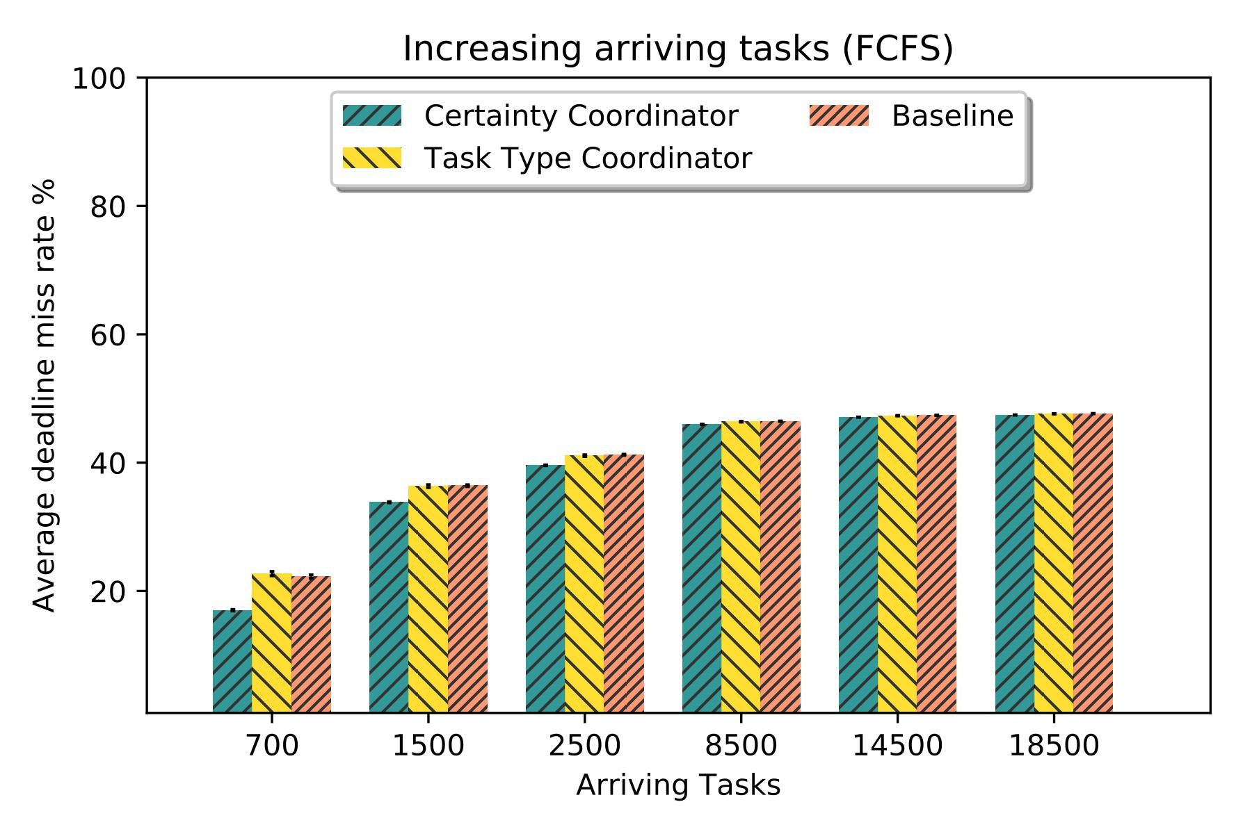
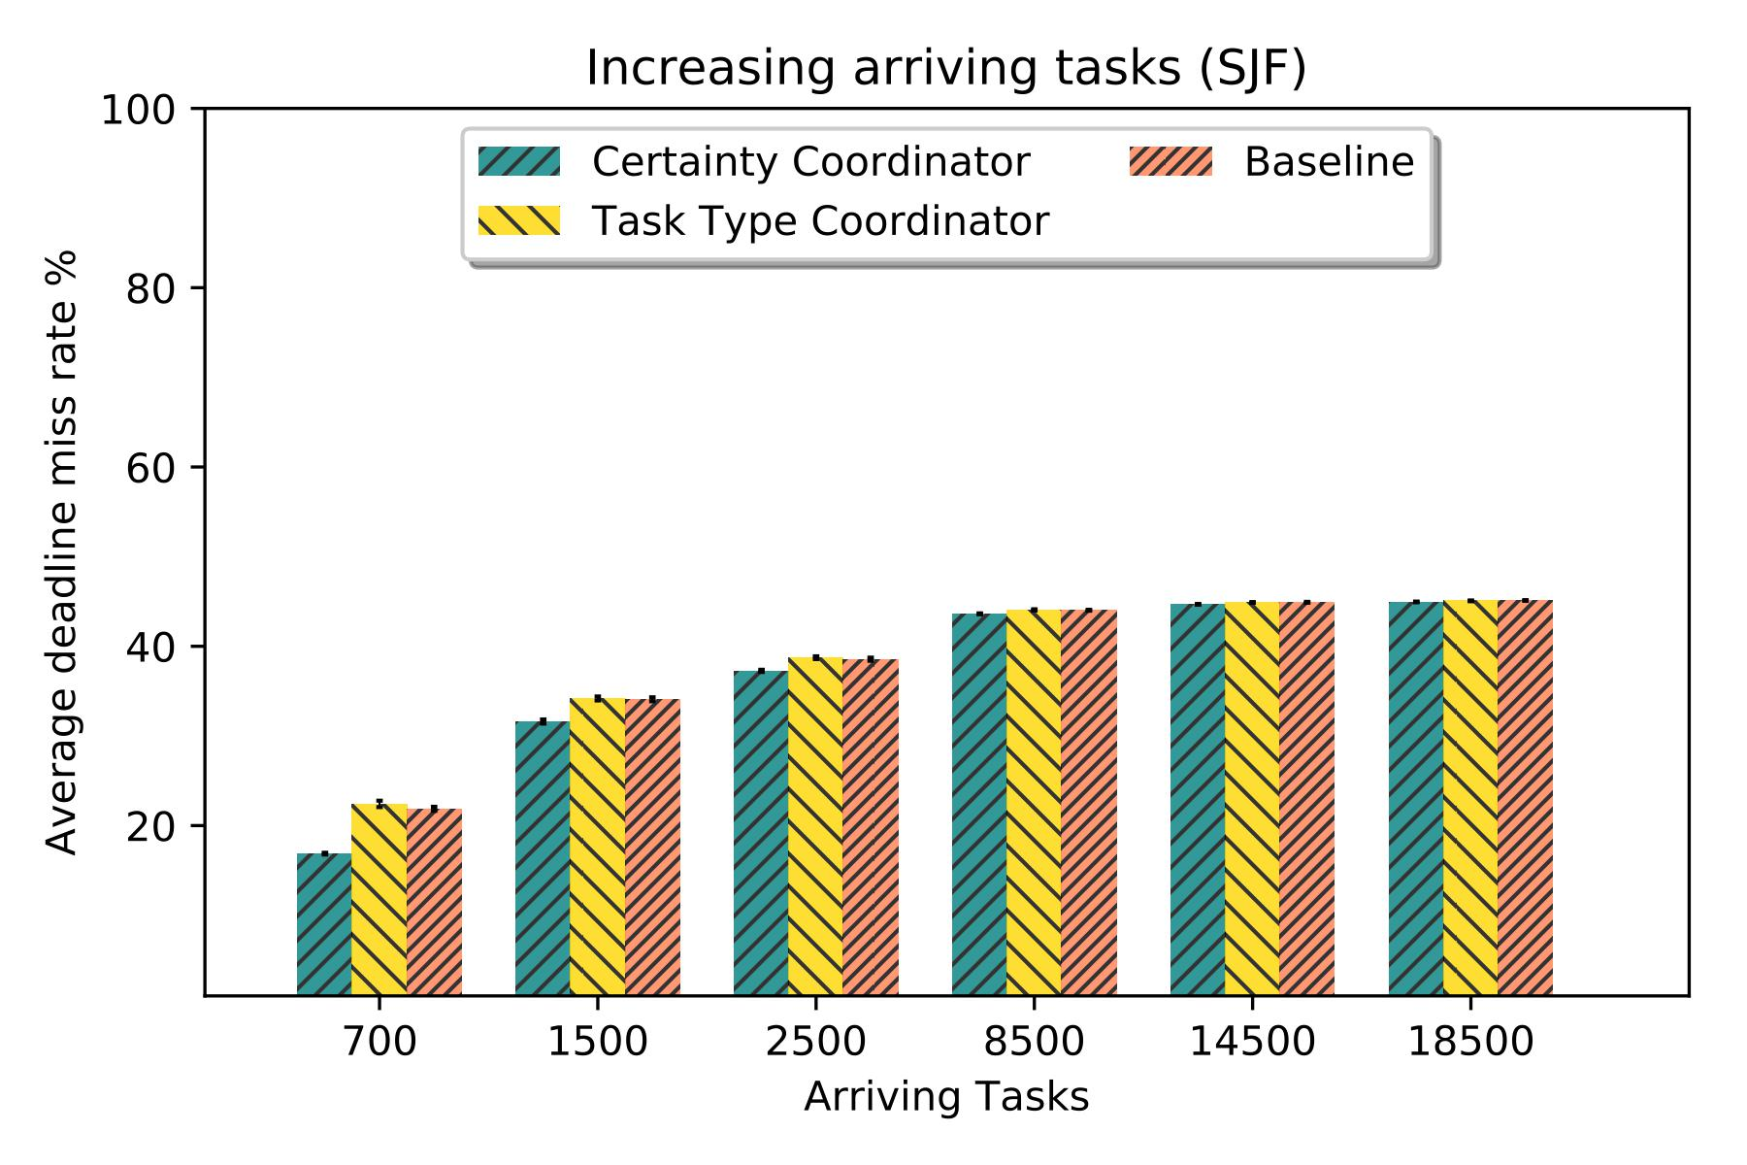
Experimental Results
The impact of increasing number of arriving tasks to the system is analyzed with proposed heuristic.
In each experiment deadline missed tasks are counted for performance evaluation.
Certainty Coordinator performs better than baseline and task type heuristics.
17% of all tasks miss their deadline using certainty heuristic whereas more than 22.2% of tasks miss their deadline with baseline heuristic.
Proposed heuristic performs slightly better using SJF scheduling due to efficient scheduling of short task first.
Notes:
The experiment indicates that limited number of edge node can improve the robustness of the system.
Certainty Coordinator performs better than baseline and task type heuristics from the beginning to the midrange of the task increase.

Slide 17
Conclusion and Future Works
A robust resource allocation model using Edge computing is proposed that copes with uncertainties both in communication and computation.
With experiment results it is proven that our model can improve the robustness of the system compared to existing Cloud Datacenter system.
Extension of proposed model could be improvement of the efficiency and heterogeneity within each computing unit.

