Slide 1





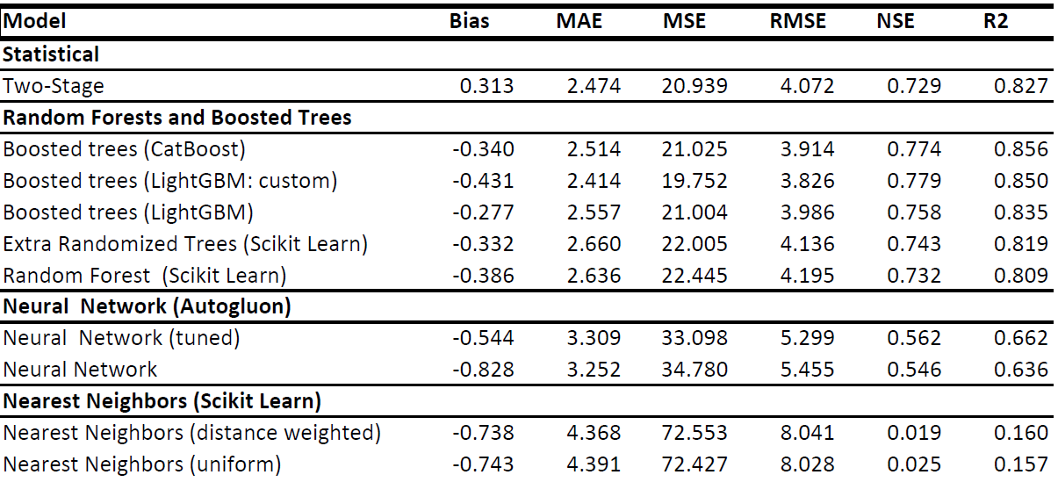
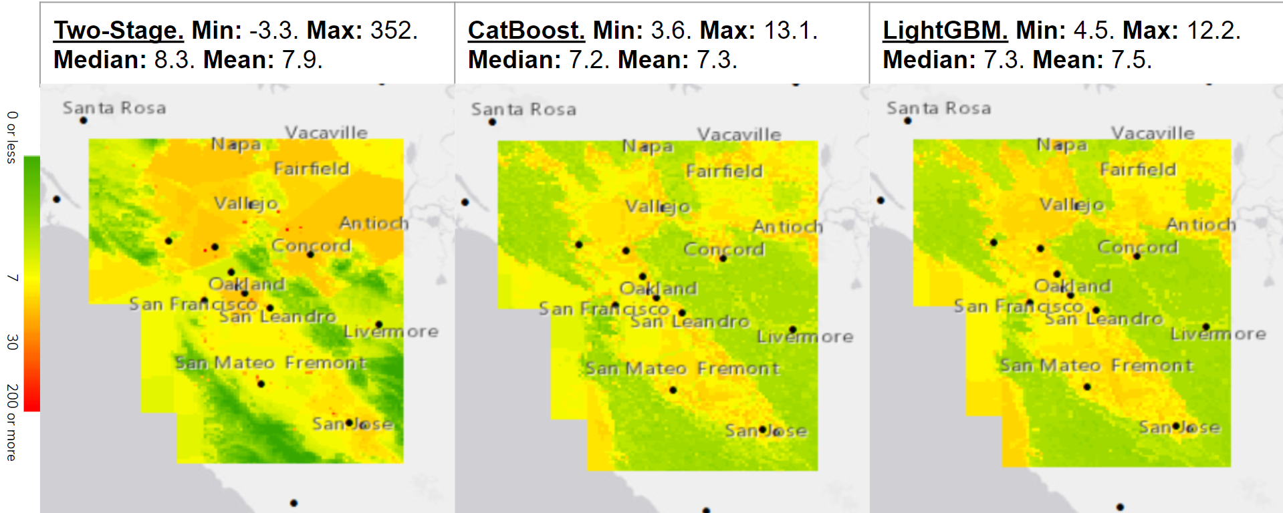
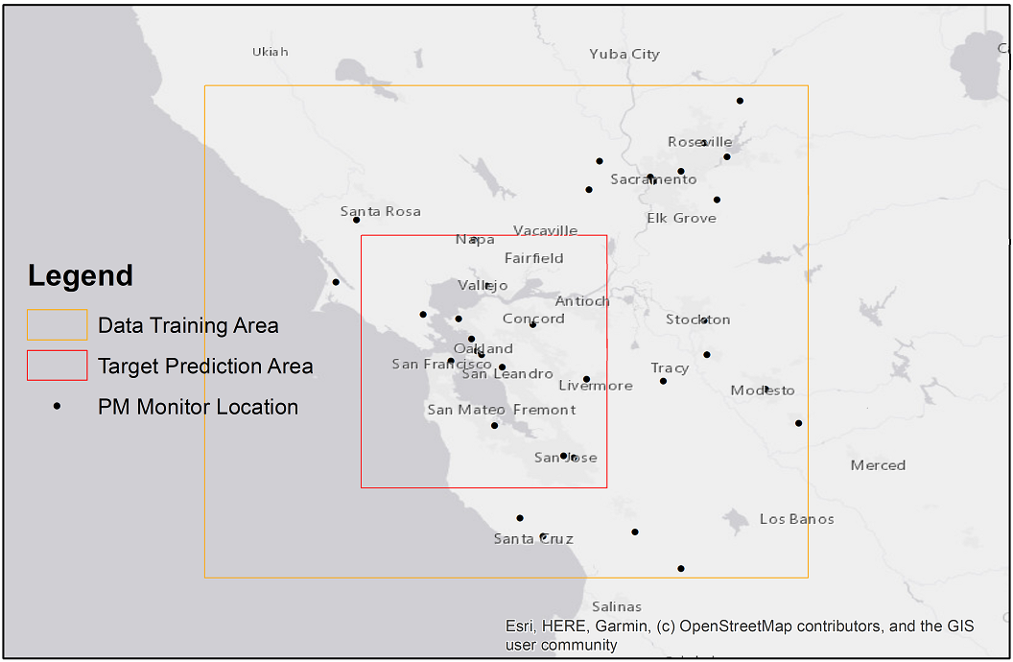
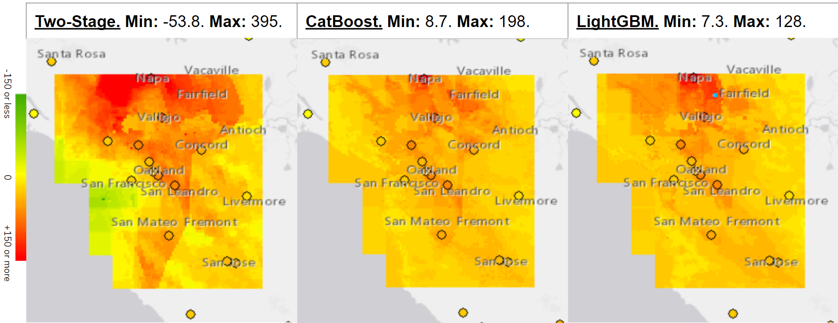

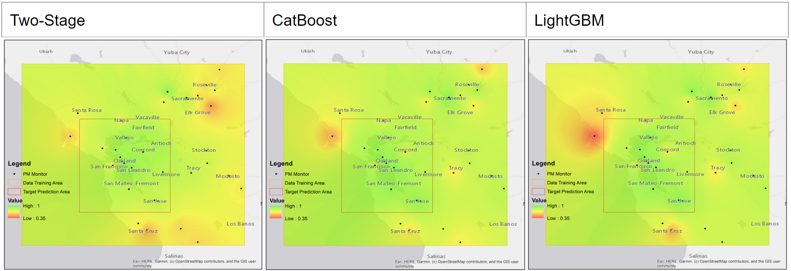

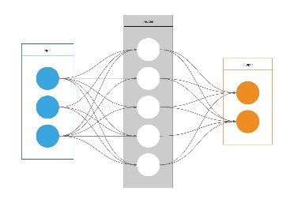
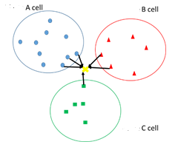
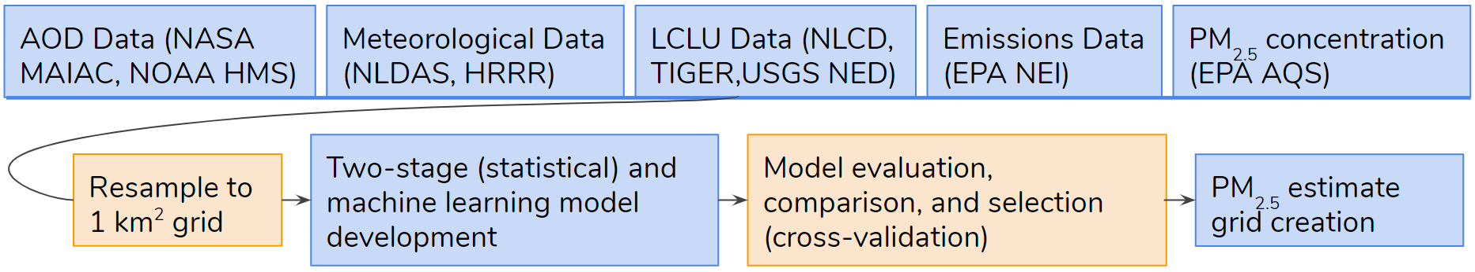
Using Statistical and Machine Learning Models with Remotely Sensed Data to Estimate PM2.5 in the San Francisco Bay Area
Anna Boser¹ , Mohammad Al-Hamdan², Christian White²
¹Bren School of Environmental Science and Management, University of California Santa Barbara
²Universities Space Research Association, NASA Marshall Space Flight Center, Huntsville, AL
Abstract
Results
Ambient fine particulate matter (PM_{2.5}) is associated with significant adverse health impacts. Continuous, high quality and high resolution PM_{2.5} data has the potential to be greatly useful in public health research and mitigation efforts, but PM_{2.5} monitors are few and unevenly distributed over the landscape. In California, this is of particular concern because catastrophic wildfires have caused and are projected to continue causing episodes of very high levels of PM_{2.5}. Previous studies have shown the potential for Aerosol Optical Depth (AOD), meteorological data, and land cover/land use (LCLU) data to estimate PM_{2.5} using a variety of models. However, the most recent research has yet to be applied in the San Francisco Bay Area, where high density episodes of PM_{2.5} were observed in 2017 and 2018. In addition, few studies have taken advantage of flexible and powerful machine learning algorithms to estimate PM_{2.5} levels, especially considering the variety of parameters known to improve such models. This study aims to apply the state of the art PM_{2.5} estimation techniques, including a proven two-stage model trained on AOD, meteorological, and LCLU data, and compare it to promising ML algorithms including random forests and gradient boosted decision trees. We envision that this approach will lead to greatly improved estimation of PM_{2.5} in California, and that more flexible ML techniques will allow for improved results when predicting extreme PM_{2.5} events, such as resulting from a wildfire, which are particularly important for public health research.
Spatially Grouped Cross-Validated Model Evaluations and Discussion
Table 1: Model Evaluations
The statistical two-stage model performs well, but certain machine learning methods, especially boosted trees, outperform it.
Neural networks do not show very good results, but this may be a result of only minimal tuning
The statistical model extrapolates poorly, both when extreme parameter values (e.g. large point source emissions) and when extreme PM_{2.5} values are present. This is evident when observing the impossibly extreme PM_{2.5} values the model predicts, even when taking the temporal average.
The boosted trees models appear to handle these non-linear relationships very well.
Maps of High Performing Models: Temporal Averages (µg/m³)
Objective
Create an accurate and high resolution (1km²) dataset of PM_{2.5} estimates that covers the San Francisco Bay Area by training and comparing comprehensive machine learning and statistical models using pertinent parameters.
Study Area
A small target prediction area encompassing the San Francisco Bay Area was selected. This area included 14 EPA PM_{2.5} monitors. In order to increase the training dataset, we designated a larger training area surrounding the target site, which included a total of 34 EPA PM_{2.5} monitors. 327 days in 2017 were included.
Maps of High Performing Models on a High PM_{2.5} Day: October 13, 2017 (Tubbs Fire) (µg/m³)
Methodology
Parameters were processed from various publicly available AOD, meteorological, LCLU, and emissions datasets. These data were resampled to a 1 km² grid, and the grid cells containing an EPA Air Quality System (AQS) PM_{2.5} monitor were selected to train and validate the various types of models:
Statistical two-stage model. Stage 1: linear mixed effects model with random effect “Day.” Stage 2: geographically weighted regression on aerosol optical depth.
Random forests and decision trees. Popular python libraries were used: CatBoost boosted trees. LightGBM boosted trees (regular and custom), Scikit learn random forest classifier. Scikit learn extremely randomized trees
Artificial Neural Networks. Autogluon tabular deep
neural networks (with and without tuning)
K Nearest Neighbors. Scikit learn nearest neighbors
(uniform and distance weighted)
A grouped cross-validation by location was performed on each model.
Maps of Spatially Grouped Cross-Validated R² Values for High Performing Models
Conclusions
Machine learning models perform the best. Certain relationships appear to be strictly non-linear, such as the contribution of point emissions to PM_{2.5} levels.
Machine learning models appear more suited to estimate extreme values. Non-linear models may be better for public health research interested in assessing the effects of a broad range of PM_{2.5} levels in areas without monitors.
The buffer zone around the target area is important. The monitors around the edges of the training area performed worse than those in the middle. This may be an issue for estimating PM_{2.5} adjacent to the coast.
More research must be done tuning the different models. The machine learning models show promising preliminary results, but more research must be done to uncover their full potential.
More research must be done on choosing the most pertinent parameters. This study has shown that a broad array of parameters can lead to promising results, but a more careful analysis of which parameters work best together is needed.
A continuous, 1 km² resolution dataset should be made available to public health researchers. This study suggests that a carefully crafted non-linear model can exhibit the necessary accuracy to be valuable to public health research.
Acknowledgments
References
Thanks to the Center for Applied Atmospheric Research and Education (CAARE), NASA Office of Education’s Minority University Research and Education Project (MUREP) Institutional Research Opportunity (MIRO) Program, NASA/MSFC/Earth Science Office, NASA/MSFC/Academic Affairs Office, and CAARE Director Dr. Sen Chiao from San Jose State University. A special thank you to mentors Dr. Mohammad Al-Hamdan and Christian White for their timely support, guidance, and encouragement throughout this whole process. We appreciate the help of CAARE interns Emily Lill and Lucas Cohen, whose input has been invaluable.
¹ Delfino, R. J., Brummel, S., Wu, J., Stern, H., Ostro, B., Lipsett, M., Winer, A., Street, D. H., Zhang, L., Tjoa, T., & Gillen, D. L. (2009). The relationship of respiratory and cardiovascular hospital admissions to the southern California wildfires of 2003. Occupational and Environmental Medicine; London, 66(3), 189.
² Westerling, A. L., & Bryant, B. P. (2008). Climate change and wildfire in California. Climatic Change, 87(1), 231–249.
³ Hu, Xuefei, et al. (2014). Estimating Ground-Level PM2.5 Concentrations in the Southeastern United States Using MAIAC AOD Retrievals and a Two-Stage Model. Remote Sensing of Environment, vol. 140, pp. 220–232., doi:10.1016/j.rse.2013.08.032.
⁴ Zamani Joharestani, M.; Cao, C.; Ni, X.; Bashir, B.; Talebiesfandarani, S. (2019). PM_{2.5} Prediction Based on Random Forest, XGBoost, and Deep Learning Using Multisource Remote Sensing Data. Atmosphere, 10, 373.
⁵ Stowell, Jennifer D, et al. (2020). Estimating PM2.5 in Southern California Using Satellite Data: Factors That Affect Model Performance. Environmental Research Letters, doi:10.1088/1748-9326/ab9334.
⁶ Al-Hamdan, Mohammad Z., et al.(2009). Methods for Characterizing Fine Particulate Matter Using Ground Observations and Remotely Sensed Data: Potential Use for Environmental Public Health Surveillance. Journal of the Air & Waste Management Association, vol. 59, no. 7, pp. 865–881., doi:10.3155/1047-3289.59.7.865.
⁷ Gupta, P., Doraiswamy, P., Levy, R., Pikelnaya, O., Maibach, J., Feenstra, B., et al. (2018). Impact of California fires on local and regional air quality: The role of a low-cost sensor network and satellite observations. GeoHealth, 2, 172–181. https://doi.org/10.1029/2018GH000136

