Slide 1
Buyer’s Market Project Presentation
A community-driven exchange platform for free & low-cost items, A place where every item finds a new home and it always stays a Buyer’s Market.
Notes:
Added tagline, refine all placeholder type text…redundant info etc.

Slide 2
Buyer’s market
Many people have items with life left in them but no easy way to give directly to others.
Buyer’s Market creates a simple, community-first space to share, request, and stay informed about free or low-cost items.
A place where every item finds a new home and it always stays a Buyer’s Market.
~ Four Functioneers,
Bellevue College, Fall 2025
Notes:
The opening slide introduces the project titled 'Buyer’s Market,' developed by the team Four Functioneers for the DEV 109 course in Fall 2025. This platform is designed as a community-focused exchange system for free and low-cost items, emphasizing accessibility and simplicity. The title slide should clearly display the project name, team name, course details, and a concise tagline that communicates the purpose of the platform. This sets the tone for the presentation and provides the audience with immediate context about the project’s goals and scope. *** Intro new tagline?***

Slide 3
Our Project & Our Client
Buyer’s Market is a simple community exchange platform where people can give, share, or request free or low-cost items. The goals is to reduce waste and make reuse easy for everyone.
Our “client” represents a local community group modeled after Buy Nothing and neighborhood freecycle movements. These groups rely on trust, sharing, and accessibility. Values that our site is designed to support.
We designed clear, intuitive flows for posting items, browsing listings, and receiving notifications. Every page focuses on ease of use, clarity, and community connection
Notes:
Buyer’s Market is a simple community exchange site that allows users to post and find items that are free or priced under $20. The fictional client represents a local community group like Buy Nothing or neighborhood freecycle initiatives. To define client goals, the team analyzed common needs of such groups, applied assignment constraints, and prioritized straightforward user flows such as posting items, browsing listings, and receiving notifications. This approach ensures that the platform remains user-friendly and meets the essential requirements of community-driven exchanges.

Slide 4
Client Goals & How We Met Them
Easy Posting
  Implemented a Post Item form with required fields to simplify the posting process for users.
Easy Browsing
  Designed an organized, simple listings page so users can easily view items and navigate categories without confusion.
Staying Informed
  We added a notification signup with category options, so users can receive updates that match their interests.
Accessibility & Mobile-Friendly
  We made sure the site is easy to read, easy to navigate, and works well on phones, tablets, and laptops. Text is clear, buttons are easy to use, and the layout adjusts automatically for smaller screens.
Notes:
The project was guided by five primary goals: (1) Easy Posting, achieved through a Post Item form with required fields; (2) Easy Browsing, implemented via a clean and organized listings page; (3) Staying Informed, supported by a notification signup system with category filters; (4) Accessibility, ensured through semantic headings, alt text, proper contrast, and clear navigation; and (5) Mobile-Friendly Foundation, established using Flex/Grid structures with plans for media queries. Each goal was addressed with practical solutions to create a functional and inclusive platform.

Slide 5
Visual Demonstration
Notes:
Screenshots: What We Built

Slide 6
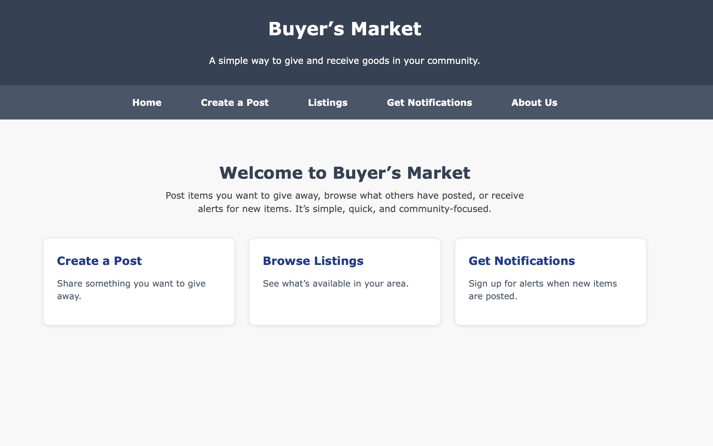
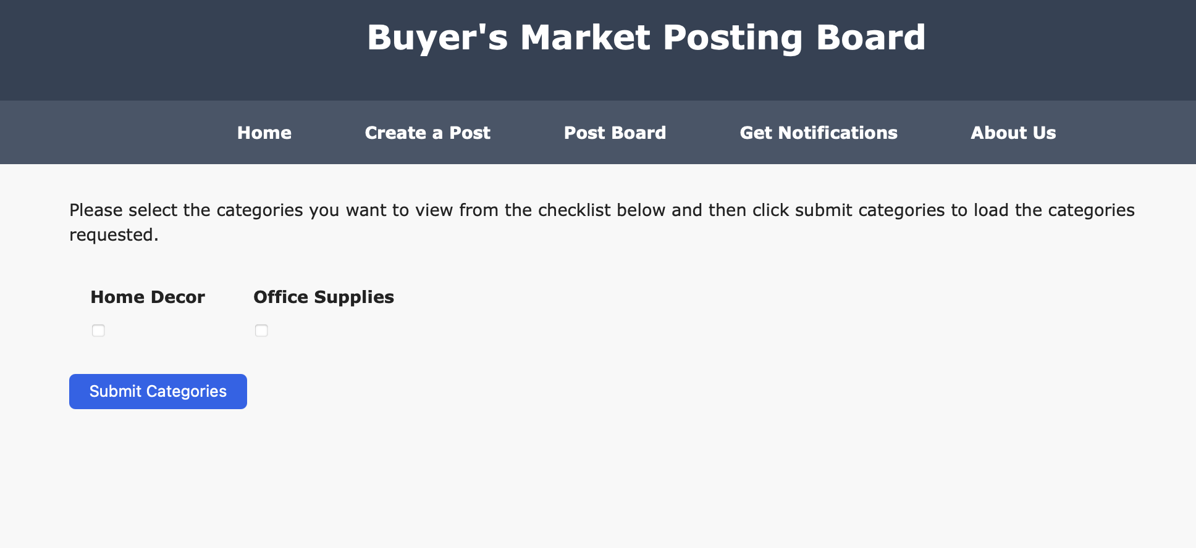
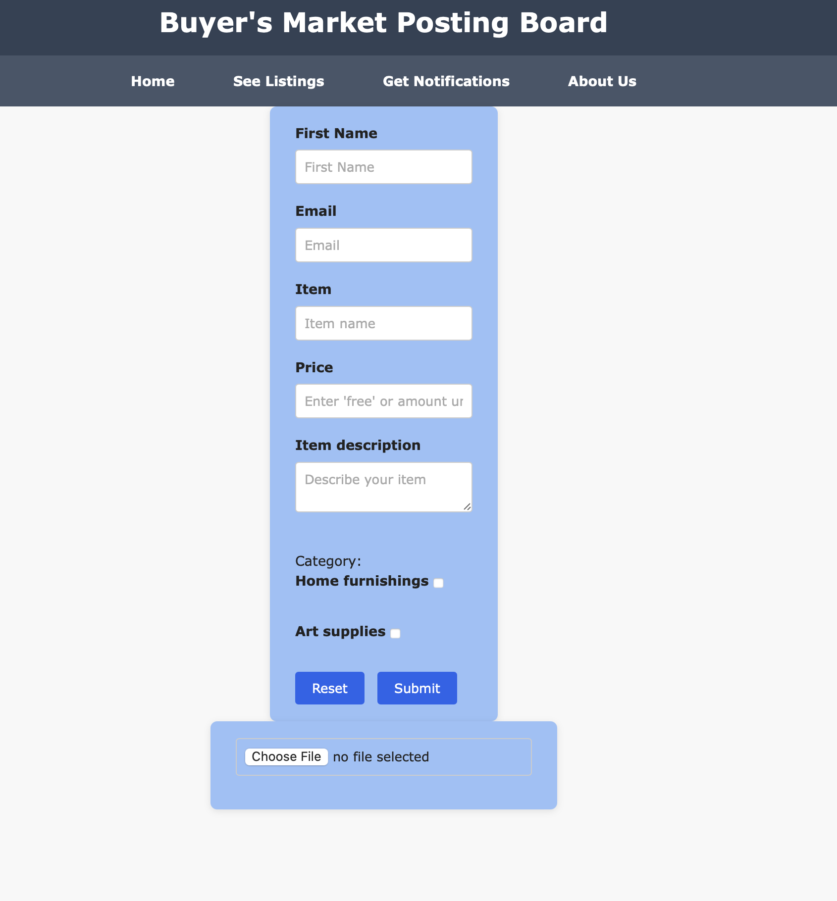
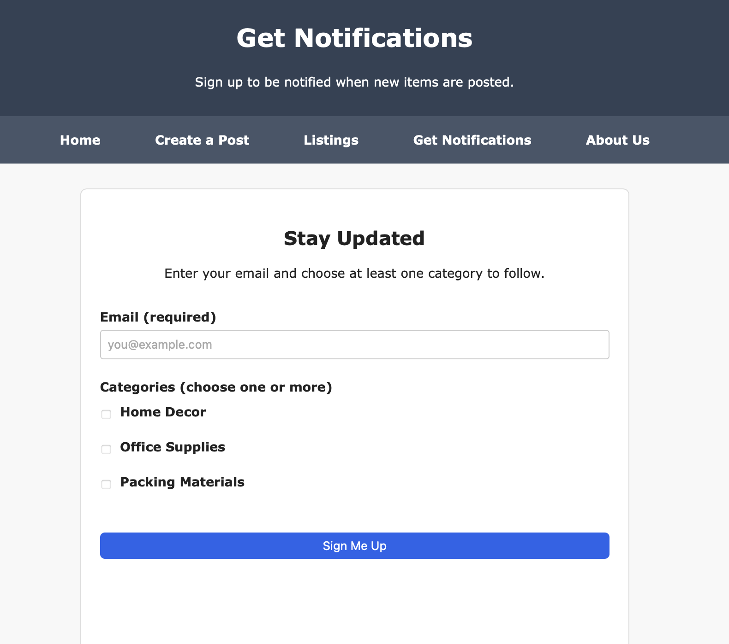
What We Built
Home Page
  Introduces the platform with a welcoming layout and a clear starting point for users.
Listings Page Prototype
  Shows available items in an organized format, making it easy for users to browse and find what they need.
Post Item Form
  Allows community members to quickly add new items with basic details, helping keep the listings fresh and useful.
Notifications Signup
  Lets users subscribe to updates and follow categories they care about, increasing engagement and convenience.
Notes:
This section provides a visual representation of the platform through screenshots of key components: the Home Page MVP, Listings Page Prototype, Post Item Form, and Notifications Signup. These images serve as a visual anchor for the audience, illustrating the tangible progress made during development. Each screenshot should include a brief caption to explain its purpose and functionality, helping viewers connect the design elements with the goals previously discussed…need to insert slides, maybe just 2 with 2 columns and captions???

Slide 7
Reflection & What’s Next
We worked well together and stayed connected throughout the project. Clear communication and shared responsibilities helped us move from early drafts to a working MVP.
Everyone contributed in different ways from building pages, organizing structure, refining styles to helping shape the flow of the site. Our combined efforts created a foundation we can continue improving.
Going forward, we plan to enhance responsiveness, refine layouts, and add new features such as??We also hope to gather feedback and make the site even more intuitive.
Notes:
Team reflections and future versions. Add end slide?

