Slide 1

Spontaneous Leptogenesis using Axions with Generic Couplings in Generic Realignment, Clockwork and Multiaxion models
Anna-Jana Rieß
Institute for Astrophysics
Institute for Theoretical Physics
University of Göttingen

Slide 2
Agenda
The mechanism:
  What is Baryogensis?
  What is Spontaneous Baryogenesis?
Model setup
  B-L violation
  Background cosmology
  Axion couplings
  Axion models
How do we compute the asymmetry?
  Transport equation for basis independence
Results!
Conclusion

Slide 3
The Problem of Baryogenesis
Today: Universe is made up of matter not anti-matter
Early universe: matter ~ antimatter
Annihilation: matter anti-matter pairs converted into photons
We know that B is a conserved quantity at lower energies.
→ Small asymmetry in the early universe generated by some mechanism!
Quantified by asymmetry parameter ??????

Slide 4
Spontanous Baryogenesis
Original mechanism proposed by Andrew Cohen and David Kapla in 1987
Coupling of scalar field to B – L current
Modification of chemical potential:
Equilibrium abundance is modified:

Slide 5
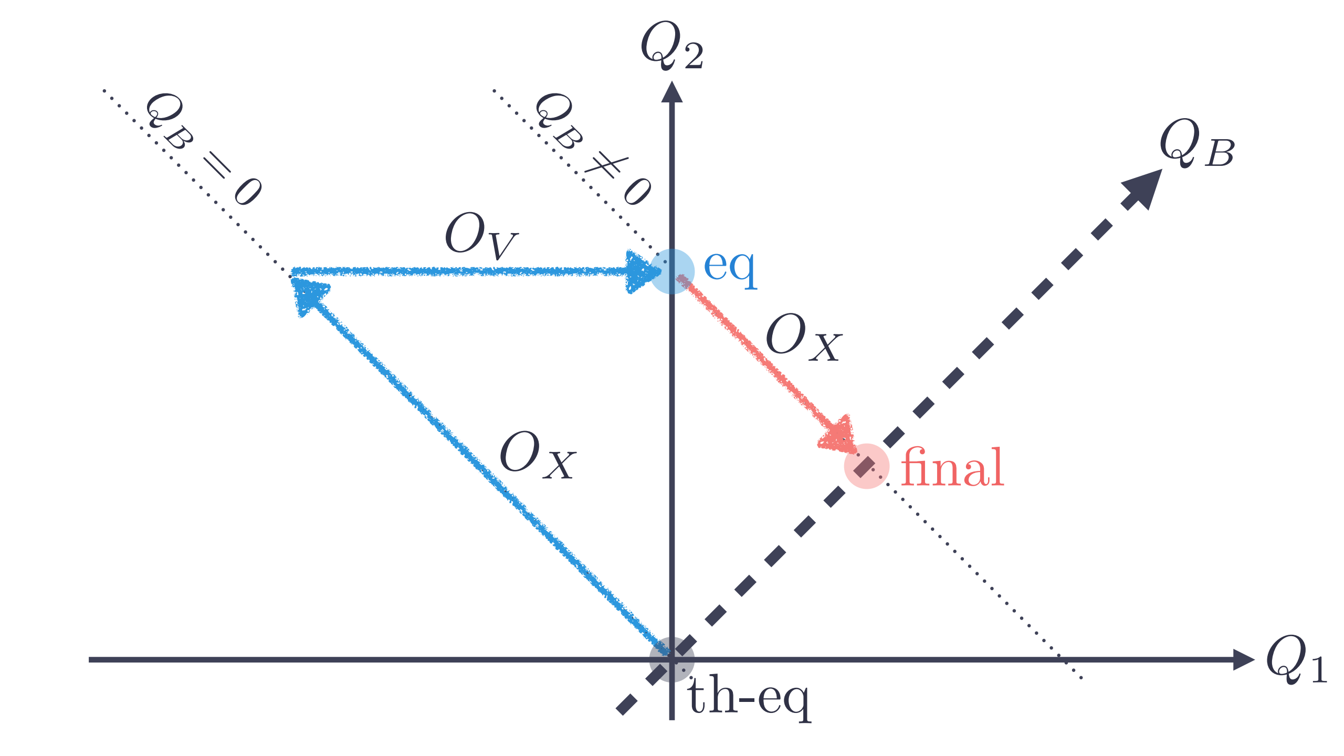
Spontanous Baryogenesis
More general mechanism described by Valerie Domcke et al. (image source: Domcke et al.):

Slide 6
Our Model:
B-L violation: Leptogenesis
Cosmological Background: Reheating
Scalar field:
  Axion Couplings
  Axion Models

Slide 7
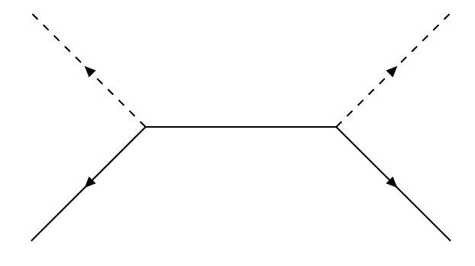
Leptogenesis
Violation of B – L by heavy right handed neutrinos
Effective Weinberg operator:
Converted to B + L by SM Sphalerons
Freeze-in temperature

Slide 8
Reheating
Need high temperatures for this mechanism
Epoch after the end of inflations at
Inflaton field decays with decay rate into SM particles
Reheating temperature reached:

Slide 9
Axion Models
Generic Realignment Axion Like Particle
Clockwork Axion
Multi Axions? (not in the talk, ask me later if you are interested)

Slide 10
Axion Couplings
Shift symmetric
Coupling to weak sphaleron:
Coupling to B – L current:
Coupling strong sphaleron:

Slide 11
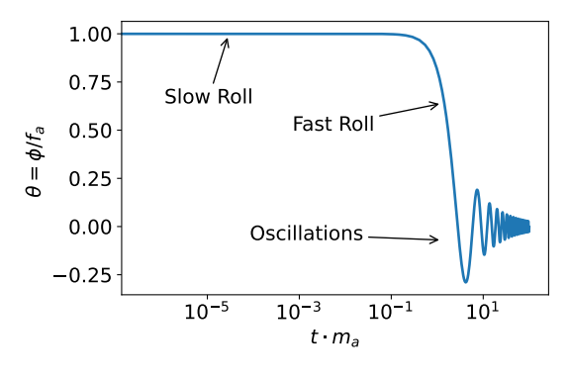
Axion Model: Generic Realignment
Lagrangian:
Generates field velocity at

Slide 12
Axion Model: Clockwork Axion
From discrete clockwork model:
… to continous model:

Slide 13
Axion Model: Clockwork Axion
Find a mass-less localized mode (low-energy theory) and integrate out the y-direction:
Canonical Field (Z: wavefunction normalization of θ):

Slide 14
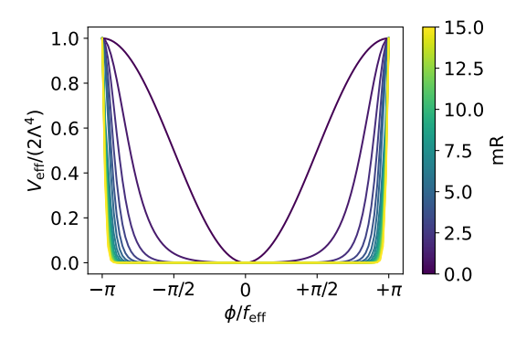
Axion Model: Clockwork Axion
Modified potential for canonical field (starting from cosine potential for θ) from trafo between fields:

Slide 15
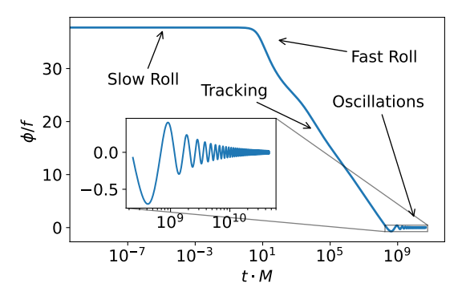
Axion Model: Clockwork Axion
Leads to tracking dynamics: density parameter conserved → relic density can explain dark matter!
Axion stable b.c.
of reduced mass,
couplings and
decay rate since
for small θ

Slide 16
How do we compute the asymmetry?
We have a model → how do compute the asymmetry?

Slide 17
How do we compute the asymmetry?
→ Transport Equation for charges which is invariant of the field basis used

Slide 18
How do we compute the asymmetry?
Naive Approch using Boltzman equations:
Problem: depends on field basis. Coupling to sphaleron requires rotating fields from sphaleron to current → rate of Weinberg operator changes!
Results in the literature incorrect e.g. A. Kusenko, K. Schmitz, T. Yanagida: Leptogenesis via Axion Oscillations after Inflation

Slide 19
How do we compute the asymmetry?
Linear Response Theory
Applied to chemical potentials:
and classical axion field:

Slide 20
How do we compute the asymmetry?
Kudo-Formula:
For pertubation

Slide 21
How do we compute the aymmetry?
We consider all standard model charges
Interactions which can change the charges are:
  Yukawa interactions (leptons, quarks)
  Sphalerons (weak, strong)

Slide 22
How do we compute the aymmetry?
Final result (on FLRW background):

Slide 23
Finally: Results!

Slide 24
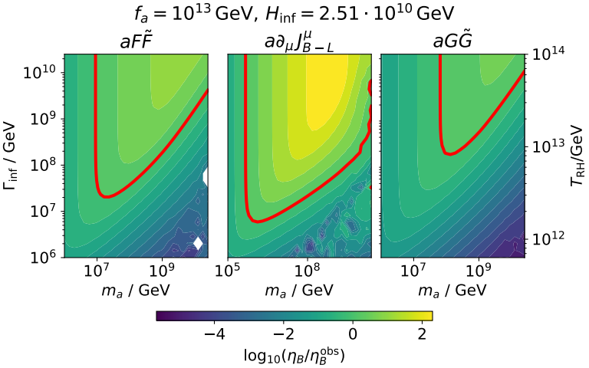
Results: Realignment

Slide 25
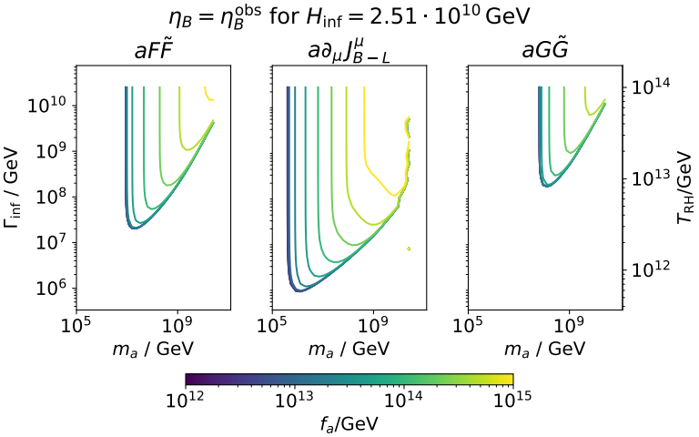
Results: Realignment

Slide 26
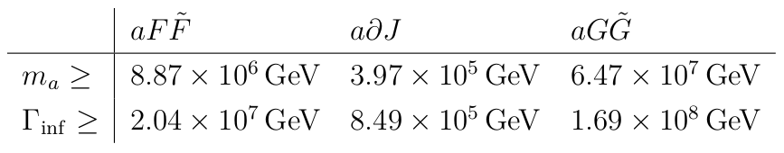
Results: Realignment
At some f_a we find the lowest possible m_a and Gamma_inf values:

Slide 27
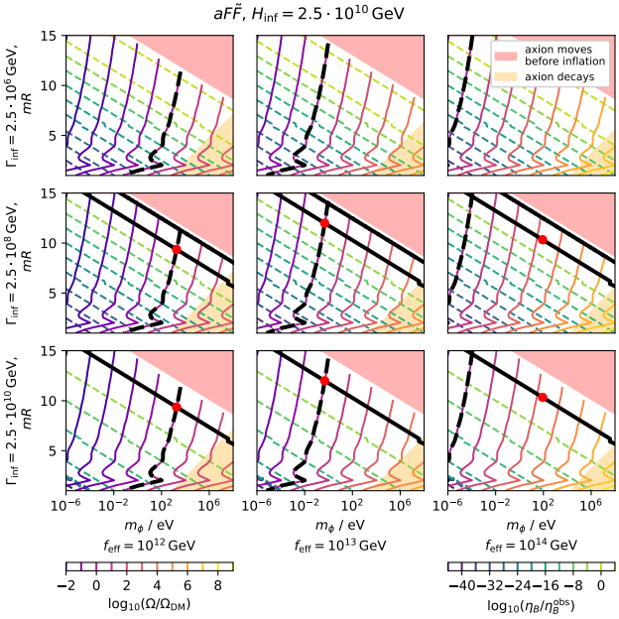
Results: Clockwork axion:

Slide 28
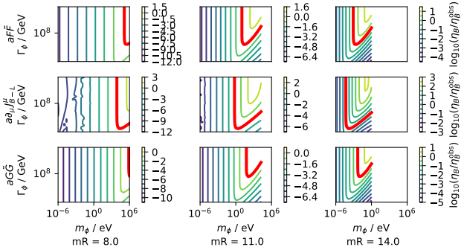
Results: Clockwork axion:

Slide 29
Conclusion:
We found that: the two axion models with different couplings could both generate the BAU in large parts of the parameter-space
Various modifications possible!
  Linear Combinations of couplings
  Modification of inflation/reheating dynamics
  Different axion models e.g. multi axions

Slide 30
Questions?
Thank you for your attention!

Slide 31
Backup Slides
????

