Slide 1

Lecture 1 | Chapter 11
Kinematics of a Particle
Position · Velocity · Acceleration
Notes:
Welcome to Lecture 1. This lecture is not about memorizing formulas of position, velocity, and acceleration. It is about understanding WHY those formulas exist, and when they fail. By the end, you will be able to derive any kinematic result from first principles — even if you forget every formula.

Slide 2
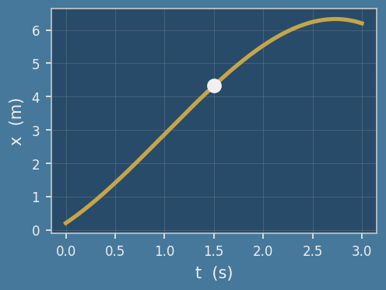
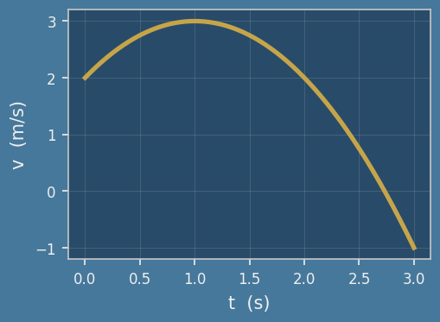
Lecture 1
KEY POINTS: The calculus chain of motion
Position · Velocity · Acceleration
x v=dx/dt a=dv/dt
Acceleration
a
Velocity
v
Displacement
Δx
Acceleration
Position
Velocity
Time
Time
Notes:
Three fundamental quantities (position, velocity, acceleration) govern all motion.
First: position x(t) in meters. It tells you where. The slope of the x-t graph is velocity.
Second: velocity v = dx/dt in m/s. Rate of change of position. The slope of the v-t graph is acceleration. Area under the v-t graph is displacement.
Third: acceleration a = dv/dt in m/s squared. Rate of change of velocity.

Slide 3
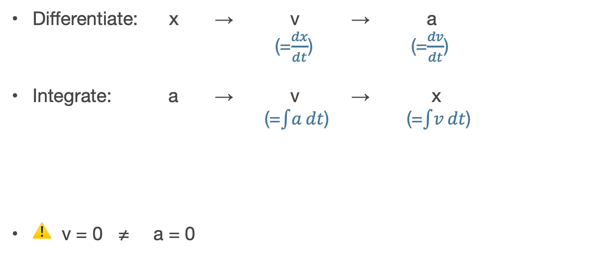
Lecture 1
KEY POINTS: The calculus chain of motion
Differentiate: x → v → a
(=$\frac{dx}{dt}$) (=$\frac{dv}{dt}$)
Integrate: a → v → x
(=$\int{a}dt$) (=$\int{v}dt$)
⚠ v = 0 ≠ a = 0
peak
v = 0
g
Notes:
So What: differentiation goes x to v to a. Integration goes a to v to x. These two operations are all you need for any kinematics problem.
So What on acceleration: v = 0 does NOT mean a = 0. A ball thrown upward has zero velocity at the peak — but gravity still pulls at 9.81 m/s squared. This is the most important single fact in kinematics.

Slide 4
Lecture 1
STRATEGY : Classify acceleration BEFORE calculating
a = constant → use v = v₀ + at x = x₀ + v₀t + ½at²
a = f(t) → integrate: v = ∫a dt x= ∫v dt
a = f(x) → use chain rule: a = v dv/dx ➡ ︎ vdv = adx
What kind of acceleration do you have?
Notes:
Before writing any equation, identify what type of acceleration you have. If acceleration a is constant: use the three standard formulas directly. They are valid only when a does not change. If acceleration a is a function of time: integrate with respect to time t. velocity v equals the integral of a dt. Position x equals the integral of v dt.
If acceleration a is a function of position x: use the chain rule. Acceleration a equals velocity v times dv/dx. Rearrange: v dv equals a dx. Integrate both sides.
So What: using v equals v-zero plus ei t when a depends on x is wrong. That formula assumes a is constant. The type identification step prevents this error.

Slide 5
Lecture 1
Example — Basic 1
Problem
A particle’s position is given by
x(t) = 3t² + 2t
Find:
The velocity v(t)
The acceleration a(t)
Notes:
Let’s solve an example: basic 1.
Given position x of t equals 3t squared plus 2t. Find velocity and acceleration.

Slide 6
Lecture 1
Example — Basic 1
Problem
A particle’s position is given by
x(t) = 3t² + 2t
Find:
The velocity v(t)
The acceleration a(t)
STEP 1
v = dx/dt = 6t + 2.
STEP2
a = dv/dt = 6 (const.)
So What
a = const.
↑ standard formulas （v = v₀ + at, x = x₀ + v₀t + ½at²）are valid
Notes:
Step 1: v equals dx/dt equals 6t plus 2. Step 2: a equals dv/dt equals 6. Constant. So What: at t equals 0, v is 2 m/s — not zero. The plus 2t term means the particle is already moving when we start watching. So What: a equals 6 is constant, so the standard formulas are valid for this problem.

Slide 7
Lecture 1
Example — Basic 2
Problem
Given constant acceleration a = 4 m/s²,
initial conditions: v(0)=v₀, x(0)=x₀
Find:
v(t), x(t)
using integration.
Notes:
Given constant acceleration a equals 4 m/s squared, initial conditions v-zero and x-zero. Derive v of t and x of t by integration

Slide 8
Lecture 1
Example — Basic 2
Problem
STEP 1
dv = 4 dt
v = 4t + C
v = v₀ + 4t
STEP2
dx = (v₀ + 4t) dt
x = v₀ t + ½ 4t² + C
x = x₀ + v₀ t + 2t²
Given constant acceleration a = 4 m/s²,
initial conditions: v(0)=v₀, x(0)=x₀
Find:
v(t), x(t)
using integration.
You just re-derived!
— no memorization needed
Notes:
Step 1: dv equals 4 dt. Integrate both sides. v equals 4t plus C. Apply v of 0 equals v-zero. Get v equals v-zero plus 4t. Step 2: dx equals v-zero plus 4t times dt. Integrate. x equals x-zero plus v-zero times t plus 2t squared. Step 3: Eliminate t. Get v squared equals v-zero squared plus 8 times x minus x-zero. So What: you just re-derived the three constant-acceleration formulas from scratch. You never need to memorize them again — just integrate.

Slide 9
Lecture 1
Key takeaway
Check “a” first.
If it varies → differentiate.
If constant → formulas OK.
Notes:
Key takeaway.
Check acceleration “a” first.
If it varies, differentiate.
If constant, formulas OK but You don’t need to memorize them. just integrate.

