Slide 1

Lecture 2 | Chapter 11
Curvilinear Motion & Relative Motion
T–N Coordinates · Projectile · Relative Velocity
Notes:
Welcome to Lecture 2. Today we move from straight-line motion to curved paths. By the end of this video, you will be able to split any curved motion into two clean components, solve projectile problems without confusion, and handle relative velocity as simple vector subtraction. Let's begin.

Slide 2
Lecture 2
KEY POINTS: Curvilinear motion - Is a turning car accelerating? -
Constant speed
Car
Velocity = magnitude + direction
Curved motion has acceleration even at constant speed.
Notes:
A car drives around a roundabout at constant speed. Is it accelerating? The speed is not changing. So the magnitude of v is constant. But the direction of v is changing continuously. Remember: velocity is a vector. It has both magnitude and direction. If the direction changes, the velocity changes. Change in velocity equals acceleration. So yes — the car is accelerating, even at constant speed. This is the central insight of this entire lecture.

Slide 3
Lecture 2
KEY POINTS: Curvilinear motion - Introducing radius of curvature ρ -
Sharp curve
Gentle curve
Straight line
V
V
V
Small ρ
Large ρ
ρ → ∞
Need more
Acceleration!
Notes:
At any point on a curve, we can ask: how sharply is it bending here? We answer that by imagining the best-fit circle at that point. The radius of that circle is rho — the radius of curvature. Sharp curve: small rho. Gentle curve: large rho. Straight line: rho equals infinity. Physical intuition: a tight curve with small rho means the direction is changing quickly. That means more acceleration is needed.

Slide 4
Lecture 2
KEY POINTS: Curvilinear motion – two independent acceleration -
Tangential
a_{t}
Tangential: a_{t} = dv/dt
→ controls SPEED change
Normal: a_{n} = v²/ρ
→ controls DIRECTION change
V
a_{n}
Normal
ρ
radius of
curvature
Two are always perpendicular, never mix
Appendix: derivation of a_{n}
Notes:
Curved motion has two completely independent acceleration components. The tangential component a_t equals dv/dt. It is along the velocity vector. It controls speed change. If a_t is positive, the particle is speeding up. If negative, slowing down. The normal component a_n equals v-squared over rho. It points toward the center of curvature. It controls direction change. It is always present when the path is curved — even at constant speed. These two are always perpendicular. They never mix.
By the way, if you want to know why this formula, please check the appendix.

Slide 5
Lecture 2
KEY POINTS: Curvilinear motion – projectile motion -
a_{x} = 0
a_{y} = - g
treat x and y as two completely independent problems
Notes:
Projectile motion is a special case of curvilinear motion where the only acceleration is gravity. Horizontal: a_x = 0 — v_x stays constant throughout the entire flight. Vertical: a_y = −g — free fall. The key insight: treat x and y as two completely independent problems. Solve each axis separately, then combine only at the end. Warning: at the peak, v_y = 0, but acceleration is still g downward. Always.

Slide 6
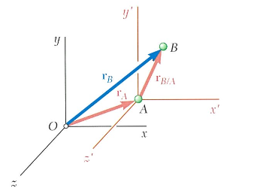
Lecture 2
KEY POINTS: Relative motion
Relative position
r_{B/A} = r_{B} - r_{A}
Relative velocity
v_{B/A} = v_{B} - v_{A}
Relative acceleration
a_{B/A} = a_{B} - a_{A}
take X_{B}, subtract X_{A}
B as seen from A.
Notes:
When two objects are both moving, we often need to know how one looks from the other's point of view. This is relative motion — and it reduces to simple vector subtraction. The rule is always the same: take the quantity of B, subtract the quantity of A.
Relative position：r_B/A = r_B − r_A Relative velocity：v_B/A = v_B − v_A Relative acceleration：a_B/A = a_B − a_A
One rule. Three quantities. Always subtraction.

Slide 7
Lecture 2
STRATEGY: Method selection for curved motion
Which situation do you have?
Curved path, speed known → use a_{n} = v²/ρ, a_{t} = dv/dt
Projectile (launch angle) → decompose x and y independently
Two moving observers → subtract vectors: v_{B/A} = v_{B} − v_{A}
Notes:
Strategy: Before writing any equation, identify which situation you have. If you see a curved path with known speed: use T-N decomposition. a_t for speed change, a_n for direction change. If you see a launch angle and gravity: use projectile method. Decompose into x and y. Solve independently. If two observers are both moving: use relative velocity. Subtract vectors. The procedure is always: identify the path type, choose the right coordinate system, write equations per direction, apply initial conditions, solve.

Slide 8
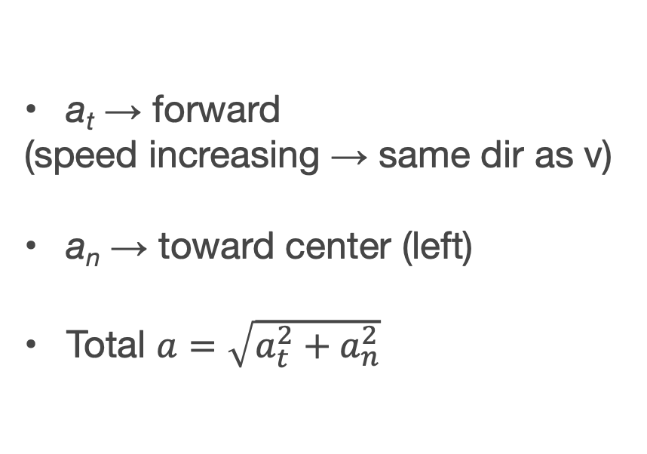
Lecture 2
Basic 1 — Direction of acceleration
a_{t} → forward
(speed increasing → same dir as v)
a_{n} → toward center (left)
Total $a=\sqrt{a_{t}^{2}+a_{n}^{2}}$
Problem
A car moves along a curved path.
At a certain instant:
Its speed is increasing
It is turning left
Describe the directions of:
Tangential acceleration a_{t}
Normal acceleration a_{n}
Velocity direction
Tangential
a_{t}
Total a
Normal
a_{t} & a_{n} are independent
So What
a_{n}
Notes:
Let’s solve examples : Basic 1. A car moves along a curved path. Its speed is increasing. It is turning left. Find the directions of tangential and normal acceleration. For a_t: speed is increasing, so a_t points in the same direction as velocity — forward. For a_n: the car turns left, so the center of curvature is to the left. a_n always points toward the center — so it points left. These two are perpendicular. The total acceleration is the vector sum. Key insight: a_t and a_n each tell you something different. a_t tells you how fast the speed is changing. a_n tells you how fast the direction is changing. They are independent.

Slide 9
Lecture 2
Basic 2 — Normal acceleration, constant speed
Problem
a_{n} = v²/r = 100/5 = 20 m/s²
a_{t} = dv/dt = 0
A particle moves in a circle of radius r = 5 (m)
with constant speed v = 10 (m/s)
Find the normal acceleration
Even at constant speed: acceleration exists and points inward
So What
Notes:
Let’s solve next example. Basic 2. A particle moves in a circle of radius 5 meters at constant speed 10 meters per second. Find the normal acceleration. a_n = v-squared divided by r = 100 divided by 5 = 20 meters per second squared. Since speed is constant, a_t = dv/dt = 0. All of the acceleration is centripetal — pointing toward the center. Physical meaning: the particle is continuously changing direction. Even at constant speed, acceleration exists.

Slide 10
Lecture 2
Key takeaway
a_{t} controls speed.
a_{n} controls direction.
They are always perpendicular.
Subtract vectors for relative motion
Notes:
Key takeaway: a_t controls speed. a_n controls direction. They are always perpendicular. For relative motion: subtract vectors.

