Slide 1

Categorization of
Movie Reviews
Group Members:
Anna 21L-5696
Maryam 21L-5685
Wajiha 21L-5612

Slide 2

Introduction
Problem Statement:
The problem revolves around categorizing movie reviews into sentiment categories such as positive, negative, or neutral based on the textual content. The objective is to develop models that can accurately predict sentiment categories for movie reviews, aiding in sentiment analysis of user opinions.

Slide 3

Description of Dataset
Source for Scraping:
IMDB
Proportion of Existing Dataset:
We have used real-world data so it Is changing with time. In our project, we have used 1500 rows
Storing Scraped Data:
Stored the scraped data in csv file

Slide 4

Preprocessing Techniques
Text Cleaning
Tokenization
Stopword Removal
Lemmatization
Handling Missing Values
Feature Extraction:
Bag of words

Slide 5

Machine Learning
Model
Logistic Regression: 94.5%
Naive Bayes: 70.5%

Slide 6

Deep Learning Models
Artificial Neural Network: 89.1%
Recurrent Neural Network: 89.6%

Slide 7

Implementation
Parameters Used
Number of Epochs
Trained for 5 epochs in ANN and same for RNN.

Slide 8

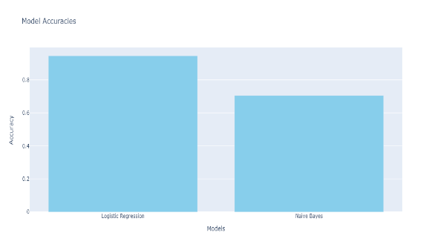
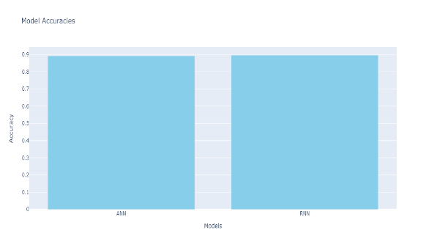
Comparing ML with DL
Models
Performance
Complexity

Slide 9

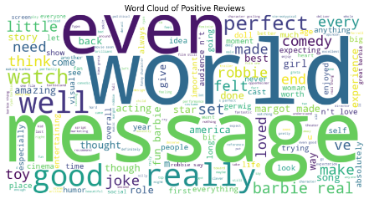
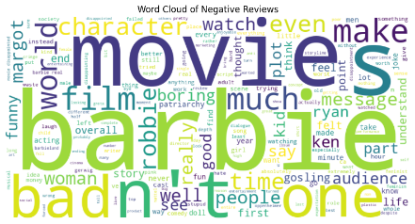
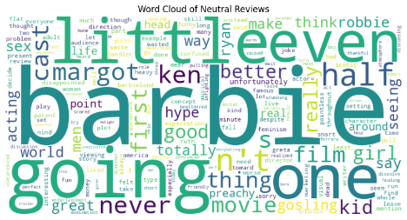
Sentiment Analysis
Using NLTK’s SentimentAnalyzer for sentiment analysis
Assigning sentiment scores and labels to the reviews

Slide 10

Conclusion
In conclusion, our analysis has shed light on the
intricate process of classifying movie reviews
and its implications for the industry.
Understanding the nuances of review
classiﬁcation is essential for industry
professionals and researchers to gain valuable
insights into audience preferences and critical
reception.

