Slide 1
Outline
Phenotype/Genotypes
Single QTL scan
Multi-QTL scan

Slide 2

Method
〇 n=108, F2 (B6 x MOLF), 12~15 weeks.
LPS IP: 25 μg/g x Body weight
7 hours
: Take body temperature once an hour until body temperature drops to 30 ℃
: Collect serum immediately after sacrifice.
ELISA for inflammation-related factors (IL-1b, IL-6, TNF, IFN).
Notes:
Next is the method.
I tested on a total of 106 F2 mice aged 6 to 8 weeks.
Each mouse was given an LPS IP and its body temperature was measured once every hour.
When passed 7 hours or the temperature dropped below 30℃, I collected serum and ELISA was performed.
And then, the tails were sent to Transnetyx and conducted genomic monitoring.

Slide 3
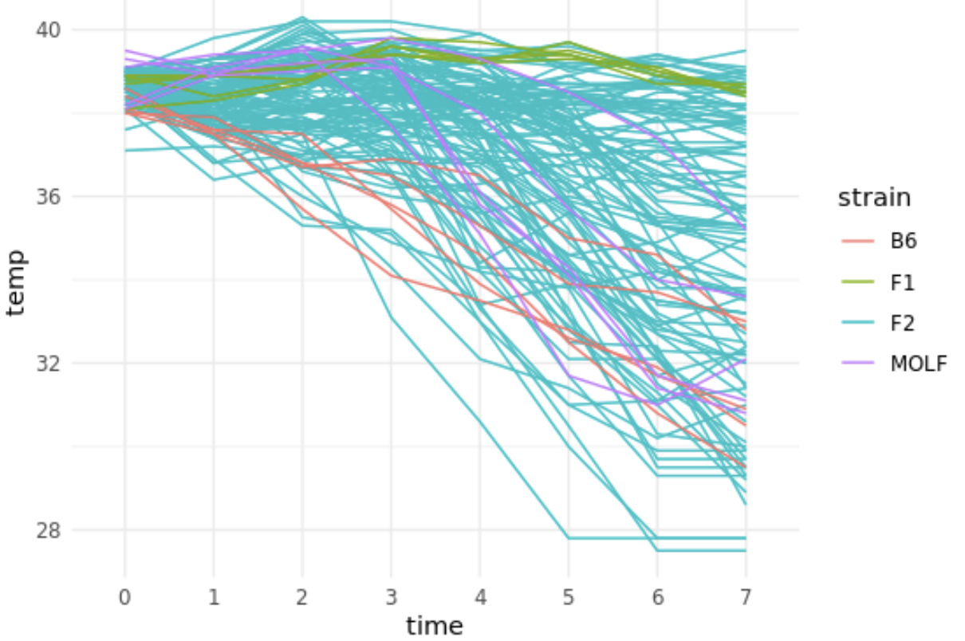
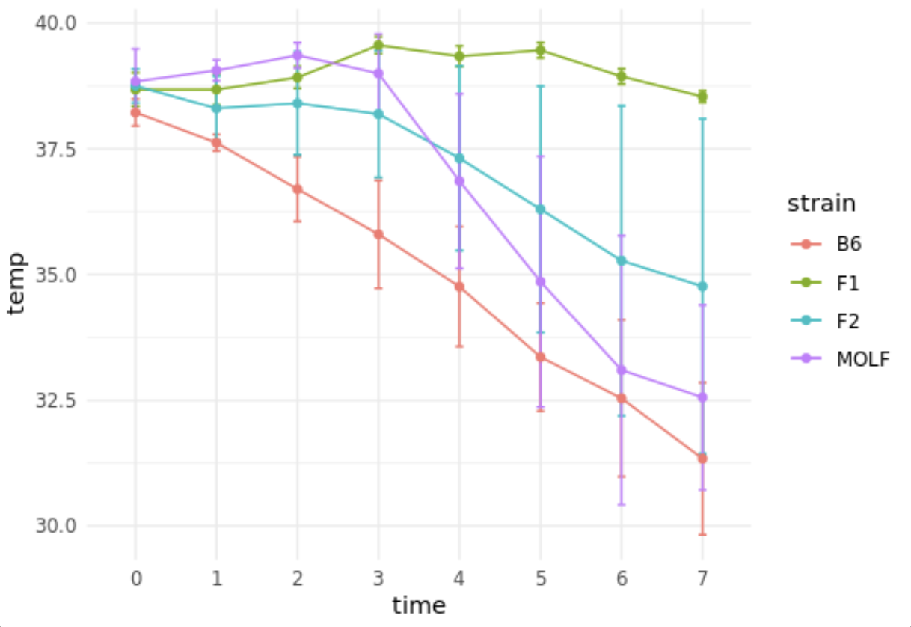
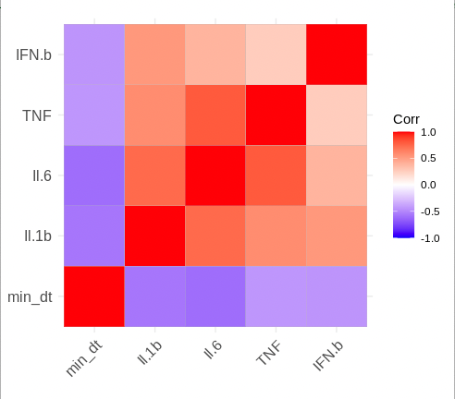
Temperature phenotype: min_t and max_t for each animal over 7h
Fever ~2h
Cytokine phenotypes @ 7h only
Hypothermia

Slide 4
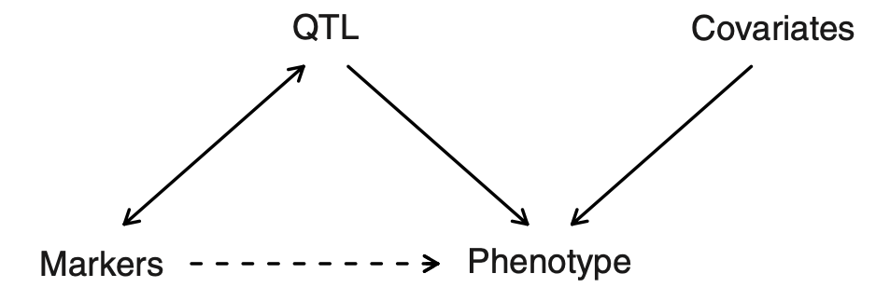





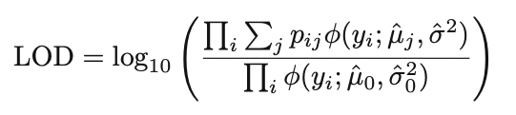



Statistical Structure
Statistical Structure
Single QTL Model
Phenotype
$$y_{i}$$
$$g_{i}$$
genotype
Unknown genotype
$$j$$
Neighboring markers
$\operatorname{Pr}\left(y_{i} \right|M_{i}, μ_{g_{i}},σ^{2}$) =
Likelihood function
Lander & Botstein 1989, Broman 2016
https://www.biostat.wisc.edu/~kbroman/
Notes:
QTL genotype probabilities
Given the marker data, the individuals phenotype follows a mixture of normal distributions, with known mixing proportions (the pij)
Phi is the density of the normal distribution
Likelihood = find parameters for which the data is most probable. Sum is over possible QTL genotypes, product over individuals, MLE by EM we obtain the mu and theta that make the data most likely
Log odds is calculated, giving the log ratio of likelihood that the site is a QTL, vs no QTL in the entire genome (mu_0 and sigma_0 estimates are calculated as the avg and sd of all individuals at the position.

Slide 5
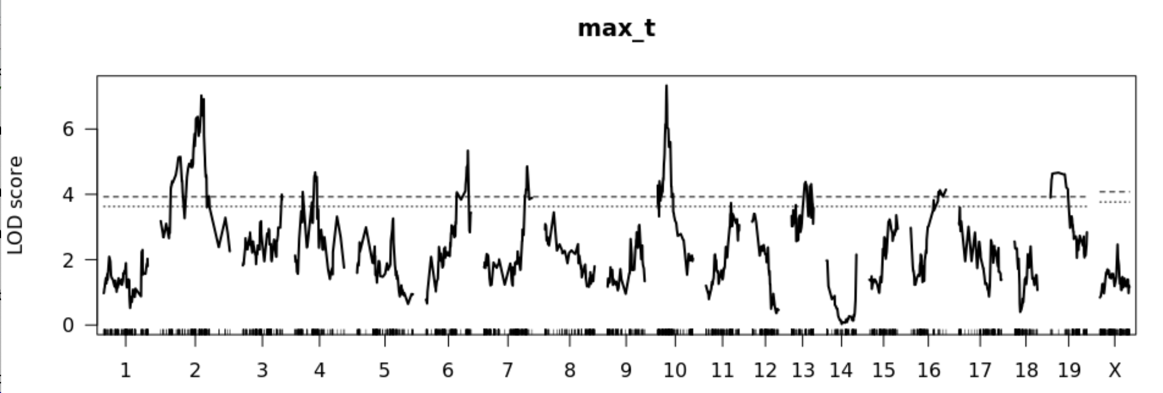
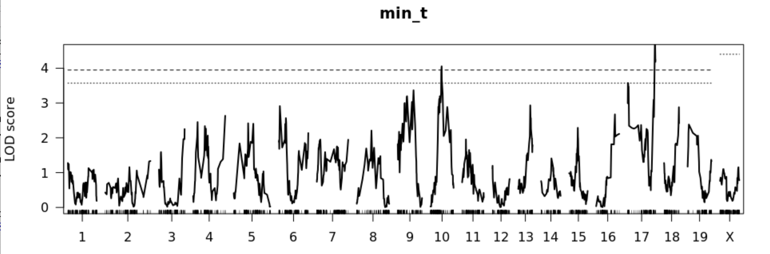
1 QTL scan, alpha < 0.05, 0.1 – no.sex.covariate, x.specific.permutation
End chr16 through end chr17

Slide 6
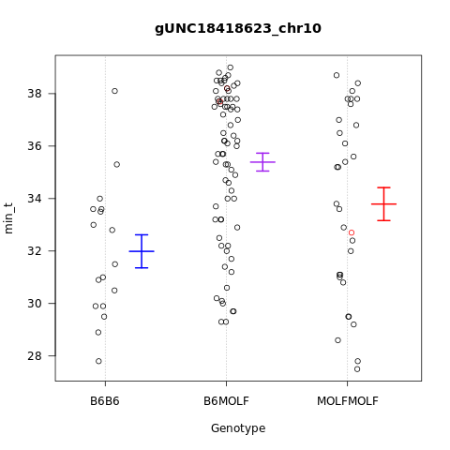
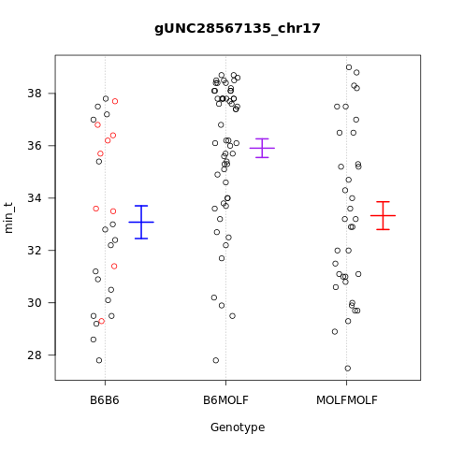
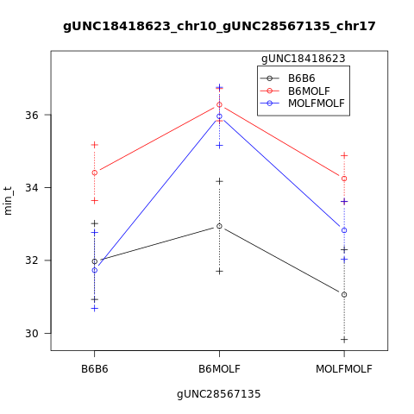
Min_t 1 QTL scan , alpha < 0.05 – no.sex.covariate,x.specific.permutation
chr | Pos (cM) | min_t | pval | markers
10 | 45.43 | 4.05 | 0.04 | gUNC18418623
17 | 58.94 | 4.94 | 0.01 | gUNC28567135

Slide 7
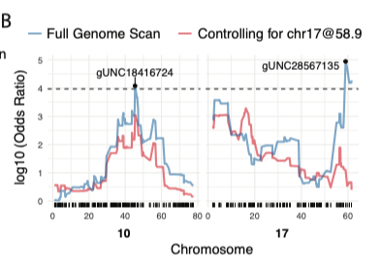
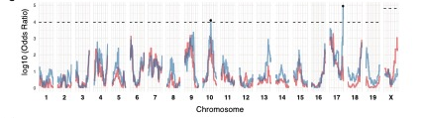
Min_t 1 QTL scan
2 QTL on chr17?

Slide 8
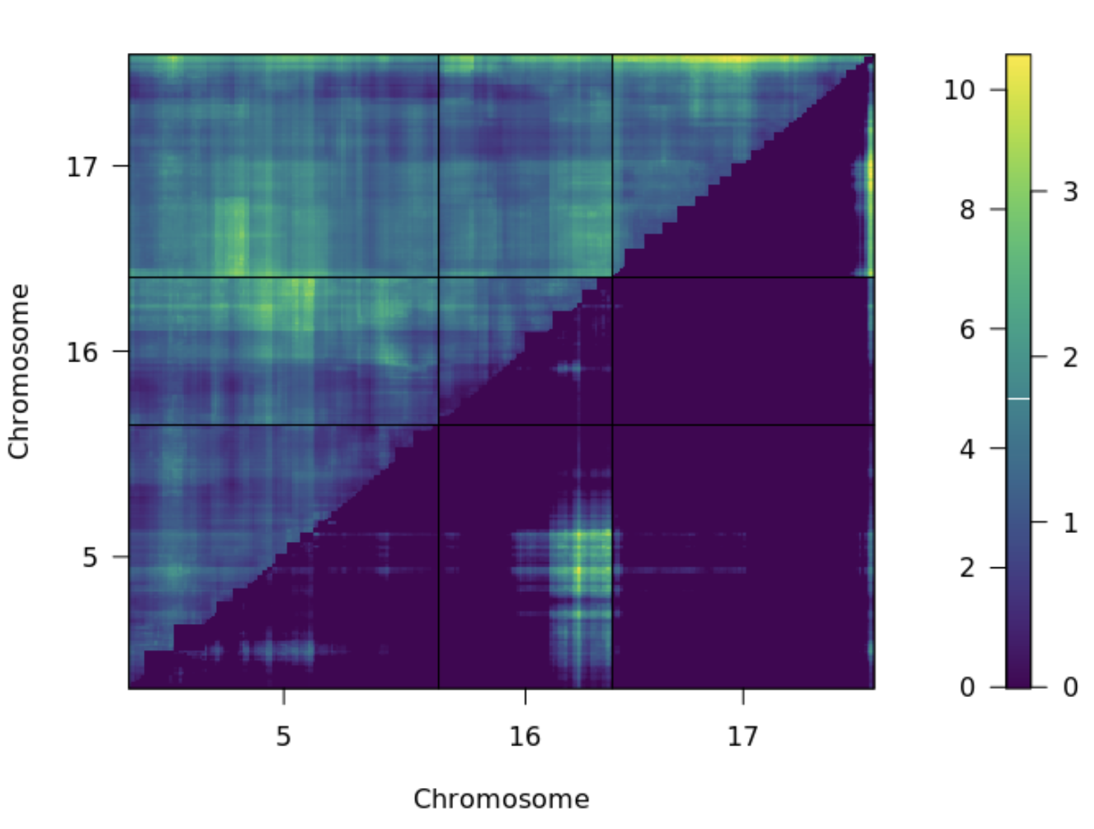
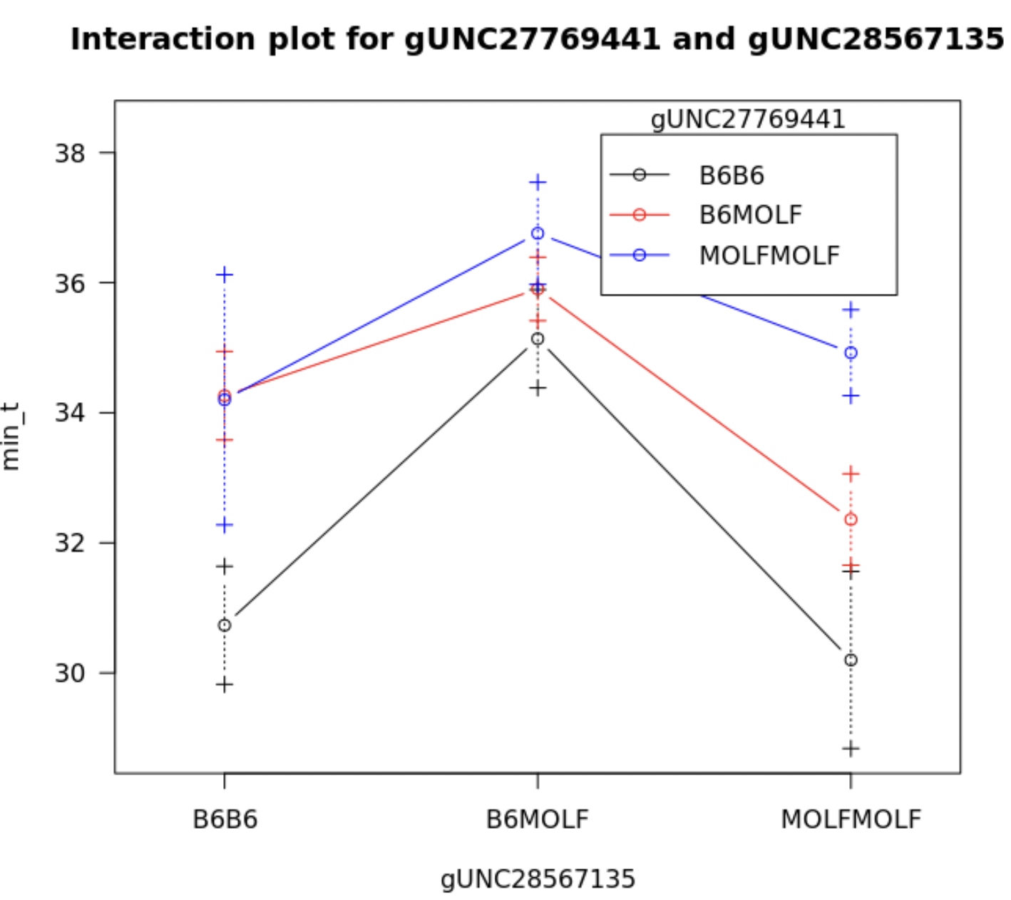
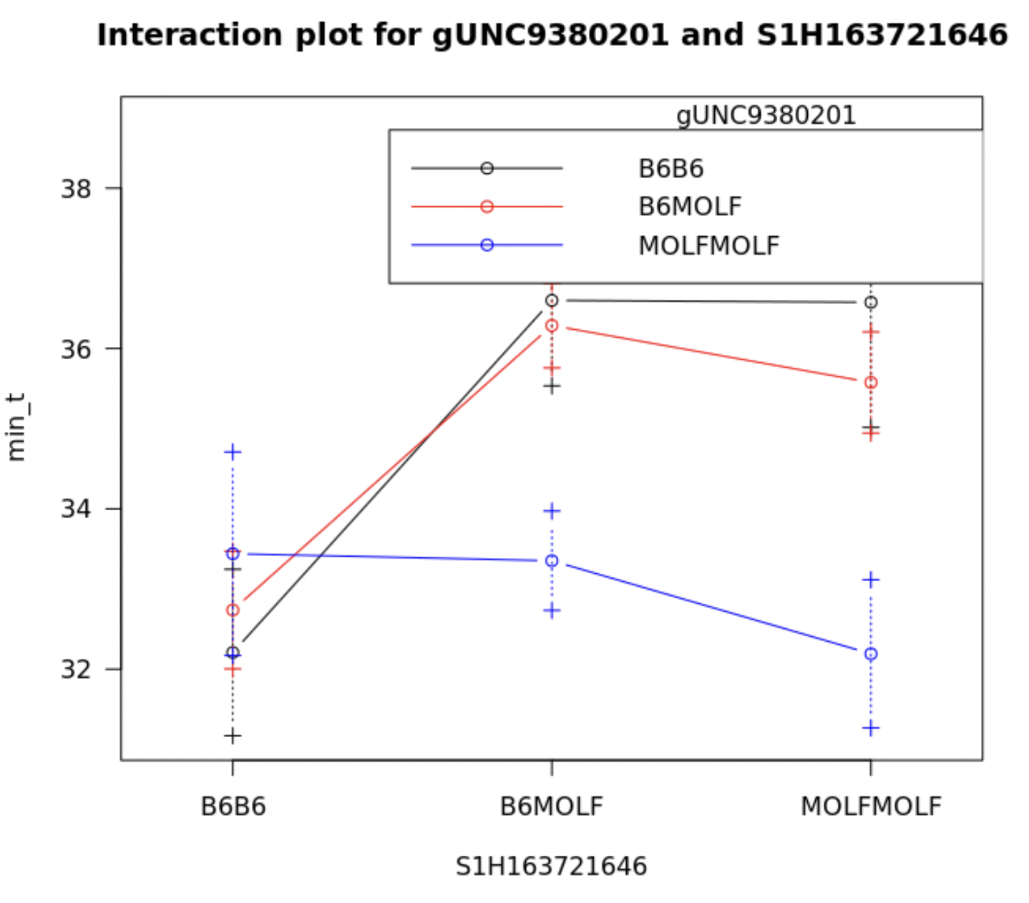
Min_t 2 QTL scan
The pairs of QTL that are significant are the following
 |  | 2 QTL model with additive terms
chr1 | chr2 | pos1a | pos2a | lod.add | pval add | lod.av1 | pval av1
5 | 16 | 56.330 | 57.439 | 6.587 | 0.088 | 3.913 | 0.026
17 | 17 | 54.050 | 104.042 | 8.706 | 0.004 | 3.763 | 0.049
Additive
chr17
chr5, chr16
Additive conditional
Here we assess whether a two-QTL model provides sufficiently improved fit over the best single-QTL model. Upper triangle the 2QTL additive model likelihood improvement over the null model. Precisely, it measures the improvement in the fit of the additive two-QTL model over a model with no QTL, and indicates evidence for at least one QTL. The lower triangle shows the improvement of the model with 2QTL over the model with 1 QTL and indicates evidence for a second QTL.

Slide 9
Questions:
Rqtl imputation necessary?
Multiple pheno
Inlcluding F1

