Slide 1
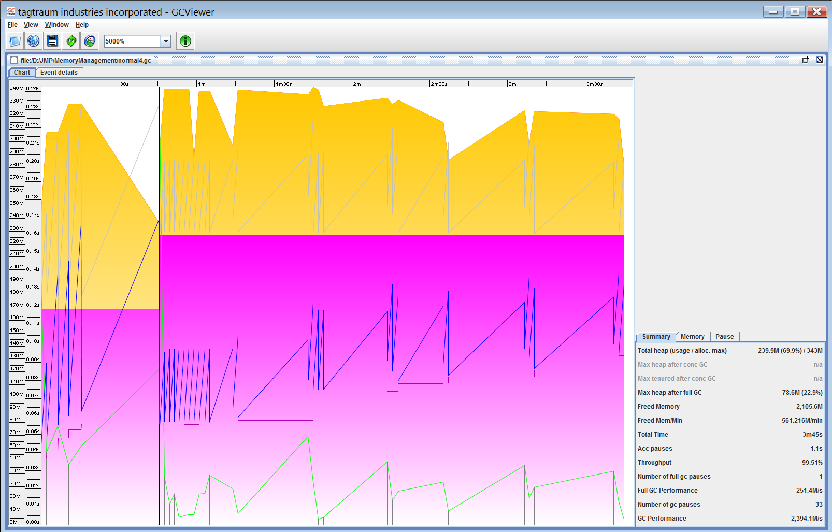
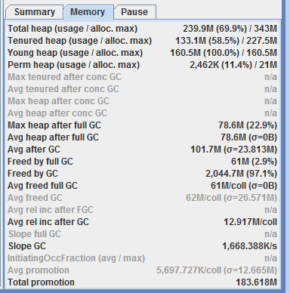
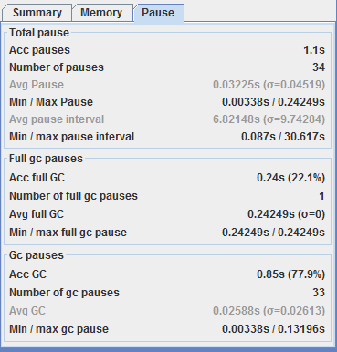
Running option 1: (Default parallel) Java 7
-Xmx512m -XX:+HeapDumpOnOutOfMemoryError -XX:HeapDumpPath=d:\JMP\MemoryManagement\heapdump.hprof
-verbose:gc
-XX:+PrintGCDetails
-Xloggc:d:\JMP\MemoryManagement\normal4.gc

Slide 2
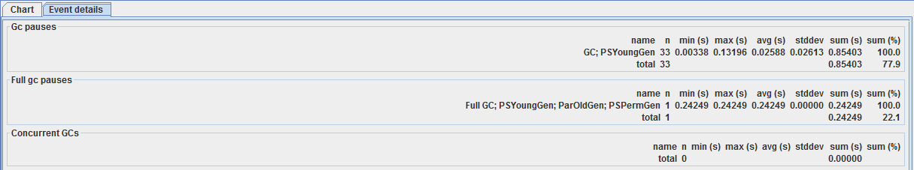
Running option 1: Java 7 (continue)
-Xmx512m -XX:+HeapDumpOnOutOfMemoryError -XX:HeapDumpPath=d:\JMP\MemoryManagement\heapdump.hprof
-verbose:gc
-XX:+PrintGCDetails
-Xloggc:d:\JMP\MemoryManagement\normal4.gc

Slide 3
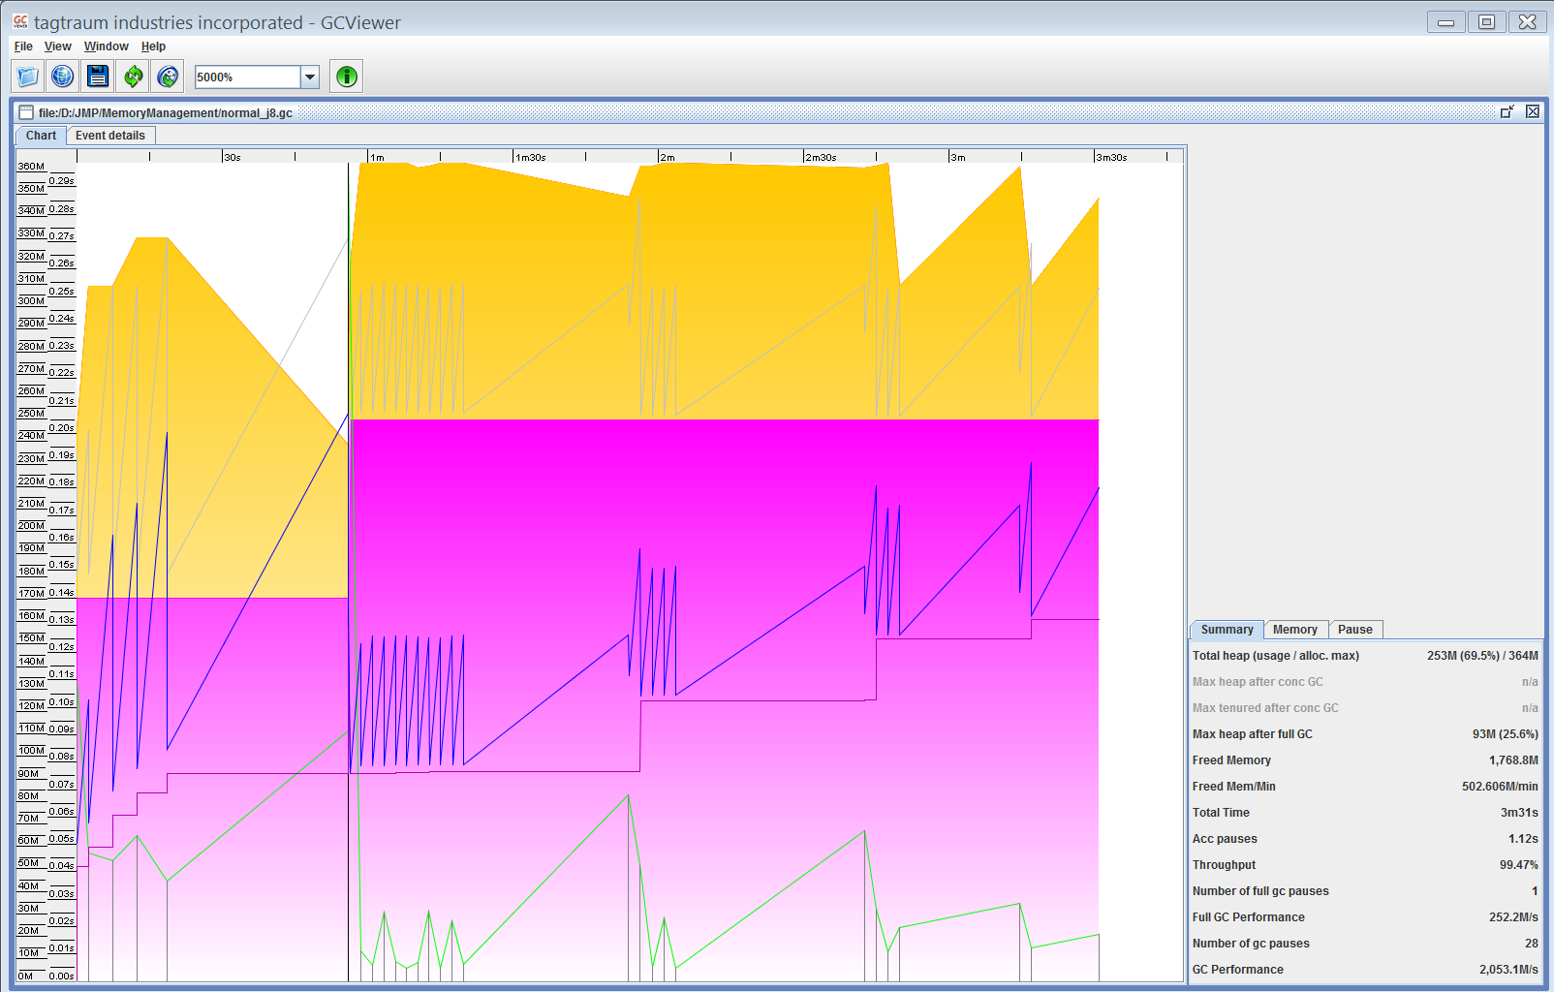
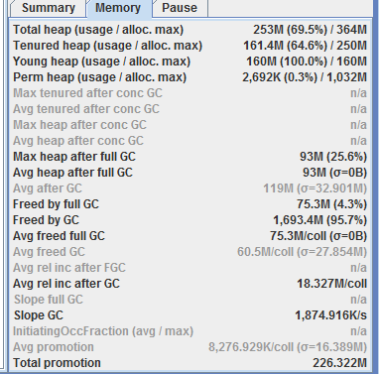
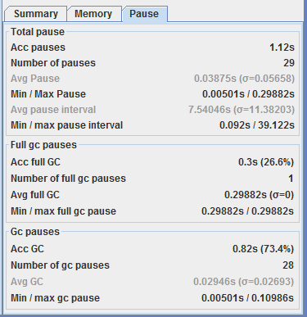
Running option 1: Java 8
-Xmx512m -XX:+HeapDumpOnOutOfMemoryError -XX:HeapDumpPath=d:\JMP\MemoryManagement\heapdump.hprof
-verbose:gc
-XX:+PrintGCDetails
-Xloggc:d:\JMP\MemoryManagement\normal_j8.gc

Slide 4
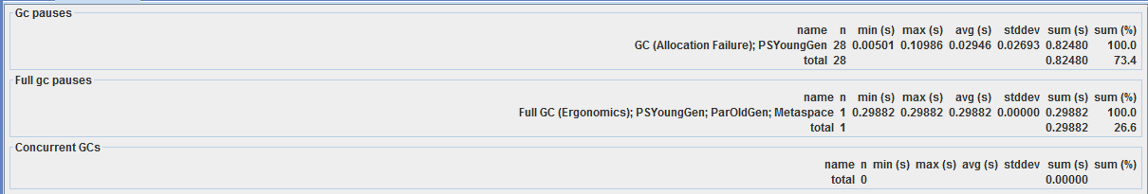
Running option 1: Java 8 (continue)
-Xmx512m -XX:+HeapDumpOnOutOfMemoryError -XX:HeapDumpPath=d:\JMP\MemoryManagement\heapdump.hprof
-verbose:gc
-XX:+PrintGCDetails
-Xloggc:d:\JMP\MemoryManagement\normal_j8.gc

Slide 5
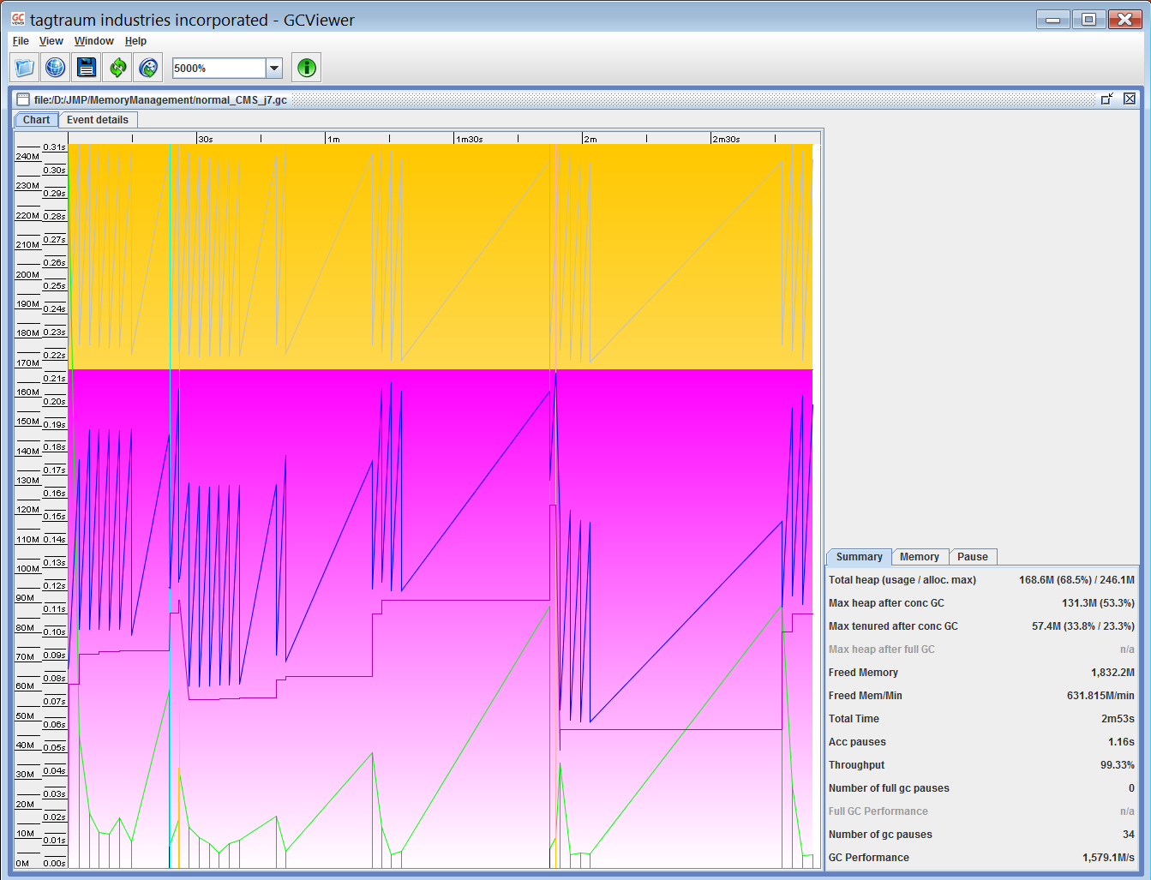
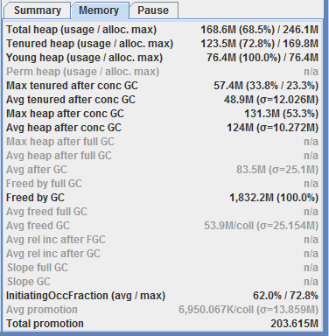
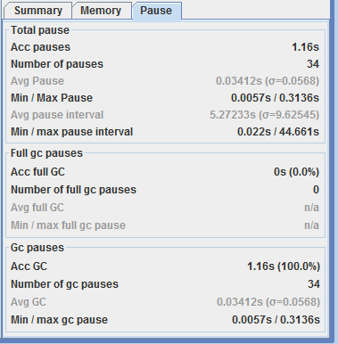
Running option 2: CMS, Java 7
-Xmx512m -XX:+HeapDumpOnOutOfMemoryError -XX:HeapDumpPath=d:\JMP\MemoryManagement\heapdump.hprof
-verbose:gc -XX:+PrintGCDetails
-XX:+UseConcMarkSweepGC
-Xloggc:d:\JMP\MemoryManagement\normal_CMS_j7.gc

Slide 6
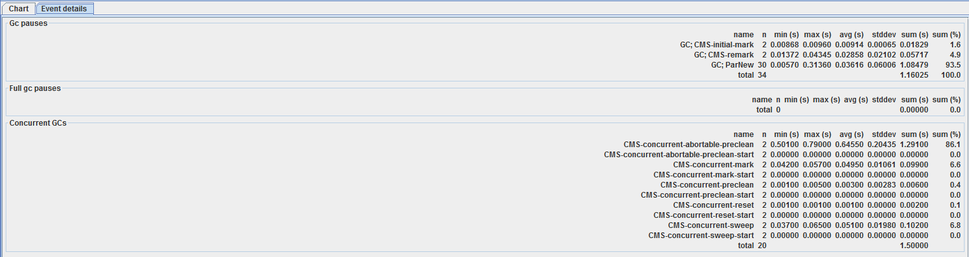
Running option 2: CMS, Java 7 (continue)
-Xmx512m -XX:+HeapDumpOnOutOfMemoryError -XX:HeapDumpPath=d:\JMP\MemoryManagement\heapdump.hprof
-verbose:gc -XX:+PrintGCDetails
-XX:+UseConcMarkSweepGC
-Xloggc:d:\JMP\MemoryManagement\normal_CMS_j7.gc

Slide 7
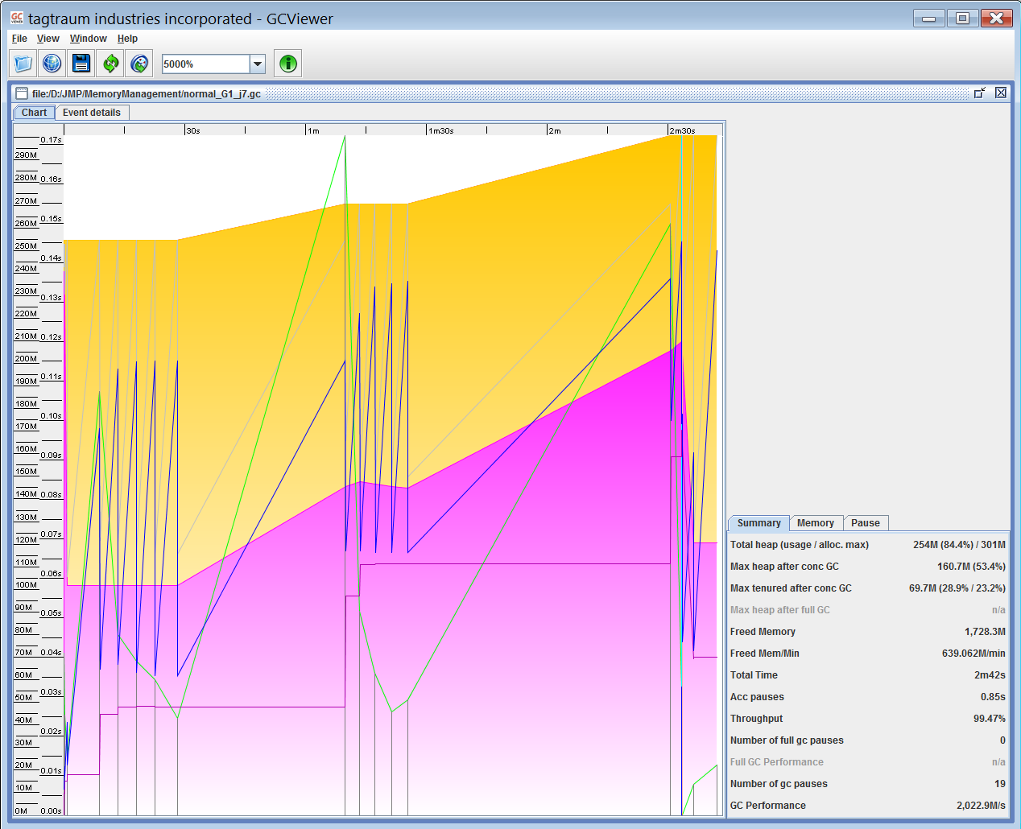
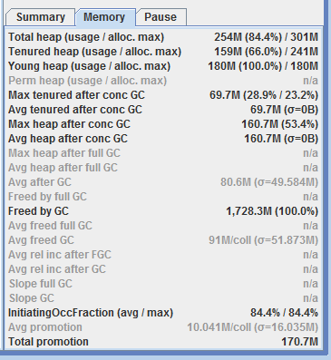
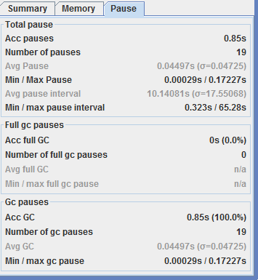
Running option 3: G1, Java 7
-Xmx512m -XX:+HeapDumpOnOutOfMemoryError -XX:HeapDumpPath=d:\JMP\MemoryManagement\heapdump.hprof
-verbose:gc
-XX:+PrintGCDetails
-XX:+UseG1GC -Xloggc:d:\JMP\MemoryManagement\normal_G1_j7.gc

Slide 8
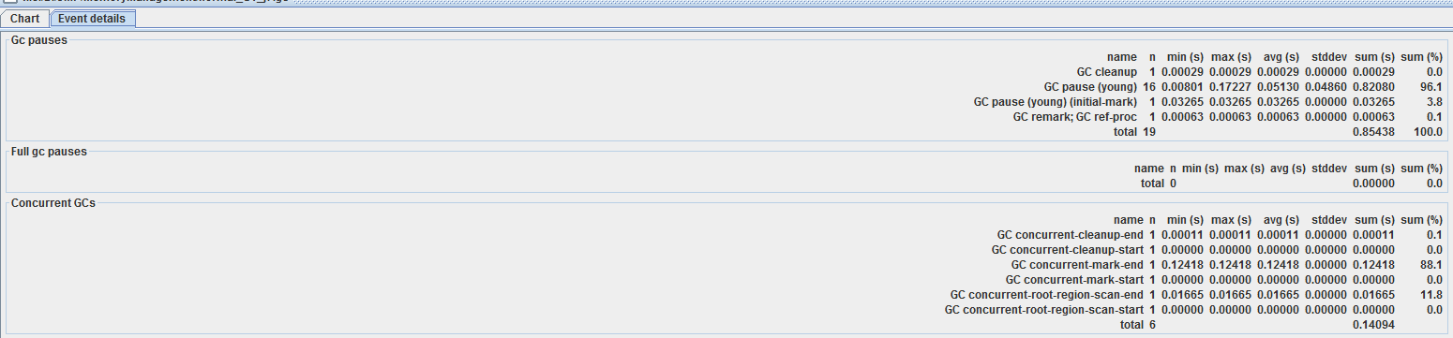
Running option 3: G1, Java 7 (continue)
-Xmx512m -XX:+HeapDumpOnOutOfMemoryError -XX:HeapDumpPath=d:\JMP\MemoryManagement\heapdump.hprof
-verbose:gc
-XX:+PrintGCDetails
-XX:+UseG1GC -Xloggc:d:\JMP\MemoryManagement\normal_G1_j7.gc

Slide 9
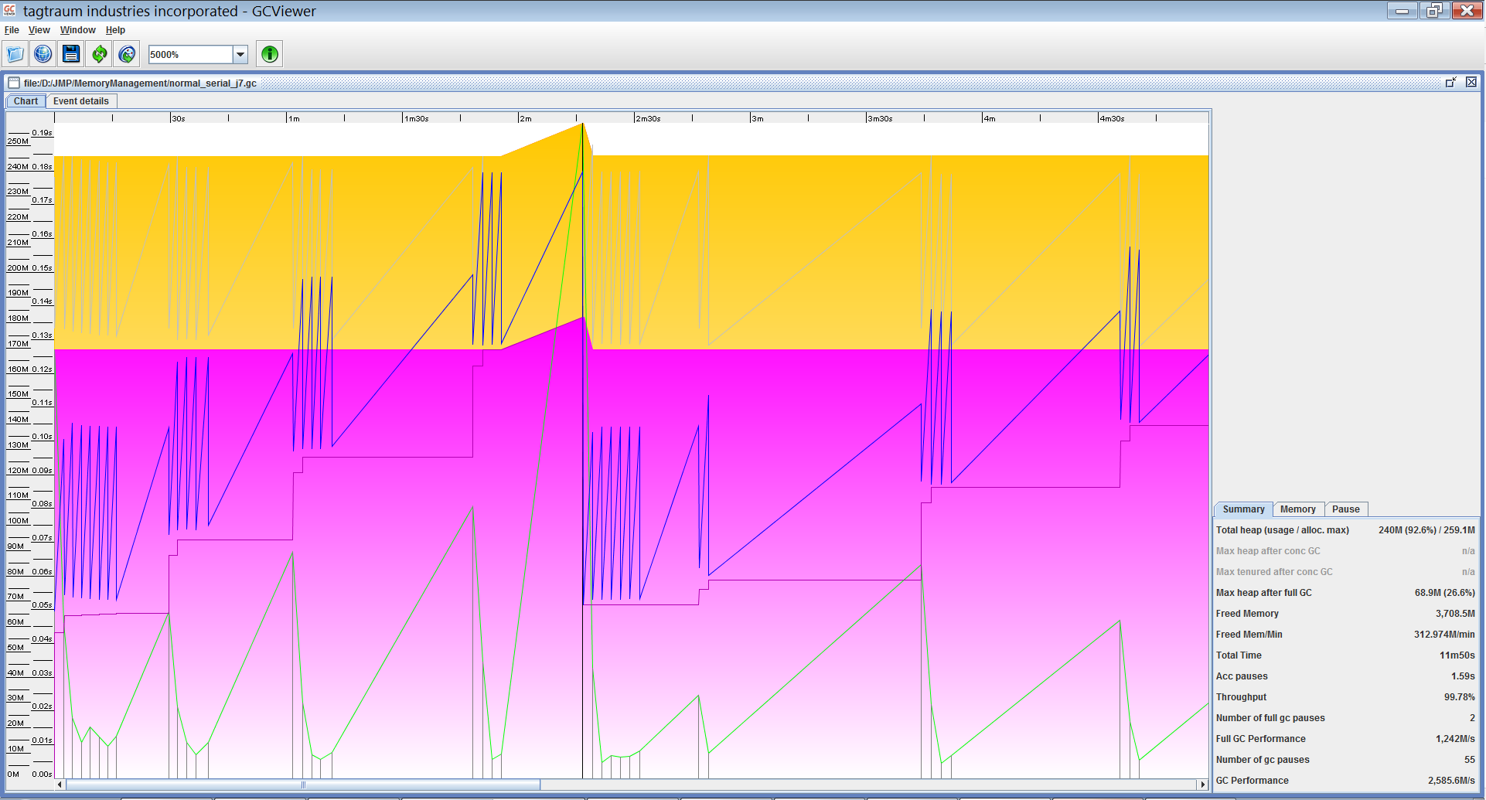
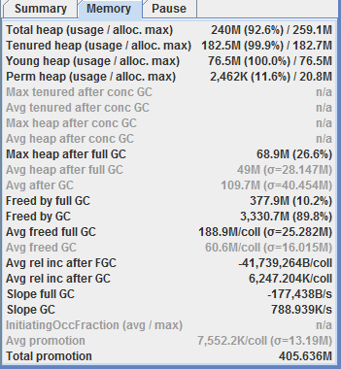
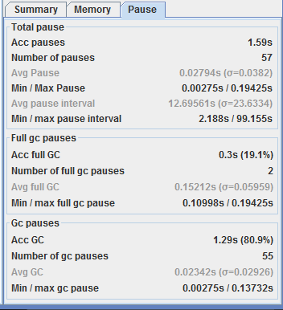
Running option 4: Serial, Java 7
-Xmx512m -XX:+HeapDumpOnOutOfMemoryError -XX:HeapDumpPath=d:\JMP\MemoryManagement\heapdump.hprof
-verbose:gc
-XX:+PrintGCDetails
-XX:+UseSerialGC
-Xloggc:d:\JMP\MemoryManagement\normal_serial_j7.gc

Slide 10
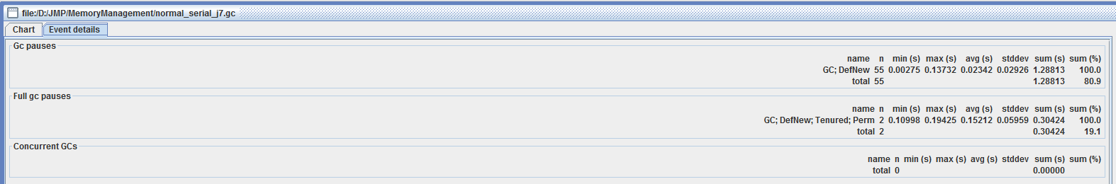
Running option 4: Serial, Java 7 (continue)
-Xmx512m -XX:+HeapDumpOnOutOfMemoryError -XX:HeapDumpPath=d:\JMP\MemoryManagement\heapdump.hprof
-verbose:gc
-XX:+PrintGCDetails
-XX:+UseSerialGC
-Xloggc:d:\JMP\MemoryManagement\normal_serial_j7.gc

