Slide 1


AMAkids: open an education center with a proven international EdTech model
Education franchise for entrepreneurs
12 years
20+ countries
800+ centers
100,000+ students
01

Slide 2





Four reasons the AMAkids model works for partners
Ready method
Own platform
Proven teaching methods and printed books for every course.
CRM, analytics, video module, 100+ educational games and a mobile app.
Partner training
Support at every step
Hands-on training so your team can teach the method from day one.
Launch guidance and ongoing technical and operational support within the agreed partnership scope.
02

Slide 3



Three ways to partner with AMAkids
Single-Unit
School Partnership
Master Franchise
For new entrepreneurs
For existing schools
For regional developers
Start a business from scratch, on a proven model.
Add a program to what you already have.
Own a territory and grow it.
Why choose this model
Why choose this model
Why choose this model
Exclusive rights to a defined territory
Earn from every partner in your sub-licensed network
Run your own centers alongside the network
Known name: launch under the AMAkids brand
Ready-made model: courses, brandbook, training, platform
Support from launch onwards, technical and operational
You already have the audience and the location
Ready-made methodology, no need to build your own
Full package or individual programs
What to plan for
What to plan for
What to plan for
Building and managing a partner network
Regional marketing and recruiting partners
Territory and terms agreed individually
Premises and a team of trainers
Local marketing and daily operations
Investment: depends on the market
Trainers prepared for the chosen programs
Local promotion to your own audience
Terms depend on the programs and scope
03
Notes:
To be confirmed: commercial terms, territory availability and obligations for each format.

Slide 4




What's in the AMAkids methodology package
The current English-language offer includes three programs for children and teens. Take the full package or choose individual programs.
Mental Arithmetic
English
Memorika
The package includes
Ready-made programs and lesson structure
Books and learning materials
Educational games and online practice
Methodology guidance for trainers
04
Notes:
Present the three programs as equal parts of the package. Support, CRM and platform access are covered on a separate slide.

Slide 5
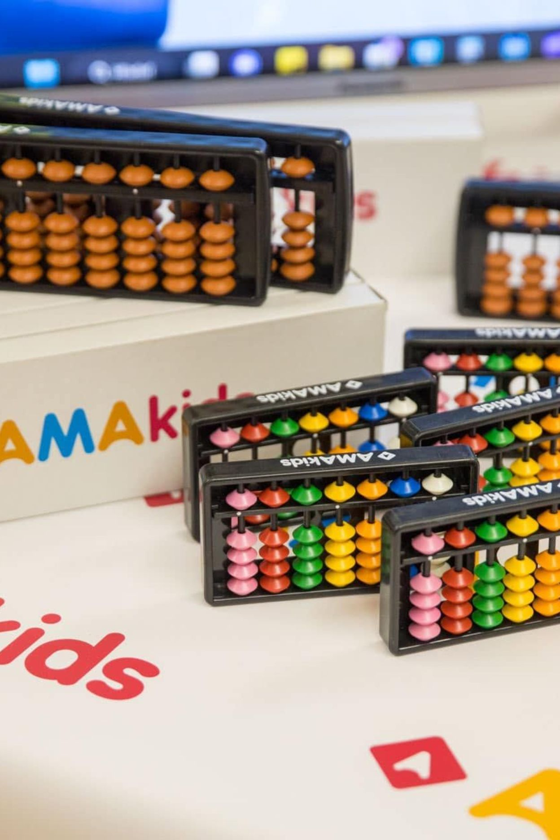



Mental Arithmetic
Ages 5–16 · Duration: 2 years · 1 lesson per week, 90 min
Use abacus-based and mental calculation exercises to develop children’s learning skills.
Addition & Subtraction
Multiplication & Division
Learning tools
Platform + mobile app
Textbooks with augmented reality
Abacuses
05

Slide 6




English
Ages 4–14 · Duration: 2–4 years · 2 lessons per week, 60 min each
A0
A1
A2
A2+
Learn to think, understand and speak English. Grammar · Vocabulary · Speaking · Writing · Phonetics · Listening · Reading
Learning tools
Web book
Platform
Workbooks
Extra preparatory level 0 (Pre-A0) before A0 · The course covers levels A0–A2+
06

Slide 7




Memorika
Ages 7–16 · Duration: 12 + 12 + 4 lessons by level · 1 lesson per week, 90 min
Move from memorizing to consciously managing information through visual and systemic thinking.
Junior
Senior
Geo-orientation
12 lessons
12 lessons
4 lessons, for course graduates
6+ memory training methods; memory coefficient measured at lessons 1 and 12.
Learning tools
Platform
Workbooks
Presentations
07
Notes:
To be confirmed: every package inclusion shown is a draft based on recommendations. Confirm scope before issuing a commercial offer.

Slide 8





Five reasons AMAkids stands out
Progress from the first lessons
Own platform and motivation system
Full-featured CRM
Teacher preparation and training
Regular Olympiads
Tools for managing the business day to day and keeping operations organized.
Every child gets a goal, a chance to show their achievements and to feel part of a big community.
Progress is made visible from the first lessons, with increasingly advanced skills as students continue.
Course-specific training and structured methodological materials prepare teachers to deliver the selected programs.
Supports practice between lessons, with new tasks and goals that keep children interested.
08

Slide 9
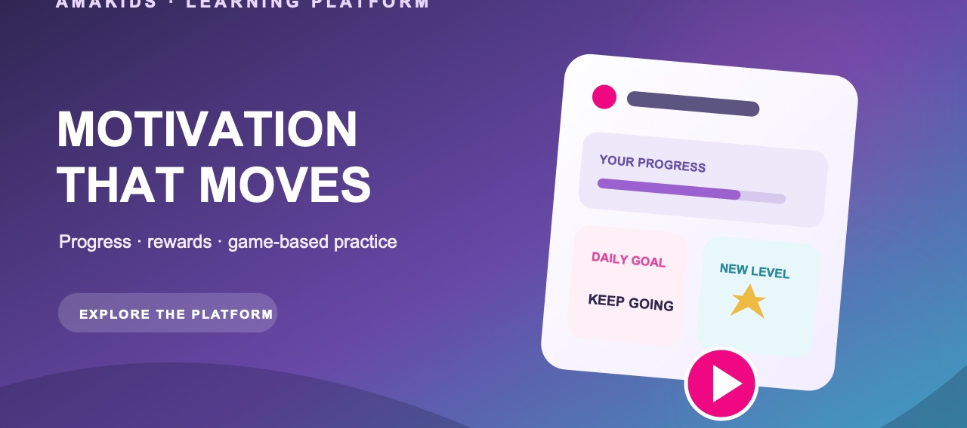
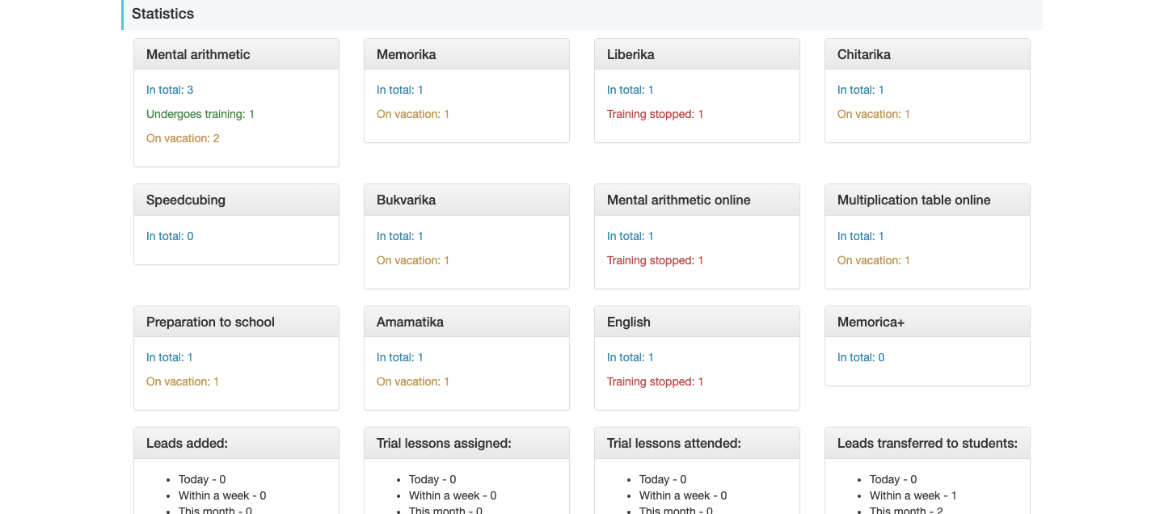


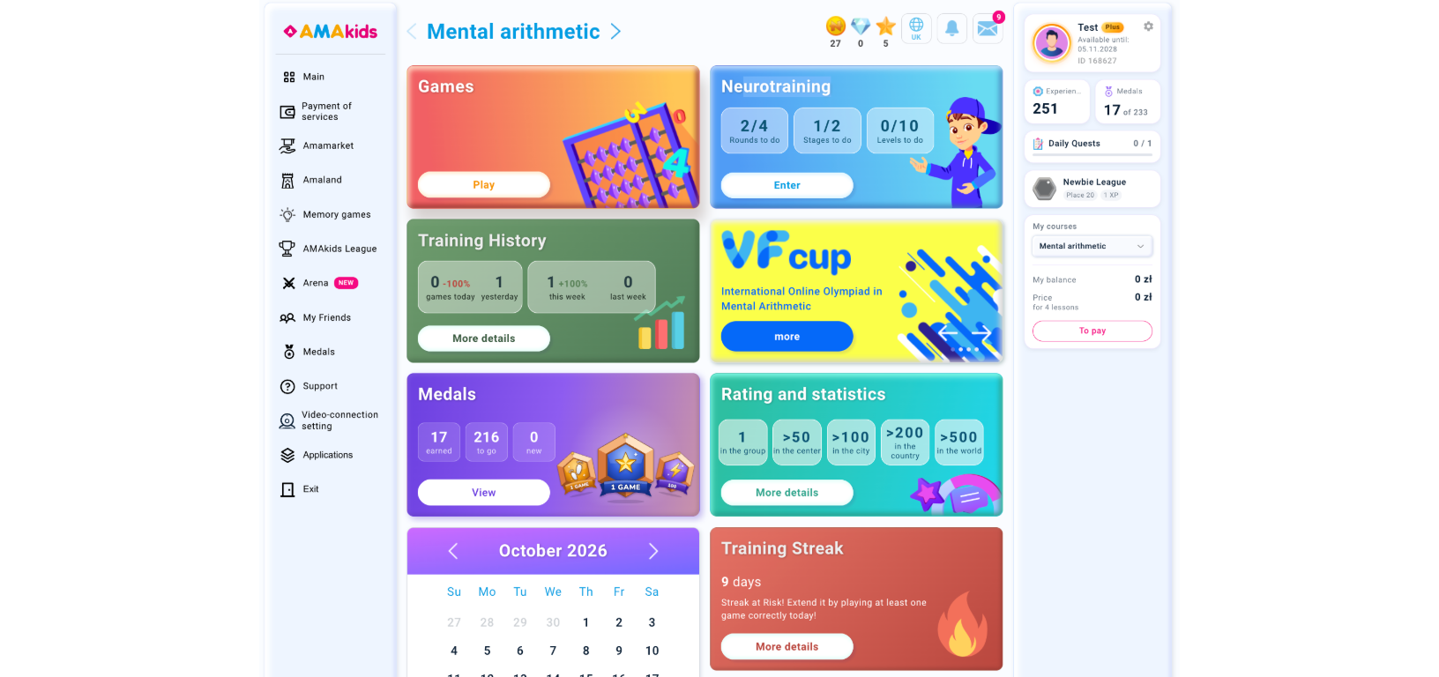
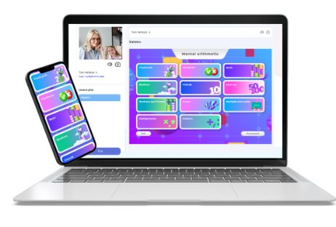
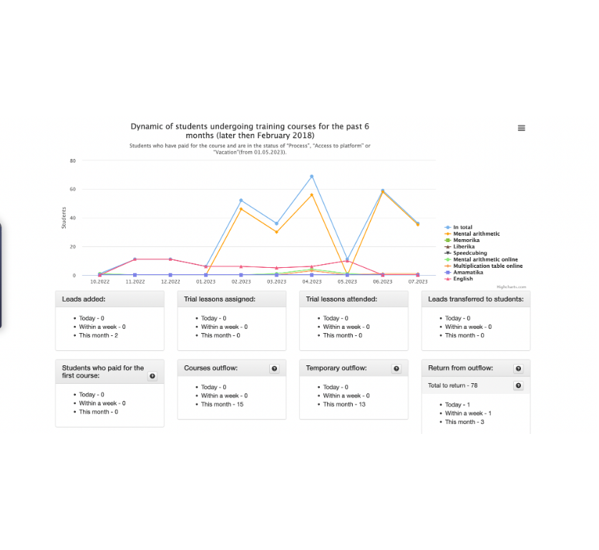
PLATFORM + CRM
One digital ecosystem for learning and operations
Engage students between lessons and keep the center’s daily work organized in the same AMAkids ecosystem.
FOR STUDENTS
FOR THE CENTER
Learning platform & mobile app
AMAkids CRM
Games, neurotraining, ratings, medals and online practice help students see progress and stay motivated between lessons.
Manage branches, leads, students, trial lessons, groups, schedules, pricing and performance statistics in one workspace.
ONGOING SUPPORT
Technical and operational guidance helps the partner set up the tools and use them in daily work within the agreed support scope.
09

Slide 10
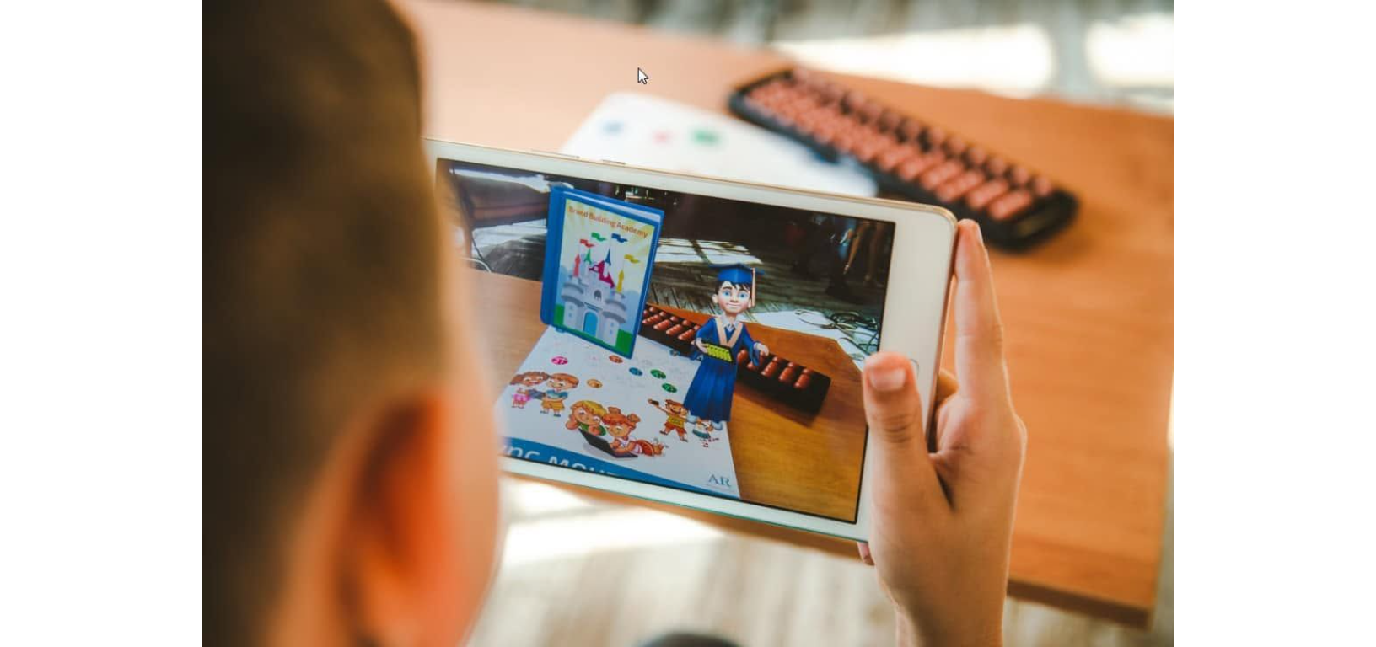
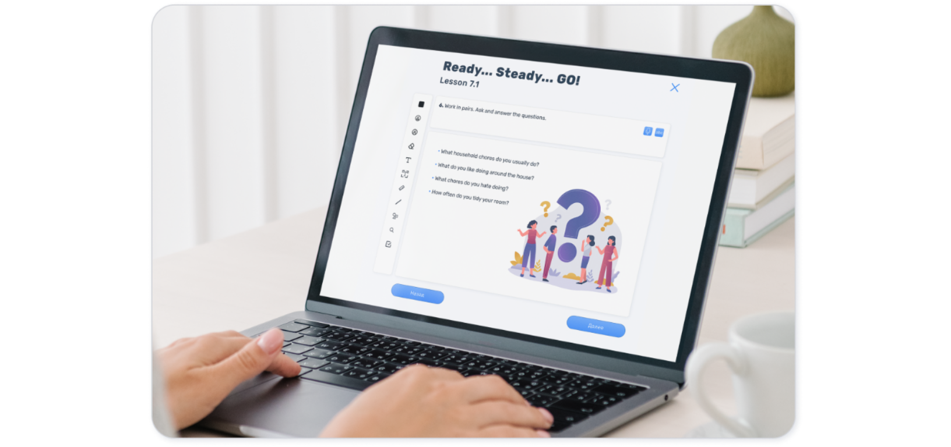
TEACHING TOOLKIT
Everything a trainer needs for every lesson
A prepared teaching package reduces lesson-planning time and helps teams deliver the selected program consistently.
READY TO USE
01
02
Lesson structure
Student materials
Step-by-step plans, presentations and trainer guidance for each stage of the course.
Printed workbooks, textbooks, web books and abacuses, depending on the program.
03
04
Digital practice
Interactive formats
Platform activities, educational games, homework and progress tools between lessons.
Augmented-reality materials and visual demonstrations that make practice more engaging.
Materials and formats vary by selected program and market.
10

Slide 11
CONTRACTS, TERRITORY & ROYALTY
Commercial terms by partnership model
The formats differ in legal scope, territory and the partner’s development responsibility.
TERM
Single-Unit
School Partnership
Master Franchise
Agreement
International Commercial Concession Agreement
License Agreement
International Commercial Concession Agreement with sub-licensing rights
Standard monthly royalty
10%
10%
5%
Territory & exclusivity
One or more centers within a limited territory, usually a city
Program licensed to a specific educational institution
Exclusive development rights for an agreed country or region
Partner’s main objective
Build brand awareness and develop the center consistently
Maintain a stable flow of students for the licensed program
Represent the brand regionally and drive network expansion
Commercial terms and territory definitions are reflected in the final individual offer and signed agreement.
11
Notes:
Master Franchise includes the partner's own centers and income from sub-licensing. Programs can be taken as a package or one by one. To be confirmed: contract type, territory and exclusivity, contract term, standard royalty percentage, and the detailed split of obligations between AMAkids and the partner.

Slide 12









What your investment includes
Initial AMAkids payment
Registration and legal setup
Deposit, renovation and premises preparation
Furniture and equipment
Equipment and learning materials
Branding and design
Launch advertising
Team recruitment and training
Working capital reserve for the first months
12
Price is set individually, depending on country, format and scale.
Notes:
Nine items make up the investment. No amounts are shown here: the price is set individually for each partner, depending on country, format and scale. To be confirmed: the exact fee and deposit terms for each market.

Slide 13
ECONOMICS
How a center builds toward profitability
Profitability is the outcome of a connected operating system—not one headline metric.
01
02
03
04
05
Attract
→
Convert
→
Fill groups
→
Retain
→
Scale
Reach the right local families
Turn enquiries and trials into enrollments
Use classroom and trainer capacity well
Deliver value and support re-enrollment
Open new groups when demand supports them
REVENUE ENGINE
COST DISCIPLINE
Active students × realized monthly price
Acquisition + team + space + operations
Enrollment, group occupancy and retention determine how much capacity becomes revenue.
Costs must match the center’s stage, local price level and realistic enrollment plan.
The model should be stress-tested for your city, tax environment and chosen format.
13

Slide 14

PLANNING EXAMPLE · NOT A FORECAST
Example: one Single-Unit center, 3 years
 | Year 1 | Year 2 | Year 3
Groups | 7 | 9 | 11
Students at year-end | 48 | 68 | 85
Net revenue | €48 213 | €71 902 | €91 319
EBITDA | €6 175 | €11 650 | €23 927
EBITDA margin | 12.8% | 16.2% | 26.2%
Starting point: 24 students and 6 groups at opening; 48 students as the 12-month target; 3 learning products.
Opening investment
Operating break-even
€16 700
Month 2
Staffing included: administrator from launch, full administrator capacity from month 7, and 0.5 FTE center director from Year 2.
Illustrative model based on an average course price of about €100 per month. Results depend on actual enrollment, retention, local taxation and operating costs.
Investment payback
21 months
14
Notes:
This is an illustrative example of one Single-Unit center, not a universal forecast. Starting point: 24 students and 6 groups at opening, 48 students as the 12-month target, 3 learning products. Key indicators: opening investment €16 700, operating break-even in month 2, investment payback in 21 months.

Slide 15
Indicators of a successful center
ILLUSTRATIVE BENCHMARKS · VALIDATE LOCALLY
KPI | Target level
Seat occupancy | 85–90%+
Average group size | 9–10 students
Monthly churn | ≤3%
Annual re-enrollment | ≥70%
Lead-to-paid conversion | 9–12%
Rent and occupancy costs | ≤15% of revenue
Total people cost | ≤30% of revenue
Ongoing marketing | ≤10% of revenue
Mature EBITDA margin | ≥20%
Cash reserve | 2–3 months of fixed costs
15
Notes:
These are the operating targets a mature AMAkids center should reach. Walk the table top to bottom: occupancy and retention drive revenue, and the cost ceilings protect margin.

Slide 16
From signed agreement to opening day
Typical preparation · around 3–6 months
01
02
03
04
05
Agreement
Training
Setup
First families
Opening
Confirm the model and available territory.
Partner training and course-specific trainer preparation.
Fit out the classroom and set up CRM.
Launch marketing and trial lessons.
Open your AMAkids center.
16

Slide 17
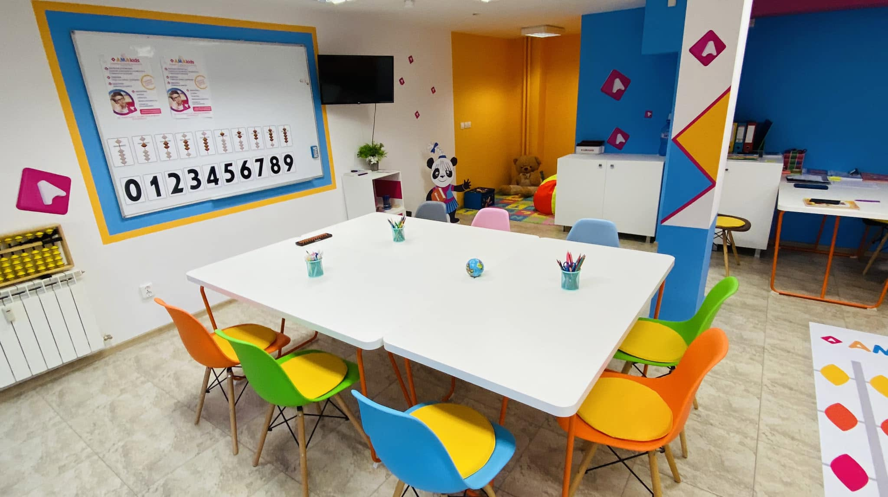
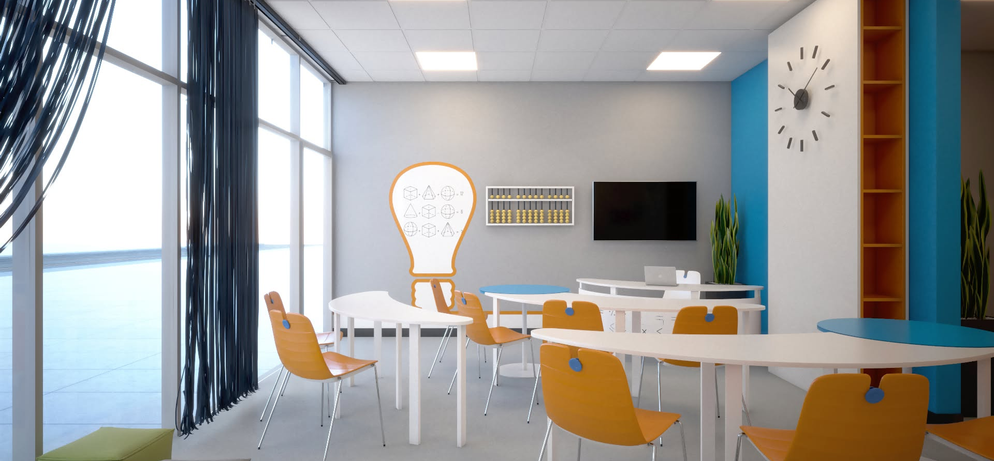
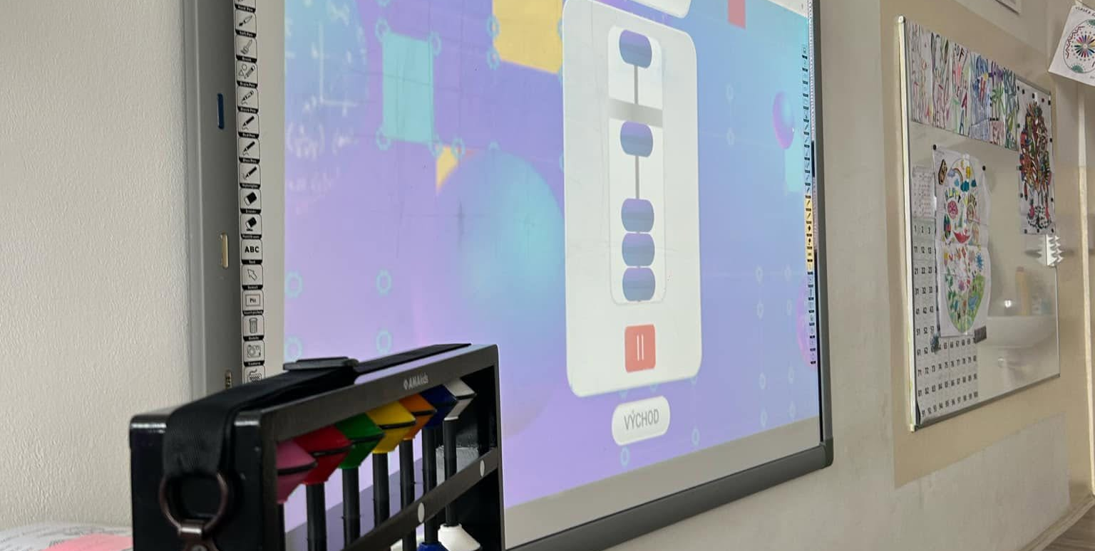
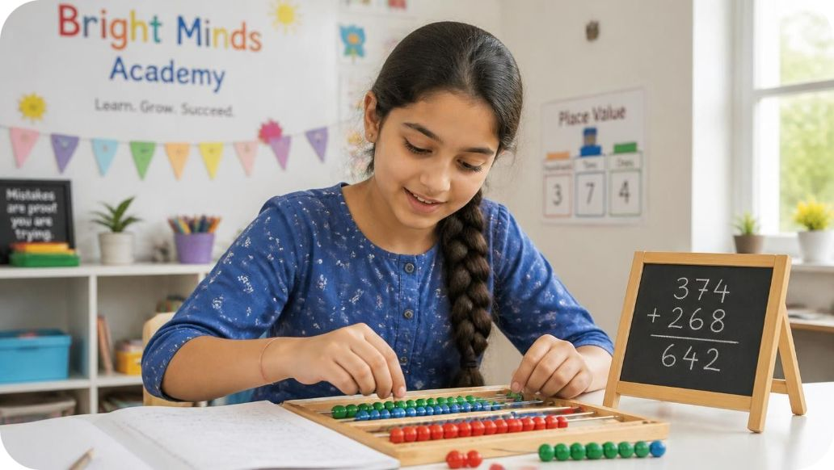
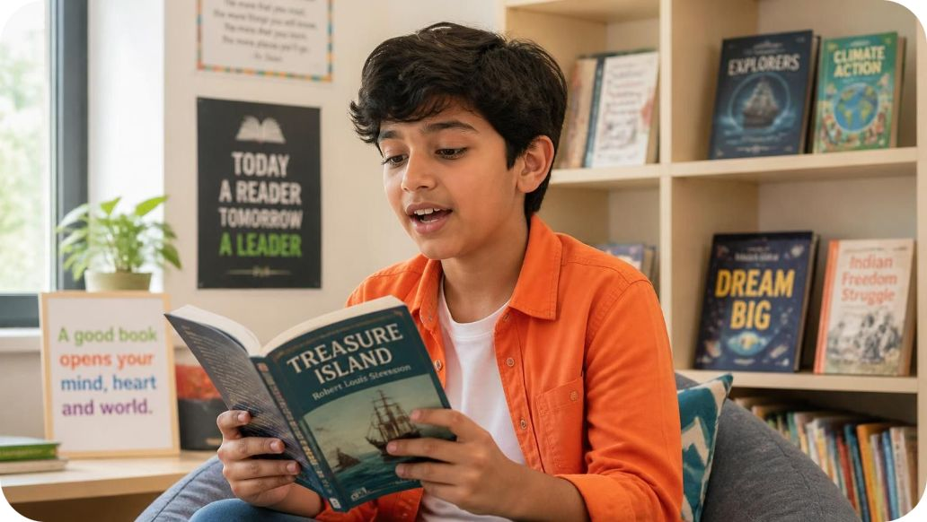
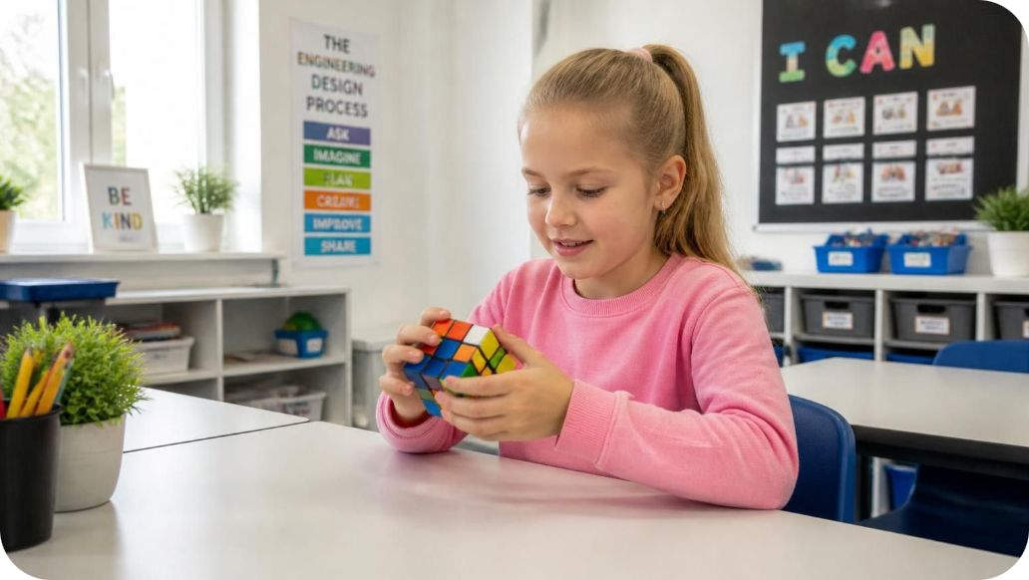
LEARNING ENVIRONMENT
What an AMAkids center can look like
A bright, welcoming space for small-group learning—adapted to the premises, local regulations and chosen programs.
DESIGN CONCEPT
EXISTING AMAKIDS CENTER
CLASSROOM IN USE
Brand identity · classroom technology · teaching tools · flexible small-group layout
17
Notes:
To be confirmed: all three partner stories. Supply names, countries, opening dates, approved photos and key results, including students after 8 months. No testimonial or case result is asserted here.

Slide 18
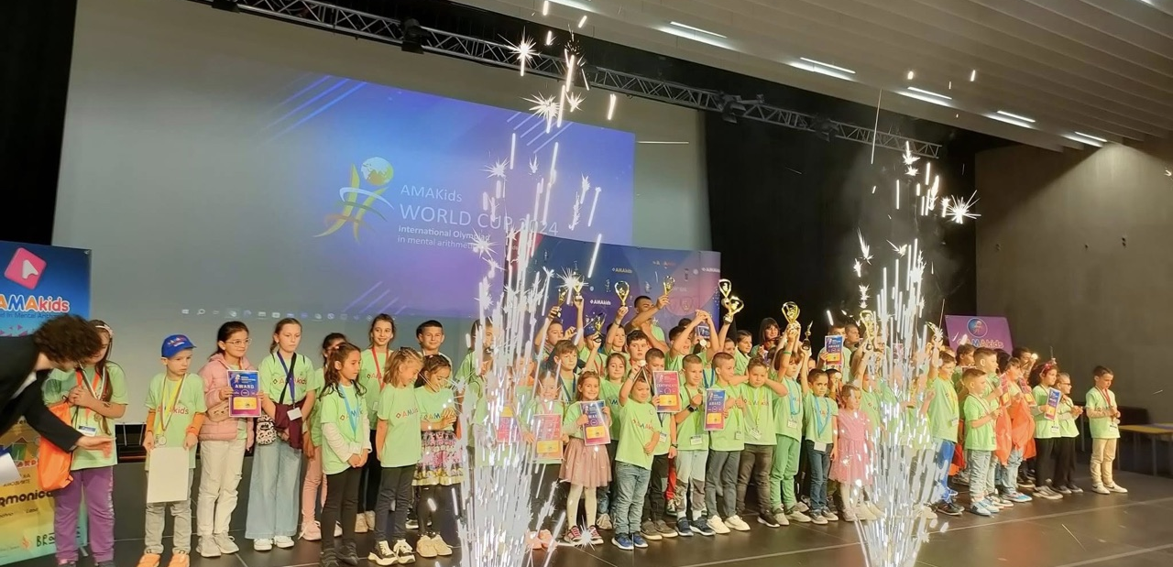

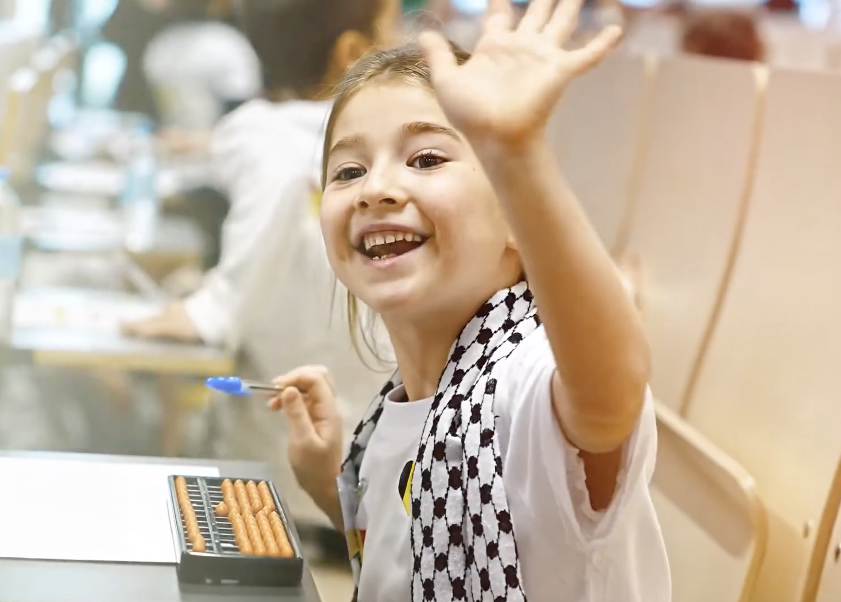
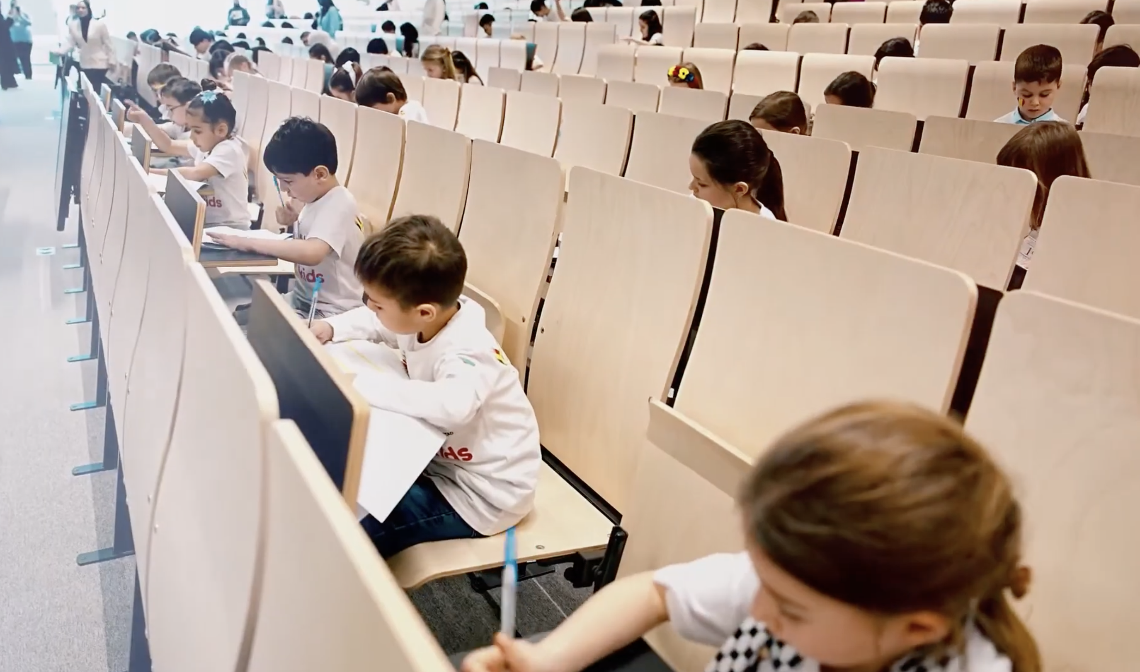
COMMUNITY & MOTIVATION
Events that make progress visible
From local Olympiads to international stages, students get goals to work toward and moments worth celebrating.
Regular event formats
Local Olympiads organized by AMAkids partners
Large international Olympiads and community events
Annual international online tournament
Mental-arithmetic battle for students
Events may vary by market and season.
18
Notes:
To be confirmed: training from zero, applicable contract type and included legal support. The 98% effectiveness claim comes from the supplied presentation; request its definition, methodology and supporting evidence.

Slide 19



CONTACT
Ready to explore AMAkids in your market?
Let’s discuss your city
Email
Book a conversation with the international development team and receive a proposal shaped around your country, format and resources.
international@amakids.com
WhatsApp / Telegram
BRING TO THE FIRST CALL
+357 94 086346
Country and city
Preferred partnership model
What you’ll get
Existing school, premises or team
A fit check, practical launch path and an individual financial discussion for your proposed format.
Programs and target launch timing
amakids.com
19
Notes:
To be confirmed: development-team WhatsApp, Telegram, email and phone. Supply the payback calculator URL and QR code. No unverified contact details or nonfunctional QR code are shown.

