Slide 1
CHARACTERIZATION OF CRYSTAL EFFICIENCY:
STATISTICAL AND SYSTEMATIC ERRORS
AUGUST 2026
ANNA SOFIA MORO

Slide 2
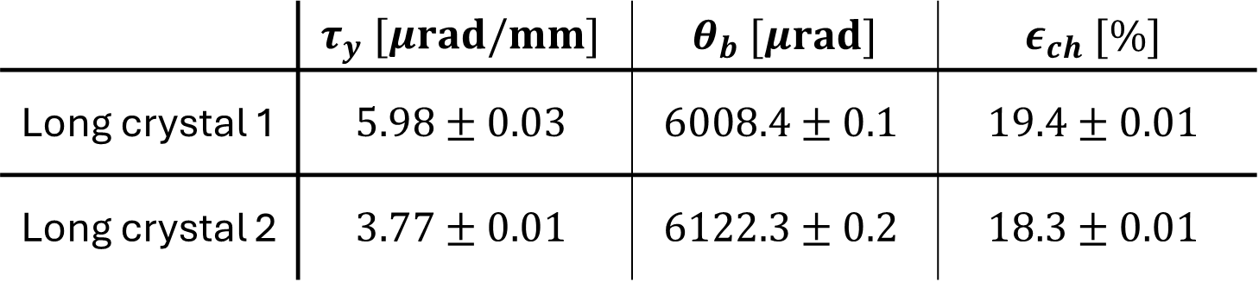
PREVIOUS RESULTS
 | $$τ_{y} [μrad/mm]$$ | $θ_{b} [μrad]$ | $$ε_{ch} [\%]$$
Long crystal 1 | $$5.98±0.03$$ | $$6008.4±0.1$$ | $$19.4±0.01$$
Long crystal 2 | $$3.77±0.01$$ | $$6122.3±0.2$$ | $$18.3±0.01$$

Slide 3
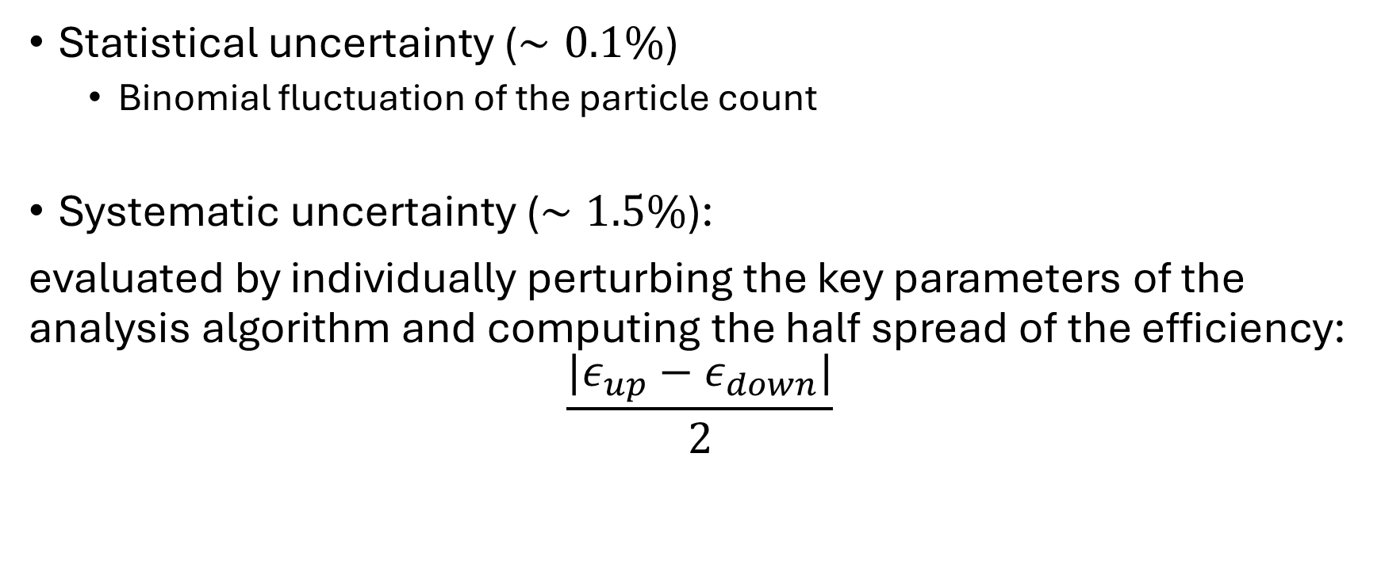
UNCERTAINTY EVALUATION
Statistical uncertainty ($∼0.1\%$)
  Binomial fluctuation of the particle count
Systematic uncertainty ($∼1.5\%$):
evaluated by individually perturbing the key parameters of the analysis algorithm and computing the half spread of the efficiency:
$$\frac{|ε_{up}−ε_{down}|}{2}$$

Slide 4





SYSTEMATIC ERRORS
Classification of sources:
Dominant: tracker resolution
  Spatial cuts along the $x$-axis
  Lindhard angular acceptance
Modeling (torsion analysis)
  Fit model choice
  Grid binning
Selection
  Integration windows
  Preliminary cuts
$$1.4\%$$
total
$$1.5\%$$
$$0.03\%$$
$$0.01\%$$

Slide 5
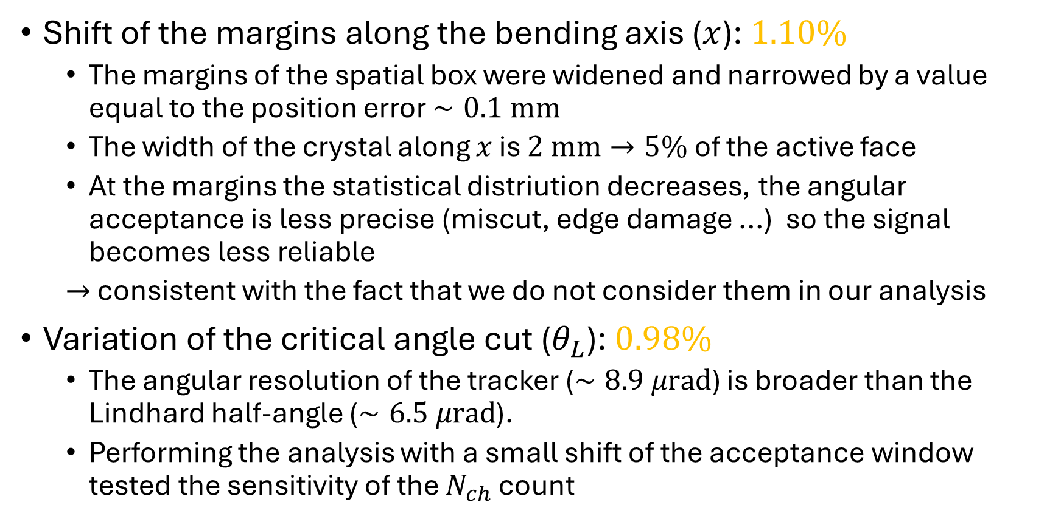
SYSTEMATIC ERRORS: DOMINANT
Shift of the margins along the bending axis ($x$): $1.10\%$
  The margins of the spatial box were widened and narrowed by a value equal to the position error $∼0.1 mm$
  The width of the crystal along $x$ is $2 mm→5\%$ of the active face
  At the margins the statistical distriution decreases, the angular acceptance is less precise (miscut, edge damage ...) so the signal becomes less reliable
  $→$ consistent with the fact that we do not consider them in our analysis
Variation of the critical angle cut ($θ_{L}$): $0.98\%$
  The angular resolution of the tracker ($∼8.9 μrad$) is broader than the Lindhard half-angle ($∼6.5 μrad$).
  Performing the analysis with a small shift of the acceptance window tested the sensitivity of the $N_{ch}$ count

Slide 6
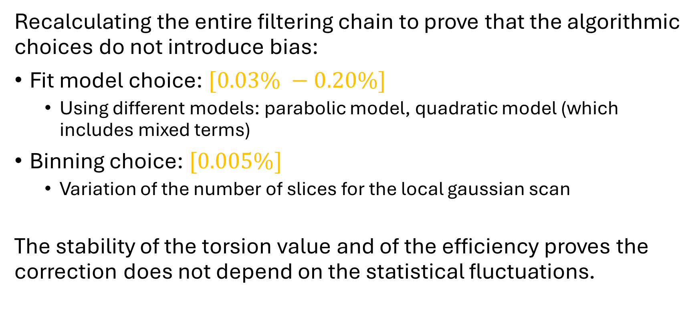
SYSTEMATIC ERRORS: MODELING
Recalculating the entire filtering chain to prove that the algorithmic choices do not introduce bias:
Fit model choice: $[0.03\% −0.20\%]$
  Using different models: parabolic model, quadratic model (which includes mixed terms)
Binning choice: $[0.005\%]$
  Variation of the number of slices for the local gaussian scan
The stability of the torsion value and of the efficiency proves the correction does not depend on the statistical fluctuations.

Slide 7
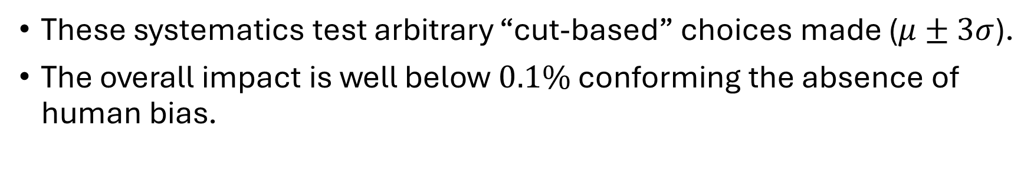
SYSTEMATIC ERRORS: SELECTION
These systematics test arbitrary “cut-based” choices made ($μ±3σ$).
The overall impact is well below $0.1\%$ conforming the absence of human bias.

Slide 8
SYSTEMATIC ERRORS: SELECTION
These systematics test arbitrary “cut-based” choices made ($μ±3σ$).
The overall impact is well below $0.1\%$ conforming the absence of human bias.
The final calculated value is robust from a data analysis perspective. The only real limitations seems to come from the telescope resolution, not from the software or the assumptions made to extract the torsion map.

Slide 9
ERROR BUDGET SUMMARY
run | efficiency | error | stat error | syst err (dom) | syst err (model) | syst err (select)
crystal 1 | 19.6% | 1.5% | 0.1% | 1.5% | 0.03% | 0.1%
 | 19.1% | 1.5% | 0.1% | 1.4% | 0.2% | 0.1%
 | 17.1% | 1.3% | 0.1% | 1.3% | 0.05% | 0.07%
crystal 2 | 18.2% | 1.4% | 0.1% | 1.4% | 0.2% | 0.2%
 | 18.3% | 1.5% | 0.1% | 1.4% | 0.1% | 0.2%

Slide 10
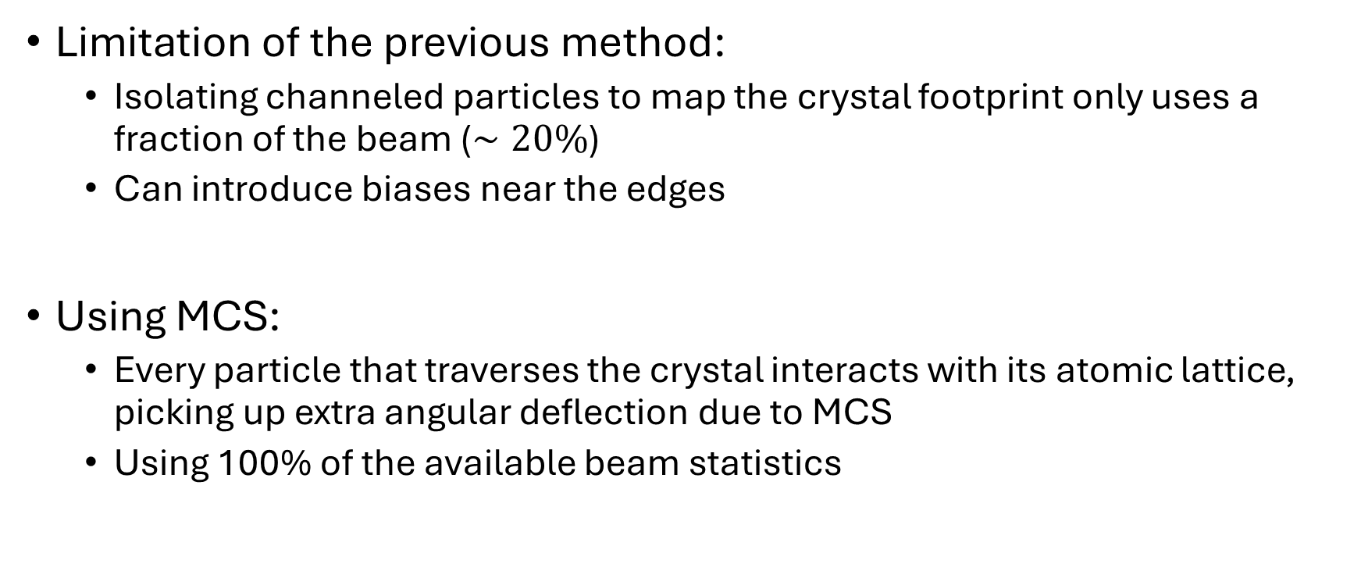
FIND THE CRYSTAL FOOTPRINT THROUGH SCATTERING
Limitation of the previous method:
  Isolating channeled particles to map the crystal footprint only uses a fraction of the beam ($∼20\%$)
  Can introduce biases near the edges
Using MCS:
  Every particle that traverses the crystal interacts with its atomic lattice, picking up extra angular deflection due to MCS
  Using 100% of the available beam statistics

Slide 11
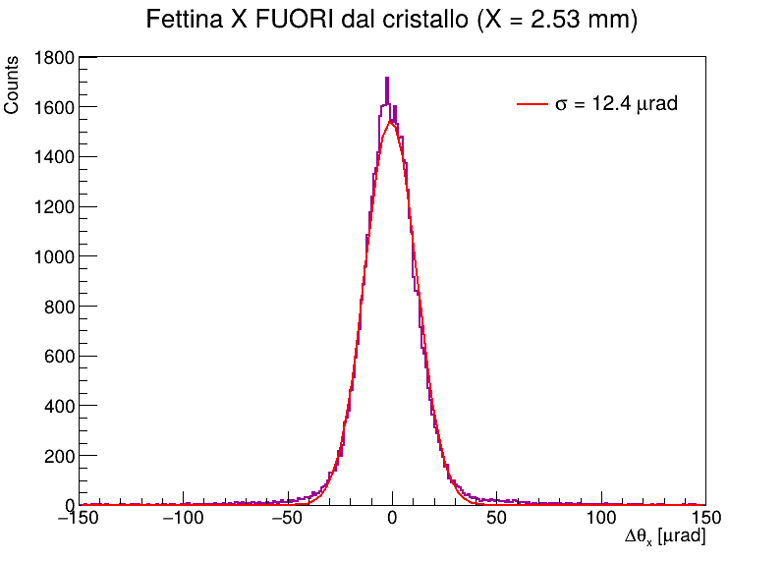
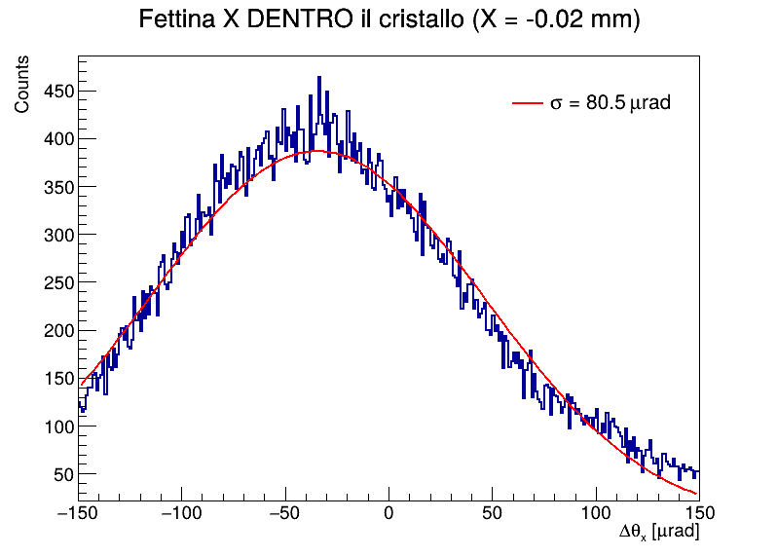

FIND THE CRYSTAL FOOTPRINT THROUGH SCATTERING
For each bin the angular distribution of the outgoing tracks $Δθ_{x}$ is fitted with a Gaussian curve
The extracted gaussian widths $σ$ are plotted against the impact position
The transition between the outside and inside regions is fitted using a Error function (Erf)
OUTSIDE
INSIDE

Slide 12
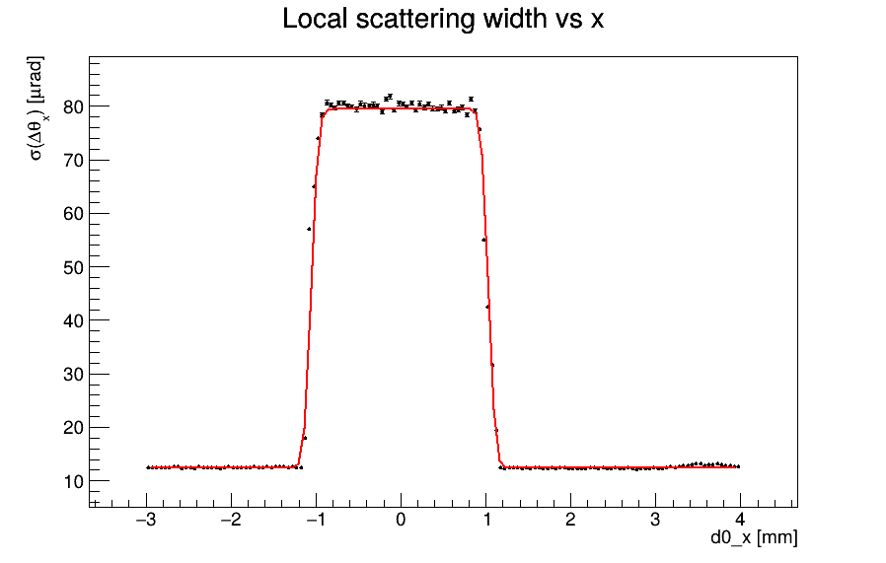
FIND THE CRYSTAL FOOTPRINT THROUGH SCATTERING
INSIDE
OUTSIDE

Slide 13
BACKUP SLIDES

Slide 14
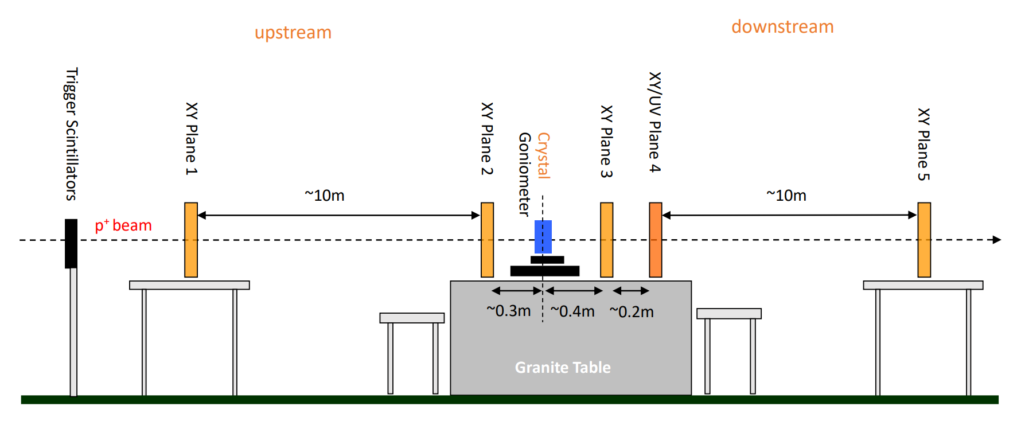
BACKUP SLIDES: SCHEMATIC LAYOUT

