Slide 1
Characterization of Long Bent Silicon Crystals for Channelling Applications at the LHC
Thesis Project
ANNA SOFIA MORO
Update 24 August 2026

Slide 2
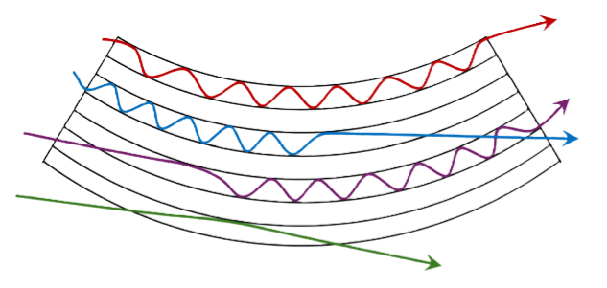
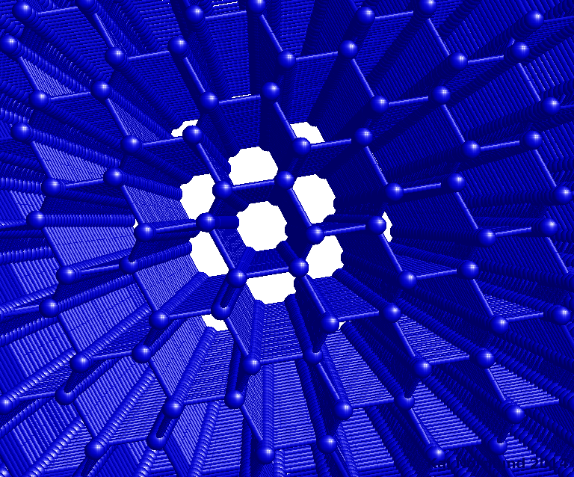
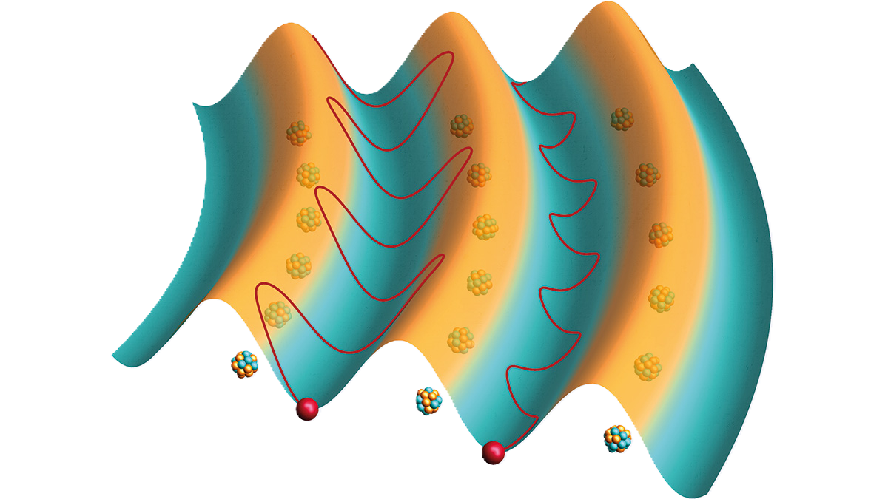
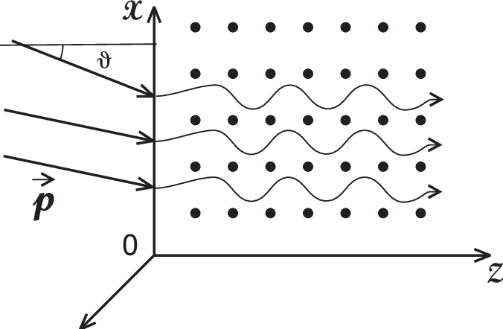
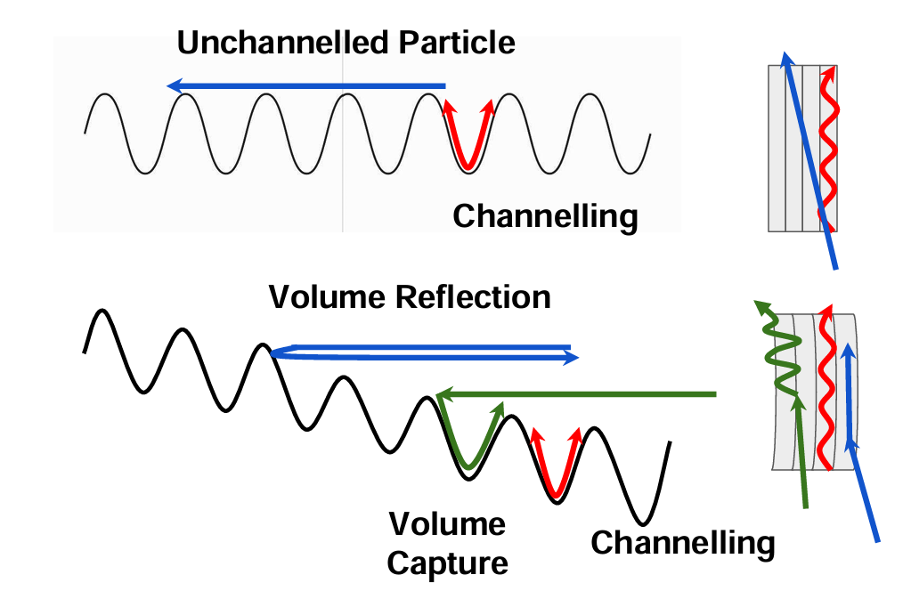
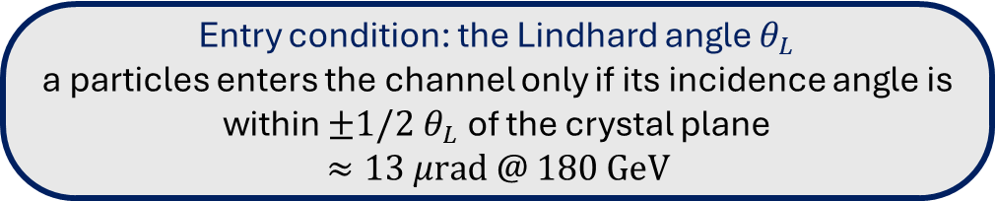
WHAT IS ‘CHANNELING’ IN CRYSTALS?
THE PHYSICS
Channeling effect
Charged particles get trapped and guided between regular atomic planes
Beam deflection
Bending the crystal physically steers the beam’s trajectory
Advantage
A compact alternative to traditional magnets for deflecting or extracting beams
Entry condition: the Lindhard angle $θ_{L}$
a particles enters the channel only if its incidence angle is within $±1/2{ θ}_{L}$ of the crystal plane
$$≈13 μrad @ 180 GeV$$
Notes:
Inside a crystal, atoms are arranged in regular planes. If a charged particle enters nearly parallel to these planes, it can become trapped and guided along their curvature, “locked” to the lattice instead of crossing it in a straight line.
When the crystal is bent, the channeled beam is deflected along with the grating: the crystal acts as a guide, offering a compact alternative to traditional magnets for deflecting or extracting a particle beam.

Slide 3
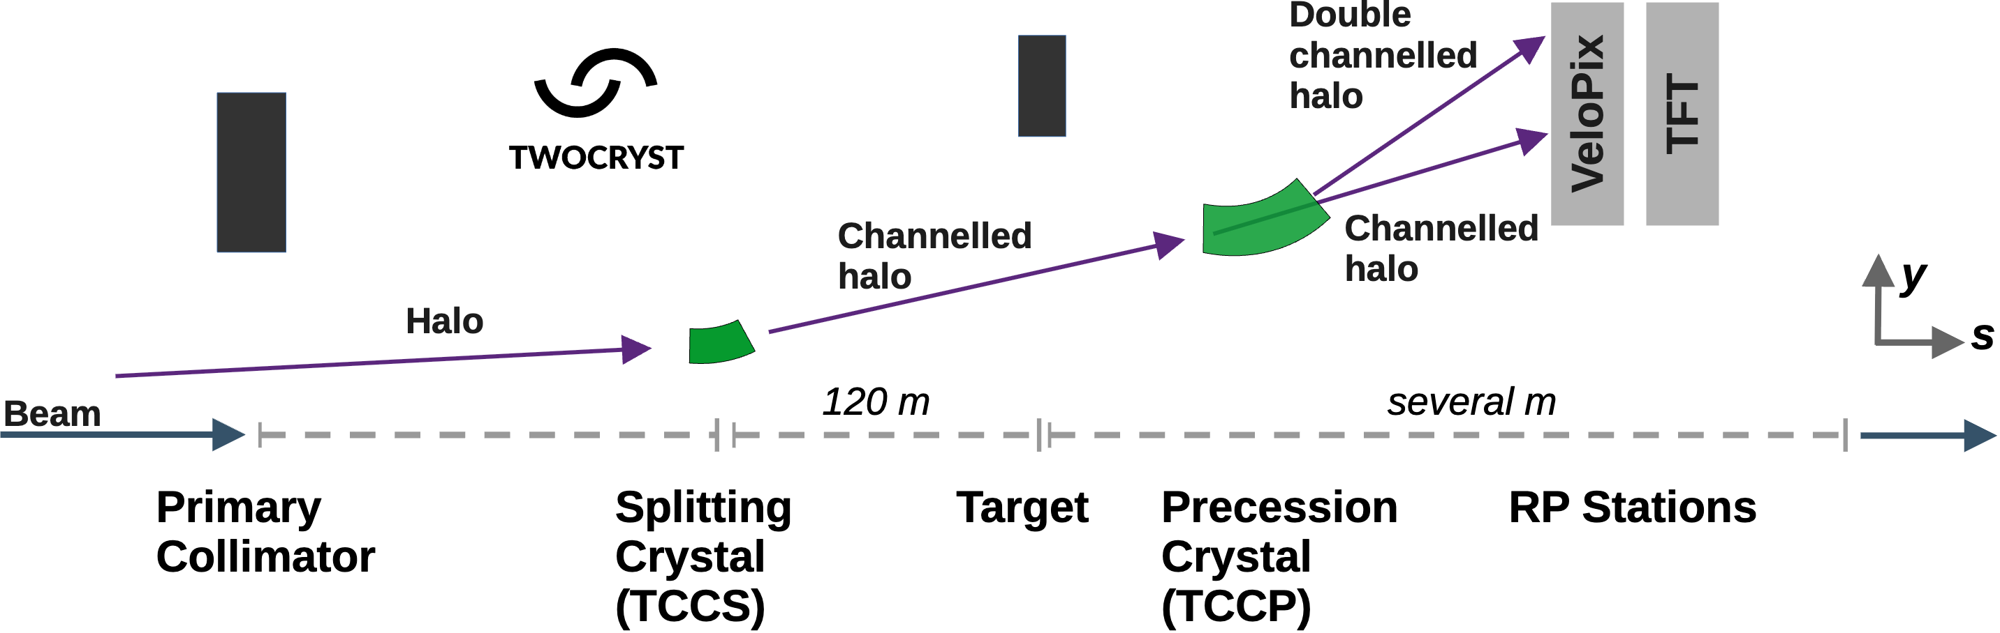
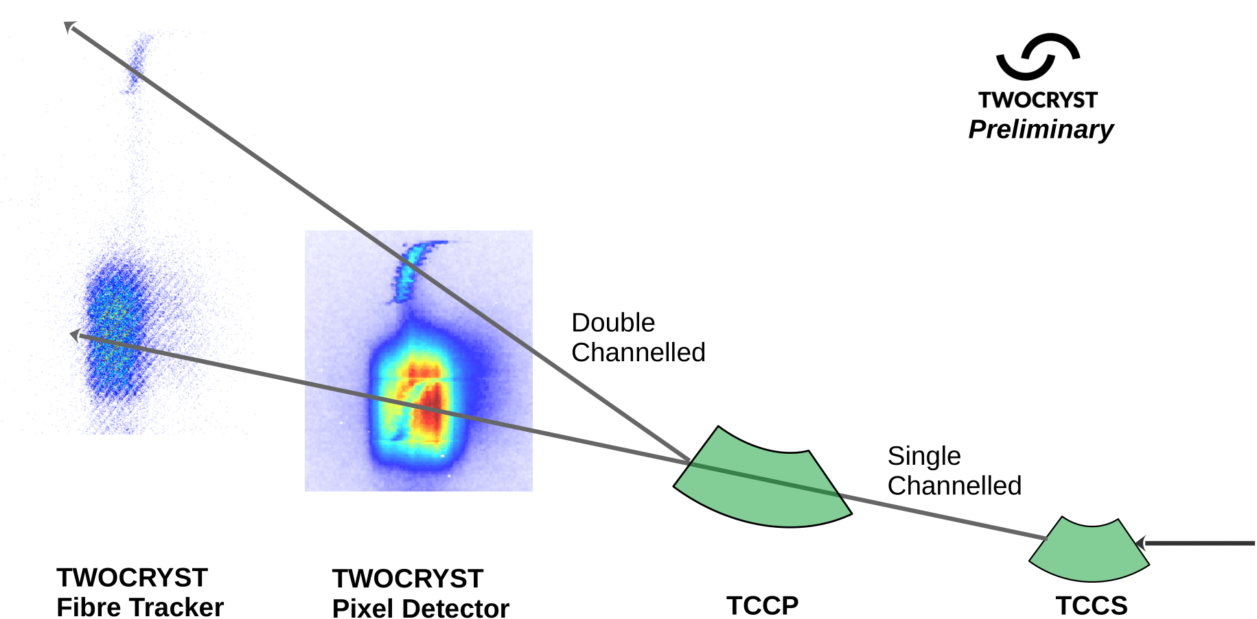
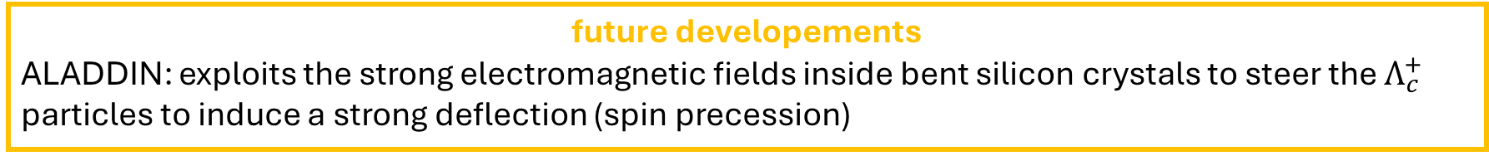
THE TWOCRYST EXPERIMENT
THE PROJECT
before
Bent crystals only used in collimation systems to deflect particles in the beam halo
(2025 - now)
Validate the operational feasibility, crystal performance, required for a double-crystal fixed-target experiment inside the LHC (TeV scales)
future developements
ALADDIN: exploits the strong electromagnetic fields inside bent silicon crystals to steer the $Λ_{c}^{+}$ particles to induce a strong deflection (spin precession)
Notes:
Bent crystals are also used in modern accelerators’ collimation systems to deflect stray particles in the beam halo into shielding blocks that safely absorb them.

Slide 4
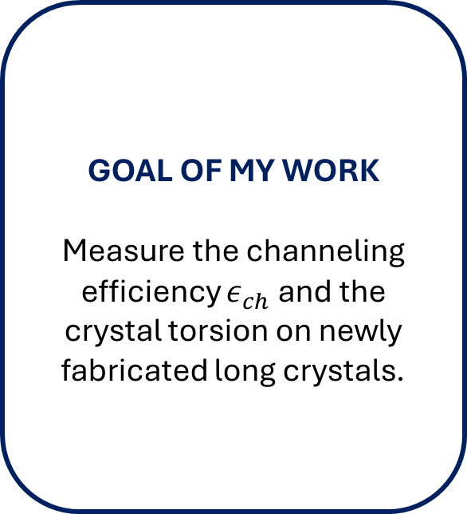
MY ANALYSIS
THE PROJECT
DATA
2024 dataset for two long crystals
Taken at SPS-H8 test bench with 180 GeV beam (70% protons and 30% pions)
GOAL OF MY WORK
Measure the channeling efficiency $ε_{ch}$ and the crystal torsion on newly fabricated long crystals.
WHAT IS NEW
These crystals were fabricated directly by CERN, unlike the ones mounted on TWOCRYST.

Slide 5
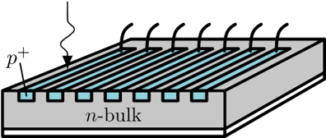
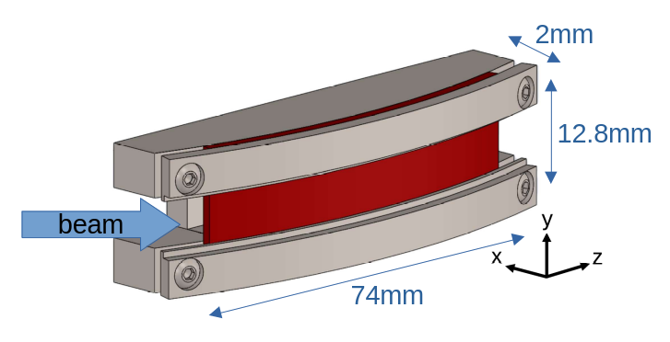
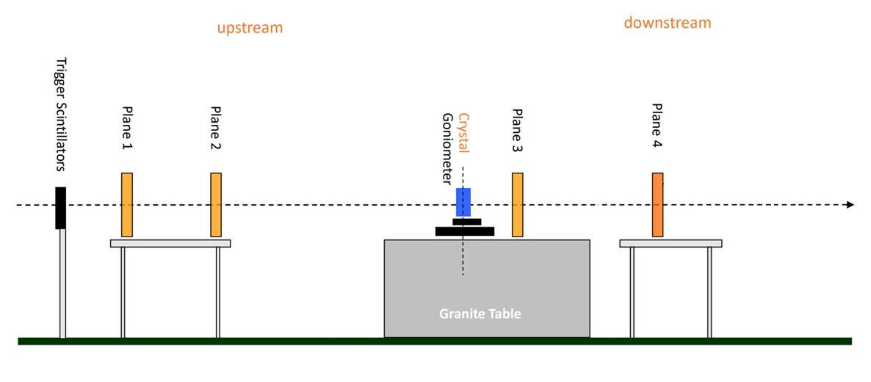
MY ANALYSIS
EXPERIMENTAL SETUP
silicon microstrip sensors
long crystal
DATA
2024 dataset for two long crystals
Taken at SPS-H8 test bench with 180 GeV beam (70% protons and 30% pions)

Slide 6
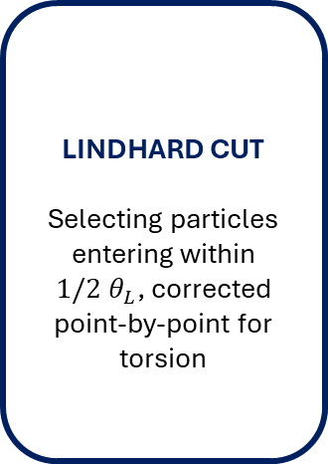
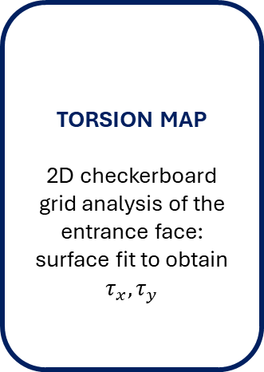
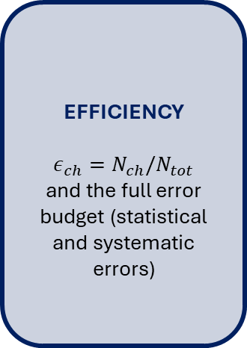
THE ANALYSIS PIPELINE
METHOD
QUALITY FILTERS
Selecting single tracks, alignment check between the upstream and downstream telescope arms
CRYSTAL EDGES
Reconstruct the (x,y) spatial window illuminated by the crystal
(2 independent methods)
TORSION MAP
2D checkerboard grid analysis of the entrance face:
surface fit to obtain $τ_{x}, τ_{y}$
LINDHARD CUT
Selecting particles entering within $1/2{ θ}_{L}$, corrected point-by-point for torsion
EFFICIENCY
$$ε_{ch}=N_{ch}/N_{tot}$$
and the full error budget (statistical and systematic errors)
Analysis implemented in Python on RDataFrame (ROOT).

Slide 7
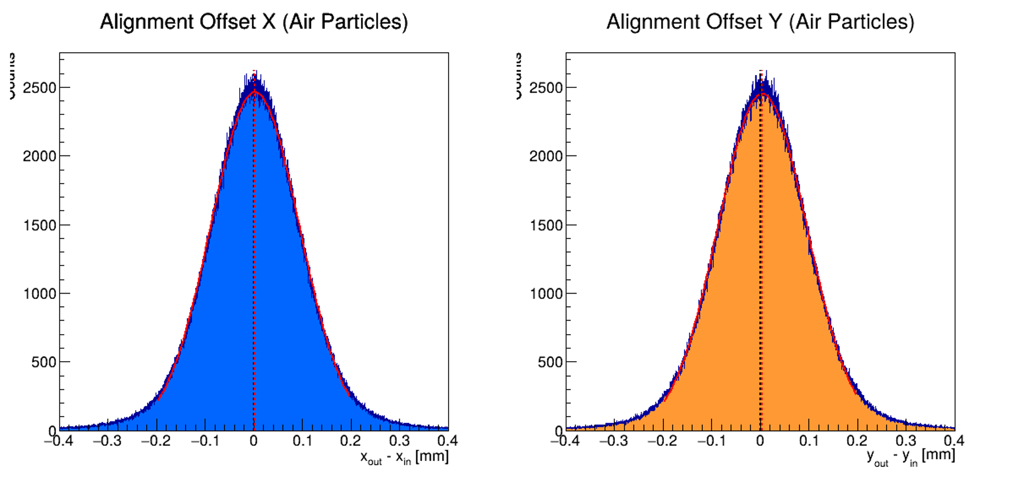
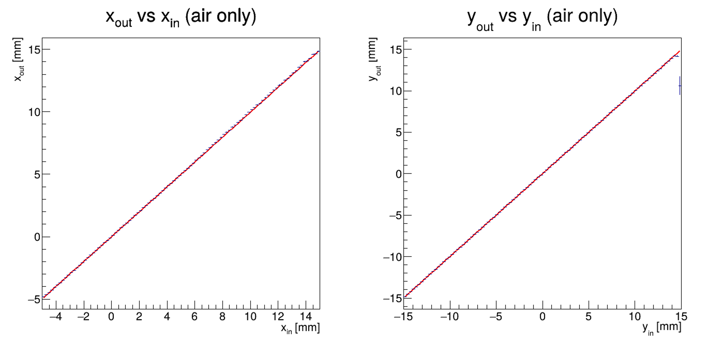


ANALYSIS: DETECTOR ALIGNMENT
PRELIMINARY ANALYSIS
To ensure that the upstream and downstream detectors are aligned, we check the deviation between the initial and final positions of particles that definitely did not hit the crystal, ensuring that is zero.
QUALITY FILTERS
Selecting single tracks, alignment check between the upstream and downstream telescope arms
$$m=0.995$$
$$q=0.007$$
$$m=0.999$$
$$q=0.006$$
We can also check the alignment by doing a linear fit between the upstream and dowstream profiles.

Slide 8
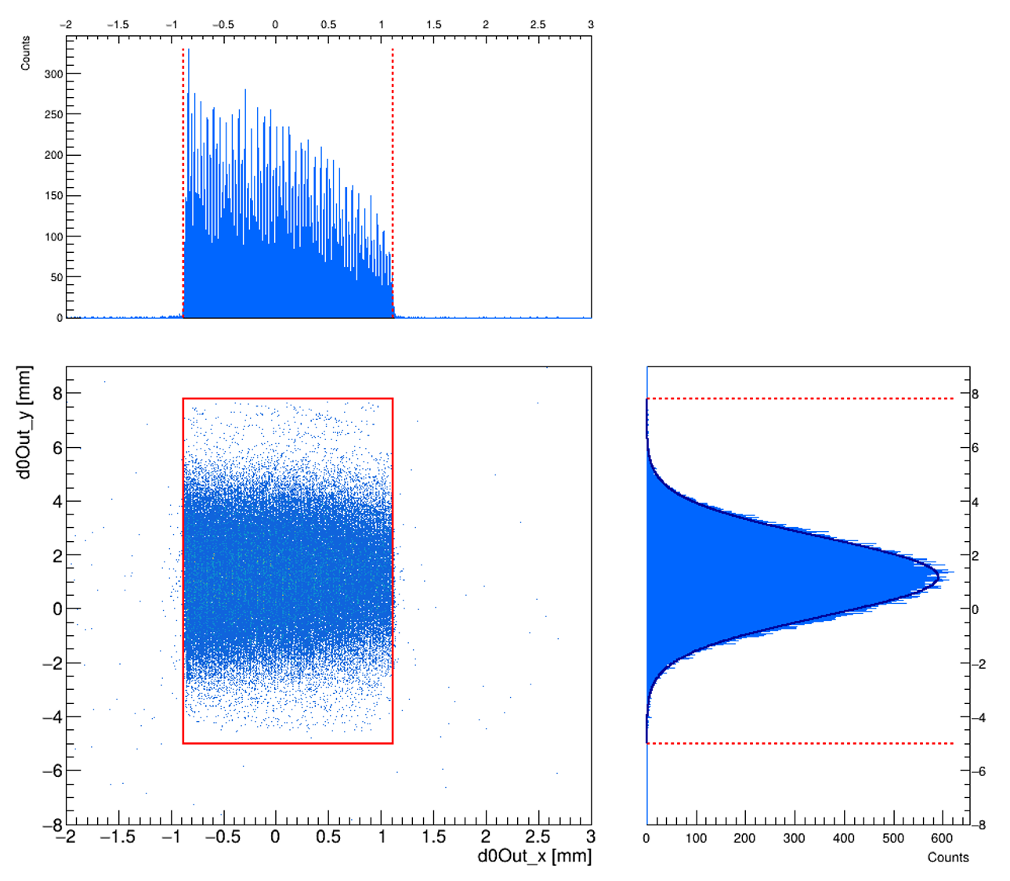

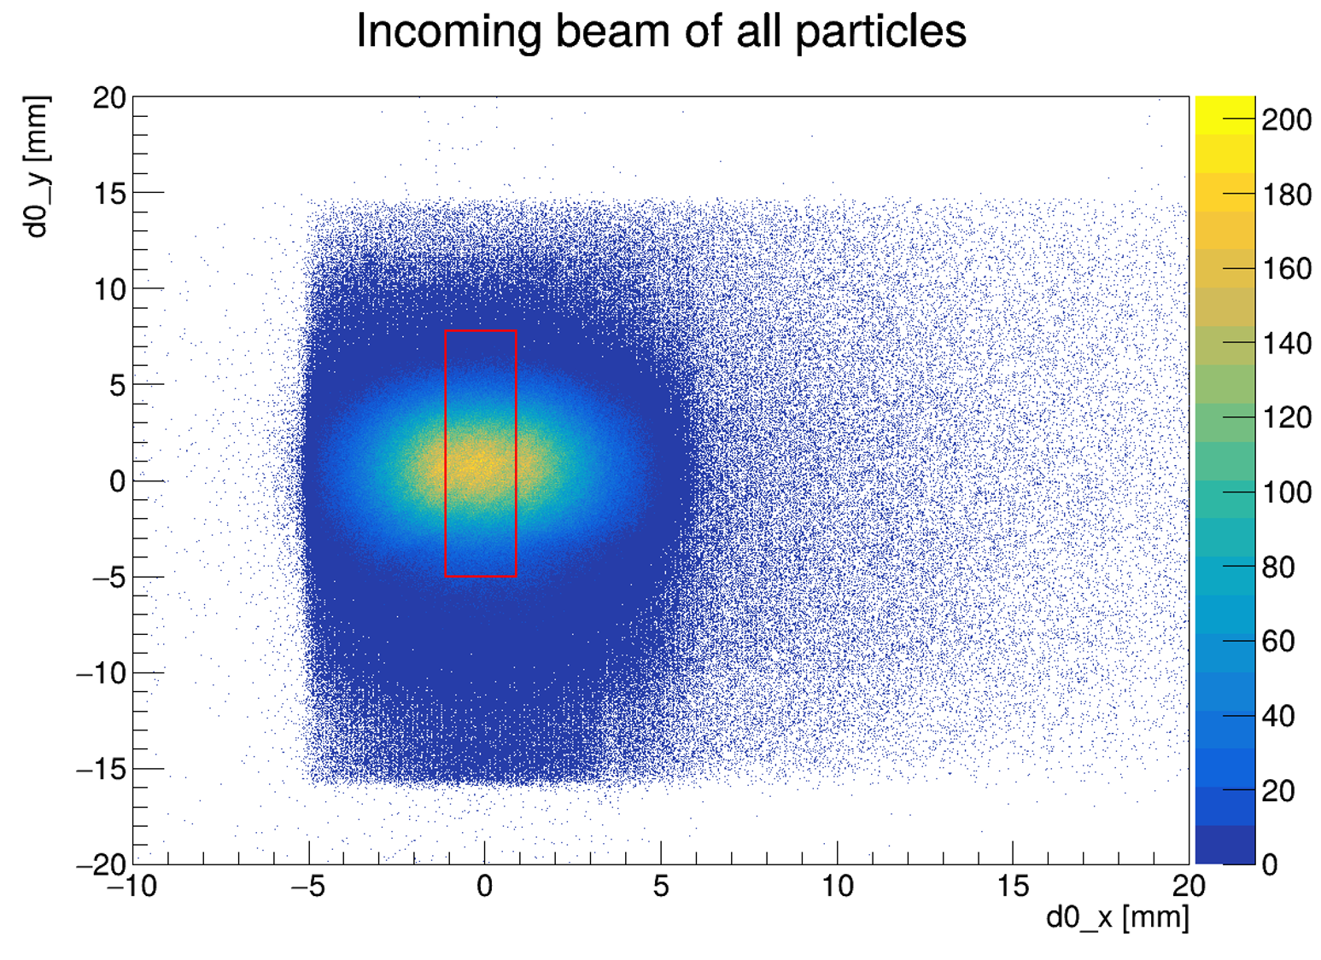


ANALYSIS: CRYSTAL EDGES
PRELIMINARY ANALYSIS
METHOD 1: CHANNELED PARTICLES
Isolate already channeled particles (only uses ~ 20% of data)
Their impact position (x, y) traces the crystal footprint, matching its expected dimension
Use of a sliding window method, which maximize the number of particles inside
To project the downstream edges back upstream a shift is needed (due to the lateral geometric drift along the $x$-axis)
CRYSTAL EDGES
Reconstruct the (x,y) spatial window illuminated by the crystal
(2 independent methods)
Selected window
$$2 mm×12.8 mm$$
METHOD 2: MULTIPLE COULOMB SCATTERING
Notes:
Results: the two methods agree on a width of 2 mm in x, in y the scattering method shows a narrower effective window due to the clamps, consistent with the torsion analysis, which already excludes the poorly-illuminated edges

Slide 9
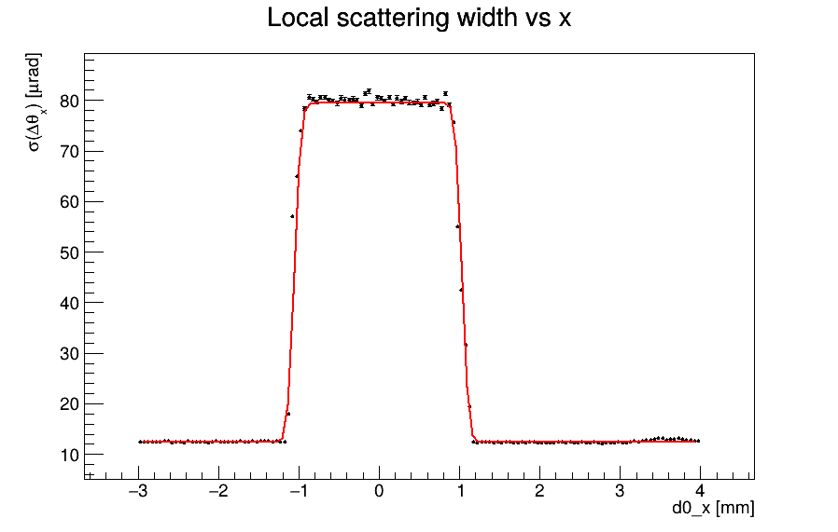
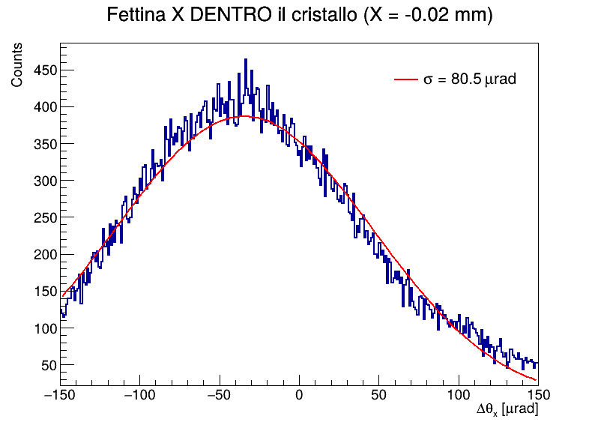
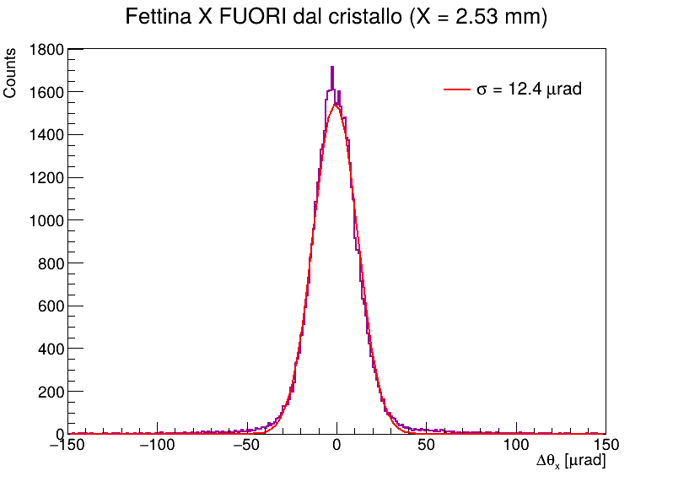


ANALYSIS: CRYSTAL EDGES
PRELIMINARY ANALYSIS
METHOD 1: CHANNELED PARTICLES
METHOD 2: MULTIPLE COULOMB SCATTERING
Particles that physically crosses the crystal picks up extra Coulomb scattering, the ones outside the crystal do not
The width $σ$ of the outgoing angular distribution is measured
A sharp transition marks the edges
CRYSTAL EDGES
Reconstruct the (x,y) spatial window illuminated by the crystal
(2 independent methods)
INSIDE
OUTSIDE
$$2 mm$$
Notes:
Results: the two methods agree on a width of 2 mm in x, in y the scattering method shows a narrower effective window due to the clamps, consistent with the torsion analysis, which already excludes the poorly-illuminated edges

Slide 10
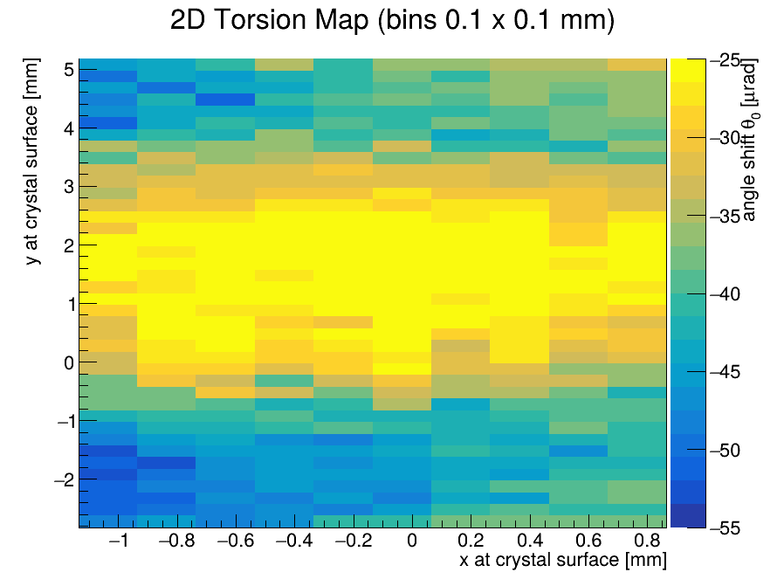
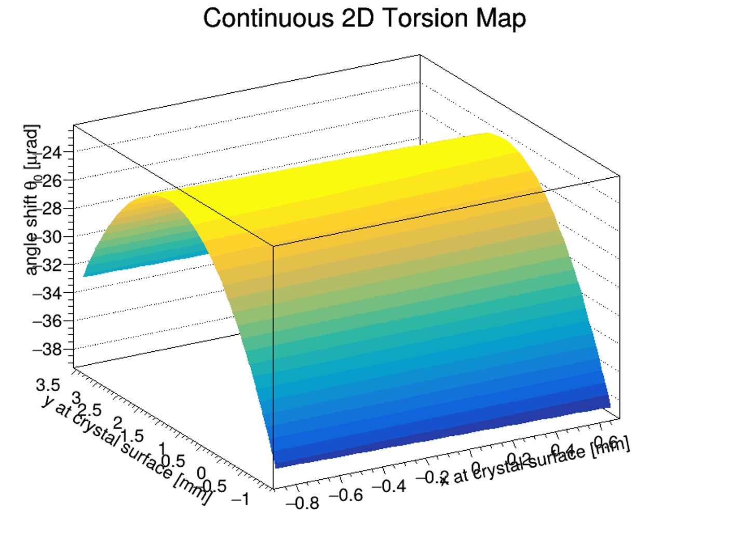

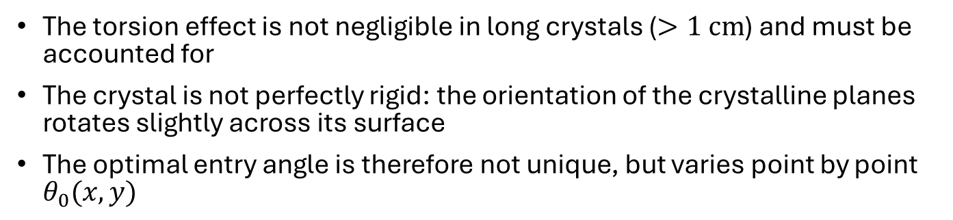


ANALYSIS: MAPPING THE TORSION
PRELIMINARY ANALYSIS
The torsion effect is not negligible in long crystals ($>1 cm$) and must be accounted for
The crystal is not perfectly rigid: the orientation of the crystalline planes rotates slightly across its surface
The optimal entry angle is therefore not unique, but varies point by point $θ_{0}(x,y)$
TORSION MAP
2D checkerboard grid analysis of the entrance face:
surface fit to obtain $τ_{x}, τ_{y}$
Beam spot divided into a 0.1 mm (x,y) grid
Angular scan
for each cell
$→$ local $θ_{0}$
that maximize
efficiency
Surface fit
(parabolic)
to extract the
global $τ_{x}, τ_{y}$
RESULTS:
Torsion along the $y$-axis: $τ_{y}=5.98(3) μrad/mm$
Negligible torsion along the $x$-axis: $τ_{x}=0.1\left(1\right) μrad/mm$
Notes:
Influence the angular range in which particles enter
$\left|θ_{x}^{in}−\left(θ_{x}^{off}+τ_{y}⋅d_{y}+τ_{x}⋅d_{x}\right)\right|≤\frac{1}{2}θ_{L}$

Slide 11
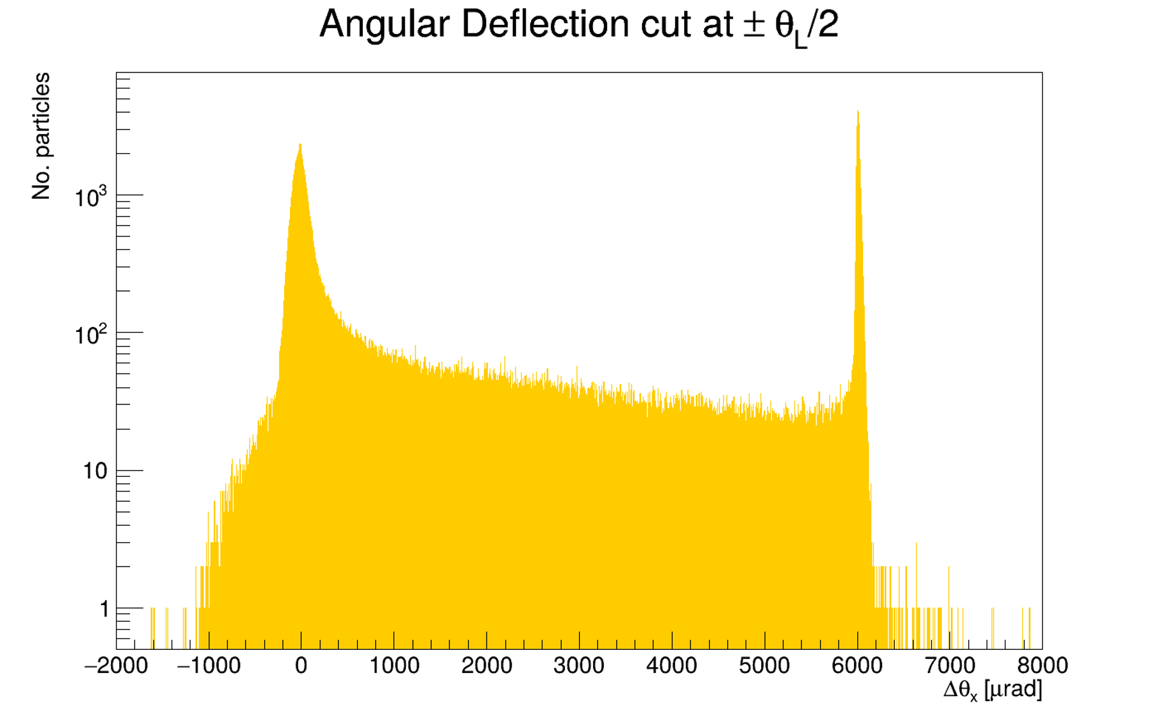
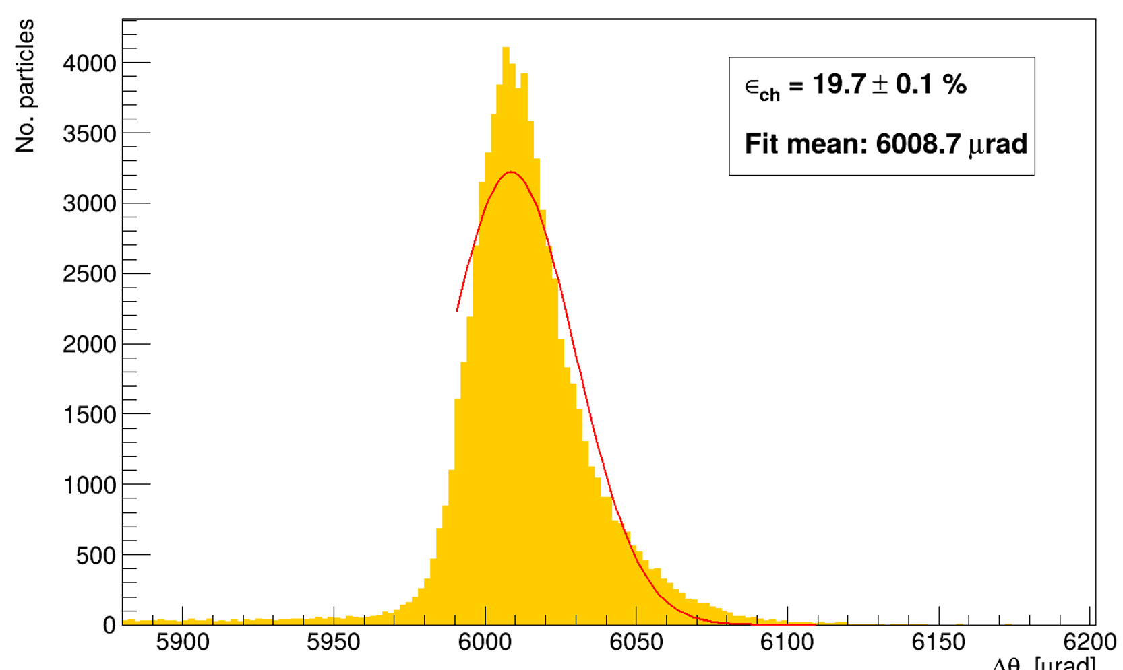



CHANNELING EFFICIENCY
ANALYSIS
CHANNELING EFFICIENCY
$$ε_{ch}=\frac{N_{ch}}{N_{tot}}$$
$$N_{tot}$$
$$N_{ch}$$
Notes:
By fitting only the right side of the peak, we ensured the cleanest possible measurement by excluding any contribution from dechanneled particles.

Slide 12
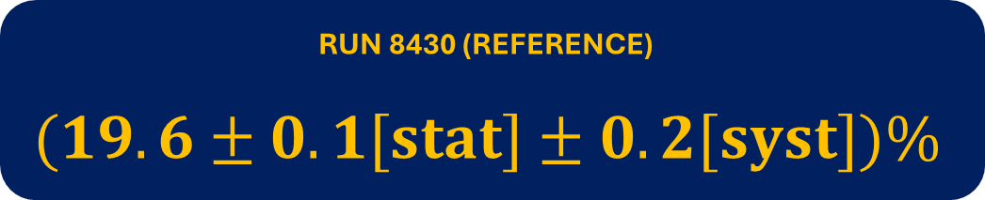
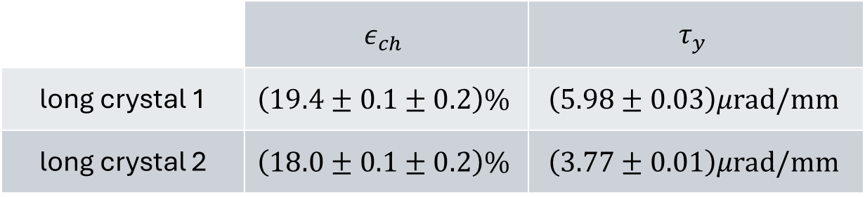
CHANNELING EFFICIENCY: RESULTS
ANALYSIS
crystal 1 crystal 2
RUN 8430 (REFERENCE)
$$(19.6±0.1[stat]±0.2[syst])\%$$
 | $$ε_{ch}$$ | $$τ_{y}$$
long crystal 1 | $$\left(19.4±0.1±0.2\right)\%$$ | $$\left(5.98±0.03\right)μrad/mm$$
long crystal 2 | $$\left(18.0±0.1±0.2\right)\%$$ | $$\left(3.77±0.01\right)μrad/mm$$
anomalous run

Slide 13
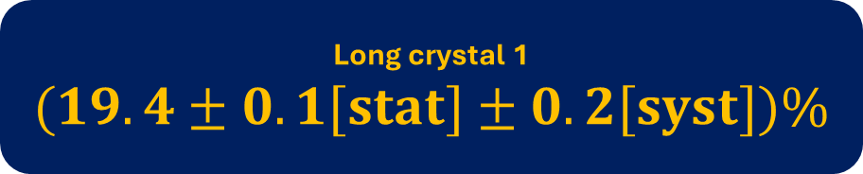



CHANNELING EFFICIENCY: RESULTS
ANALYSIS
Long crystal 1
$$(19.4±0.1[stat]±0.2[syst])\%$$
ERROR BUDGET
Statistical error:
Binomial error
Fit errors
Systematic error:
Fit model choice
Binning choices
$$0.1\%$$
Long crystal 2
$$(18.0±0.1[stat]±0.2[syst])\%$$
$$0.2\%$$

Slide 14
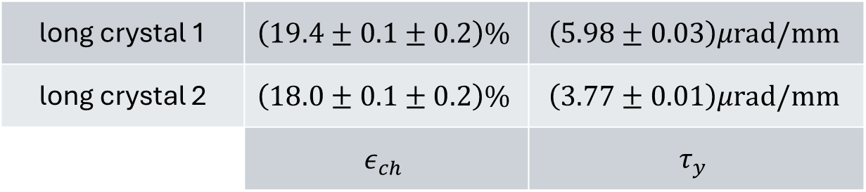
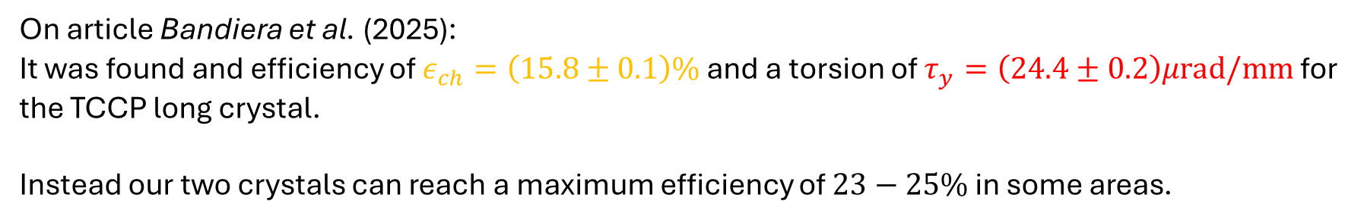
CHANNELING EFFICIENCY: RESULTS
ANALYSIS
long crystal 1 | $$\left(19.4±0.1±0.2\right)\%$$ | $$\left(5.98±0.03\right)μrad/mm$$
long crystal 2 | $$\left(18.0±0.1±0.2\right)\%$$ | $$\left(3.77±0.01\right)μrad/mm$$
 | $$ε_{ch}$$ | $$τ_{y}$$
On article Bandiera et al. (2025):
It was found and efficiency of $ε_{ch}=\left(15.8±0.1\right)\%$ and a torsion of $τ_{y}=\left(24.4±0.2\right)μrad/mm$ for the TCCP long crystal.
Instead our two crystals can reach a maximum efficiency of $23−25\%$ in some areas.

Slide 15
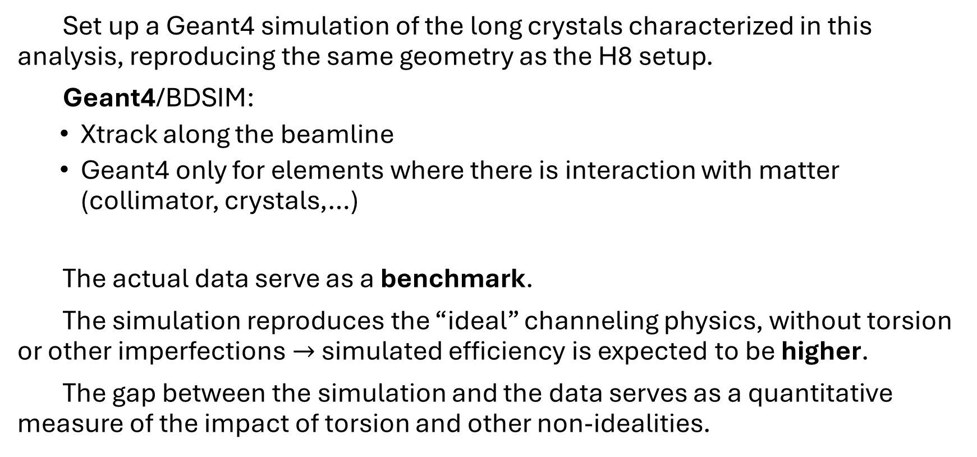
WHAT’S NEXT: SIMULATION
NEXT STEPS
Set up a Geant4 simulation of the long crystals characterized in this analysis, reproducing the same geometry as the H8 setup.
Geant4/BDSIM:
  Xtrack along the beamline
  Geant4 only for elements where there is interaction with matter (collimator, crystals,…)
The actual data serve as a benchmark.
The simulation reproduces the “ideal” channeling physics, without torsion or other imperfections $→$ simulated efficiency is expected to be higher.
The gap between the simulation and the data serves as a quantitative measure of the impact of torsion and other non-idealities.

Slide 16
BACKUP SLIDES

Slide 17

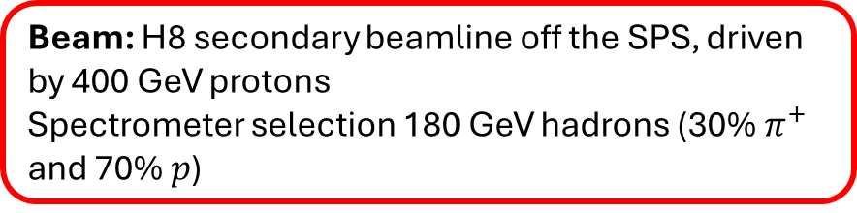

SCHEMATIC LAYOUT
BACKUP SLIDE
Beam: H8 secondary beamline off the SPS, driven by 400 GeV protons
Spectrometer selection 180 GeV hadrons (30% $π^{+}$ and 70% $p$)
Trackers:
2 silicon microstrip sensors
639 strips, 98 mm length
with a ~ 7 um resolution
Station 1
z ~ -12.4 m
Station 2
z ~ -10.4 m
crystal
z = 0 m
Station 3
z ~ 0.5 m
Station 4
z ~ 4.7 m
Beam
direction
$$z$$
Incoming arm vacuum pipe
Downstream arm vacuum pipe

Slide 18
SCHEMATIC LAYOUT
BACKUP SLIDE

Slide 19
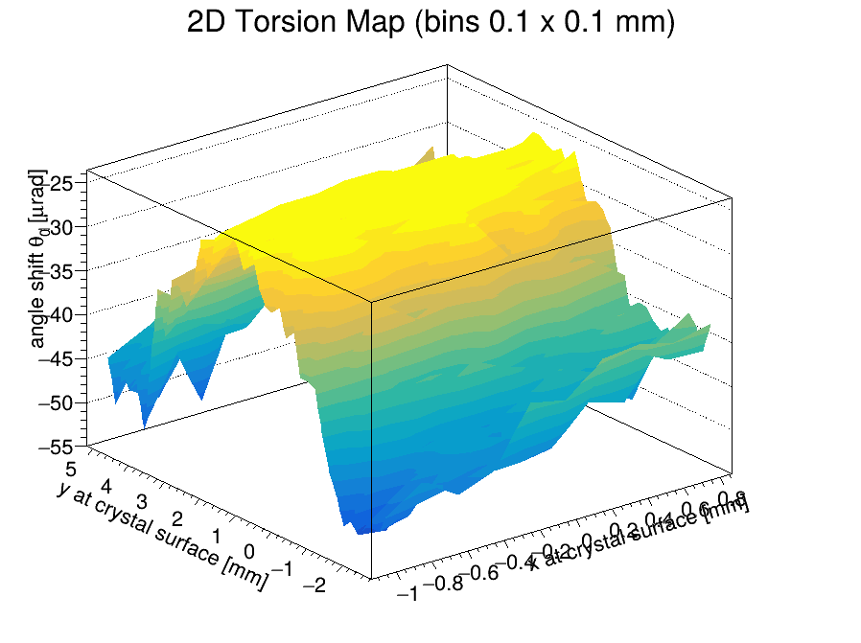

TORSION FIT
BACKUP SLIDE
The 2d map is fitted through a parabolic function:
$$θ_{corr}\left(x,y\right)=θ_{0}+τ_{x}⋅x+τ_{y}⋅y+p_{3}y^{2}$$
Now we correct the effect of torsion using the parameter $θ_{0}(x,y)$ found for each bin:
instead of the Lindhard cut ${|θ}_{in,x}|≤\frac{1}{2}θ_{L}$ we will use
$\left|θ_{x}^{in}−\left(θ_{x}^{off}+τ_{y}⋅d_{y}+τ_{x}⋅d_{x}\right)\right|≤\frac{1}{2}θ_{L}$
Notes:
This allowed us to apply a continuous torsion correction. So, instead of using a standard Lindhard cut centered at zero, we corrected the incoming angle using the fitted parameters found for each spatial bin.

Slide 20
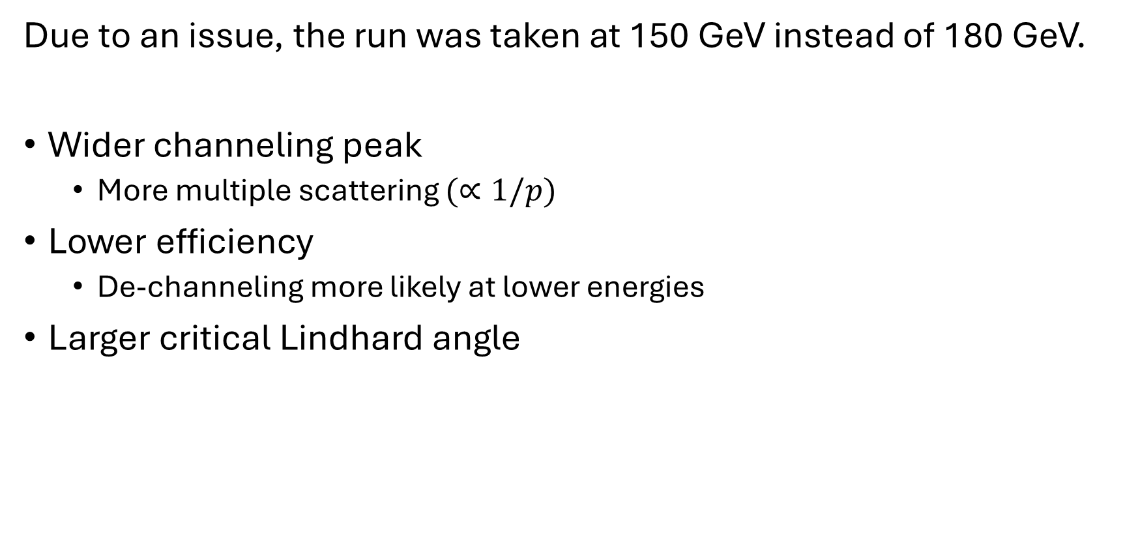
ANOMALOUS RUN 8650
BACKUP SLIDE
Due to an issue, the run was taken at 150 GeV instead of 180 GeV.
Wider channeling peak
  More multiple scattering $(∝1/p)$
Lower efficiency
  De-channeling more likely at lower energies
Larger critical Lindhard angle

Slide 21


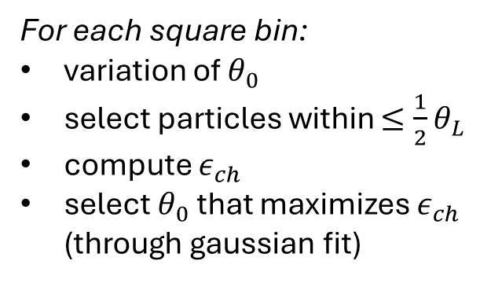

ANGLE SELECTION
BACKUP SLIDE
For each square bin:
variation of $θ_{0}$
select particles within $≤\frac{1}{2}θ_{L}$
compute $ε_{ch}$
select $θ_{0}$ that maximizes $ε_{ch}$ (through gaussian fit)
$±\frac{1}{2}θ_{L}$ cut
Notes:
If not considering any torsion correction: we would just calculate the channeling efficiency through several iterations varying $θ_{0}$ until the highest efficiency is found, representing the best alignment of incoming particles with the crystalline planes

Slide 22
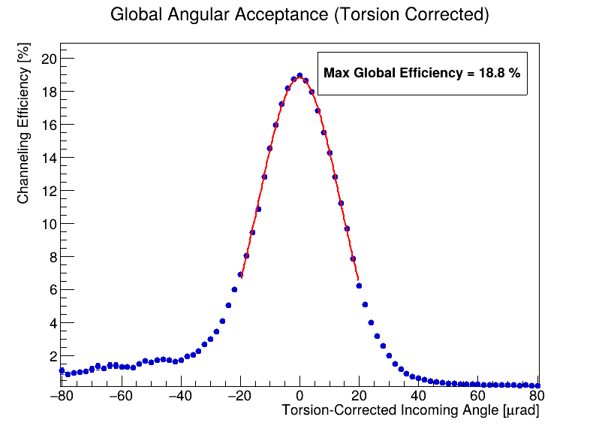
EFFICIENCY CURVE
BACKUP SLIDE
Crystal efficiency as a function of the incoming angle, after application of the torsion correction. The value of the peak is the efficiency of the crystal when it is perfectly aligned to the beam.
Notes:
Applying this torsion correction significantly improves our analysis. When we plot the crystal efficiency as a function of the torsion-corrected incoming angle, the peak of this curve represents the efficiency of the crystal when it is perfectly aligned to the beam, which in this case reached 18.8%.

