Slide 1
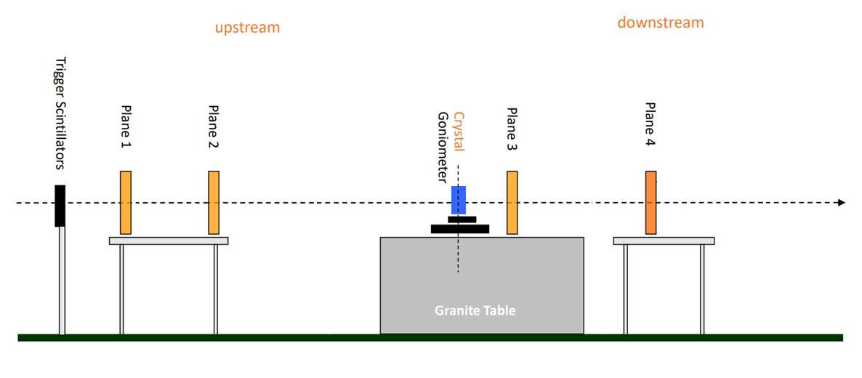
SCHEMATIC LAYOUT
-12.434 -10.356 0 0. 487 4.714 [m]
2.078 10.356 0.487 4.227 [m]

Slide 2

SCHEMATIC LAYOUT
Station 1
z = -12434 mm
Station 2
z = -10356 mm
crystal
z = 0 mm
Station 3
z = 487 mm
Station 4
z = 4714 mm
Beam
direction
$$z$$
Incoming arm vacuum pipe
Downstream arm vacuum pipe

Slide 3
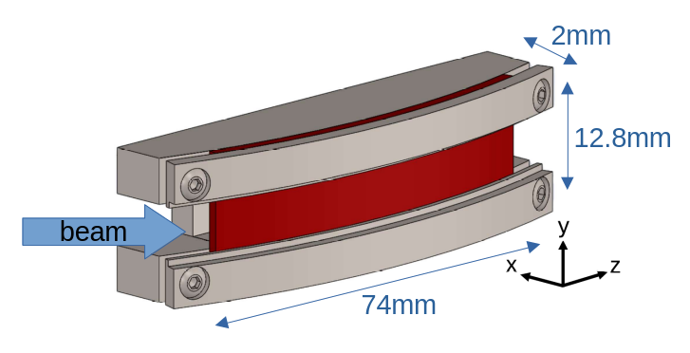
SCHEMATIC LAYOUT

Slide 4
VACUUM PIPES
Vacuum pipes segments fill the arm specifically to suppress MCS in air between stations, the tracker stations themselves sit in the short breaks where a pipe segment has been removed to house the plane
In a standard UA9 5-plane layout, the longest pipe sections are between plane 1-2 and 4-5
For large bending long crystals, only 4 planes are used, and the downstream is deliberately short

Slide 5
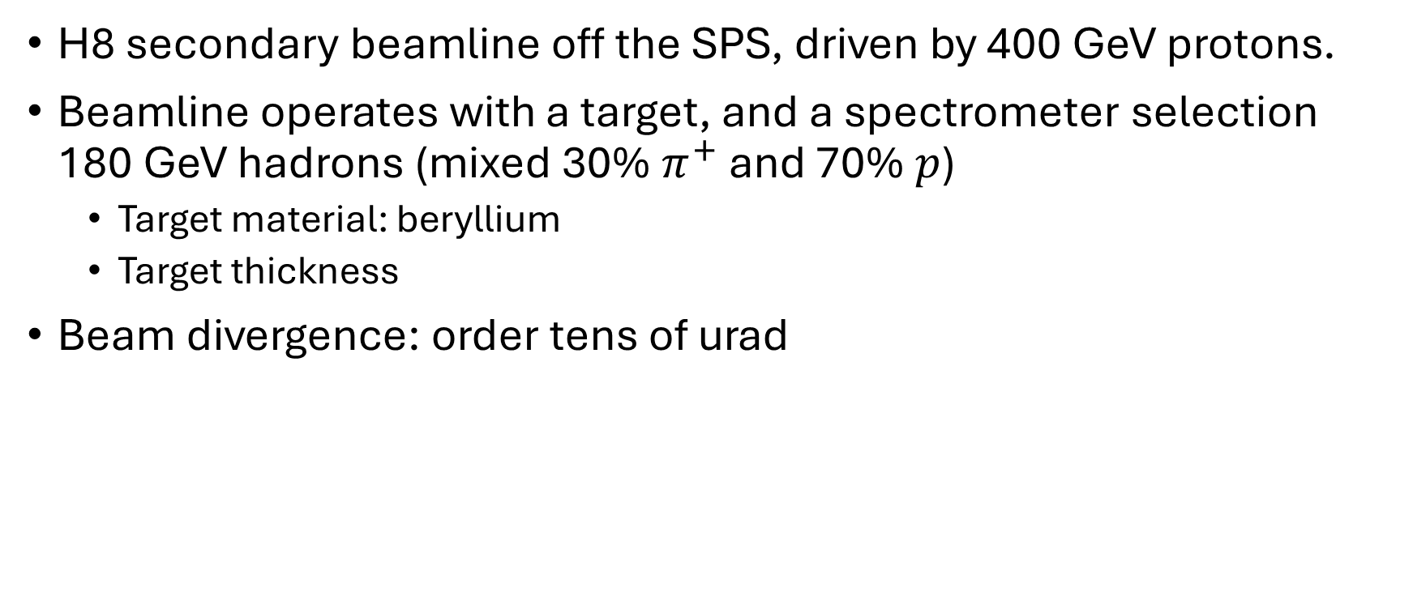
BEAM FEATURES
H8 secondary beamline off the SPS, driven by 400 GeV protons.
Beamline operates with a target, and a spectrometer selection 180 GeV hadrons (mixed 30% $π^{+}$ and 70% $p$)
  Target material: beryllium
  Target thickness
Beam divergence: order tens of urad

Slide 6
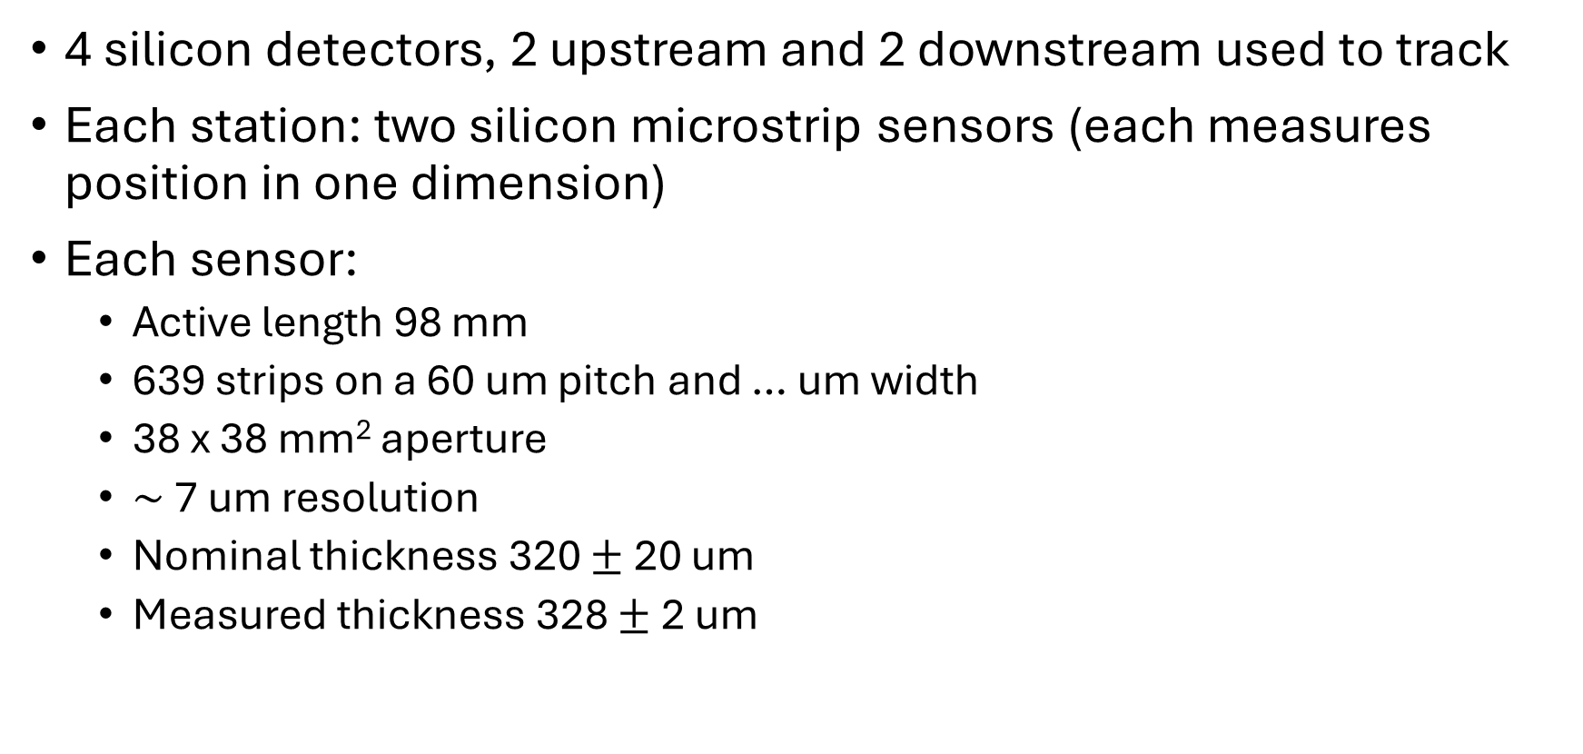
TRACKERS FEATURES
4 silicon detectors, 2 upstream and 2 downstream used to track
Each station: two silicon microstrip sensors (each measures position in one dimension)
Each sensor:
  Active length 98 mm
  639 strips on a 60 um pitch and … um width
  38 x 38 mm² aperture
  $∼$ 7 um resolution
  Nominal thickness 320 $±$ 20 um
  Measured thickness 328 $±$ 2 um

