Slide 1
SEPTEMBER 2026 UPDATE
ANNA SOFIA MORO

Slide 2
WHAT’S NEW?
Multiple Coulomb Scattering
  Analysis made for both x and y
  Clamp material evaluation
Analysis of the beam distribution of real data
  Check the distributions
  Check the correlation/covariance
Simulation
  Reproduce the real data beam features
  Channeling efficiency analysis
Thesis
  Possible order of topics in the table of contents

Slide 3
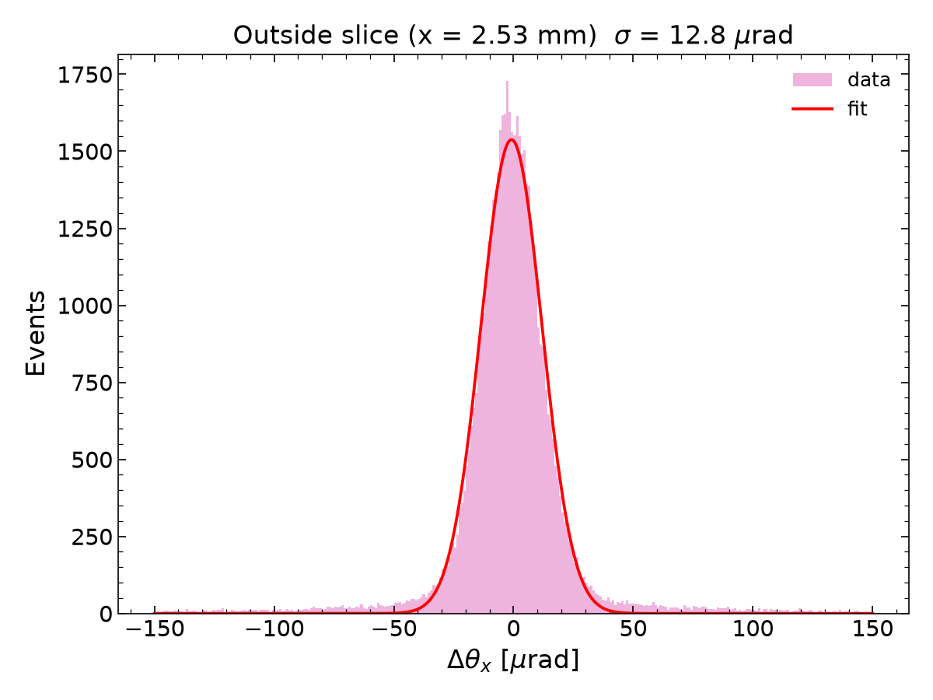
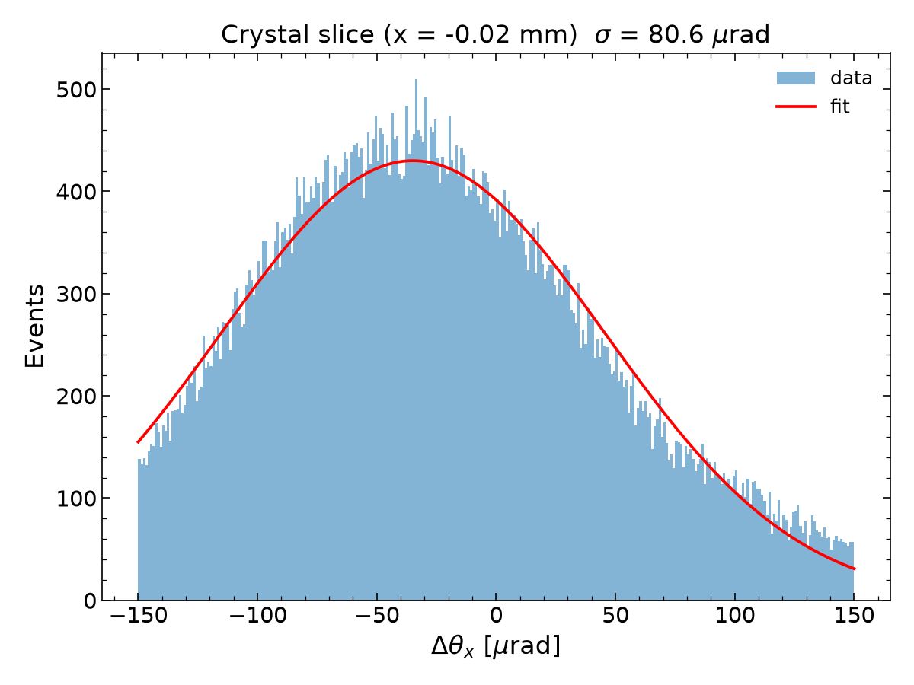



FIND THE CRYSTAL FOOTPRINT THROUGH SCATTERING
Divided the crystal into slices along $x$ or $y$
Width of the angular distribution $σ$ for each slice
$$y$$
$$x$$
OUTSIDE
INSIDE

Slide 4
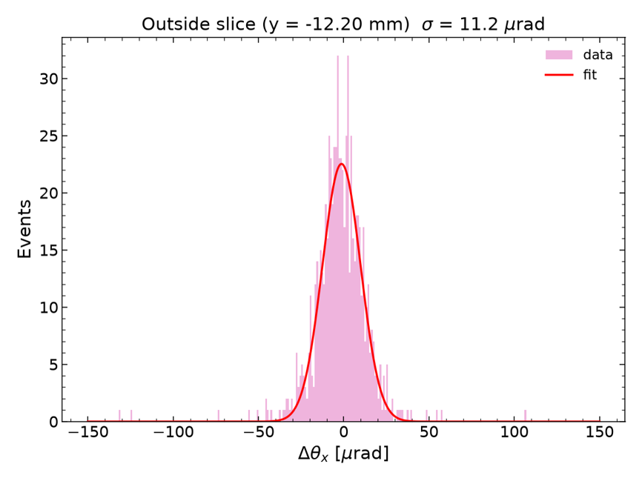
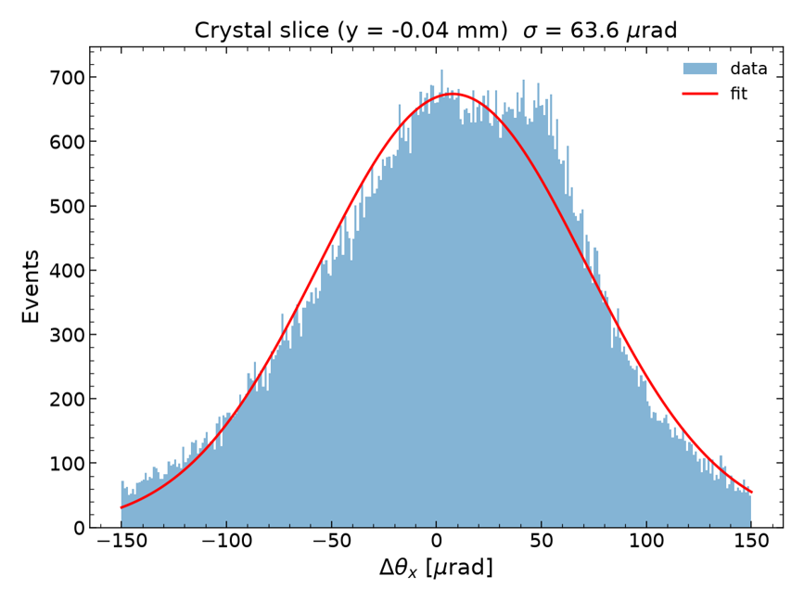
FIND THE CRYSTAL FOOTPRINT THROUGH SCATTERING
Divided the crystal into slices along $x$ or $y$
Width of the angular distribution $σ$ for each slice
$$y$$
$$x$$
OUTSIDE
INSIDE

Slide 5
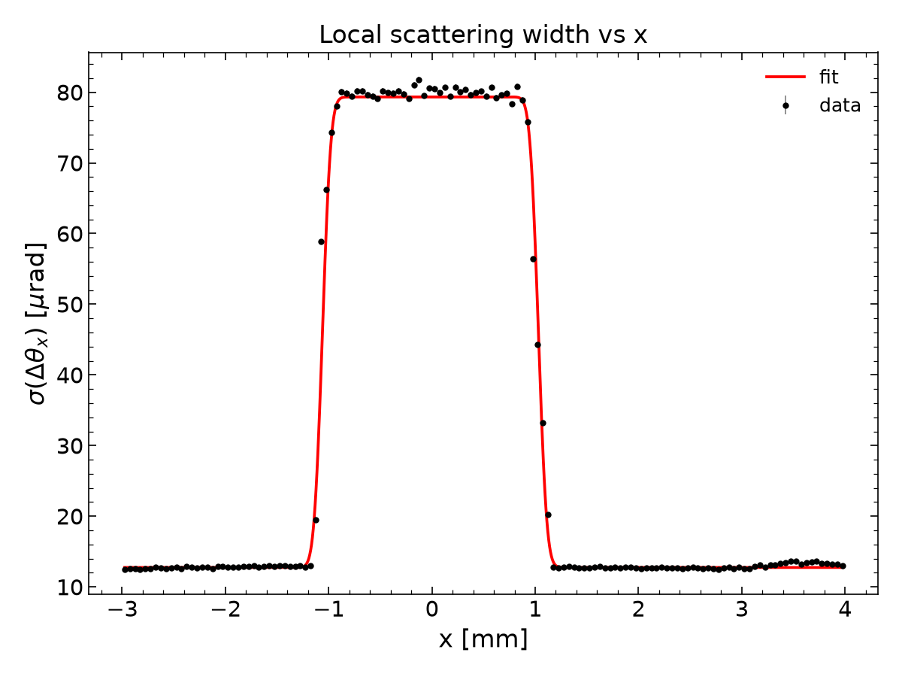
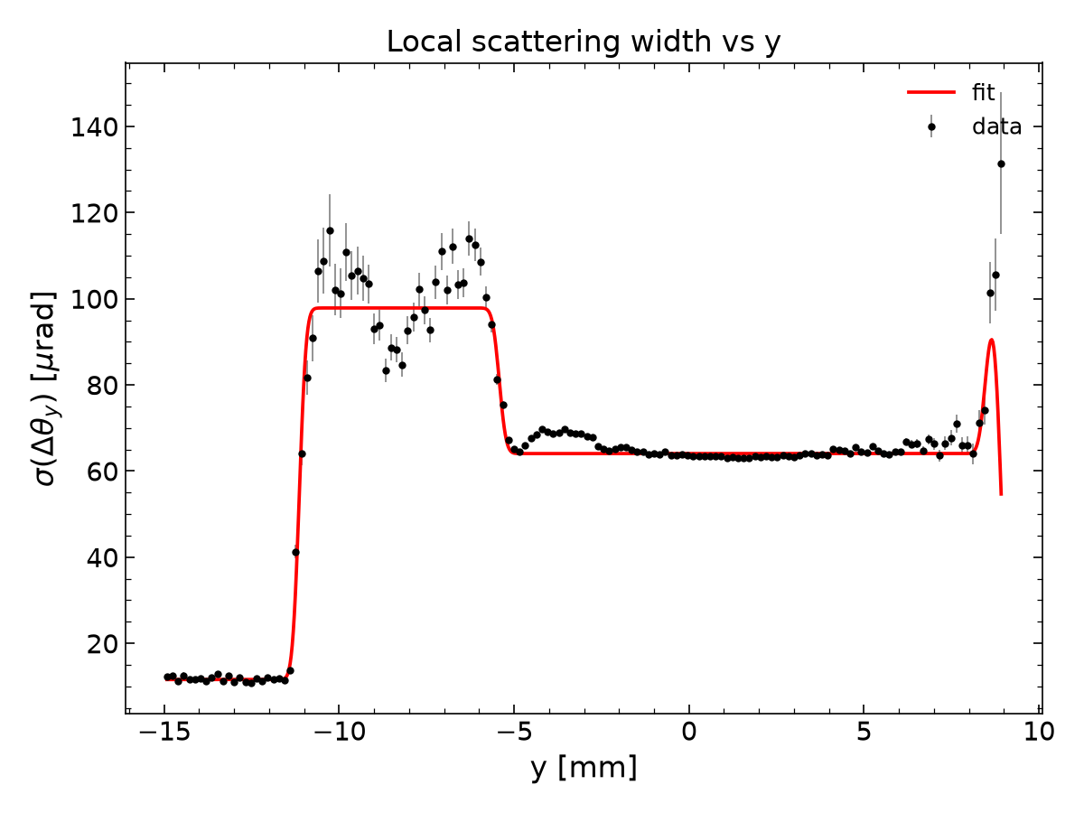



FIND THE CRYSTAL FOOTPRINT THROUGH SCATTERING
The extracted gaussian widths $σ$ are plotted against the impact position
The transition between the outside and inside regions is fitted using a Error function (Erf)
$$y$$
$$x$$

Slide 6


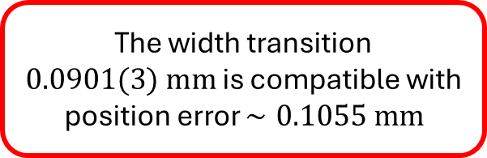

FIND THE CRYSTAL FOOTPRINT THROUGH SCATTERING
The window @ half height
$$2.0911±0.0004$$
INSIDE
OUTSIDE
The width transition $0.0901(3) mm$ is compatible with position error $∼0.1055 mm$

Slide 7

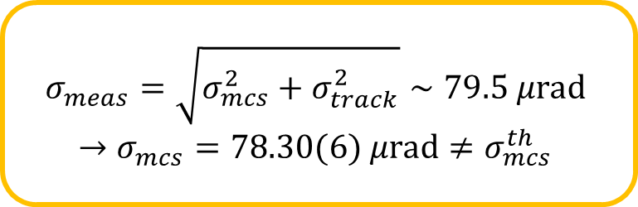
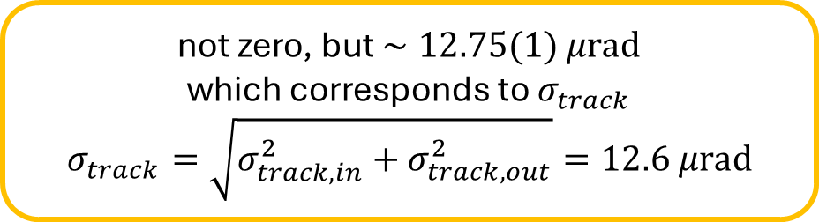

FIND THE CRYSTAL FOOTPRINT THROUGH SCATTERING
$${⟨θ}_{MCS}⟩=\frac{13.6 MeV}{βcp}z\sqrt{\frac{x}{X_{0}}}\left[1+0.038 ln\left(\frac{xz^{2}}{X_{0}β^{2}}\right)\right]=66.5 μrad$$
$$σ_{meas}=\sqrt{σ_{mcs}^{2}+σ_{track}^{2}}∼79.5 μrad$$
$$→σ_{mcs}=78.30(6) μrad≠σ_{mcs}^{th}$$
Jump = $66.6 μrad$
not zero, but $∼12.75(1) μrad$
which corresponds to $σ_{track}$
$$σ_{track}=\sqrt{σ_{track,in}^{2}+σ_{track,out}^{2}}=12.6 μrad$$

Slide 8
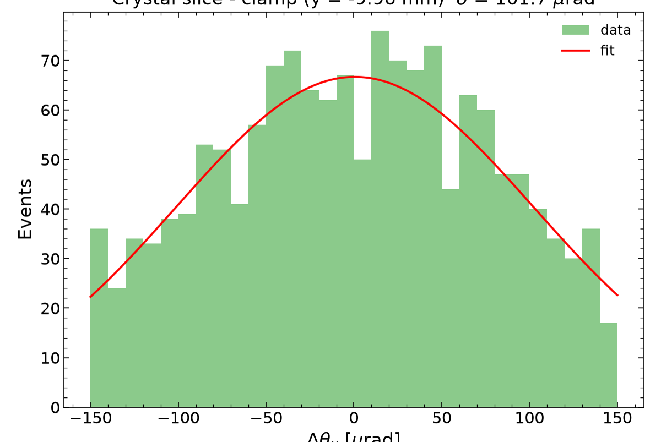
FIND THE CRYSTAL FOOTPRINT THROUGH SCATTERING
CLAMP?
OUTSIDE
INSIDE

Slide 9
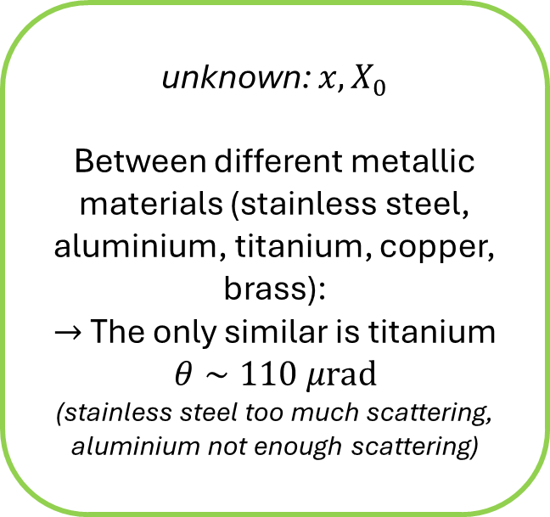
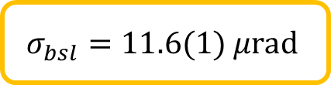
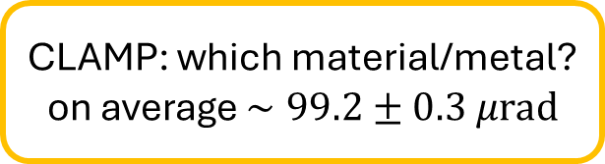

FIND THE CRYSTAL FOOTPRINT THROUGH SCATTERING
CLAMP: which material/metal?
on average $∼99.2±0.3 μrad$
unknown: $x, X_{0}$
Between different metallic materials (stainless steel, aluminium, titanium, copper, brass):
$→$ The only similar is titanium
$$θ∼110 μrad$$
(stainless steel too much scattering, aluminium not enough scattering)
$$σ_{mcs}=\sqrt{σ_{meas}^{2}−σ_{bsl}^{2}}=62.99(4) μrad$$
$$σ_{bsl}=11.6(1) μrad$$

Slide 10
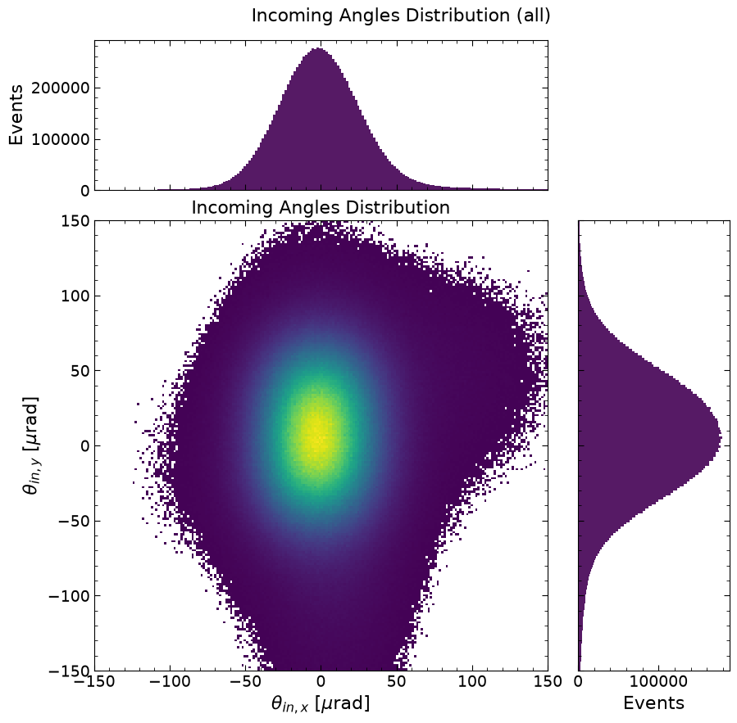
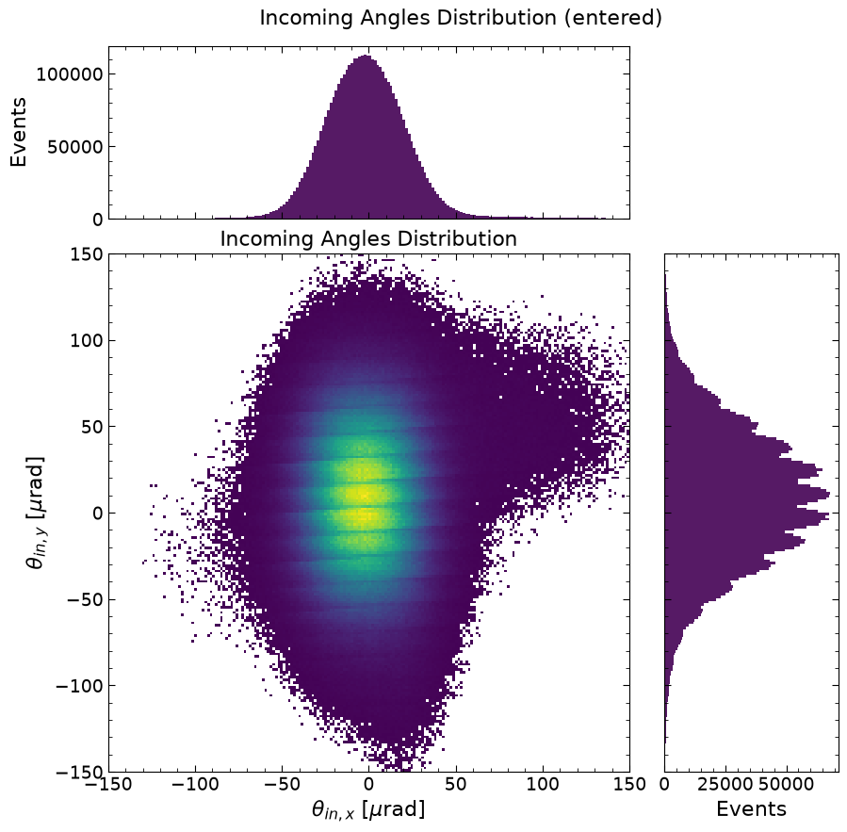
ANALYSIS OF THE BEAM DISTRIBUTION (REAL DATA)
Instrumentalartifact?
tracking system’s discretization effect: due to the discrete spatial resolution of the microstrip detectors
Notes:
assuming $x$ same as crystal:

Slide 11
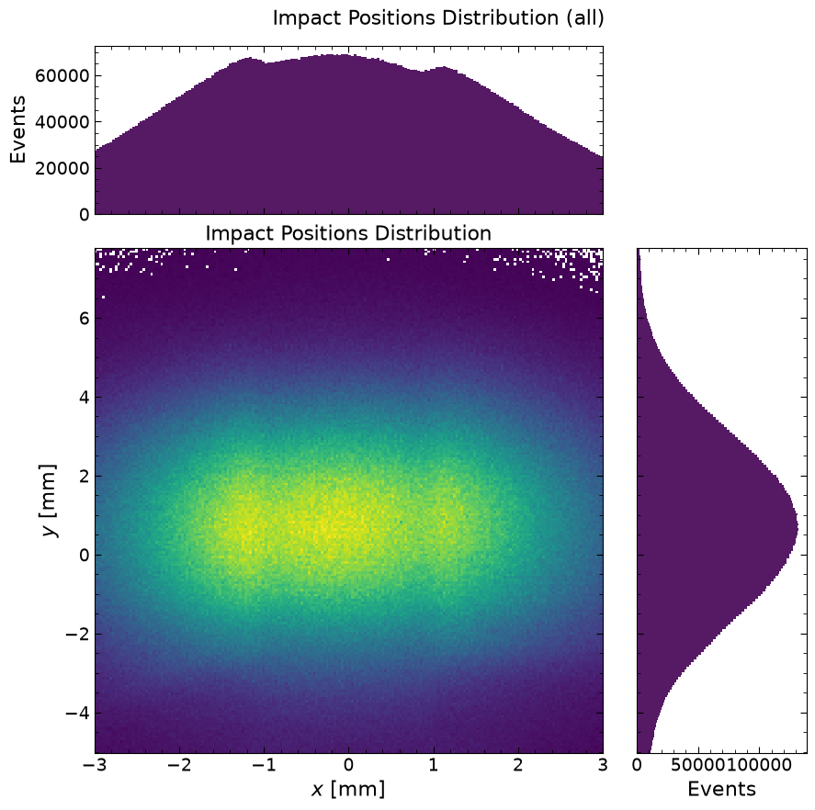
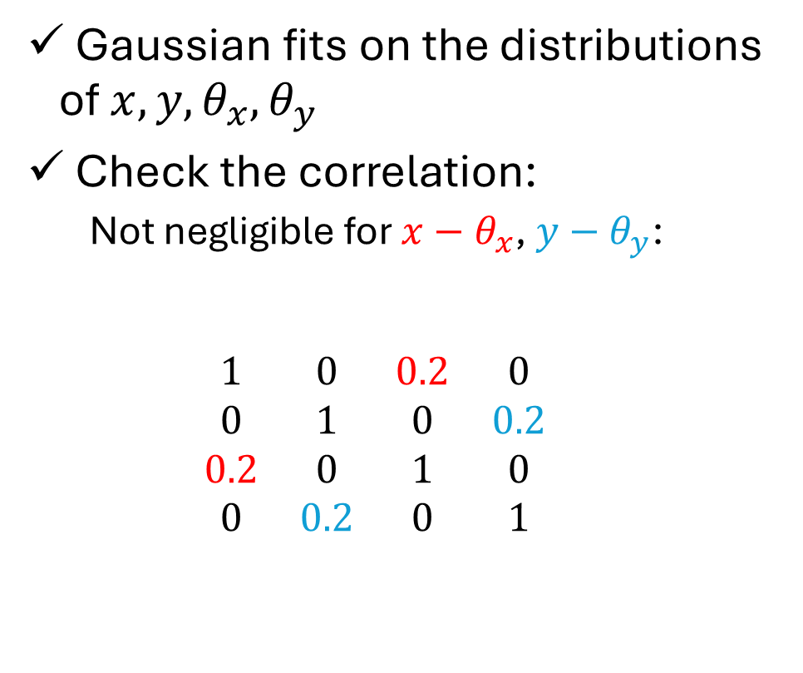


ANALYSIS OF THE BEAM DISTRIBUTION (REAL DATA)
Gaussian fits on the distributions of $x, y, θ_{x}, θ_{y}$
Check the correlation:
  Not negligible for $x−θ_{x}$, $y−θ_{y}$:
  $$\begin{matrix}1 & 0 & 0.2 & 0 \\ 0 & 1 & 0 & 0.2 \\ 0.2 & 0 & 1 & 0 \\ 0 & 0.2 & 0 & 1\end{matrix}$$
$$x y θ_{x} θ_{y}$$
$$x$$
$$y$$
$$θ_{x}$$
$$θ_{y}$$

Slide 12
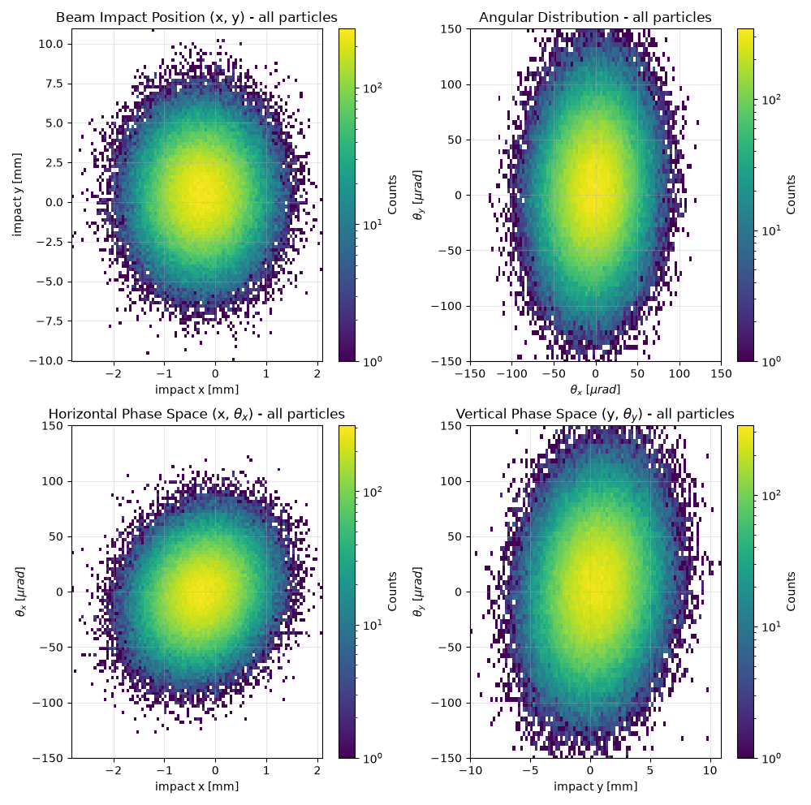
SIMULATING THE SHORT CRYSTAL
Fitting the 1d marginal distributions and then sampling them indipendently would not be correct if variables are uncorrelated.
Solution:
Using a multivariate random normal distribution (thanks to the covariance matrix reproduce the correlation)

Slide 13
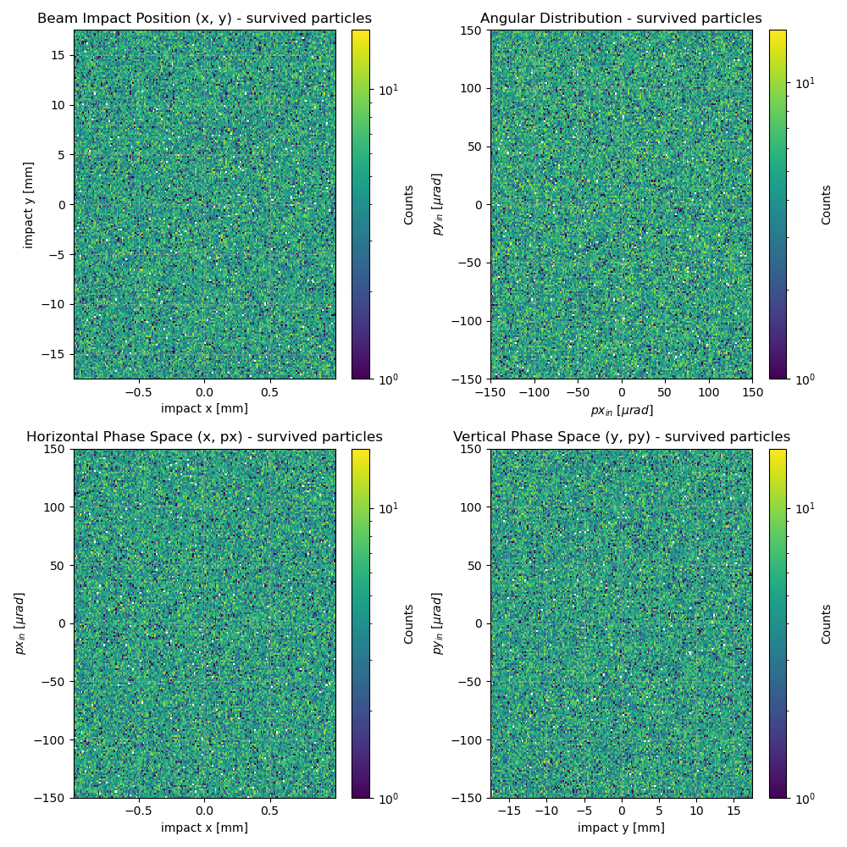
SIMULATING THE SHORT CRYSTAL
Before: normal distribution
Now: normal distribution

Slide 14
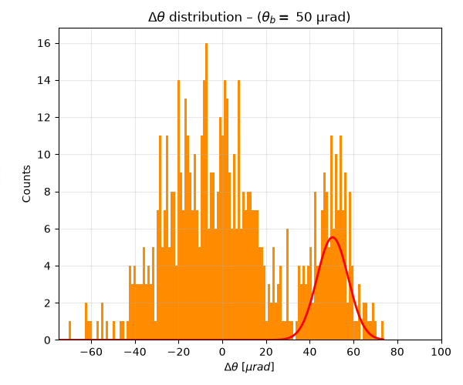
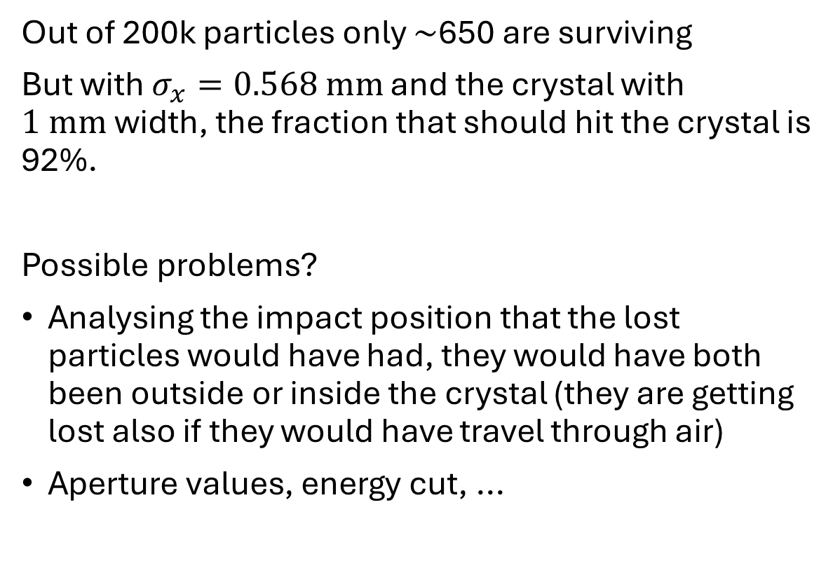
SIMULATING THE SHORT CRYSTAL
Out of 200k particles only $∼$650 are surviving
But with $σ_{x}=0.568 mm$ and the crystal with $1 mm$width, the fraction that should hit the crystal is 92%.
Possible problems?
Analysing the impact position that the lost particles would have had, they would have both been outside or inside the crystal (they are getting lost also if they would have travel through air)
Aperture values, energy cut, ...

Slide 15
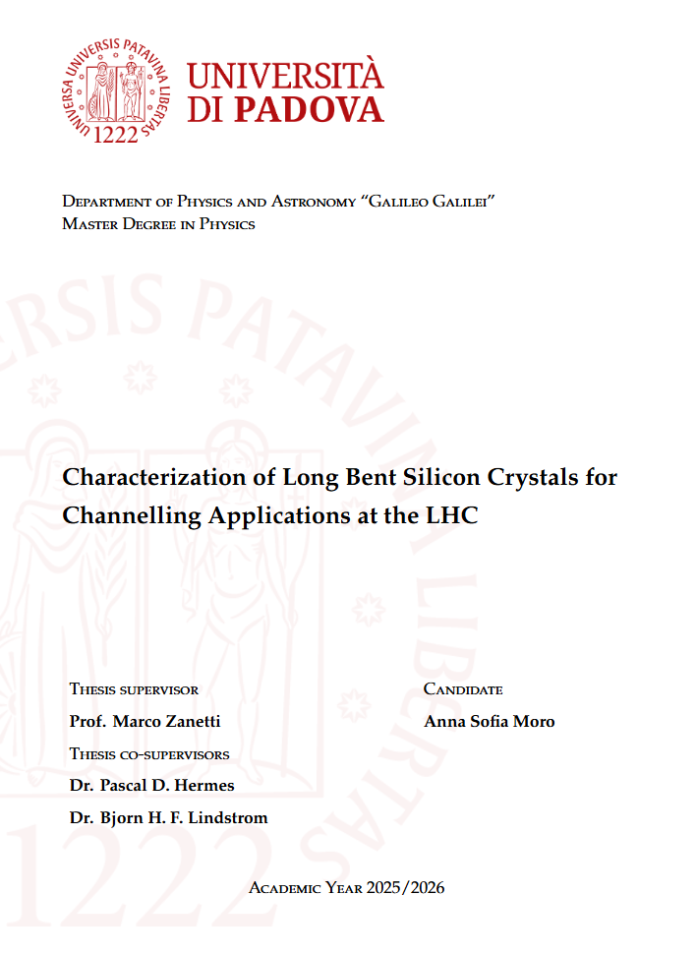
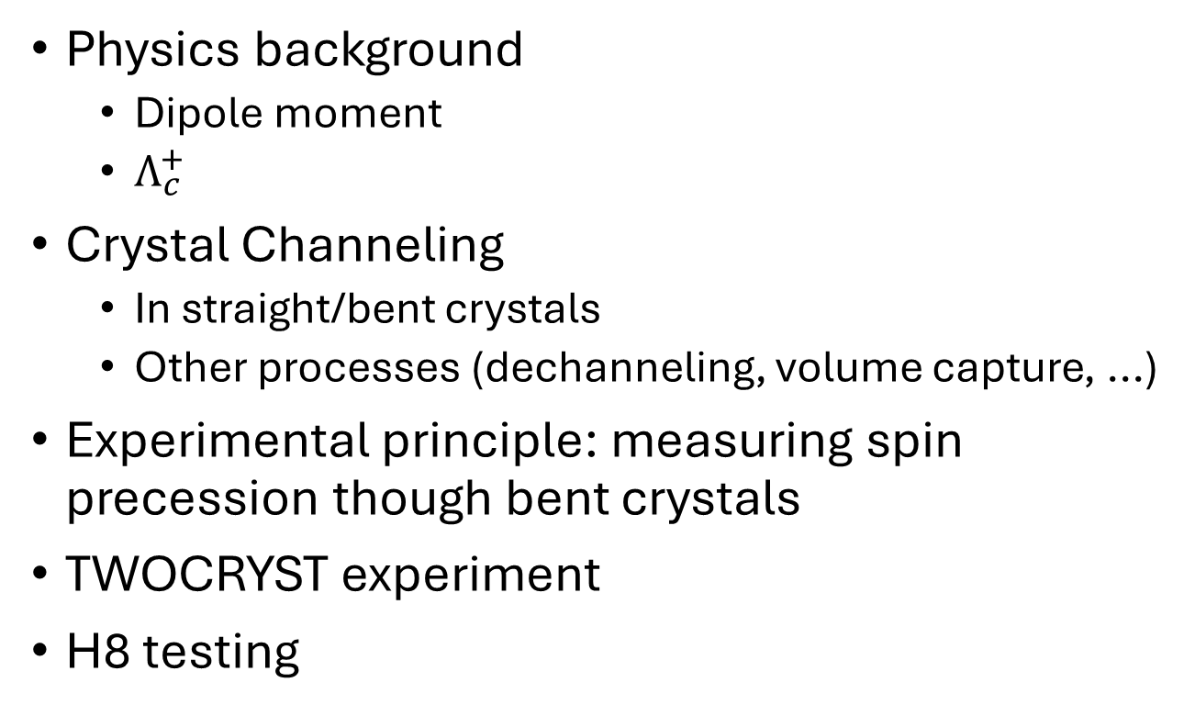
THESIS: PART I
Physics background
  Dipole moment
  $Λ_{c}^{+}$
Crystal Channeling
  In straight/bent crystals
  Other processes (dechanneling, volume capture, ...)
Experimental principle: measuring spin precession though bent crystals
TWOCRYST experiment
H8 testing

