Slide 1
CHARACTERIZATION OF CRYSTAL EFFICIENCY
2024 dataset
for TCCP and TCCPA
JULY 2026
ANNA SOFIA MORO

Slide 2
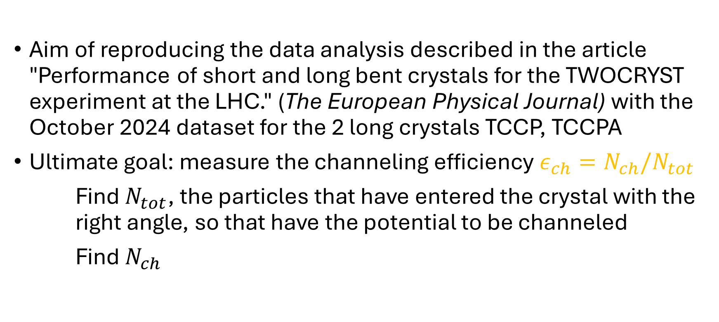
…
Aim of reproducing the data analysis described in the article "Performance of short and long bent crystals for the TWOCRYST experiment at the LHC." (The European Physical Journal) with the October 2024 dataset for the 2 long crystals TCCP, TCCPA
Ultimate goal: measure the channeling efficiency $ε_{ch}=N_{ch}/N_{tot}$
Find $N_{tot}$, the particles that have entered the crystal with the right angle, so that have the potential to be channeled
Find $N_{ch}$

Slide 3

FINDING $N_{tot}$
Filtering the data:
1. The particle produce a single track:
prevent from considering events from «pile-up effect», electronic noise and delta rays.
2. The beam profile is larger than the crystal. We must select only particles that physically enter the crystal area:
we need to know the position of the crystals with respect to the incoming flux of particles.
Notes:
the different orientations of the crystallographic planes along the crystal front surface influence the angular range in which particles can be channelled, i.e., the cut at $±1/2 θ_{L}$ may not be centred on zero,

Slide 4
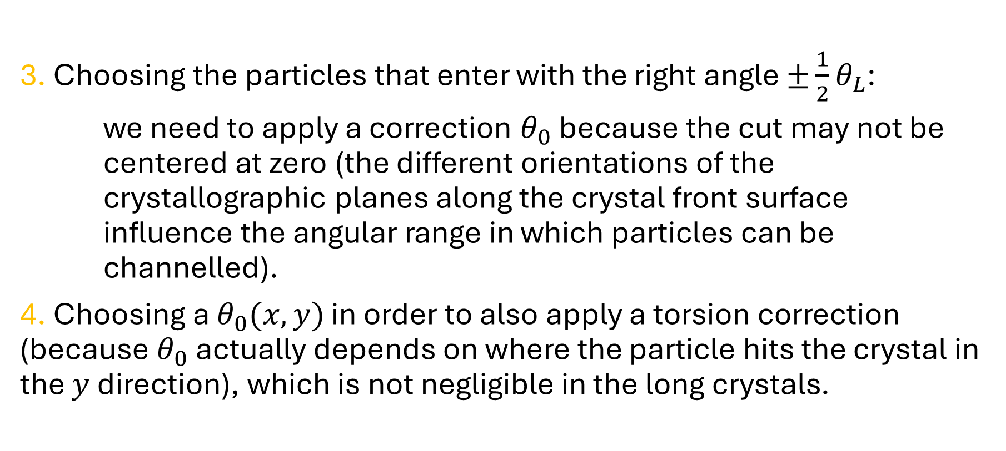
FINDING $N_{tot}$
3. Choosing the particles that enter with the right angle $±\frac{1}{2}θ_{L}$:
we need to apply a correction $θ_{0}$ because the cut may not be centered at zero (the different orientations of the crystallographic planes along the crystal front surface influence the angular range in which particles can be channelled).
4. Choosing a $θ_{0}(x,y)$ in order to also apply a torsion correction (because $θ_{0}$ actually depends on where the particle hits the crystal in the $y$ direction), which is not negligible in the long crystals.

Slide 5
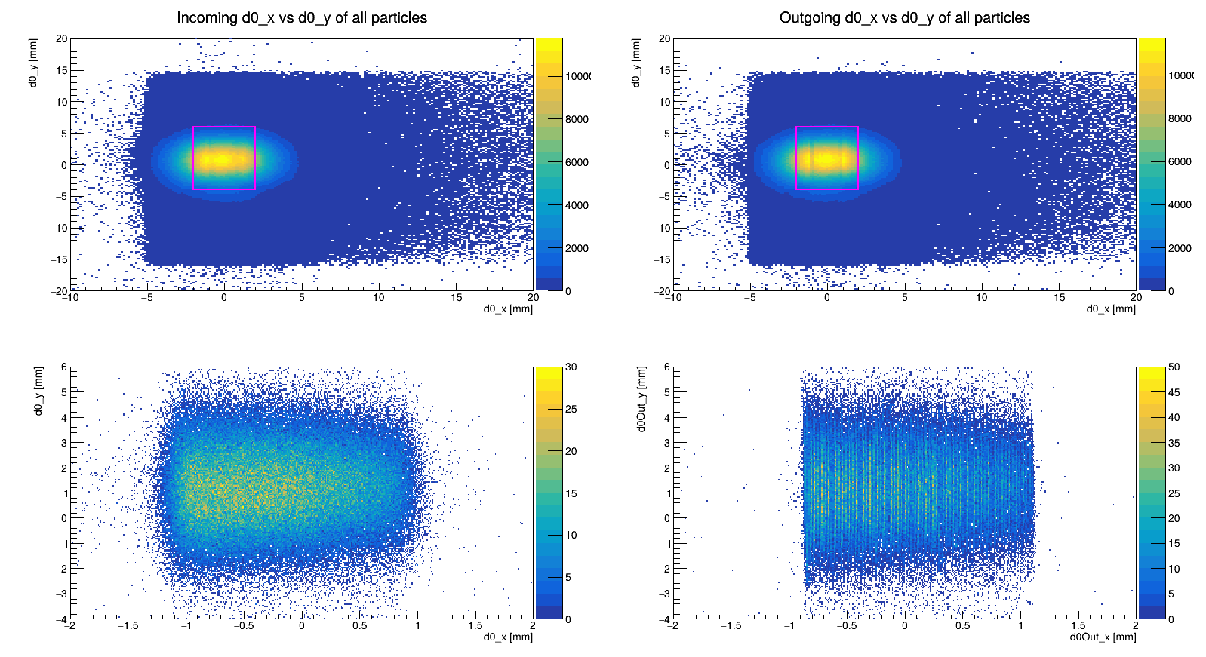
FILTER 2: SPATIAL CUT
To select the particles that actually enter the crystal we first need to know the position of the crystal with respect to the beam of particles.
Incoming and outgoing streams of particles:
We then look at channeled particles only using a preliminary deflection cut. Their impact points reveal the crystal's physical location.

Slide 6
FILTER 2: SPATIAL CUT

Slide 7

FILTER 2: SPATIAL CUT
We notice that the position in the beam of the channeled particles has the dimension of the crystal (2mm x 8mm).
To find the edges along $x$ (that have an asymmetrical distribution) we perform a «sliding window» method (fixed width & precision of 0.01mm), aiming for the position that maximize the number of particles inside.

Slide 8
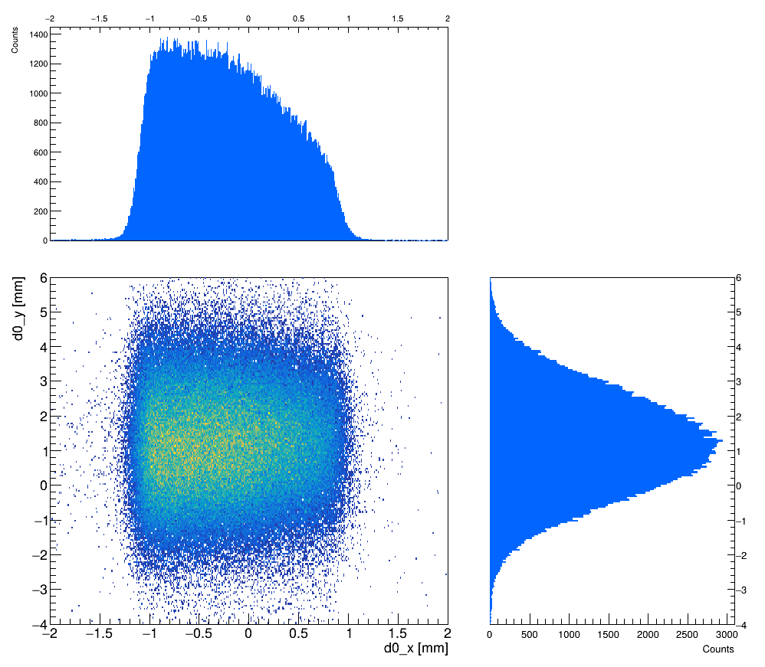
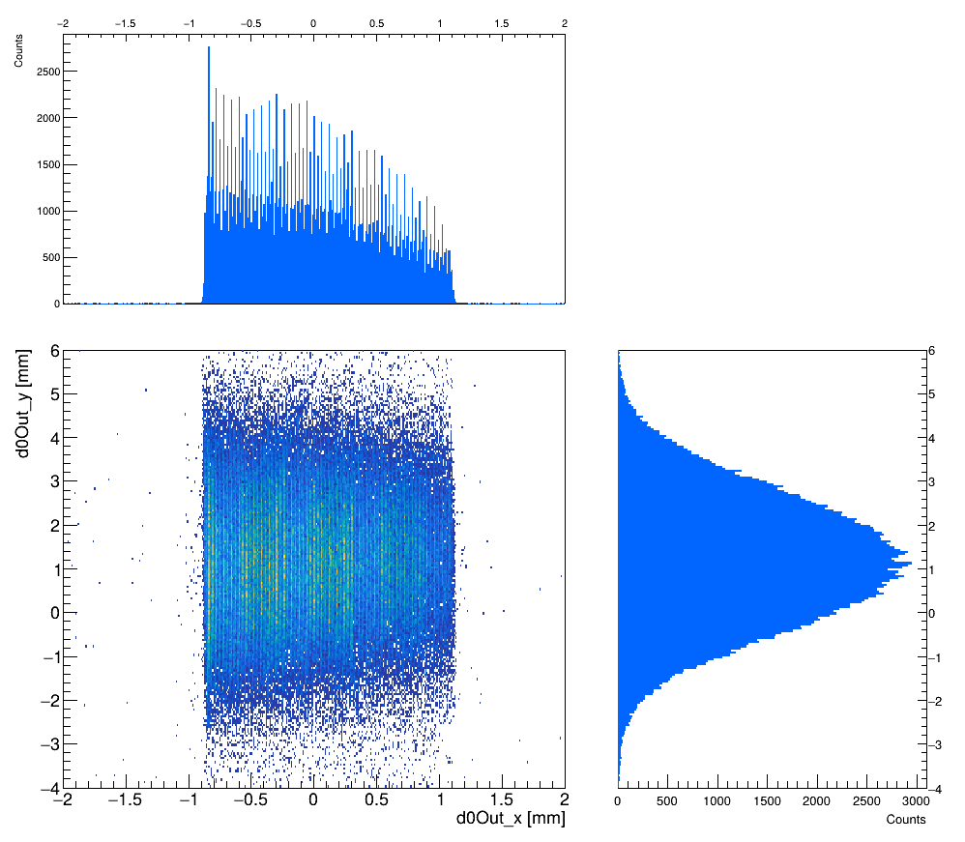
FILTER 2: SPATIAL CUT
The sliding window method was performed on the outgoing distribution, since presents more defined edges.
INCOMING BEAM
OUTGOING BEAM

Slide 9

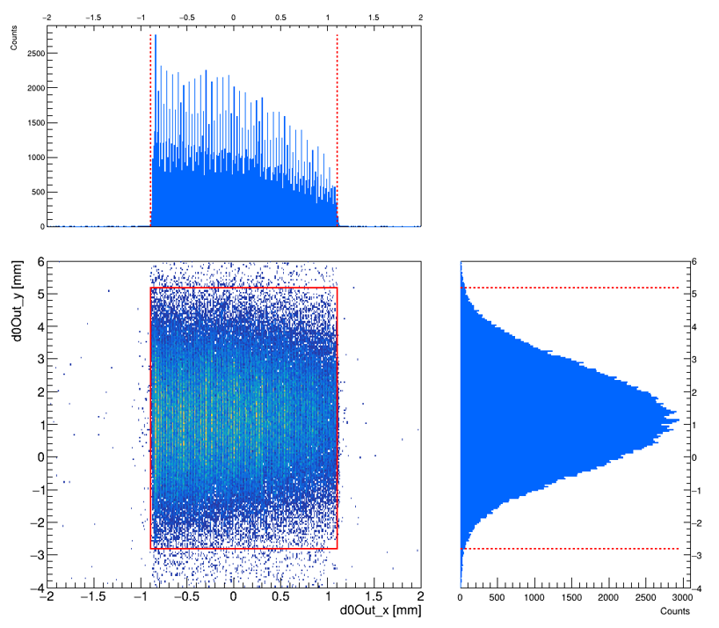
FILTER 2: SPATIAL CUT
INCOMING BEAM
OUTGOING BEAM

Slide 10
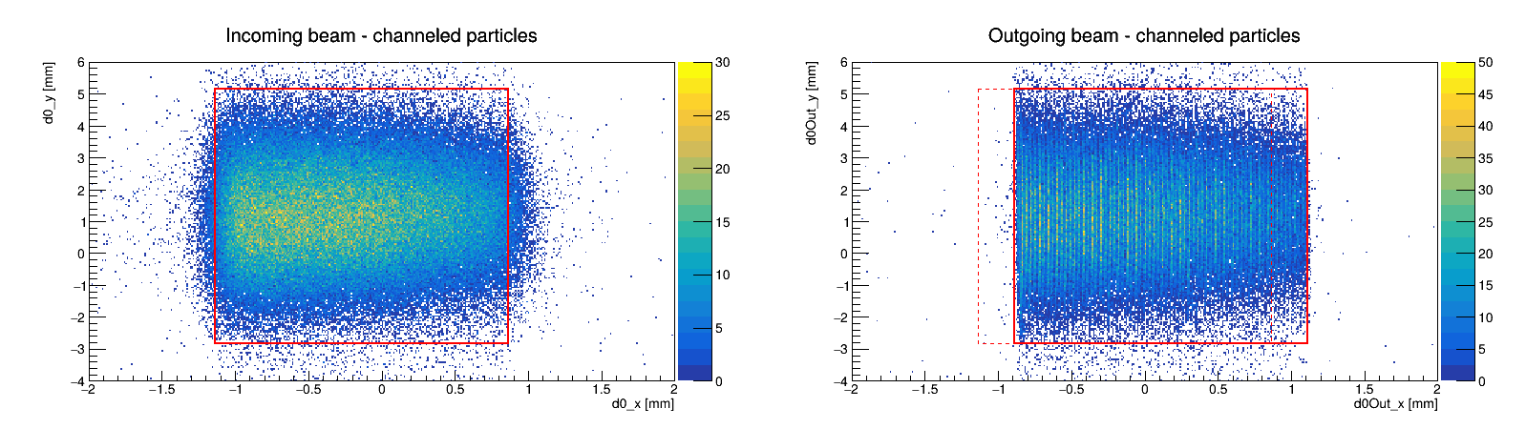

FILTER 2: SPATIAL CUT
Due to the drift of the channeled particles the window is shifted of $∼0.24$ mm.
This value was found empirically! To make the computation more accurate we need the distance between the detectors (for example).

Slide 11
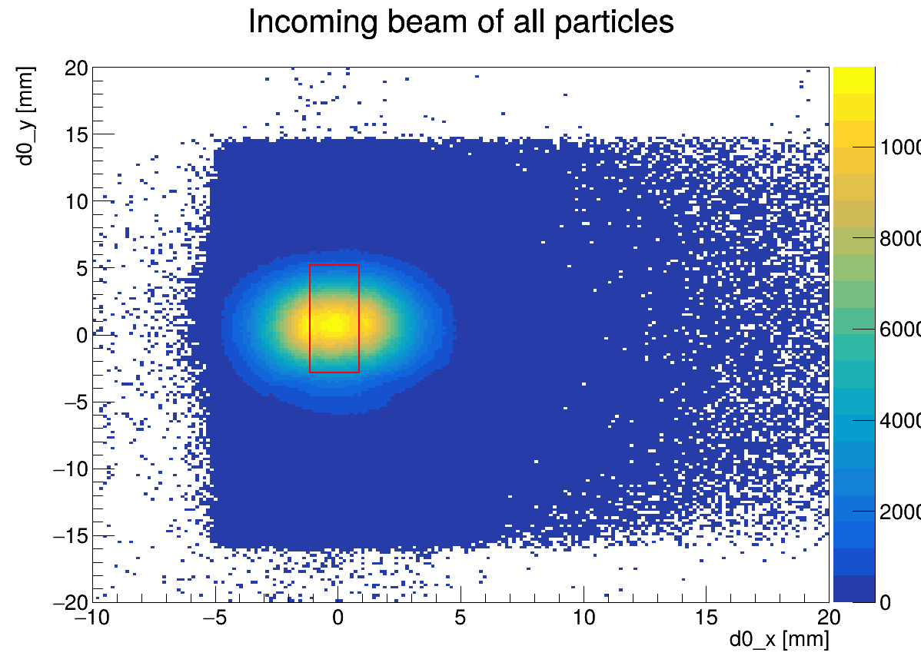
FILTER 2: SPATIAL CUT
This 2D beam profile (d0_{x} vs d0_{y}) shows the selected crystal area in red. This spatial filter ensures we only analyze particles with correct impact parameters.
Notes:
This 2D beam profile (d0_{x} vs d0_{y}) shows the selected crystal area in red. This spatial filter ensures we only analyze particles with correct impact parameters.

Slide 12
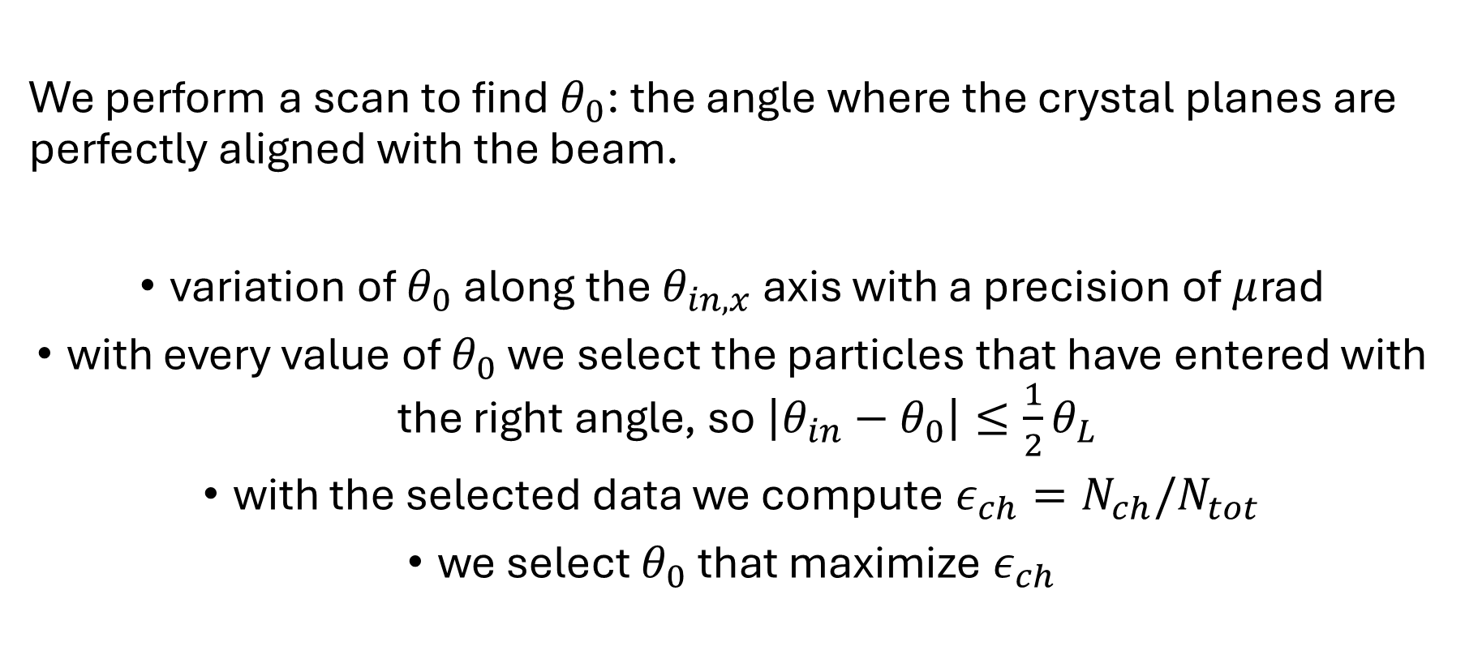
FILTER 3: ANGULAR SELECTION
We perform a scan to find $θ_{0}$: the angle where the crystal planes are perfectly aligned with the beam.
variation of $θ_{0}$ along the $θ_{in,x}$ axis with a precision of $μ$rad
with every value of $θ_{0}$ we select the particles that have entered with the right angle, so $\left|θ_{in}−θ_{0}\right|≤\frac{1}{2}θ_{L}$
with the selected data we compute $ε_{ch}=N_{ch}/N_{tot}$
we select $θ_{0}$ that maximize $ε_{ch}$

Slide 13


FILTER 3: ANGULAR SELECTION
The efficiency vs incident angle profile is is fitted with a Gaussian function. This identifies the mean $θ_{0}$ with high precision.

Slide 14


FILTER 3: ANGULAR SELECTION
$±\frac{1}{2}θ_{L}$ cut

Slide 15

FILTER 3: ANGULAR SELECTION
$±\frac{1}{2}θ_{L}$ cut
next step: instead of a flat cut, we upgrade to:
$$\left|θ_{in,x}−\left(θ_{0}+τ_{y}∗d0_{y}\right)\right|<\frac{1}{2}θ_{L}$$

Slide 16
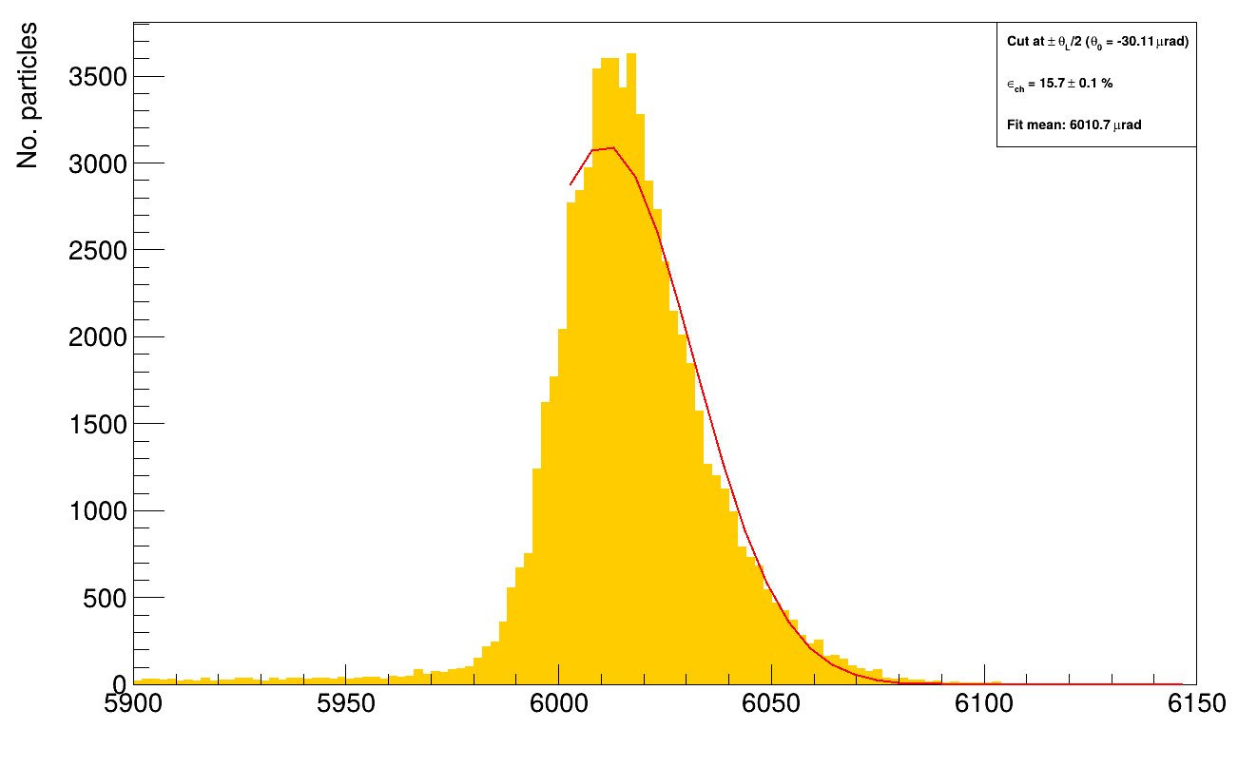
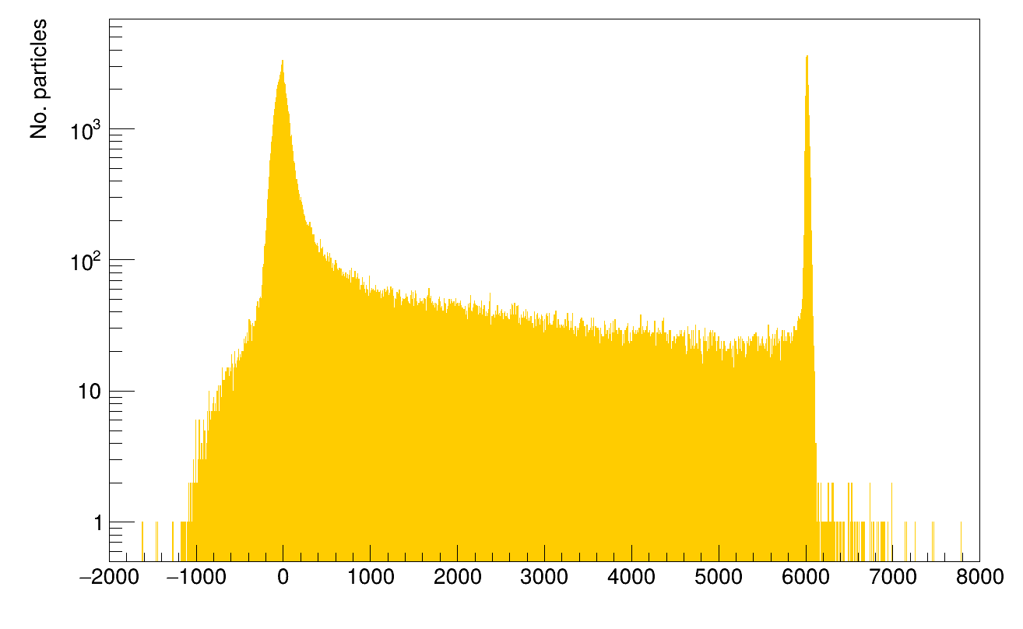
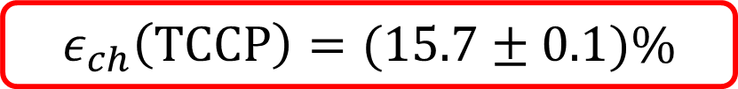
MEASUREMENT EXTRACTION
A Gaussian fit is performed on the deflection peak. We fit the right side of the peak to ensure the cleanest measurement.
$$ε_{ch}\left(TCCP\right)=(15.7±0.1)\%$$

Slide 17
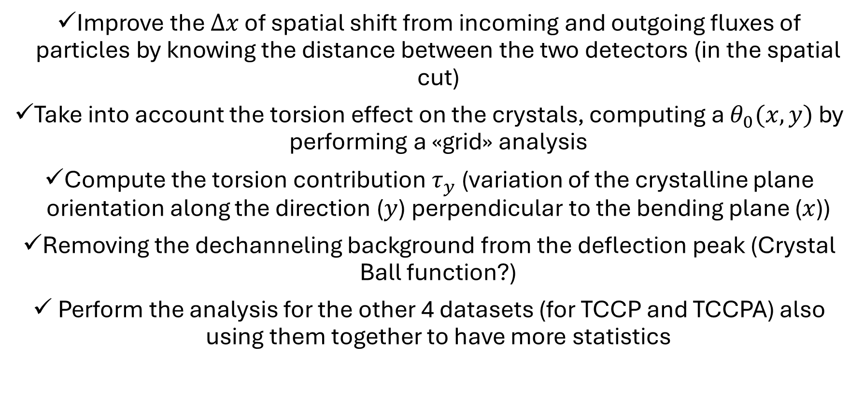
TO DO
Improve the $Δx$ of spatial shift from incoming and outgoing fluxes of particles by knowing the distance between the two detectors (in the spatial cut)
Take into account the torsion effect on the crystals, computing a $θ_{0}(x,y)$ by performing a «grid» analysis
Compute the torsion contribution $τ_{y}$ (variation of the crystalline plane orientation along the direction ($y$) perpendicular to the bending plane ($x$))
Removing the dechanneling background from the deflection peak (Crystal Ball function?)
Perform the analysis for the other 4 datasets (for TCCP and TCCPA) also using them together to have more statistics

