Slide 1
OCTOBER 2026 UPDATE
ANNA SOFIA MORO

Slide 2
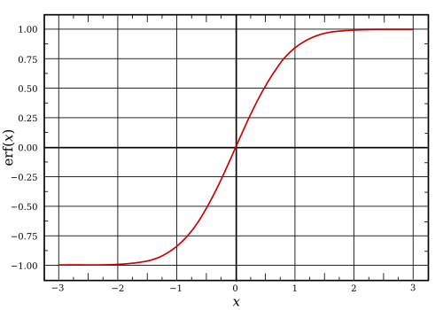
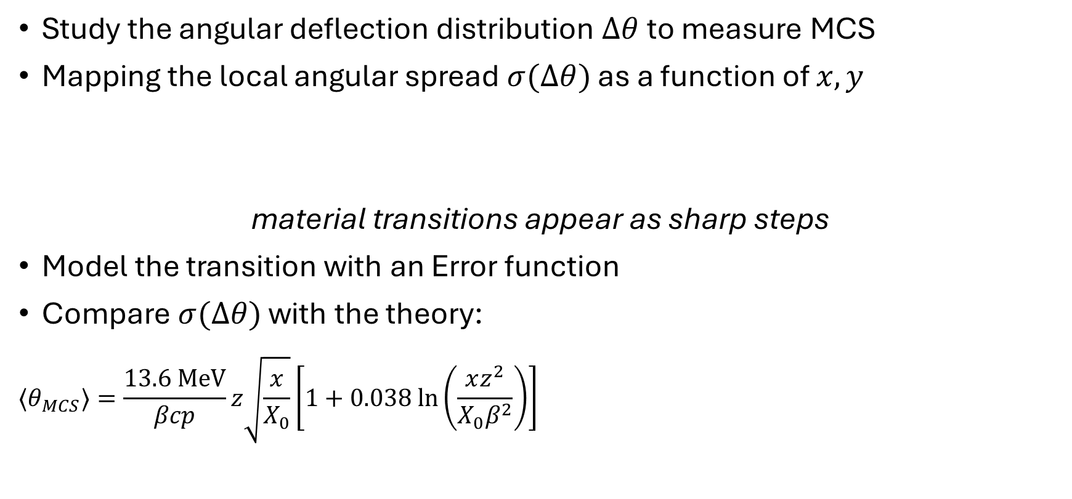
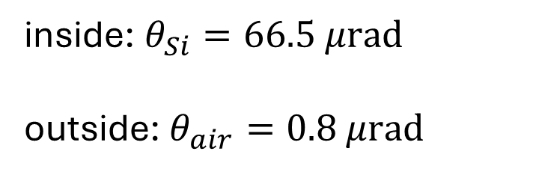
ABOUT MULTIPLE COULOMB SCATTERING
Study the angular deflection distribution $Δθ$ to measure MCS
Mapping the local angular spread $σ(Δθ)$ as a function of $x,y$
material transitions appear as sharp steps
Model the transition with an Error function
Compare $σ(Δθ)$ with the theory:
$${⟨θ}_{MCS}⟩=\frac{13.6 MeV}{βcp}z\sqrt{\frac{x}{X_{0}}}\left[1+0.038 ln\left(\frac{xz^{2}}{X_{0}β^{2}}\right)\right]$$
what to expect?
inside: $θ_{Si}=66.5 μrad$
outside: $θ_{air}=0.8 μrad$

Slide 3
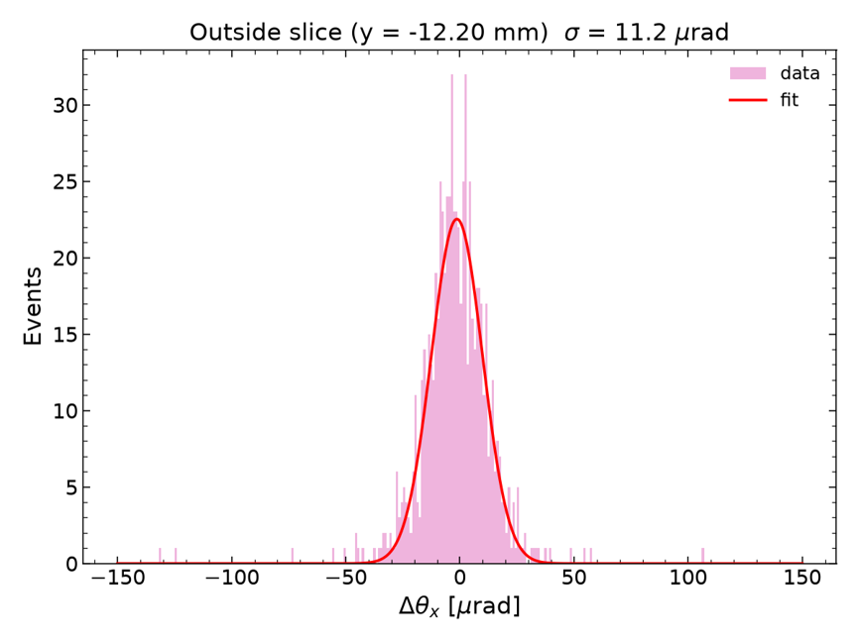





METHOD
Divided the crystal into slices along $x$ and $y$
Width of the angular distribution $σ$ for each slice
  I always expect a distribution centered at zero
  Gaussian fit within $μ±2.5σ$
  The measured width also accounts for the tracker uncertainty of 12 𝜇rad.
CRYSTAL
$$y$$
CRYSTAL
$$y$$
$$x$$
$$x$$
example of slice
outside the crystal

Slide 4
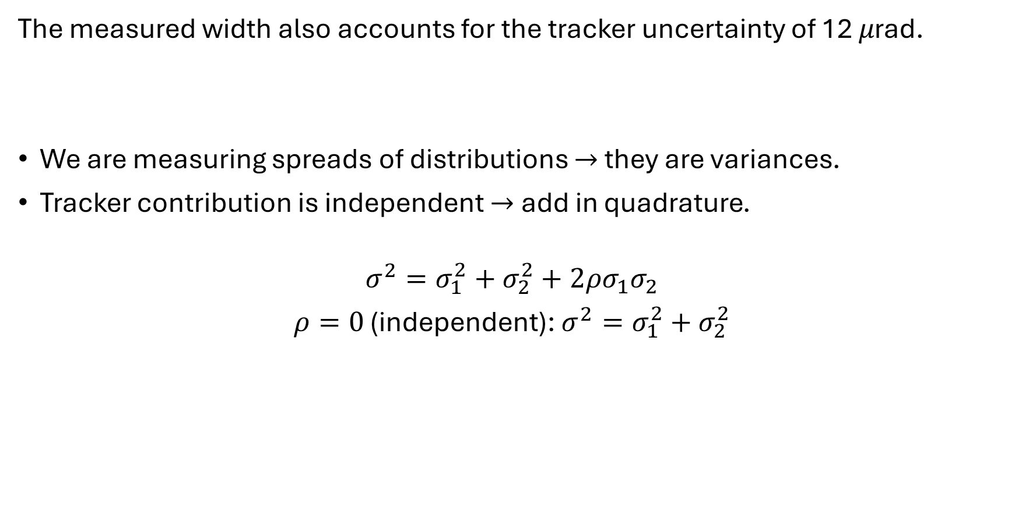
METHOD
The measured width also accounts for the tracker uncertainty of 12 𝜇rad.
We are measuring spreads of distributions $→$ they are variances.
Tracker contribution is independent $→$ add in quadrature.
$$σ^{2}=σ_{1}^{2}+σ_{2}^{2}+2ρσ_{1}σ_{2}$$
$ρ=0$ (independent): $σ^{2}=σ_{1}^{2}+σ_{2}^{2}$
how to take it into account?

Slide 5
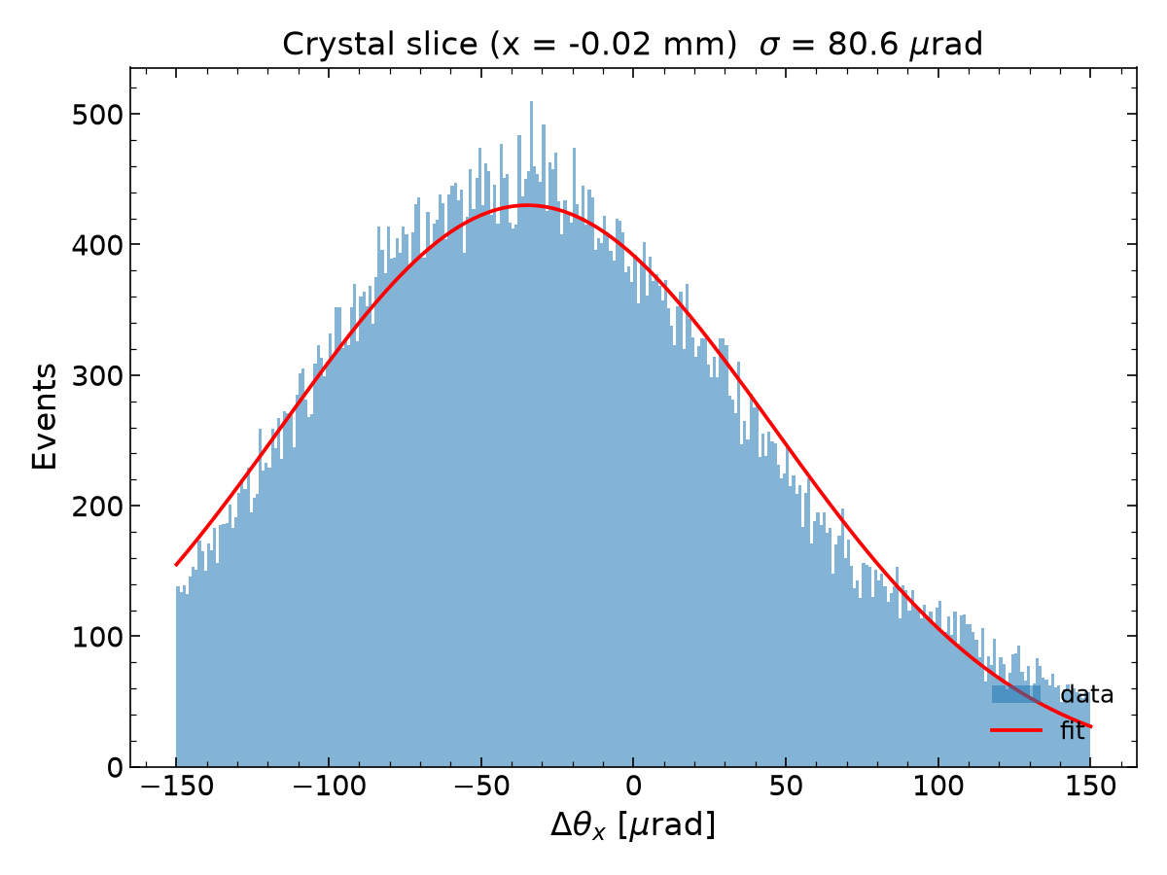
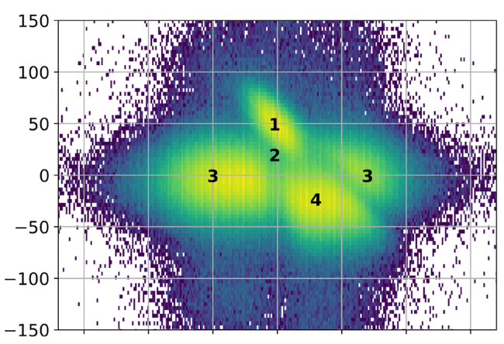
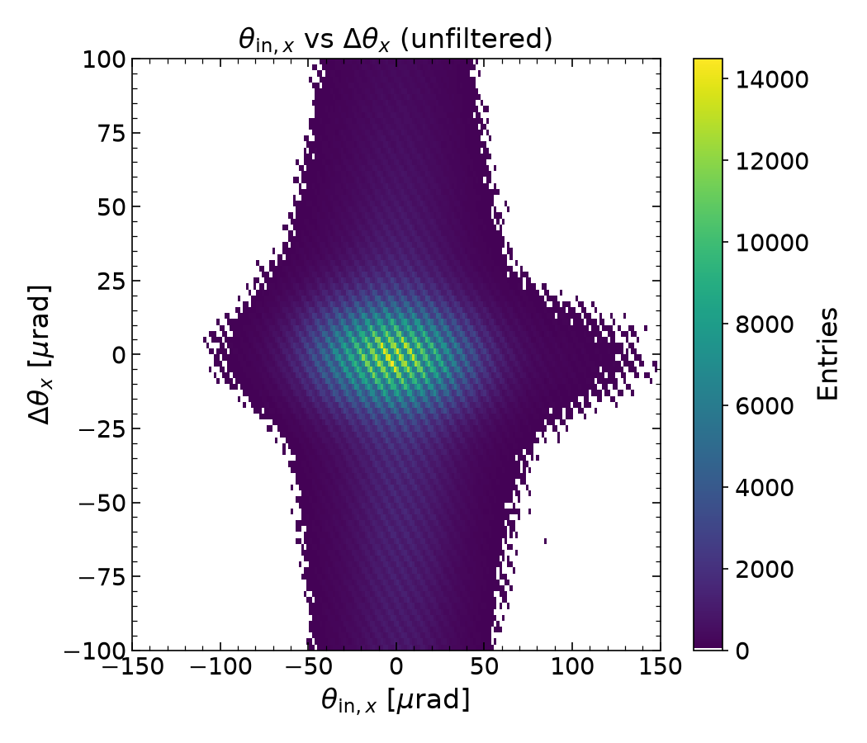

METHOD
Problem: distribution not centered at zero and $σ_{meas}≫σ_{mcs}^{th}$
  Unreliable results
filter on the incoming angle?
  In short crystals we are able to indentify and filter the regions
Solution: use only $Δθ_{y}$ instead of $Δθ_{x}$ to have pure MCS (isotropic)
Not in long
crystals!

Slide 6
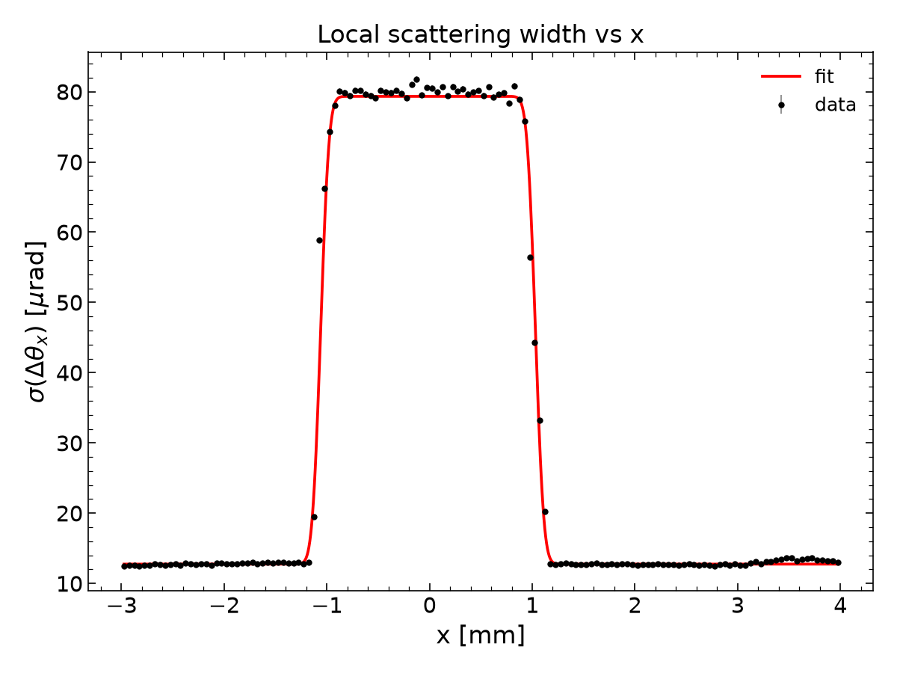
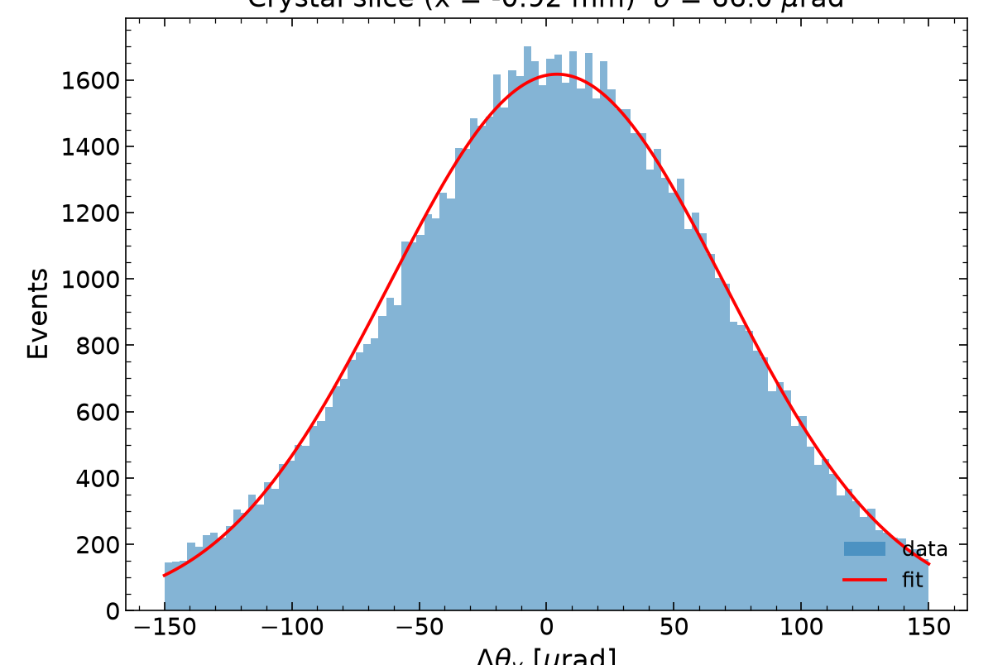
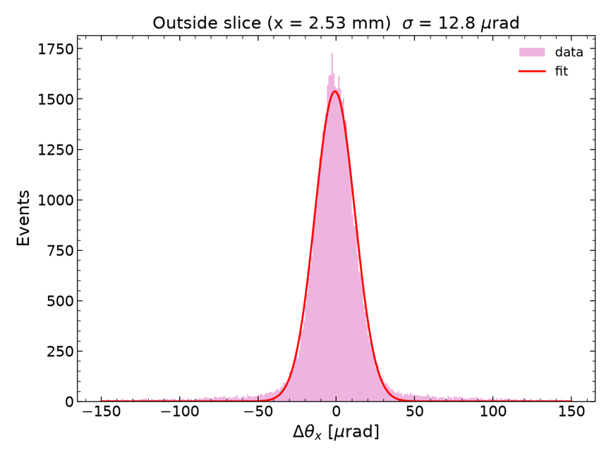
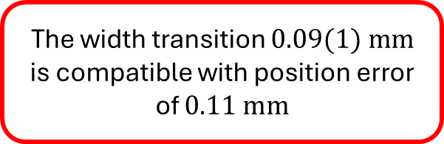

RESULTS ALONG $x$
The window @ half height
$$2.09±0.01$$
INSIDE
OUTSIDE
The width transition $0.09(1) mm$ is compatible with position error of $0.11 mm$

Slide 7
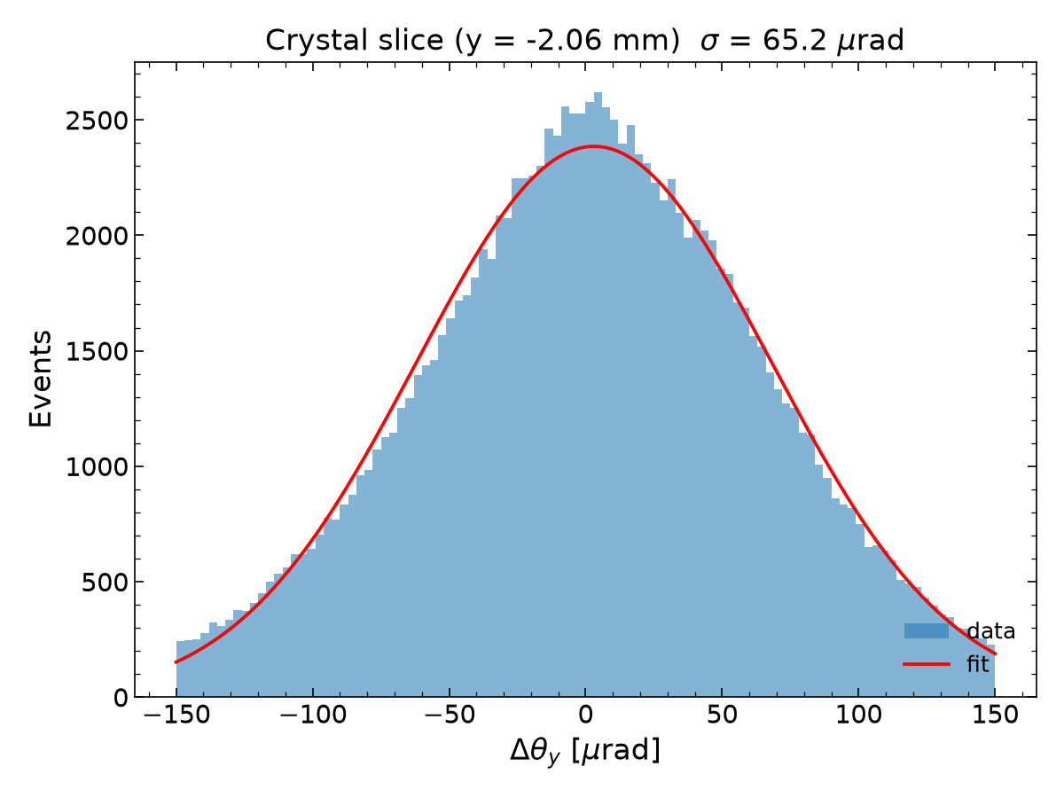
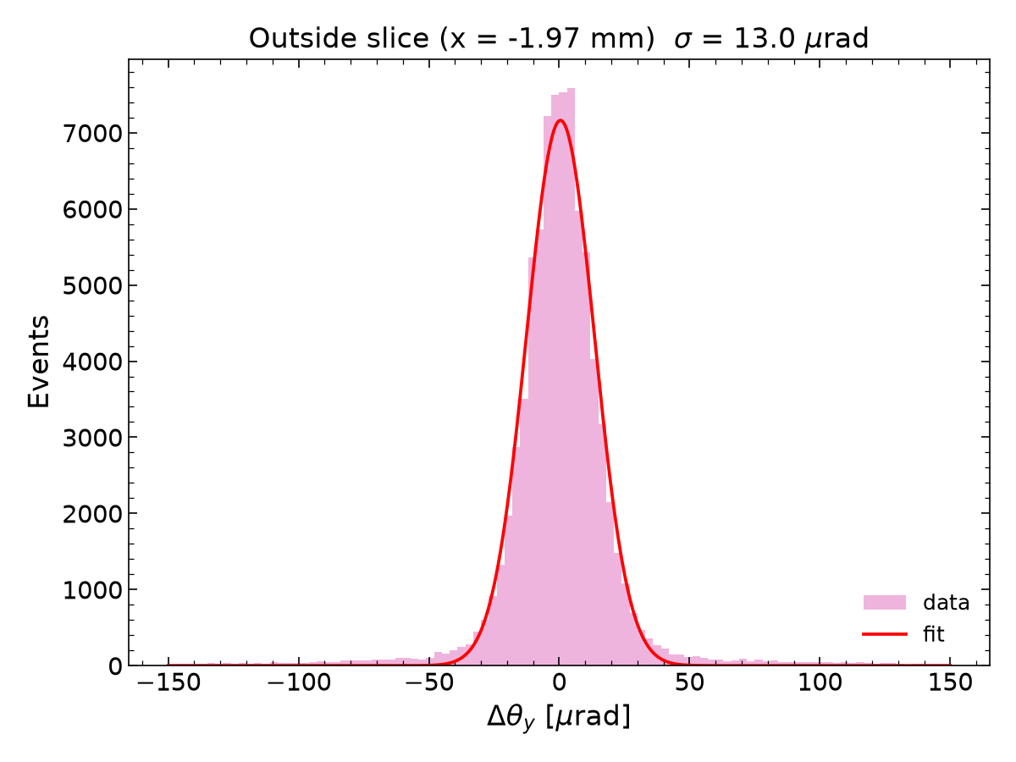
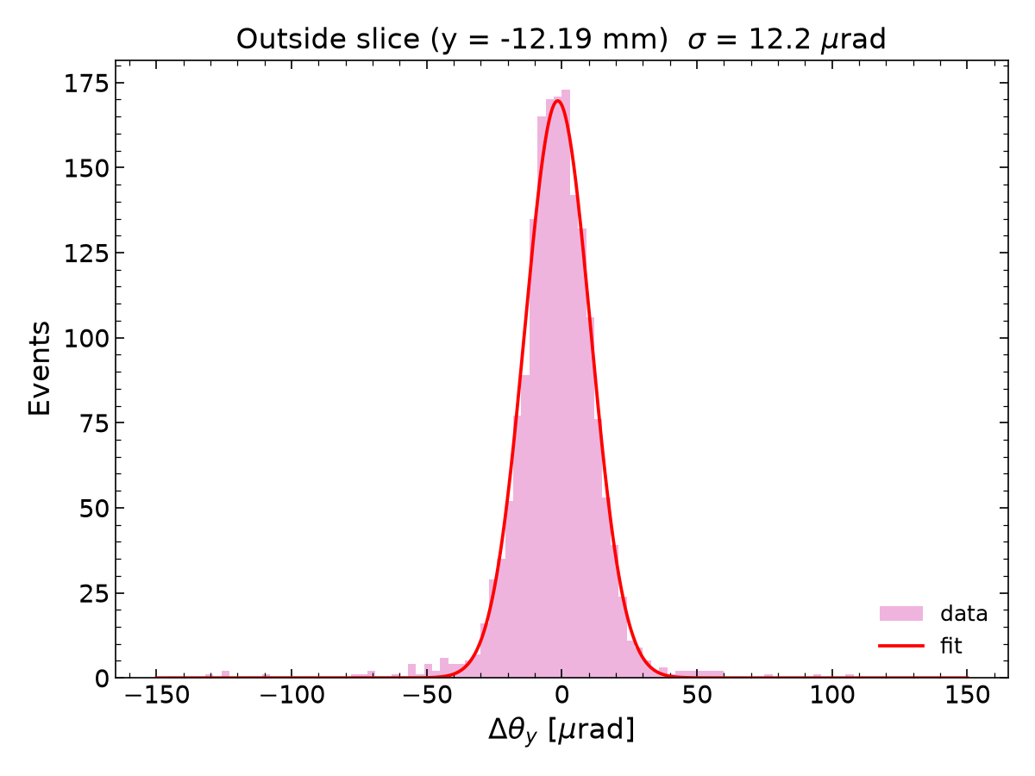






RESULTS
INSIDE
$$θ_{MCS}^{th}=66.5 μrad$$
$$σ_{meas}=\sqrt{σ_{mcs}^{2}+σ_{tracker}^{2}}$$
$$θ_{MCS}^{meas}=\sqrt{σ_{fit}^{2}−σ_{tracker}^{2}}=65 μrad$$
OUTSIDE
$$θ_{MCS}^{th}=0.8 μrad$$
$$σ_{meas}=\sqrt{σ_{air}^{2}+σ_{track}^{2}}$$
$$θ_{MCS}^{meas}=\sqrt{σ_{fit}^{2}−σ_{tracker}^{2}}=1 μrad$$
$$x$$
$$y$$
$$x$$
$$y$$

Slide 8
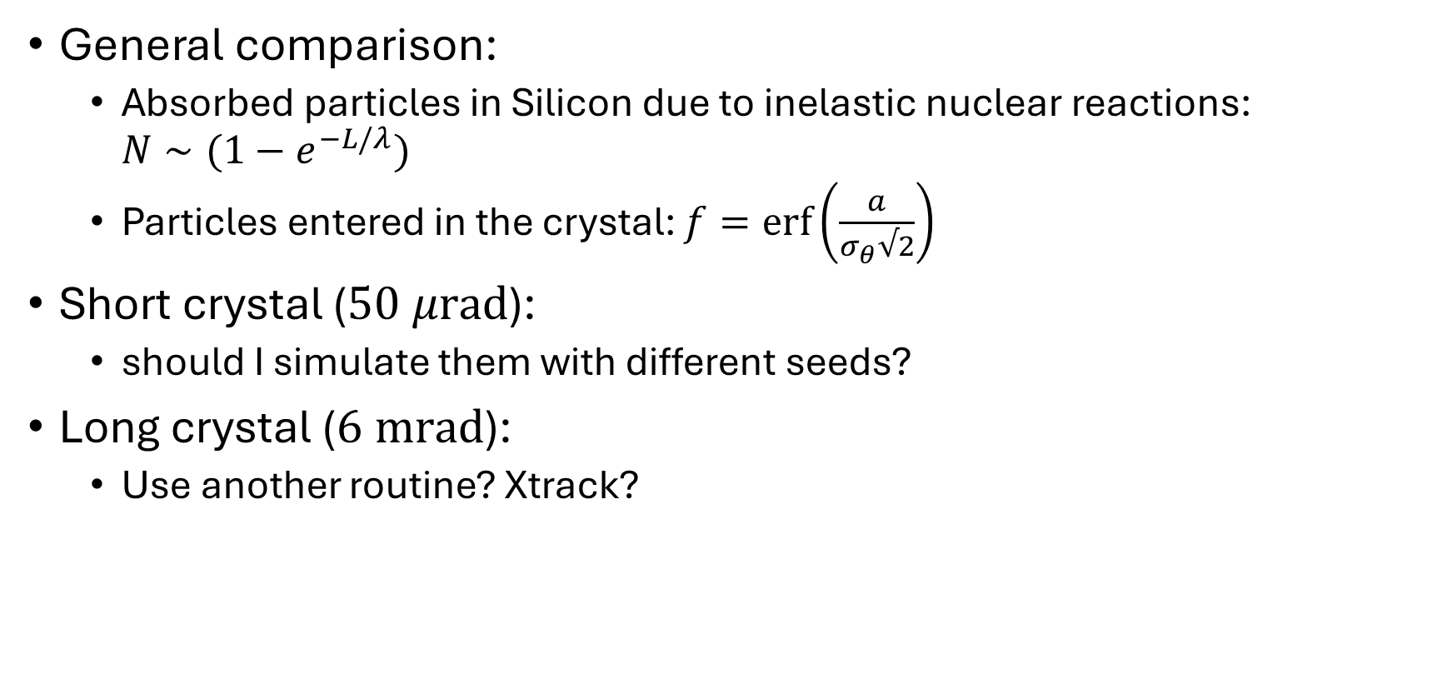
ABOUT THE SIMULATIONS
General comparison:
  Absorbed particles in Silicon due to inelastic nuclear reactions: $N∼(1−e^{−L/λ})$
  Particles entered in the crystal: $f=\operatorname{erf}\left(\frac{a}{σ_{θ}√2}\right)$
Short crystal ($50 μrad$):
  should I simulate them with different seeds?
Long crystal ($6 mrad$):
  Use another routine? Xtrack?

Slide 9
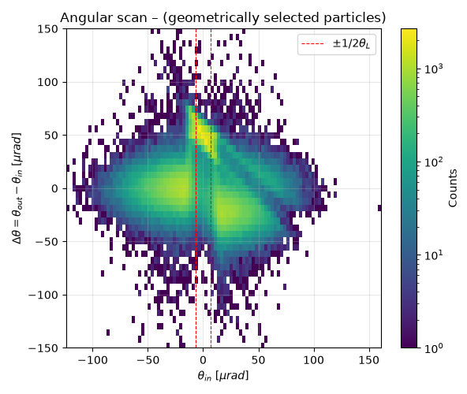
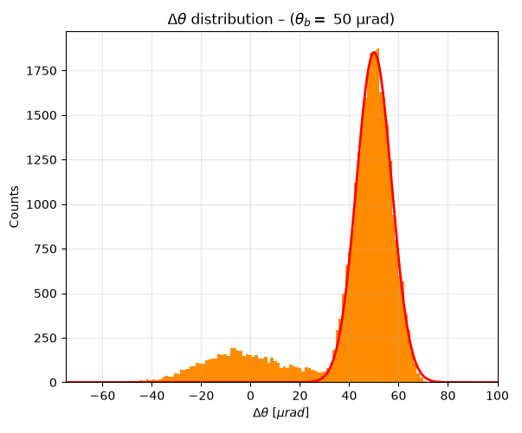
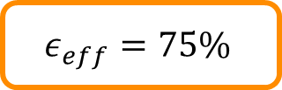
SIMULATING THE SHORT CRYSTAL
$$ε_{eff}=75\%$$
CH
DCH
AM
AM
VR

Slide 10
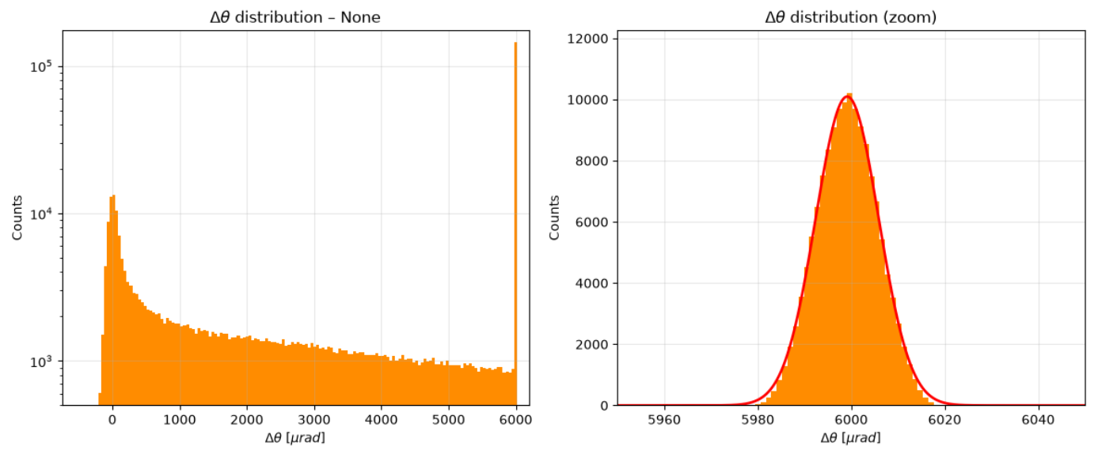
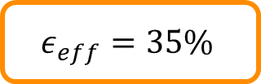
SIMULATING THE LONG CRYSTAL
$$ε_{eff}=35\%$$

Slide 11
BACKUP

Slide 12
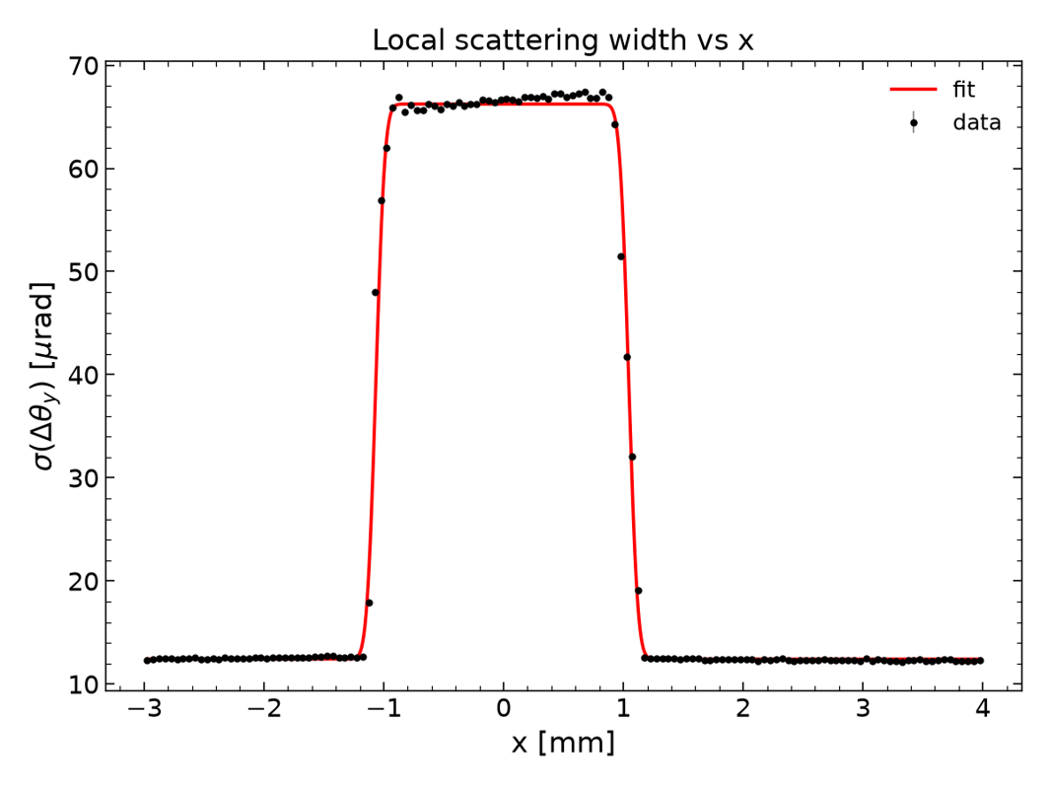
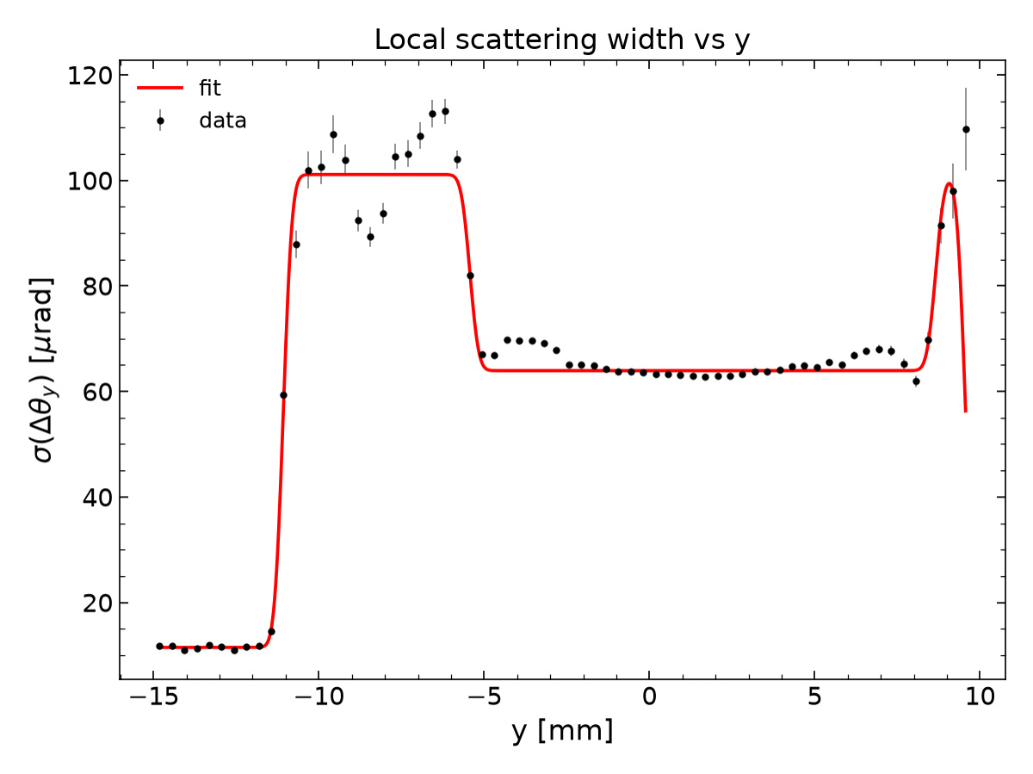


RESULTS
$$y$$
$$x$$

Slide 13

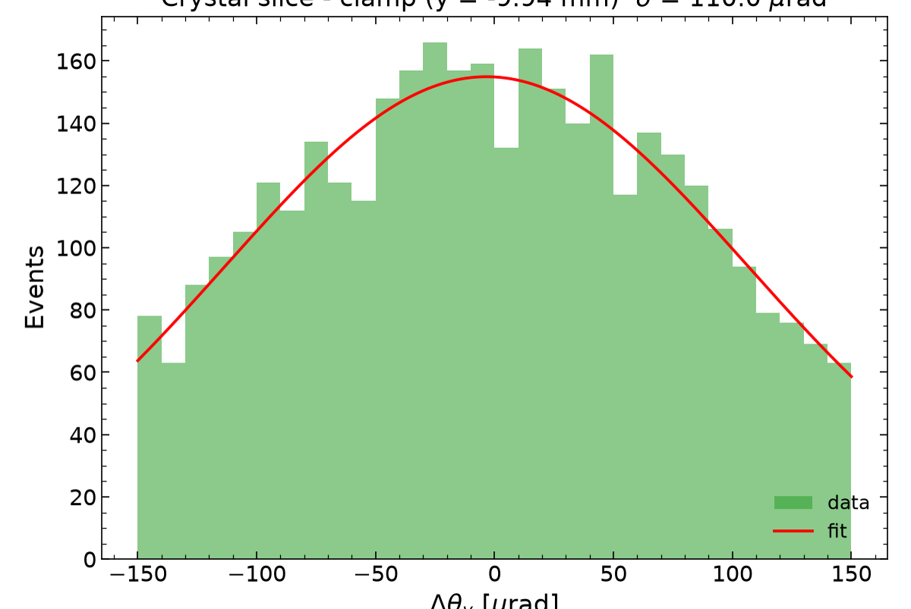
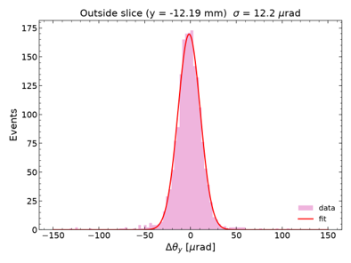

RESULTS
CLAMP?
OUTSIDE
INSIDE

