Slide 1
NOVEMBER 2026 UPDATE
ANNA SOFIA MORO

Slide 2
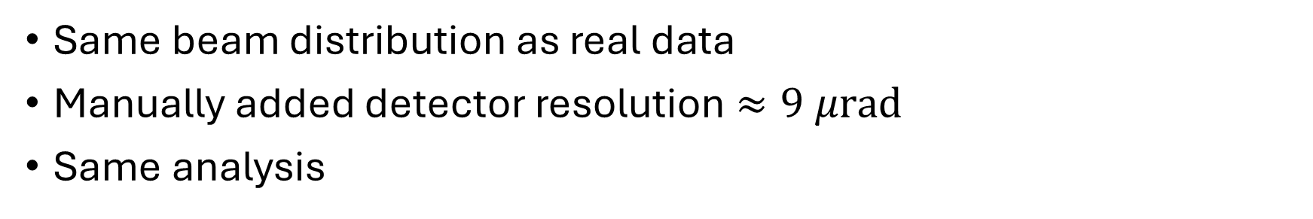
SIMULATIONS
 | BDSIM (GEANT4) | XCOLL (XSUITE)
SHORT CRYSTAL
LONG CRYSTAL
Compare crystal – different routines
Compare crystal – different routines and data
Same beam distribution as real data
Manually added detector resolution $≈9 μrad$
Same analysis

Slide 3
1) BDSIM – SHORT CRYSTAL

Slide 4
2) XCOLL – SHORT CRYSTAL

Slide 5
3) BDSIM – LONG CRYSTAL

Slide 6
4) XCOLL – LONG CRYSTAL

Slide 7
SIMULATIONS
 | BDSIM (GEANT4) | XCOLL (XSUITE)
SHORT CRYSTAL
LONG CRYSTAL

Slide 8
BACKUP

