Slide 1
Characterization of Long Bent Silicon Crystals for Channelling Applications at the LHC
Thesis Project
ANNA SOFIA MORO
Update 24 August 2026

Slide 2
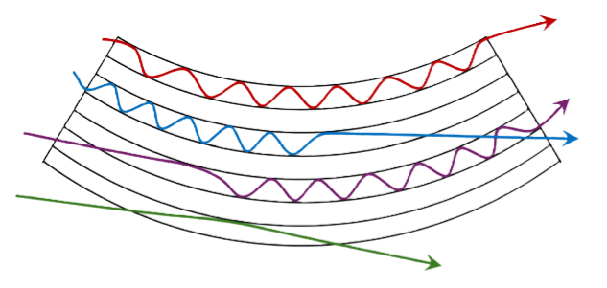
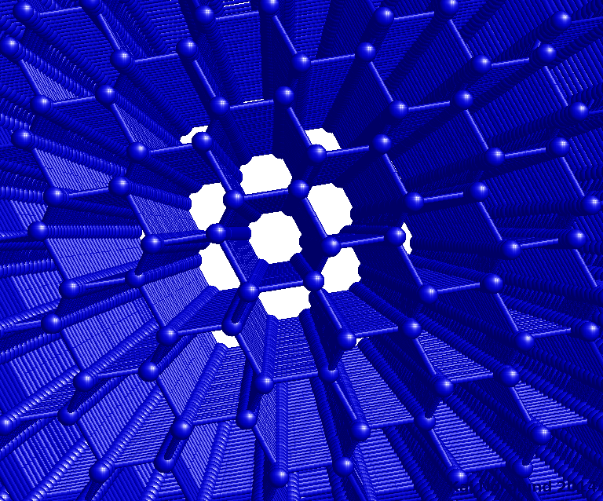
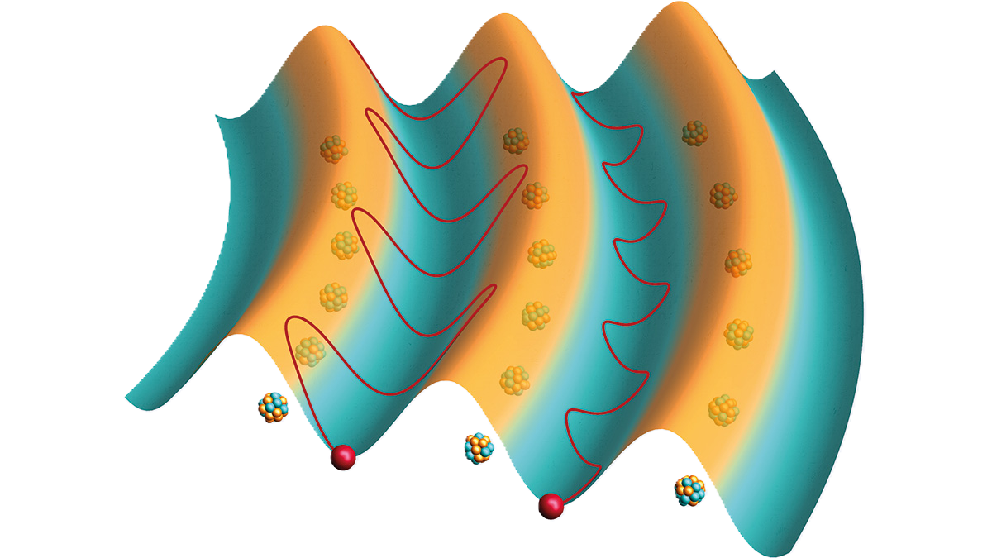
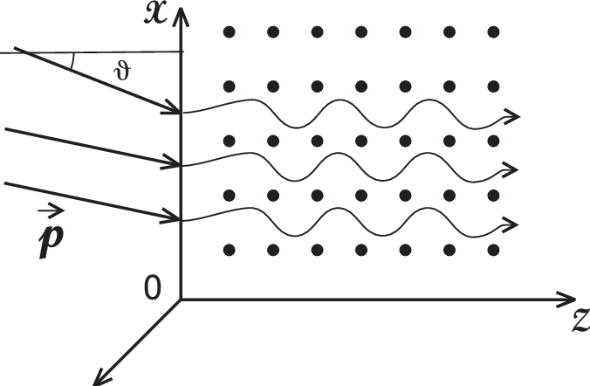
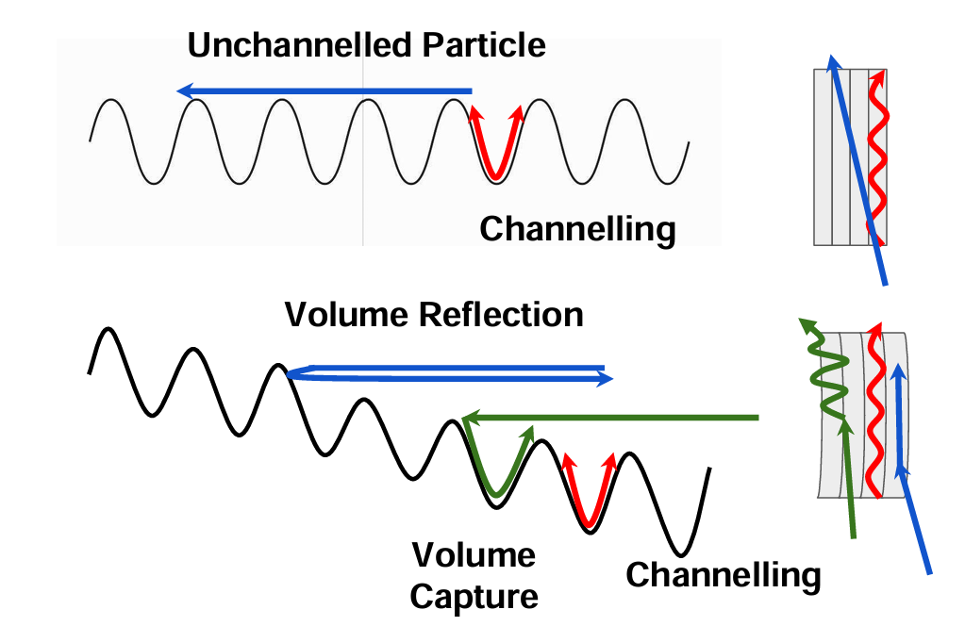
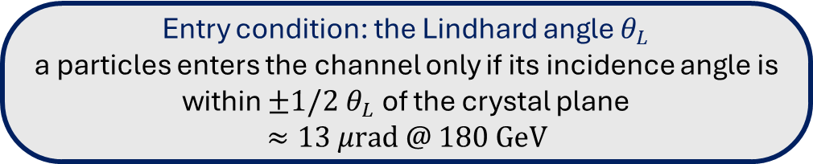
WHAT IS ‘CHANNELING’ IN CRYSTALS?
THE PHYSICS
Channeling effect
Charged particles get trapped and guided between regular atomic planes
Beam deflection
Bending the crystal physically steers the beam’s trajectory
Advantage
A compact alternative to traditional magnets for deflecting or extracting beams
Entry condition: the Lindhard angle $θ_{L}$
a particles enters the channel only if its incidence angle is within $±1/2{ θ}_{L}$ of the crystal plane
$$≈13 μrad @ 180 GeV$$
Notes:
Inside a crystal, atoms are arranged in regular planes. If a charged particle enters nearly parallel to these planes, it can become trapped and guided along their curvature, “locked” to the lattice instead of crossing it in a straight line.
When the crystal is bent, the channeled beam is deflected along with the grating: the crystal acts as a guide, offering a compact alternative to traditional magnets for deflecting or extracting a particle beam.

Slide 3
THE TWOCRYST EXPERIMENT
THE PROJECT

Slide 4
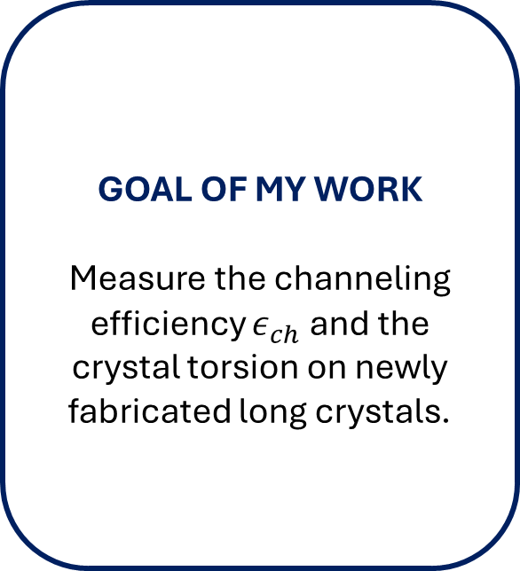
MY ANALYSIS
THE PROJECT
My work takes place on the SPS – H8 test bench, where individual crystals are characterized before being used.
DATA
2024 dataset for two long crystals
180 GeV beam (70% protons and 30% pions)
GOAL OF MY WORK
Measure the channeling efficiency $ε_{ch}$ and the crystal torsion on newly fabricated long crystals.
WHAT IS NEW
ggg

Slide 5
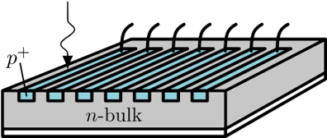
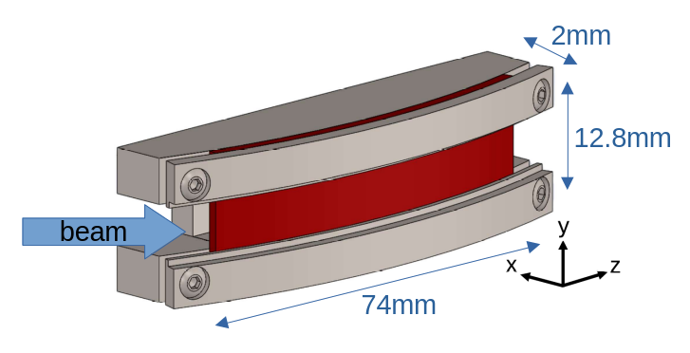
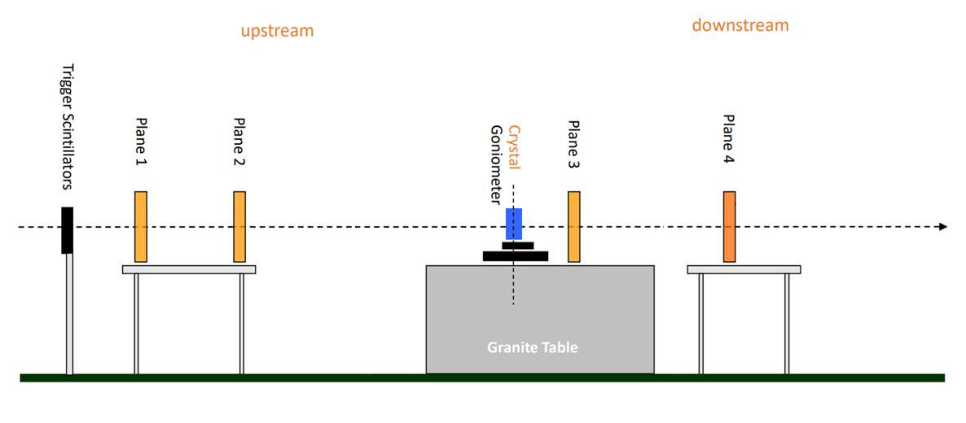
MY ANALYSIS
EXPERIMENTAL SETUP
My work takes place on the SPS – H8 test bench, where individual crystals are characterized before being used.
DATA
2024 dataset for two long crystals
180 GeV beam (70% protons and 30% pions)
silicon microstrip sensors
long crystal

Slide 6
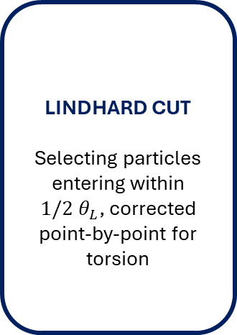
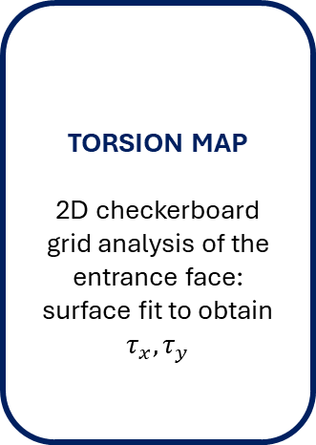
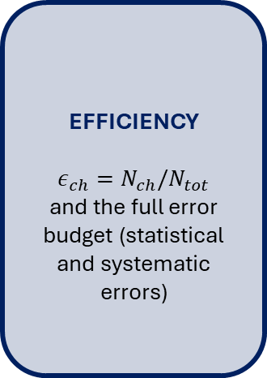
THE ANALYSIS PIPELINE
METHOD
QUALITY FILTERS
Selecting single tracks, alignment check between the upstream and downstream telescope arms
CRYSTAL EDGES
Reconstruct the (x,y) spatial window illuminated by the crystal
(2 independent methods)
TORSION MAP
2D checkerboard grid analysis of the entrance face:
surface fit to obtain $τ_{x}, τ_{y}$
LINDHARD CUT
Selecting particles entering within $1/2{ θ}_{L}$, corrected point-by-point for torsion
EFFICIENCY
$$ε_{ch}=N_{ch}/N_{tot}$$
and the full error budget (statistical and systematic errors)
Analysis implemented in Python on RDataFrame (ROOT).

Slide 7
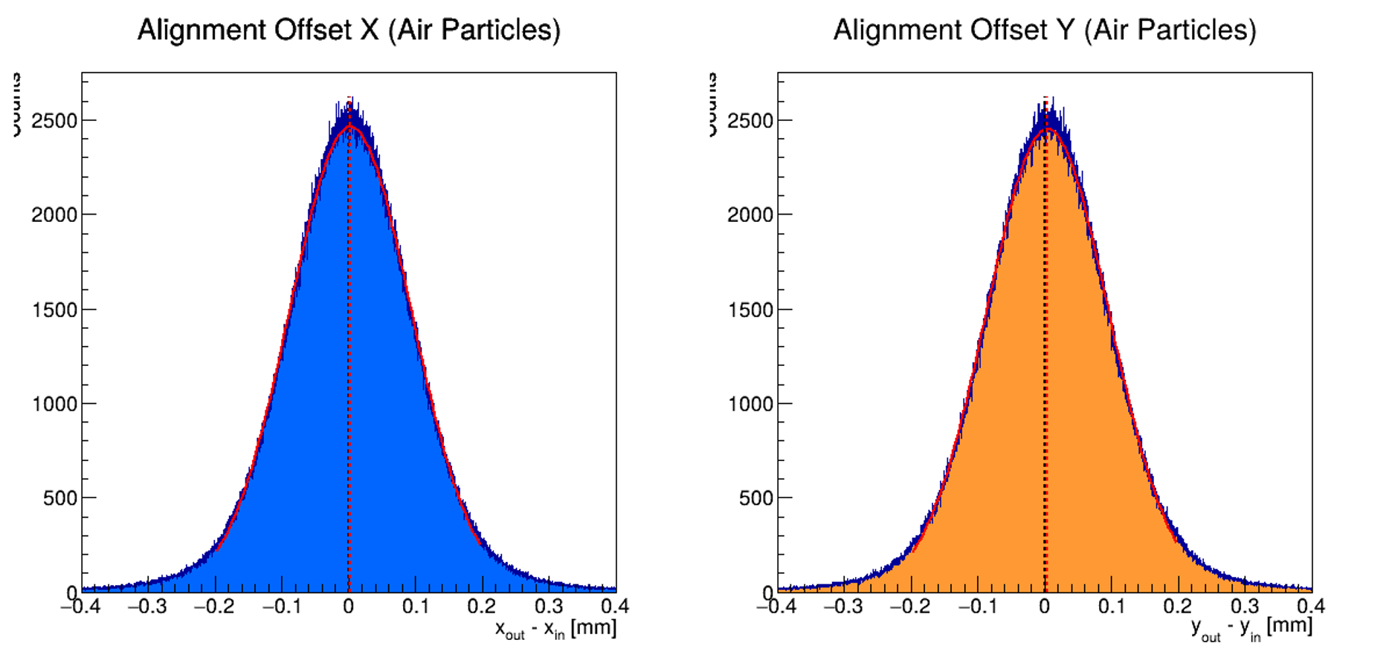
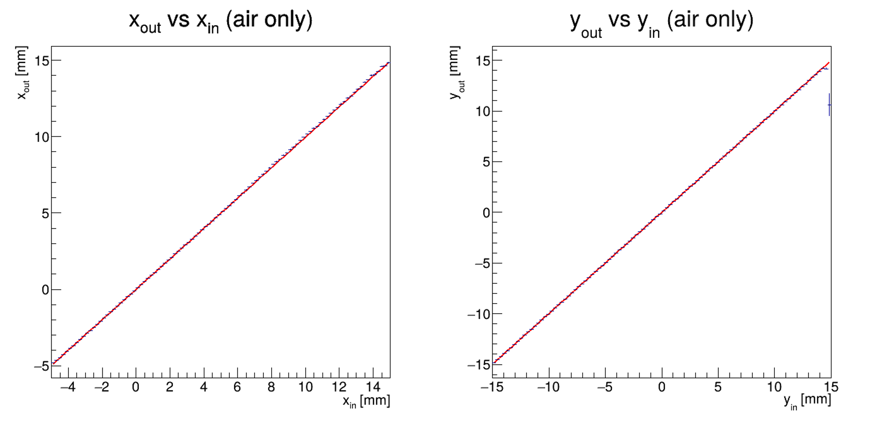


ANALYSIS: DETECTOR ALIGNMENT
PRELIMINARY ANALYSIS
To ensure that the upstream and downstream detectors are aligned, we check the deviation between the initial and final positions of particles that definitely did not hit the crystal, ensuring that is zero.
QUALITY FILTERS
Selecting single tracks, alignment check between the upstream and downstream telescope arms
$$m=0.995$$
$$q=0.007$$
$$m=0.999$$
$$q=0.006$$
We can also check the alignment by doing a linear fit between the upstream and dowstream profiles.

Slide 8
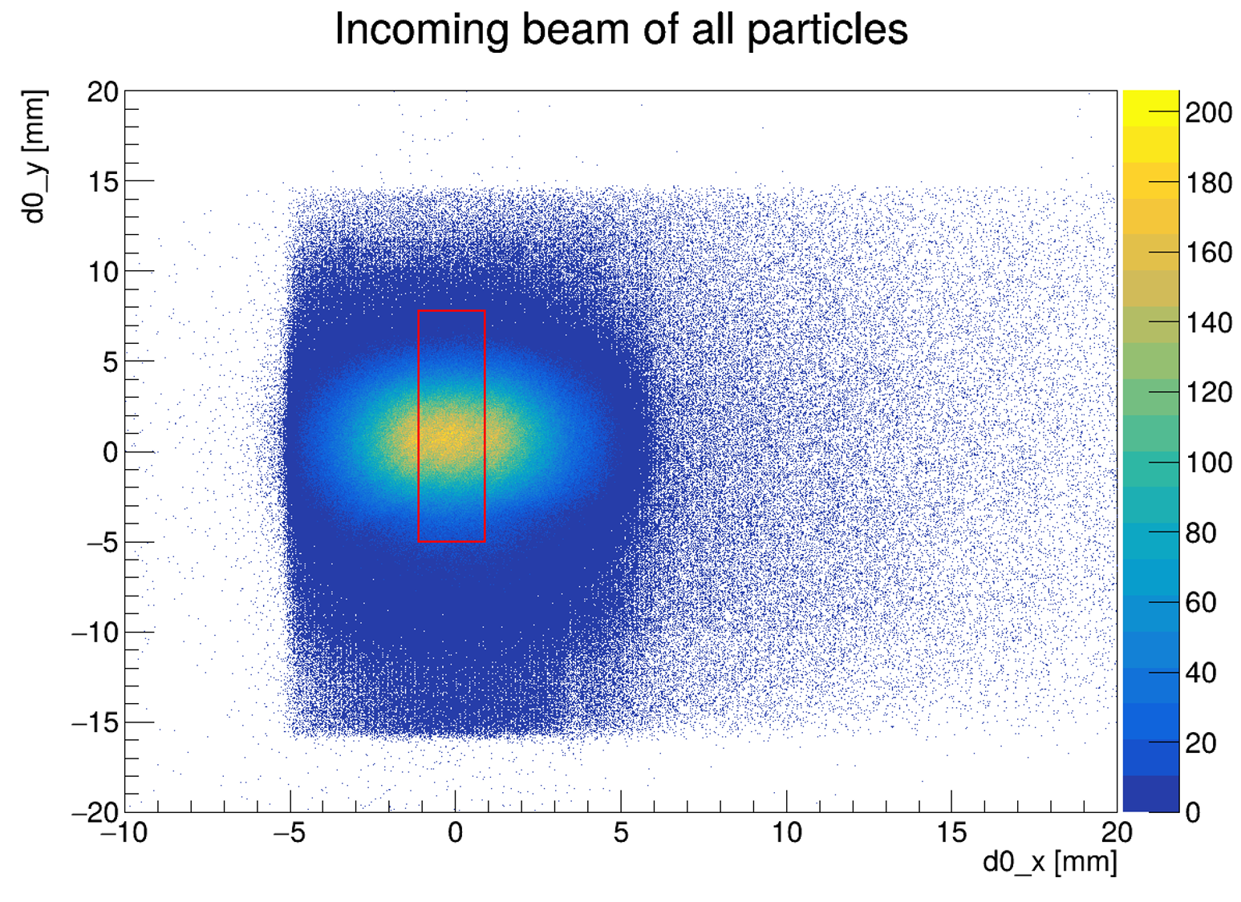
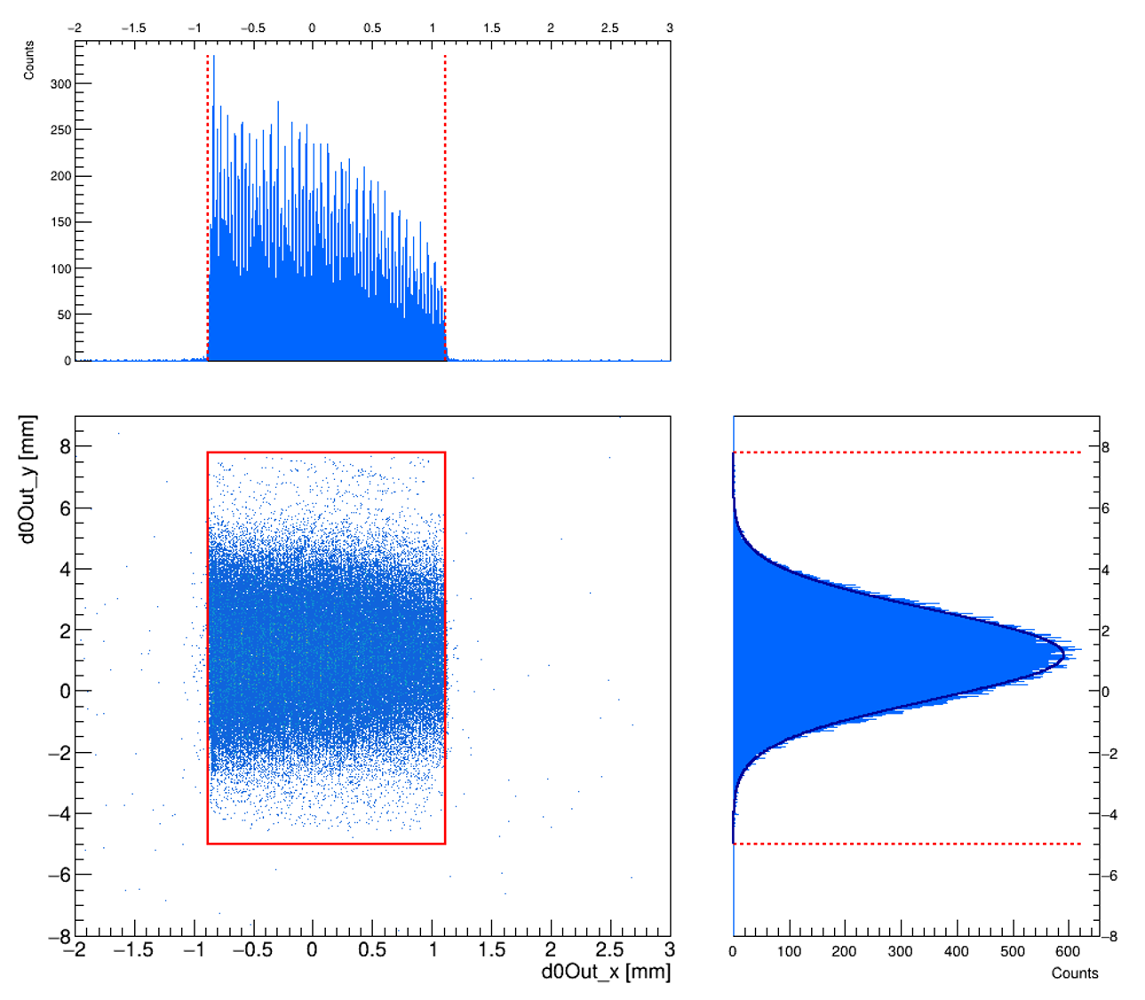
ANALYSIS: CRYSTAL EDGES
PRELIMINARY ANALYSIS
METHOD 1: CHANNELED PARTICLES
Isolate already channeled particles (only uses ~ 20% of data)
Their impact position (x, y) traces the crystal footprint, matching its expected dimension
CRYSTAL EDGES
Reconstruct the (x,y) spatial window illuminated by the crystal
(2 independent methods)
METHOD 2: MULTIPLE COULOMB SCATTERING
Notes:
Results: the two methods agree on a width of 2 mm in x, in y the scattering method shows a narrower effective window due to the clamps, consistent with the torsion analysis, which already excludes the poorly-illuminated edges

Slide 9
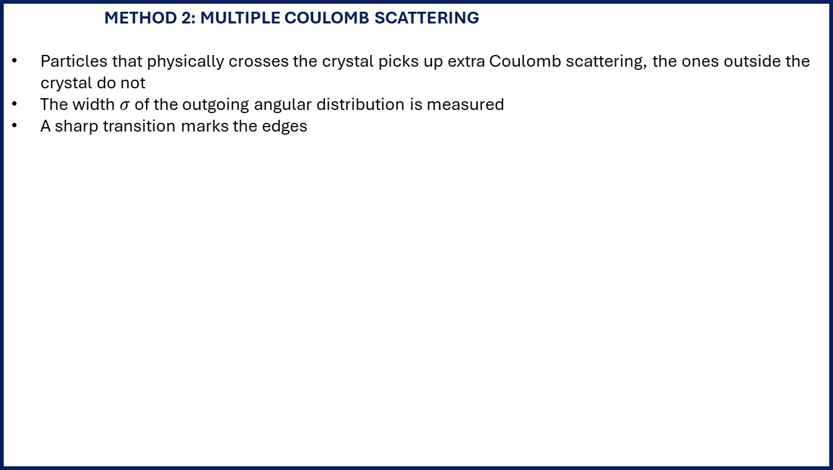
ANALYSIS: CRYSTAL EDGES
PRELIMINARY ANALYSIS
METHOD 1: CHANNELED PARTICLES
METHOD 2: MULTIPLE COULOMB SCATTERING
Particles that physically crosses the crystal picks up extra Coulomb scattering, the ones outside the crystal do not
The width $σ$ of the outgoing angular distribution is measured
A sharp transition marks the edges
CRYSTAL EDGES
Reconstruct the (x,y) spatial window illuminated by the crystal
(2 independent methods)
Notes:
Results: the two methods agree on a width of 2 mm in x, in y the scattering method shows a narrower effective window due to the clamps, consistent with the torsion analysis, which already excludes the poorly-illuminated edges

Slide 10
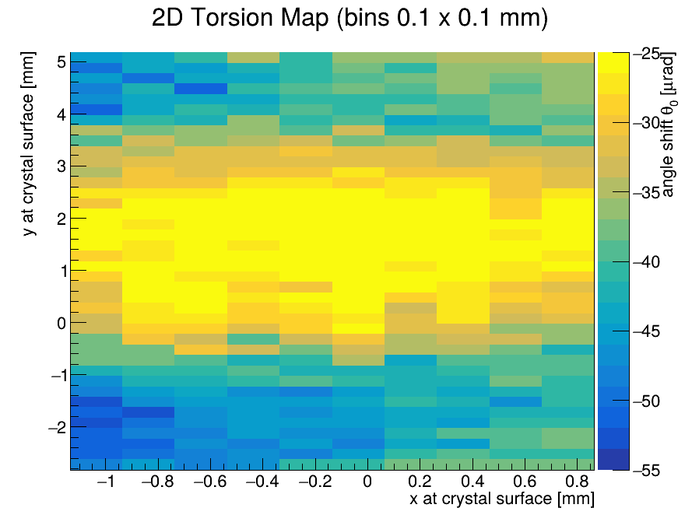
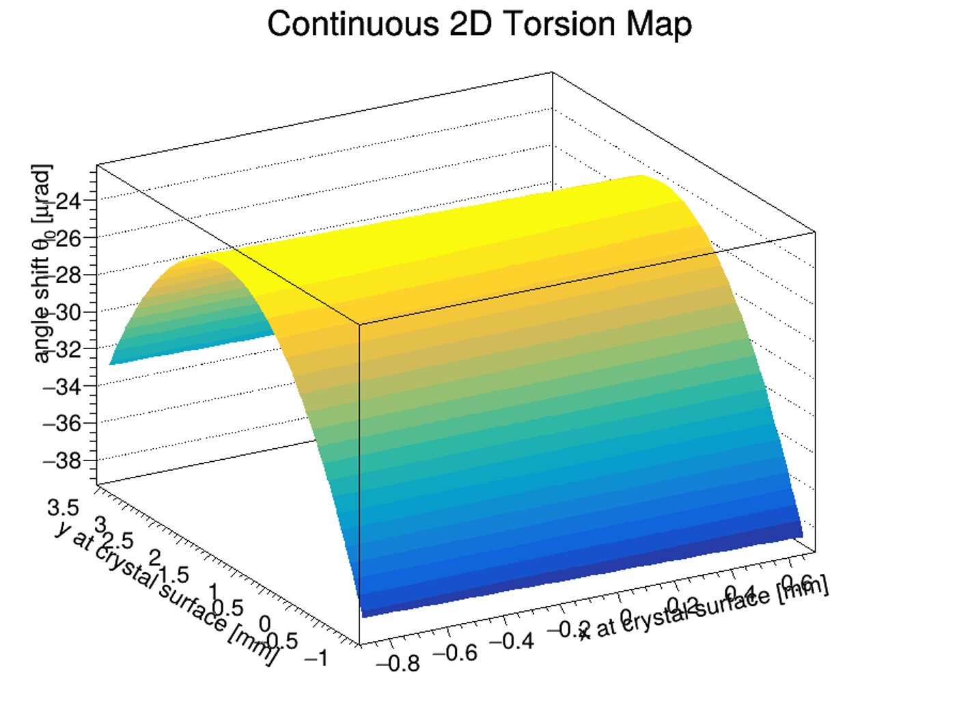

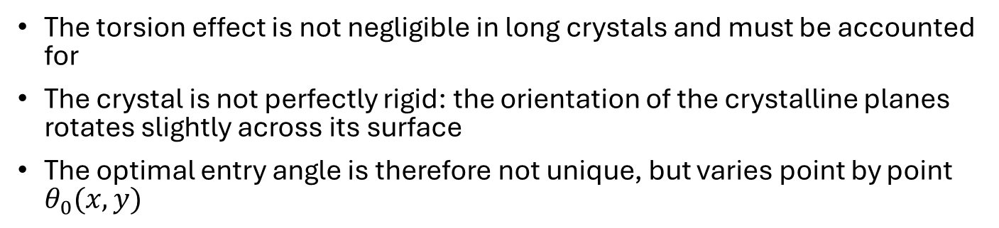

ANALYSIS: MAPPING THE TORSION
PRELIMINARY ANALYSIS
The torsion effect is not negligible in long crystals and must be accounted for
The crystal is not perfectly rigid: the orientation of the crystalline planes rotates slightly across its surface
The optimal entry angle is therefore not unique, but varies point by point $θ_{0}(x,y)$
TORSION MAP
2D checkerboard grid analysis of the entrance face:
surface fit to obtain $τ_{x}, τ_{y}$
Beam spot divided into a 0.1 mm (x,y) grid
Angular scan
for each cell
$→$ local $θ_{0}$
that maximize
efficiency
Surface fit
(parabolic)
to extract the
global $τ_{x}, τ_{y}$
RESULTS:
ggg

Slide 11
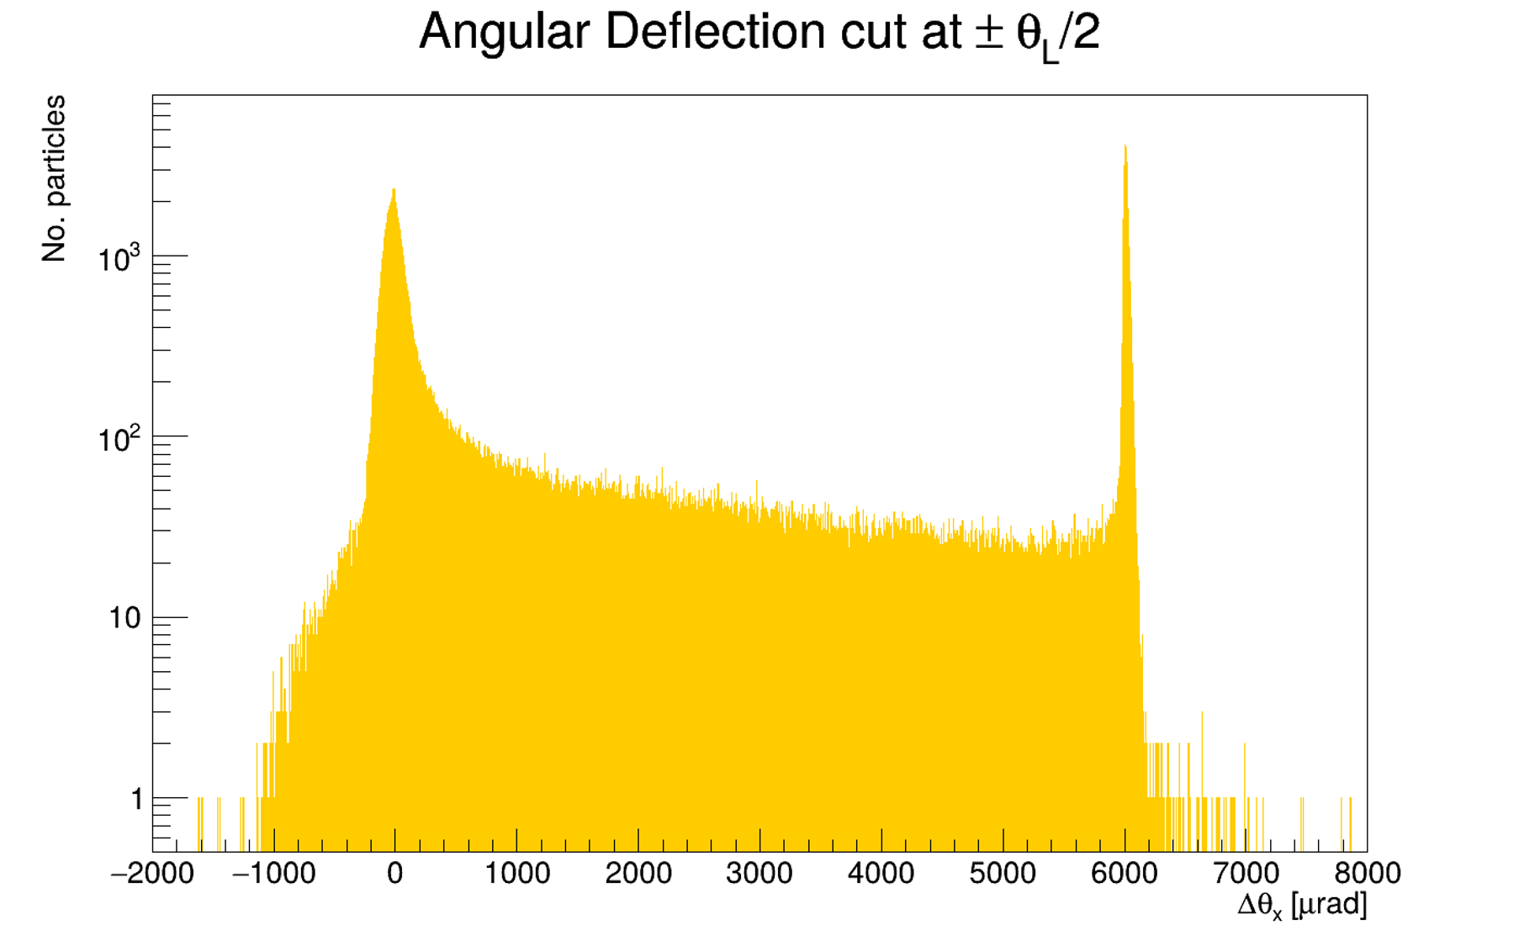
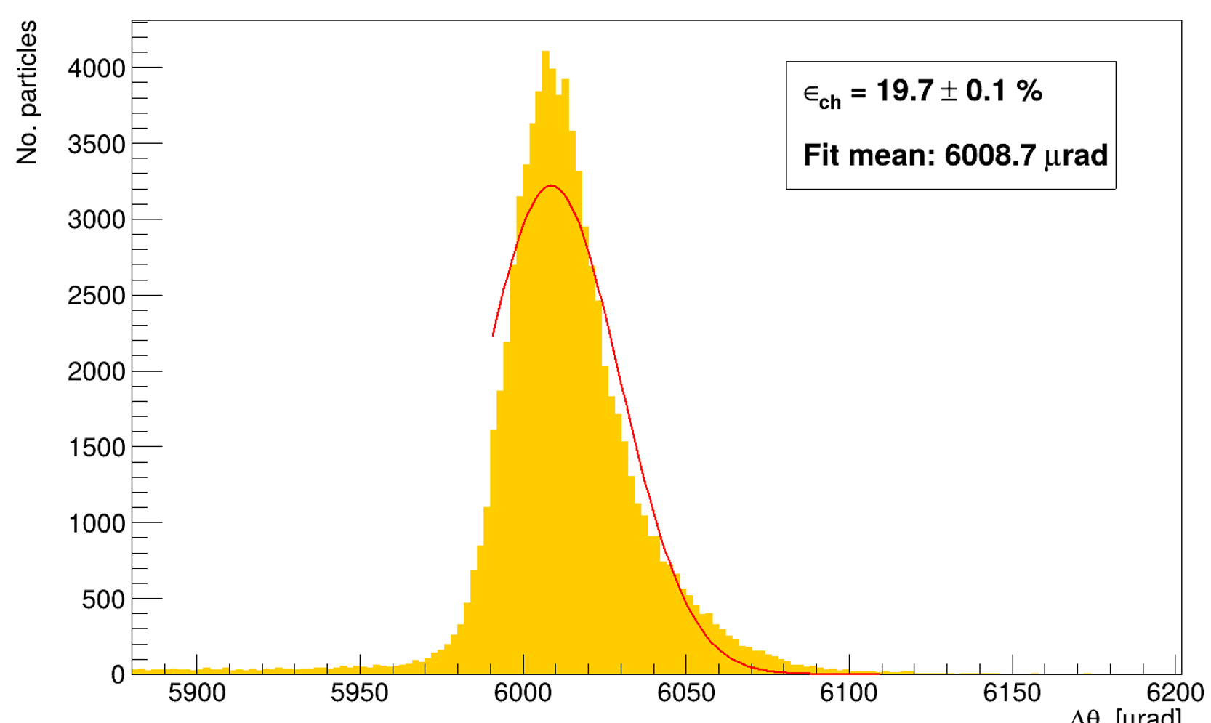



CHANNELING EFFICIENCY
ANALYSIS
CHANNELING EFFICIENCY
$$ε_{ch}=\frac{N_{ch}}{N_{tot}}$$
$$N_{tot}$$
$$N_{ch}$$
Notes:
By fitting only the right side of the peak, we ensured the cleanest possible measurement by excluding any contribution from dechanneled particles.

Slide 12

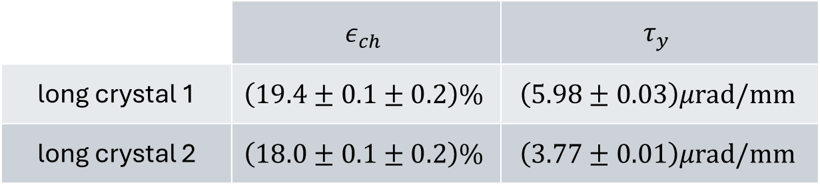
CHANNELING EFFICIENCY: RESULTS
ANALYSIS
crystal 1 crystal 2
RUN 8430 (REFERENCE)
$$(19.6±0.1[stat]±0.2[syst])\%$$
 | $$ε_{ch}$$ | $$τ_{y}$$
long crystal 1 | $$\left(19.4±0.1±0.2\right)\%$$ | $$\left(5.98±0.03\right)μrad/mm$$
long crystal 2 | $$\left(18.0±0.1±0.2\right)\%$$ | $$\left(3.77±0.01\right)μrad/mm$$
anomalous run

Slide 13
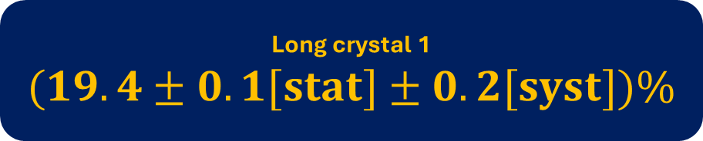



CHANNELING EFFICIENCY: RESULTS
ANALYSIS
Long crystal 1
$$(19.4±0.1[stat]±0.2[syst])\%$$
ERROR BUDGET
Statistical error:
Binomial error
Fit errors
Systematic error:
Fit model choice
Binning choices
$$0.1\%$$
Long crystal 2
$$(18.0±0.1[stat]±0.2[syst])\%$$
$$0.2\%$$

Slide 14
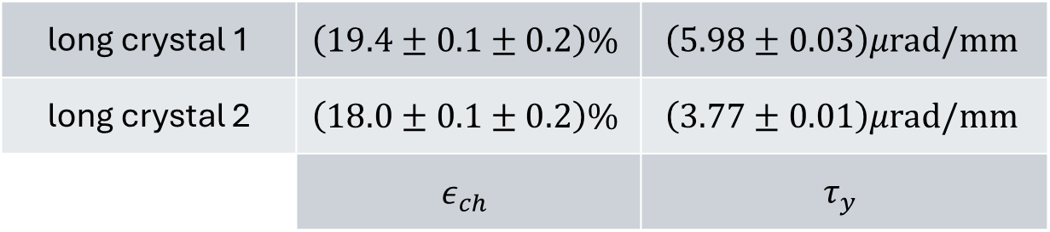

CHANNELING EFFICIENCY: RESULTS
ANALYSIS
long crystal 1 | $$\left(19.4±0.1±0.2\right)\%$$ | $$\left(5.98±0.03\right)μrad/mm$$
long crystal 2 | $$\left(18.0±0.1±0.2\right)\%$$ | $$\left(3.77±0.01\right)μrad/mm$$
 | $$ε_{ch}$$ | $$τ_{y}$$
On article …
It was found and efficiency of $ε_{ch}=\left(15.8±0.1\right)\%$ and a torsion of $τ_{y}=\left(24.4±0.2\right)μrad/mm$ for the TCCP long crystal.

Slide 15
WHAT’S NEXT: SIMULATION
NEXT STEPS

Slide 16
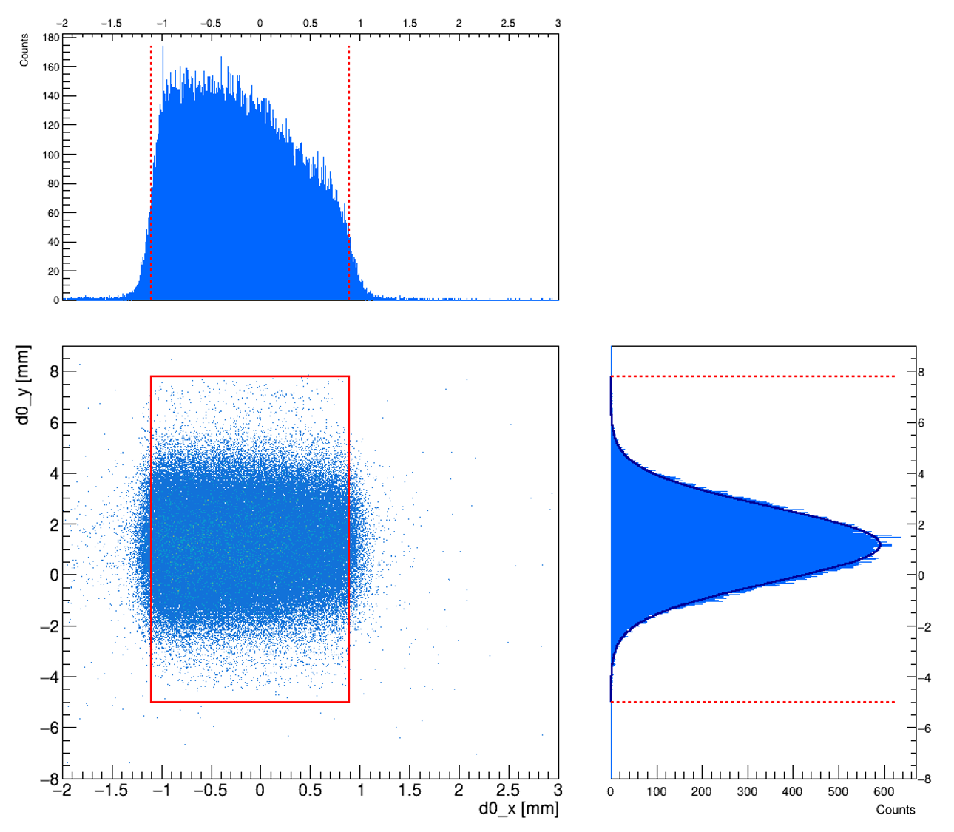



2. PREVIOUS ANALYSIS: CRYSTAL EDGES
To define the true footprint at the entrance face we must project the downstream edges back upstream.
We need to subtract a shift $Δx$ from the downstream edge position.
Channeled particles follow the bent lattice planes, resulting in a lateral geometric drift along the $x$-axis as they traverse the crystal.
$$Δx=\frac{θ_{b}⋅L}{2}∼0.22 mm$$
Notes:
While the crystal edges are identified using the downstream particle profiles (where channeled particles are distinctly separated), our subsequent analysis strictly requires upstream coordinates.
Channeled particles follow the bent lattice planes, resulting in a lateral geometric drift along the x-axis as they traverse the crystal. To define the true physical footprint at the entrance face, we must project the downstream edges back upstream.

Slide 17
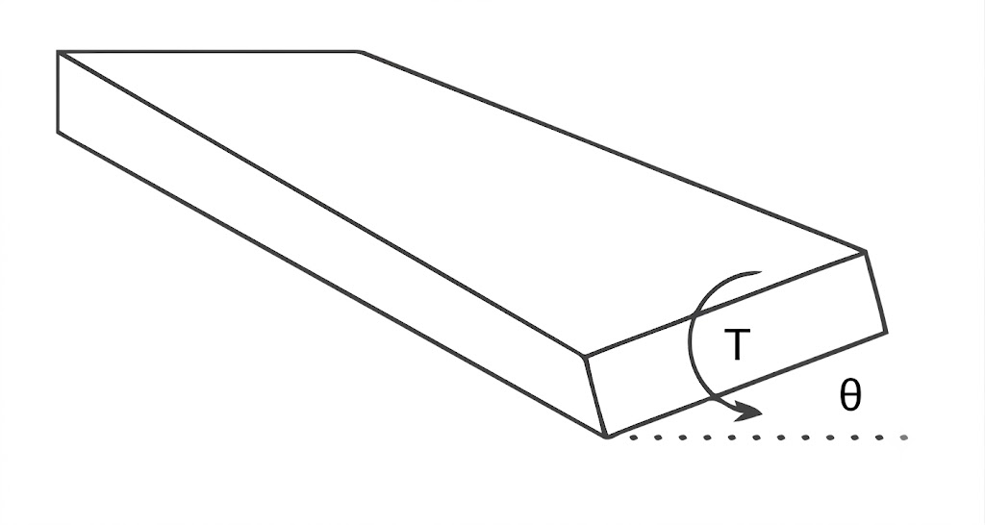
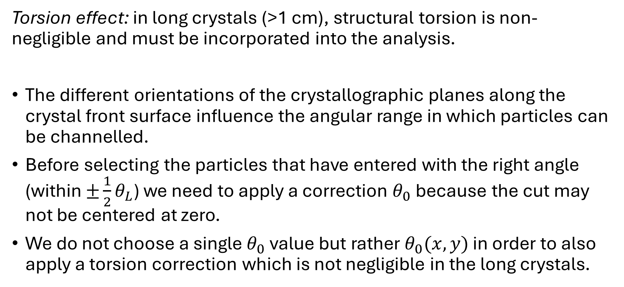
3. ANALYSIS: TORSION EFFECT
Torsion effect: in long crystals (>1 cm), structural torsion is non-negligible and must be incorporated into the analysis.
The different orientations of the crystallographic planes along the crystal front surface influence the angular range in which particles can be channelled.
Before selecting the particles that have entered with the right angle (within $±\frac{1}{2}θ_{L}$) we need to apply a correction $θ_{0}$ because the cut may not be centered at zero.
We do not choose a single $θ_{0}$ value but rather $θ_{0}(x,y)$ in order to also apply a torsion correction which is not negligible in the long crystals.
Notes:
torsion is the variation of the crystalline plane orientation along the y direction perpendicular to the bending plane
$θ_{0}$: the angle where the crystal planes are perfectly aligned with the beam.

Slide 18
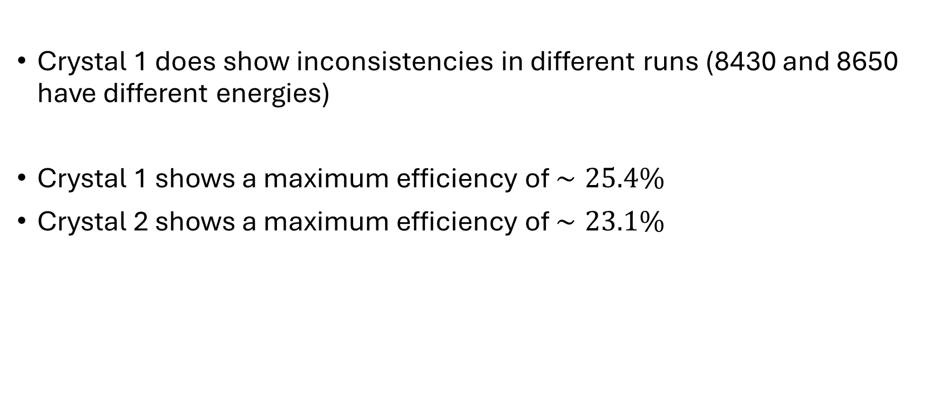
4. FINAL RESULTS
Crystal 1 does show inconsistencies in different runs (8430 and 8650 have different energies)
Crystal 1 shows a maximum efficiency of $∼25.4\%$
Crystal 2 shows a maximum efficiency of $∼23.1\%$
Notes:
CONSISTENT ACROSS DIFFERENT RUNS FOR THE SAME CRYSTALS

Slide 19
BACKUP SLIDES

Slide 20

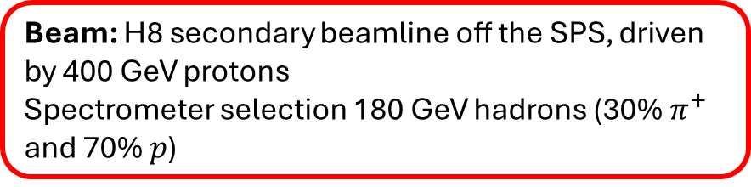

SCHEMATIC LAYOUT
BACKUP SLIDE
Beam: H8 secondary beamline off the SPS, driven by 400 GeV protons
Spectrometer selection 180 GeV hadrons (30% $π^{+}$ and 70% $p$)
Trackers:
2 silicon microstrip sensors
639 strips, 98 mm length
with a ~ 7 um resolution
Station 1
z ~ -12.4 m
Station 2
z ~ -10.4 m
crystal
z = 0 m
Station 3
z ~ 0.5 m
Station 4
z ~ 4.7 m
Beam
direction
$$z$$
Incoming arm vacuum pipe
Downstream arm vacuum pipe

Slide 21
SCHEMATIC LAYOUT
BACKUP SLIDE

Slide 22
SPATIAL CUT
BACKUP SLIDE
12.8 mm
2 mm

Slide 23
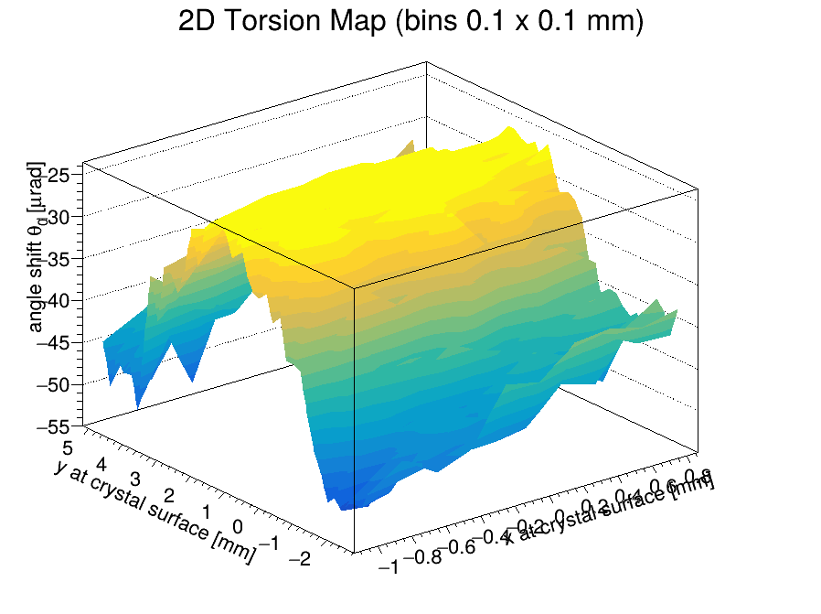

TORSION FIT
BACKUP SLIDE
The 2d map is fitted through a parabolic function:
$$θ_{corr}\left(x,y\right)=θ_{0}+τ_{x}⋅x+τ_{y}⋅y+p_{3}y^{2}$$
Now we correct the effect of torsion using the parameter $θ_{0}(x,y)$ found for each bin:
instead of the Lindhard cut ${|θ}_{in,x}|≤\frac{1}{2}θ_{L}$ we will use
$\left|θ_{x}^{in}−\left(θ_{x}^{off}+τ_{y}⋅d_{y}+τ_{x}⋅d_{x}\right)\right|≤\frac{1}{2}θ_{L}$
Notes:
This allowed us to apply a continuous torsion correction. So, instead of using a standard Lindhard cut centered at zero, we corrected the incoming angle using the fitted parameters found for each spatial bin.

Slide 24
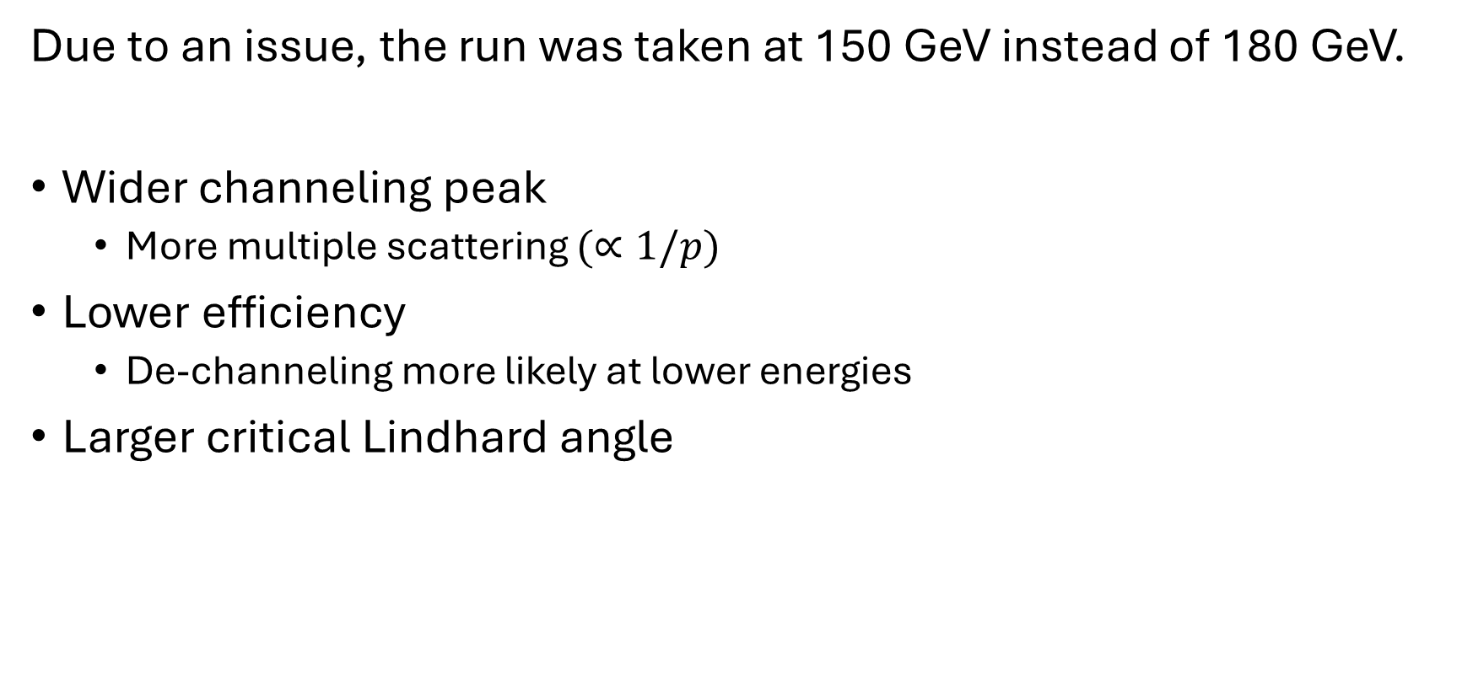
ANOMALOUS RUN 8650
BACKUP SLIDE
Due to an issue, the run was taken at 150 GeV instead of 180 GeV.
Wider channeling peak
  More multiple scattering $(∝1/p)$
Lower efficiency
  De-channeling more likely at lower energies
Larger critical Lindhard angle

Slide 25

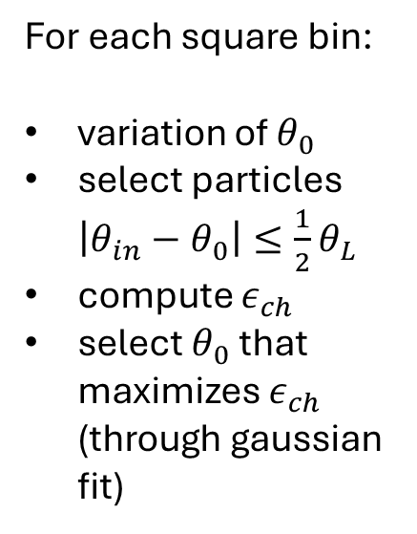
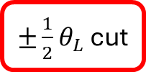
ANGLE SELECTION
BACKUP SLIDE
$±\frac{1}{2}θ_{L}$ cut
For each square bin:
variation of $θ_{0}$
select particles $\left|θ_{in}−θ_{0}\right|≤\frac{1}{2}θ_{L}$
compute $ε_{ch}$
select $θ_{0}$ that maximizes $ε_{ch}$ (through gaussian fit)
Notes:
If not considering any torsion correction: we would just calculate the channeling efficiency through several iterations varying $θ_{0}$ until the highest efficiency is found, representing the best alignment of incoming particles with the crystalline planes

Slide 26

ANGLE SELECTION
BACKUP SLIDE
For each square bin:
variation of $θ_{0}$
select particles $\left|θ_{in}−θ_{0}\right|≤\frac{1}{2}θ_{L}$
compute $ε_{ch}$
select $θ_{0}$ that maximizes $ε_{ch}$ (through gaussian fit)

Slide 27
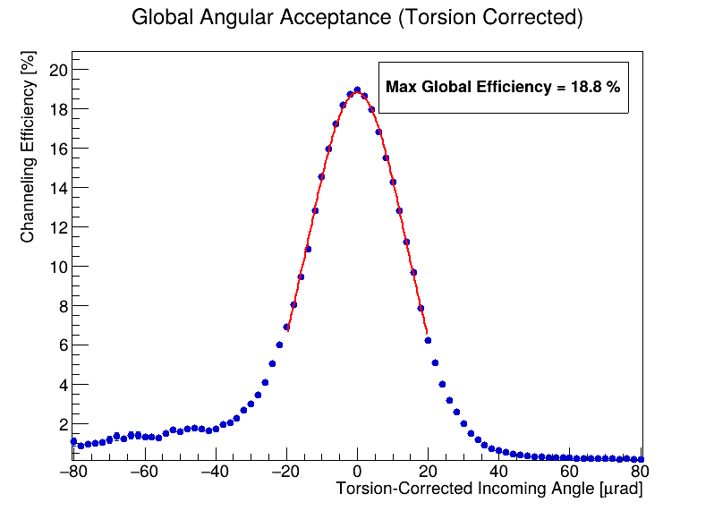
EFFICIENCY CURVE
BACKUP SLIDE
Crystal efficiency as a function of the incoming angle, after application of the torsion correction. The value of the peak is the efficiency of the crystal when it is perfectly aligned to the beam.
Notes:
Applying this torsion correction significantly improves our analysis. When we plot the crystal efficiency as a function of the torsion-corrected incoming angle, the peak of this curve represents the efficiency of the crystal when it is perfectly aligned to the beam, which in this case reached 18.8%.

