Slide 1
CHARACTERIZATION OF CRYSTAL EFFICIENCY:
Methodology, Corrections, and Results
JULY 2026
ANNA SOFIA MORO

Slide 2
1. DATA ANALYZED
Analysis of 2024 dataset for two long crystals:
  LHCTBMCP0001-0001: runs 8430, 8431, 8650
  LHCTBMCP0001-0002: runs 8655, 8656
Configuration:
  Central goniometer
  Energy 180 GeV/c or 150 GeV/c for run 8650
Notes:
this analysis is based on a 2024 dataset for two long crystals, which we refer to as crystal 1 and crystal 2

Slide 3
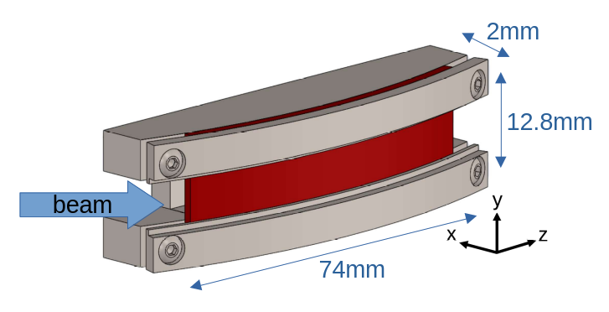
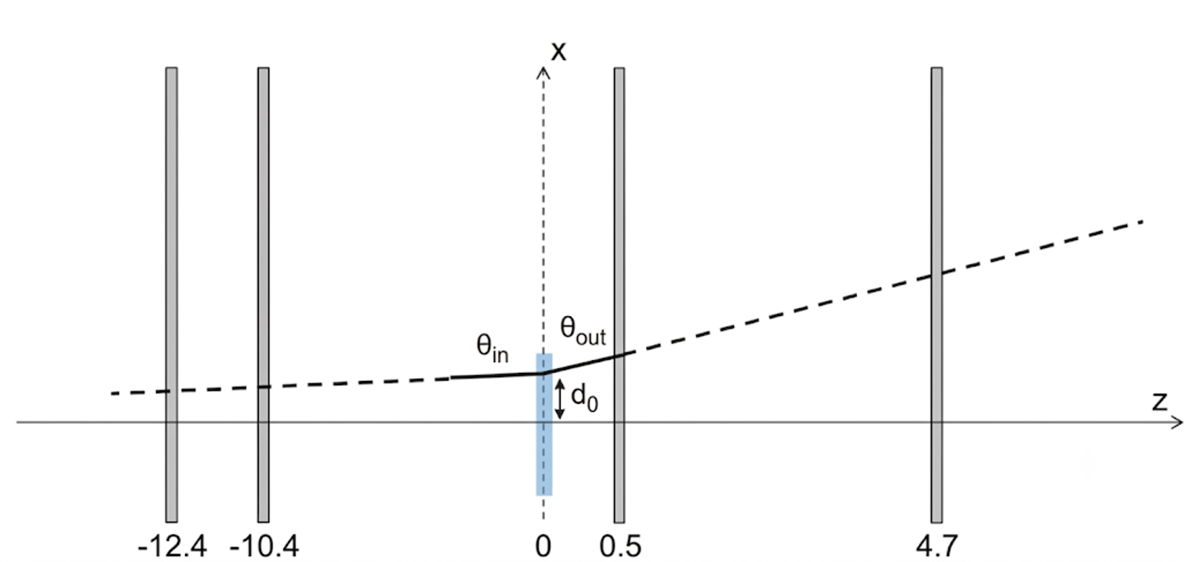
1. SCHEMATIC LAYOUT
T1
T2
T3
C4
[m]
crystal

Slide 4
2. PREVIOUS ANALYSIS
SELECT SINGLE TRACKS
Selection of single tracks to eliminate multi-scattering events and multi-hit events (pile-up effect) from the dataset.
PARTICLE ENTRY
Validation of which particles successfully entered the crystal.
Since we do not know the relative beam position:
algorithmic identification of the physical crystal edges based on interaction density profiles.
DETECTOR ALIGNMENT
Ensuring precision and the alignment of the detectors.
Any misalignment between tracking planes corrupts the angular measurements, necessitating corrections.
Notes:
Before diving into the efficiency evaluation, we performed several preliminary analysis steps.
Next, because the relative beam position was unknown, we had to algorithmically identify the physical edges of the crystal to validate which particles successfully entered it.

Slide 5
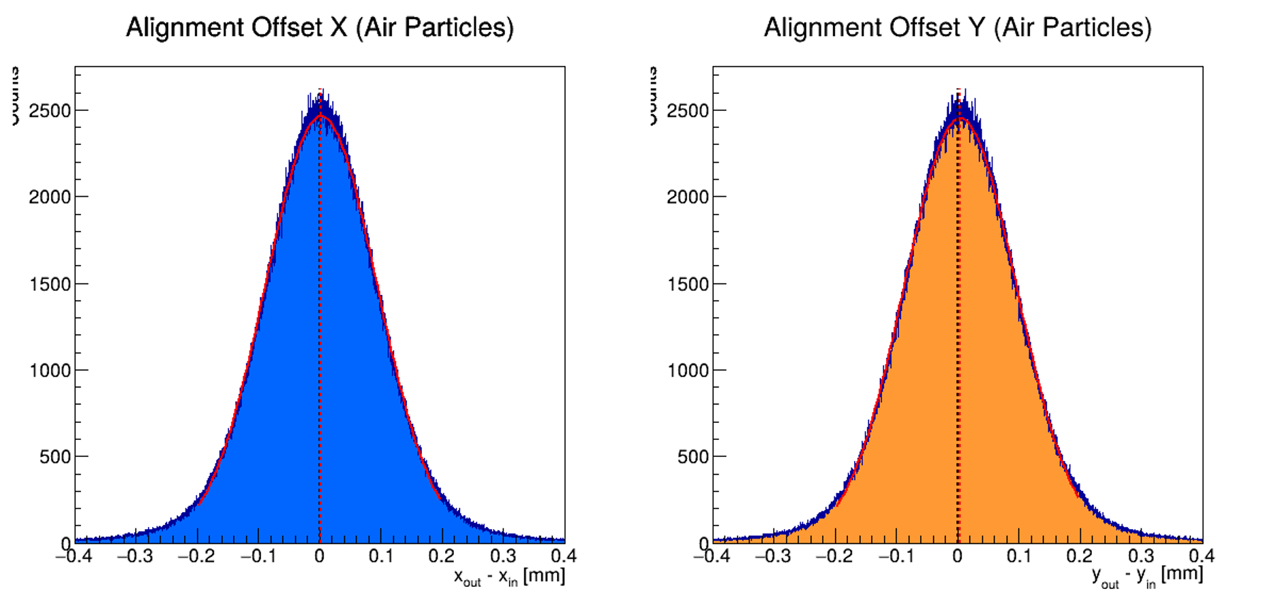
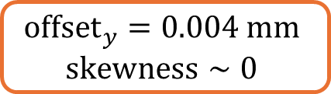
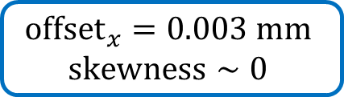
2. PREVIOUS ANALYSIS: ALIGNMENT
To ensure that the upstream and downstream detectors are aligned, we check the deviation between the initial and final positions of particles that definitely did not hit the crystal, ensuring that is zero.
$${offset}_{x}=0.003 mm$$
$$skewness∼0$$
$${offset}_{y}=0.004 mm$$
$$skewness∼0$$
Notes:
As you can see, the deviation is essentially zero—with an x-offset of 0.003 millimeters and a y-offset of 0.004 millimeters, both showing a skewness near zero.

Slide 6
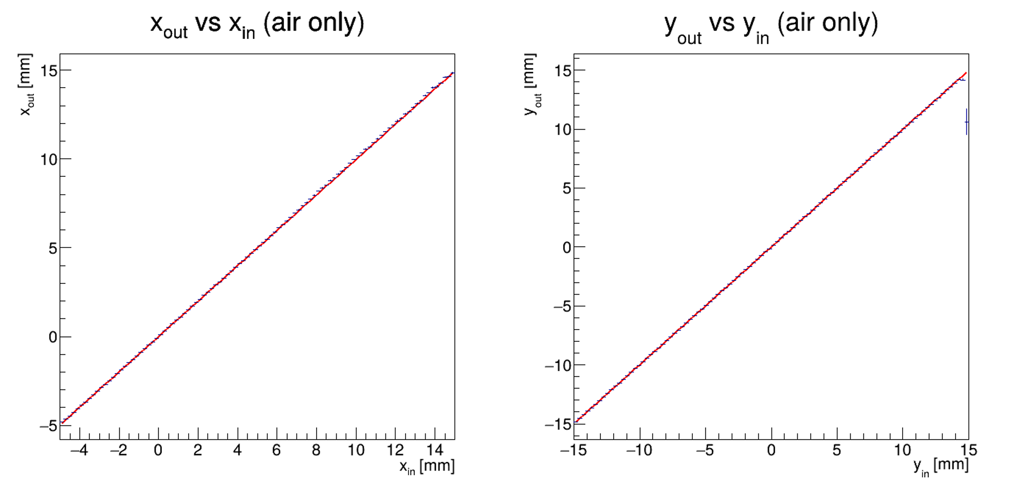
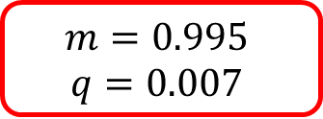

BACKUP SLIDES: ALIGNMENT
We can also check the alignment by doing a linear fit between the upstream and dowstream profiles.
$$m=0.995$$
$$q=0.007$$
$$m=0.999$$
$$q=0.006$$

Slide 7
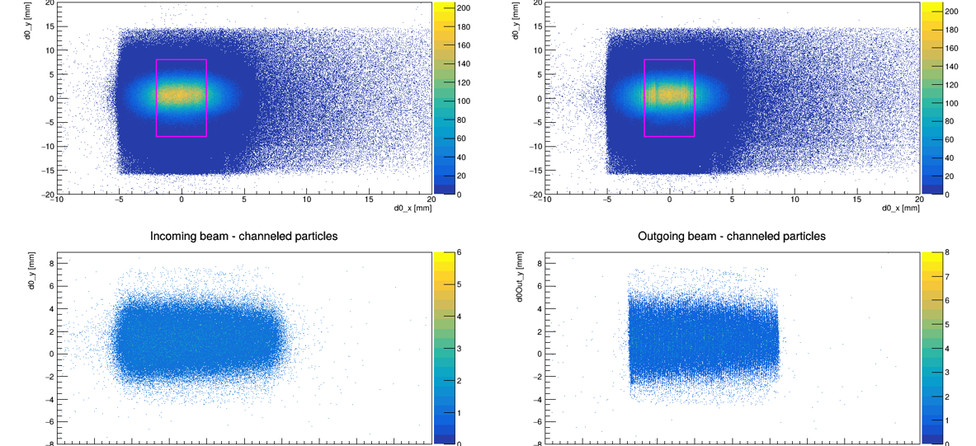
2. PREVIOUS ANALYSIS: CRYSTAL EDGES
To select the particles that actually enter the crystal we first need to know the position of the crystal with respect to the beam.
We then look at channeled particles only using a preliminary deflection cut. Their impact points reveal the crystal's physical location, matching its expected dimensions.
IMPACT POSITION
OF ALL PARTICLES
OF CHANNELED PARTICLES
Notes:
To define the position of the crystal with respect to the beam, we looked specifically at channeled particles.
The impact points of these particles revealed the physical location of the crystal, matching its expected dimensions of 2 by 8 millimeters

Slide 8
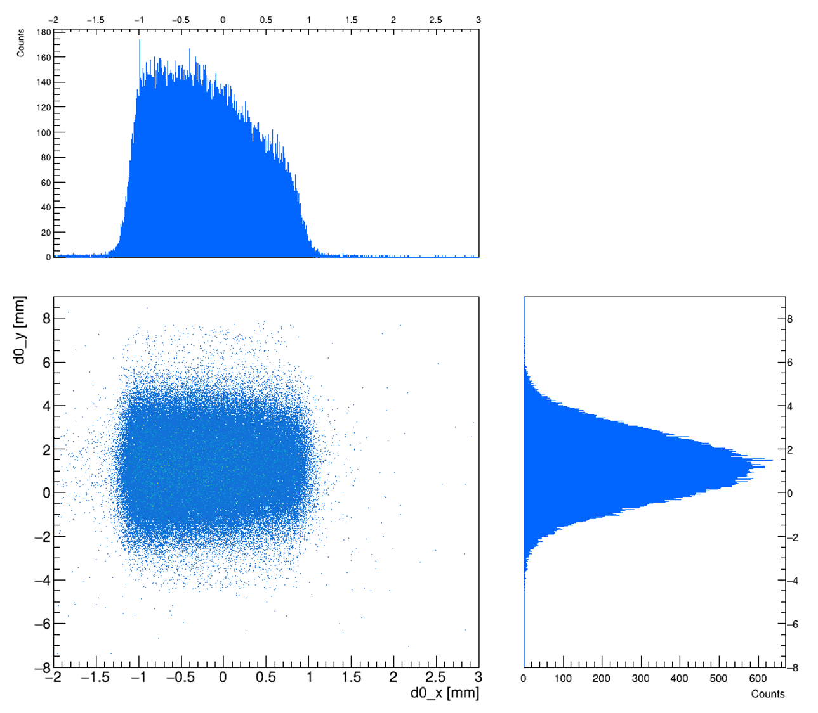
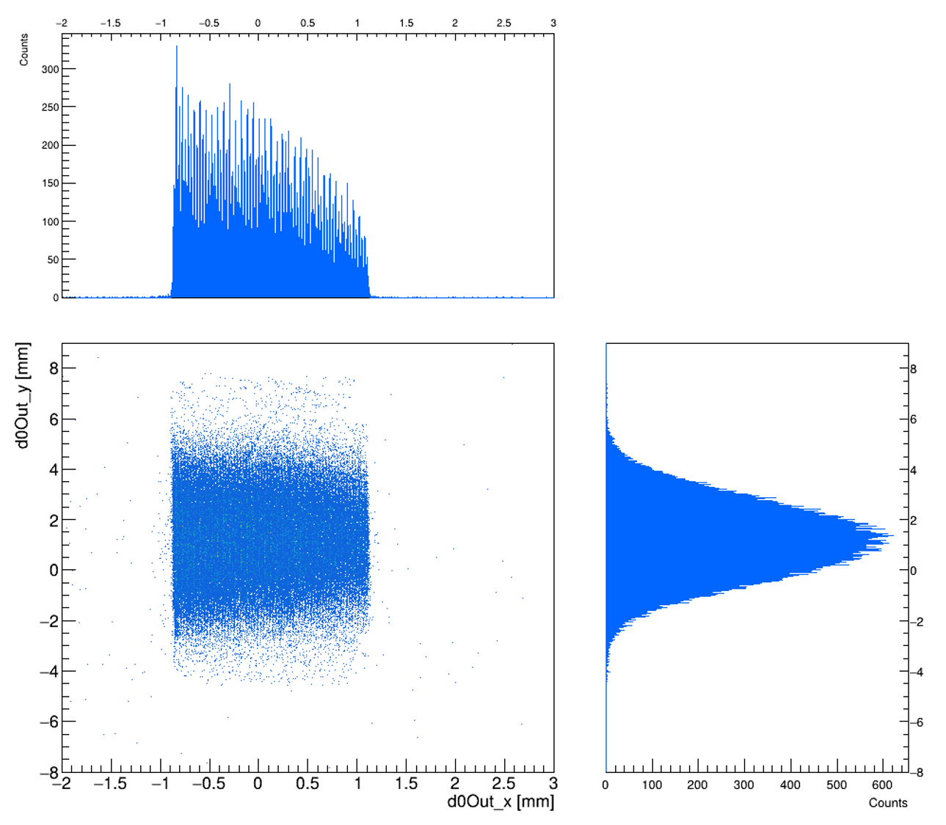

2. PREVIOUS ANALYSIS: CRYSTAL EDGES
The impact points of these particles revealed the physical location of the crystal, matching its expected dimensions of 2 by 12.8 mm.
To find the edges along $x$ (that have an asymmetrical distribution) we perform a «sliding window» method (fixed width & precision of 0.01mm), aiming for the position that maximize the number of particles inside.

Slide 9

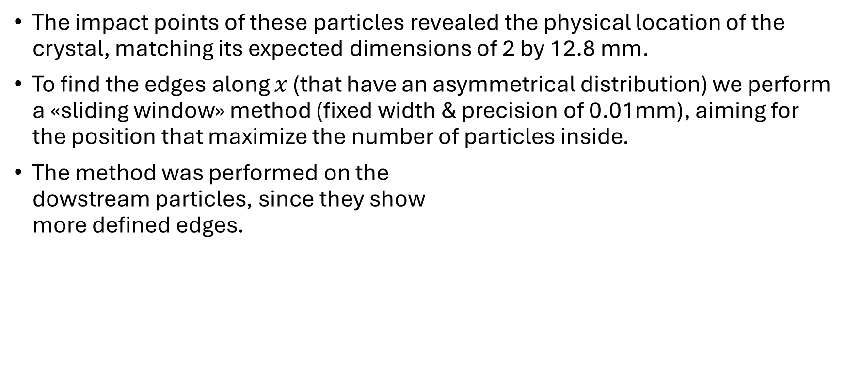
2. PREVIOUS ANALYSIS: CRYSTAL EDGES
The impact points of these particles revealed the physical location of the crystal, matching its expected dimensions of 2 by 12.8 mm.
To find the edges along $x$ (that have an asymmetrical distribution) we perform a «sliding window» method (fixed width & precision of 0.01mm), aiming for the position that maximize the number of particles inside.
The method was performed on the dowstream particles, since they show more defined edges.

Slide 10
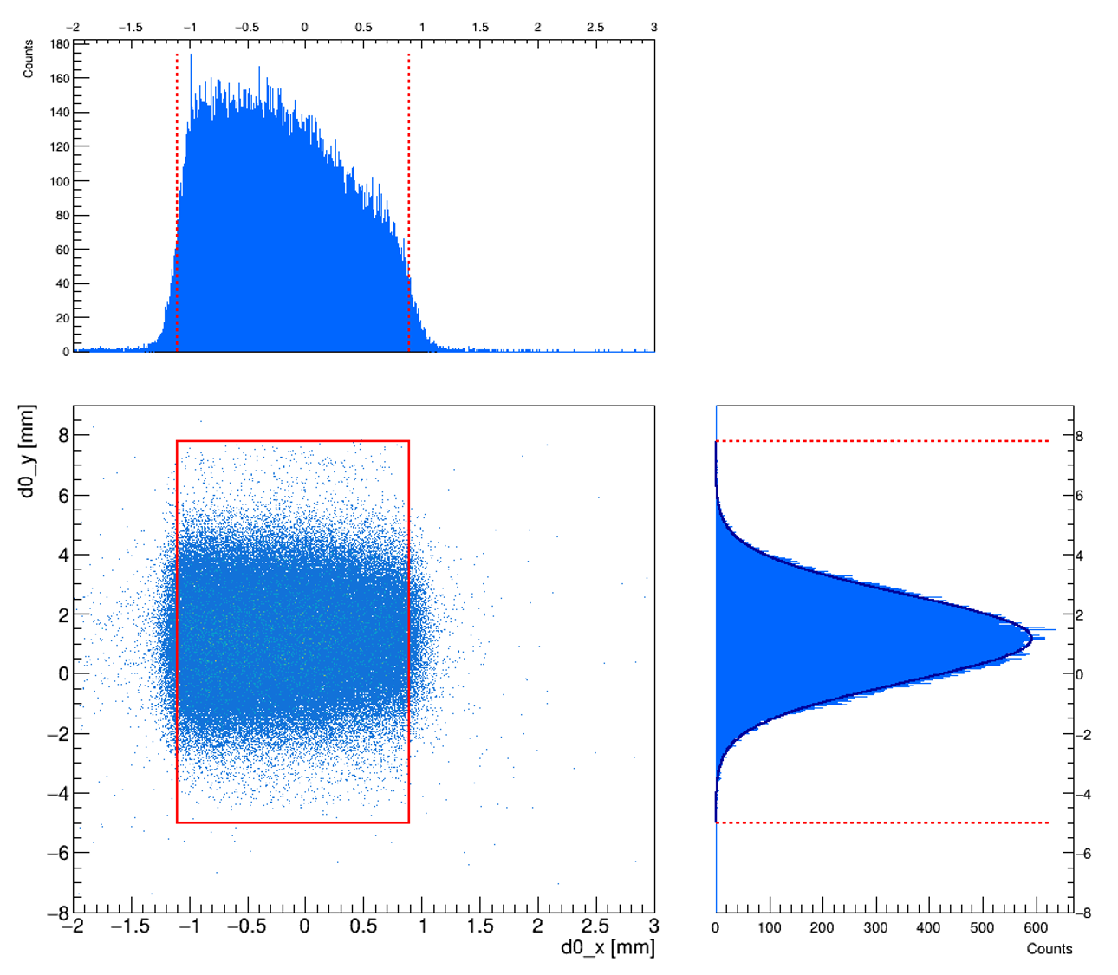



2. PREVIOUS ANALYSIS: CRYSTAL EDGES
To define the true footprint at the entrance face we must project the downstream edges back upstream.
We need to subtract a shift $Δx$ from the downstream edge position.
Channeled particles follow the bent lattice planes, resulting in a lateral geometric drift along the $x$-axis as they traverse the crystal.
$$Δx=\frac{θ_{b}⋅L}{2}∼0.22 mm$$
Notes:
While the crystal edges are identified using the downstream particle profiles (where channeled particles are distinctly separated), our subsequent analysis strictly requires upstream coordinates.
Channeled particles follow the bent lattice planes, resulting in a lateral geometric drift along the x-axis as they traverse the crystal. To define the true physical footprint at the entrance face, we must project the downstream edges back upstream.

Slide 11
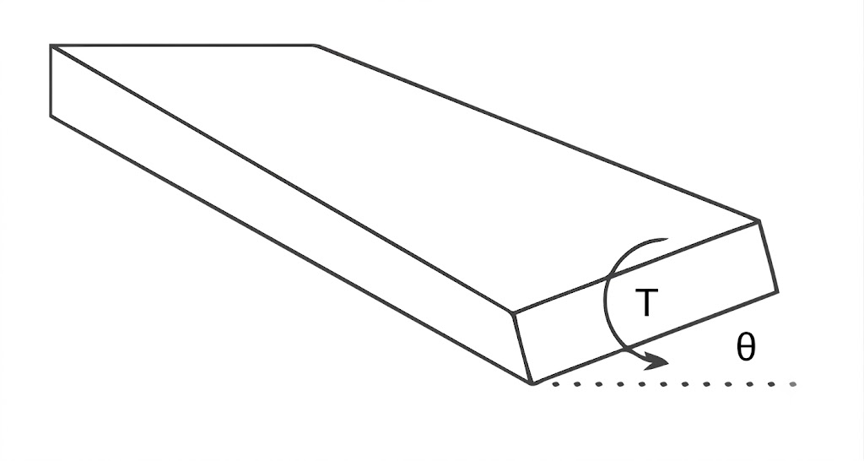
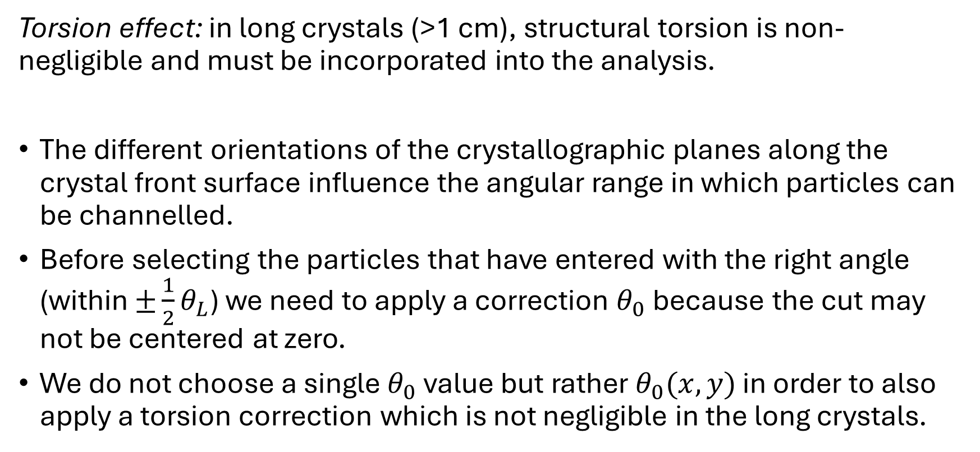
3. ANALYSIS: TORSION EFFECT
Torsion effect: in long crystals (>1 cm), structural torsion is non-negligible and must be incorporated into the analysis.
The different orientations of the crystallographic planes along the crystal front surface influence the angular range in which particles can be channelled.
Before selecting the particles that have entered with the right angle (within $±\frac{1}{2}θ_{L}$) we need to apply a correction $θ_{0}$ because the cut may not be centered at zero.
We do not choose a single $θ_{0}$ value but rather $θ_{0}(x,y)$ in order to also apply a torsion correction which is not negligible in the long crystals.
Notes:
torsion is the variation of the crystalline plane orientation along the y direction perpendicular to the bending plane
$θ_{0}$: the angle where the crystal planes are perfectly aligned with the beam.

Slide 12
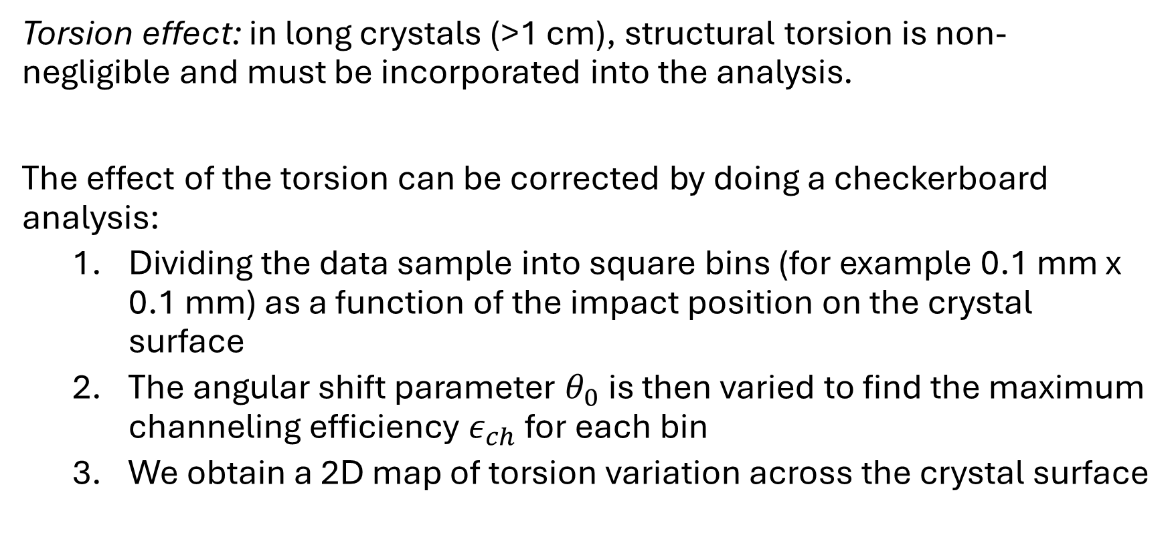
3. ANALYSIS: TORSION EFFECT
Torsion effect: in long crystals (>1 cm), structural torsion is non-negligible and must be incorporated into the analysis.
The effect of the torsion can be corrected by doing a checkerboard analysis:
  Dividing the data sample into square bins (for example 0.1 mm x 0.1 mm) as a function of the impact position on the crystal surface
  The angular shift parameter $θ_{0}$ is then varied to find the maximum channeling efficiency $ε_{ch}$ for each bin
  We obtain a 2D map of torsion variation across the crystal surface
Notes:
$θ_{0}$: the angle where the crystal planes are perfectly aligned with the beam.

Slide 13
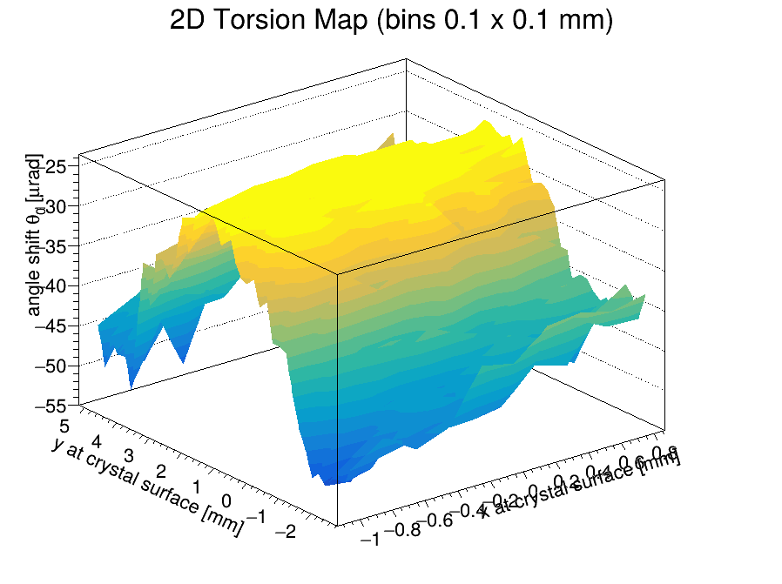
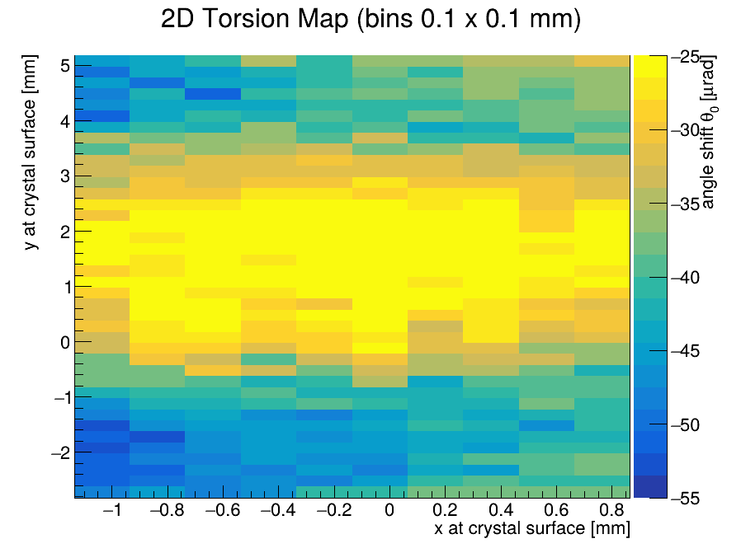
3. ANALYSIS: TORSION EFFECT

Slide 14
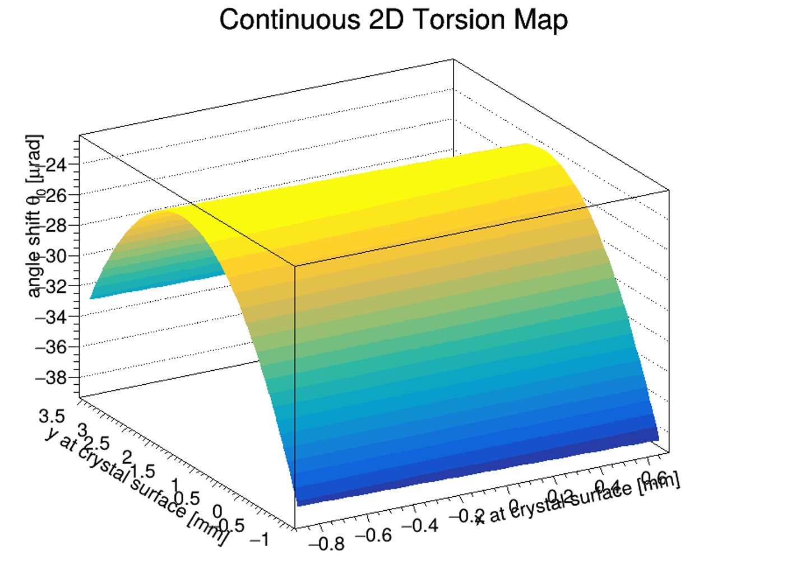

3. ANALYSIS: TORSION FIT
The 2d map is fitted through a parabolic function:
$$θ_{corr}\left(x,y\right)=θ_{0}+τ_{x}⋅x+τ_{y}⋅y+p_{3}y^{2}$$
Notes:
This allowed us to apply a continuous torsion correction. So, instead of using a standard Lindhard cut centered at zero, we corrected the incoming angle using the fitted parameters found for each spatial bin.
I want to use the simplest model that can accurately describe the data, but not so simple that it hides the actual physics.

Slide 15
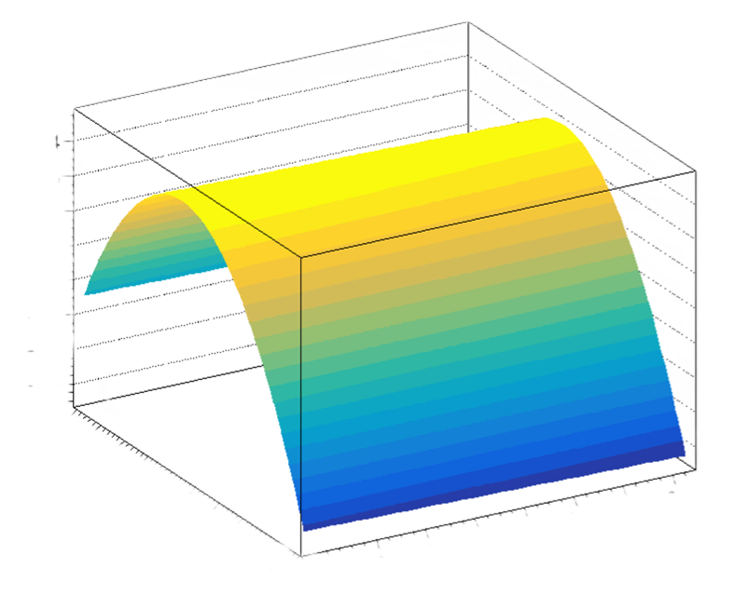
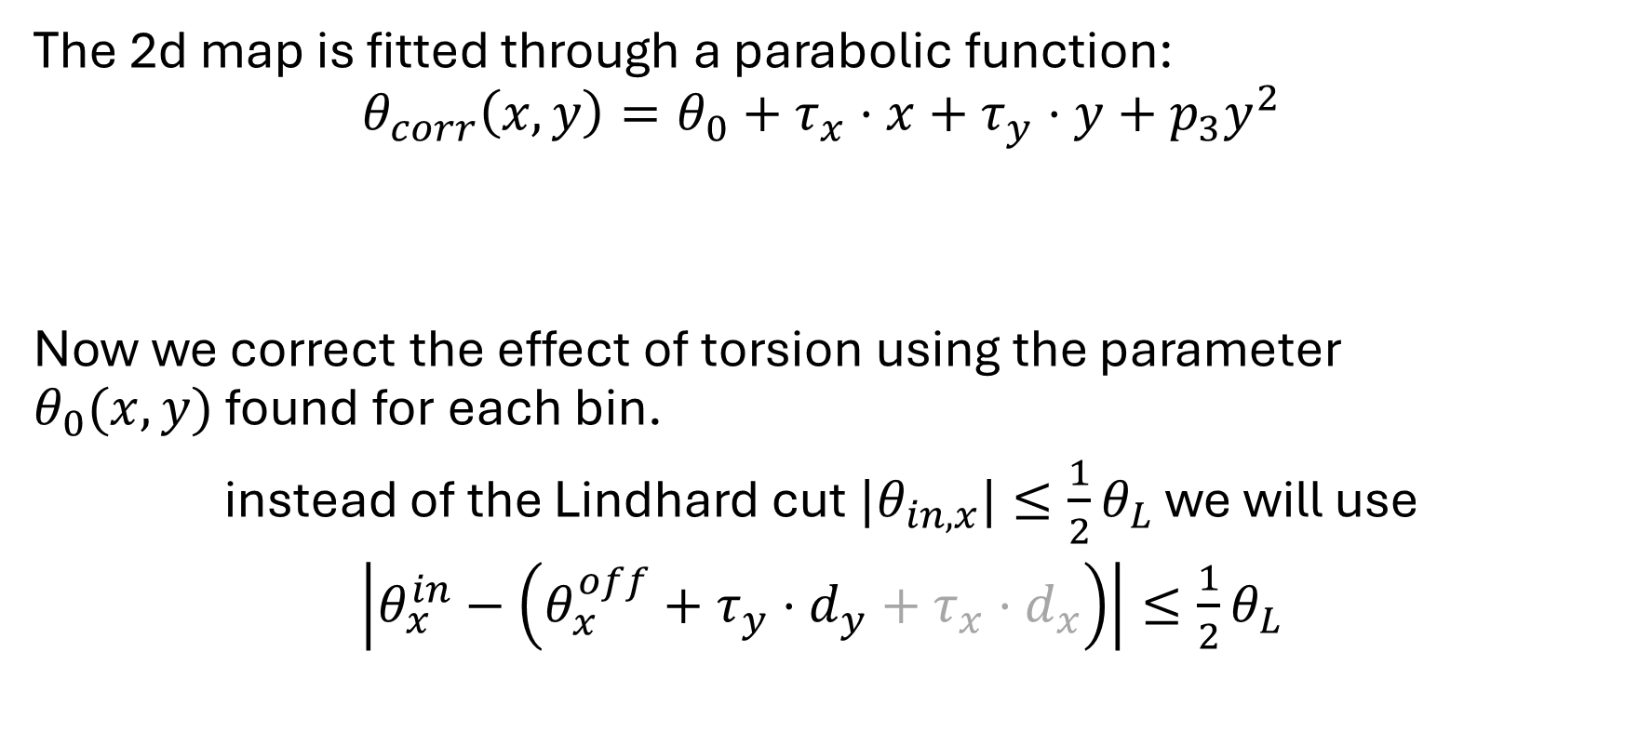
3. ANALYSIS: TORSION EFFECT
The 2d map is fitted through a parabolic function:
$$θ_{corr}\left(x,y\right)=θ_{0}+τ_{x}⋅x+τ_{y}⋅y+p_{3}y^{2}$$
Now we correct the effect of torsion using the parameter $θ_{0}(x,y)$ found for each bin.
instead of the Lindhard cut ${|θ}_{in,x}|≤\frac{1}{2}θ_{L}$ we will use
$\left|θ_{x}^{in}−\left(θ_{x}^{off}+τ_{y}⋅d_{y}+τ_{x}⋅d_{x}\right)\right|≤\frac{1}{2}θ_{L}$
Notes:
This allowed us to apply a continuous torsion correction. So, instead of using a standard Lindhard cut centered at zero, we corrected the incoming angle using the fitted parameters found for each spatial bin.

Slide 16
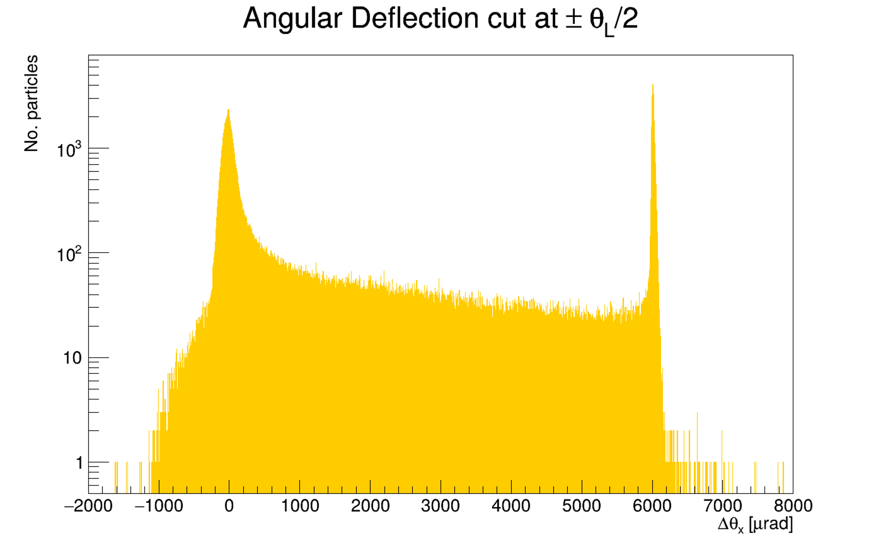

3. ANALYSIS
We can now compute the efficiency as the ratio of successfully channeled particles to the total number of incident particles.
CHANNELING EFFICIENCY
$$ε_{ch}=\frac{N_{ch}}{N_{tot}}$$

Slide 17
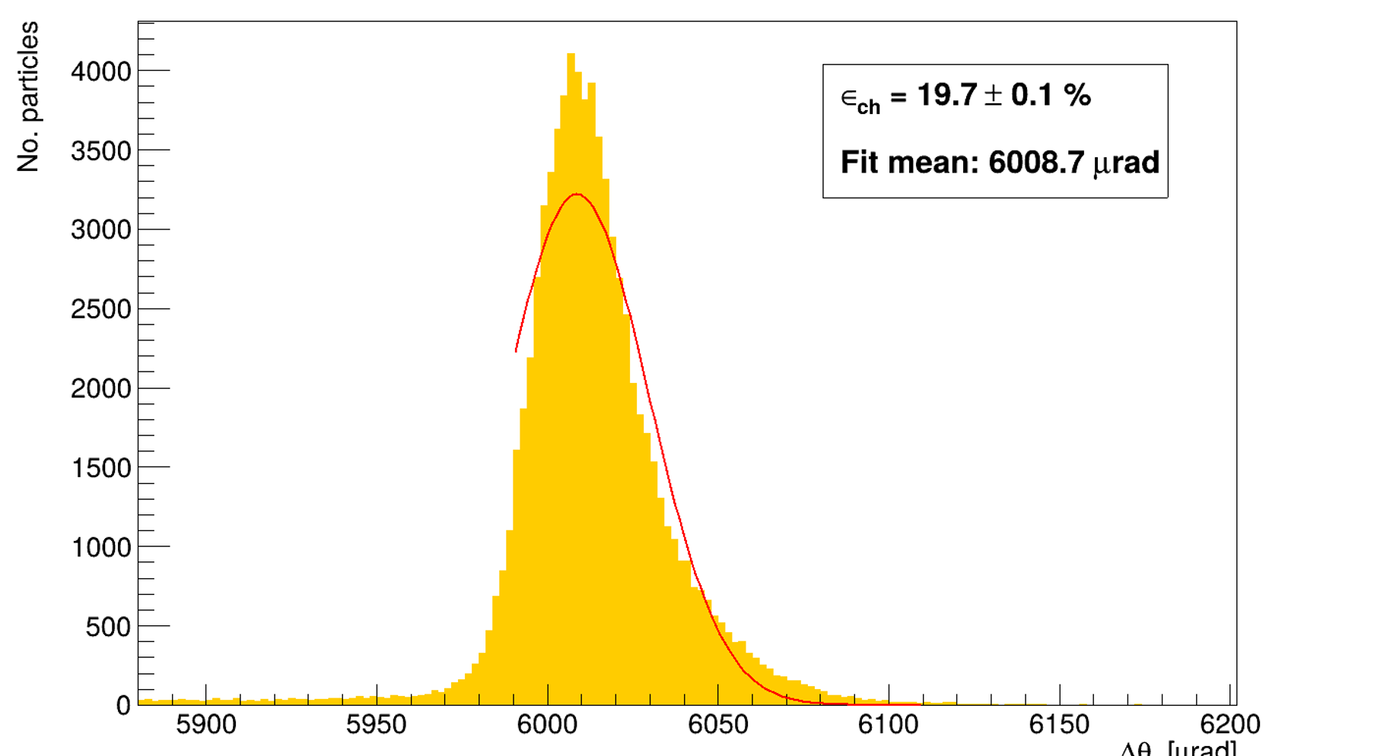


3. ANALYSIS
A Gaussian fit is performed on the deflection peak.
We fit the right side of the peak to ensure the cleanest measurement (no dechanneled particles contribution).
$$N_{tot}$$
$$N_{ch}$$
Notes:
By fitting only the right side of the peak, we ensured the cleanest possible measurement by excluding any contribution from dechanneled particles.

Slide 18
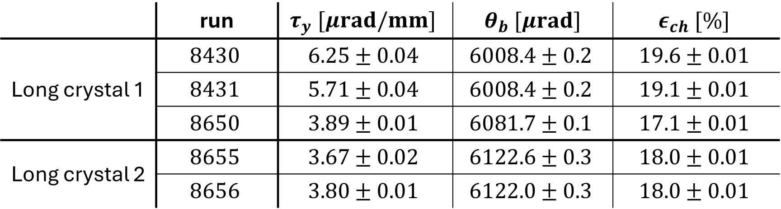
4. RESULTS
 | run | $$τ_{y} [μrad/mm]$$ | $θ_{b} [μrad]$ | $$ε_{ch} [\%]$$
Long crystal 1 | $$8430$$ | $$6.25±0.04$$ | $$6008.4±0.2$$ | $$19.6±0.01$$
 | $$8431$$ | $$5.71±0.04$$ | $$6008.4±0.2$$ | $$19.1±0.01$$
 | $$8650$$ | $$3.89±0.01$$ | $$6081.7±0.1$$ | $$17.1±0.01$$
Long crystal 2 | $$8655$$ | $$3.67±0.02$$ | $$6122.6±0.3$$ | $$18.0±0.01$$
 | $$8656$$ | $$3.80±0.01$$ | $$6122.0±0.3$$ | $$18.0±0.01$$
Notes:
CONSISTENT ACROSS DIFFERENT RUNS FOR THE SAME CRYSTALS

Slide 19
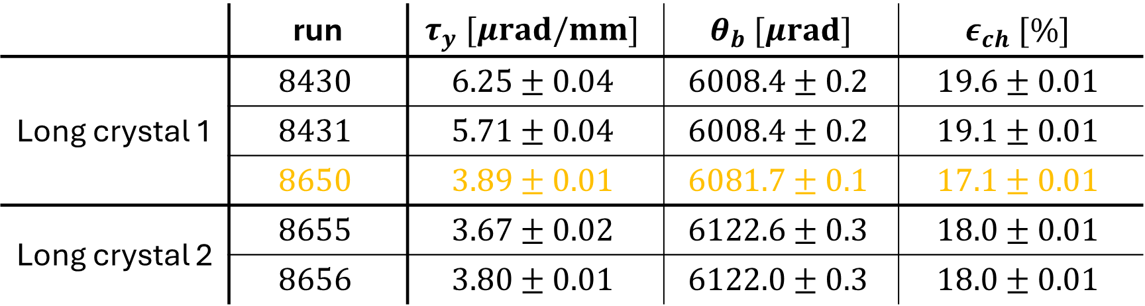
4. RESULTS
 | run | $$τ_{y} [μrad/mm]$$ | $θ_{b} [μrad]$ | $$ε_{ch} [\%]$$
Long crystal 1 | $$8430$$ | $$6.25±0.04$$ | $$6008.4±0.2$$ | $$19.6±0.01$$
 | $$8431$$ | $$5.71±0.04$$ | $$6008.4±0.2$$ | $$19.1±0.01$$
 | $$8650$$ | $$3.89±0.01$$ | $$6081.7±0.1$$ | $$17.1±0.01$$
Long crystal 2 | $$8655$$ | $$3.67±0.02$$ | $$6122.6±0.3$$ | $$18.0±0.01$$
 | $$8656$$ | $$3.80±0.01$$ | $$6122.0±0.3$$ | $$18.0±0.01$$
Notes:
CONSISTENT ACROSS DIFFERENT RUNS FOR THE SAME CRYSTALS

Slide 20
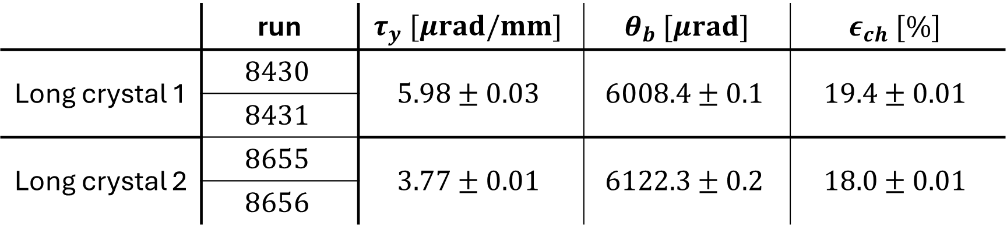
4. COMBINED RESULTS
 | run | $$τ_{y} [μrad/mm]$$ | $θ_{b} [μrad]$ | $$ε_{ch} [\%]$$
Long crystal 1 | $$8430$$ | $$5.98±0.03$$ | $$6008.4±0.1$$ | $$19.4±0.01$$
 | $$8431$$
Long crystal 2 | $$8655$$ | $$3.77±0.01$$ | $$6122.3±0.2$$ | $$18.0±0.01$$
 | $$8656$$
Notes:
CONSISTENT ACROSS DIFFERENT RUNS FOR THE SAME CRYSTALS

Slide 21
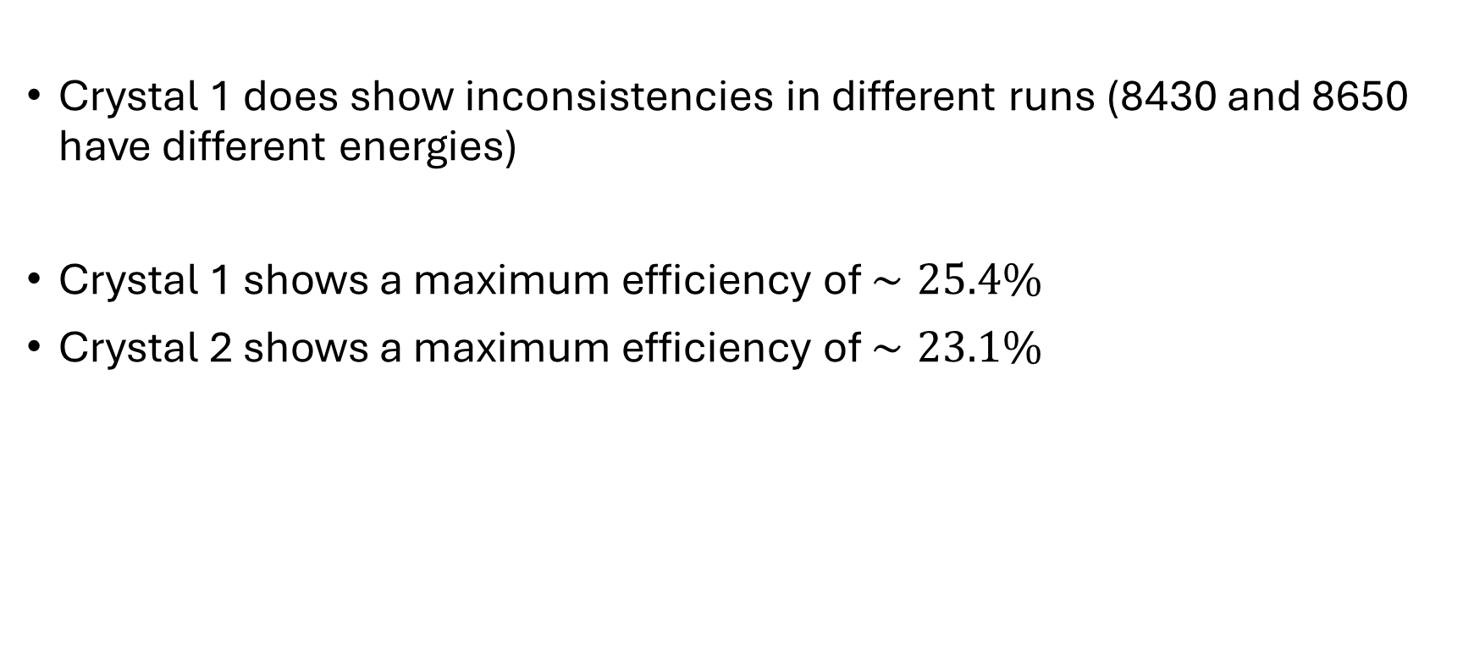
4. FINAL RESULTS
Crystal 1 does show inconsistencies in different runs (8430 and 8650 have different energies)
Crystal 1 shows a maximum efficiency of $∼25.4\%$
Crystal 2 shows a maximum efficiency of $∼23.1\%$
Notes:
CONSISTENT ACROSS DIFFERENT RUNS FOR THE SAME CRYSTALS

Slide 22

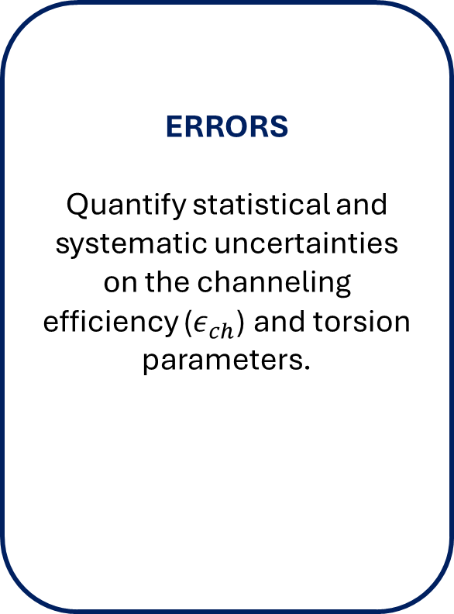
4. NEXT STEPS
ERRORS
Quantify statistical and systematic uncertainties on the channeling efficiency ($ε_{ch}$) and torsion parameters.
SPIKES
Explore the spikes found in the histogram from the channeled particles
RUN 8650
Understand why run 8650 shows an incompatible channeling peak.
Notes:
Before diving into the efficiency evaluation, we performed several preliminary analysis steps.
Next, because the relative beam position was unknown, we had to algorithmically identify the physical edges of the crystal to validate which particles successfully entered it.

Slide 23
BACKUP SLIDES

Slide 24
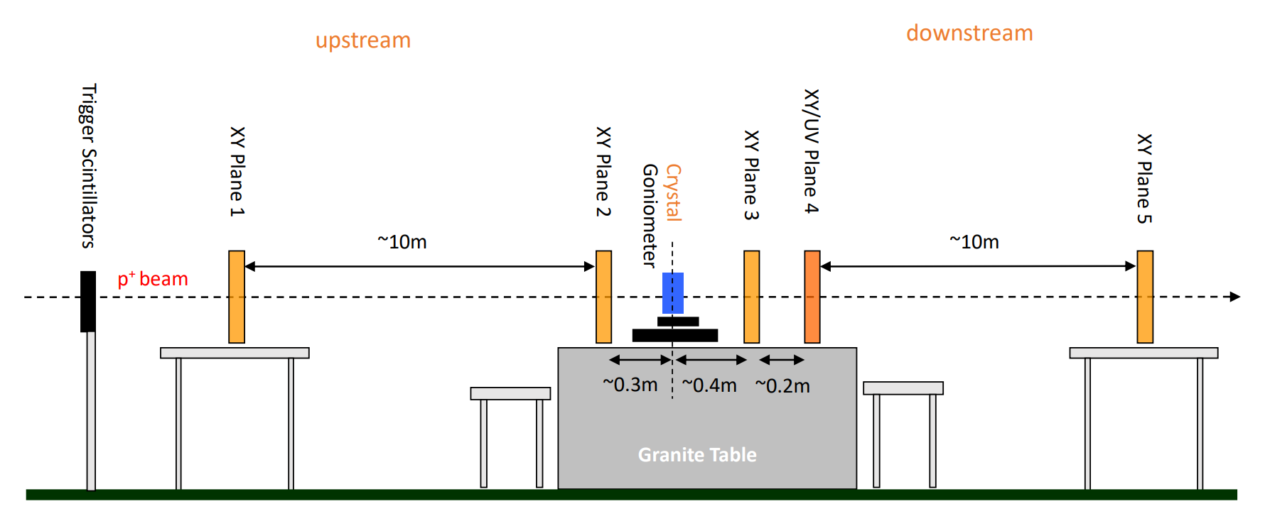
BACKUP SLIDES: SCHEMATIC LAYOUT

Slide 25
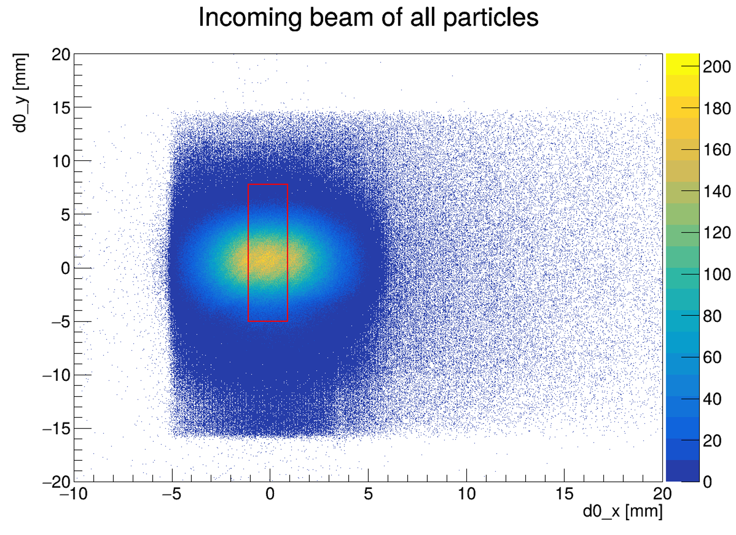
BACKUP SLIDES: SPATIAL CUT
12.8 mm
2 mm

Slide 26

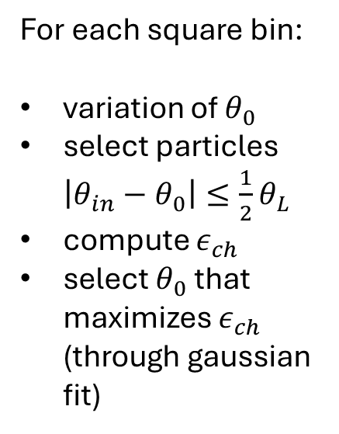
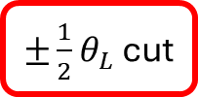
BACKUP SLIDES: ANGLE SELECTION
$±\frac{1}{2}θ_{L}$ cut
For each square bin:
variation of $θ_{0}$
select particles $\left|θ_{in}−θ_{0}\right|≤\frac{1}{2}θ_{L}$
compute $ε_{ch}$
select $θ_{0}$ that maximizes $ε_{ch}$ (through gaussian fit)
Notes:
If not considering any torsion correction: we would just calculate the channeling efficiency through several iterations varying $θ_{0}$ until the highest efficiency is found, representing the best alignment of incoming particles with the crystalline planes

Slide 27

BACKUP SLIDES: ANGLE SELECTION
For each square bin:
variation of $θ_{0}$
select particles $\left|θ_{in}−θ_{0}\right|≤\frac{1}{2}θ_{L}$
compute $ε_{ch}$
select $θ_{0}$ that maximizes $ε_{ch}$ (through gaussian fit)

Slide 28
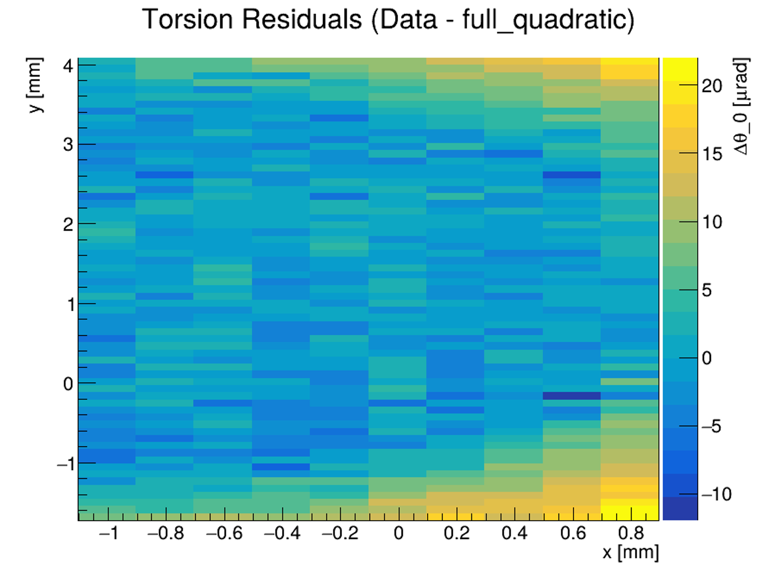
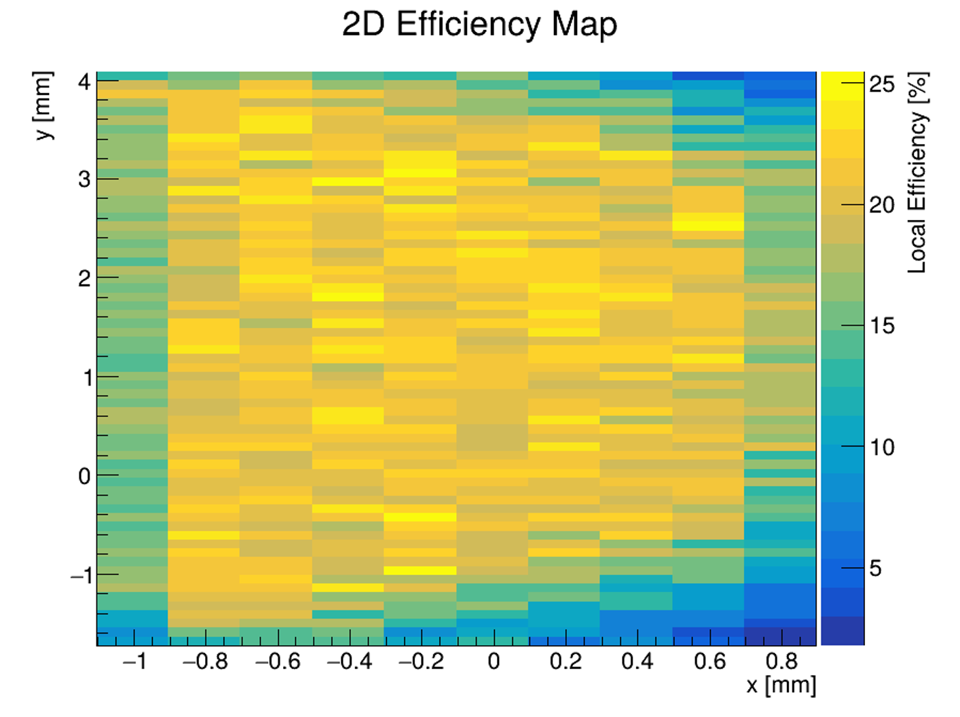
BACKUP SLIDES: TORSION FIT

Slide 29
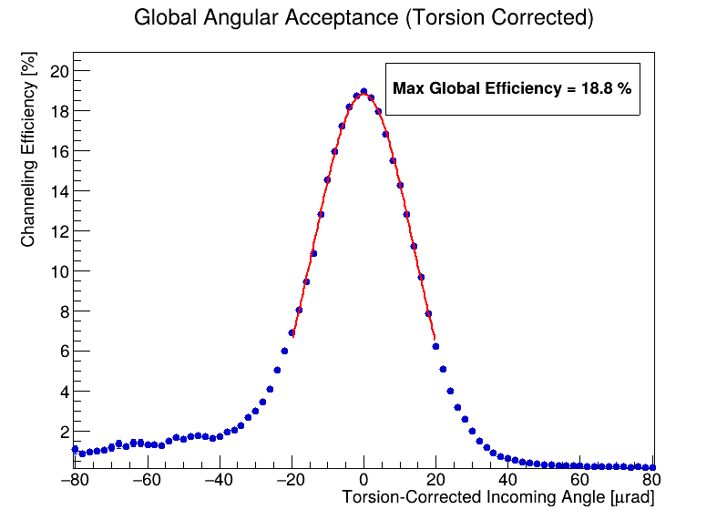
BACKUP SLIDES: EFFICIENCY CURVE
Crystal efficiency as a function of the incoming angle, after application of the torsion correction. The value of the peak is the efficiency of the crystal when it is perfectly aligned to the beam.
Notes:
Applying this torsion correction significantly improves our analysis. When we plot the crystal efficiency as a function of the torsion-corrected incoming angle, the peak of this curve represents the efficiency of the crystal when it is perfectly aligned to the beam, which in this case reached 18.8%.

