Slide 1
SIMULATIONS UPDATE
ANNA SOFIA MORO

Slide 2
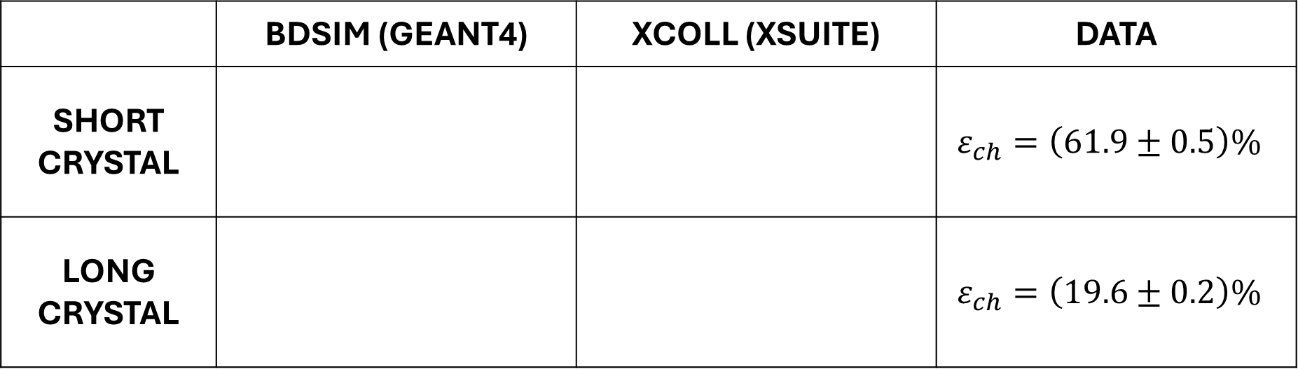
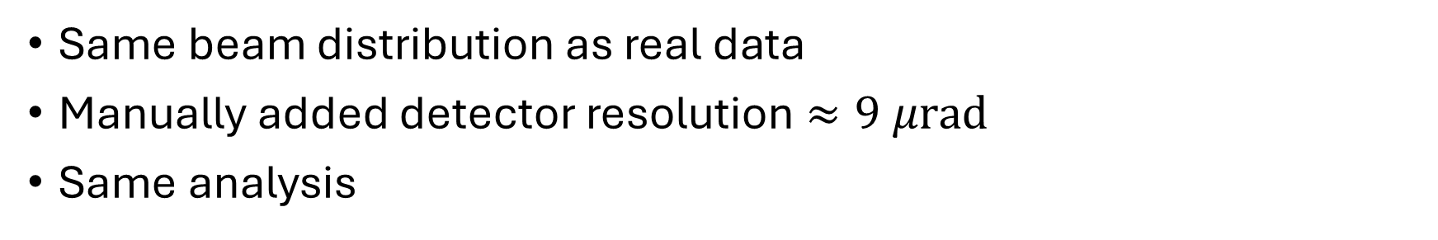
SIMULATIONS
 | BDSIM (GEANT4) | XCOLL (XSUITE) | DATA
SHORT CRYSTAL |  |  | $$ε_{ch}=\left(61.9±0.5\right)\%$$
LONG CRYSTAL |  |  | $$ε_{ch}=\left(19.6±0.2\right)\%$$
Same beam distribution as real data
Manually added detector resolution $≈9 μrad$
Same analysis

Slide 3
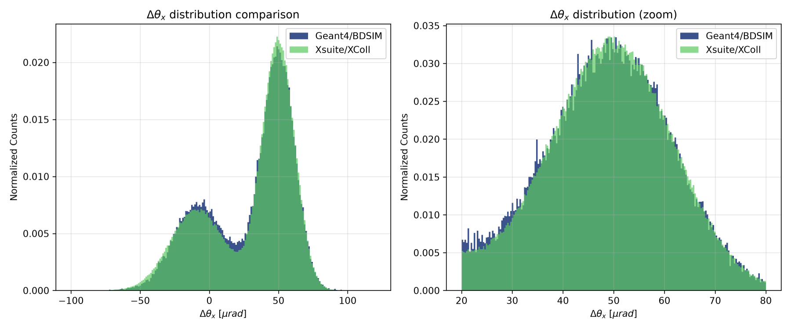
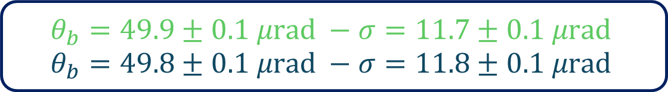
SHORT CRYSTAL - COMPARISON
$$ε_{ch}=\left(64.8±0.2\right)\% ε_{ch}=\left(62.6±0.5\right)\%$$
$$θ_{b}=49.9±0.1 μrad −σ=11.7±0.1 μrad$$
$$θ_{b}=49.8±0.1 μrad −σ=11.8±0.1 μrad$$

Slide 4
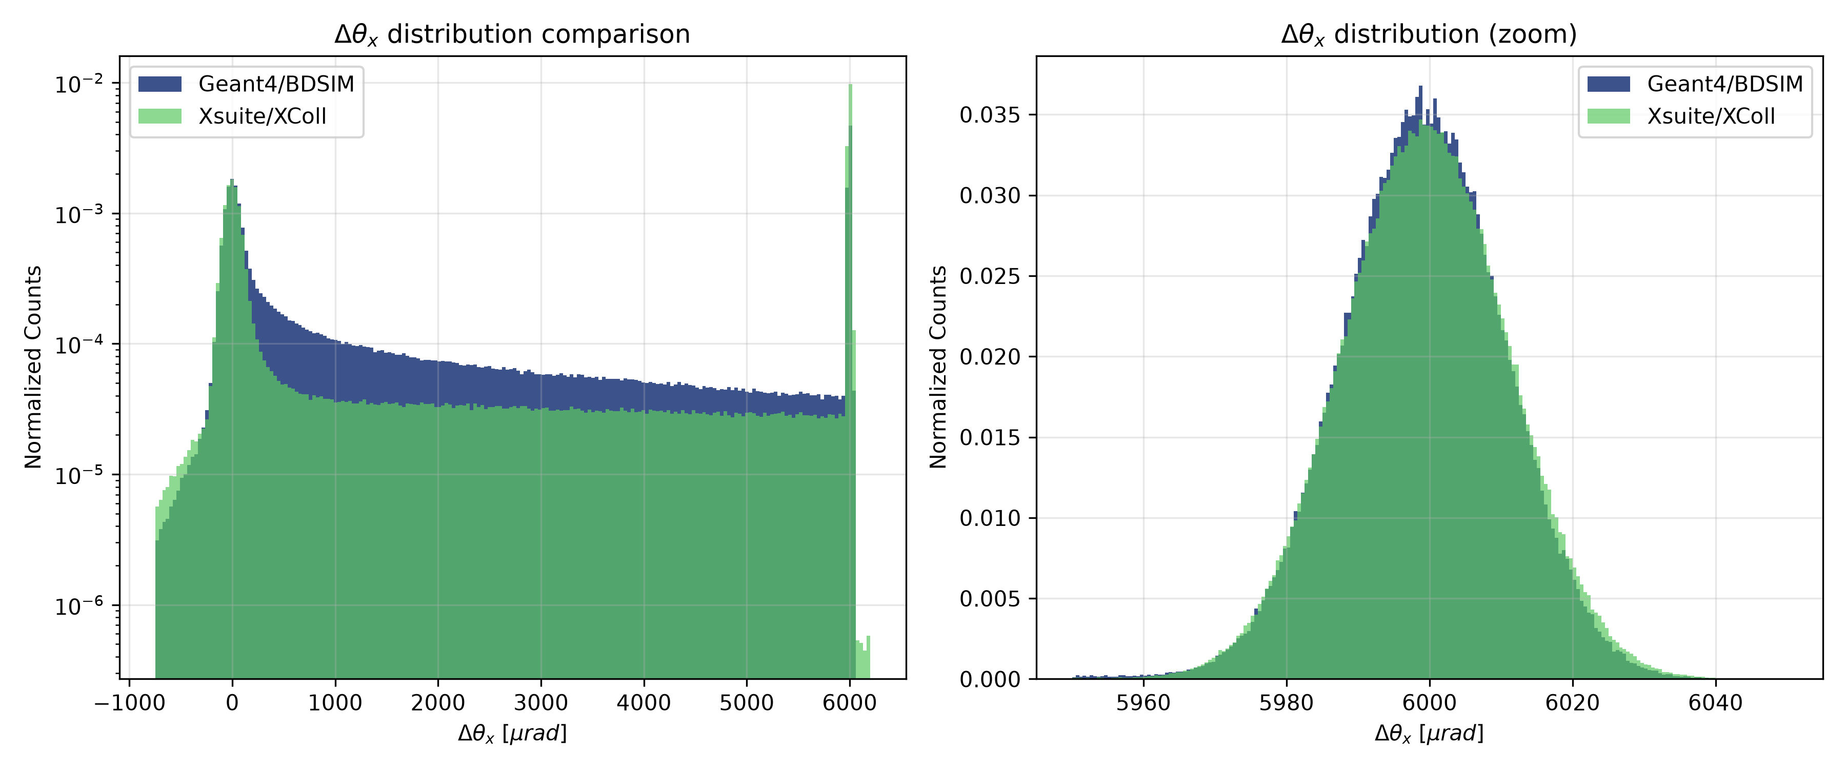
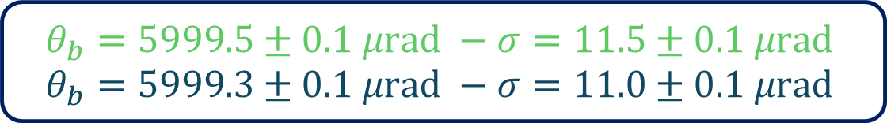
LONG CRYSTAL - COMPARISON
$$ε_{ch}=\left(41.2±0.1\right)\% ε_{ch}=\left(20.2±0.1\right)\%$$
$$θ_{b}=5999.5±0.1 μrad −σ=11.5±0.1 μrad$$
$$θ_{b}=5999.3±0.1 μrad −σ=11.0±0.1 μrad$$

Slide 5
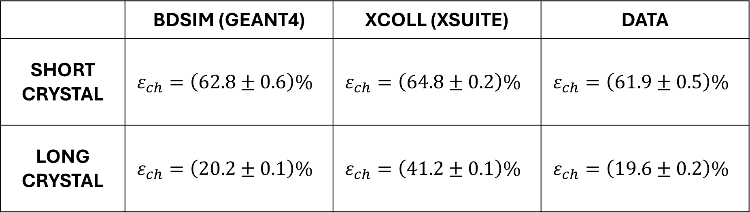
RESULTS
 | BDSIM (GEANT4) | XCOLL (XSUITE) | DATA
SHORT CRYSTAL | $$ε_{ch}=\left(62.8±0.6\right)\%$$ | $$ε_{ch}=\left(64.8±0.2\right)\%$$ | $$ε_{ch}=\left(61.9±0.5\right)\%$$
LONG CRYSTAL | $$ε_{ch}=\left(20.2±0.1\right)\%$$ | $$ε_{ch}=\left(41.2±0.1\right)\%$$ | $$ε_{ch}=\left(19.6±0.2\right)\%$$

Slide 6
BACKUP

Slide 7
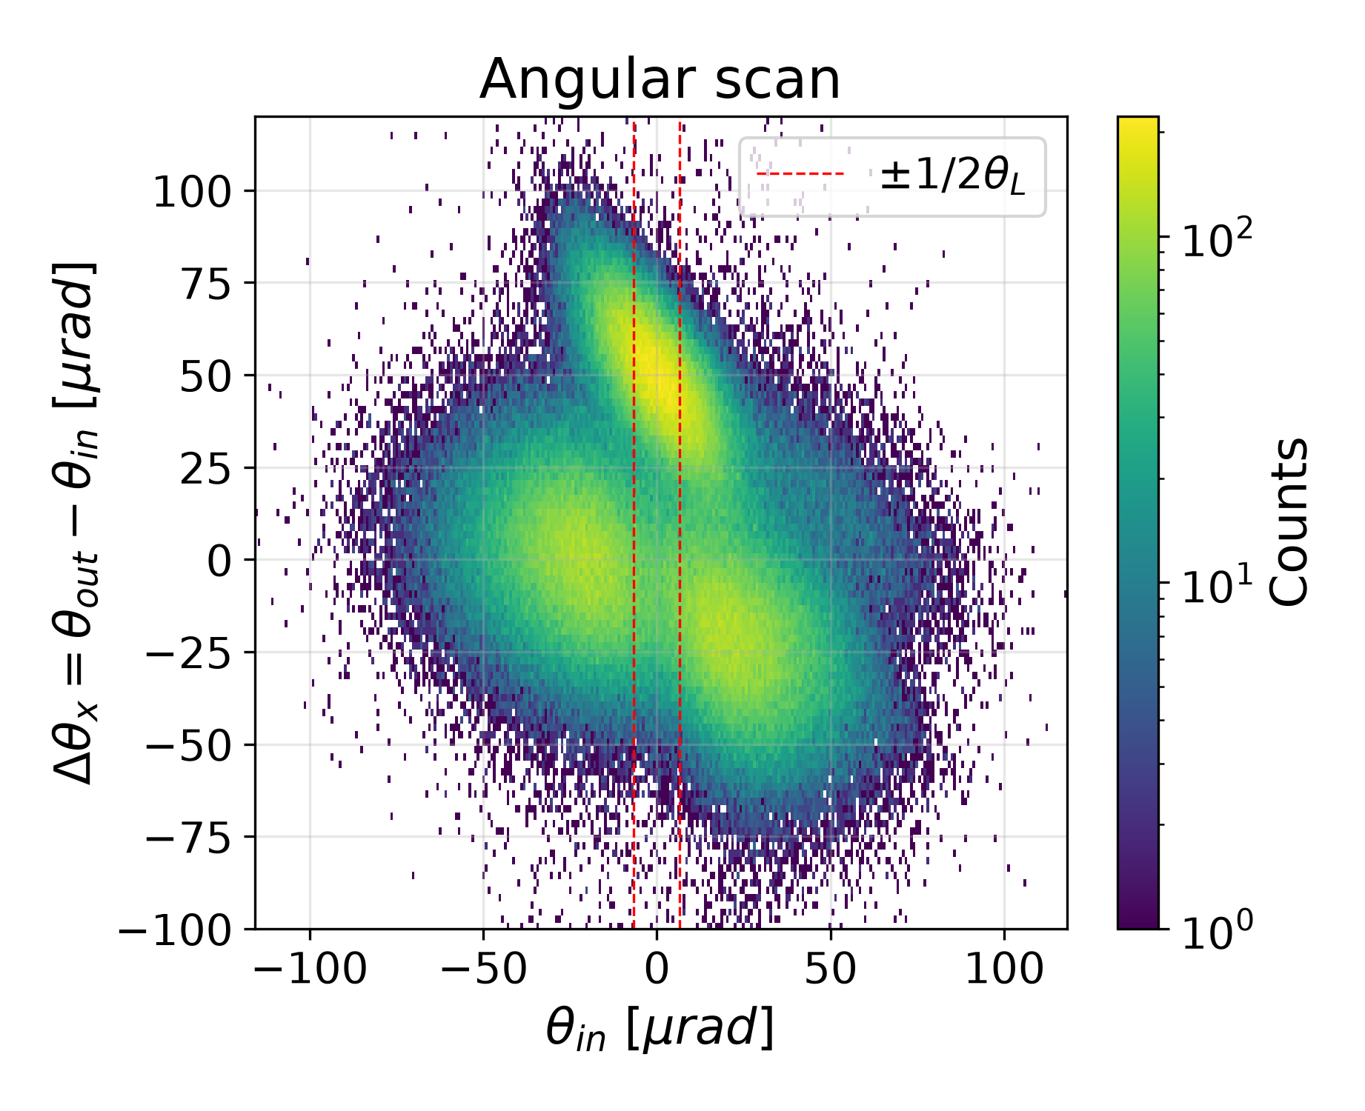
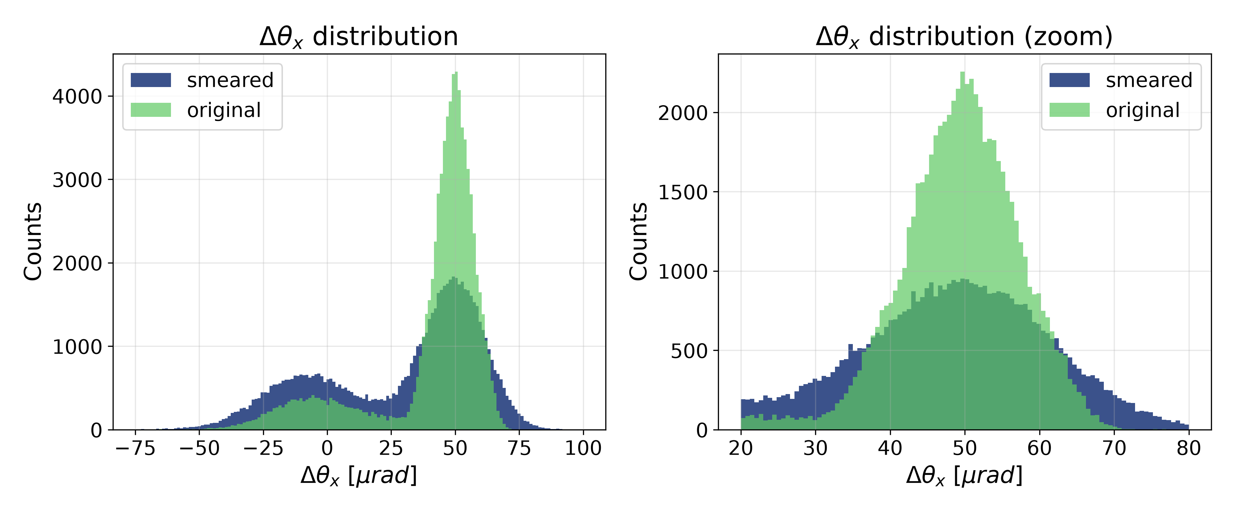

SHORT CRYSTAL: BDSIM
without smear $ε_{ch}=\left(79±1\right)\%$
with smear $ε_{ch}=\left(62.6±0.5\right)\%$

Slide 8
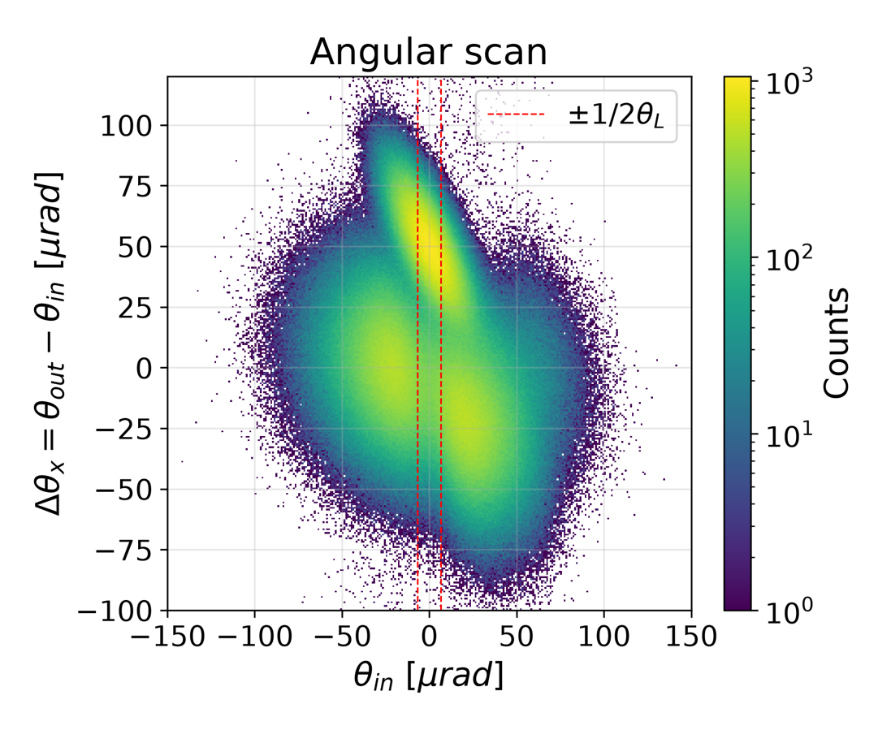
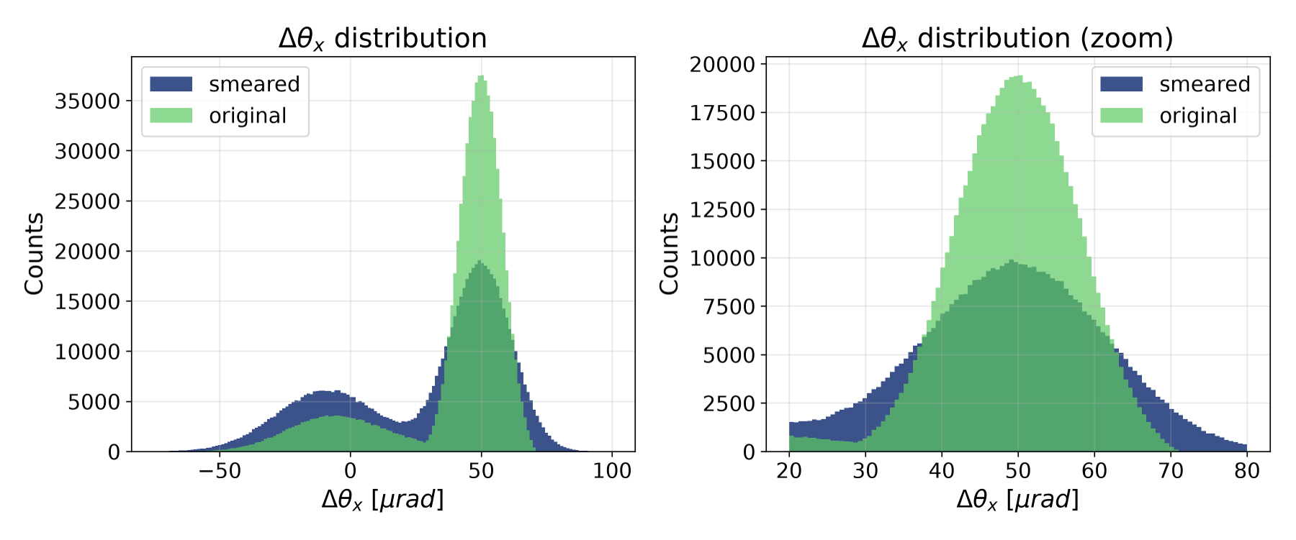

SHORT CRYSTAL: XCOLL
without smear $ε_{ch}=\left(75±1\right)\%$
with smear $ε_{ch}=\left(64.8±0.2\right)\%$

Slide 9
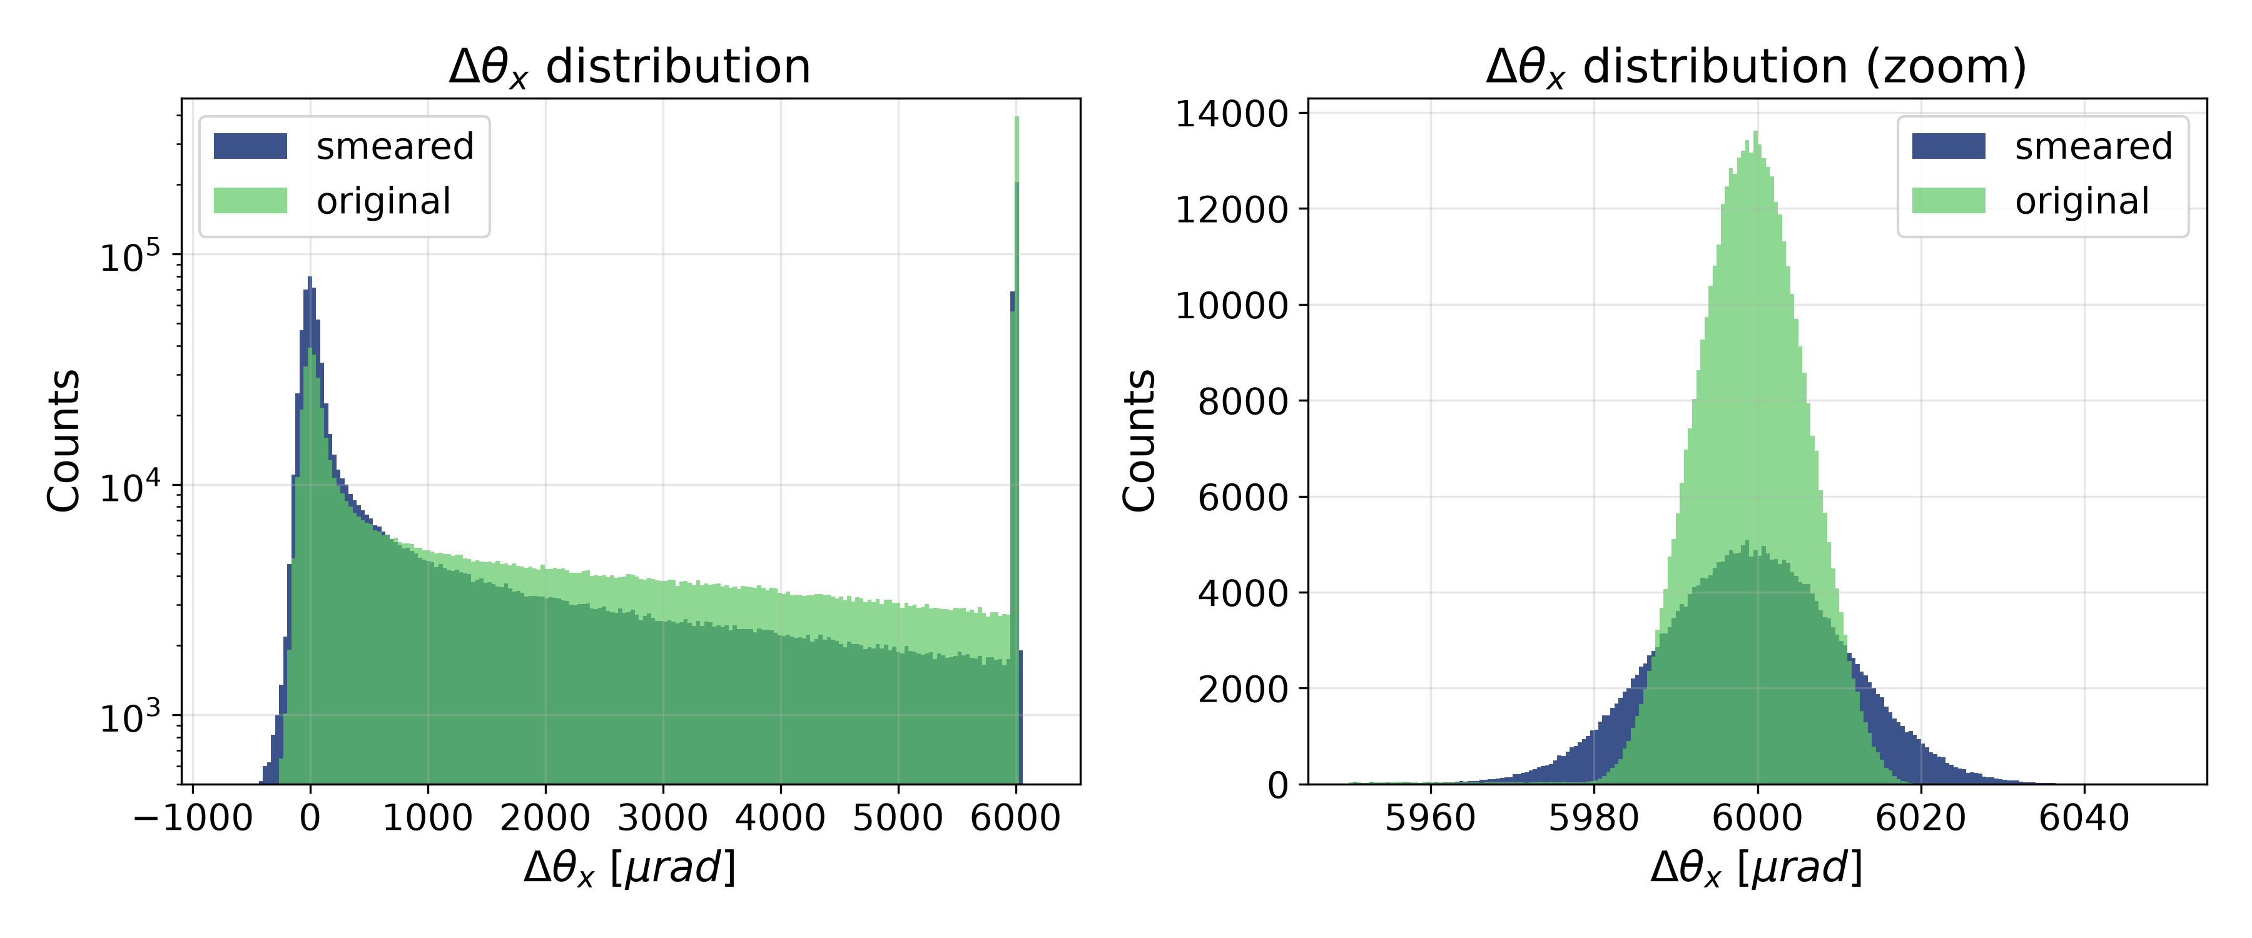
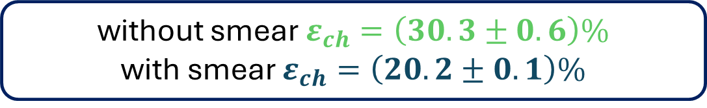
LONG CRYSTAL: BDSIM
without smear $ε_{ch}=\left(30.3±0.6\right)\%$
with smear $ε_{ch}=\left(20.2±0.1\right)\%$

Slide 10
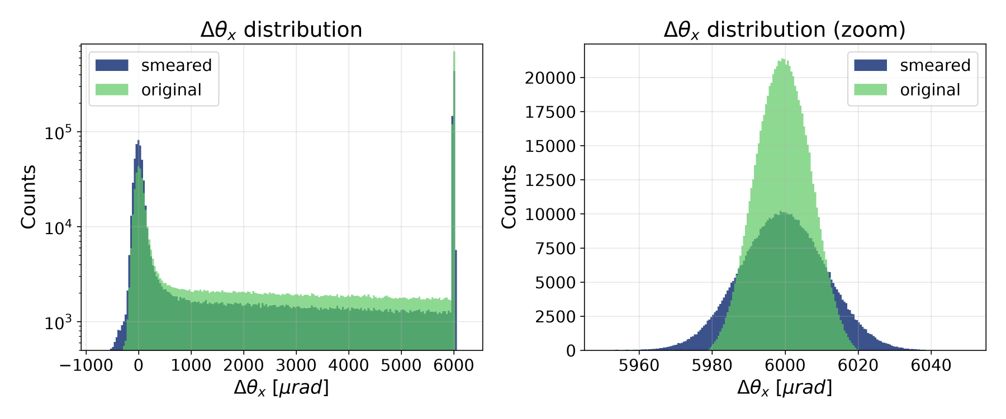
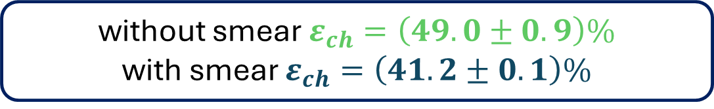
LONG CRYSTAL: XCOLL
without smear $ε_{ch}=\left(49.0±0.9\right)\%$
with smear $ε_{ch}=\left(41.2±0.1\right)\%$

Slide 11
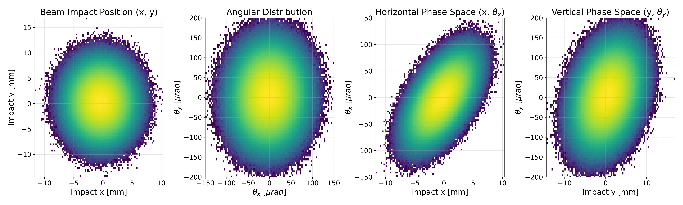
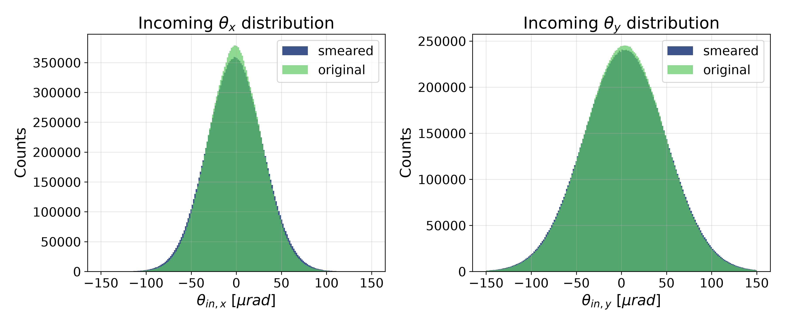
SIMULATIONS

Slide 12
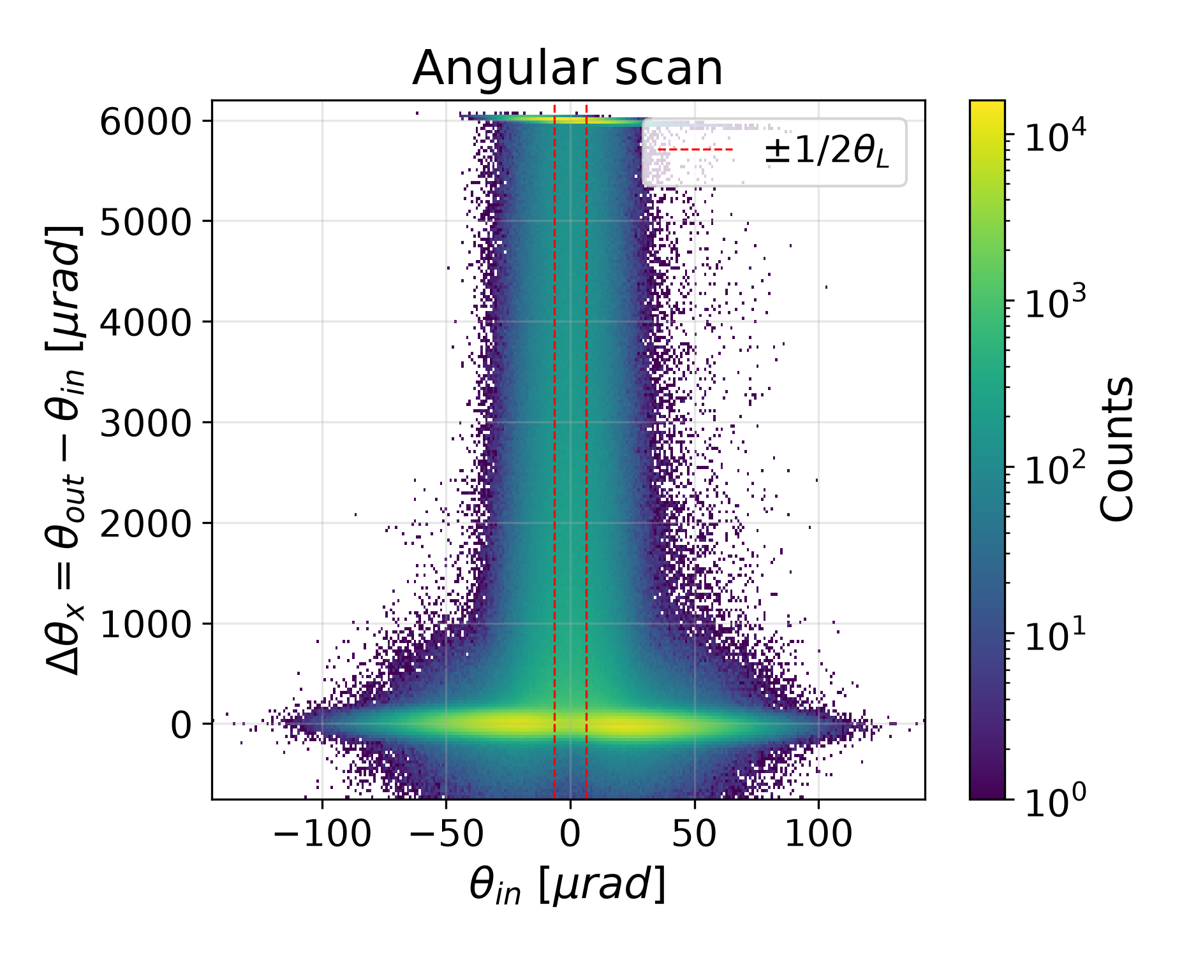
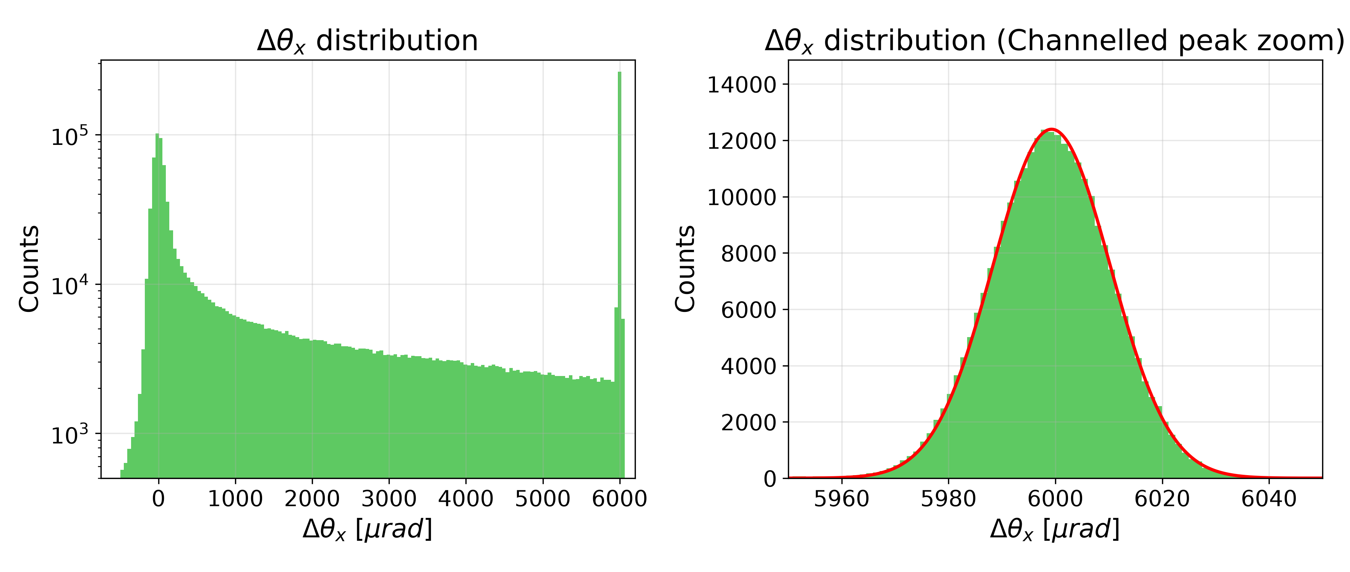
BDSIM – LONG CRYSTAL
$$θ_{b}=5999.3±0.1 μrad$$
$$σ=11.0±0.1 μrad$$

Slide 13
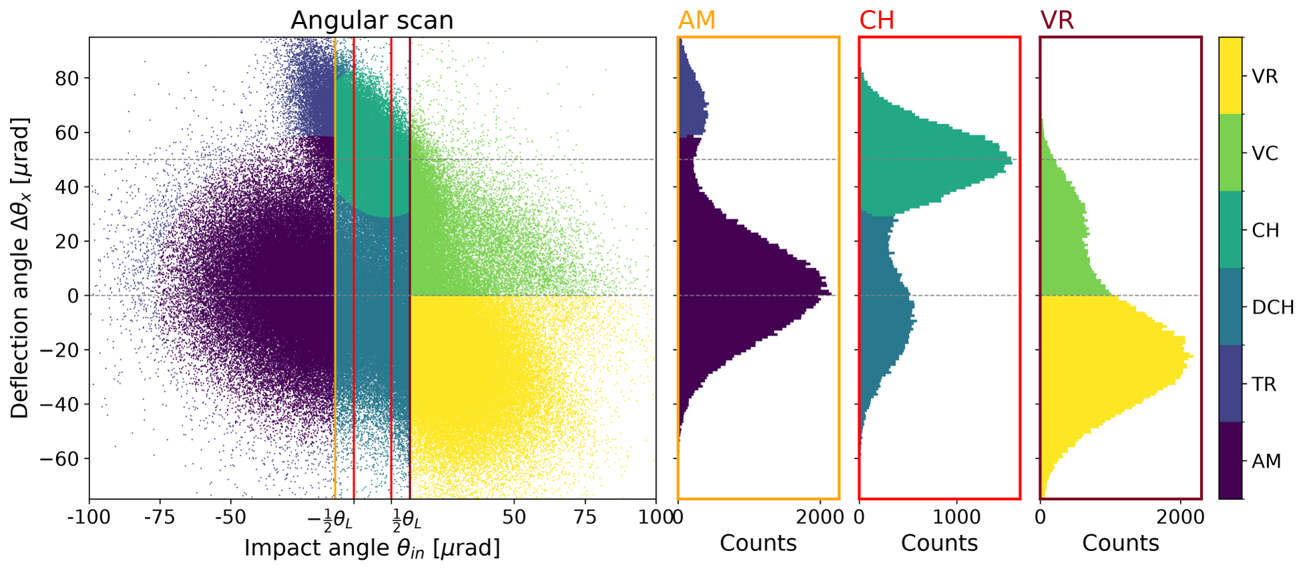
SHORT CRYSTAL

