Slide 1
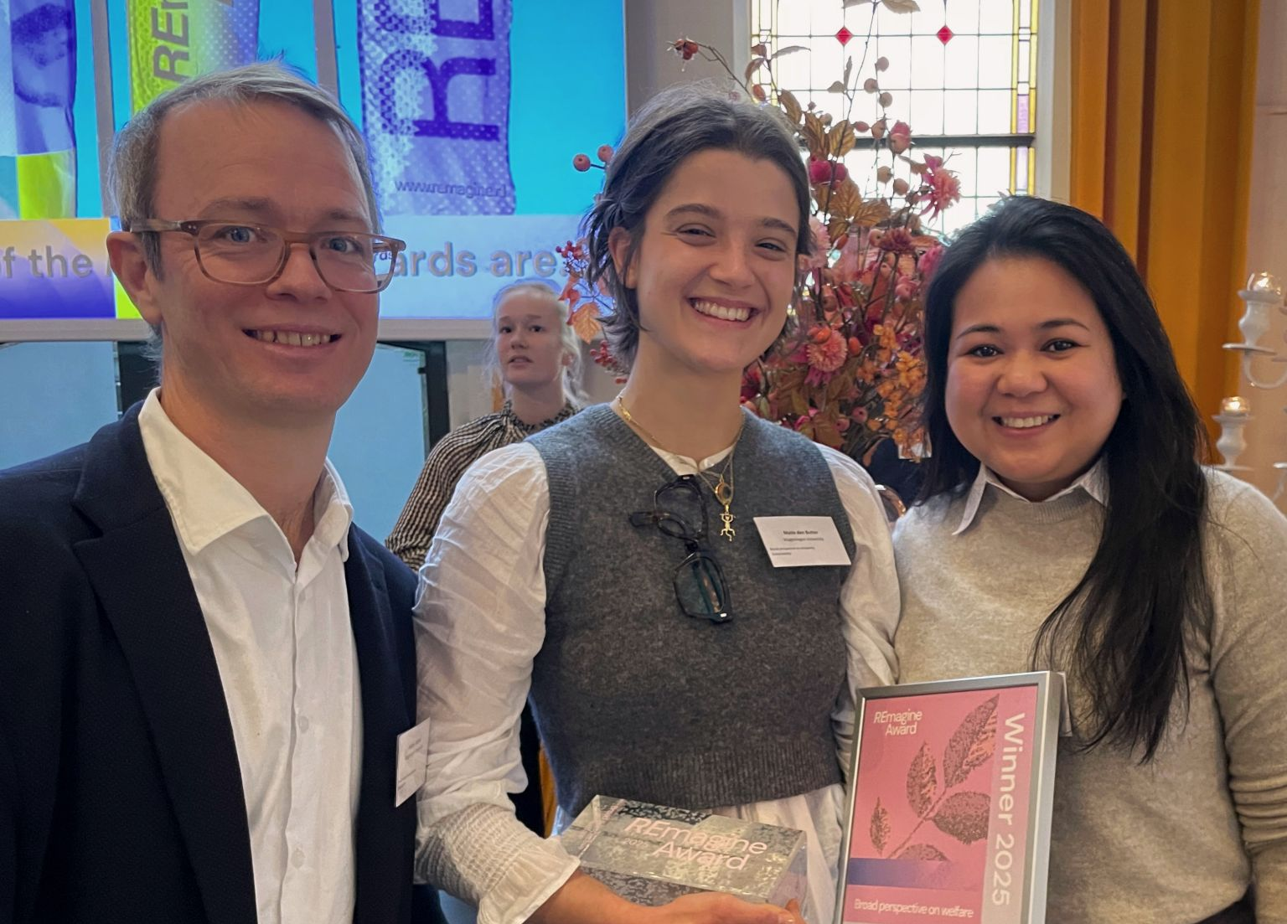
Winner 2025
Rewarding ideas for a fairer and more inclusive future
supervisors
Anna Lou Abatayo
Andries Richter
REmagine Award
Maite den butter |
Broad perspectives on prosperity

Slide 2
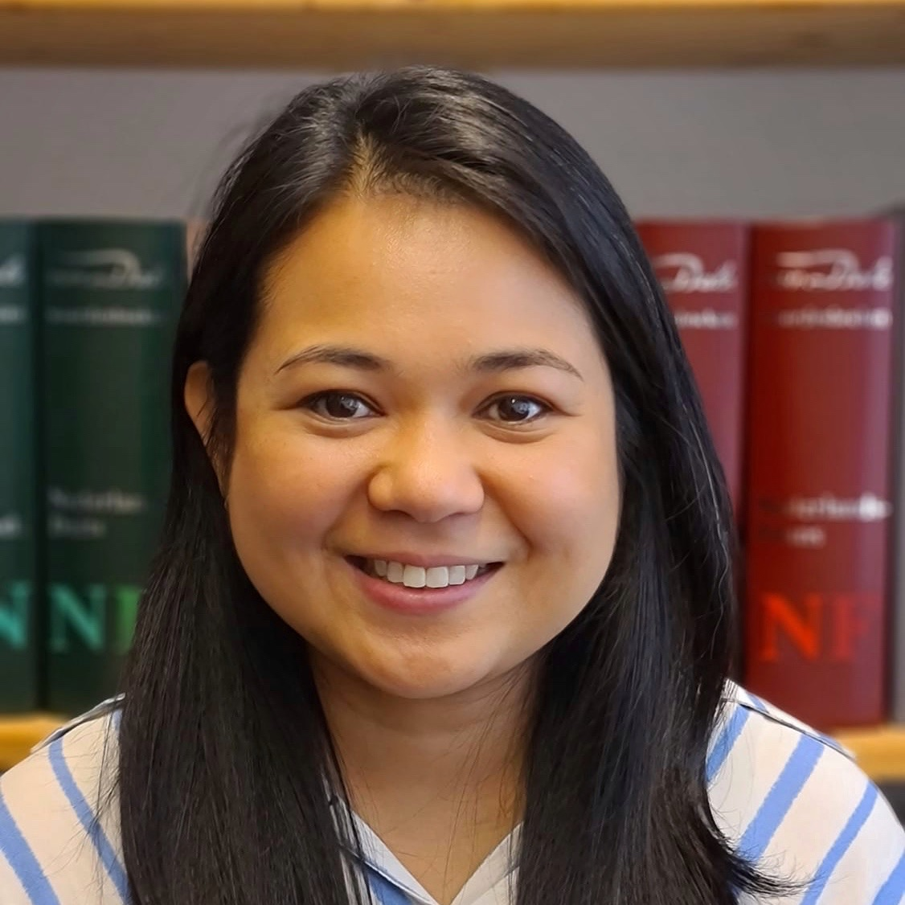

Congratulations!
Anna Lou
Abatayo
on winning the
NWO Open Competition SSH XS grant
for her project
Why Here? Drivers of
Marine Protection in
The Coral Triangle
Supporting
innovative and
bold ideas that open
new directions in
the social sciences
and humanities.
Her project investigates the determinants of marine
protected area placement in the Coral Triangle –
the world’s most biodiverse marine region – and
Provides new evidence on how conservation
Priorities translate into spatial protection

