Slide 1
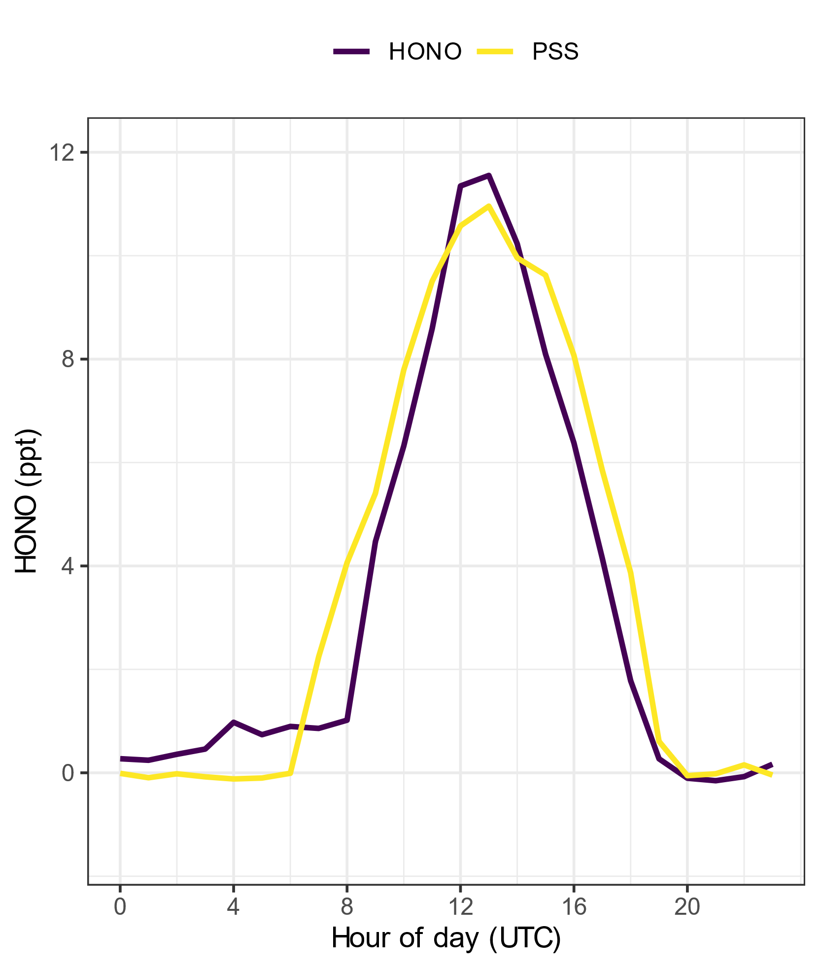
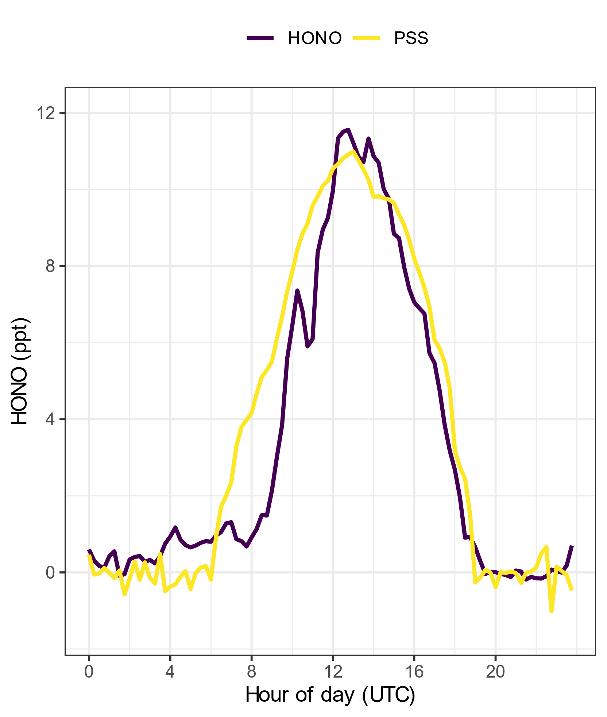
Hourly vs 15-minute average diurnals
The 15-minute average diurnals show that in the evening the decrease of HONO is pretty accurately captured by the PSS calculations.
The increase of HONO in the morning is off even looking at the 15-minute average, with the PSS rising earlier -> broader diurnal compared to measurement
Notes:
For the 15-minute averages, I interpolated for photolysis rates and for OH mixing ratios because these measurements were only hourly.

Slide 2
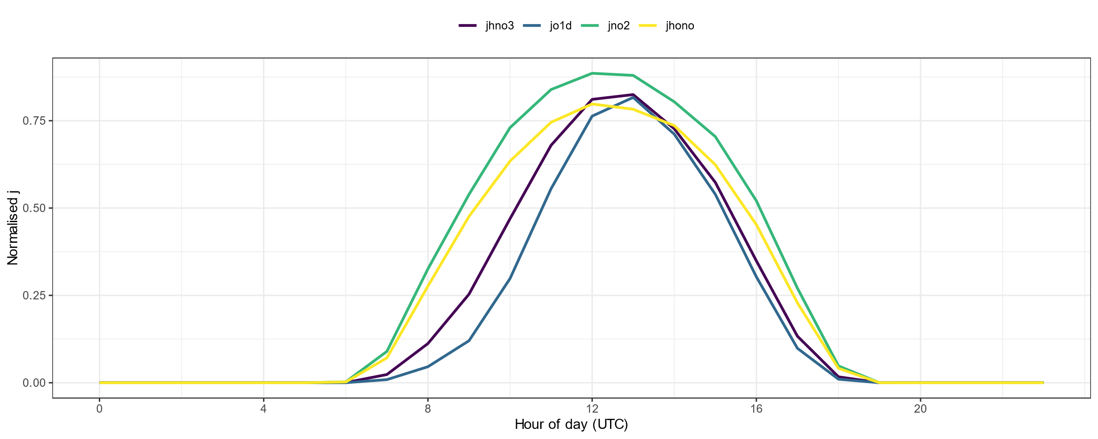
Comparing photolysis rate constants

Slide 3
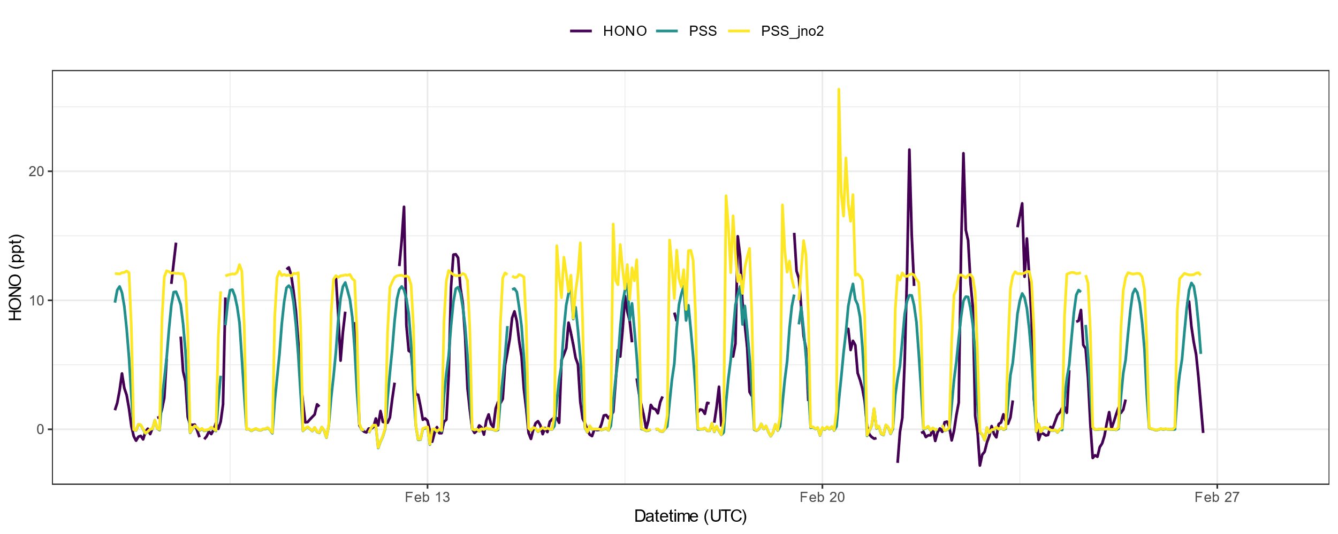
Comparing PSS calculated with j_{HNO3} and j_{NO2}

Slide 4
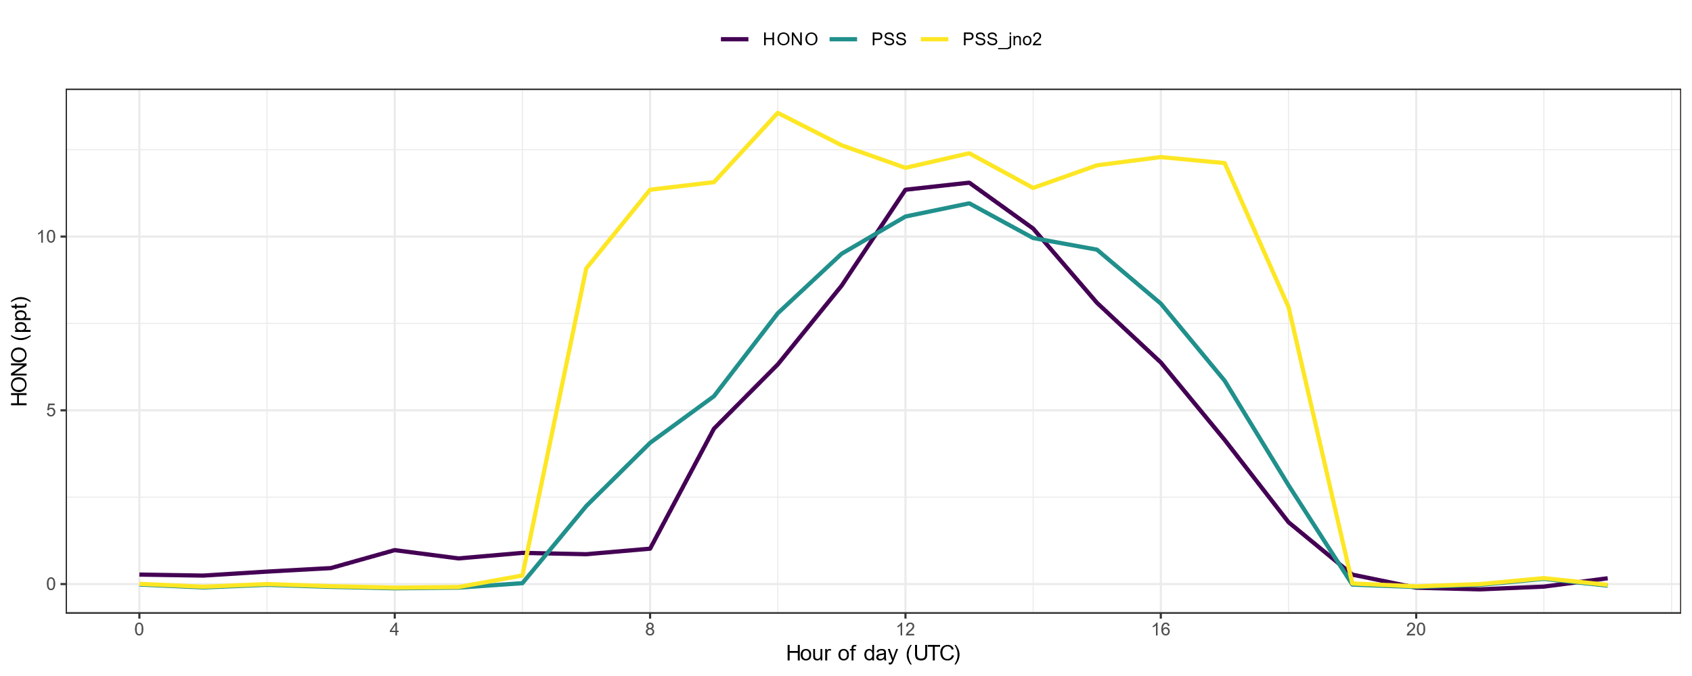
Diurnal of PSS calculated with j_{HNO3} and j_{NO2}

Slide 5
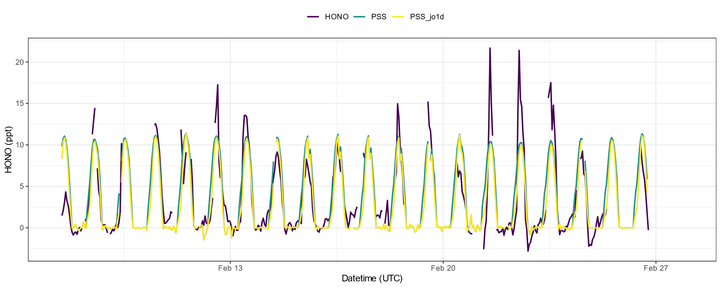
Comparing PSS calculated with j_{HNO3} and j_{O1D}

Slide 6
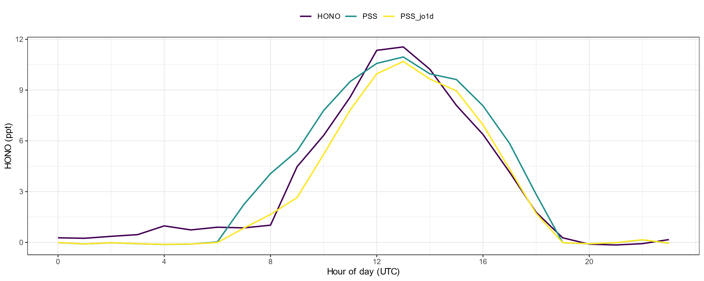
Diurnal of PSS calculated with j_{HNO3} and j_{O1D}

