Slide 1
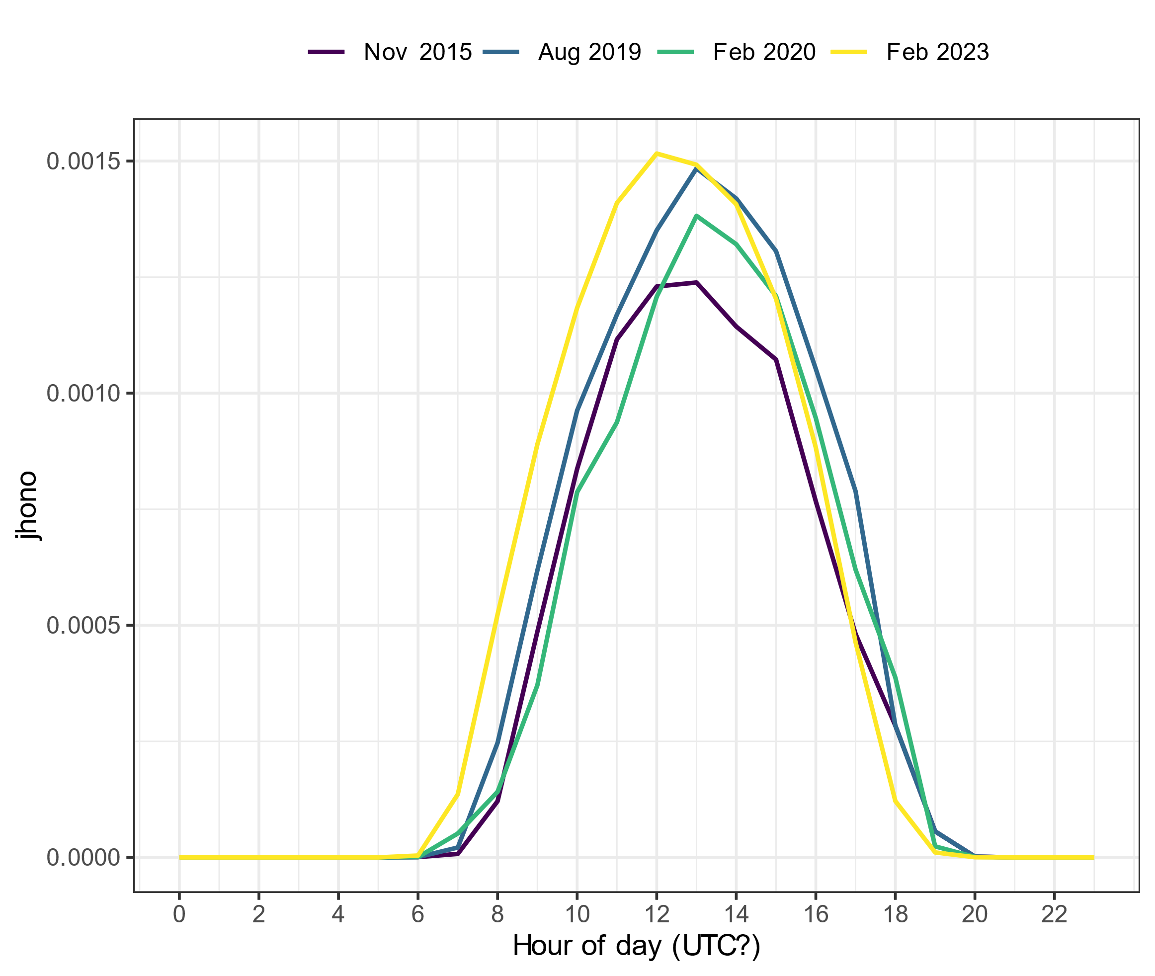
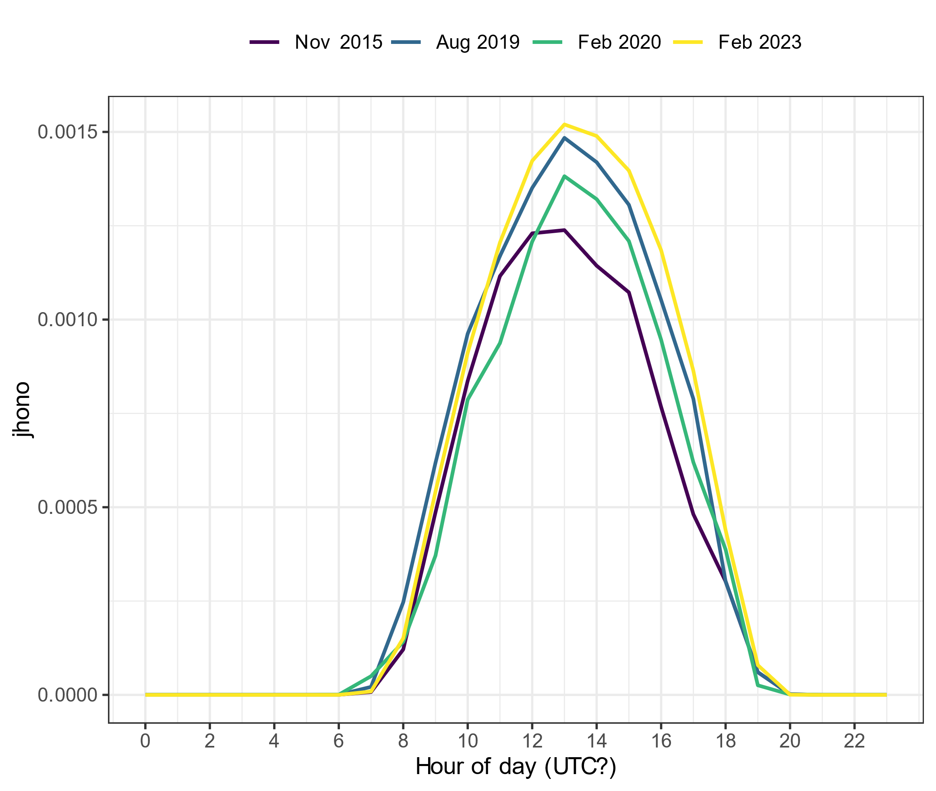
Spec rad data in UTC?
j_{HONO} without any corrections
j_{HONO} with correction on 2023 data
Notes:
2015 data from one excel file (jrates_all_new_2015-2020)
2019 and 2020 data from the same excel file (2016_2020_Spec_rad_Hourly)
2023 data from another excel file (Specrad_hour_23_with_calc)

Slide 2
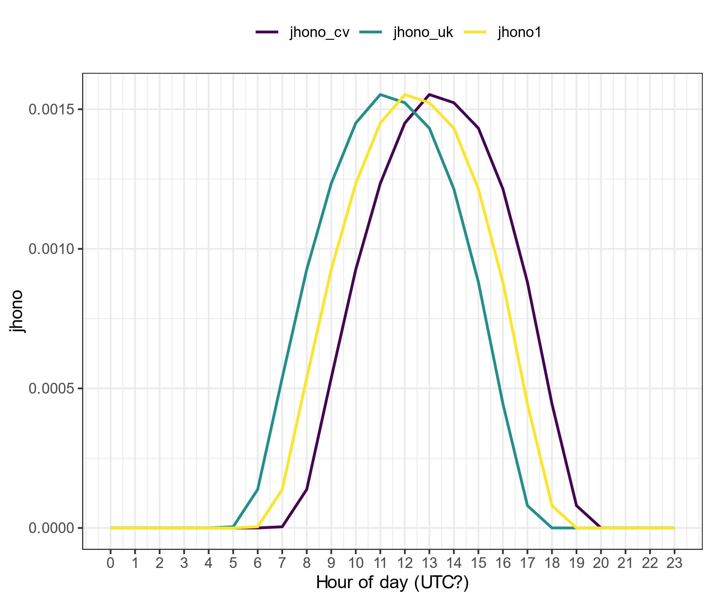
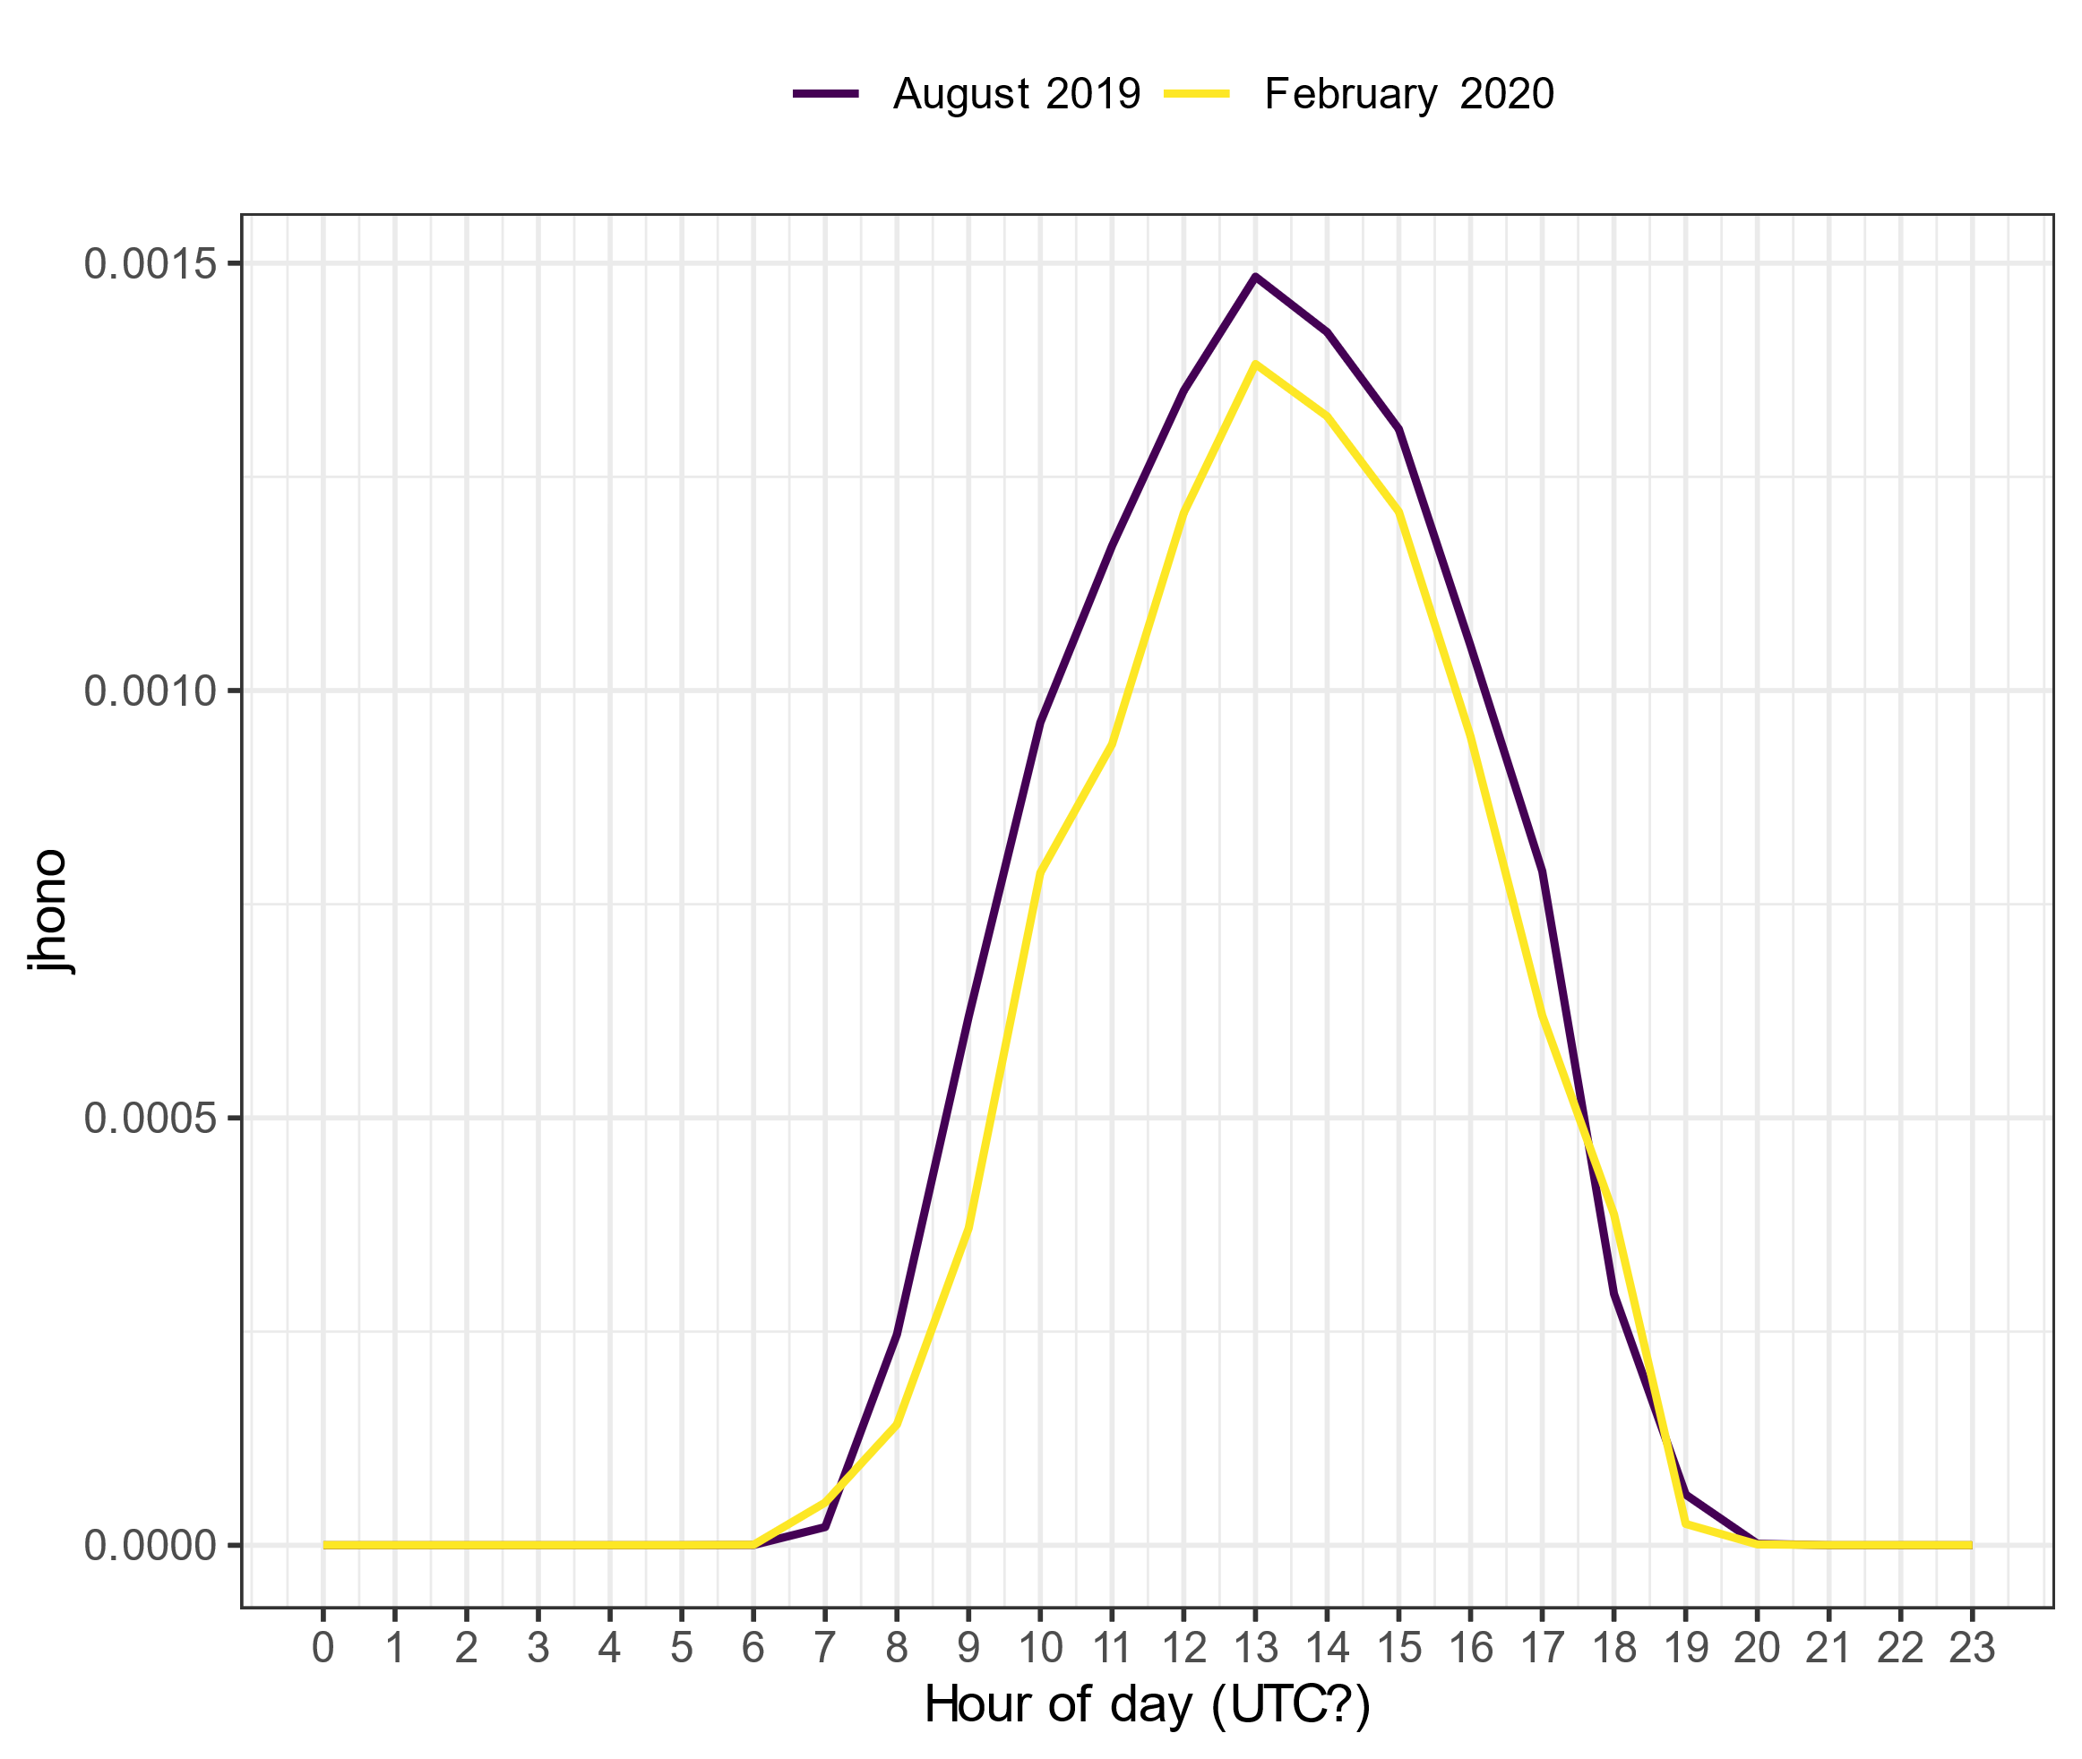
j_{HONO} from February 2023 with different time corrections

Slide 3
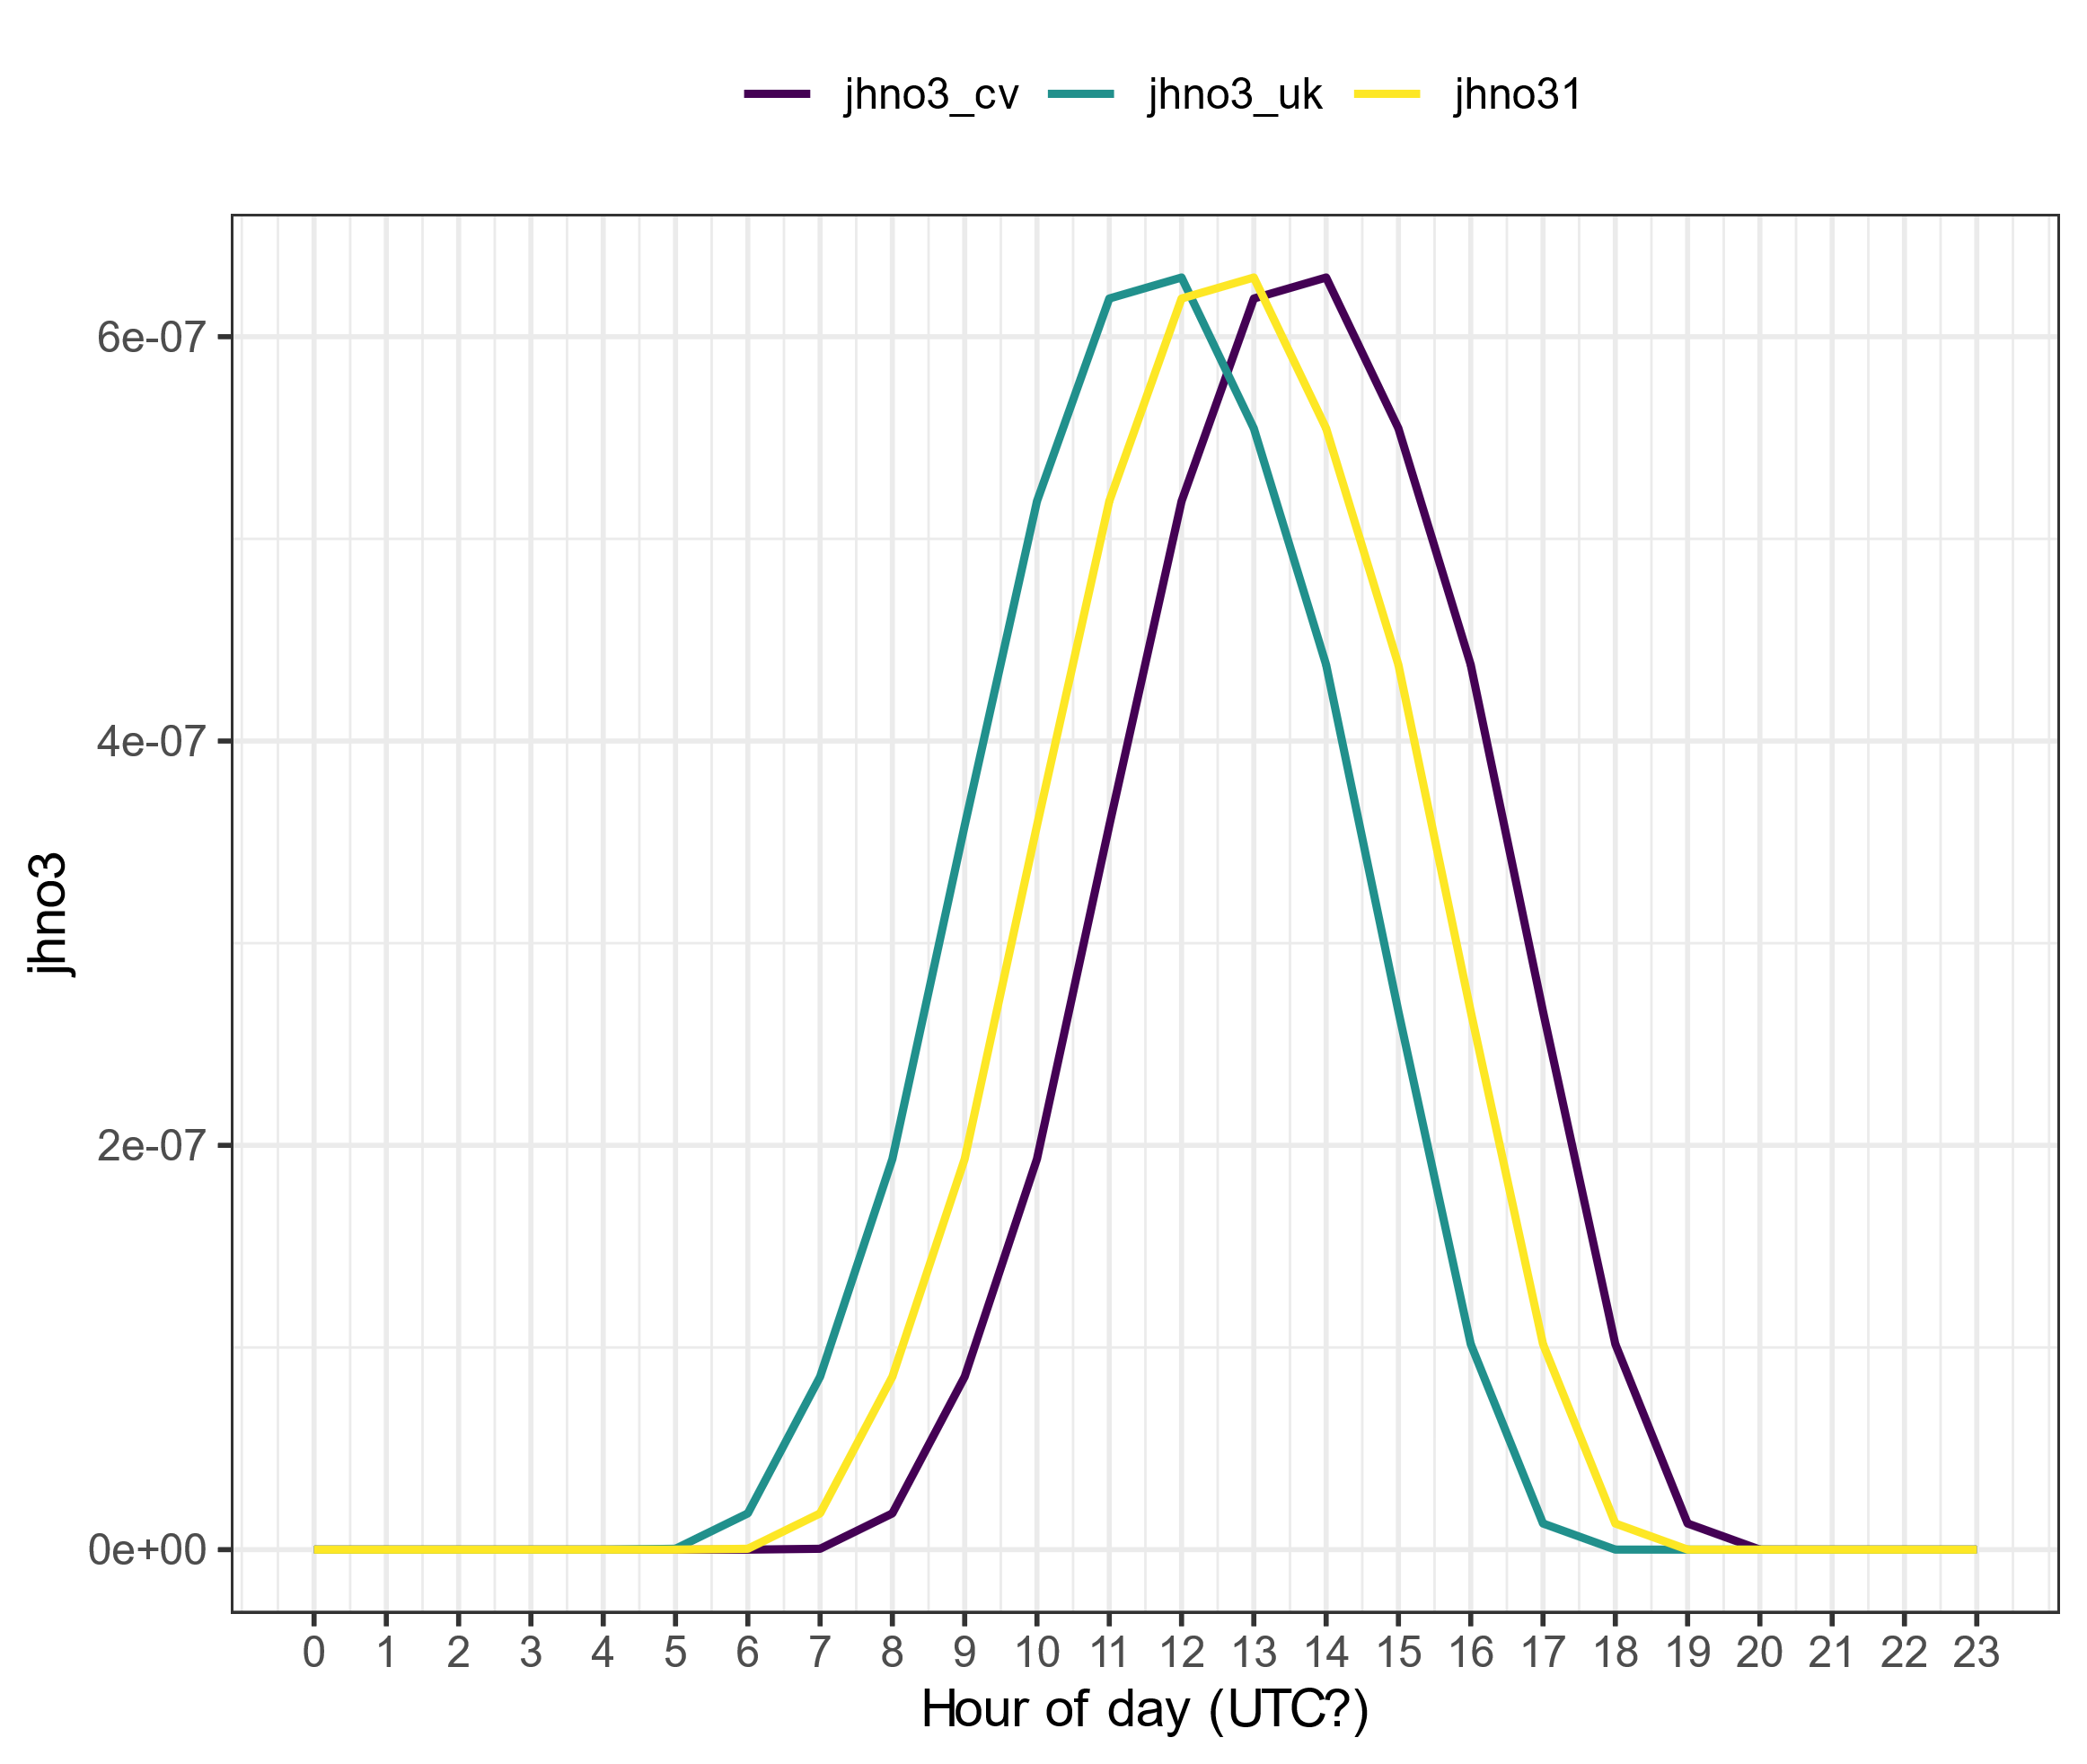
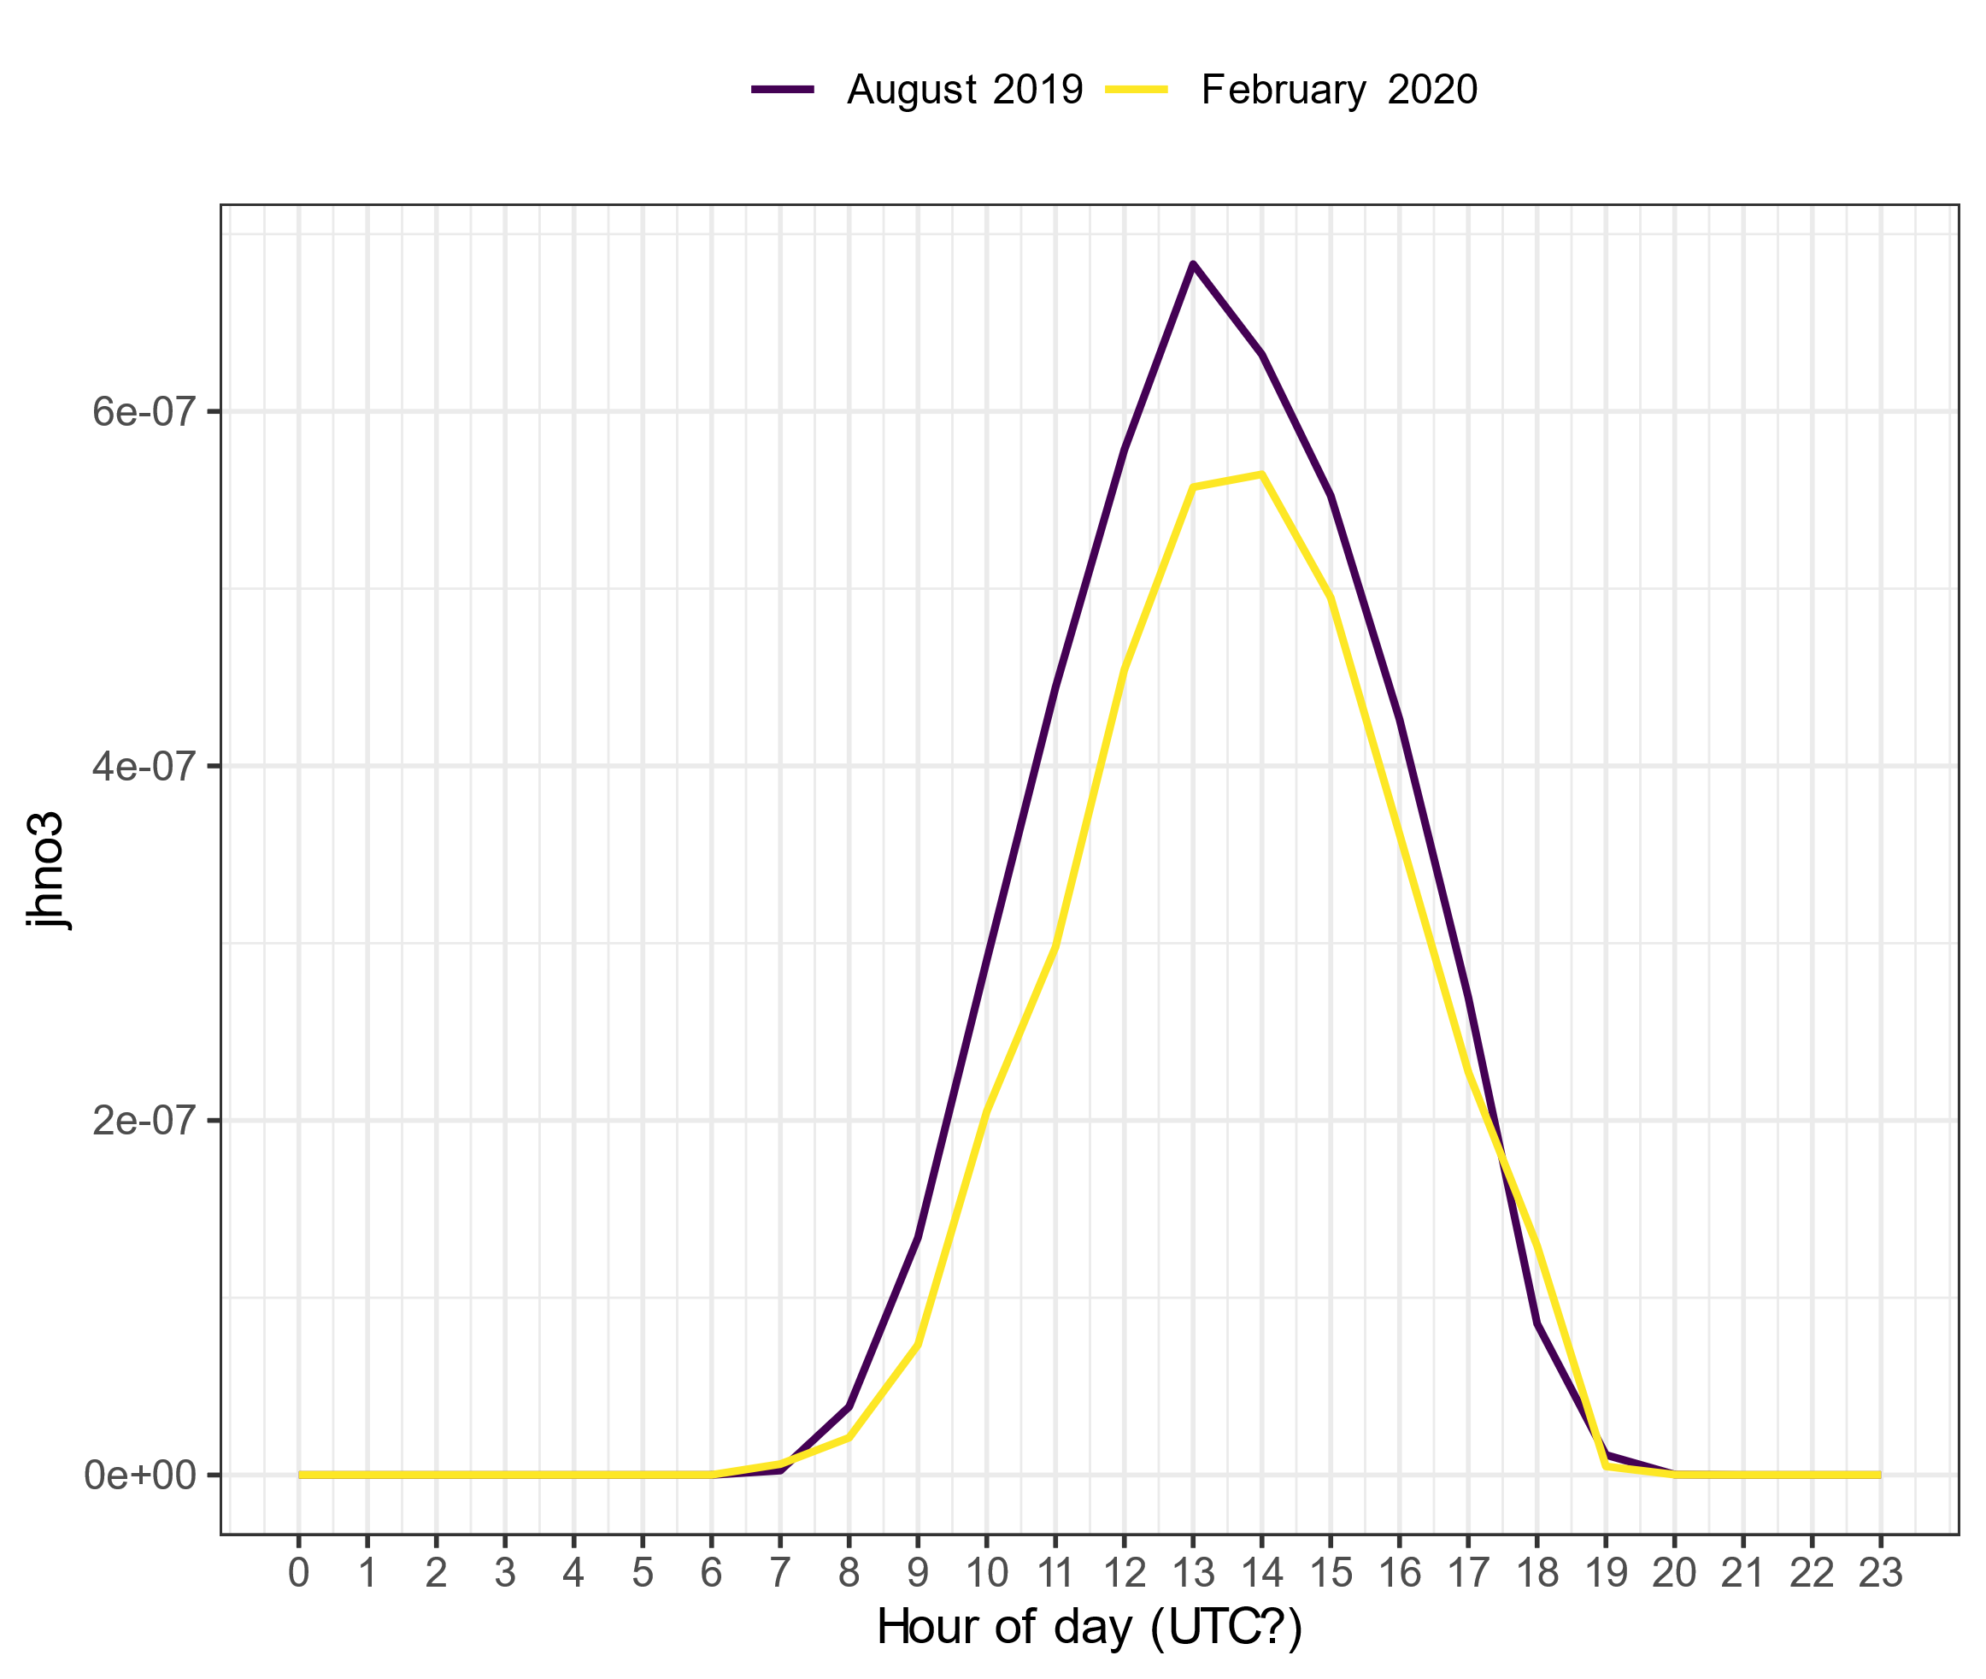
j_{HNO3} from February 2023 with different time corrections

Slide 4
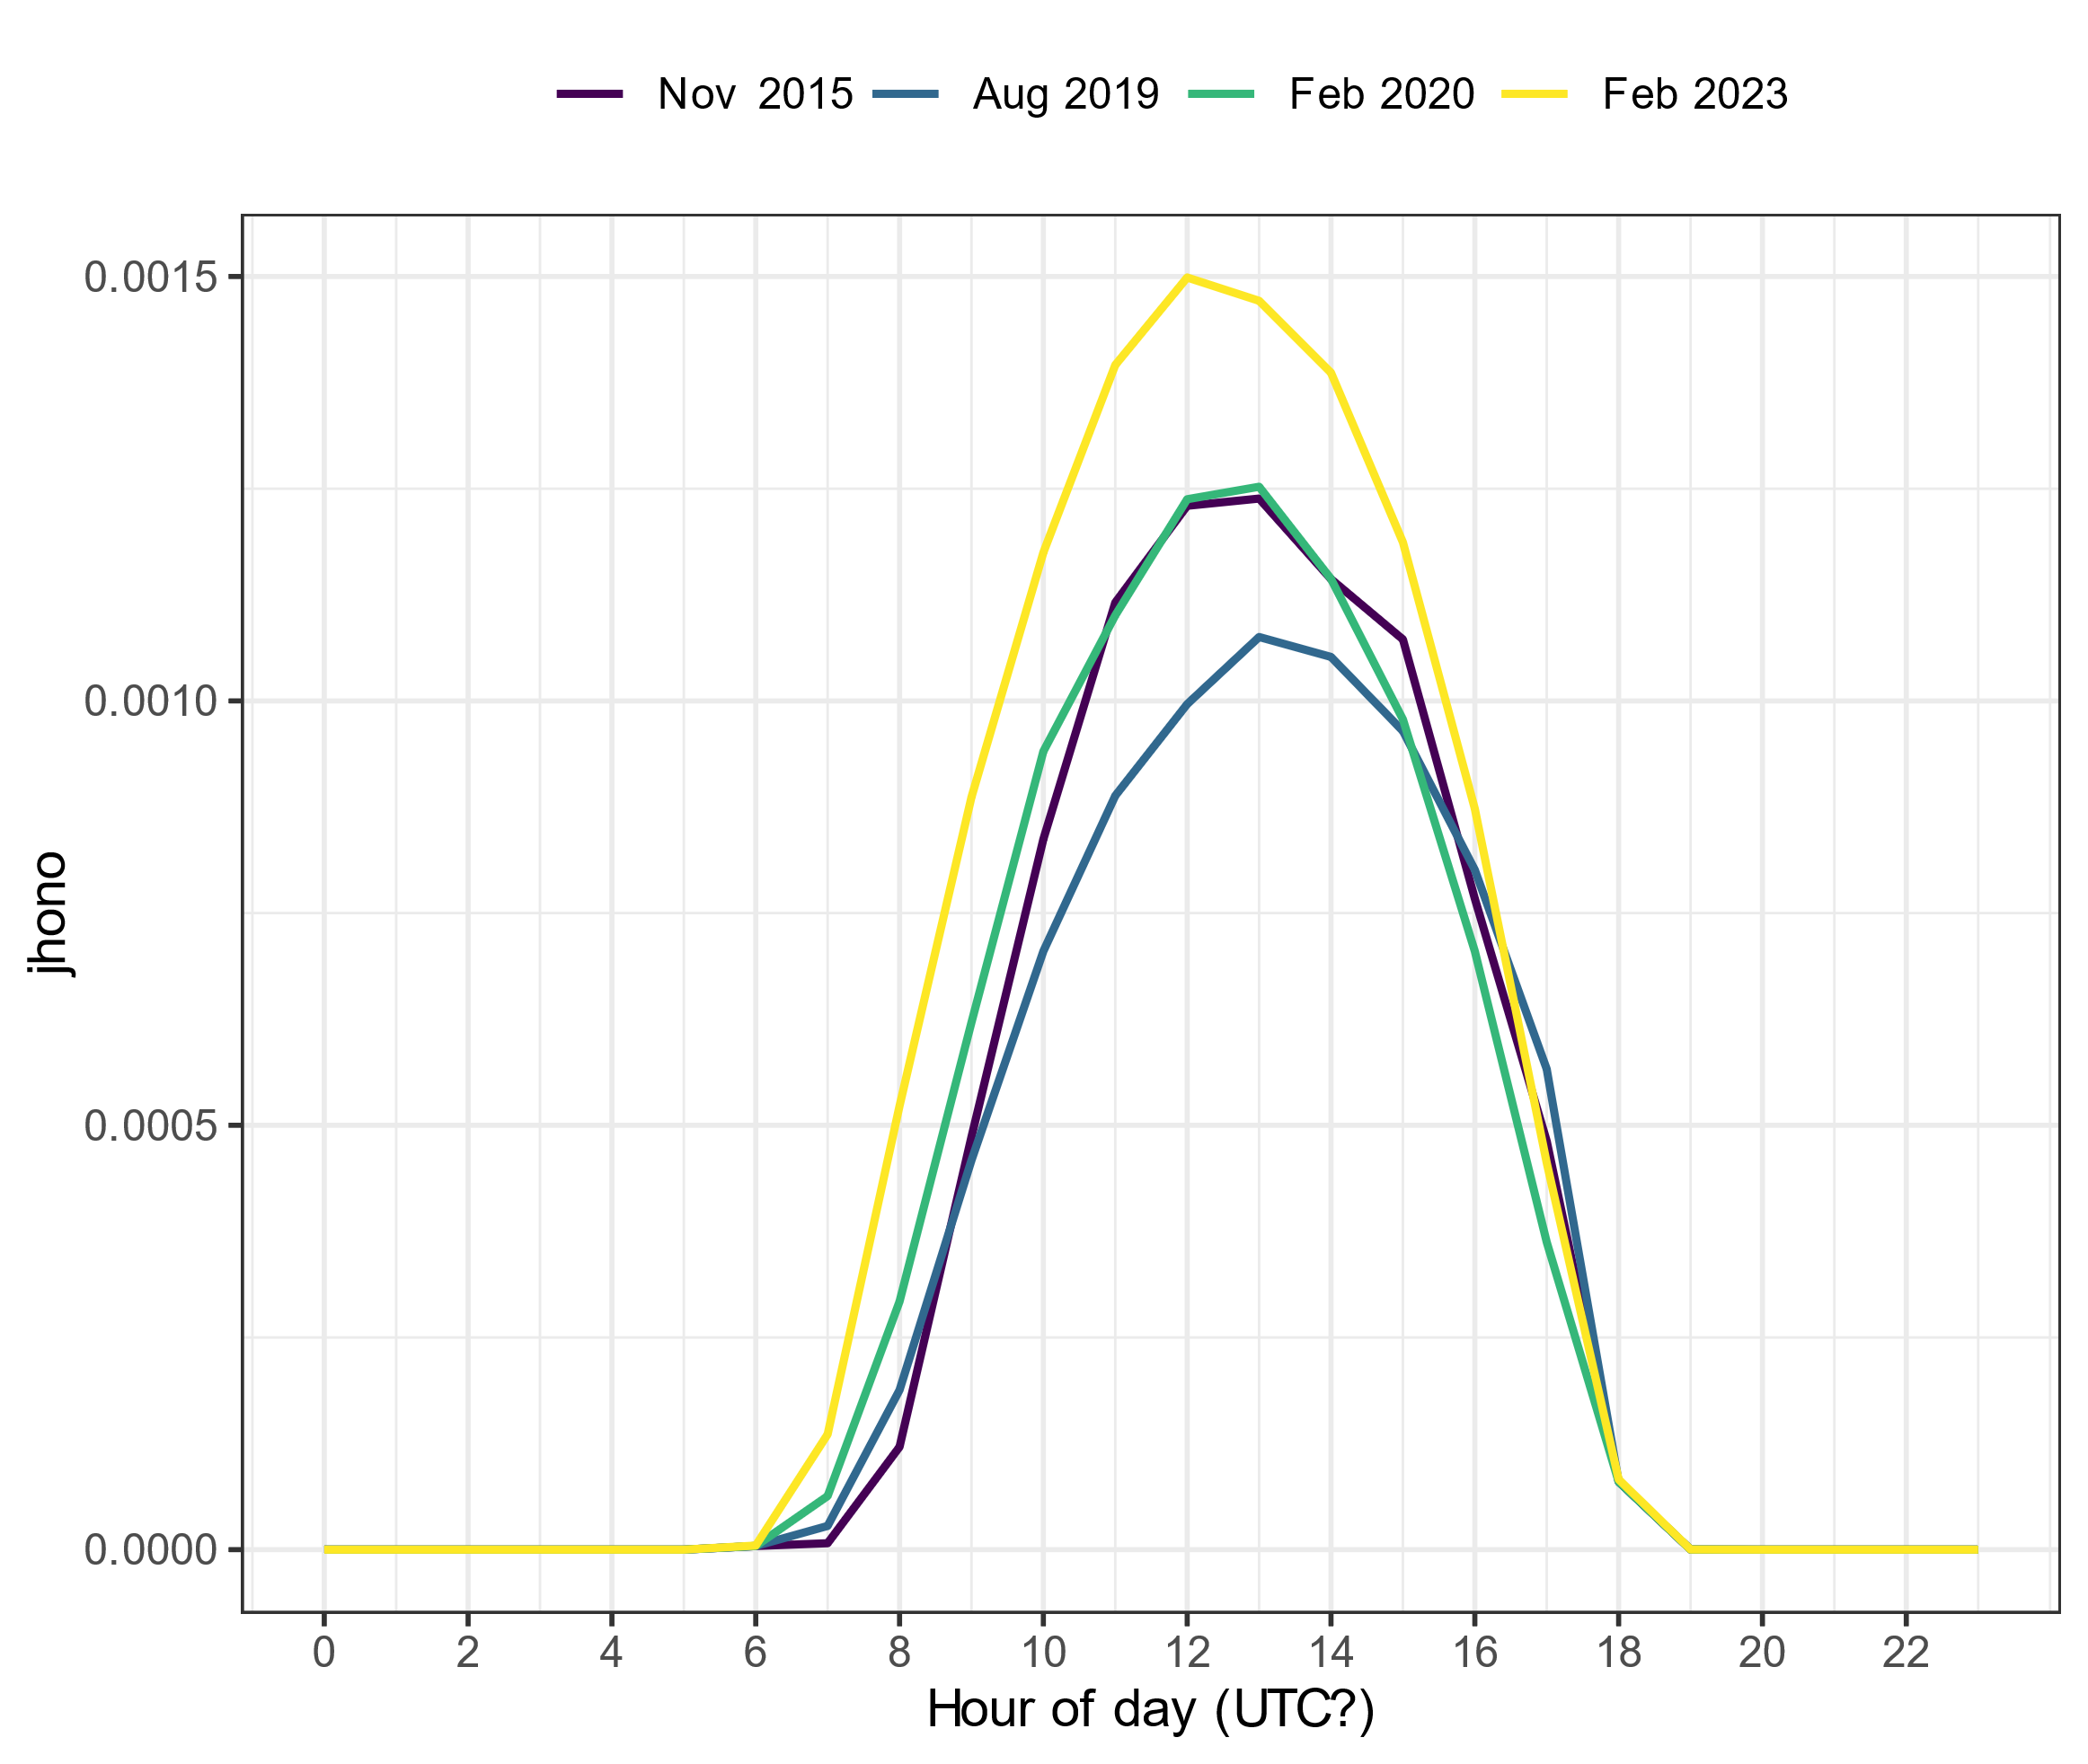
Spec rad data in UTC?
j_{HONO} without any corrections
j_{HONO} with old dataset for 2019 and 2020 data
Notes:
2015, 2019 and 2020 data from one excel file (jrates_all_new_2015-2020)
2023 data from another excel file (Specrad_hour_23_with_calc)

Slide 5
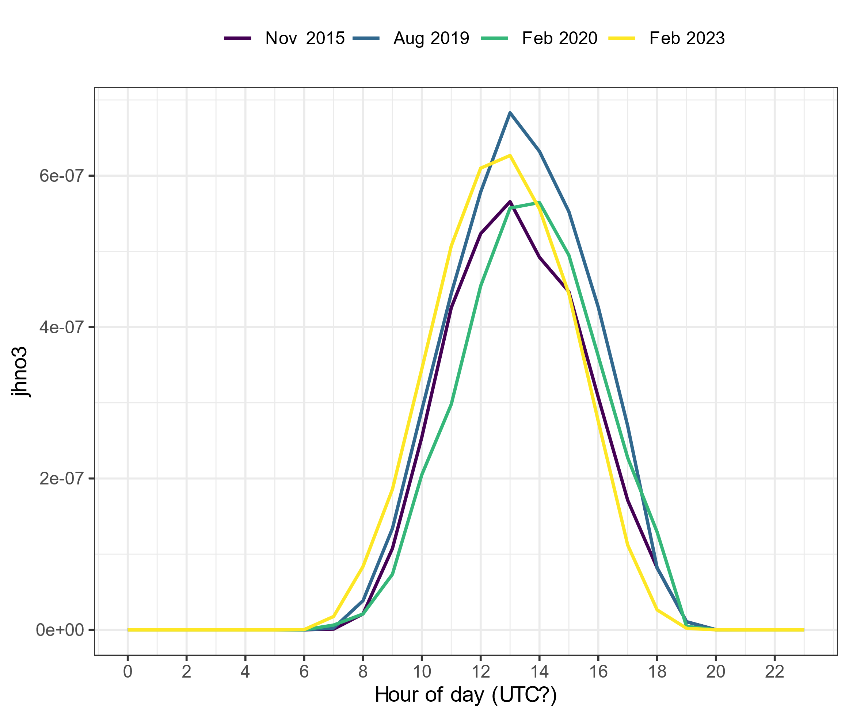
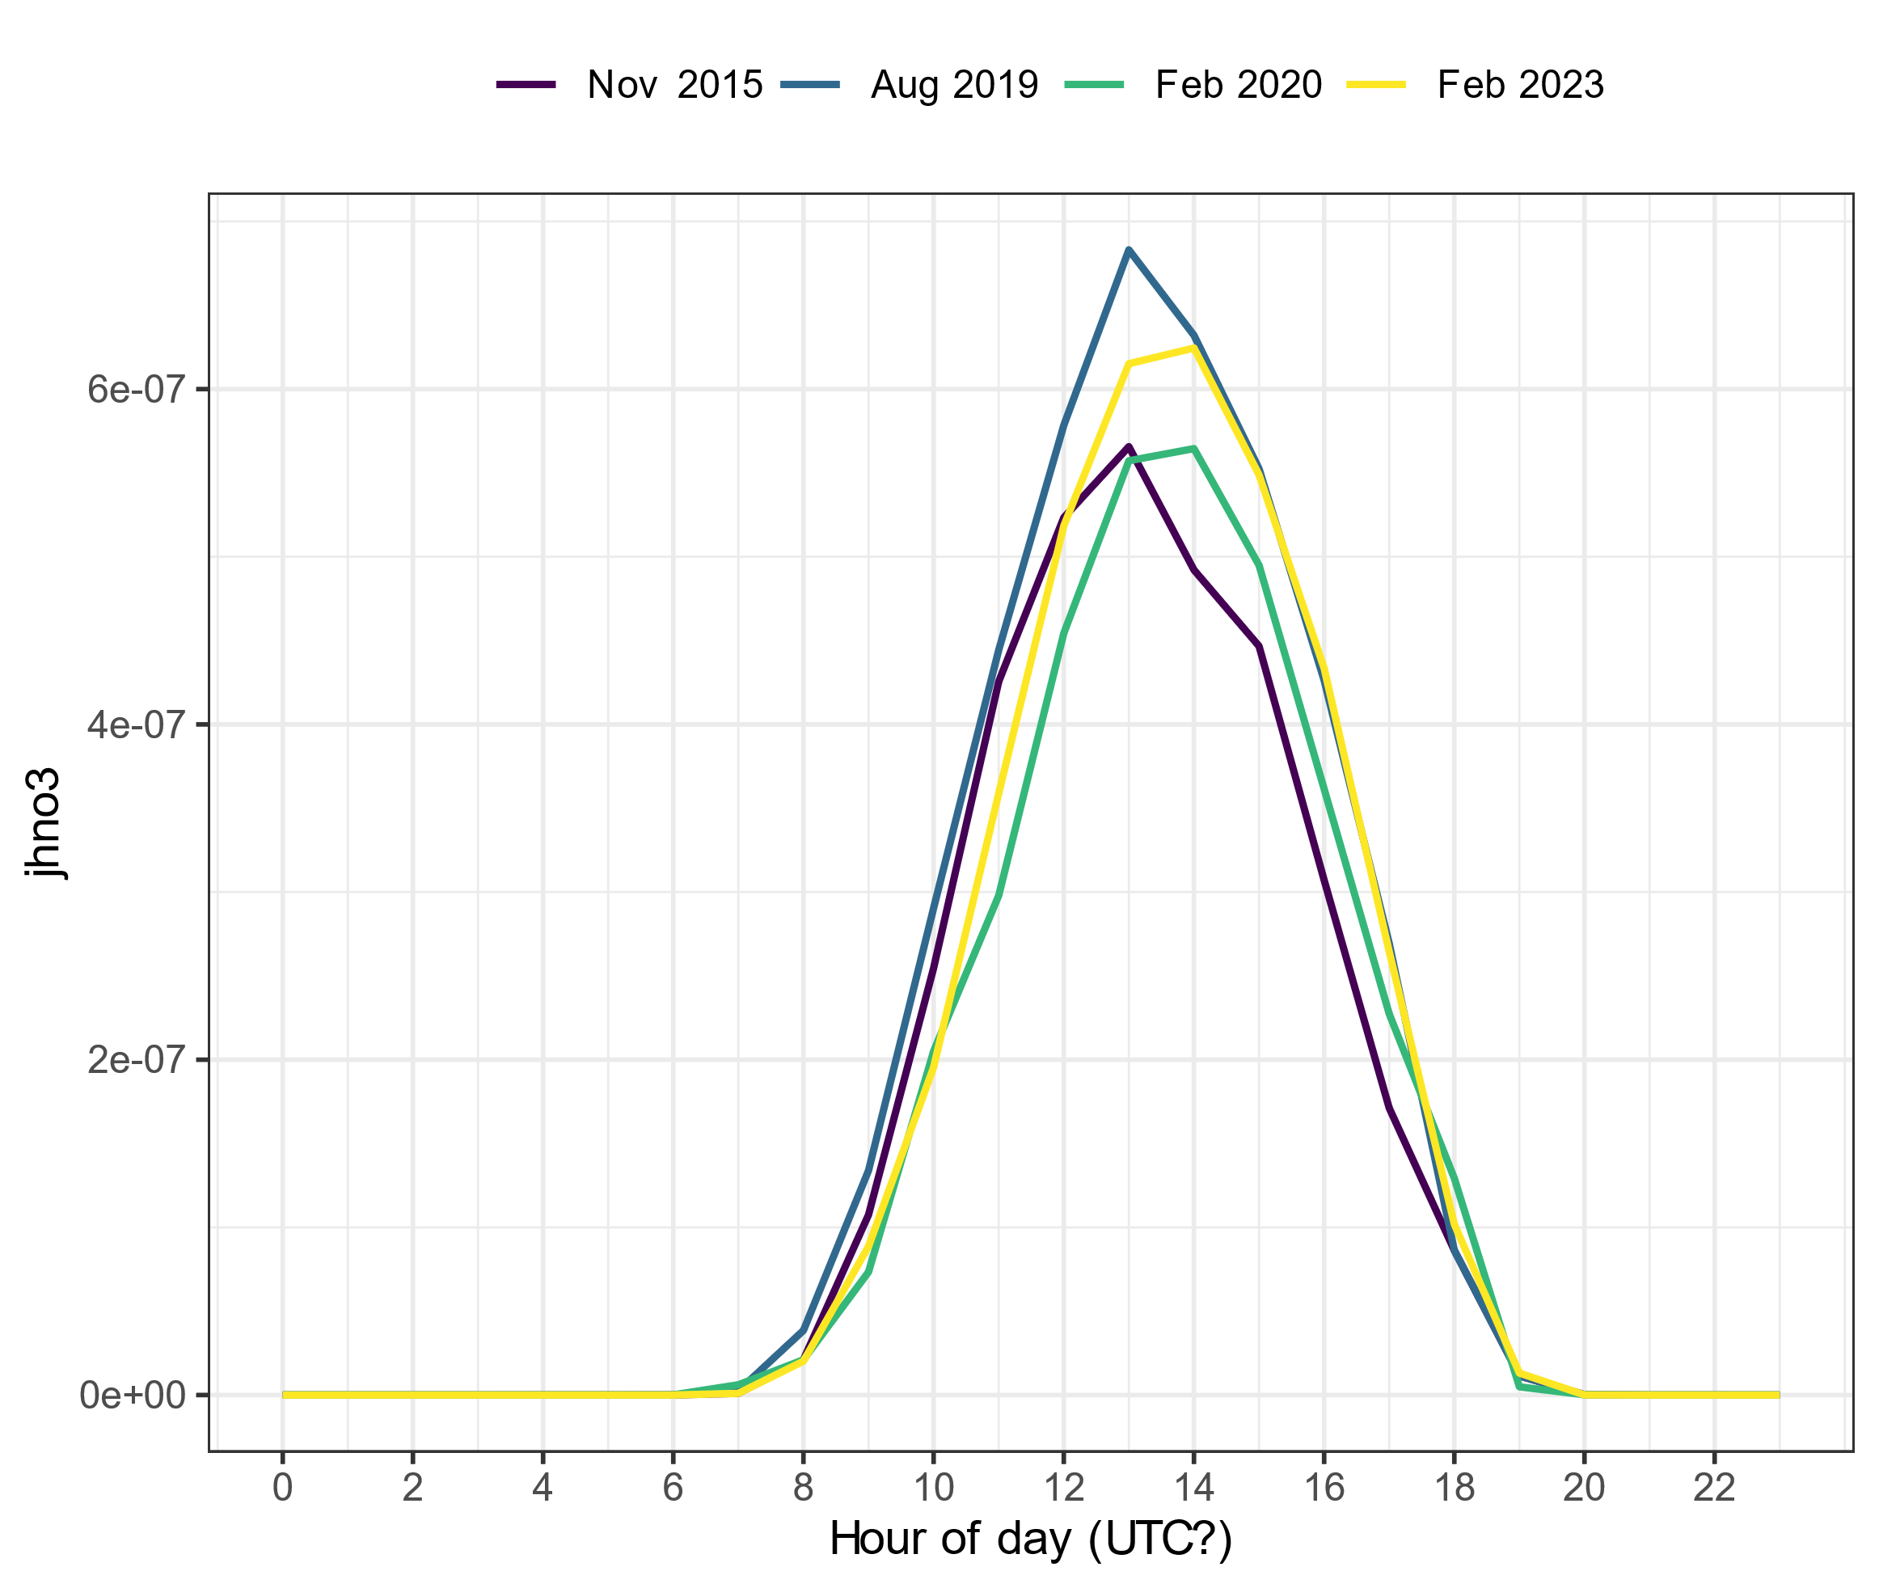
Spec rad data in UTC?
j_{HNO3} without any corrections
j_{HNO3} with correction on 2023 data

Slide 6
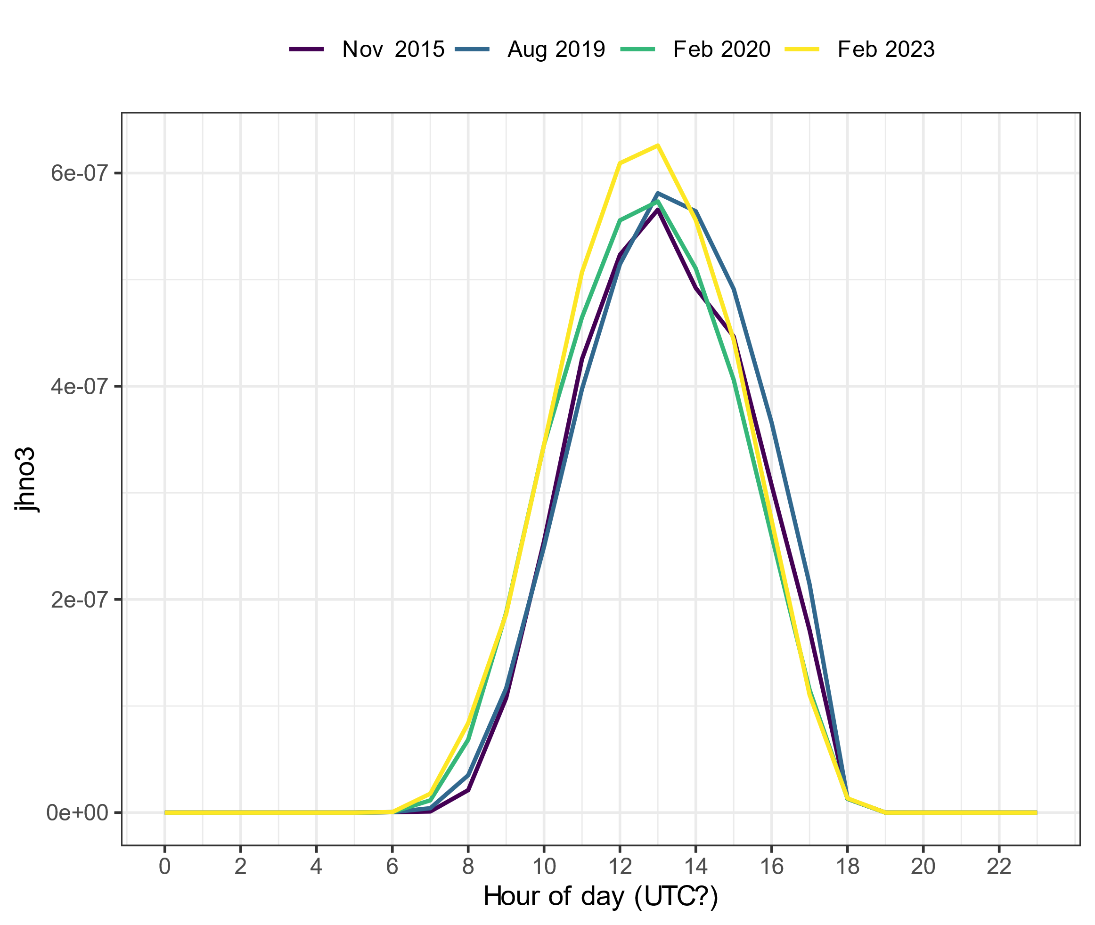
Spec rad data in UTC?
j_{HNO3} without any corrections
j_{HNO3} with old dataset for 2019 and 2020 data

Slide 7
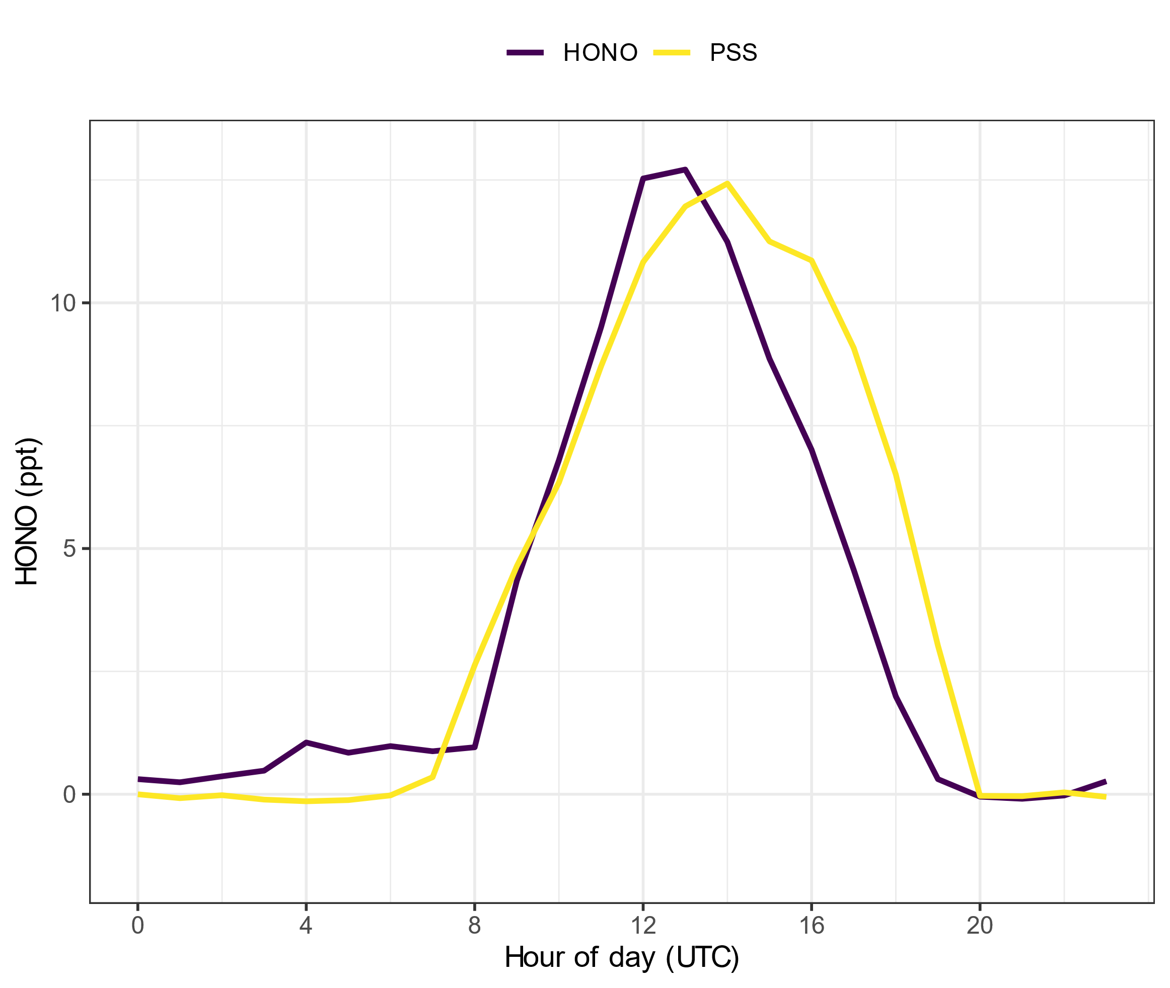
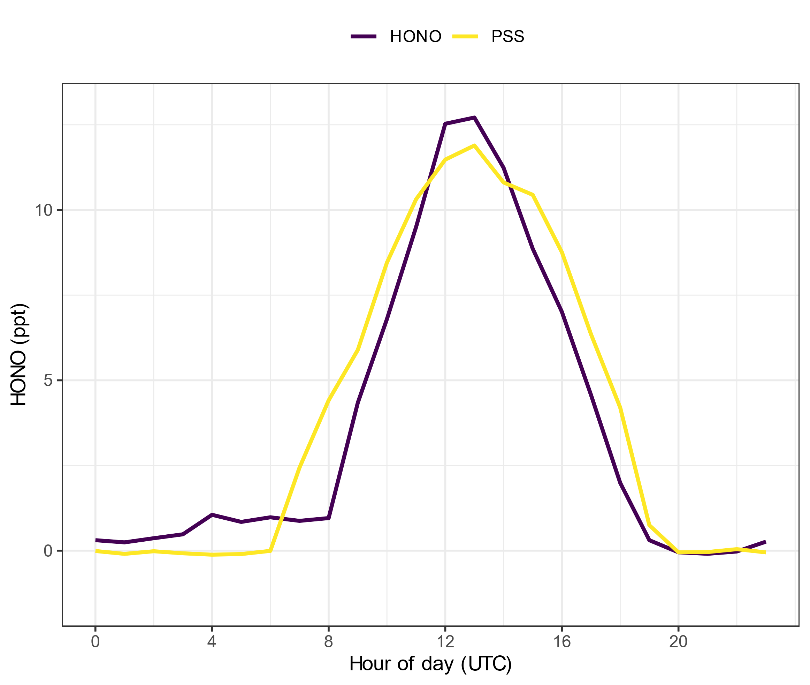
How does the spec rad change affect the PSS
Date corrected
Date not corrected

