Slide 1
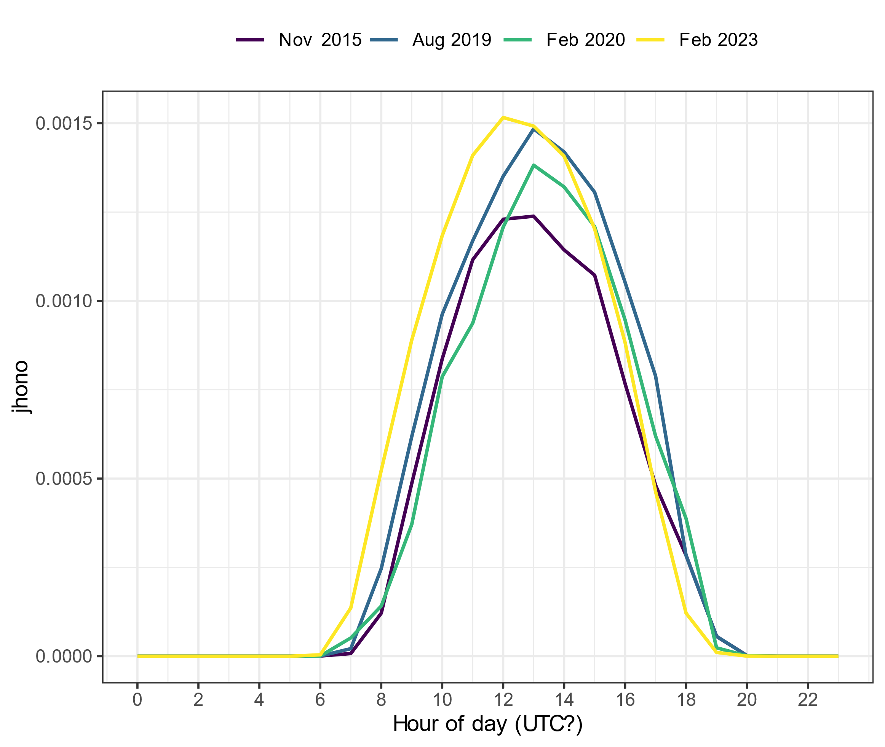
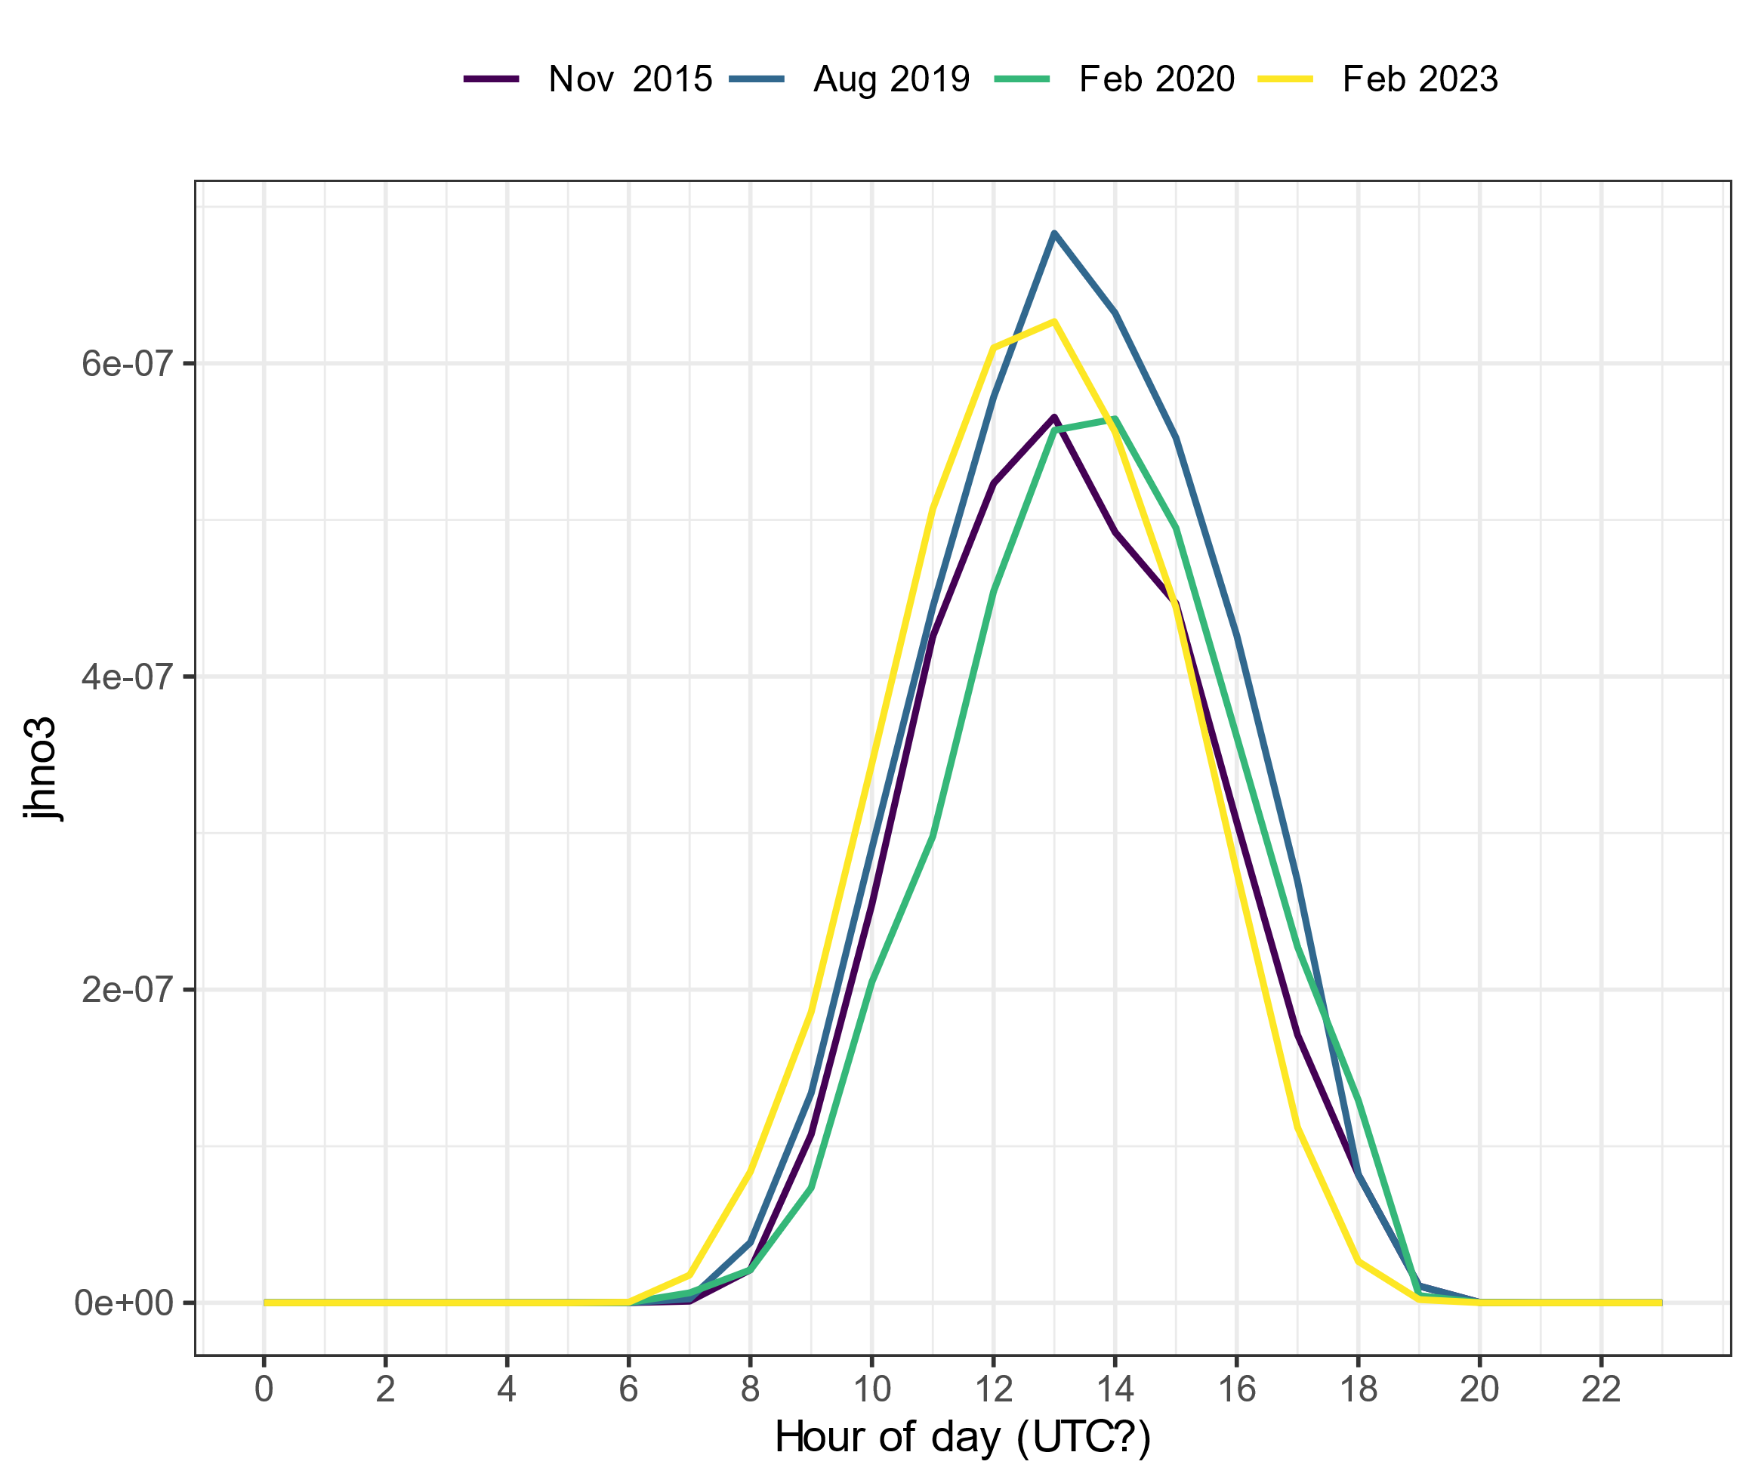
Spec rad data in UTC?
Notes:
2015 data from one excel file (jrates_all_new_2015-2020)
2019 and 2020 data from the same excel file (2016_2020_Spec_rad_Hourly)
2023 data from another excel file (Specrad_hour_23_with_calc)

Slide 2
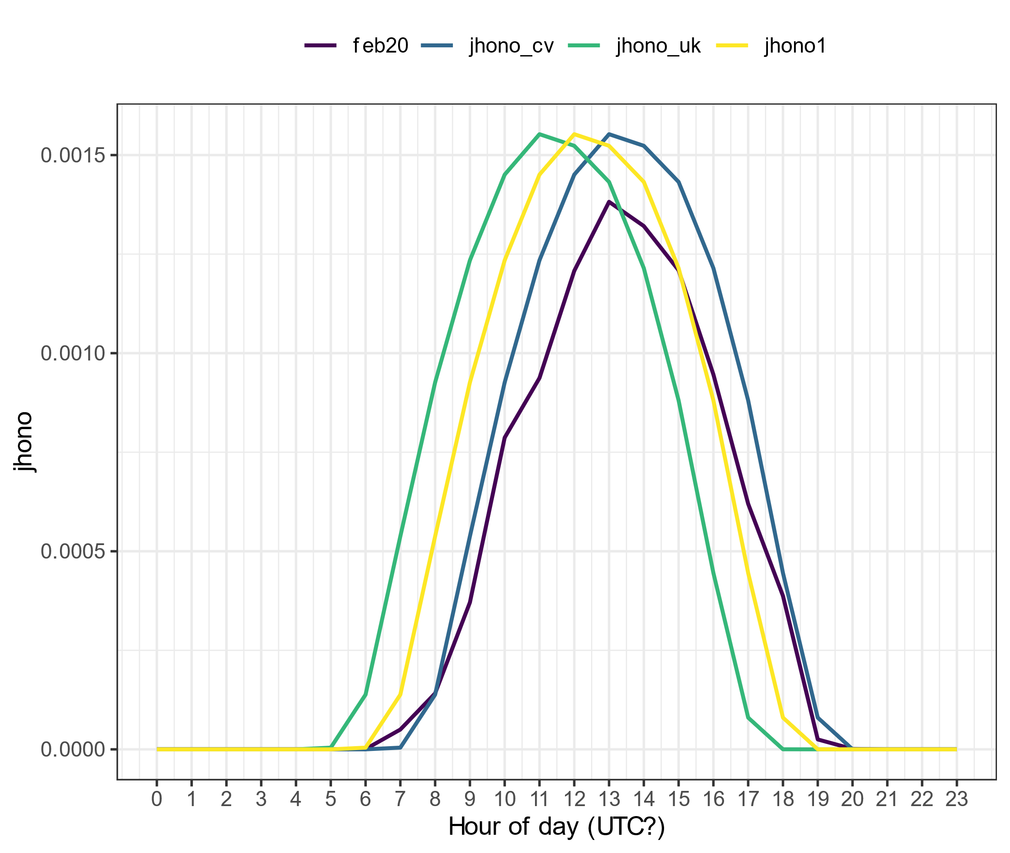
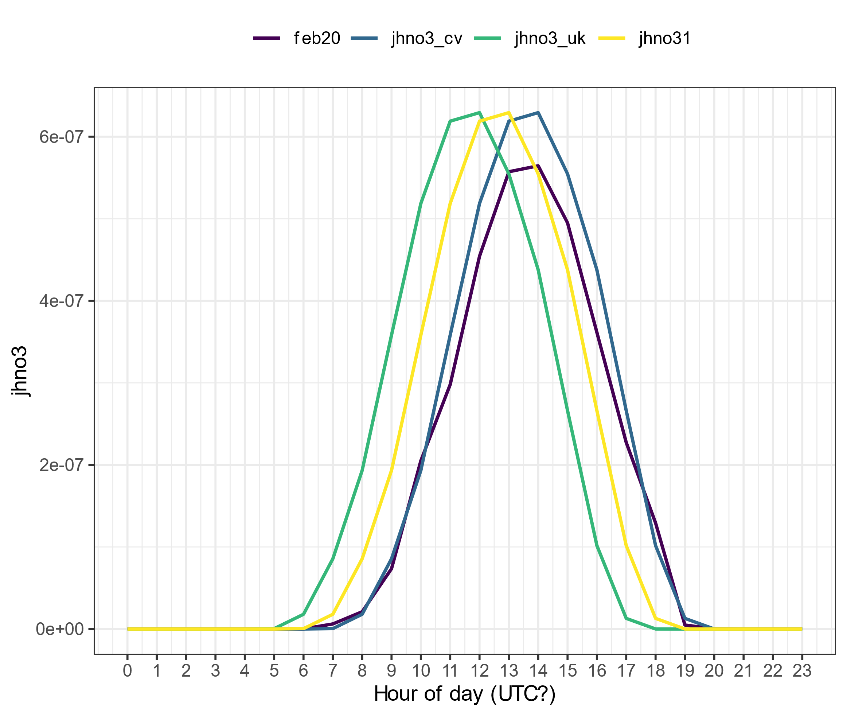
Comparison with February 2020 data
Notes:
j_{HONO1} is the uncorrected j_{HONO} data from February 2023
feb20 is the j_{HONO} from February 2020
j_{HONO}_cv has been corrected by adding an hour (so assuming the data was in CV tz, which is UTC-1, therefore needs an hour added to make it UTC)
j_{HONO}_uk has been corrected by subtracting an hour (so assuming the data was in BST, which is UTC+1, therefore removing an hour makes it UTC)
not sure what to say about the difference in magnitude

