Slide 1
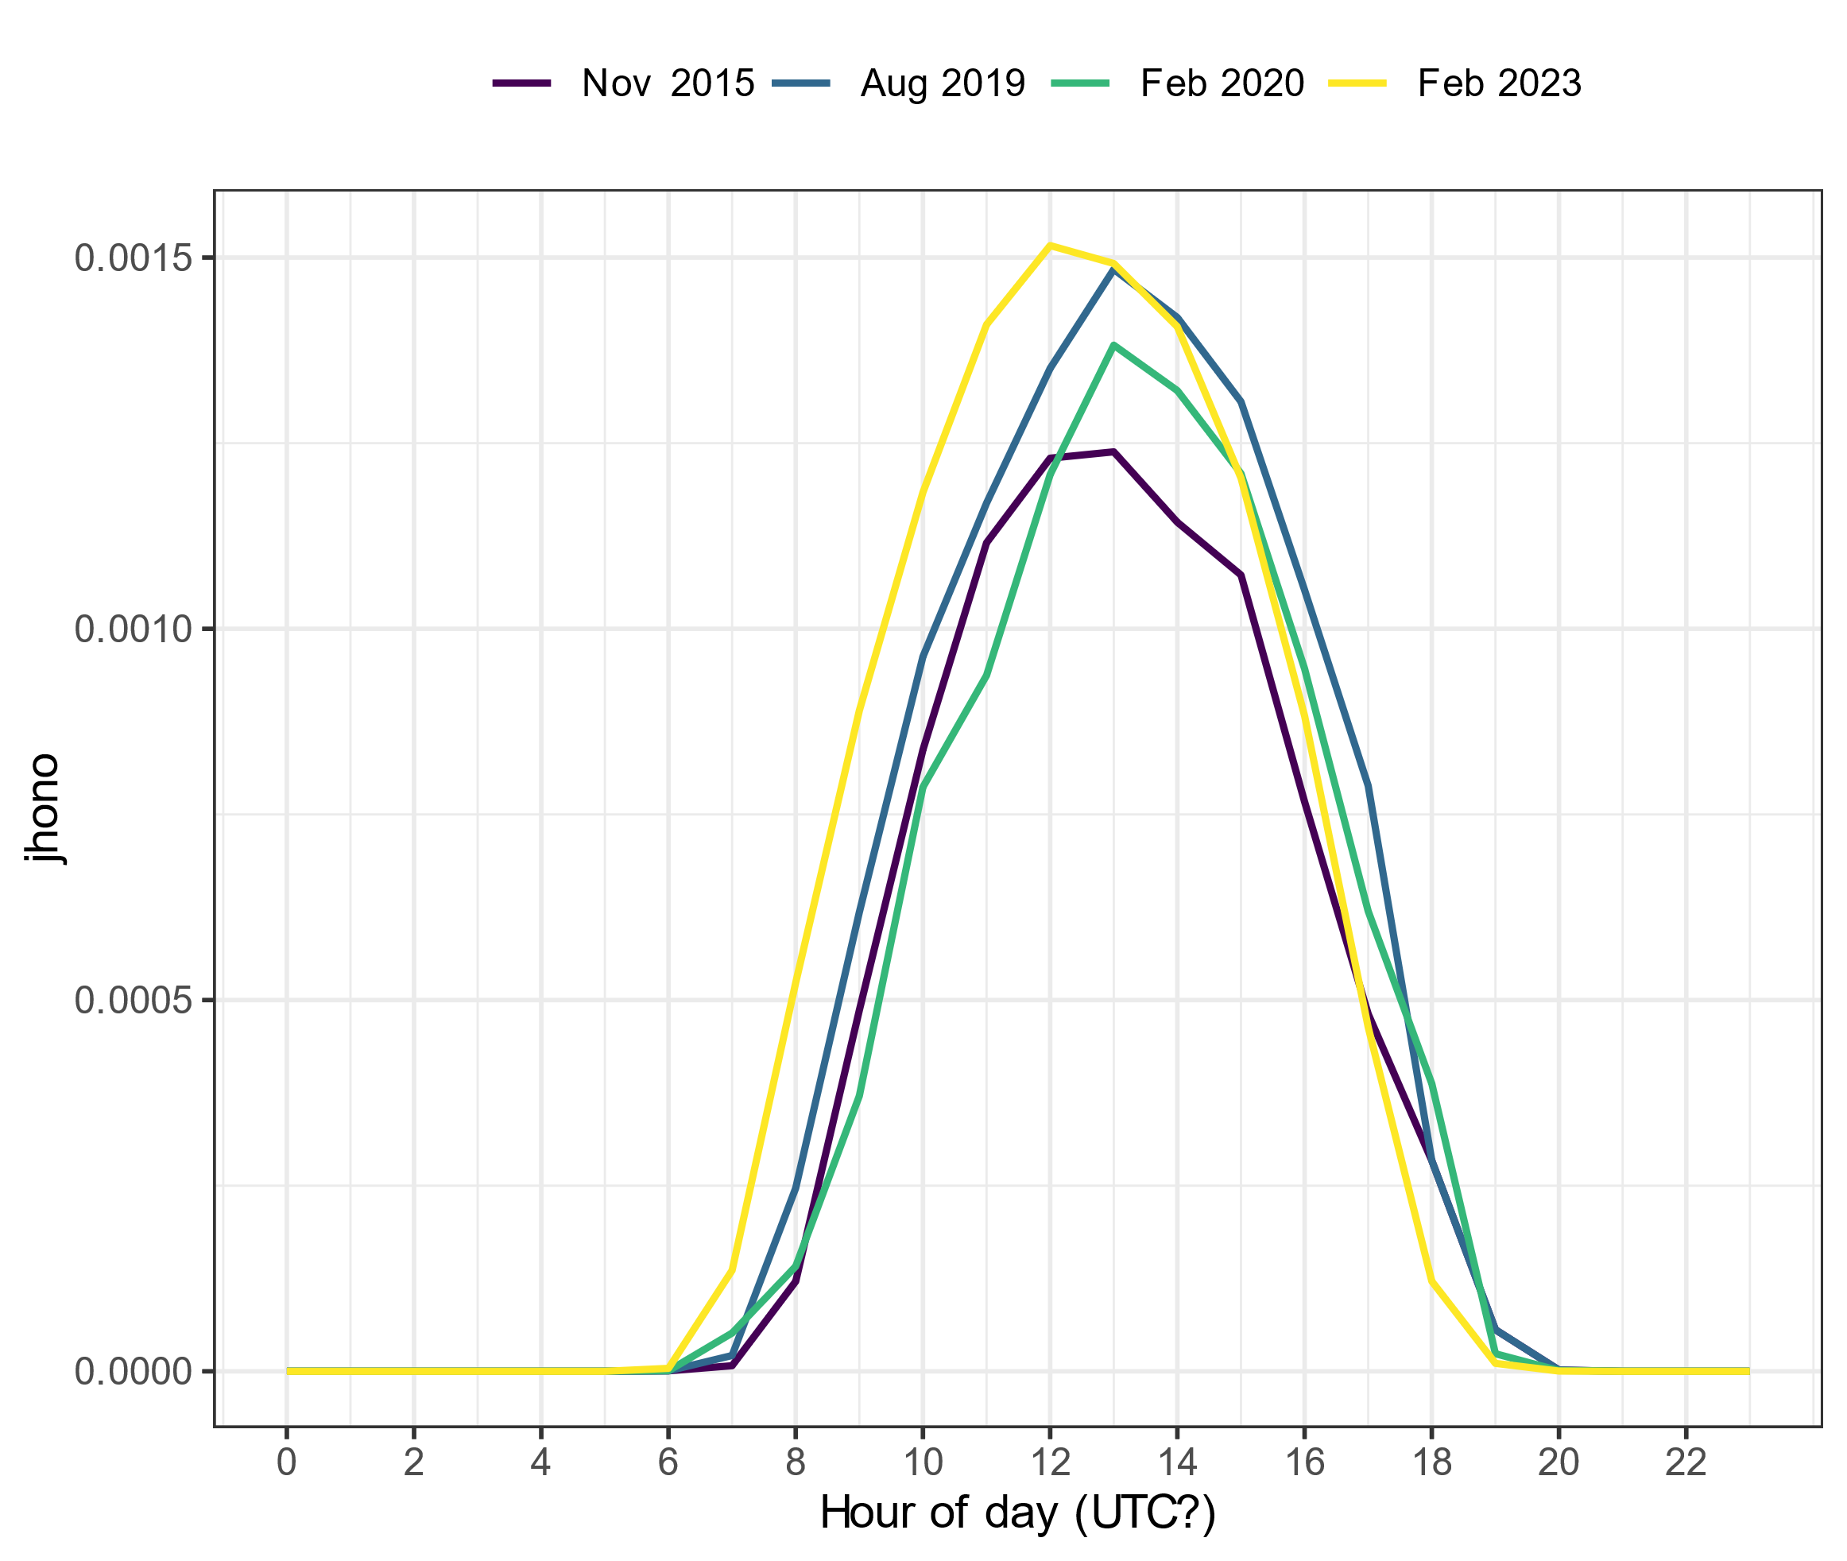
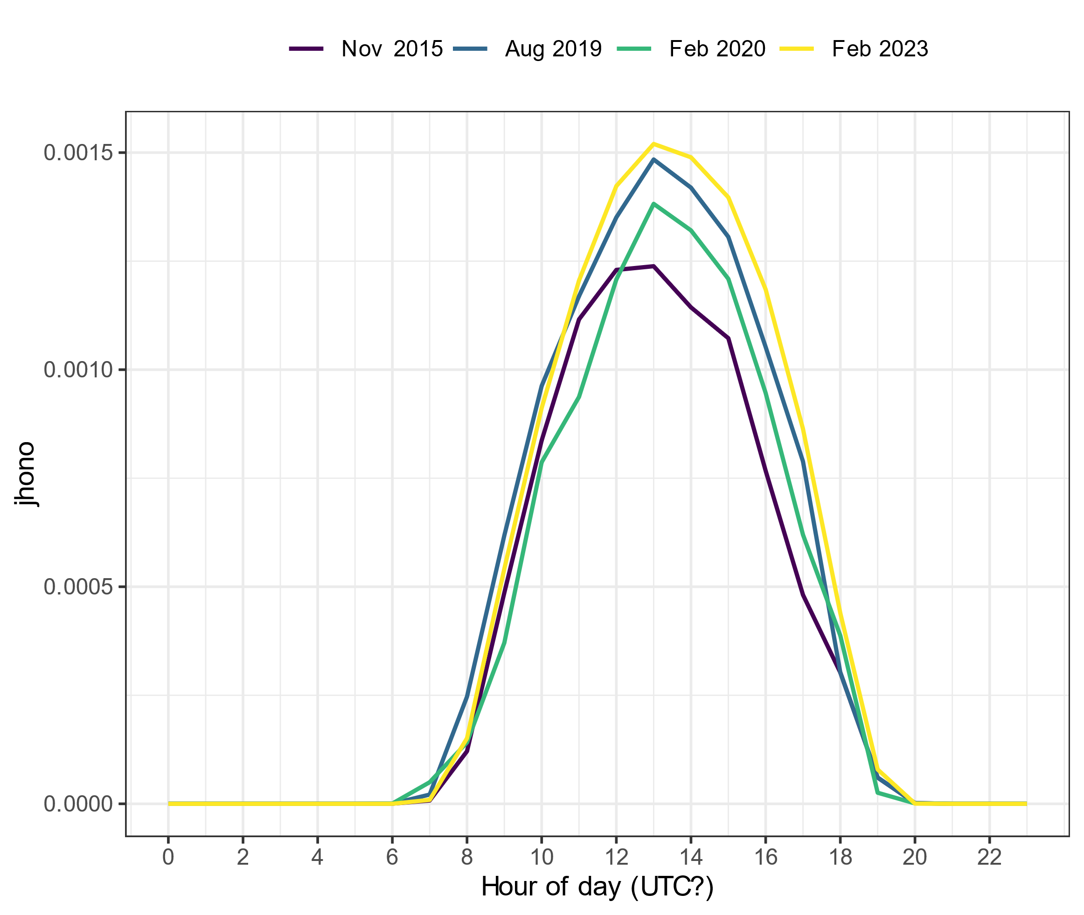
Spec rad data in UTC?
j_{HONO} without any corrections
j_{HONO} with correction on 2023 data
Notes:
2015 data from one excel file (jrates_all_new_2015-2020)
2019 and 2020 data from the same excel file (2016_2020_Spec_rad_Hourly)
2023 data from another excel file (Specrad_hour_23_with_calc)

Slide 2
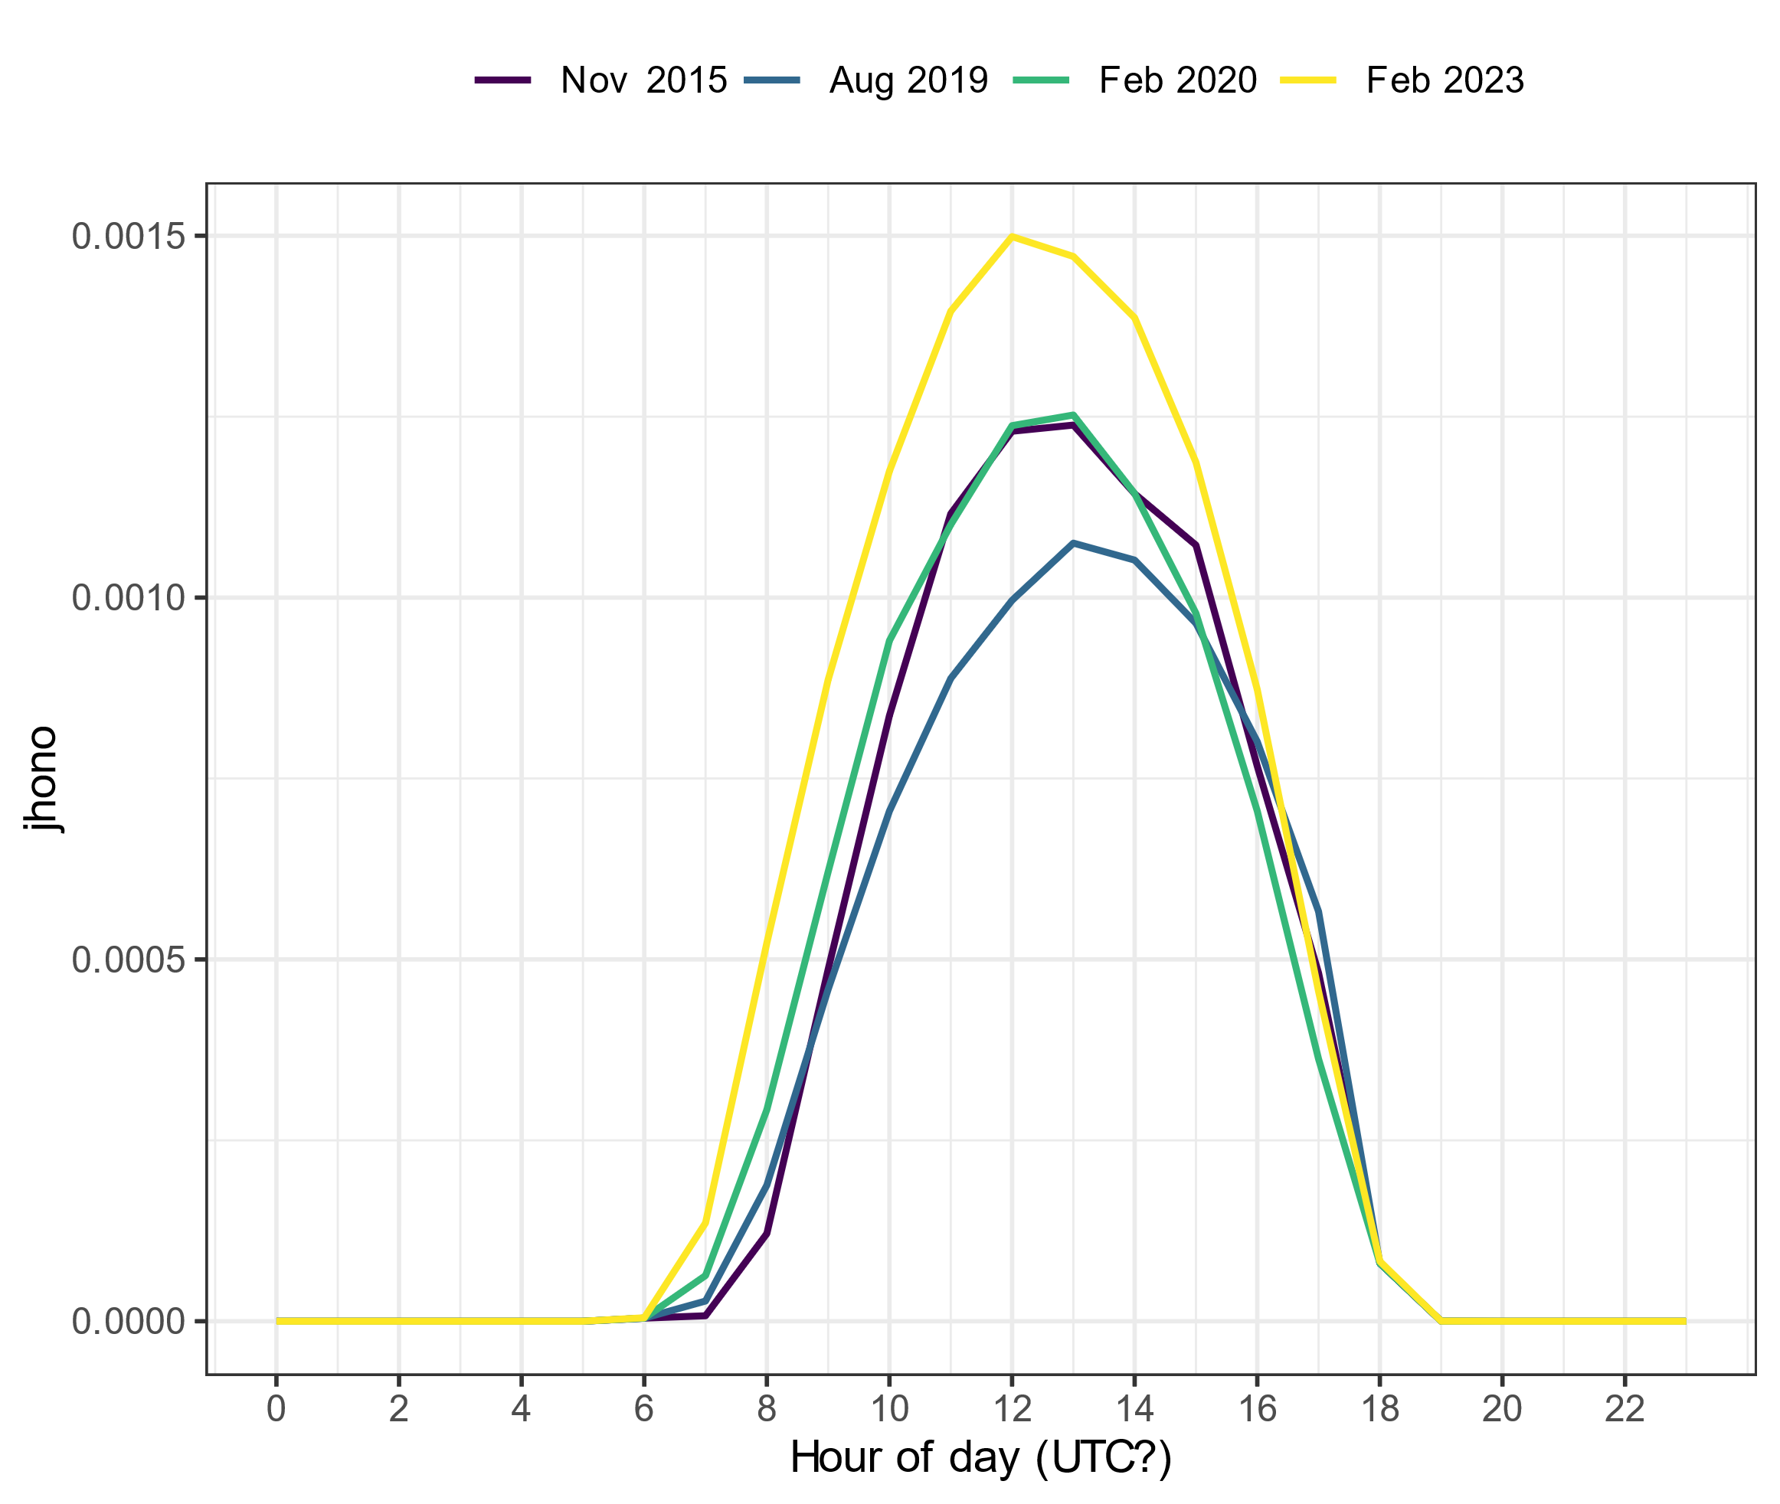
Spec rad data in UTC?
j_{HONO} without any corrections
j_{HONO} with old dataset for 2019 and 2020 data
Notes:
2015, 2019 and 2020 data from one excel file (jrates_all_new_2015-2020)
2023 data from another excel file (Specrad_hour_23_with_calc)

Slide 3
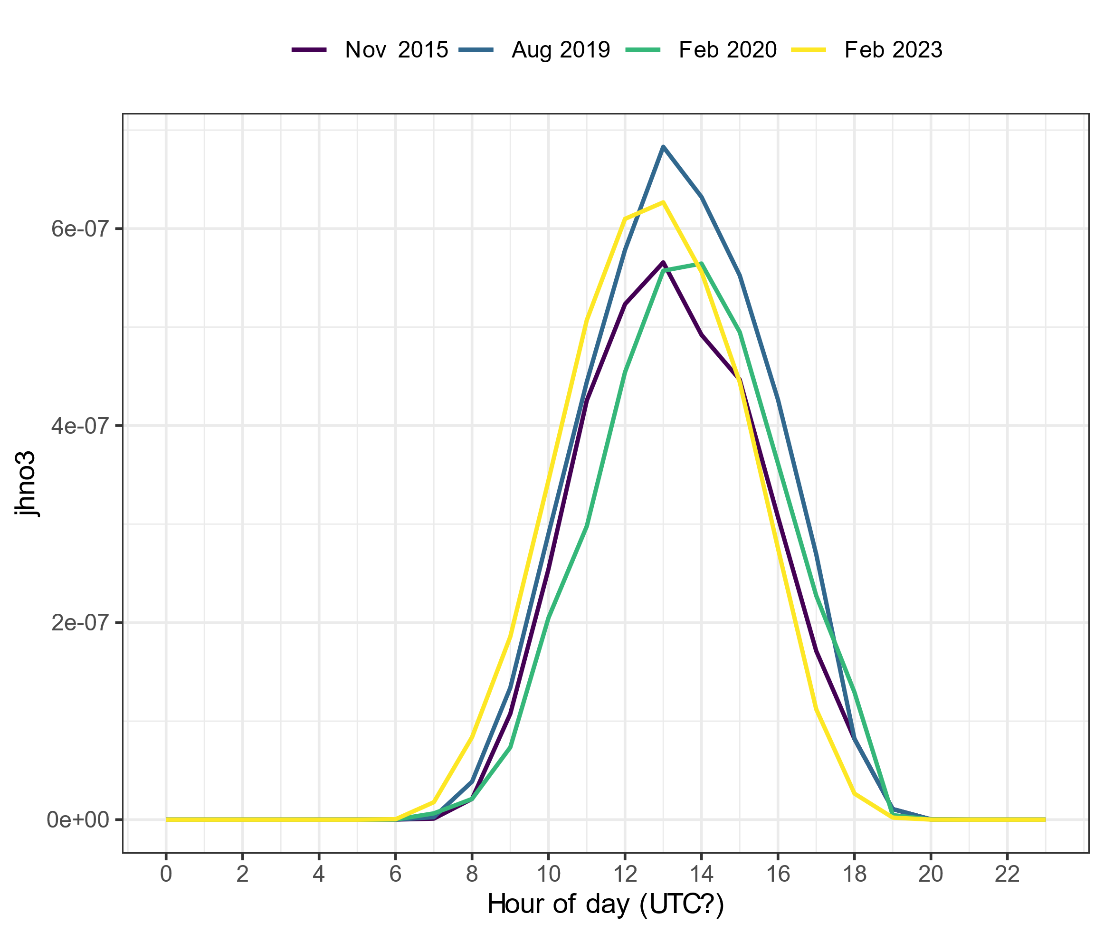
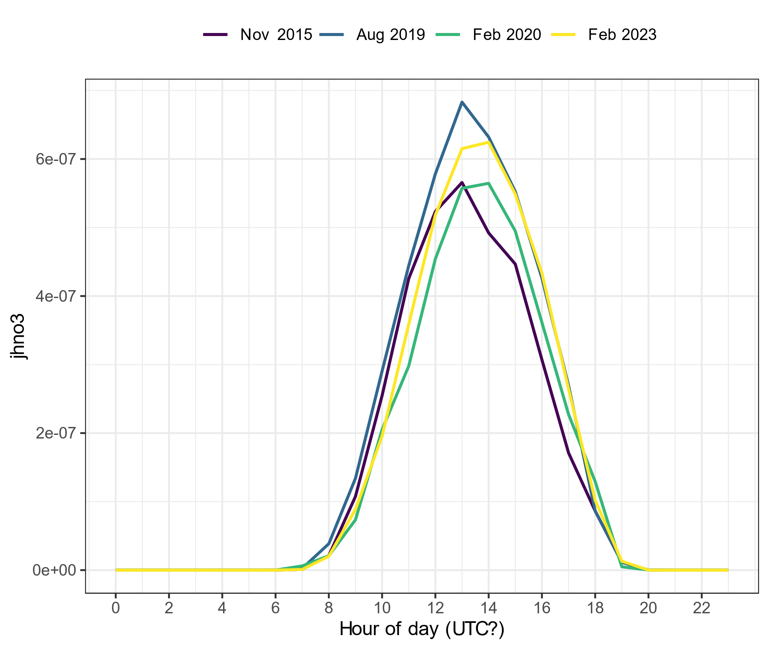
Spec rad data in UTC?
j_{HNO3} without any corrections
j_{HNO3} with correction on 2023 data

Slide 4
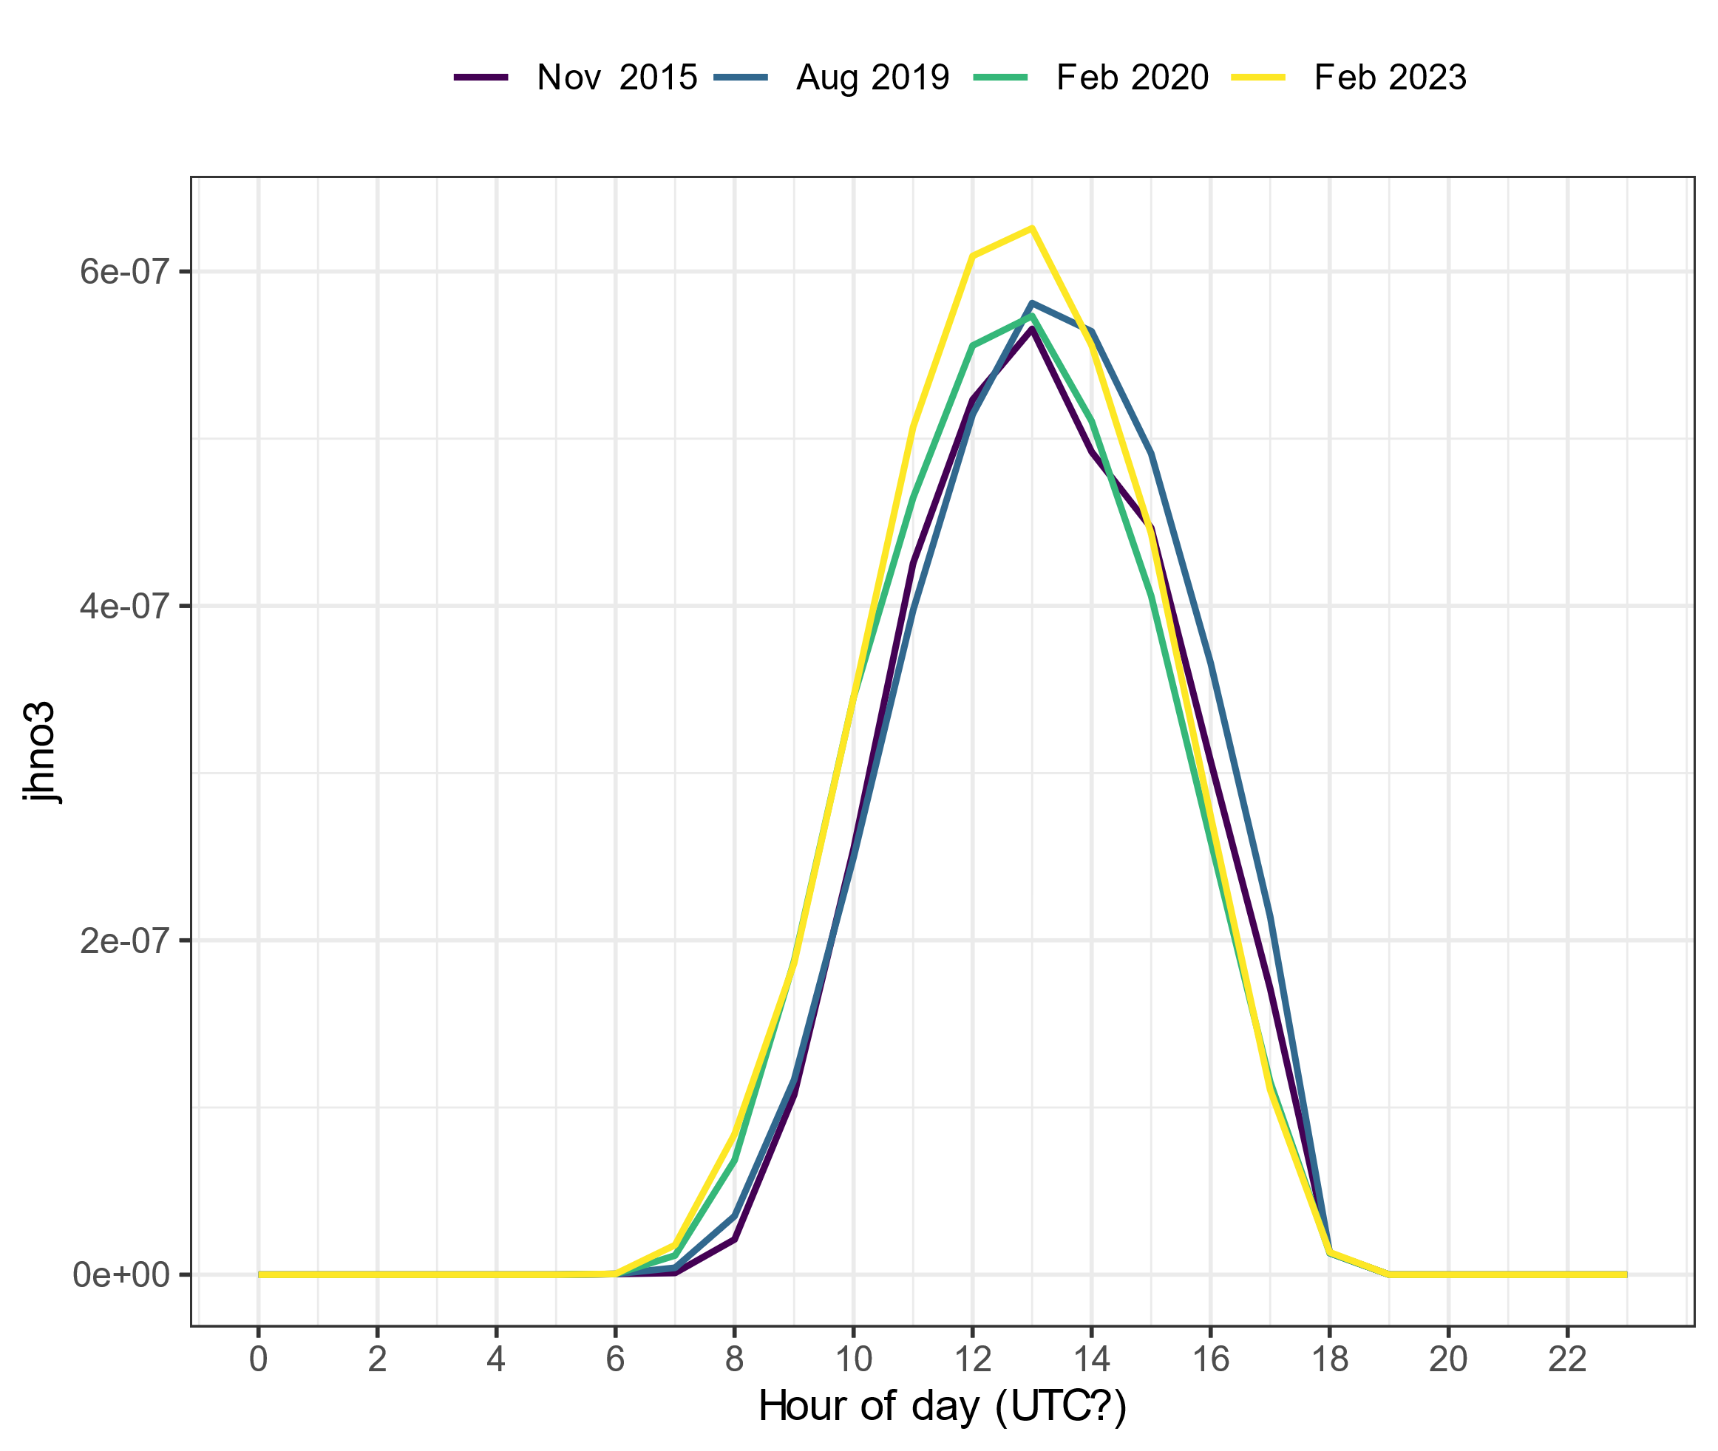
Spec rad data in UTC?
j_{HNO3} without any corrections
j_{HNO3} with old dataset for 2019 and 2020 data

Slide 5
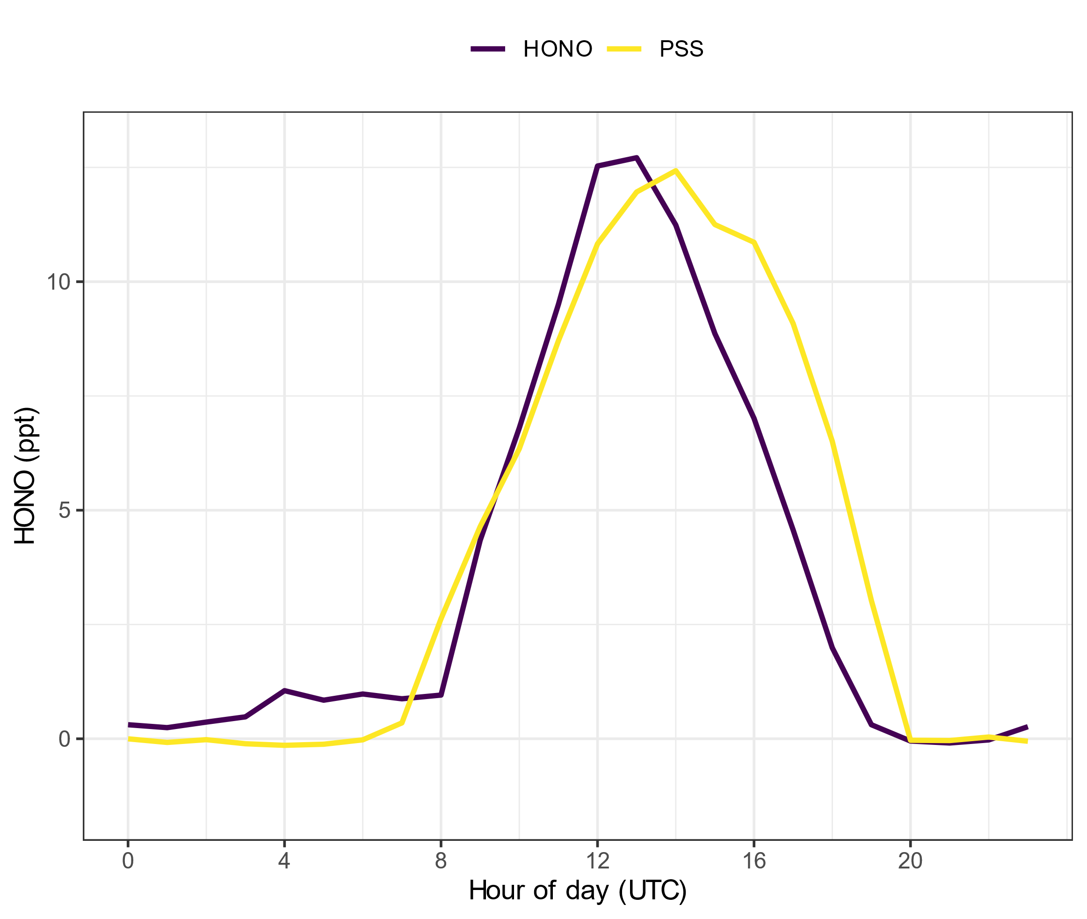
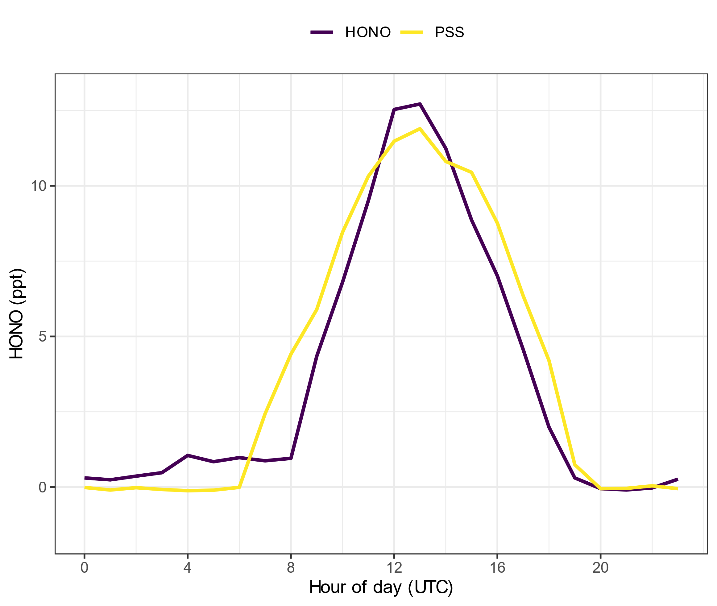
How does the spec rad change affect the PSS
Date corrected
Date not corrected

