Slide 1
HONO measurements September 2024 – issues with zeroes
Before 11th September, N₂ flow was set at 1.2 L min⁻¹ on the assumption that the gas flow was 1 L min⁻¹, however checks at the inlet revealed that the gas flow was very variable
After 11th September, N₂ flow was adjusted to 1.8 L min⁻¹ to ensure that it was overflowing the inlet (never saw the gas flow higher than 1.6 L min⁻¹), but can this be trusted?
Using N₂ zeroes to adjust the baseline, HONO isn’t 0 at night, whereas using nighttime values HONO is “forced” to be zero at night – is this the right course of action? Can we assume HONO is 0 at night and the issues seen with the N₂ zeroes are due to the variable gas flow?

Slide 2
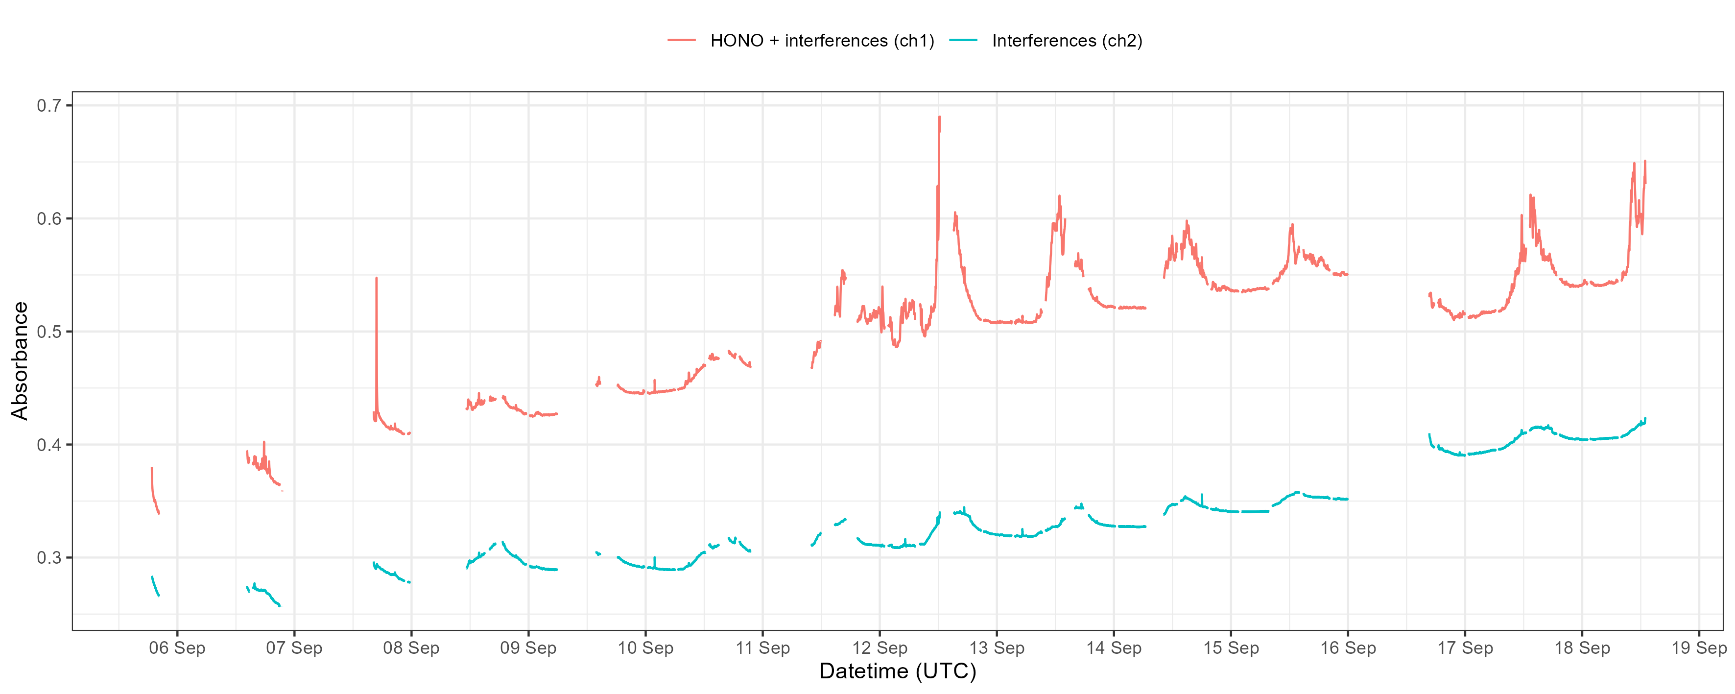
Raw data (without zeroes, cals or problem periods)

Slide 3
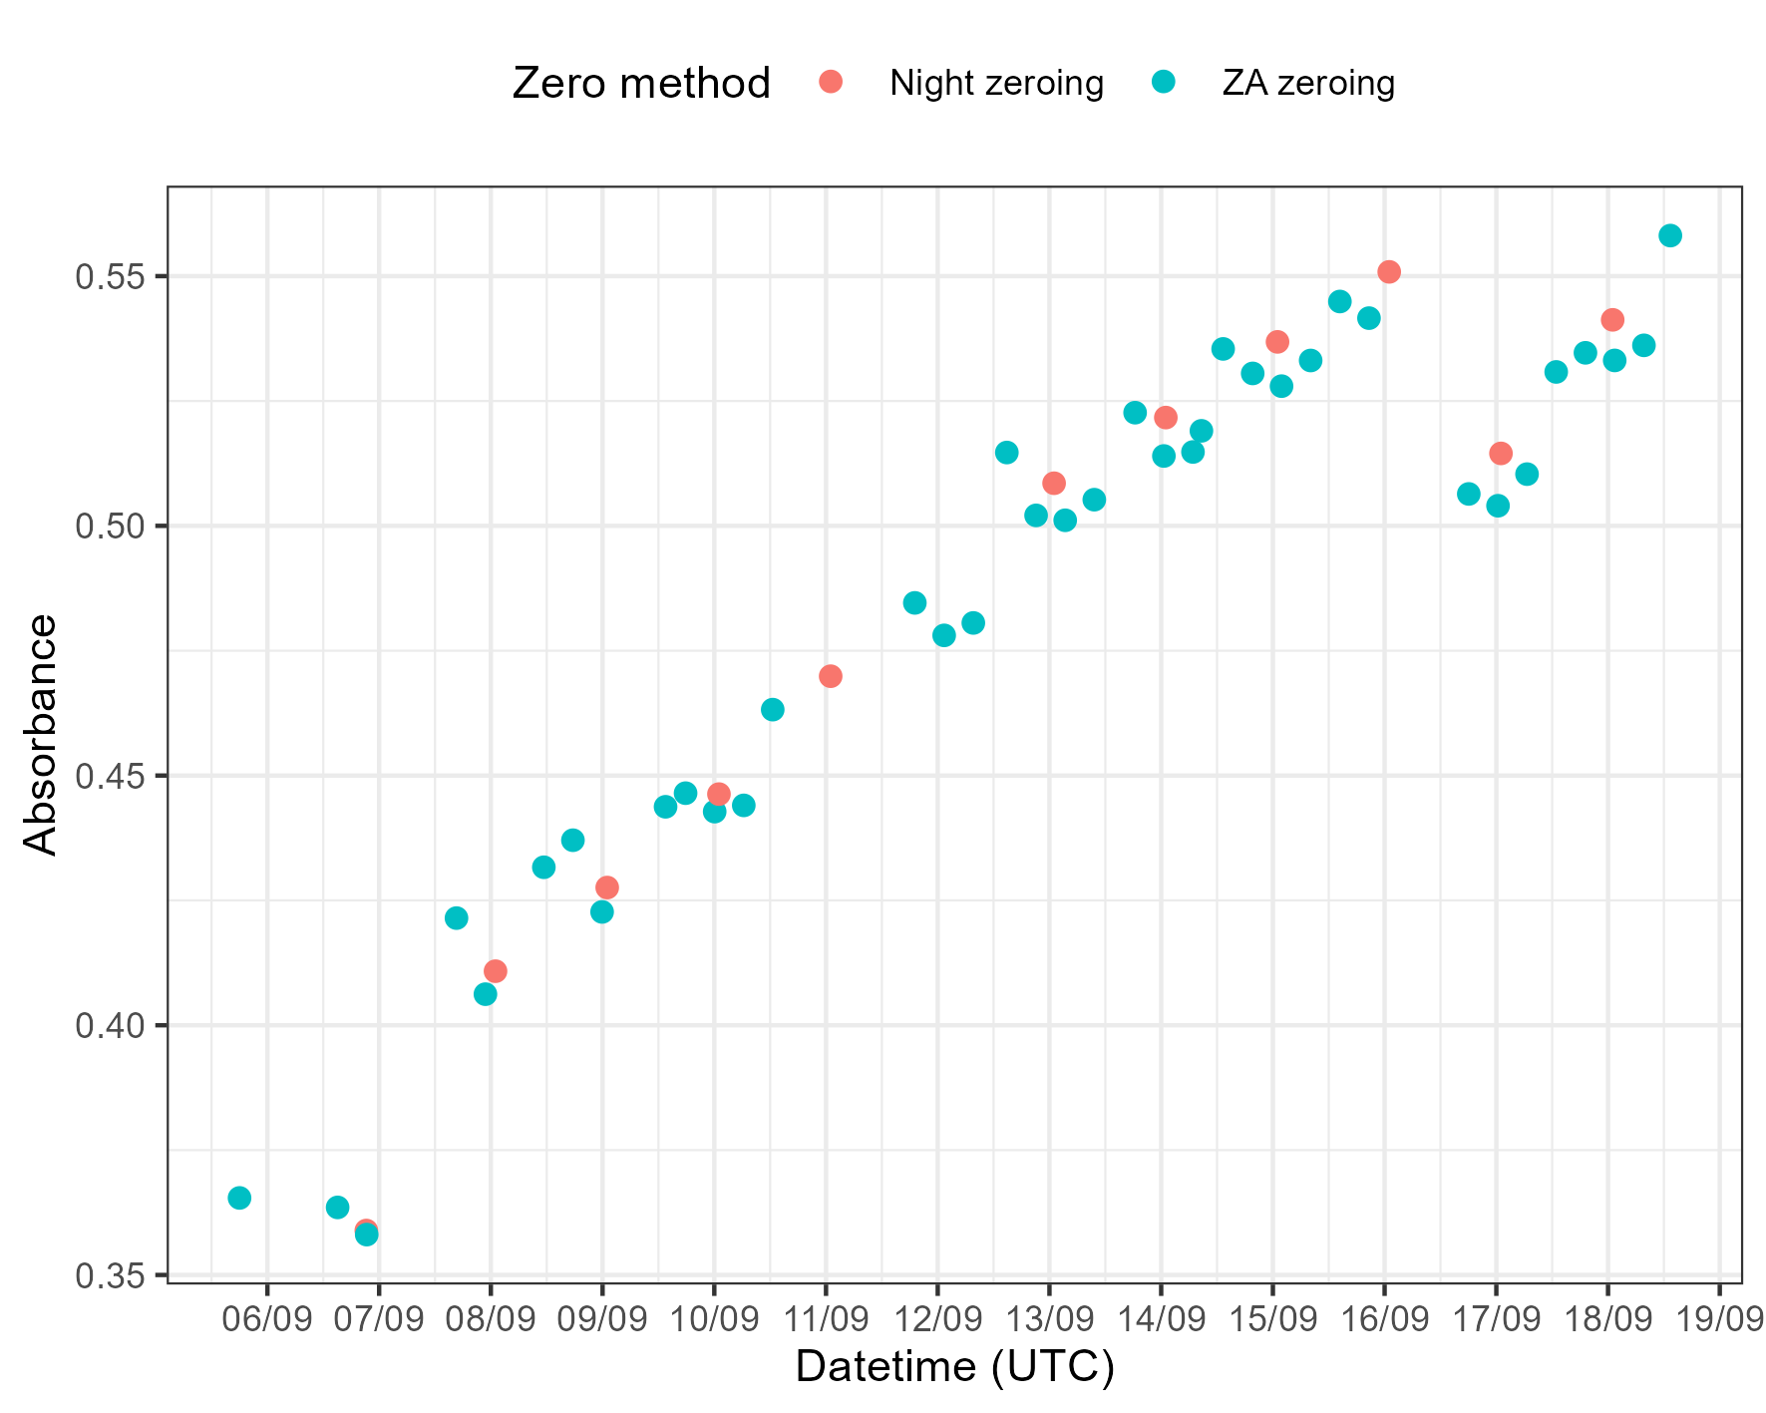
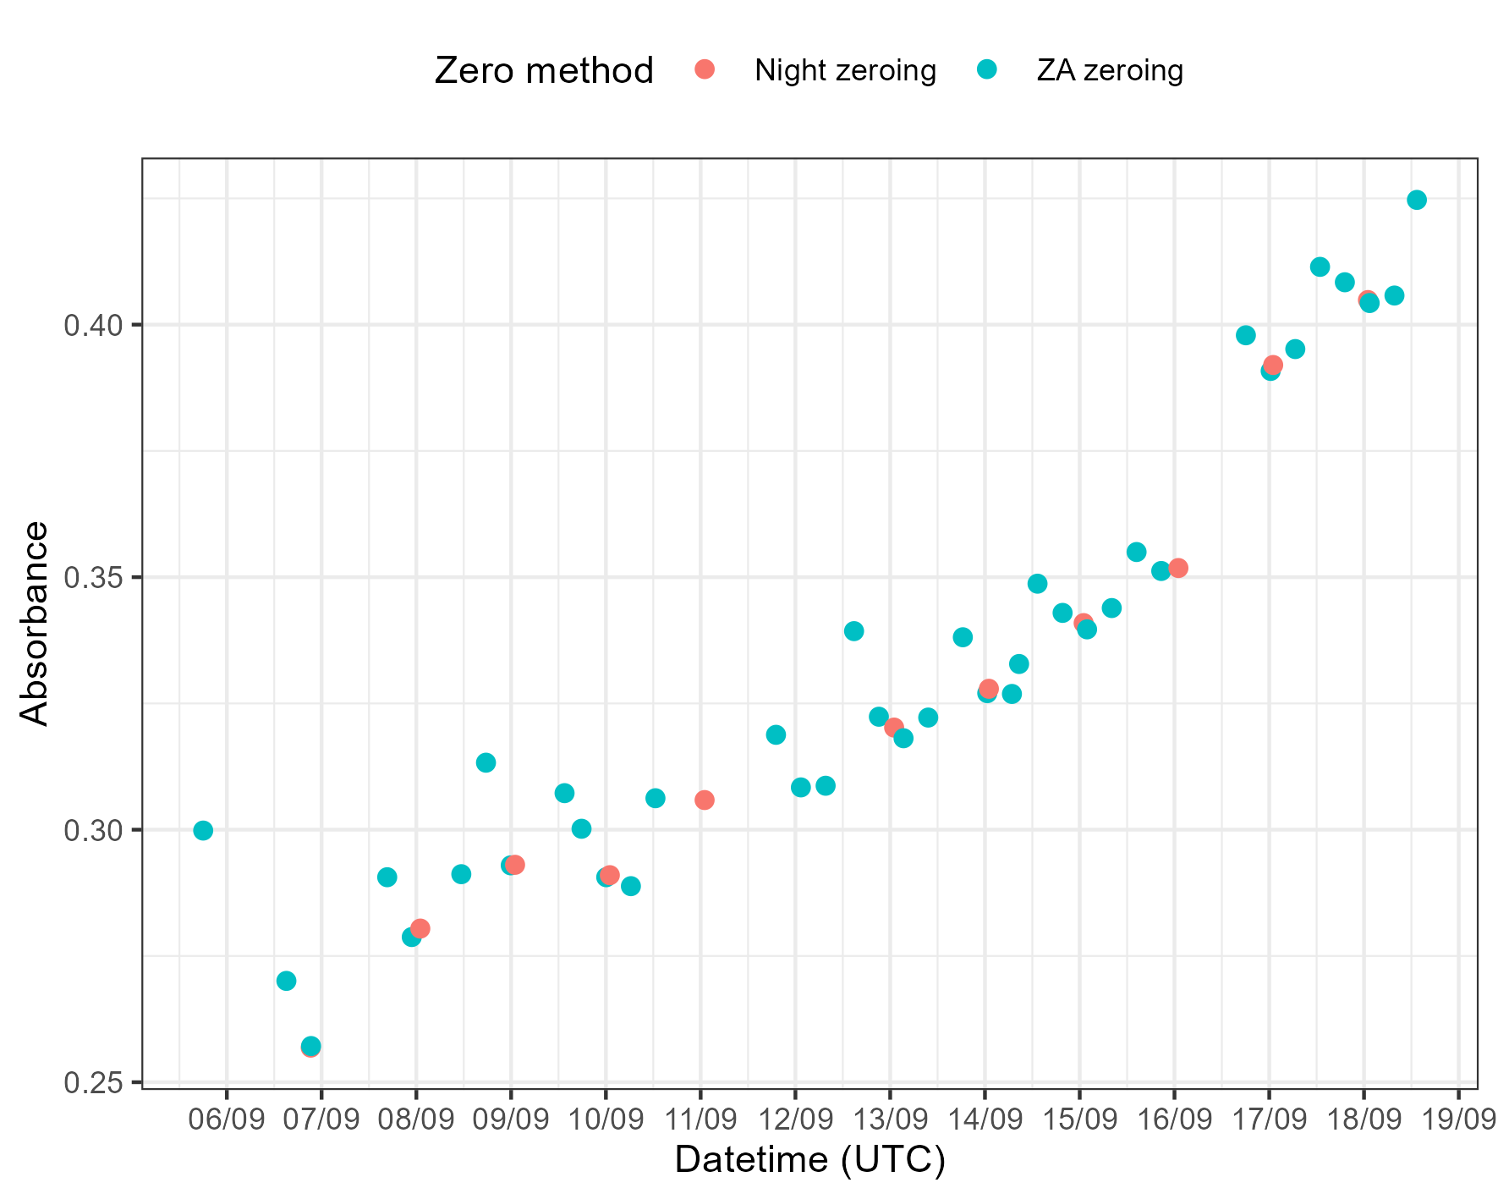
Zeroes
Channel 1 (HONO + interferences)
Channel 2 (just interferences)

Slide 4
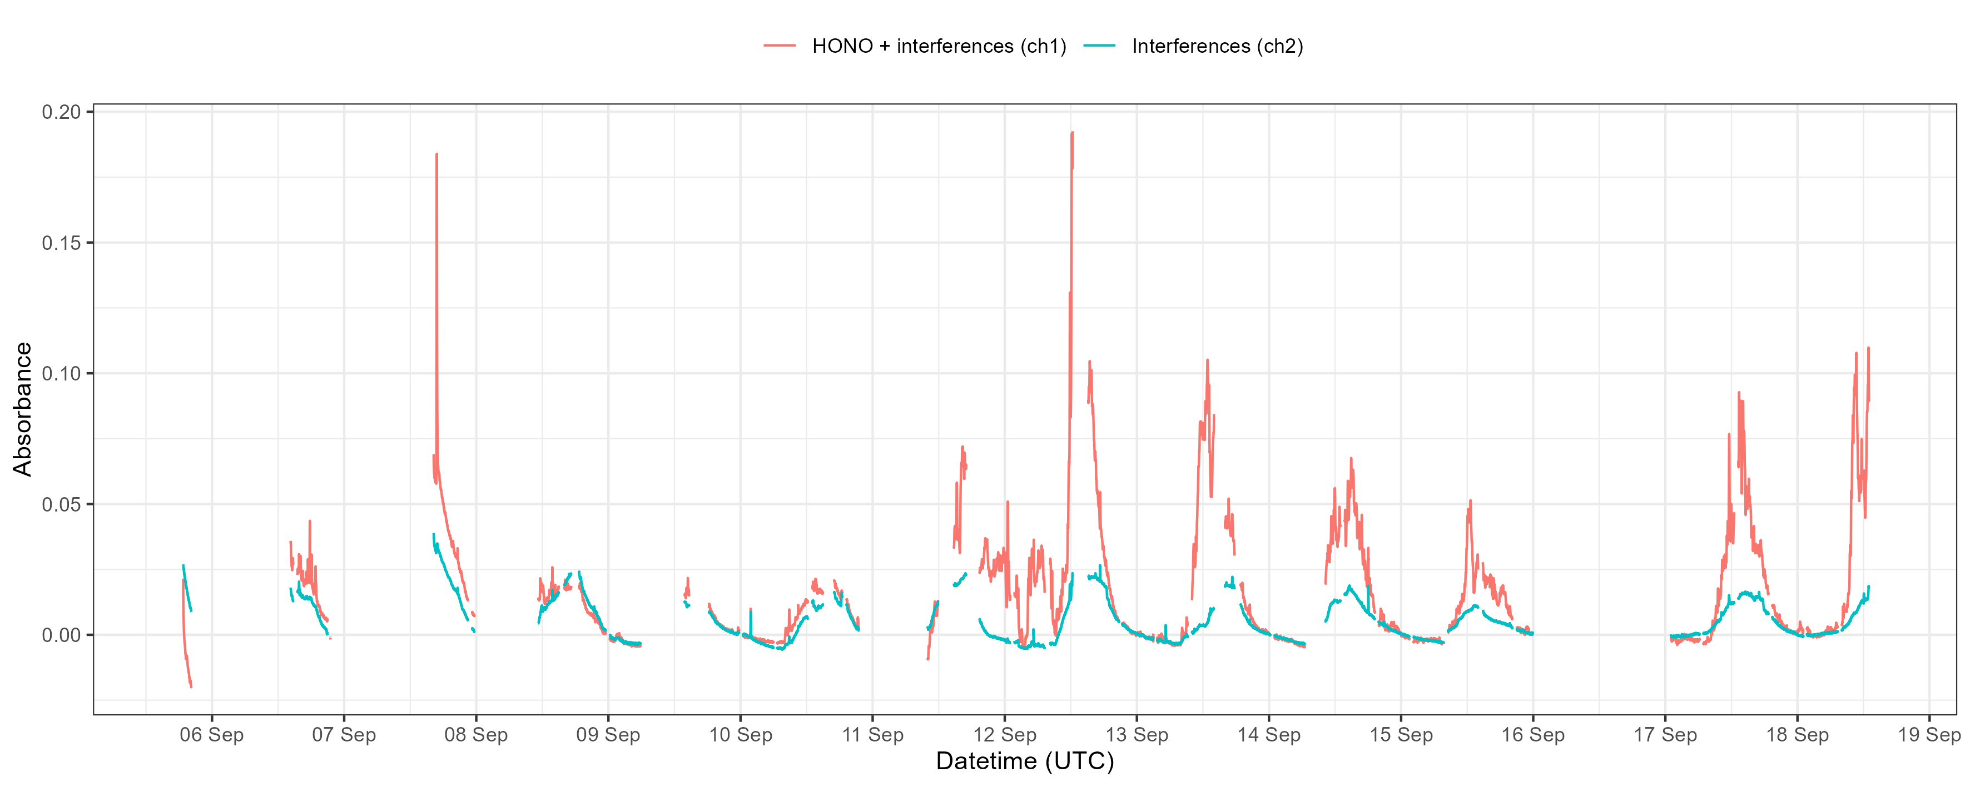
Zeroed data (using nighttime values – between 21:00 and 04:00 UTC)

Slide 5
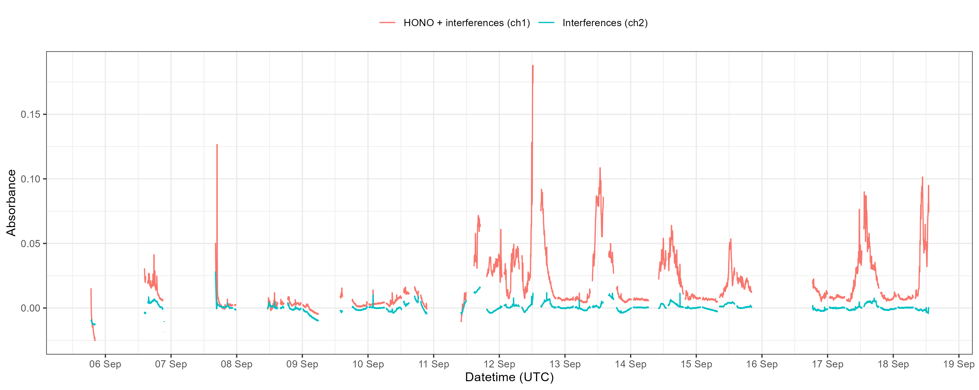
Zeroed data (using ZA values)

Slide 6
HONO measurements September 2024 – issues with gas flow
The gas flow is used in the calibration calculations to calculate the sampling efficiency and the HONO concentration measured during the calibrations
As long as the gas flow is stable, it doesn’t really matter what it is… Unfortunately it didn’t appear to be stable at CVAO and there was no way while out there to log what the gas flow was (other than pen and paper – and this wasn’t logging what the flow was at the inlet, which I have reason to believe is slightly lower than what it was when measuring the flow within the main instrument)

Slide 7
Log of HONO gas flow checks – lab cal
Gas flow calibration in York before LOPAP was shipped showed it was slightly lower than its setpoint
Setpoint / mL min⁻¹ | Measured / mL min⁻¹
500 | 442
750 | 658
1000 | 871
1250 | 1084
1500 | 1295
1750 | 1503
2000 | 1712
Checked gas flow at inlet once instrument was set up at CVAO (2nd September) → roughly 800 L min⁻¹

Slide 8
Log of HONO gas flow checks
Gas flow was next checked on 11th September
At around 12:00, it was 1.4 L min⁻¹
At around 12:30, it was 0.85 L min⁻¹
At around 18:00, it was 1.5 L min⁻¹
A gas flow calibration was performed by placing the flow meter in line in the main instrument (before the MFC and the gas pump, after the particle filter and HCl scrubber – different from previous gas flow measurements up until now, which have been carried out at the inlet)

Slide 9
Log of LOPAP gas flow checks – calibration from the field
Setpoint / mL min⁻¹ | Measured / mL min⁻¹
500 | 630
750 | 920
1000 | 1180
1250 | 1420
1500 | Unable to reach
1750 | Unable to reach
2000 | Unable to reach
When gas flow was set at the higher values, it was unable to reach them

Slide 10
Log of LOPAP gas flow checks
After these issues were uncovered, the flow meter was left in line in the instrument and was checked regularly, whilst I was at the site (could not be set up to log)
From 11th September to 17th September the gas flow values seemed to vary quite a bit (between 1150 and 1640)

Slide 11
Effect of different gas flows on measurements
Fortunately, calibrations are done using a liquid standard and the gas flow doesn’t matter, so it can be changed during data processing to see what effect it has on measurements and as I figure out what it could have been when the instrument was measuring (may have to break down the data day by day and use different gas flow values for each day)
Biggest question is what is the relationship between gas flow at the inlet and gas flow in the instrument and I can’t answer that until I have the instrument back

Slide 12
Calibrations
Three calibrations
On 9th September – maybe the zero air can’t be trusted to be overflowing the inlet for this cal?
On 13th September – cal carried out after variable gas flow was discovered, wanted to do a cal whilst checking what the gas flow (not super necessary since it doesn’t actually affect the calibration)
On 14th September – spectra adjusted, so cal will be used from 14th September onwards

Slide 13
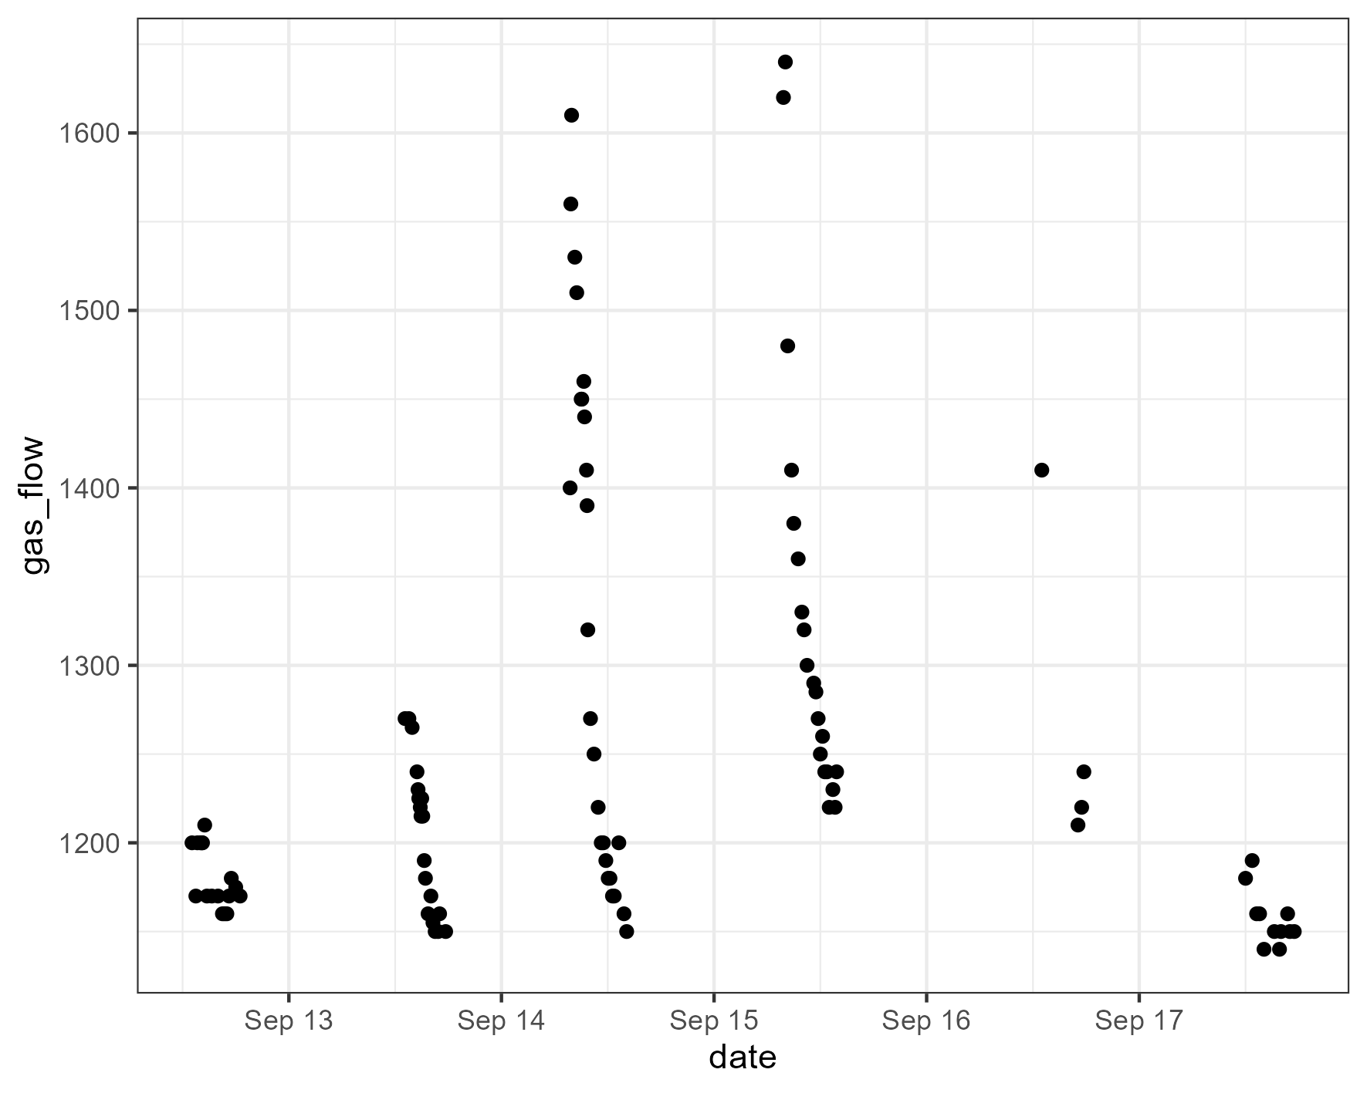
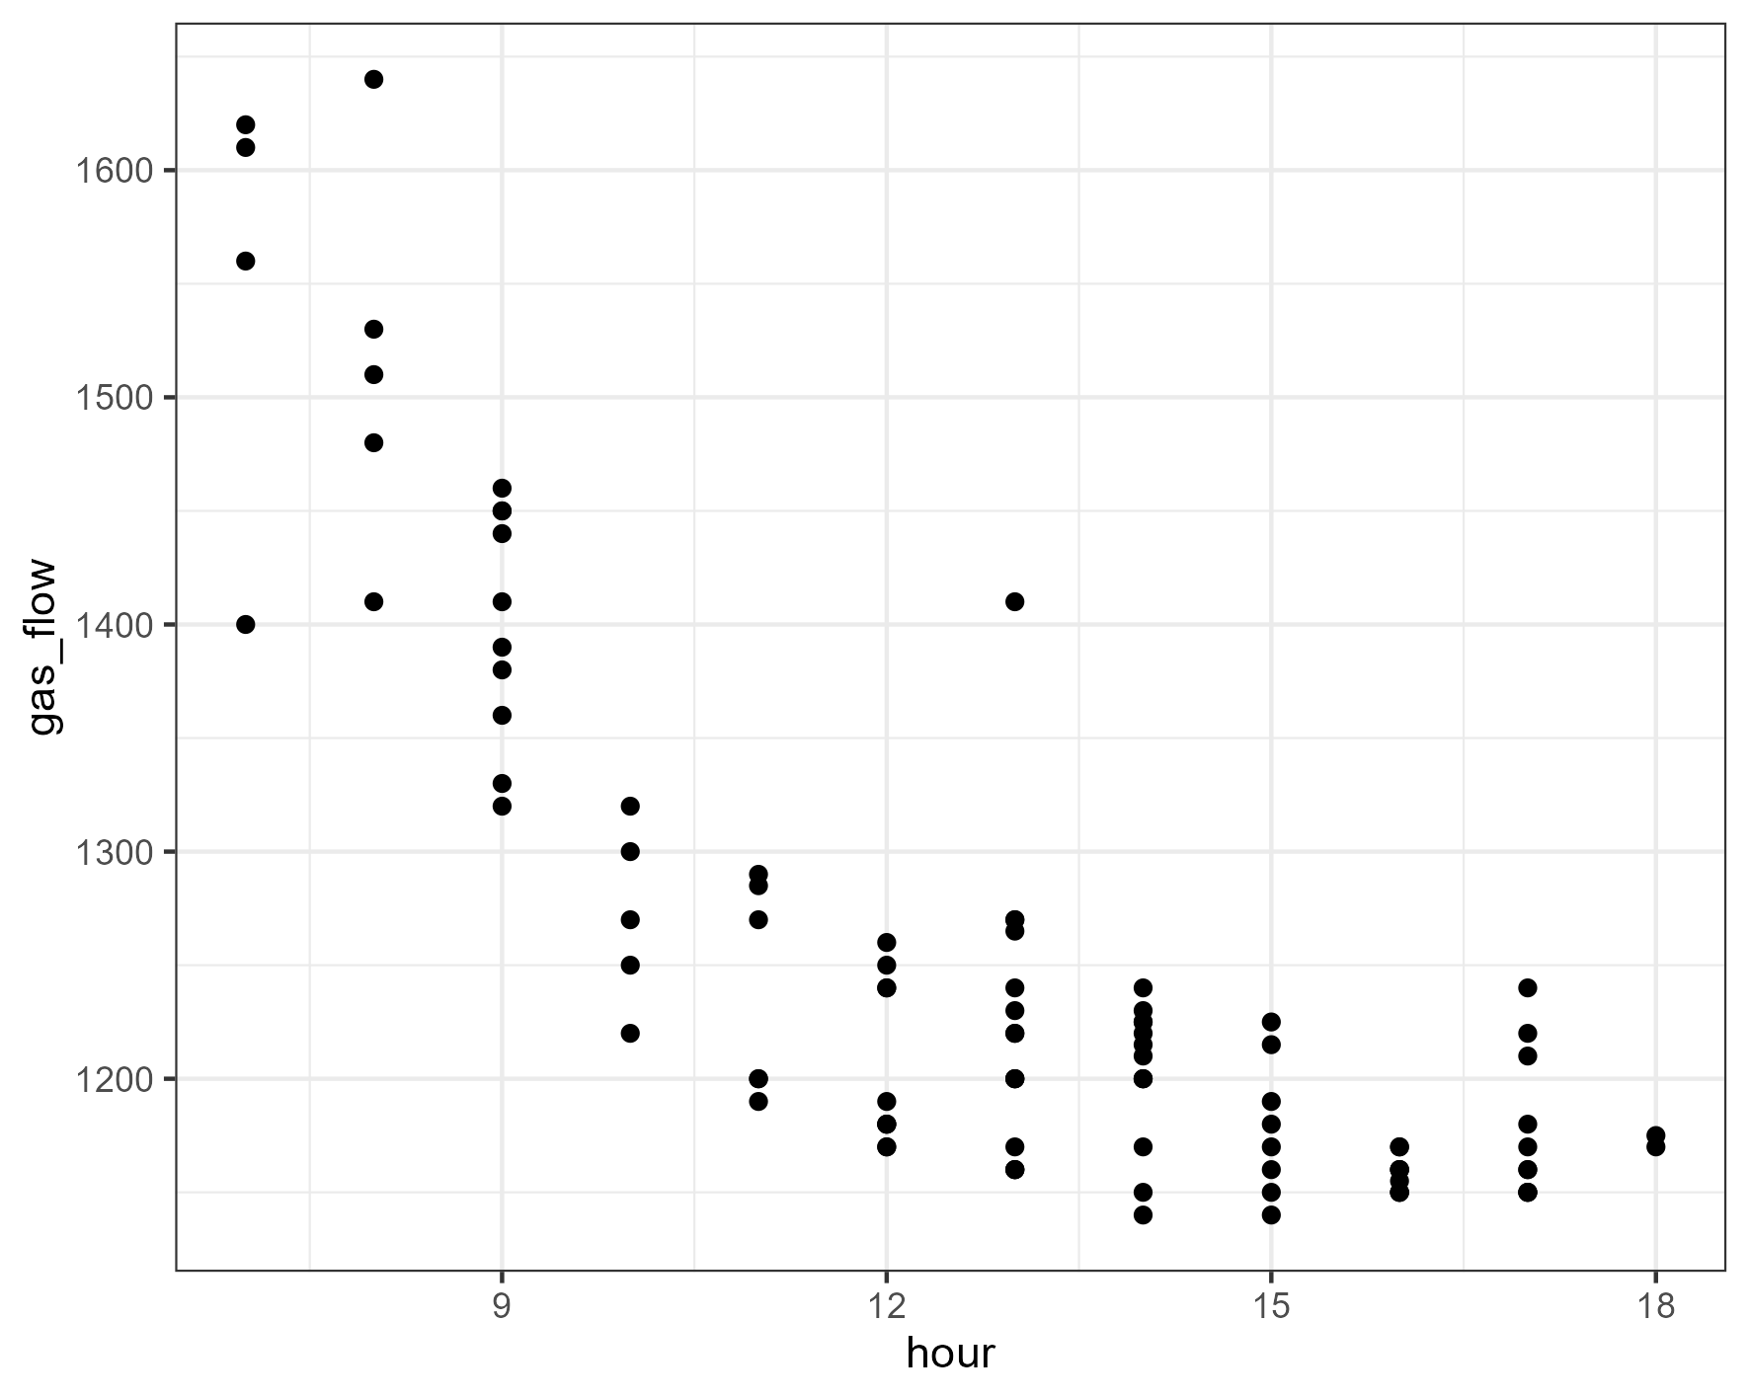
Plot of manually recorded gas flow
From the limited data available, it looks like there is a temporal influence on the gas flow measurement??? More tests are required in York

Slide 14
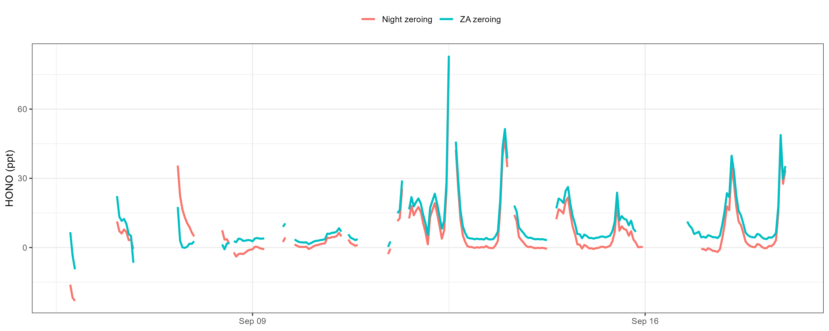
Comparison of ZA and nighttime zeroed HONO measurements

