Slide 1

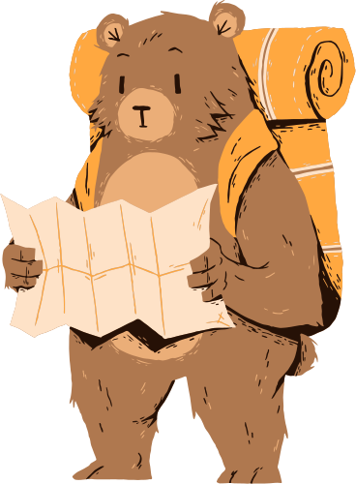

Classifier
The Bear
By Anna Han
ahan92@uchicago.edu
ADSP 31009 Machine Learning & Predictive Analysis
Final Project

Slide 2
Table of Contents
01
Problem Statement
04
Feature Engineering
02
Assumptions
05
Model: Approach, Results
03
Exploratory Data Analysis
06
Future Work

Slide 3

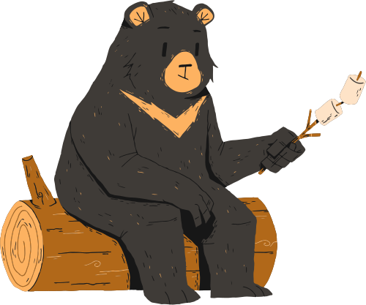
Problem Statement
The PURPOSE of this project is to classify bears by species based on a still image.
We focus on four macro species of Ursus:
Our APPROACH is technical: we construct our very own convolutional neural network to learn features that are unique inter-species but common intra-species. The presence and absence of these traits are used to quantify the likelihood a bear is black, brown, polar or panda.
APPLICATION of our model:
Aid Zoological Studies accelerated by climate change. Their solitary nature and menacing strength when aggravated make bear studies heavily reliant upon remote surveillance equipment. Automated classification could automate footage processing to expedite ecological research.
Study Case of ML vs. Human. Aside from color scheme, the average person tends to describe all bears rather homogenously – e.g., two semi-circular ears, knubby tail, and hunkering proportions. Our subject choice presents an opportunity for convolutional neural networks to surpass the layman.
Personal Penchant. We confess a personal admiration for bears had a non-negligible impact on our topic choice.
Common Name | Scientific Name
Black | americanus, thibetanus
Grizzly | arctos
Polar | maritimus
Panda | ailuropoda melanoleuca
1. Reference: raw data files in github.

Slide 4

ASSUMPTIONS
Grounding bases and preliminary hypotheses.
1
2
3
INPUT/OUTPUT
Input has a specific structure (i.e., image of fixed dimensions) containing bear(s) belonging to exclusively one of four classes. The format of our output is a single class; therefore, inputs cannot be multiple species, none, or other class bears.
FEATURES
Features must exhibit similarities intra-class and differences inter-class for our model to be effective. However, we cannot assume said feature is of the bear itself. It is possible our model picks up on background clues – e.g., snowy habitats of polar bears or bamboo for snacking pandas.
COLOR

Slide 5

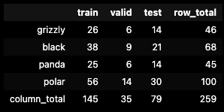
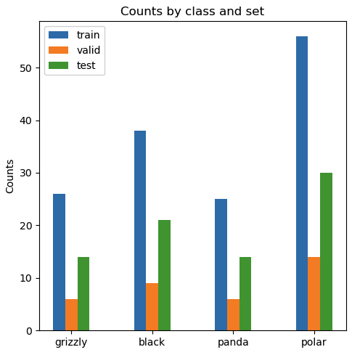
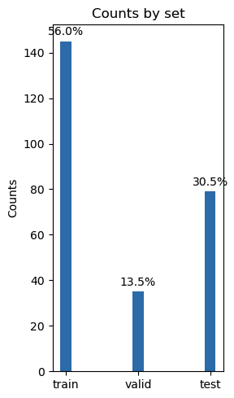
Exploratory
Data Analysis
STRATIFIED SPLIT 70/30 to training/test datasets and another 80/20 for training/validation. These figures were determined through much trial and error; and, found to somewhat balance over- vs. under-fitting challenges plaguing small sample sets.
DISTRIBUTION of data is as follows:
The BEAR DATASET¹ initially consisted of 309 non-uniform images (.jgp) grouped into five folders: grizzly, black, teddy, panda, and polar. This is a notably small sample set.
DISCARD TEDDY class to focus on real bears in lieu of our business applications (ref: slide 3).
STANDARDIZE DIMENSIONS to 256x256x3 based on dataset average.
1. https://www.kaggle.com/datasets/hoturam/bear-dataset/data

Slide 6
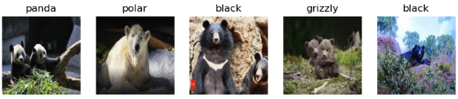
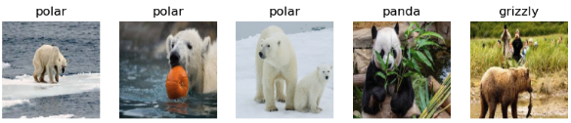
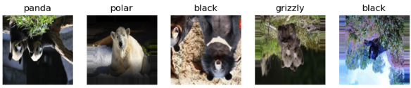
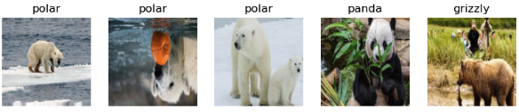
Pre-Augmentation
Post-Augmentation
Exploratory Data Analysis
ANOMALIES:
Multiple bears in one image;
Non-bear figures (e.g., human, polar-caps, trees);
Computer-generated vs. real-life photos;
Watermarks;
Captions, sometimes containing class label.
For our initial approach, we take note of but do not prune these anomaly samples.
AUGMENTATION: Sheer, Zoom, Flip
While we observe a variety of camera angles and off-center positioning, the majority of our data presents a right-side up clear image. In cases of ecological research (ref: Problem Statement), surveillance devices often get knocked over, partially covered, blurred, or discolored (e.g., night cameras). Our augmentation choices somewhat pre-emptively account for some of these real-life challenges of nature equipment; and, additionally modeling difficulties plaguing small sample sets..

Slide 7
Feature Engineering
Standard Resolution
Class Encoding
Data Augmentation
Earlier we found our dataset images came in a variety of sizes. To optimize our convolutional neural network performance, which requires a fixed input size, we chose to standardize inputs.
Based on EDA and model trial and error, we found the rather large dimensions of 254 x 254 (x3 for RGB) held up well.
Additionally, we chose to add padding when running the convolutional layer to account for various positioning differences across our samples.
We translated classifications into one-hot encodings for computational ease.
See previous slide: Exploratory Data Analysis.
Data Pruning
Shuffle
Removing the Teddy class was intended to reduce model noise as the original dataset had too few samples to learn the vast intra-class variety of Teddy. However, we are cognizant that our model depends on the assumption every input has one or bears belonging exclusively to one of four classes. Later we discuss adding an “other” class for better generalization.
Initially our samples were ordered by class. We intentionally shuffle training, validation, and test datasets upon creation in order to prevent our model from picking up on unrealistic ordering.

Slide 8
Model Approach
Bear Fun Fact
Black bears stay expert tree climbers, but brown bears quickly grow too big to climb.
Before diving in to model specifics, we pay homage to the classic (but also cringe) computer scientist phrase:
“Garbage in, garbage out.”
We spent an enormous amount of time trying different combinations of data preparation – ratios for splitting, magnitude of augmentation, shuffling, resolution, drop/add subsets, etc.
Our data escapades help built an intuitive feel to better guide our model approach, and ultimate selection, within the bounds of our given time and resource constraints.

Slide 9
Model Approach
Neural Network
Optimization
Valuation
Adapt framework of convolutional neural network (CNN) due to their lauded strengths in image classification.
Employ the keras (sequential) model to serves our needs for customization.
Avoid pre-trained models and transfer learning as to honor the exploratory purposes of this final project.
Hyperparameter tuning by Bayesian Optimization or Random Search to optimize model performance.
Early stopping to avoid overfitting while being cognizant of computational resources.
Multiple iterations with fresh shuffling of datasets to guide tuning. In layman terms: trial + error + patience.
Consider various performance metrics (e.g., accuracy vs. loss) for absolute evaluation.
Relative valuation metrics (e.g., cross-validation) for clues on over- vs. underfitting and bias vs. variance.
Reference code: Construct Model

Slide 10
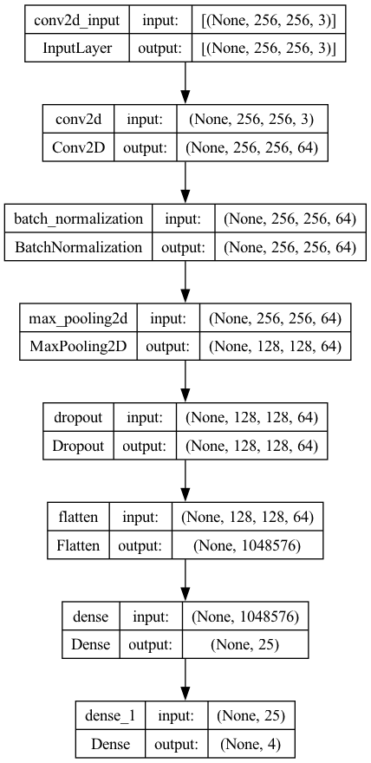
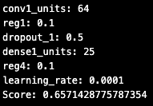
Model Solution
Neural Network
Optimization
Valuation
- Better performance with a single convolutional layer (vs. multiple) followed by batch normalization, max pooling, dropout, flattening, and two dense layers.
- ‘Relu’ activation functions, kernel regularization, padding, and learning schedule served to mitigate overfitting while providing enough complexity to perform better than random guessing.
Bayesian Optimization bias towards ”exploration” (vs. exploitation) to search hyperparameter ranges of convolutional units, L2 regularization, dropout, learning rate and decay.
Further ran trials to find the best objective (validation loss vs. accuracy), optimal epoch, and early stop metrics.
Best Hyperparameters:
Reference code: Construct, Hypertune, Visualize, Best Epoch.

Slide 11
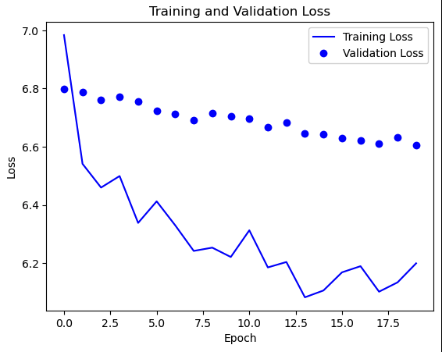
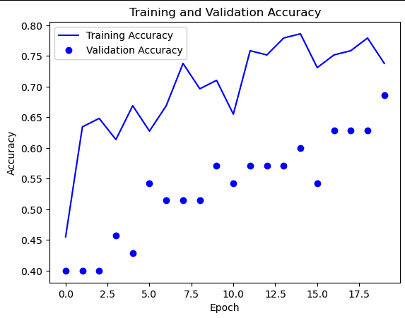
Accuracy: Train, 0.74; Valid 0.69
Results, Accuracy: Full Model
“Full model” trained over the full 20 epochs (without early stop).
Performance Results after 20 epochs:
Loss: training, 6.2; validation, 6.6.
Accuracy: training, 0.74; validation, 0.69.
Mild decay in validation vs. training performance suggests over-fitting. Still, this optimized combination of hyperparmeters (ref: Model Solution) evaluated to be the least offensive and most stable.
Despite the volatility in accuracy and the relatively slower decline in validation loss, overall directional trends of both are encouraging.
From Full Model, we find the full 20 epochs achieved the best overall validation loss and accuracy.
Reference code: Best Epoch.

Slide 12
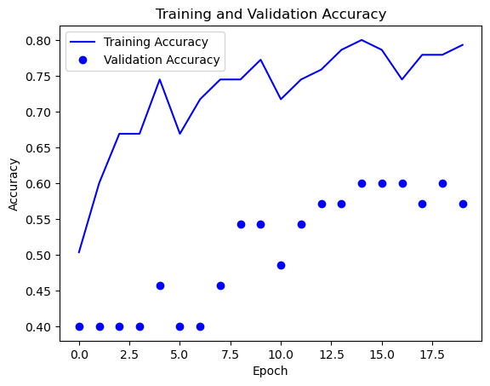
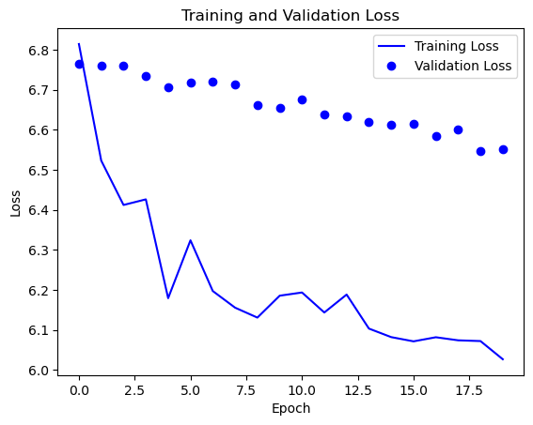
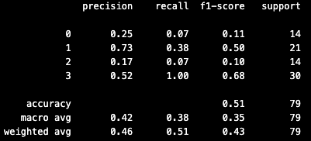
Accuracy: Train, 0.79; Valid 0.57
Best Epoch + Early Stop
Building off the “Full model”, we optimize for best epoch count by valid accuracy and loss. Though purely quantitatively it is equivalent to the full 20 epochs. While all 20 were computationally expensive (i.e., time consuming), we believe it is feasible.
To our “best epoch” model, we added an early stop condition based on both validation accuracy and loss with patience = 5; but, it was not breached in this iteration. This level was determined through trial and error while conscious of (1) our low learning rate and decay; and (2) difficulties of small sample size.
Evaluation on unseen test data exhibits notable decay in accuracy, which suggests overfitting despite our attempts to drop and regularize. Overall performance appears much less equivalent to a coin flip. We fully acknowledge this is quite low.
As the class level, the model performs excels at recall of polar (3); and, precision in black bears (1). It is weakest in recall and precision in pandas (2).
Test: accuracy 0.51
Reference code: Tuned Model with Early Stopping, without Early Stopping.
Notes:
Grizzly (0), black (1), panda (2), polar (3)

Slide 13

Learnings
We Talkin’ Bout Practice?
Unlike Allen Iverson¹, our model does need practice. We tried hundreds of runs and hyperparameter combinations to narrow their ranges before entrusting to mechanized tuning.
Purely relying on quantitative tools resulted in aimless searching and less fruitful results. In that regard, we needed to practice with the data to build intuition; and, the model needed to practice (reiterate, re-tune, re-fit²) to achieve better results.
Back to Basics
It is tempting to ”go ham” and stack layers with all the bells and whistles; but, we found that complexity did not improve our model with the added burden of inexplicability. Our main nemesis throughout was overfitting yet some traditional mitigation techniques exacerbated our troubles. Reverting to a basic (single convolutional) model, which still proved to be quite the labor of love, improved performance.
https://www.youtube.com/watch?v=eGDBR2L5kzI&ab_channel=gordievsky
We noticed even with a set seed some variation in same model performance. This could be our error and we intend to explore this further in future versions.

Slide 14


Future Work
Next we would like to deep-dive into the more discerning feature filters learned by our convolution layer. Are the features bear-centric or of other background clues – e.g., ice caps (polar bear) or bamboo sticks (panda)? Are learning these latter background clues “fair game” for our business purposes? Can we introduce a bias based on apriori knowledge of where the image was taken? These are items worth exploring.
We also want to expand to handle other species of bear and null bear scenarios. While it is unrealistic that real images would capture multiple bear species in one image, the former cases are quite common. There are eight overarching species of bears; surveillance equipment tends to be motion sensor driven and could pick up on any type of wildlife. It would be prudent for our algo to classify the “other” and “null” bear images.
Last, expanding sample dataset.

Slide 15
Thank you!
Anna Han
ahan92@uchicago.edu

