Slide 1
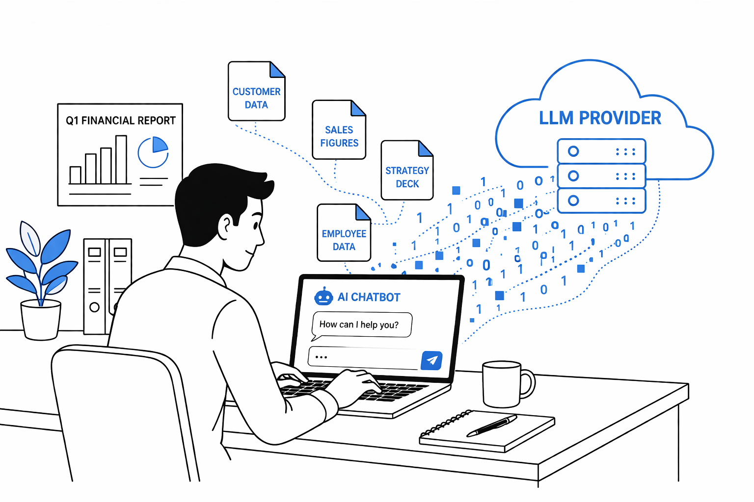
Notes:
Argus:
AI Usage Intelligence Plattform
helps companies govern AI adoption before liability
employees leaking data to LLMs and you don’t know
(source code, customer data)
no visibility or control
this is reality
growing compliance gap in your blindspot (AI usage increases)
ARGUS takes this into the light

Slide 2
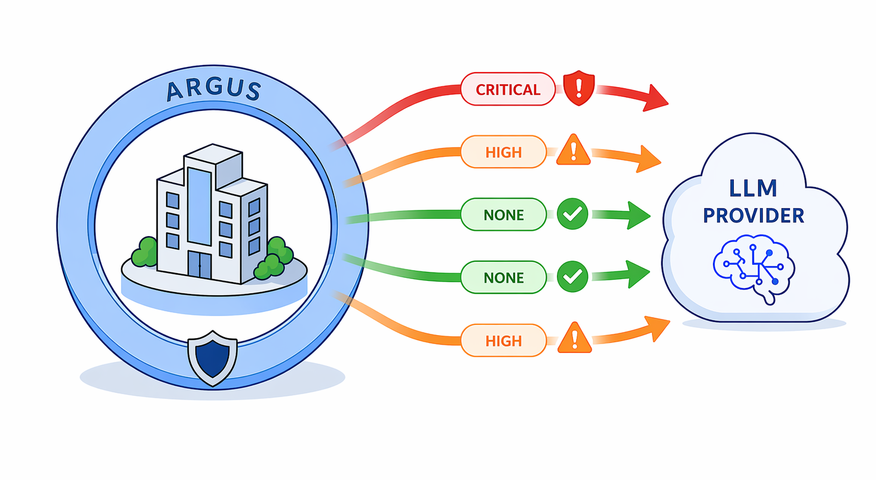
Notes:
data integrity needs to be upheld! (fundamental principle) - data left your network -> lost control
EU AI Act mandates audit trails and risk documentation for AI usage
most companies operate today:
data flowing out unchecked
no audit trail
no cost tracking
Data integrity: gone. Compliance: impossible.
with ARGUS deployed:
every flow monitored
risks flagged
data integrity upheld. A compliance score your auditor can actually use. Governed.
- potential customer receives easy to use ready-to-go lab device to test the service and proves your risk exposure
Then our engineers deploy ARGUS on your infrastructure - on-prem or as our managed service

Slide 3
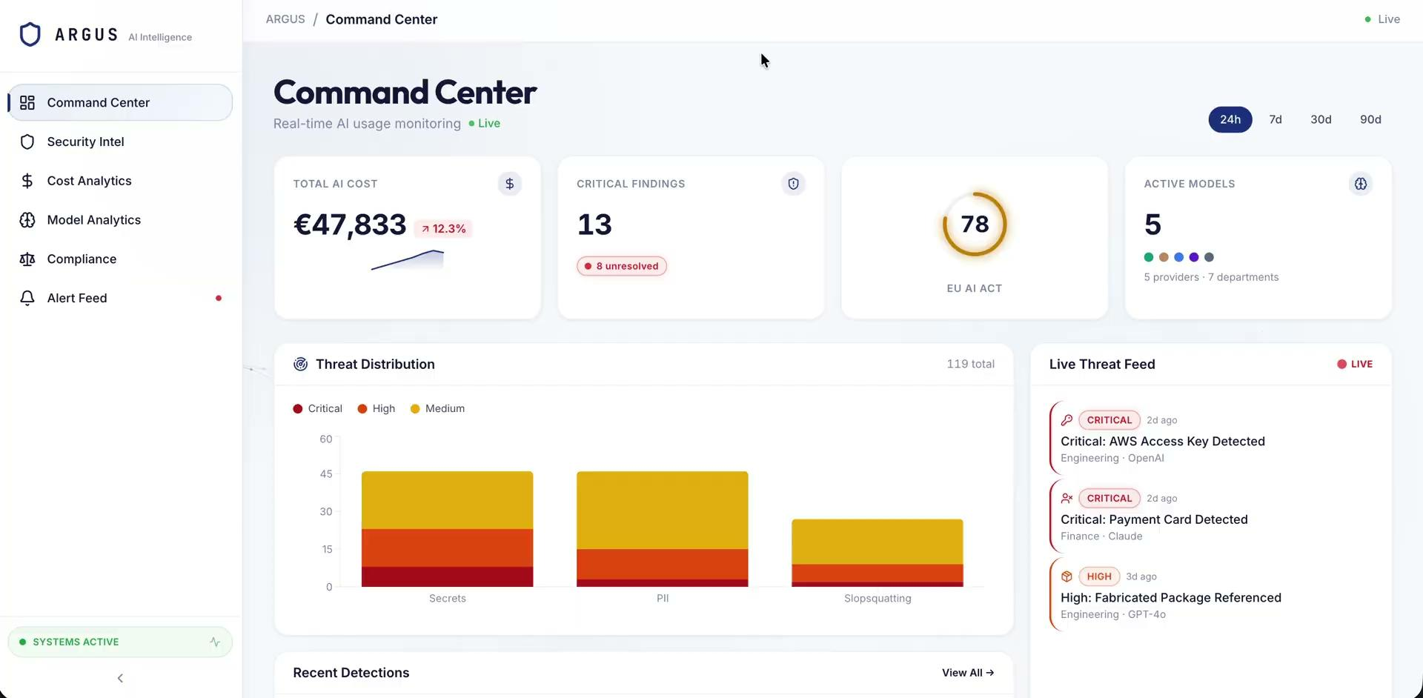
DEMO
Notes:
In your ARGUS Dashboard right now: - Secret & credential leaks — caught before damage is done - Full conversation audit trail — see exactly what was sent, to whom - AI provider map — which tools your company actually uses - Compliance risk score — audit-ready, always up to date - Real AI spend — across all providers, by team

Slide 4
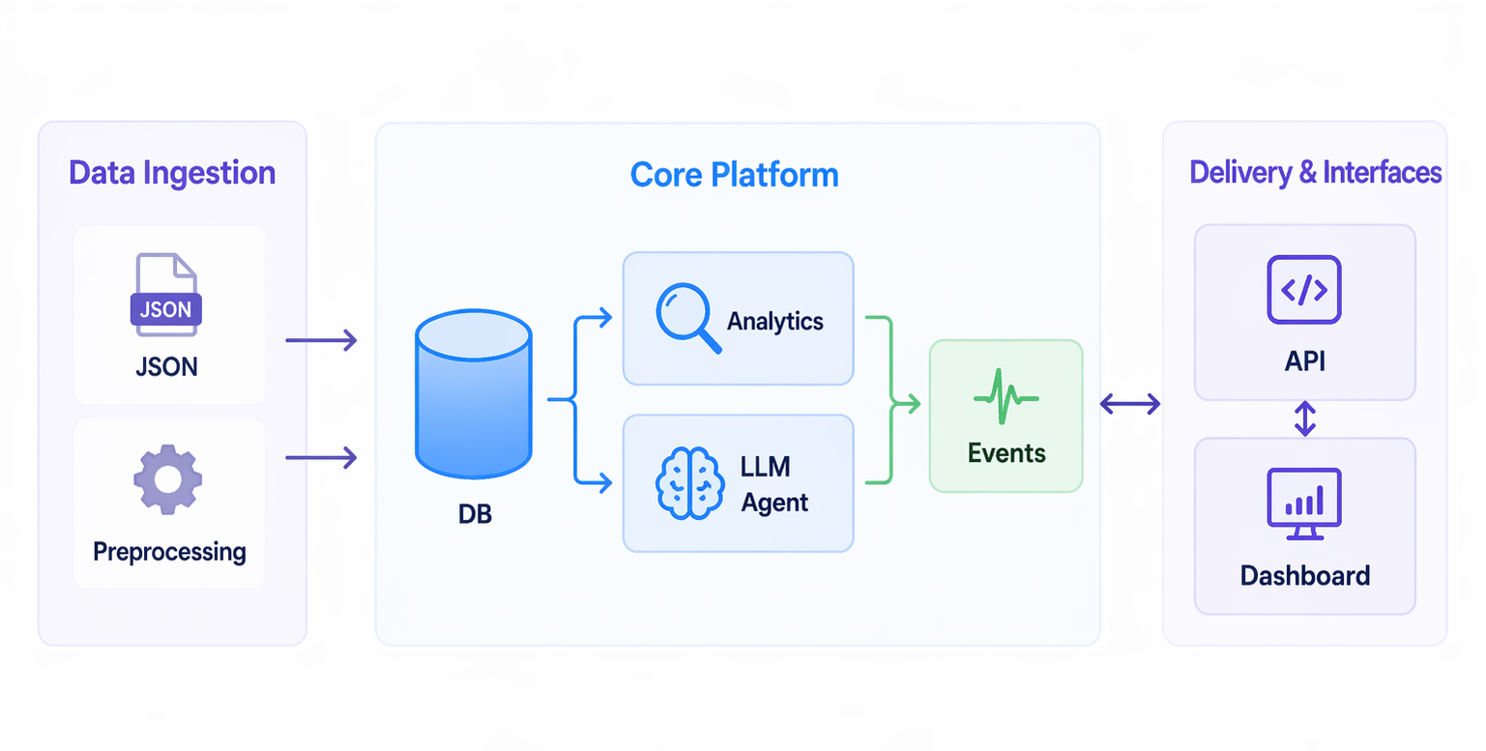
Notes:
ingesting your AI conversations
run them through deterministic scanning + LLM analysis layer
live dashboard for event data
API
dashboard
whole stack runs on premise (your infrastructure) or we host it for you

Slide 5
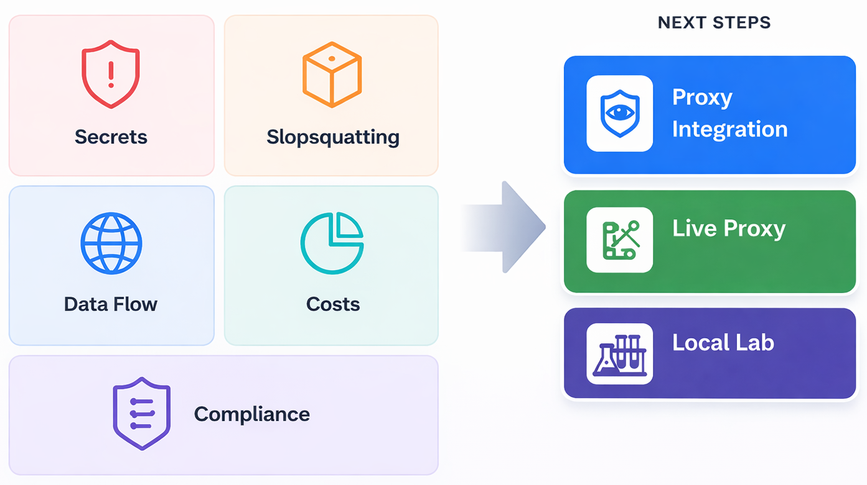
Notes:
five risk categories today:
leaked secrets
hallucinated packages
data flows ( unspecific company info)
costs
and compliance exposure
Next:
live proxy that intercepts AI traffic in real time (no export needed) - just continuous monitoring
-> full production deployment.

Slide 6

Try it Yourself!
Notes:
You can’t ban AI usage, it will be used anyway, you should govern. We built the governance layer.
Try it yourself now!

