Slide 1

Annabel Keppel-Palmer Spring 2023
Professor Scharff
CS 668 Capstone Project
Title : Measuring the attitudes of governments towards their female population : A cluster analysis on discriminatory policies
Name : Annabel Keppel-Palmer
Github : https://github.com/annabelkeppelpalmer/capstone-project
1

Slide 2
Measuring the attitudes of governments towards their female population: A cluster analysis on discriminatory policies
Research Question(s) :
By assessing discriminatory regulations, can we state which governments are actively working to lessen the gender gap?
Which governments/ countries have the best policies in place to protect and empower their female citizens?
Which areas face the biggest discrimination for women?
2

Slide 3
Measuring the attitudes of governments towards their female population: A cluster analysis on discriminatory policies
Motivation
My own personal experience as a woman having lived in multiple countries
Constant changing laws in the United States that affect women on a daily basis
Going into a male dominated workforce, starting the conversation with those that do not identify as female
3

Slide 4
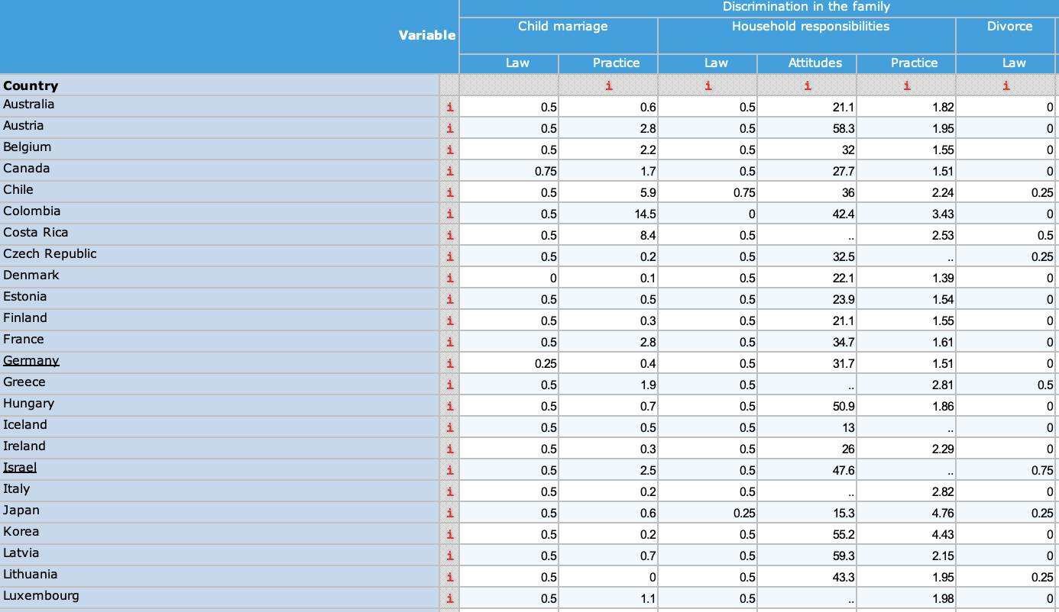
Measuring the attitudes of governments towards their female population: A cluster analysis on discriminatory policies
Dataset : The Gender, Institutions and Development Database (GID-DB)
Covers 180 countries and territories.
Helps to analyse women’s empowerment and understand gender gaps
Uses the Social Institutions and Gender Index to assign scores for each category
Each category has a different methodology to assign scores.
E.g. Discrimination in the family
Laws on child marriage
Laws on household responsibilities
Laws on Divorce
Laws on Inheritance
180 rows (Countries) 35 columns (laws/ practices)
4
Notes:
34 columns

Slide 5
Measuring the attitudes of governments towards their female population: A cluster analysis on discriminatory policies
Literature Review
Many papers analyze the gender pay gap only
Combination of econometric and machine learning approaches
Clustering algorithms* heavily used across many research papers
For predictions, regression and KNN used
Gender gap is decreasing, however at a slow rate
Authors Referenced
H. Alatrista-Salas, B. Esposito, M. Nunez-del-Prado, M. Valdivieso (2017)
K. Gupta, R. Rani, A. Sharma, P. Bansal, A. Dev, R. Gandhi (2023)
Strittmatter A, Wunsch C (2021)
Michael Danquah, Abdul Malik Iddrisu, Ernest Owusu Boakye, Solomon Owusu (2021)
Jaanika Meriküll, Merike Kukk,Tairi Rõõm (2020)
Albanesi S, Şahin A (2018)
Hugo Alatrista-Salas, Pilar Hidalgo-Leon, Miguel Nunez-del-Prado (2018)
Andrey Shastri (2014)
*From reading these papers, I have decided to use clustering techniques for my project as I am looking to group the countries based on the data.
5

Slide 6
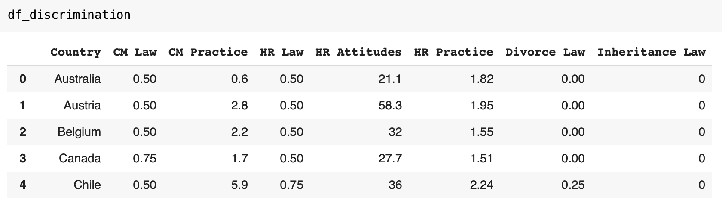
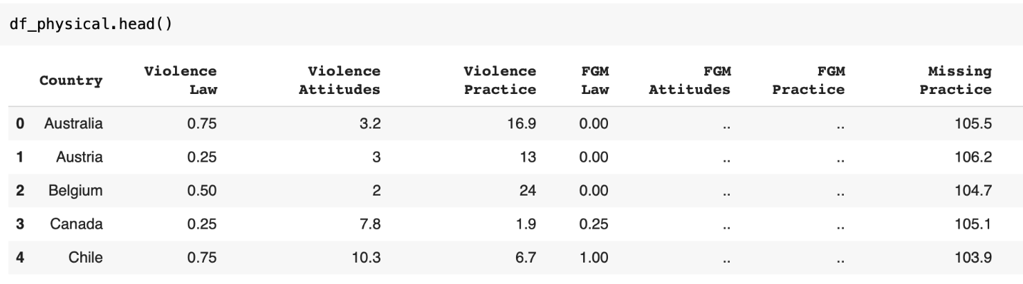
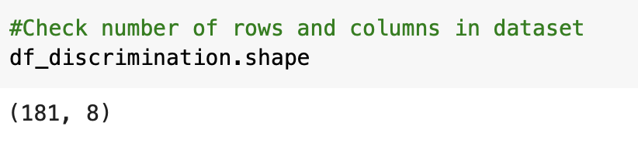
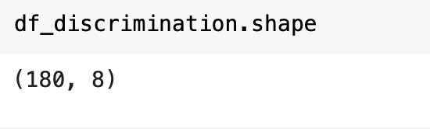
Measuring the attitudes of governments towards their female population: A cluster analysis on discriminatory policies
Preliminary Data Preprocessing and EDA :
Separated the dataset into four tables based on the different categories
Discrimination in the family
Restricted physical integrity
Restricted access to productive and financial resources
Restricted civil liberties
Preprocessing undertaken so far includes:
Checking for duplicates
Checking for null values
Dropping rows
Checking data types
After removing row
6

Slide 7
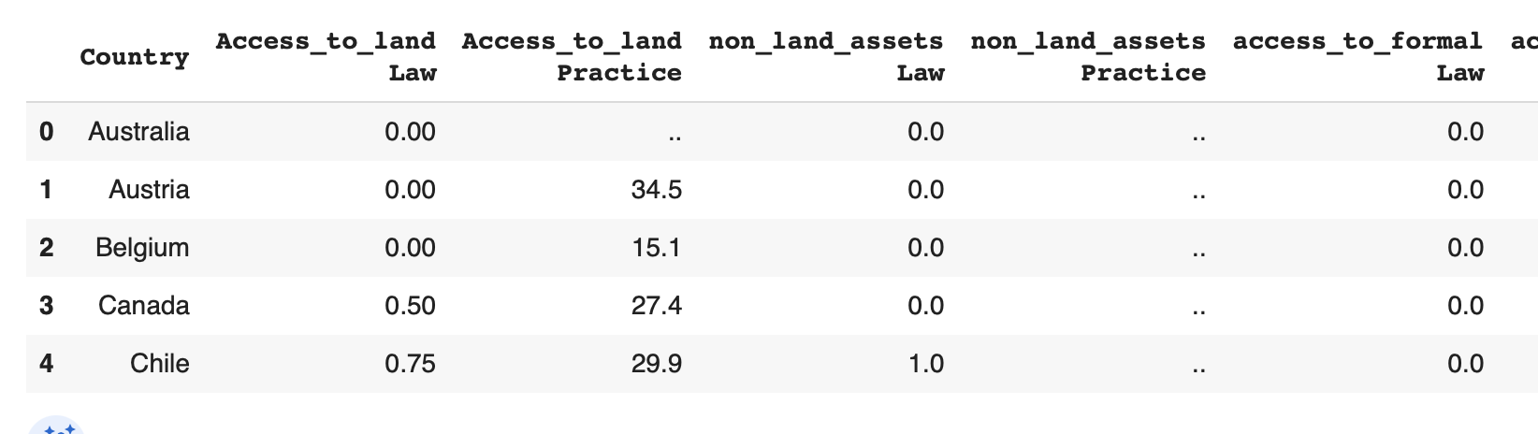
Measuring the attitudes of governments towards their female population: A cluster analysis on discriminatory policies
Preliminary Data Preprocessing and EDA :
Further Data Preprocessing needs to be taken, as some of my values are inputted as objects “..”
Before I can continue with EDA, I need to replace these with mean values or remove columns so continue with my analysis
7

Slide 8
Measuring the attitudes of governments towards their female population: A cluster analysis on discriminatory policies
Methodology & Experimentation
Link to the dataset : https://colab.research.google.com/drive/1sOK8F1BNC4HxUWBjId55qTiIAwXep2Km?usp=sharing
8

Slide 9
Measuring the attitudes of governments towards their female population: A cluster analysis on discriminatory policies
Methodology & Experimentation
I knew that I wanted to use a clustering machine learning technique in order to group together my data.
The goal of this is to group together countries that have similar legal systems (based on their scores in the dataset.
From the list of 180 countries, I initially started to chose to separate the data into 5 clusters. This number is simply just a placeholder while I build the model. I later plan to use the elbow method in order to find the optimal number of clusters
9

Slide 10
Measuring the attitudes of governments towards their female population: A cluster analysis on discriminatory policies
Methodology & Experimentation
Model:
The model I chose to use was the K-Means Clustering algorithm. K means clustering is very useful when you do not have a specific outcome to predict; data scientists use K-Means to find patterns and observe similarities between data points.
As these clusters were not predetermined, this unsupervised learning technique was one of the most suitable for my choice in data.
10

Slide 11
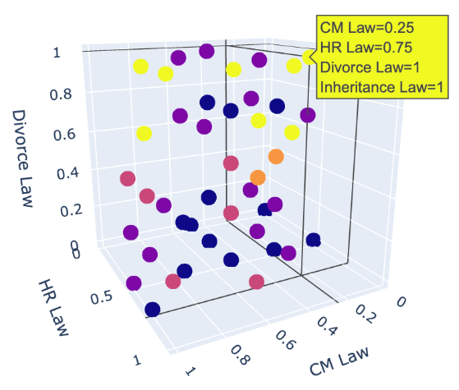
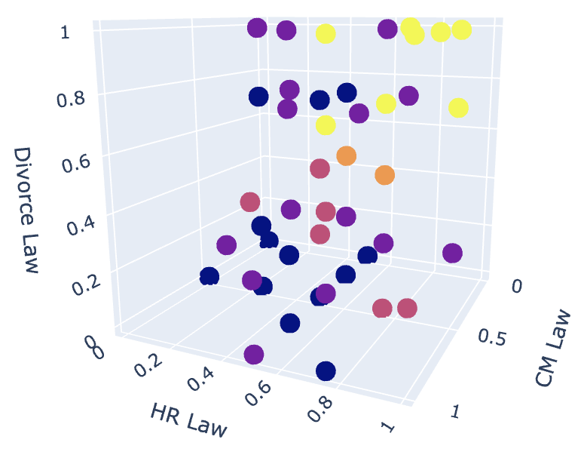
Measuring the attitudes of governments towards their female population: A cluster analysis on discriminatory policies
Methodology & Experimentation
A big goal of mine for this project, was to challenge myself by experimenting with new visualization methods.
Above are screenshots of 3d scatterplots showing the correlation between the different variables in the data. Each attribute is represented by a different color.
*The results are just for one table in my dataset - “Discrimination in the family”
11

Slide 12
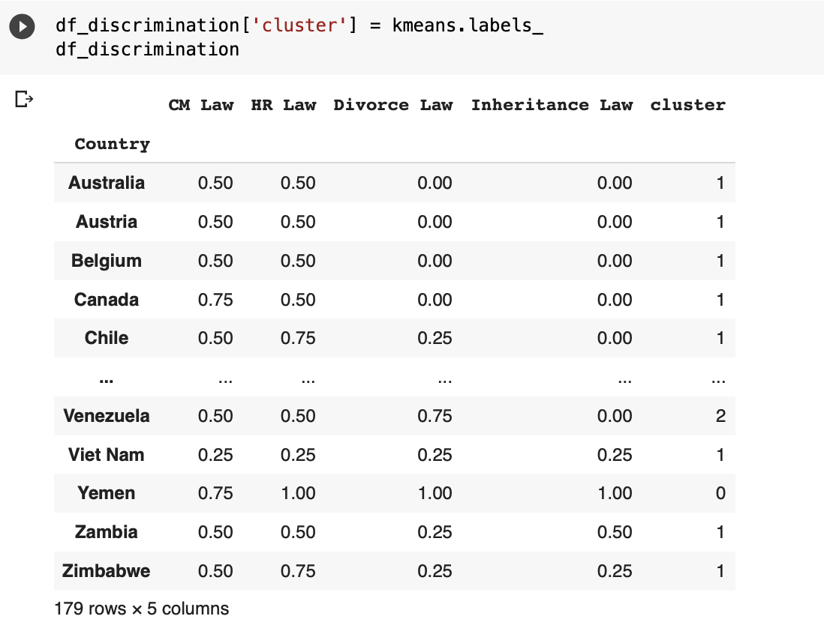
Measuring the attitudes of governments towards their female population: A cluster analysis on discriminatory policies
Methodology & Experimentation
The K Means algorithm was successful in separating the data into 3 different clusters (labelled 0-2).
Using these results, I added an additional column to my dataset containing the cluster of that specific country based on the 4 attributes (‘CM Law’, ‘HR Law’, ‘Divorce Law’, ‘Inheritance Law’).
12

Slide 13
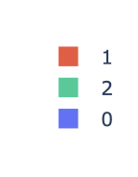
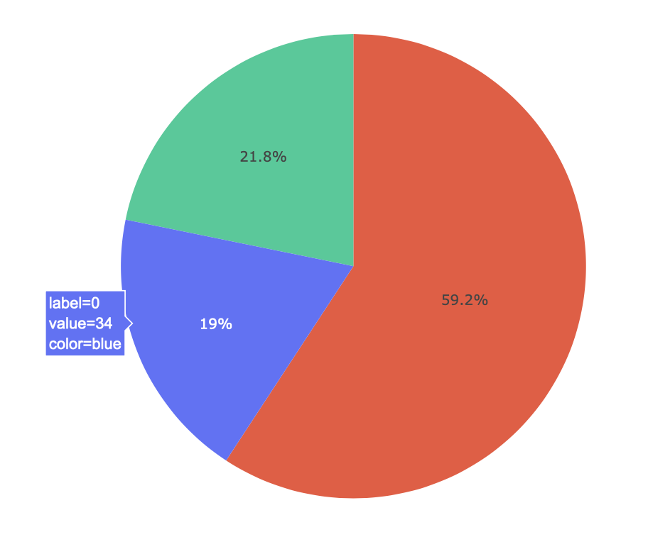
Measuring the attitudes of governments towards their female population: A cluster analysis on discriminatory policies
Methodology & Experimentation
Again, to work on my goal of challenging the visualization methods I use in this project, I used the results from the K-Means clustering to represent the data as a pie chart.
This pie chart is interactive, and when the user hovers over the segment, they are able to learn more about that cluster.
In the example to the right, we can see that label 0 (cluster 0) contains 34 countries.
13

Slide 14
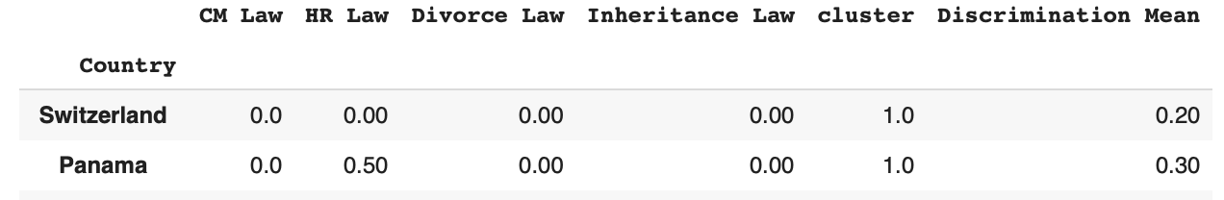
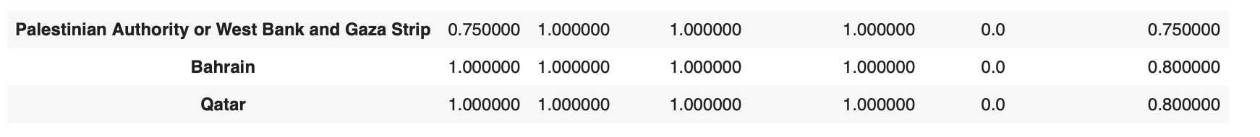
Measuring the attitudes of governments towards their female population: A cluster analysis on discriminatory policies
Results
Once completing this for each table in the dataset, I was able to find the highest and lowest performing clusters for each category. After doing so, it enabled me to see the countries that are the most and least discriminatory for each category (table).
The results above show that for Discrimination in the Family, Switzerland has the lowest mean score meaning the least discriminatory, whereas Bahrain and Qatar have the highest mean score, representing the most discriminatory laws.
14

Slide 15
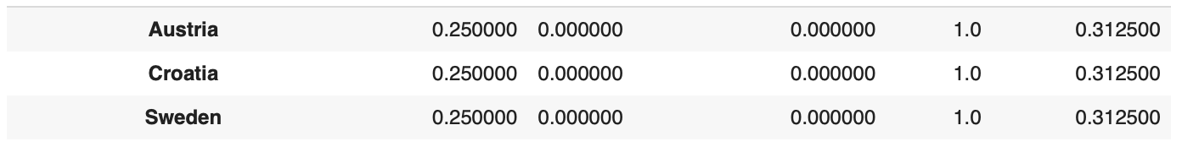
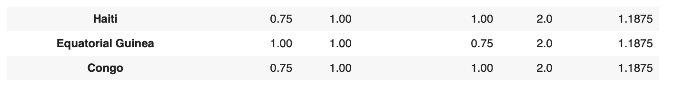
Measuring the attitudes of governments towards their female population: A cluster analysis on discriminatory policies
Results
For Restricted Physical Integrity:
Austria, Croatia and Sweden hold the lowest mean scores, whilst Haiti, Equatorial Guinea and Congo have the highest.
15

Slide 16
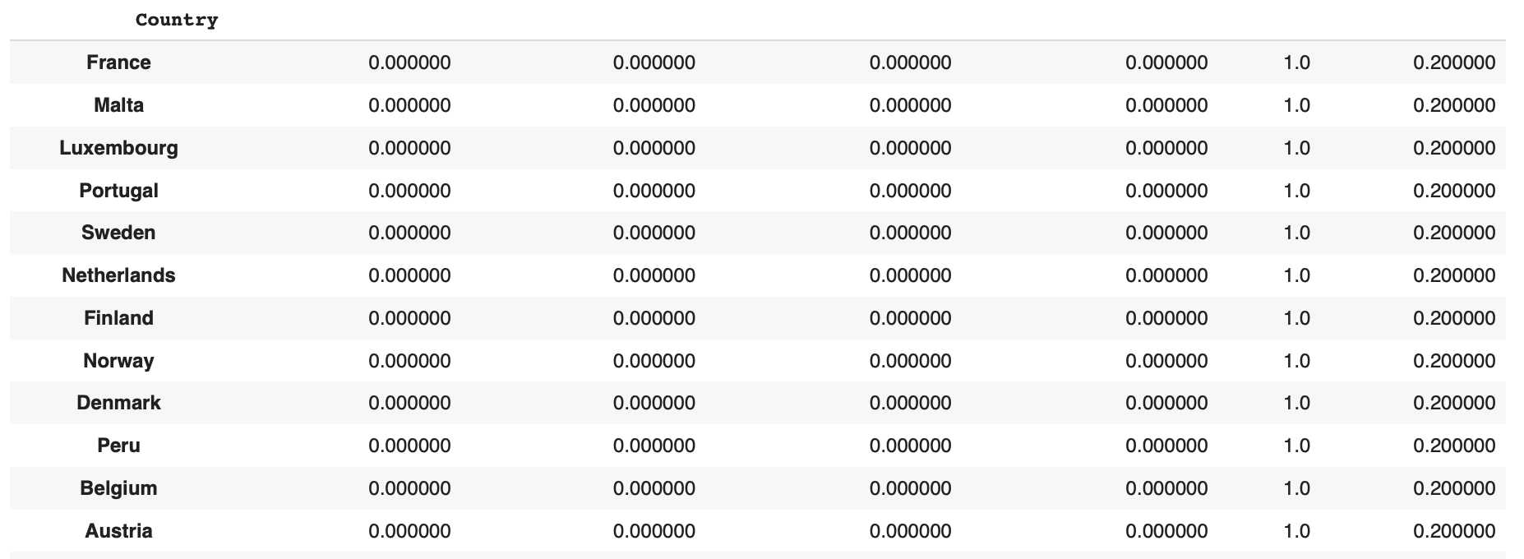
Measuring the attitudes of governments towards their female population: A cluster analysis on discriminatory policies
Results
For Restricted Access to Productive and Financial Resources:
Twelve different (mostly European) countries hold the lowest mean scores, whilst Guinea-Bissou has the highest.
16

Slide 17
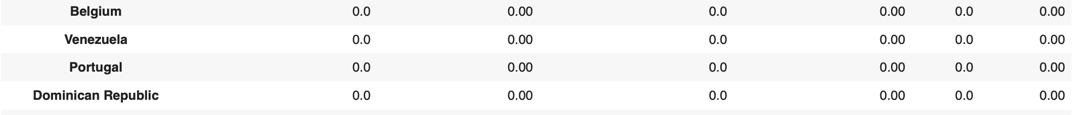
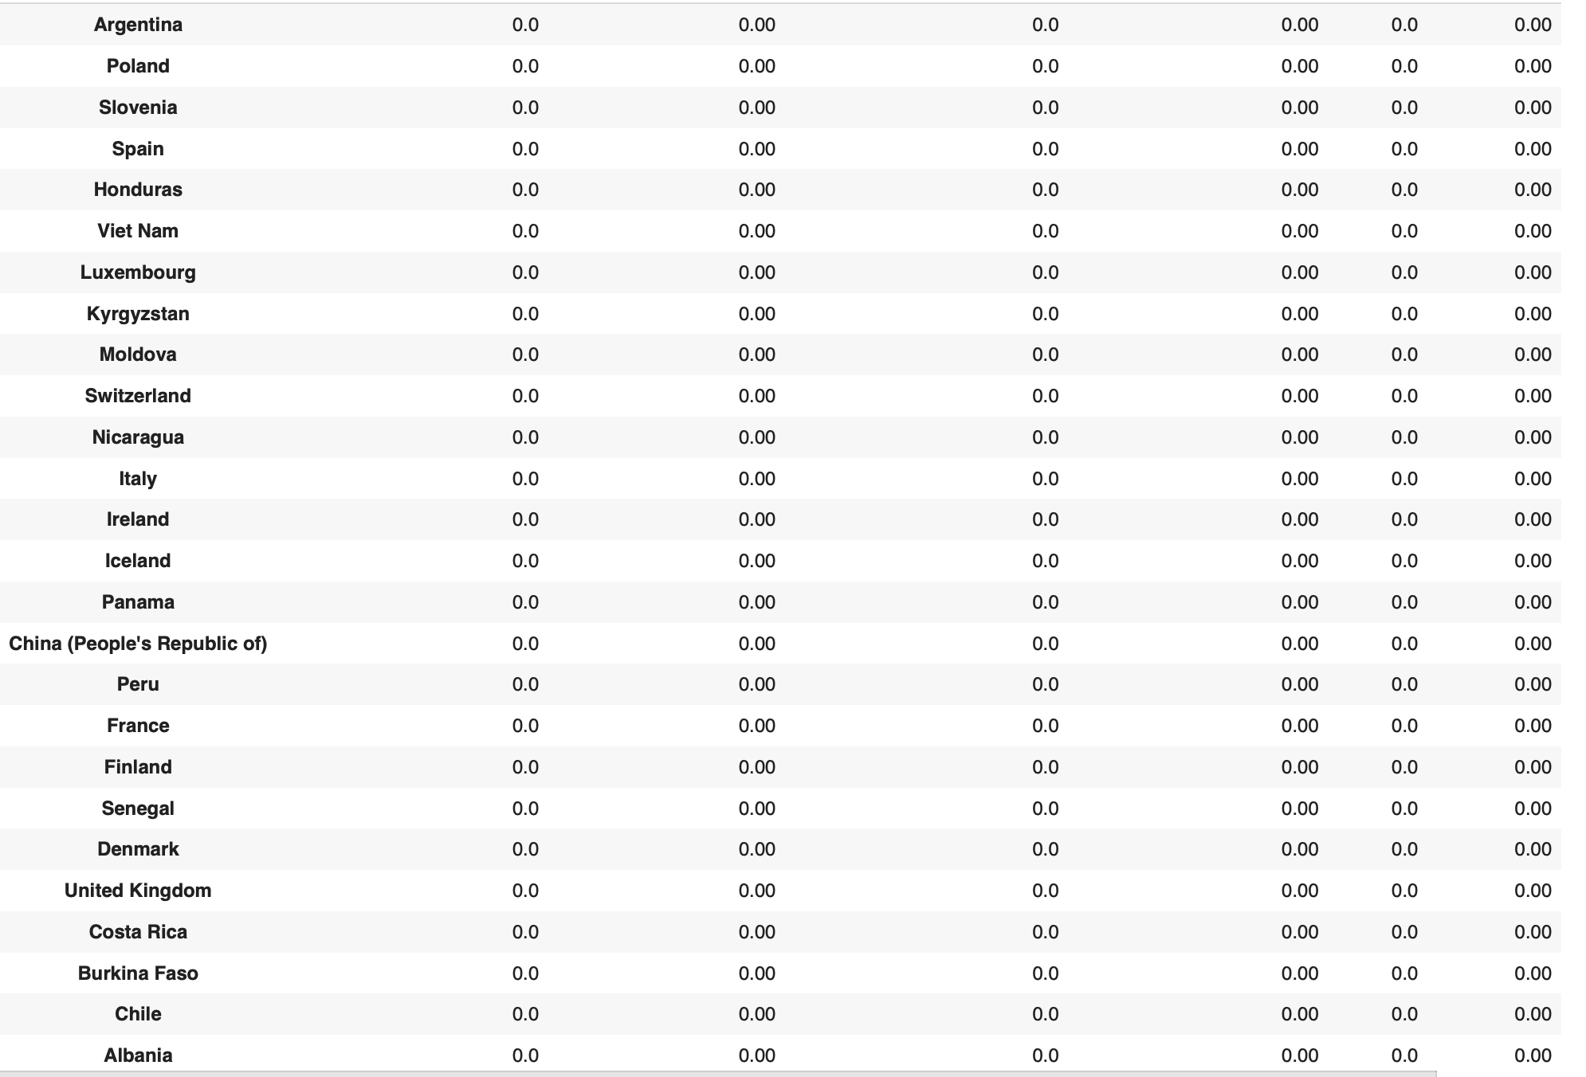
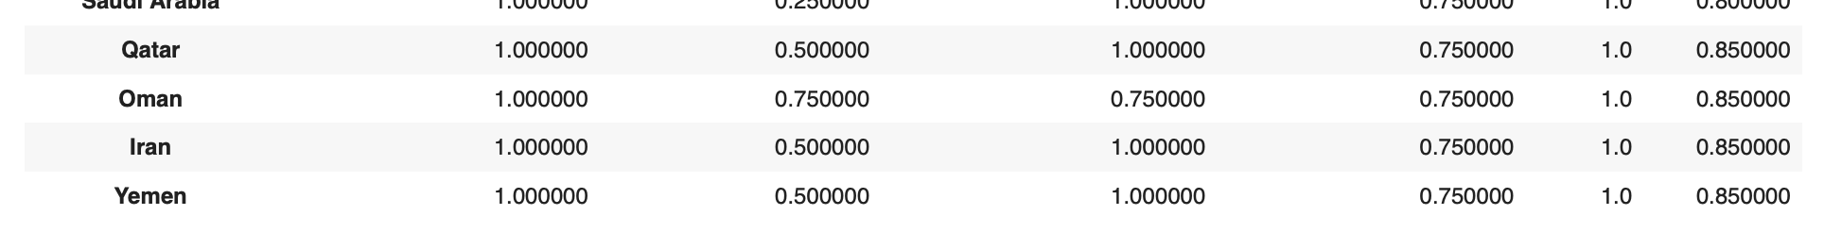
Measuring the attitudes of governments towards their female population: A cluster analysis on discriminatory policies
Results
For Restricted Civil Liberties:
For this category, 30 countries had a perfect score of 0.00. The lowest mean scores for restricted civil liberties came from Qatar, Oman, Iran and Yemen.
17

Slide 18
Measuring the attitudes of governments towards their female population: A cluster analysis on discriminatory policies
Conclusion:
From the results produced, and the study undertaken, what does this show? It shows that we are still very far from truly achieving gender equality in the world today.
It was very surprising to see that some of the most financially powerful and economically developed countries (such as United States, United Kingdom and Germany), whilst were all in the top cluster of each category, they were not the world leaders.
As a woman that lives in one of these countries, it is sad to see just how well some smaller countries such as Switzerland and Finland are doing in comparison. The study hopes to shed light on the realities of living in the United States as a woman, and hopes to bring about positive change.
18

Slide 19
Measuring the attitudes of governments towards their female population: A cluster analysis on discriminatory policies
Future Work:
To continue with this study, it would be extremely useful to assess the “practice” column that was initially dropped during this study. This column shows the effectiveness of how each government actually implement these laws in their countries.
It would be very interesting to compare this column to the initial results we have to see if the clusters and results remain the same, or is there is a drastic change based on the implementation of the law.
This study can also be applied to other social topics in society today, such as racial tension, homophobia and disability laws. With the same methodology, I would love to apply this model to other critical topics that are not spoken about enough.
19

