Slide 1
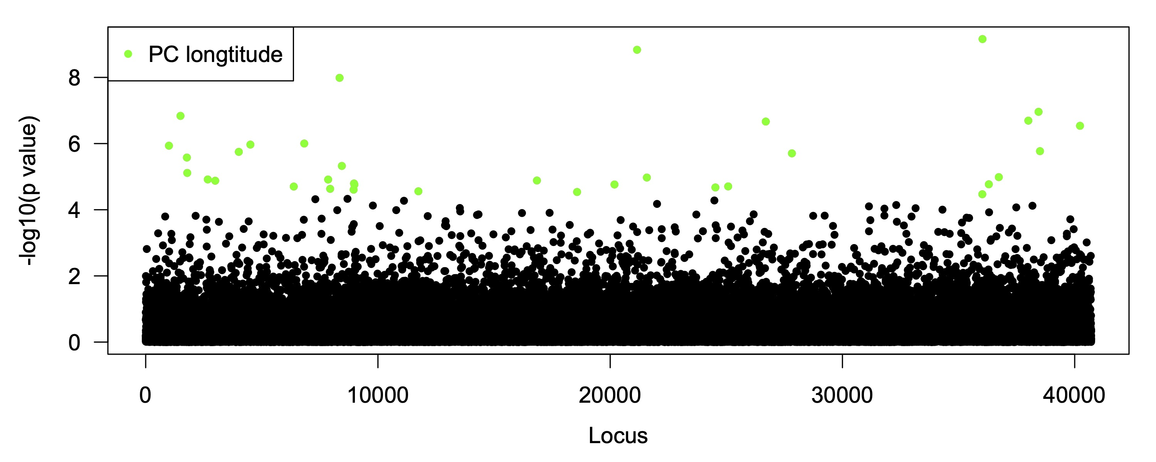
(a) BayeScan posterior distribution
(b) PCAdapt scree plot
(c) LFMM scree plot
Density
Proportion variance explained
Proportion variance explained
log Likelihood
Principal component
Principal component
(d) LFMM outlier loci for longitude PC
(e) Number and overlap of outlier loci

