Slide 1
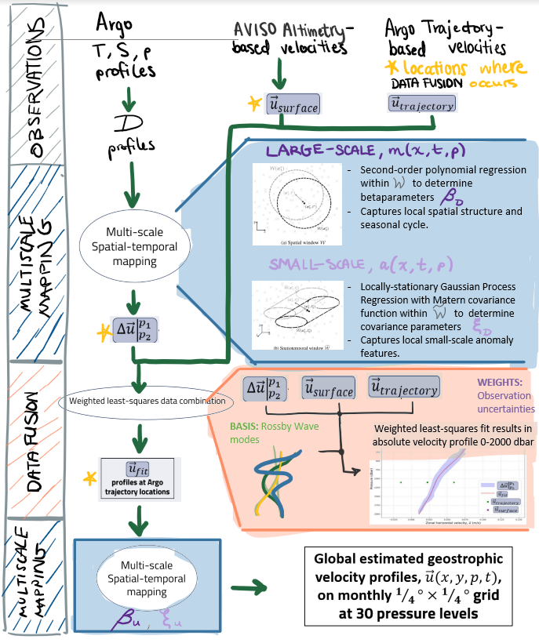
= location grid point to compute weighted average
= data point
= window around grid point to select data

