Slide 1
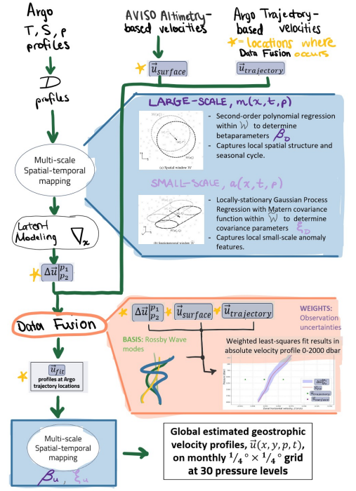
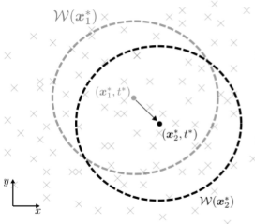
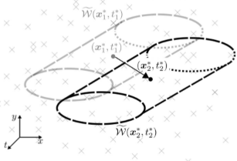





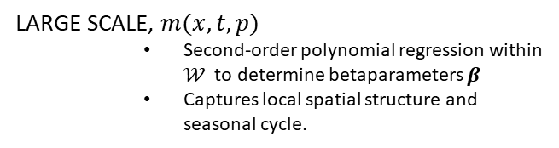


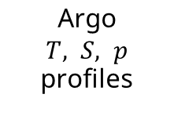
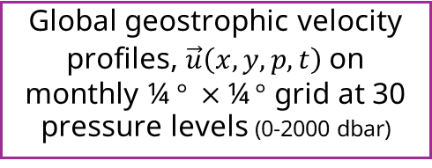



Argo
$T, S, p$ profiles
AVISO
Altimetry-based
velocities
Argo Trajectory-based velocities
locations where
Data Fusion occurs
=
$${\vec{u}}_{surface}$$
$${\vec{u}}_{trajectory}$$
Dynamic height $D$
profiles
LARGE SCALE, $m(x, t, p)$
Second-order polynomial regression within $𝒲$ to determine betaparameters $β$
Captures local spatial structure and seasonal cycle.
Multi-scale
Spatial-temporal
Mapping
SMALL SCALE, $a(x, t, p)$
Locally-stationary Gaussian Process Regression with Matern covariance function within $\tilde{𝒲}$ to determine covariance parameters $ξ$
Captures local spatial structure and seasonal cycle.
Latent Modeling $∇_{x}$
$$Δ\vec{u} _{p_{2}}^{p_{1}}$$
$$Δ\vec{u} _{p_{2}}^{p_{1}}$$
$${\vec{u}}_{surface}$$
$${\vec{u}}_{trajectory}$$
Weighted least squares fit ➔ absolute velocity profiles
Data Fusion
Weights: Observation uncertainties
Basis: Rossby wave modes
$${\vec{u}}_{fit}$$
Multi-scale
Spatial-temporal
Mapping
Global geostrophic velocity profiles, $\vec{u}\left(x,y,p,t\right)$on monthly ¼ $° ×$¼ $°$ grid at 30 pressure levels (0-2000 dbar)

Slide 2


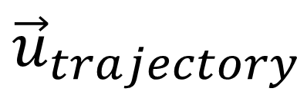
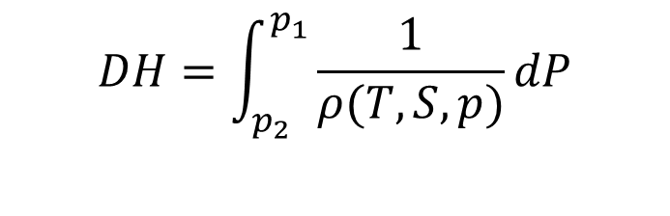
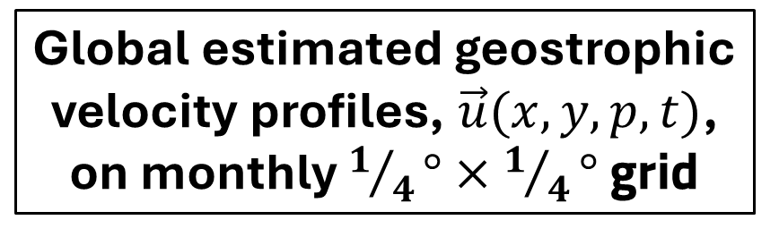




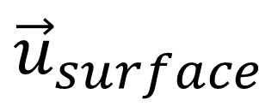
$$DH=\int_{p_{2}}^{p_{1}}{\frac{1}{ρ(T, S, p)}dP}$$
Multi-scale
Spatial-temporal mapping
Gridded large-scale & small-scale parameters
Argo Temperature & Salinity profiles
$DH$ profiles
$$Δ\vec{u} _{p_{2}}^{p_{1}}= \frac{1}{f}k ×∇DH$$
$${\vec{u}}_{trajectory}$$
$$Δ\vec{u} _{p_{2}}^{p_{1}}$$
$${\vec{u}}_{surface}$$
Weighted least-squares data combination
Internal wave modes used as basis
Multi-scale
Spatial-temporal mapping
Gridded large-scale & small-scale parameters
Global estimated geostrophic velocity profiles, $\vec{u}(x,y,p,t)$, on monthly $1/4°×1/4°$grid
$${\vec{u}}_{w}$$

