Slide 1
Comparison of methods for estimating genetic correlation between complex traits using GWAS summary statistics
Yiliang Zhang, Youshu Cheng, Wei Jiang, Yixuan Ye, Qiongshi Lu and Hongyu Zhao

Slide 2
Introduction
Genetic correlation quantifies the overall genetic similarity between complex traits.
GWAS-based methods estimate genetic correlation using individual genotype data or GWAS summary statistics.
Summary-statistics-based methods are popular due to data accessibility and computational efficiency.
Objective: Benchmark and compare the performance of different genetic correlation estimation methods under realistic settings.
2025-03-04
Research Bites
1

Slide 3
Methods
Evaluated three summary-statistics-based methods: LDSC, GNOVA, and HDL.
Simulated phenotypes using real genotype data from UKBB, WTCCC, NFBC, and MIGen.
Investigated performance using in-sample, external, and mismatched reference panels for LD.
Assessed robustness against model misspecification.
Applied methods to real GWAS data from UKBB, WTCCC, and NFBC.
2025-03-04
Research Bites
2

Slide 4
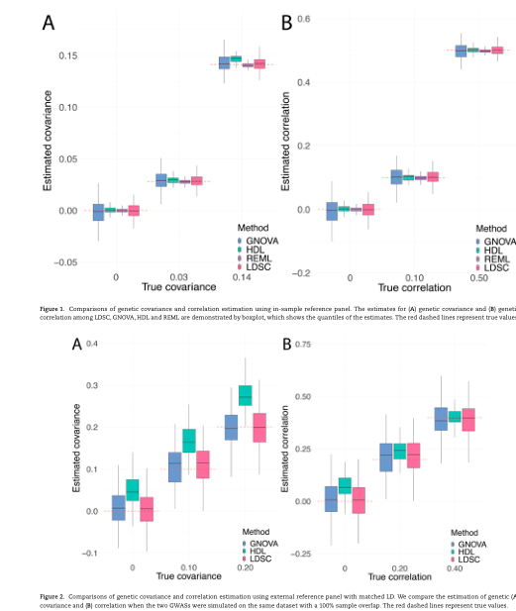
In-Sample Reference Panel Simulation Results
REML outperformed all summary-statistics-based methods.
LDSC and GNOVA provided unbiased estimates for genetic covariance.
LDSC achieved more accurate estimation than GNOVA.
HDL overestimated genetic covariance when the true genetic covariance was relatively high.
Figure 1
2025-03-04
Research Bites
3

Slide 5
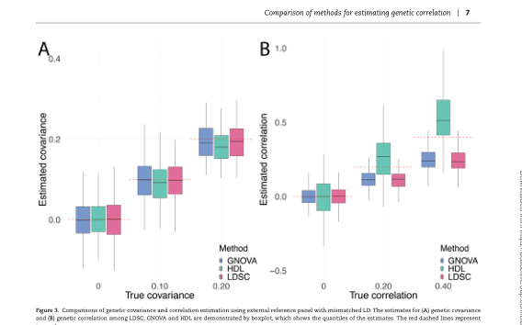
External Reference Panel with Matched LD Simulation Results
LDSC and GNOVA provided similar unbiased estimates for genetic covariance and correlation.
HDL consistently overestimated the parameters, except for genetic correlation when the true value was relatively large.
Severe type I error inflation for HDL, while GNOVA achieved the lowest type I error.
Figure 2
2025-03-04
Research Bites
4

Slide 6
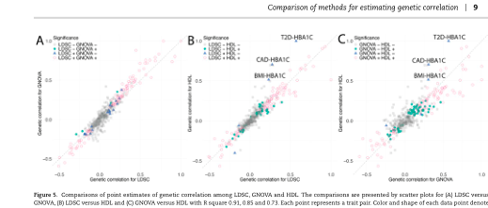
External Reference Panel with Mismatched LD Simulation Results
All methods showed unbiased estimators for genetic covariance except HDL for high genetic covariance.
LDSC and GNOVA underestimated the genetic correlation, while HDL overestimated it.
Genetic covariance estimation was more stable than genetic correlation estimation.
Figure 3
2025-03-04
Research Bites
5

Slide 7
Application to UKBB, WTCCC and NFBC
Compared performance on GWAS with individual-level data to compare with REML.
Used traits in UKBB, WTCCC and NFBC.
Assessed performance by the difference from REML results.
Figure 4
2025-03-04
Research Bites
6

Slide 8
Application to 30 Complex Traits
Applied LDSC, GNOVA and HDL to estimate genetic correlation among 30 complex traits for European population.
126, 112 and 166 trait pairs identified by LDSC, GNOVA and HDL, respectively.
104 trait pairs were identified by all three methods and 42 trait pairs were exclusively identified by HDL.
Figure 5
2025-03-04
Research Bites
7

Slide 9
Conclusion
LDSC and GNOVA were more similar and robust to LD and sample overlap compared with HDL.
HDL could not provide unbiased estimates for genetic covariance in most cases and could not distinguish genetic correlation from non-genetic correlation.
There is more flexibility of choosing the reference panel for LDSC and GNOVA by the users.
None of the summary-data-based methods worked well for genetic correlation estimation under a mismatched reference panel.
2025-03-04
Research Bites
8

