Slide 1
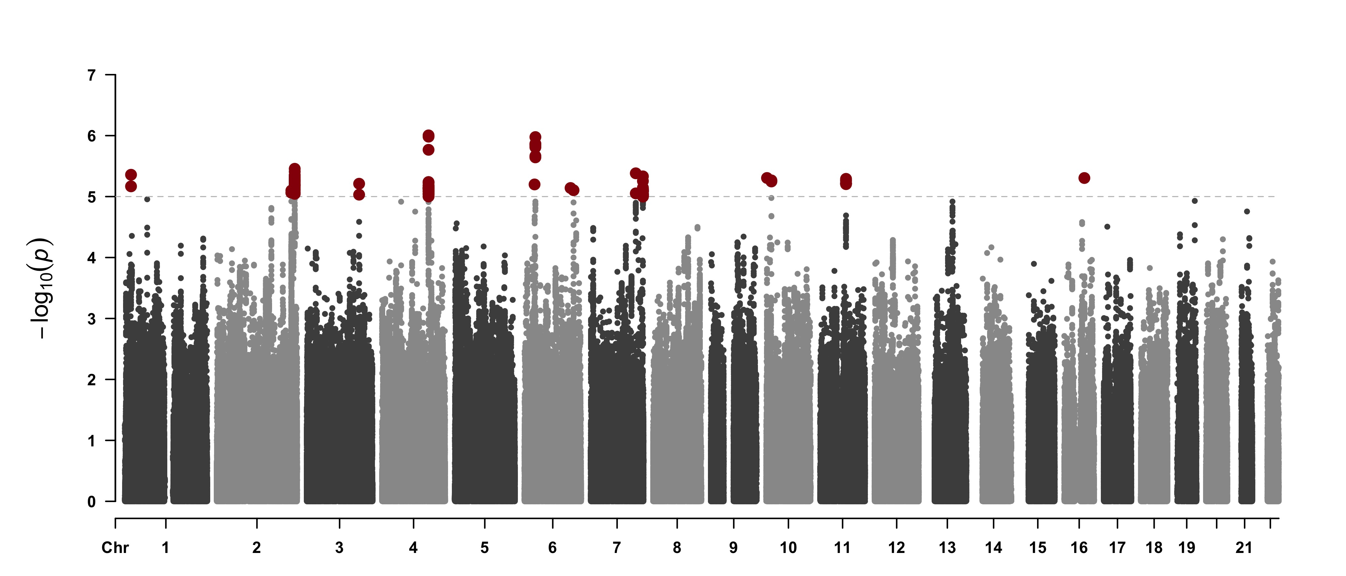
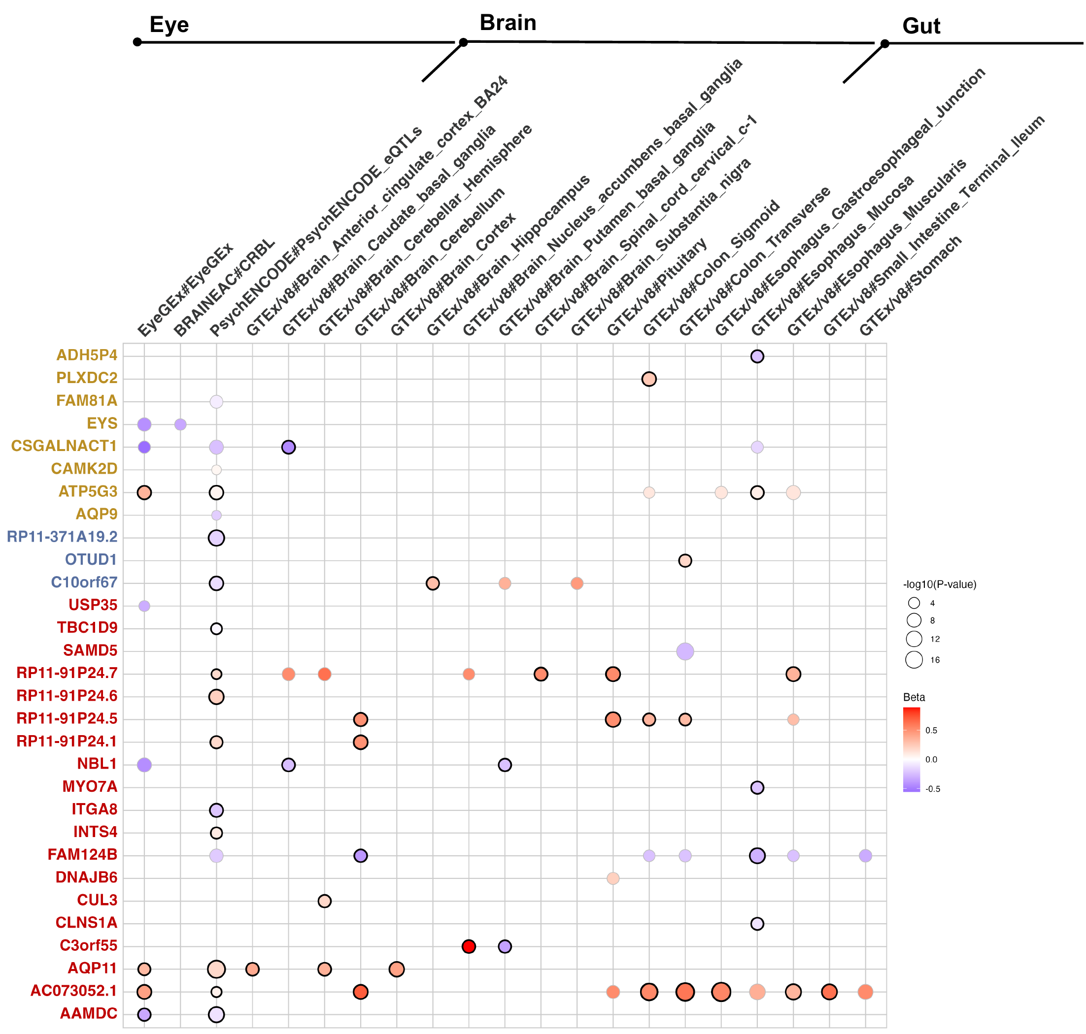
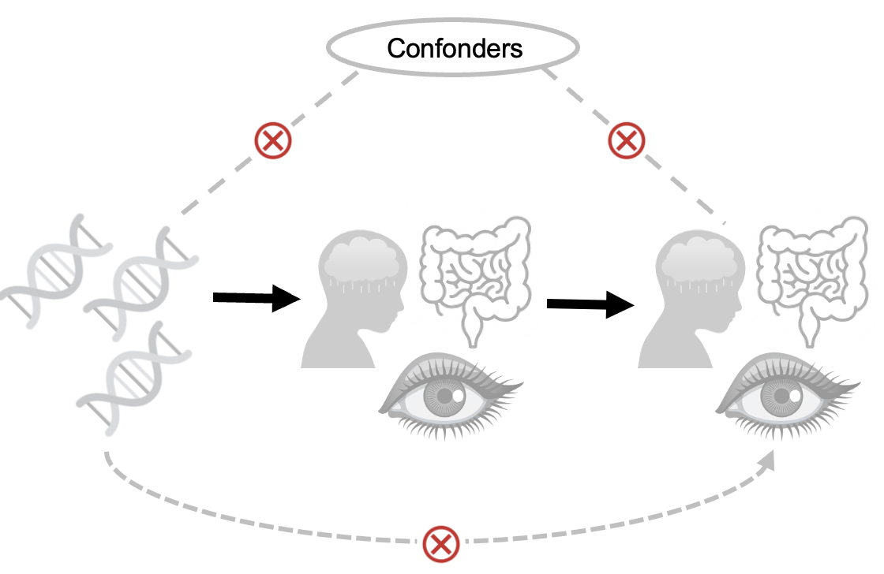
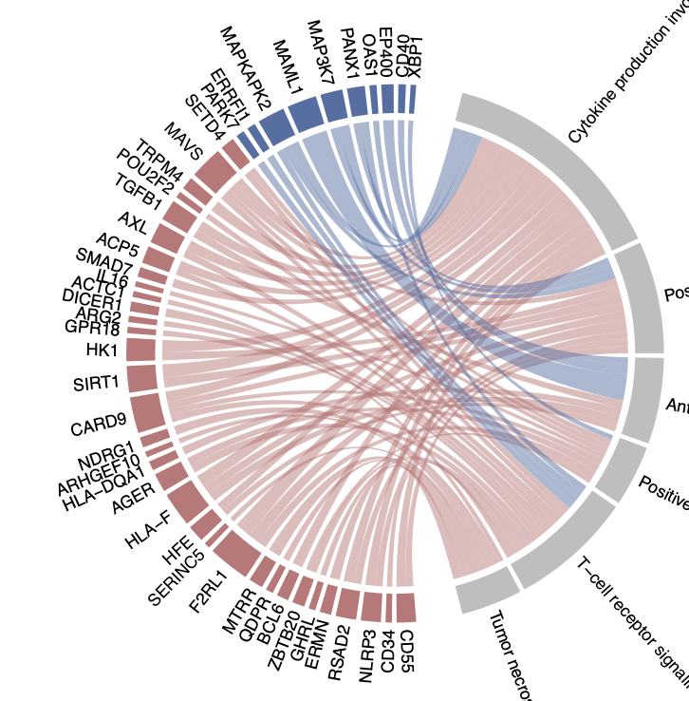
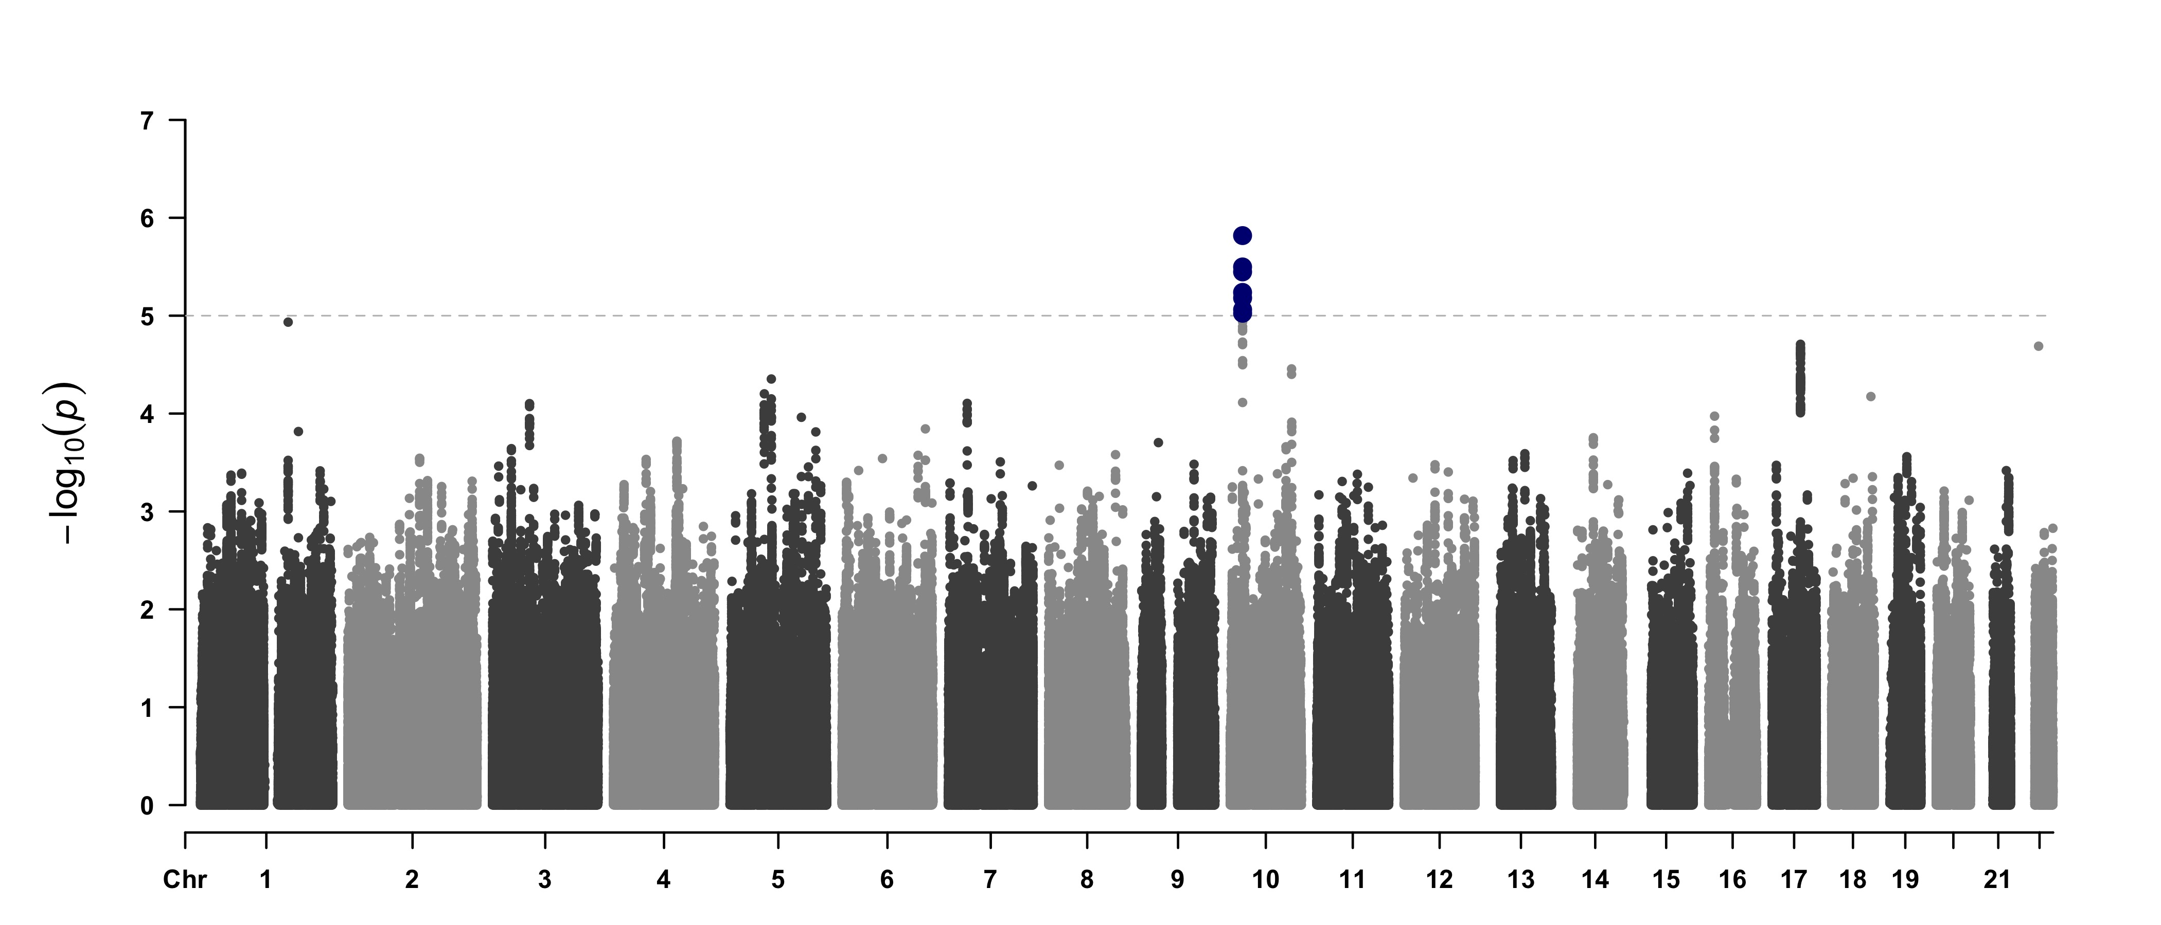
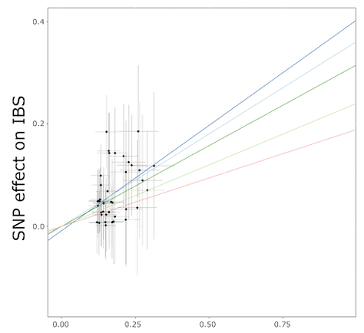
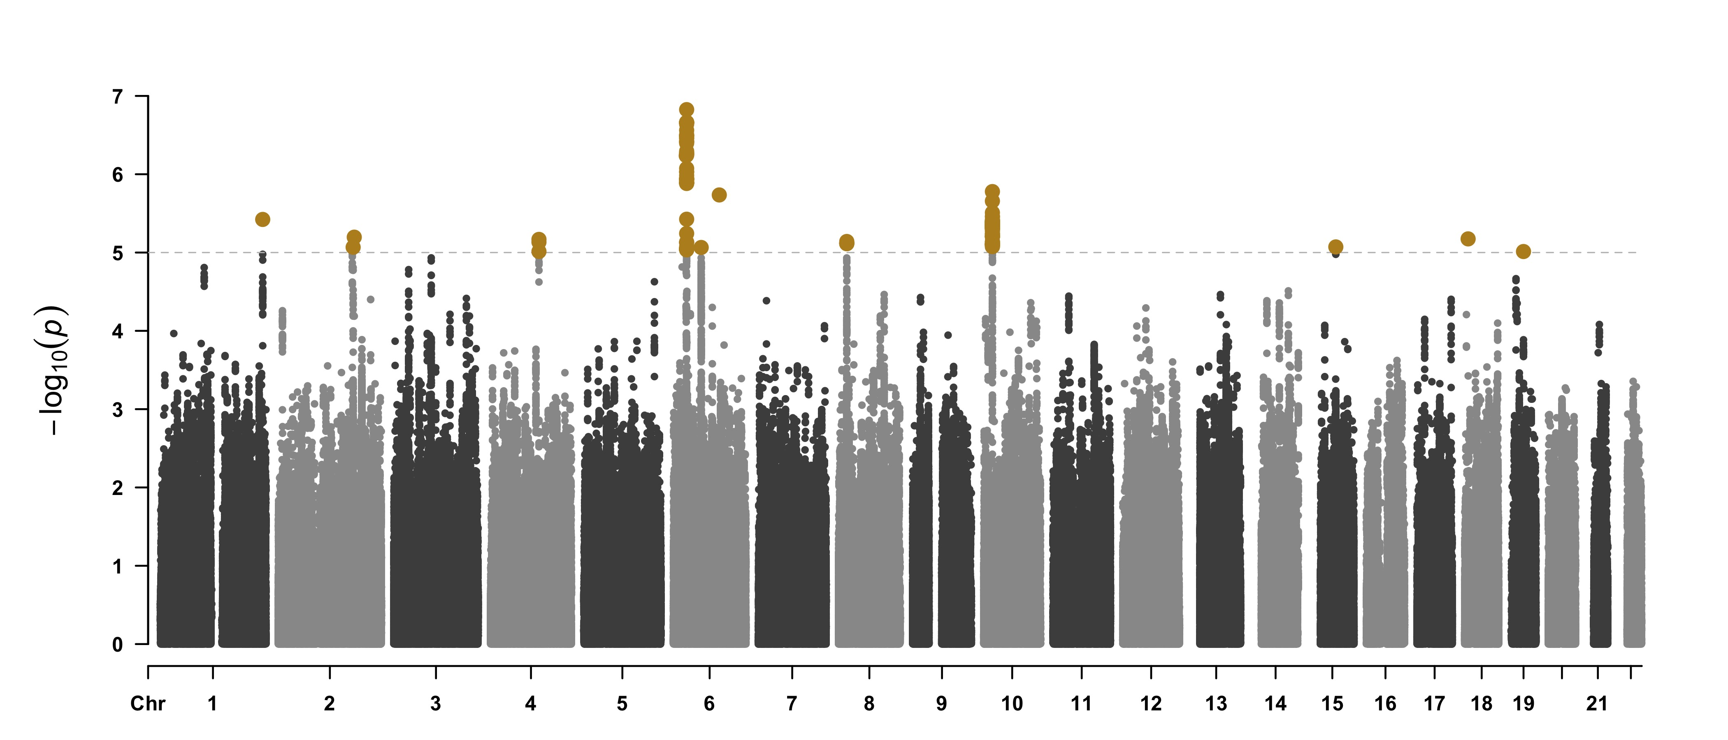
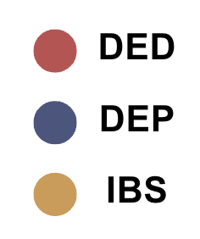
GWAS & LD adjustments
Functional Annotation
Mendelian Randomization
Dry-Eye
Cytokine production involved in immune response
Positive regulation of cytokine production involved in immune response
IV
D₁
D₂
Depression
SNP-to-Gene mapping
SNP-to-Gene mapping
Antigen binding
Positive regulation of interleukin 6 production
x 6 directions
T-cell receptor signaling
Tumor necrosis factor superfamily
cytokine production
SNP effect on D₁
SNP effect on D₂
Irritable Bowel
SNP effect on D₂
SNP effect on D₁

Slide 2





Confonders

