Slide 1
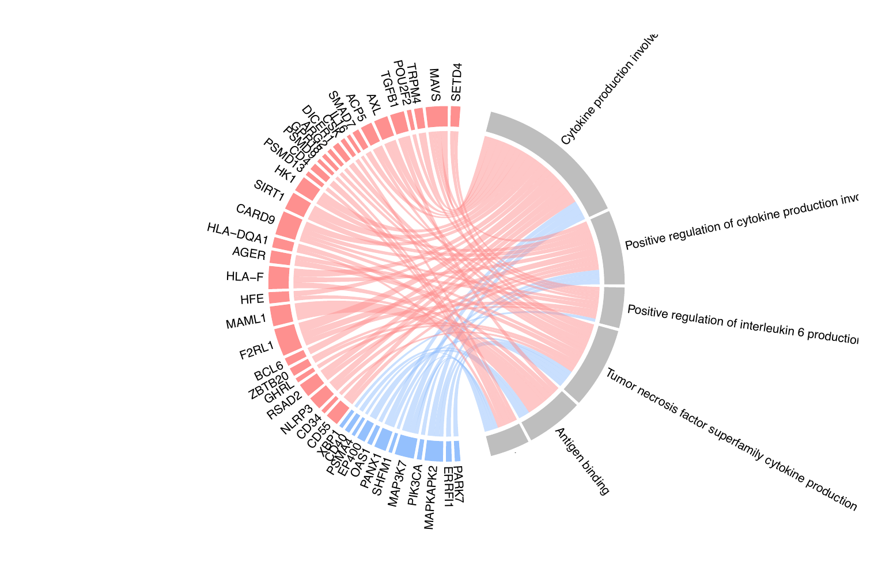
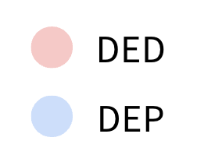
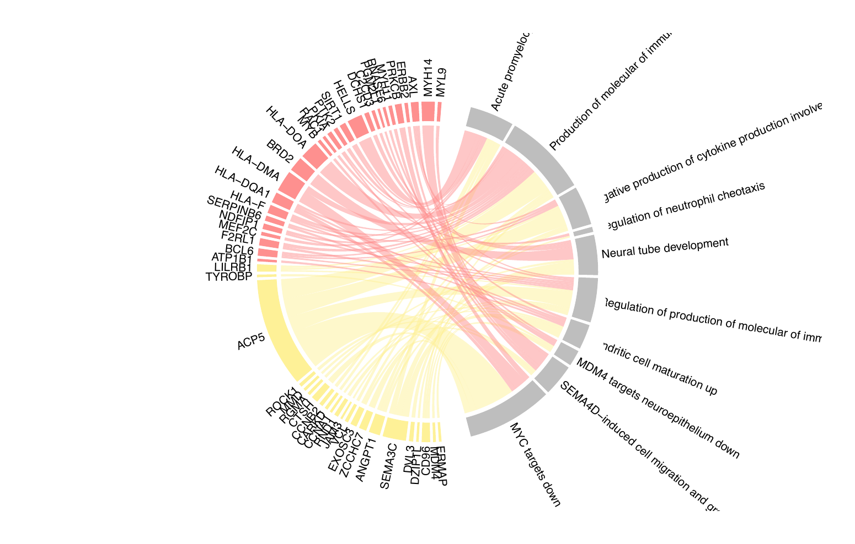
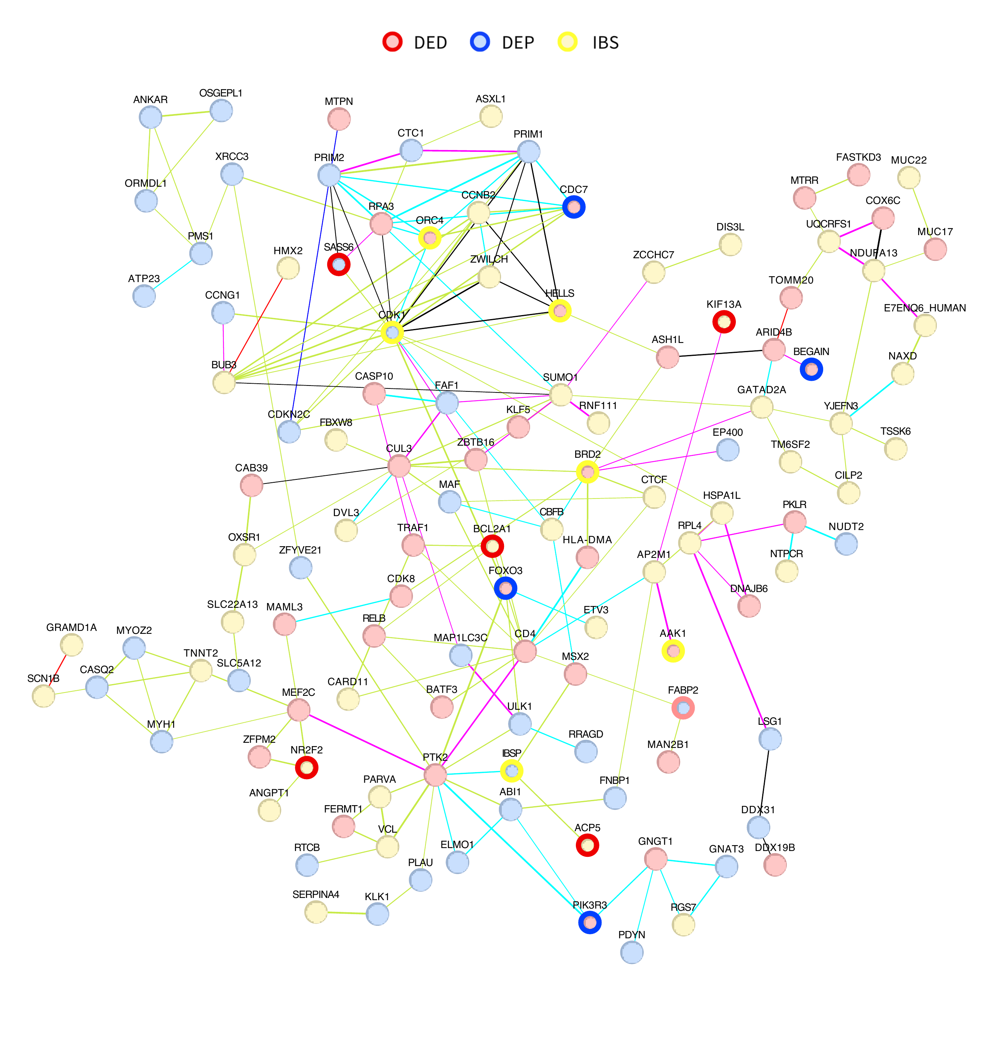
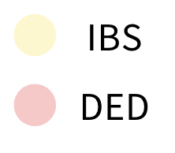
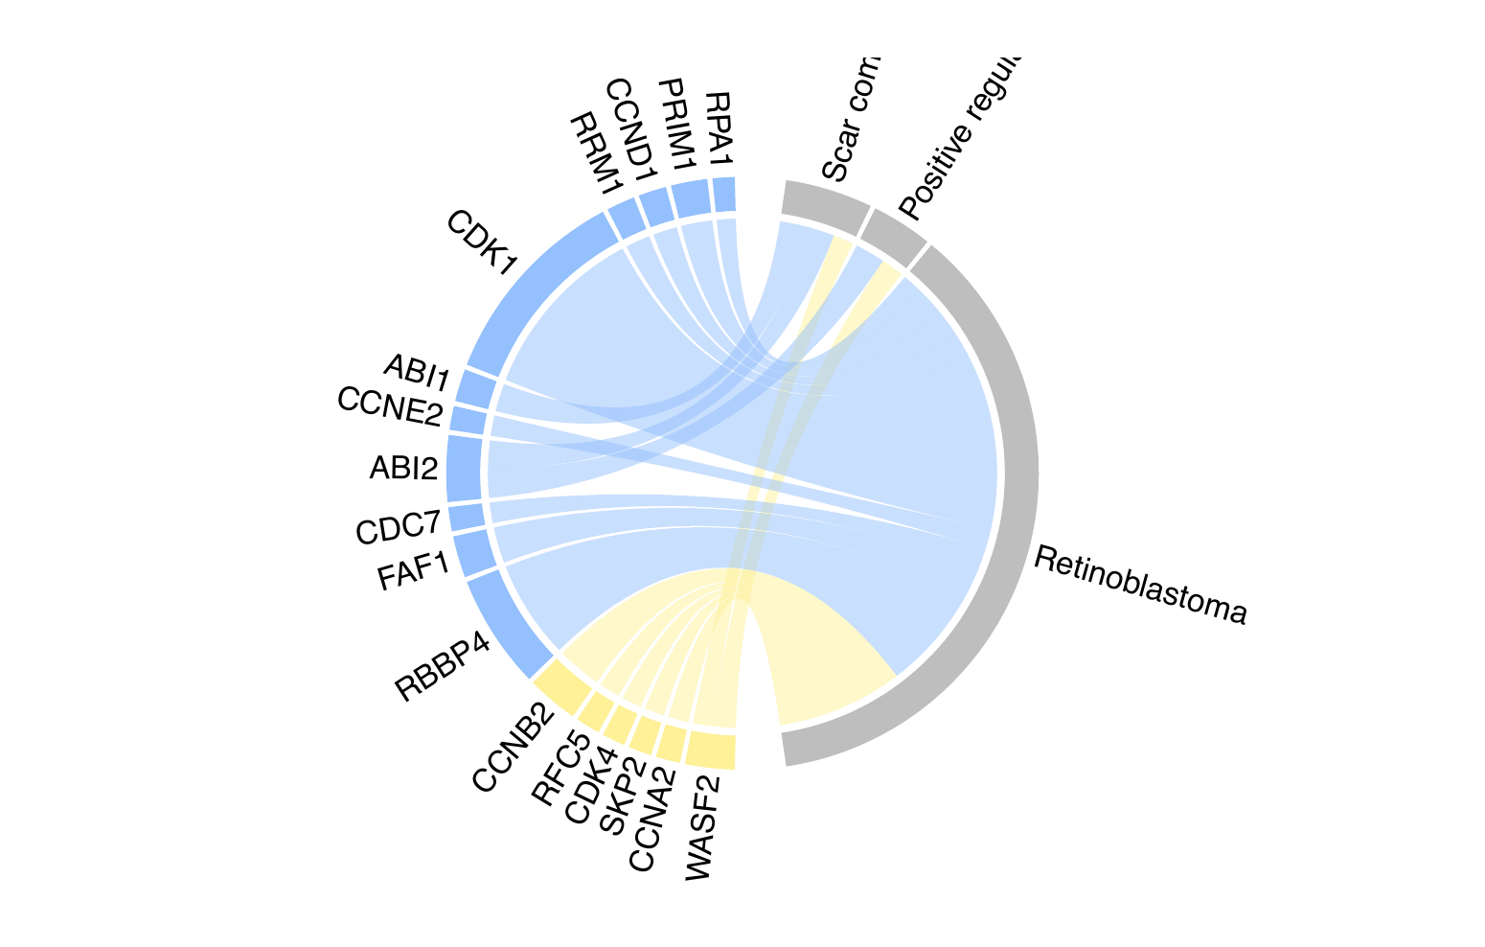
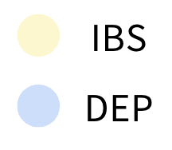
A
Cytokine production involved
in immune response
Positive regulation of cytokine production
involved in immune response
Positive regulation of interleukin 6 production
Tumor necrosis factor superfamily
cytokine production
Antigen binding
T-cell receptor signaling
B
Acute promyelocytic leukemia down
E
Production of molecular of immune response down
Negative production of cytokine production involved in immune response
Regulation of neutrophil cheotaxis
Neural tube development
Regulation of production of molecular of immune response
Dendritic cell maturation up
MDM4 targets neuroepithelium down
SEMA4D-induced cell migration and growth cone collapse
C
MYC targets down
Positive regulation of APR2/3 complex mediated actin nucleation
Scar complex
Retinoblastoma

Slide 2
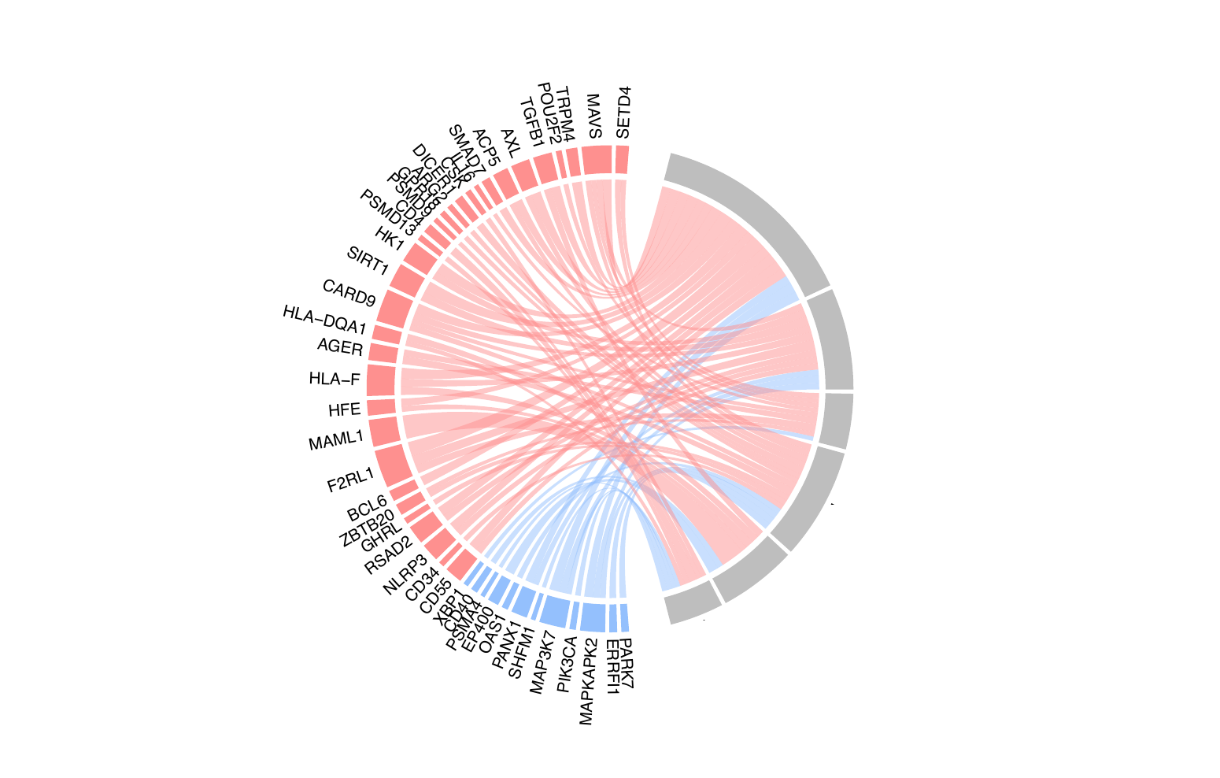
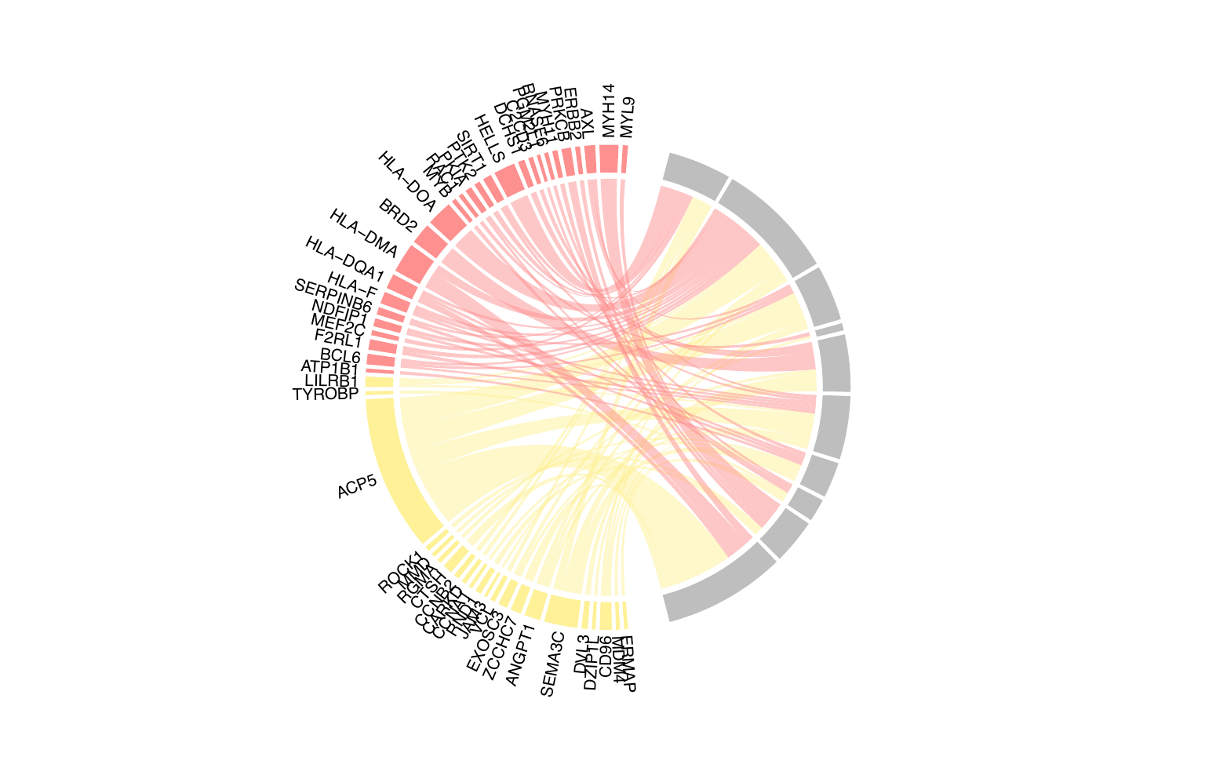
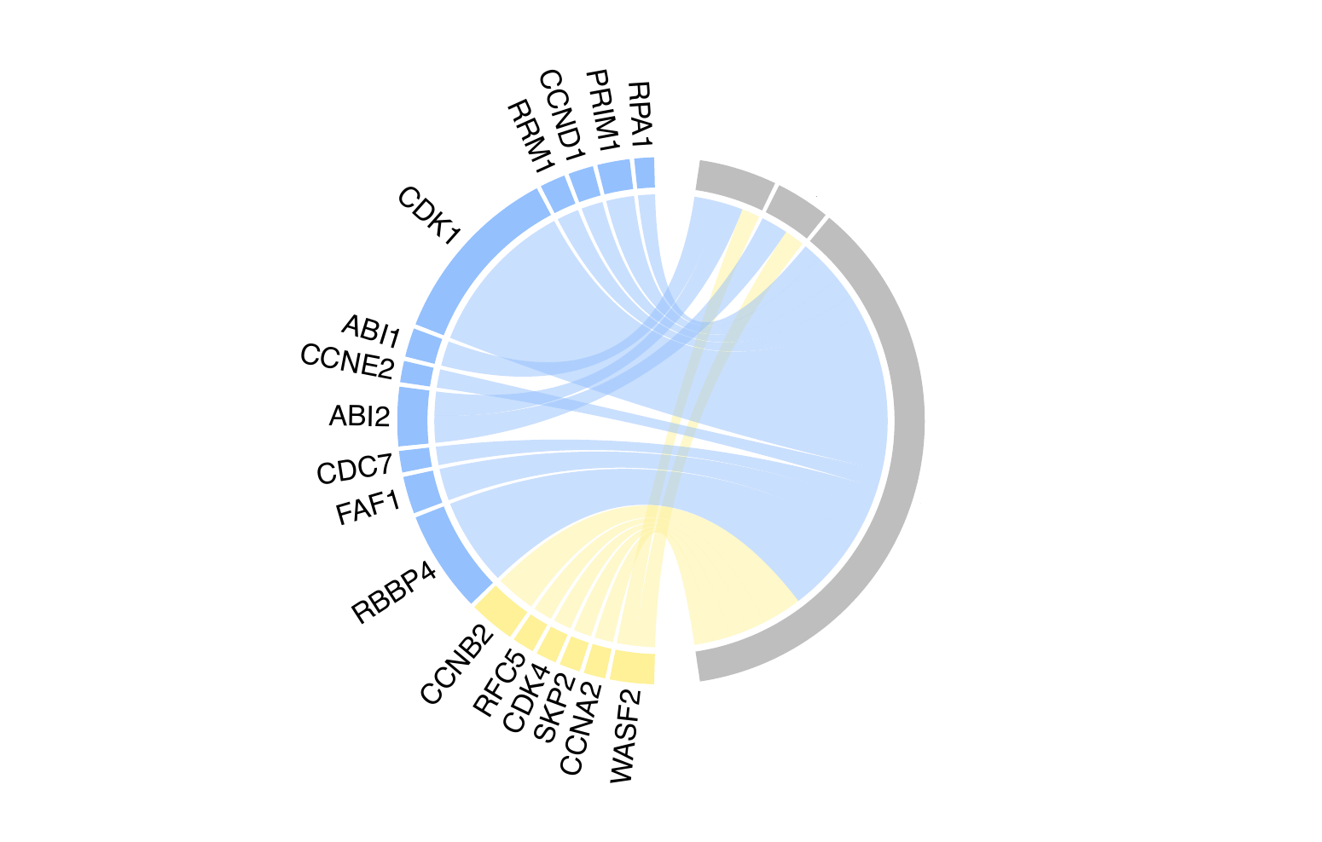
A
Cytokine production involved in immune response
Positive regulation of cytokine production involved in immune response
Positive regulation of interleukin 6 production
Tumor necrosis factor superfamily cytokine production
Antigen binding
T-cell receptor signaling
B
Acute promyelocytic leukemia down
Production of molecular of immune response down
Negative production of cytokine production involved in immune response
Regulation of neutrophil cheotaxis
Neural tube development
Regulation of production of molecular of immune response
Dendritic cell maturation up
MDM4 targets neuroepithelium down
SEMA4D-induced cell migration and growth cone collapse
MYC targets down
C
Scar complex
Positive regulation of APR2/3 complex mediated actin nucleation
Retinoblastoma

