Slide 1
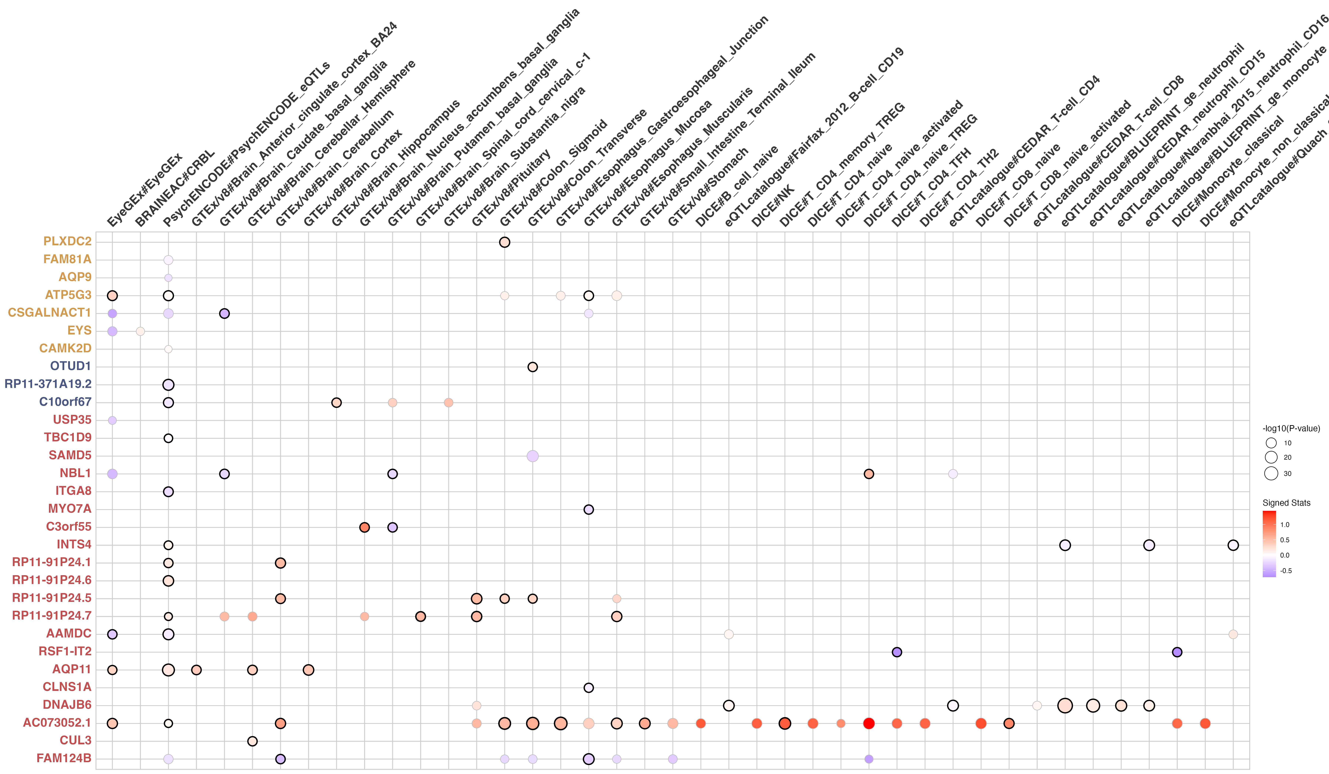
Eye
Brain
Gut
Immune
_monocyte_naive
l
Beta

