Slide 1




Crypto Car Sharing
Car Sharing Made Simple and Pay With Crypto

Slide 2
Crypto Car Share Team
Anna Kolbasova - kolbasova78@aol.com (Team Leader)
Free-lance Front-end and Blockchain Developer (Solidity, Rust, Solana, JavaScript, Typescript)
Luis Vertiz – lvertiz@gmail.com
Blockchain Developer (Solidity, Rust, JavaScript, python)
Juan Isaac - juandejesusisaac@gmail.com
Full-stack blockchain developer (Solidity, GraphQL, Typesscript, JavaScript)
Charles Okochu – ocobra@gmail.com
Cloud Architect and Project manager (AWS, Google Cloud, Python, javascript)

Slide 3
What is Crypto CarShare?
Crypto Car Share is a car sharing application which allows you to pay in crypto (ETH, MATIC, and uses Decentralized Identification (DiD) and temporary NFTs assigned to drivers when they book a vehicle at various locations.
Notes:
Crypto Car Share is a car sharing application which allows you to pay in crypto and uses Decentralized Identity (DiD) and temporary NFTs assigned to drivers when they book a vehicle at various locations.
Imagine a situation where you flew to a foreign destination for several hours and upon arrival, you need to rent a car. But you have to wait in line to process the paperwork, get insurance and pay in foreign currency. The whole process is very inefficient and time consuming.

Slide 4
How To Use Crypto Car Share
One-time Registration
Locate a Car Near you
Attach your crypto wallet
Select Time Duration and book the car
Pay with crypto (ETH, MATIC)
Car Information and Location is Sent to User Wallet as NFT
Present the NFT QR code to unlock the car and drive
Return the car at the end of the duration
Notes:
Create your account on the website – Standard procedure. Pass authorization documents, upload drivers license, e-sign the agreement.
Install the app on your phone and sign in.
Locate a car Near You. Currently only one location
Attach your Crypto Wallet (MetaMask)
Select Time Duration (in 30 minute intervals) and book the car.
Pay in Crypto from the MetaMask wallet – not many business accept crypto currencies at the moment.
NFT is minted and car information (and location) and NFT QR code is sent to the mobile app and stored in wallet.
Present the NFT QR code at the car parking lot. NFT also includes a countdown timer to the end of the rental. Unlock the car and drive!
Return the car at the end of the duration. In 7 days after the end of the car rental, the NFT burns down as you don’t want to clutter up your wallet with unnecessary NFts.

Slide 5
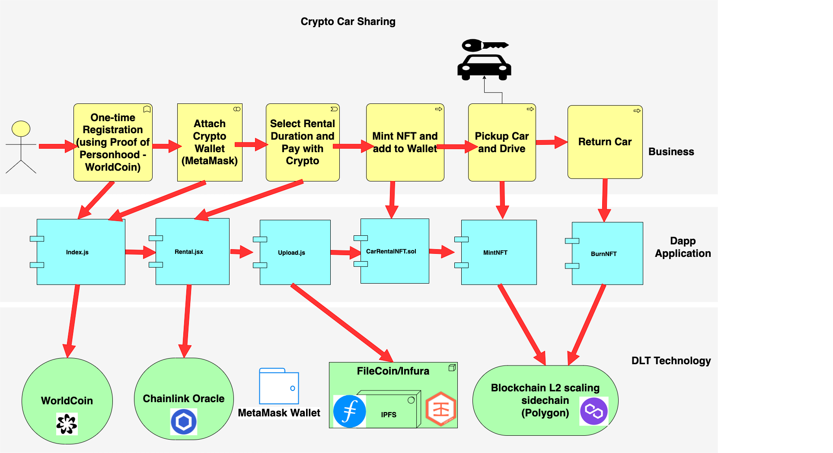
How it works
Notes:
Worldcoin provides Biometric Proof-of-Personhood by ensuring each person can only register once. Similar to biometric identification, the system needs to compare each user’s embedding to every other entry in the database. If none match, the user’s registration is successful and their embedding is added to the database. If there is a match, the user has likely registered before and is therefore rejected.

Slide 6
Customer Value Proposition
Ease and convenience
Comparable and competitive cost
Pay with Crypto
Flexibility - Pay per use rounded to 30 minute increments

Slide 7
Additional Resources
Video - https://youtu.be/pwOP_vFpkl4
Github Repo - https://github.com/annabnn812/Car-Sharing-App-using-NFT

Slide 8
Thank you!
Questions?

