Slide 1


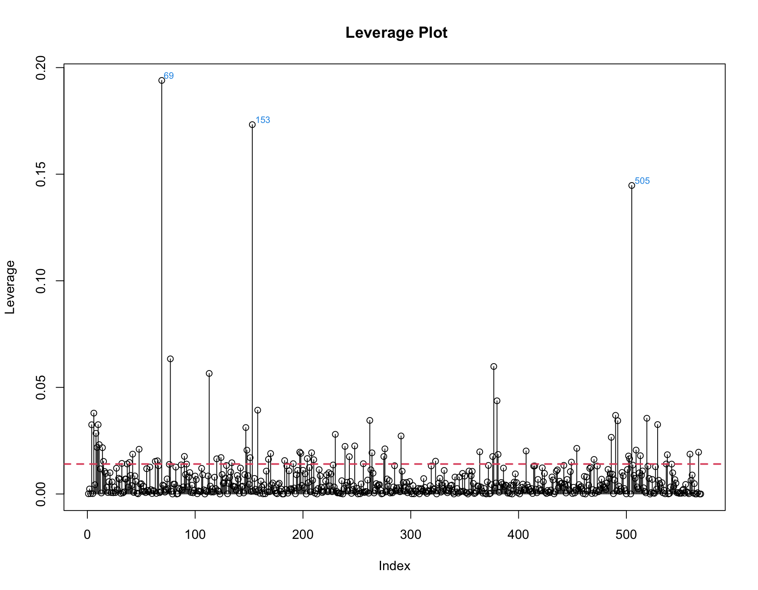
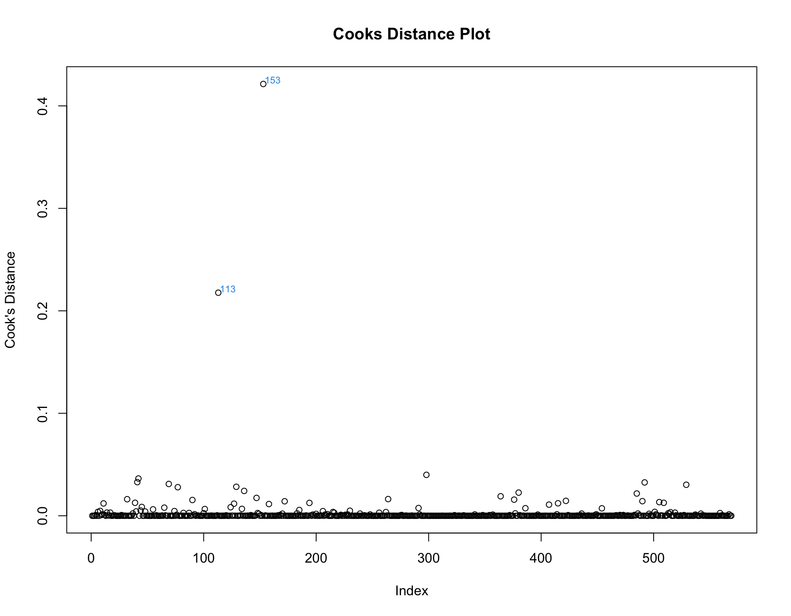
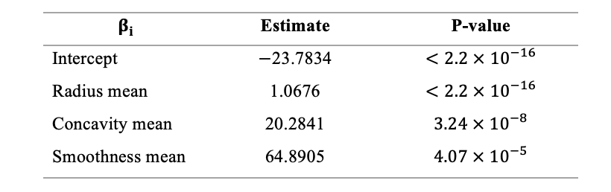
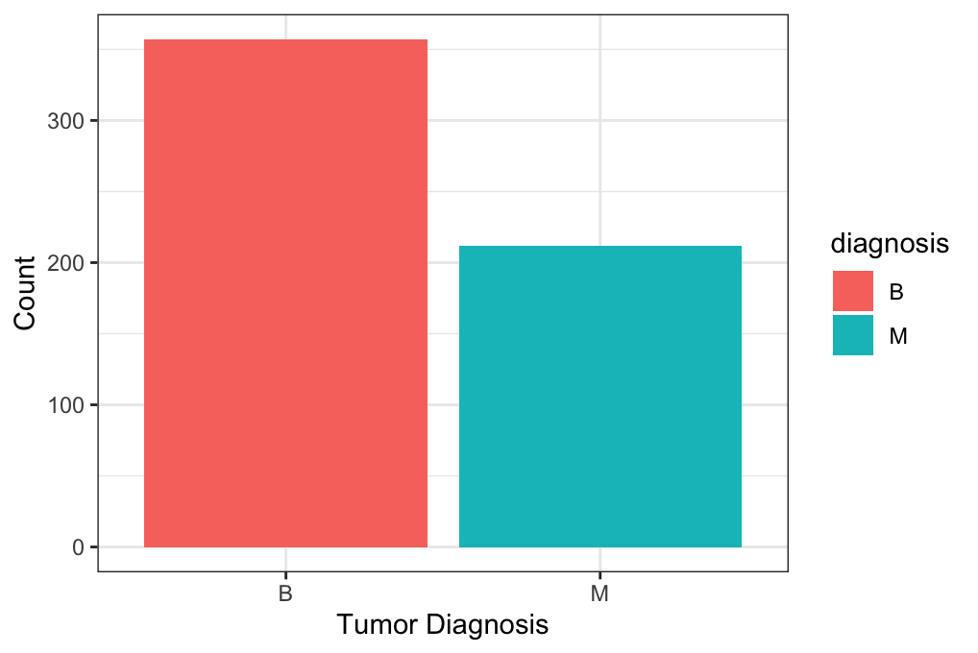
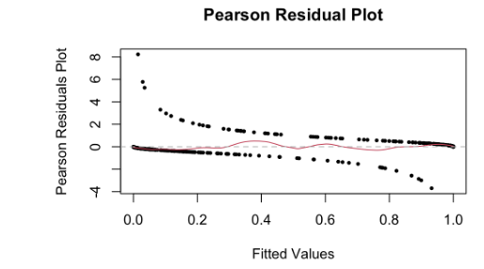


STA 223 Project 1: Breast Cancer Diagnosis Modeling
Ana Boeriu
MS Biostatistics
Introduction
Breast cancer is a type of cancer that causes uncontrollable growth of abnormal breast cells that form a mass called a tumor. Because of genetic mutations, cancer cells have different sizes and shapes compared to healthy cells, thus are unable to function properly
The main goal of this project is to build a model and find the most significant variables when determining tumor diagnosis.
Data Description and Preprocessing
Data: Breast Cancer Wisconsin (Diagnostic) Data Set
This dataset consists of the tumor diagnosis and the characteristics of cell nuclei, computed from 569 digitized images of a fine needle aspirate (FNA) breast mass
Assume a breast mass can have more than one nucleus
No missing values
Response variable: tumor diagnosis (M, B)
Total of 357 benign tumors and 212 malignant tumors.
10 numeric predictors that describe the size and shape of the cell nucleus: area, radius, perimeter, fractal dimension, concavity, , smoothness, symmetry, compactness, concave points, texture
Mean, standard error, worst(mean of largest three values) also computed for reach predictor resulting in 30 total predictors.
Issue of collinearity between predictors.
Removed all columns of “standard error” and “worst”
Removed predictors of texture, area, perimeter, concave points, compactness
Remaining variables:
diagnosis, radius mean, smoothness mean,
symmetry mean, fractal dimension mean, concavity mean
Methods
Since tumor diagnosis is categorical, we will use logistic regression.
Linear predictor: $η=Xβ$
Random component: $nY∼Bin\left(n,π\right)$
Link function: $η=log\left(\frac{μ}{1−μ}\right)$
Before proceeding to model selection, we performed an overall regression test where we test the following:
${H_{o}:β}_{p}=0$ versus $H_{A}$: $β_{p}≠0$ where p denotes the number of coefficients in the model
We proceed to model selection where we choose BIC as our criterion and forwards backwards as our stepwise selection
BIC(p) = D(p) + p*log(n)
Next, we check for leverage and influential points.
If $h_{ii}>\frac{2p}{n}$ , where n is the sample size, then the observation is a suspected leverage point.
observations with high Cook’s distance are influential points and may need to be deleted.
Overall Regression Test &
Model Diagnostics
Overall Regression Test:
$H_{o}:β_{radius mean}=β_{smoothness mean}=β_{symmetry mean}=β_{fractal dimention mean }=β_{concavity mean }= 0$
$H_{a}:at least one{ β}_{i}≠0$
With a p-value of less than $2.2×{10}^{−16}$ and at any significant alpha, we conclude that some predictors have an overall significant effect with tumor diagnosis
Model fits the data well and there is no obvious sign of lack of fit
We found that even after removing these points and performing the same type of analysis as in part A there was no significant difference in our p-values. Thus, there is no need to remove these points
Results
Our final model with main effects is
$η$ $=−23.783+1.068X_{radius mean}+20.284X_{concavity mean}+64.89X_{smoothness mean}$
The predictor radius mean is the most significant predictor
All predictors have a positive effect in determining tumor diagnosis
As the average radius, average concavity, average smoothness increase in the cell nuclei the tumor is more likely to be malignant.
As will all shape variables a high smoothness values corresponds to less regular contour and thus higher probability of malignancy.
Acknowledgements
I would like to thank Professor Müller, Poorbita Kundu, and Han Chen for their support and guidance throughout this project
References
Breast Cancer Wisconsin (Diagnostic) Data Set. (2016, September 25). Kaggle.
https://www.kaggle.com/uciml/breast-cancer-wisconsin-data
Street, W. N., Wolberg, W. H., & Mangasarian, O. L. (1992). Nuclear Feature Extraction for Breast Tumor Diagnosis. International Symposium on Electronic Imaging: Science and Technology, 1905, 861–870.
https://citeseerx.ist.psu.edu/viewdoc/download?doi=10.1.1.56.707&re p=rep1&type=pdf

