Slide 1
Project 2: Health Monitoring App
Anna Burlyaeva, Lucila Rondissone, Himani Singh, Alina Smirnova

Slide 2
Health Monitoring App
A tool to log, monitor and visualize different indicators about a specific health condition.
For example, a person with diabetes might want to track his blood sugar level daily, and monitor his daily insulin dose. That way, if a given symptom appears that could be related to the medication, it can be easily visualized and identified.

Slide 3
Health Monitoring App
Our app is designed as a web application using:
A SQL database
A Python script using Pandas and SQLalchemy for querying the database
A Flask server
A website designed with React JS and Material UI

Slide 4
Data acquisition and loading
To emulate the user’s input on our app, we used a csv file from Kaggle comprising 6 months of daily diabetes info from a 60 year old female from Paris.
The csv contains information about several indicators like glucose level, insulin dose, etc, with notes from the user.
The csv was loaded as different tables on a SQL database, using the user_id and the indicator_id as relational keys.

Slide 5
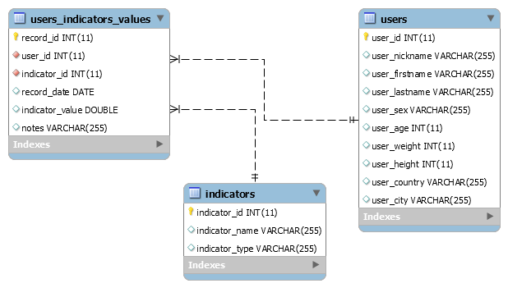
myHealthApp – ER Diagram

Slide 6
Backend: data_prep.py
The aim of the backend work was to create a JSON file to send to Flask.
For this we created a data_prep function which takes database name and username as input and returns a JSON File.
The function :
Is used to make a mySQL database connection.
Use SQLALCHEMY to reflect tables and write queries

Slide 7
Backend: data_prep.py
The following queries were used to build the user dictionary:
Design a query to retrieve the patient’s unique user id based on the username input parameter.
Design a query to retrieve the patient/user first and last name
Design a query to retrieve all the indicator ids for the patient
Design a query to retrieve all the indicator names for the patient's Indicator ids
Design a query to retrieve all the indicator type for the patient's Indicator ids
Design a query to retrieve the patient’s start date of the observations
Design a query to retrieve the patient’s end date of the observations
Design a query to retrieve the observation details for patient's indicators for a period of time
Design a query to determine the observation period for patient's indicators
Combine all the result sets to create a final dictionary and convert it to a JSON file to be consumed by FLASK.

Slide 8
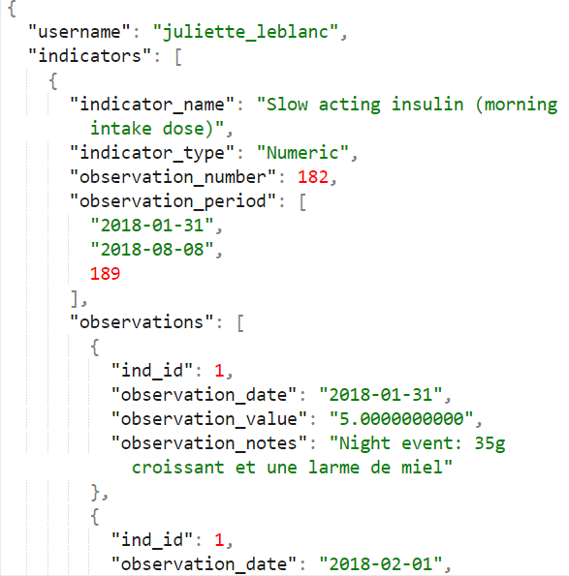
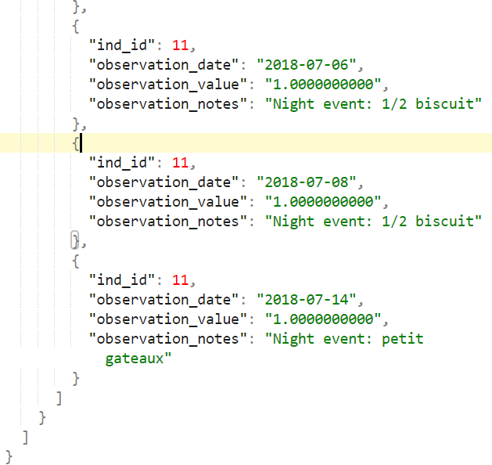
Backend: data_prep.py
The final JSON structure –

Slide 9
Future Features/Enhancements
Authentication: Signup or Sign In to the App by creating a user’s account and logging in using a username and password.
Health Summary : A summary of information about all medications that our user is taking (names, doses, schedule for taking medications) and to download basic information (e.g. main side effects, drug interactions, composition, rules for taking of these medications, etc.) about these medications from different DBs (or APIs).
User’s Indicators Control
Calendar: The feature will allow user to choose a date from a calendar pop-up.
Alerts: To send alert messages to the user for medication reminders and reminders to log medication details into the App.
Visualization: To create some graphs for indicators monitoring (indicators dynamics, etc.)

