Slide 1
TEMPEST DESIGN DISCUSSION
A mathematical closure bake-off for TEMPEST
A computational evaluation harness for analytic, learned, and hybrid closures
Notes:
Frame the project as a computational evaluation harness for closure science: fixed test problems and forcing regimes, one model interface, and uniform accuracy, stability, reliability, and cost metrics. MTF is the first application profile, not the definition of the framework.
[Sources]
- README.md
- docs/PROJECT_BRIEF.md
- docs/benchmark_specification.md
- docs/evaluation_protocol.md

Slide 2
First ask: what mathematical object does the method learn?
(Methods = PINNs, neural ops, ROD, neural ODEs, world models, etc.)
One solution
PINN One PDE instance from residuals, conditions, and optional observations.
A solution operator
Neural operator / PINO A family of solution maps from paired simulations, optionally with residuals.
Reduced dynamics
Closure / neural ODE / world model A closure, vector field, flow map, memory state, or controlled simulator.
2
Notes:
The background chapter's unifying move is to classify methods by the mathematical object being approximated and by the information each method receives.
[Sources]
- references/closure_pinns_operators_world_models.pdf

Slide 3
Mathematical work/theory to organize the discarded information
(Currently using Hani, et al. to rigorously define and prove these triple closures)
PARTICLE -> KINETIC
KINETIC -> FLUID
WAVE -> KINETIC
Hard spheres -> Boltzmann
Collision cumulants encode connected recollisions.
Boltzmann -> fluid
One linked limit tracks error across both reductions.
NLS -> WKE
Spectral cumulants and layered gardens encode resonant history.
3
Notes:
These papers are rigorous scale-limit results, not ready-made MTF closures. Their computational value is the organization of discarded correlations, histories, and remainder terms.
[Sources]
- https://arxiv.org/abs/2408.07818
- https://arxiv.org/abs/2503.01800
- https://arxiv.org/abs/2311.10082

Slide 4
Transfer the diagnostics of Hani, et al.—not the physics
Controlled scaling
Dilute particles or weak waves admit a clean small parameter and a provable limit.
Idealized structure
Controlled geometry and interactions make discarded cumulants asymptotically small.
TEMPEST physics
Magnetized, driven, bounded multiphysics adds long-range forces, shocks, interfaces, and nonlocal transport.
Closure failure is the target
Correlations and memory may remain order one—and must be measured.
Reuse the harness; replace the equations, assumptions, state, and coefficients.
4
Notes:
The canonical results and TEMPEST applications do not share a physical regime. The reusable object is the diagnostic and evaluation harness. Each application replaces the equations, state, scalings, constraints, architecture, and trained coefficients.
[Sources]
- docs/mathematical_closure_program.md
- docs/benchmark_specification.md
- docs/evaluation_protocol.md
- https://arxiv.org/abs/2408.07818
- https://arxiv.org/abs/2503.01800
- https://arxiv.org/abs/2311.10082

Slide 5
Hani, et al. proofs provide four testable hypotheses
Detectability
Correlation diagnostics precede resolved-model error.
Compressibility
A compact cumulant state explains closure error.
Finite memory
At matched dimension, bounded history beats a Markov correction.
Transfer
After physics-specific adaptation, the harness recovers closure state and failure regimes.
f2 = f1 f1 + g2 | partial_t f1 = L f1 + C[f1] + R[g2, g3, ...]
5
Notes:
Detectability, compressibility, finite memory, and transfer become uniform tests in the harness. Failure of any hypothesis is a scientific result, not a reason to discard a run.
[Sources]
- docs/mathematical_closure_program.md
- docs/benchmark_specification.md
- docs/evaluation_protocol.md

Slide 6
Design: one computational harness, many closure strategies plug in
Fixed test suite
Canonical and application problems span valid and controlled-breakdown regimes.
Common interface
Invoke analytic, learned, and hybrid closures through the same adapter.
Uniform evaluation
Score accuracy, stability, reliability, structure, and cost with shared code.
TEST
INVOKE
SCORE
6
Notes:
This is the computational evaluation harness: a fixed suite of problems and forcing regimes, a common interface for analytic, learned, and hybrid closures, and a standardized battery of accuracy, stability, reliability, structure, and cost metrics. Data handling, integration, scoring, and report generation remain shared scaffolding.
[Sources]
- README.md
- docs/PROJECT_BRIEF.md
- docs/benchmark_specification.md
- docs/evaluation_protocol.md
- docs/DECISIONS.md

Slide 7
Fair by construction: match information and compute (some methods assume PDEs, some require all data)
Every run carries an information ledger.
No method gets a hidden advantage from closure labels, future history, test-time cumulants, or extra solver calls.
Report matched-information, matched-compute, and unrestricted results separately.
Equations
Full / partial / none
Data
Pairs / ensembles / trajectories
Online state
Cumulants / moments / history
Deployment cost
Solver calls / actions / observables
7
Notes:
The shared harness makes fairness an engineering property rather than a promise. Every result records equation access, data, online state, solver calls, actions, observables, compute, and failures.
[Sources]
- docs/information_budgets.md
- docs/evaluation_protocol.md
- docs/DECISIONS.md

Slide 8
The harness transfers to any application; each application replaces the physics
1 CANONICAL TESTS
2 PHYSICS MAP
3 SCIENCE TEST
Validate the harness
Measure limits, correlations, memory, uncertainty, and failure boundaries.
Replace the physics
Replace equations, state, scales, constraints, and observables; define the closure defect.
Make the decision
Retrain, embed, and test a domain quantity at acceptable risk and cost.
8
Notes:
The evaluation harness transfers across applications; the physical model does not. Each application supplies a physics map that replaces equations, state, scalings, constraints, observables, architecture, and coefficients before the science test.
[Sources]
- docs/PROJECT_BRIEF.md
- docs/mathematical_closure_program.md
- docs/benchmark_specification.md

Slide 9
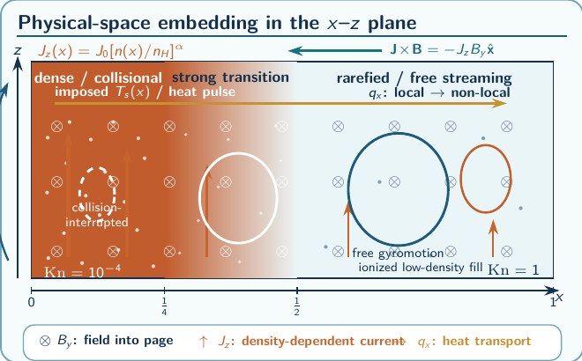
MTF is Application Profile 1
MTF application profile
High fidelity 1D2V kinetic slab Reduced carrier Braginskii MHD Closure target q = q_Brag + delta q_NL Gate recover the local limit; preserve conservation and admissibility; improve a design observable with quantified uncertainty.
9
Notes:
MTF is Application Profile 1. The shared harness supplies data handling, integration, scoring, and provenance; the MTF physics map supplies the 1D2V kinetic reference, Braginskii carrier, nonlocal heat-flux target, constraints, and design observable.
[Sources]
- references/TEMPEST_Line_of_Sight_to_Magnetic_Target_Fusion_Andrew.pdf, pages 8-10
- references/TEMPEST_proposal.pdf
- docs/benchmark_options_memo.md
- docs/benchmark_specification.md

