Slide 1



Towards Understanding the Invertibility of Convolutional Neural Networks
Anna C. Gilbert¹, Yi Zhang¹, Kibok Lee¹, Yuting Zhang¹, Honglak Lee^{1,2} ¹University of Michigan ²Google Brain

Slide 2
Invertibility of CNNs
Reconstruction from deep features obtained by CNNs is nearly perfect.

Slide 3
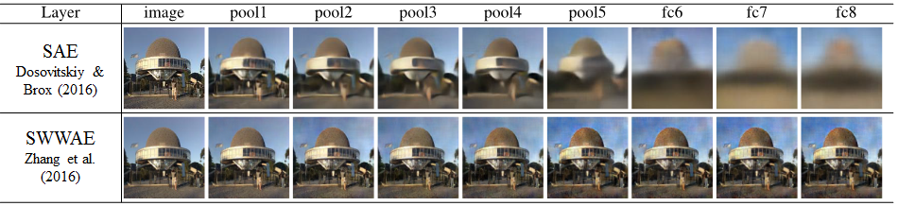
Invertibility of CNNs
Reconstruction from deep features obtained by CNNs is nearly perfect.
Stacked “what-where” autoencoders (SWWAE) (Zhao et al., 2016)
Unpooling max-pooled values (“what”) to the known switch locations (“where”) transferred from the encoder
Zhao et al., Stacked what-where auto-encoders, ICLR 2016
Dosovitskiy and Brox, Inverting visual representations with convolutional networks, CVPR 2016
Zhang et al., Augmenting supervised neural networks with unsupervised objectives for large-scale image classification, ICML 2016

Slide 4
Invertibility of CNNs
Reconstruction from deep features obtained by CNNs is nearly perfect.
We provide theoretical analysis about the invertibility of CNNs.
Contribution:
CNNs are analyzable with the theory of compressive sensing.
We derive a theoretical reconstruction error bound.

Slide 5
Outlines
CNNs and compressive sensing
Reconstruction error bound
Empirical observation

Slide 6
CNNs and compressive sensing

Slide 7
Outlines
Components of CNNs
Which parts need analysis
Compressive sensing
Restricted Isometry Property (RIP)
Model-RIP
Theoretical result
Transposed convolution satisfies the model-RIP

Slide 8
Components of CNNs
The state-of-the-art deep CNN architectures consist of
Convolution
Pooling
Nonlinear activation (ReLU: max(0,x))
Conv
Pool
Nonlinear
Width
Channels
Height
Output
Input

Slide 9
Components of CNNs
The state-of-the-art deep CNN architectures consist of
Convolution
Pooling
Nonlinear activation (ReLU: max(0,x))
Shang et al. (2016): learned CNN filters with ReLU tend to come in positive and negative pairs
Thus invertible
f(x) = max(0,f(x)) - max(0,-f(x))
Conv
Pool
Nonlinear
Output
Input
Shang et al., Understanding and improving convolutional neural networks via concatenated rectified linear units, ICML 2016

Slide 10
Components of CNNs
The state-of-the-art deep CNN architectures consist of
Convolution
Pooling
Conv
Pool
Output
Input

Slide 11
Components of CNNs and decoder
The state-of-the-art deep CNN architectures consist of
Convolution
Pooling
Its decoding networks consist of
Unpooling
Deconvolution
Conv
Pool
Unpool
Deconv
Output
Input
Recon

Slide 12
Components of CNNs and decoder
The state-of-the-art deep CNN architectures consist of
Convolution
Pooling
Its decoding networks consist of
Unpooling (with pooling switches)
Deconvolution
Conv
Pool
Unpool
Deconv
Output
Switch
Input
Recon

Slide 13
Components of CNNs and decoder
Unpooling without switches
Unpool to top-left corner in each block
1 | 5 | 4 | 4
2 | 6 | 7 | 9
8 | 0 | 1 | 5
3 | 3 | 2 | 6
6 | 0 | 9 | 0
0 | 0 | 0 | 0
8 | 0 | 6 | 0
0 | 0 | 0 | 0
6 | 9
8 | 6
Conv
Pool
Unpool
Deconv
Output
Input
Recon

Slide 14
Components of CNNs and decoder
Unpooling with switches
Unpool to where the pooled values was
1 | 5 | 4 | 4
2 | 6 | 7 | 9
8 | 0 | 1 | 5
3 | 3 | 2 | 6
0 | 0 | 0 | 0
0 | 6 | 0 | 9
8 | 0 | 0 | 0
0 | 0 | 0 | 6
6 | 9
8 | 6
Conv
Pool
Unpool
Deconv
Output
Switch
Input
Recon

Slide 15
Components of CNNs and decoder
How can we get the reconstruction error bound?
Encoder | Decoder
Convolution | Deconvolution
Pooling | Unpooling
Conv
Pool
Unpool
Deconv
Output
Switch
Input
Recon

Slide 16

Compressive sensing
Compressive sensing
Acquiring and reconstructing a signal in an underdetermined system Φ
Restricted isometry property (RIP)
For a vector z with k non-zero entries, ∃ δ_{k} > 0 s.t.
Nearly orthonormal on sparse signals
Gaussian random matrices satisfy RIP with high probability. (Vershynin, 2010)
Can we say that (de)convolution satisfies RIP?
Is the output of CNNs sparse?
Is (de)convolution multiplicative?
Is Gaussian random filters assumption reasonable?
Vershynin, Introduction to the nonasymptotic analysis of random matrices, arXiv 2010

Slide 17

Compressive sensing
Is the output of CNNs sparse?
Taking account of pooling and the recovery from unpooling, yes.
Zero padding
ReLU also contributes to the sparsity.
The sparse signal is structured.
Model-RIP
RIP for a “model-k-sparse” vector z
Divide the support of c into K blocks (channels)
Each block has at most one non-zero entry
k non-zero entries in total (k < K)
K blocks
k non-zero entries (k < K)

Slide 18
Compressive sensing
Is (de)convolution multiplicative?
Let’s think about 1-d example.
Filter
Input
Output

Slide 19
Compressive sensing
Is (de)convolution multiplicative?
Let’s think about 1-d example.
Filter
Input
Output

Slide 20
Compressive sensing
Is (de)convolution multiplicative?
Let’s think about 1-d example.
Filter
Input
Output

Slide 21
Compressive sensing
Is (de)convolution multiplicative?
Let’s think about 1-d example.
Filter
Input
Output

Slide 22
Compressive sensing
Is (de)convolution multiplicative?
Let’s think about 1-d example.
Equivalently, in matrix multiplication form,
Input
Output
Filters

Slide 23
Compressive sensing
Is (de)convolution multiplicative?
Let’s think about 1-d example.
Taking account of multiple input and output channels,
Wx = z
x
z
W

Slide 24
Compressive sensing
Is (de)convolution multiplicative?
The below 1-d example is extendable to 2-d.
Taking account of multiple input and output channels,
Wx = z
x
z
W

Slide 25
Compressive sensing
Is Gaussian random filters assumption reasonable?
Proved to be effective in supervised and unsupervised tasks
Jarrett et al. (2009), Saxe et al. (2011), Giryes et al. (2016), He et al. (2016)
Jarrett et al., What is the best multi-stage architecture for object recognition?, ICCV 2009 Saxe et al., On random weights and unsupervised feature learning, ICML 2011 Giryes et al., Deep neural networks with random gaussian weights: A universal classification strategy, IEEE TSP 2016 He et al., A powerful generative model using random weights for the deep image representation, arXiv 2016

Slide 26
CNNs and Model-RIP
In summary,
Is the output of CNNs sparse? Unpooling places lots of zeros, so yes.
Is (de)convolution multiplicative? Yes.
Is Gaussian random filters assumption reasonable? Practically, yes.
Corollary: In random CNNs, transposed convolution operator (WT) satisfies
model-RIP with high probability.
Small filter size makes negative contribution to the probability.
Multiple input channels make positive contribution to the probability.

Slide 27
Reconstruction error bound

Slide 28
Outlines
CNNs and IHT
The equivalency of CNNs and a sparse signal recovery algorithm
Components of CNNs and decoder via IHT
Theoretical result
Reconstruction error bound

Slide 29

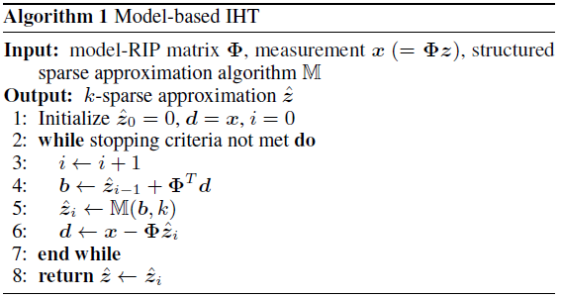
CNNs and IHT
Iterative hard thresholding (IHT) is a sparse signal recovery algorithm. (Blumensath and Davies, 2009)
Convolution + pooling can be seen as one iteration of IHT.
Φ : model-RIP matrix; e.g., WT in CNNs
M : block sparsification operator; e.g., pooling + unpooling
Deconv
Conv + Pool + Unpool
Blumensath and Davies, Iterative hard thresholding for compressed sensing, Applied and Computational Harmonic Analysis, 2009

Slide 30
Components of CNNs and decoder
Encoder | Decoder
Convolution | Deconvolution
Pooling | Unpooling
Conv
Pool
Unpool
Deconv
Output
Switch
Input
Recon

Slide 31
Components of CNNs and decoder via IHT
Encoder | Decoder
Convolution | Transposed convolution
Pooling | Unpooling
Conv
Pool
Unpool
Deconv
Output
Switch
Input
Recon

Slide 32
Components of CNNs and decoder via IHT
Encoder | Decoder
Convolution | Transposed convolution
Pooling + Unpooling
Conv
Pool
Unpool
Deconv
Switch
Input
Output
Recon

Slide 33







Components of CNNs and decoder via IHT
Encoder | Decoder
Convolution | Transposed convolution
Pooling + Unpooling
Switch

Slide 34

Reconstruction error bound
From our theorem, the reconstruction error bound is
Distortion factors 0 < δ_{k}, δ_{2k} < 1 are expected to be small.
Exact calculation is strongly NP-hard.
We can observe the empirical reconstruction errors to measure the bound.

Slide 35
Empirical observation

Slide 36
Outlines
Model-RIP condition and reconstruction error
Synthesized 1-d / 2-d environment
Real 2-d environment
Image reconstruction
IHT with learned / random filter
Random activation

Slide 37


Experiment: 1-d model-RIP
Synthesized environment
To see the distribution of the model-RIP condition and the reconstruction error in an ideal case
Model-k-sparse random signal z
Gaussian random filters (Structured Gaussian random matrix W)

Slide 38

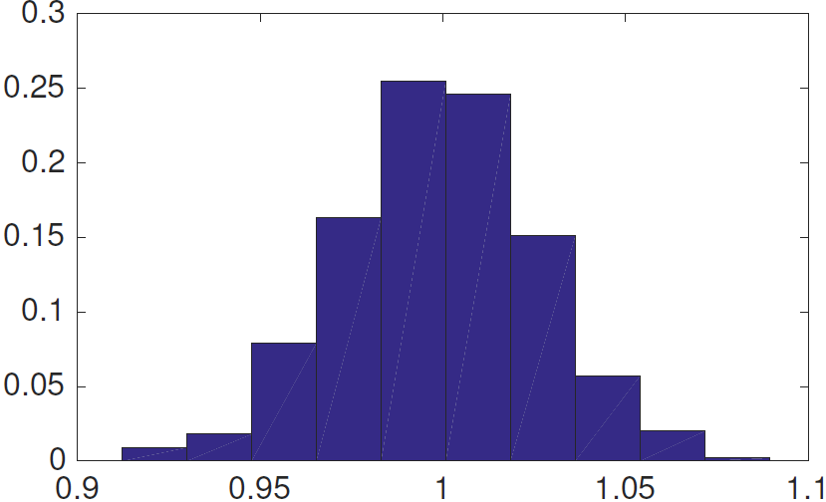
Experiment: 1-d model-RIP
Synthesized environment
To see the distribution of the model-RIP condition and the reconstruction error in an ideal case
Model-k-sparse random signal z
Gaussian random filters (Structured Gaussian random matrix W)
Model-RIP condition:

Slide 39
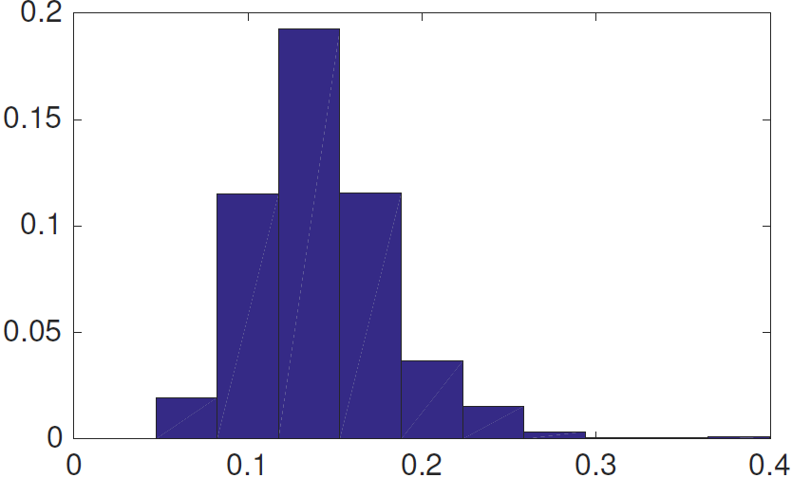
Experiment: 1-d model-RIP
Synthesized environment
To see the distribution of the model-RIP condition and the reconstruction error in an ideal case
Model-k-sparse random signal z
Gaussian random filters (Structured Gaussian random matrix W)
Reconstruction error:

Slide 40

Experiment: 2-d model-RIP
VGGNet-16
To see the distribution of the model-RIP condition in a real case
Latent signal z
conv(5,1) filters
: Conv(5,1)
: Deconv(5,1)
: Pool(4)
: Unpool(4)
Image
Encoder
Switch
Decoder
Recon

Slide 41
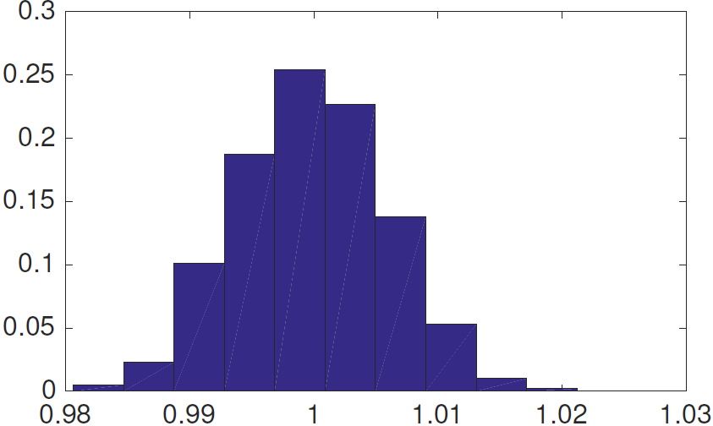
Experiment: 2-d model-RIP
VGGNet-16
To see the distribution of the model-RIP condition in a real case
Model-k-sparse random signal z
conv(5,1) filters
Model-RIP condition:
: Conv(5,1)
: Deconv(5,1)
: Pool(4)
: Unpool(4)
Image
Encoder
Switch
Decoder
Recon

Slide 42
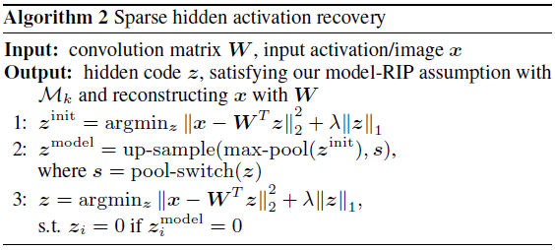
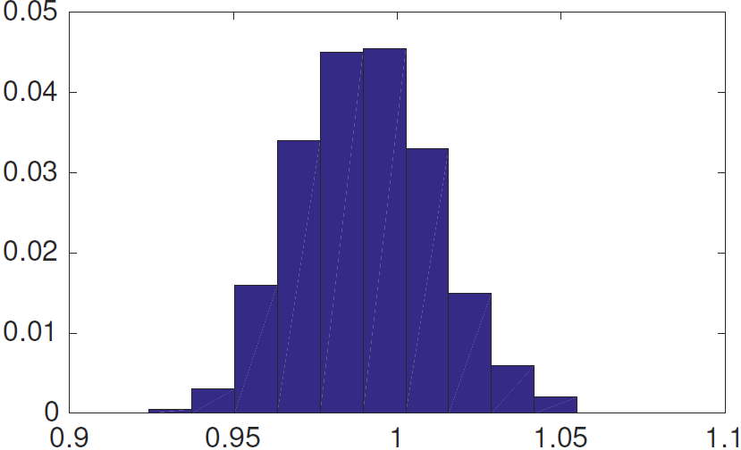
Experiment: 2-d model-RIP
VGGNet-16
To see the distribution of the model-RIP condition in a real case
Model-k-sparse signal z (recovery from Algorithm 2)
conv(5,1) filters
Model-RIP condition:
: Conv(5,1)
: Deconv(5,1)
: Pool(4)
: Unpool(4)
Image
Encoder
Switch
Decoder
Recon

Slide 43
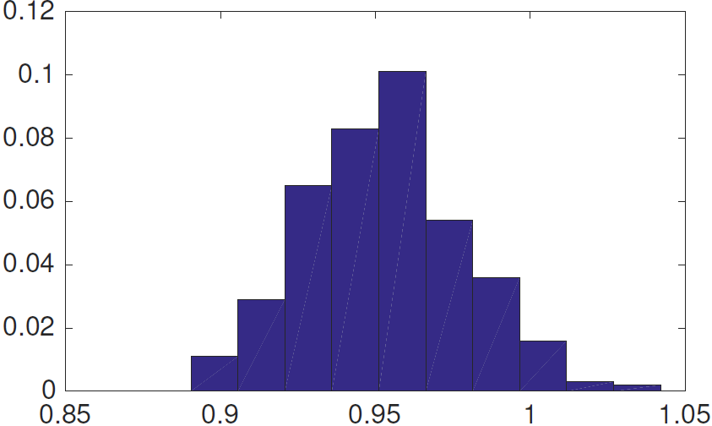
Experiment: 2-d model-RIP
VGGNet-16
To see the distribution of the model-RIP condition in a real case
Model-k-sparse signal z (recovery from Algorithm 2)
conv(5,1) filters with ReLU
Model-RIP condition:
: Conv(5,1)
: Deconv(5,1)
: Pool(4)
: Unpool(4)
Image
Encoder
Switch
Decoder
Recon

Slide 44


Experiment: image reconstruction
W* : Learned deconv(5,1)
W^{T} : transpose of conv(5,1)
VGGNet-16; (a) Original images
: Conv(5,1)
: Deconv(5,1)
: Pool(4)
: Unpool(4)
Image
Encoder
Switch
Decoder
Recon

Slide 45
Experiment: image reconstruction
W* : Learned deconv(5,1)
W^{T} : transpose of conv(5,1)
VGGNet-16; (b) Reconstruction from the learned decoder
: Conv(5,1)
: Deconv(5,1)
: Pool(4)
: Unpool(4)
Image
Encoder
Switch
Decoder
Recon

Slide 46
Experiment: image reconstruction
W* : Learned deconv(5,1)
W^{T} : transpose of conv(5,1)
VGGNet-16; (c) Reconstruction from IHT with learned filters
: Conv(5,1)
: Deconv(5,1)
: Pool(4)
: Unpool(4)
Image
Encoder
Decoder
Recon

Slide 47
Experiment: image reconstruction
W* : Learned deconv(5,1)
W^{T} : transpose of conv(5,1)
VGGNet-16; (d) Reconstruction from IHT with random filters
: Conv(5,1)
: Deconv(5,1)
: Pool(4)
: Unpool(4)
Image
Encoder
Decoder
Recon

Slide 48
Experiment: image reconstruction
W* : Learned deconv(5,1)
W^{T} : transpose of conv(5,1)
VGGNet-16; (e) Reconstruction of random activation from the learned decoder
: Conv(5,1)
: Deconv(5,1)
: Pool(4)
: Unpool(4)
Image
Encoder
Switch
Decoder
Recon

Slide 49
Experiment: image reconstruction
W* : Learned deconv(5,1)
W^{T} : transpose of conv(5,1)
Content information is preserved in the hidden activation.
Spatial detail is preserved in the pooling switches.

Slide 50
Experiment: reconstruction error
W* : Learned deconv(5,1)
W^{T} : transpose of conv(5,1)
VGGNet-16
Macro layer | Image space relative error |  |  | Activation space relative error
1
2
3
4
: Conv(5,1)
: Deconv(5,1)
: Pool(4)
: Unpool(4)
Image
Encoder
Switch
Decoder
Recon

Slide 51
Experiment: reconstruction error
W* : Learned deconv(5,1)
W^{T} : transpose of conv(5,1)
VGGNet-16
Macro layer | Image space relative error |  |  | Activation space relative error
 | (d) Random filters |  |  | (d) Random filters
1 | 0.380 |  |  | 0.872
2 | 0.438 |  |  | 0.926
3 | 0.345 |  |  | 0.862
4 | 0.357 |  |  | 0.992
: Conv(5,1)
: Deconv(5,1)
: Pool(4)
: Unpool(4)
Image
Encoder
Decoder
Recon

Slide 52
Experiment: reconstruction error
W* : Learned deconv(5,1)
W^{T} : transpose of conv(5,1)
VGGNet-16
Macro layer | Image space relative error |  |  | Activation space relative error
 | (d) Random filters | (c) Learned filters |  | (d) Random filters | (c) Learned filters
1 | 0.380 | 0.423 |  | 0.872 | 0.895
2 | 0.438 | 0.692 |  | 0.926 | 0.961
3 | 0.345 | 0.326 |  | 0.862 | 0.912
4 | 0.357 | 0.379 |  | 0.992 | 1.051
: Conv(5,1)
: Deconv(5,1)
: Pool(4)
: Unpool(4)
Image
Encoder
Decoder
Recon

Slide 53
Experiment: reconstruction error
W* : Learned deconv(5,1)
W^{T} : transpose of conv(5,1)
VGGNet-16
Macro layer | Image space relative error |  |  | Activation space relative error
 | (d) Random filters | (c) Learned filters | (e) Random activations | (d) Random filters | (c) Learned filters | (e) Random activations
1 | 0.380 | 0.423 | 0.610 | 0.872 | 0.895 | 1.414
2 | 0.438 | 0.692 | 0.864 | 0.926 | 0.961 | 1.414
3 | 0.345 | 0.326 | 0.652 | 0.862 | 0.912 | 1.414
4 | 0.357 | 0.379 | 0.436 | 0.992 | 1.051 | 1.414
: Conv(5,1)
: Deconv(5,1)
: Pool(4)
: Unpool(4)
Image
Encoder
Switch
Decoder
Recon

Slide 54
Conclusion
In CNNs, transposed convolution operator satisfies model-RIP with high probability.
By analyzing CNNs with the theory of compressive sensing, we derive a reconstruction error bound.

Slide 55
Thank you!

