Slide 1







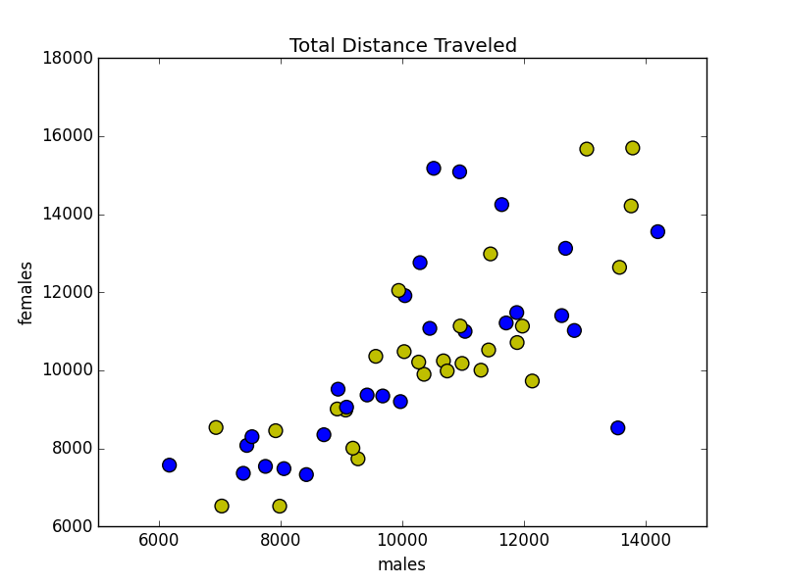
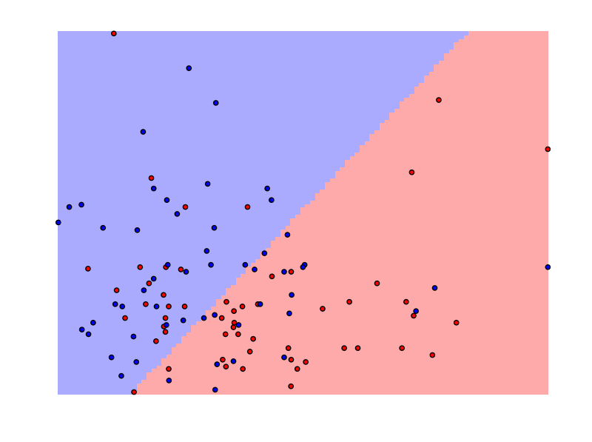
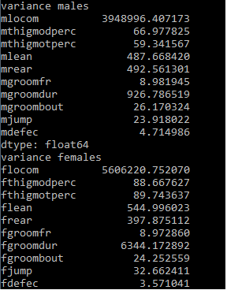
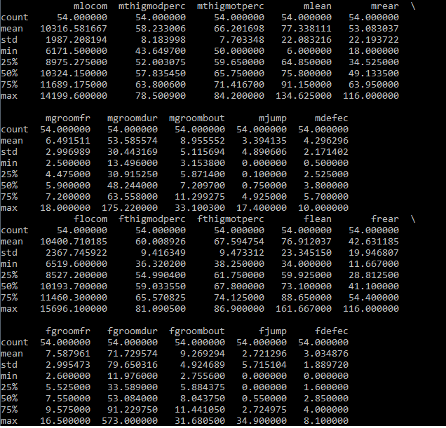
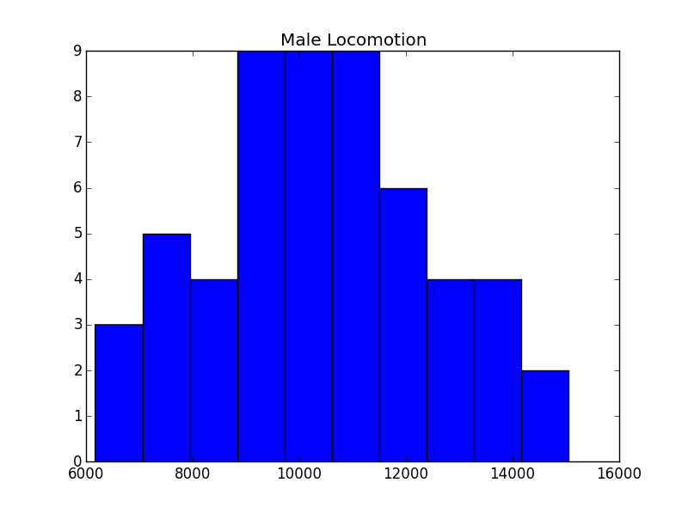
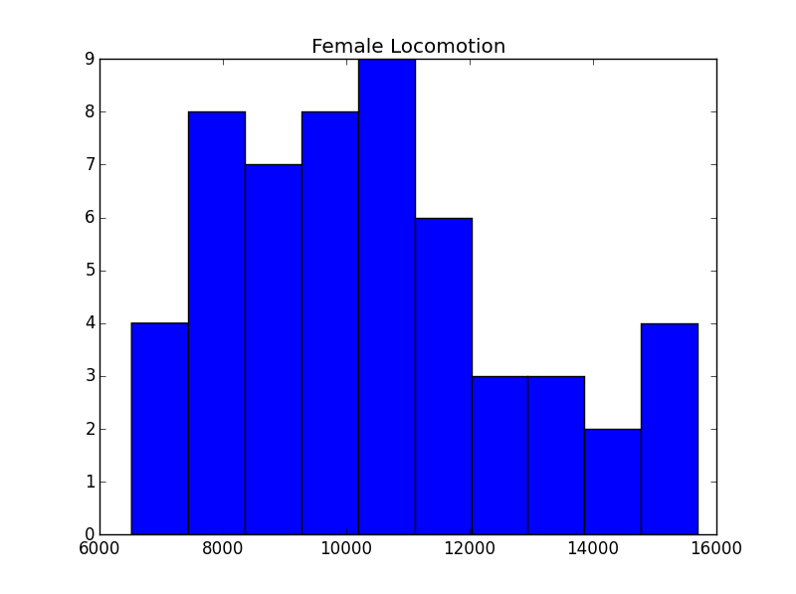
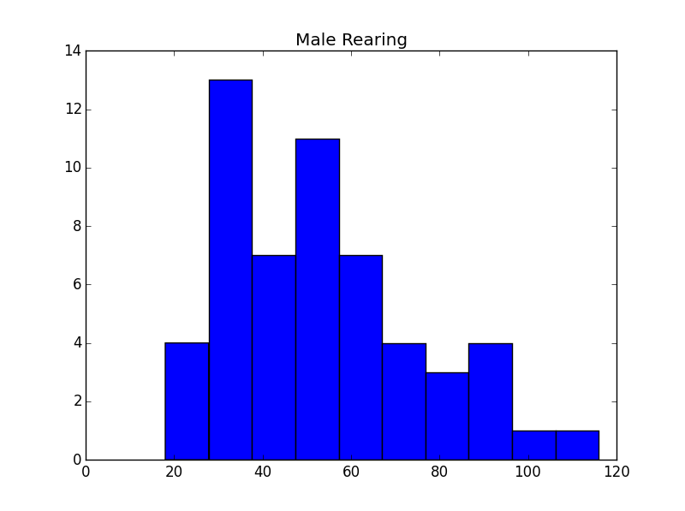
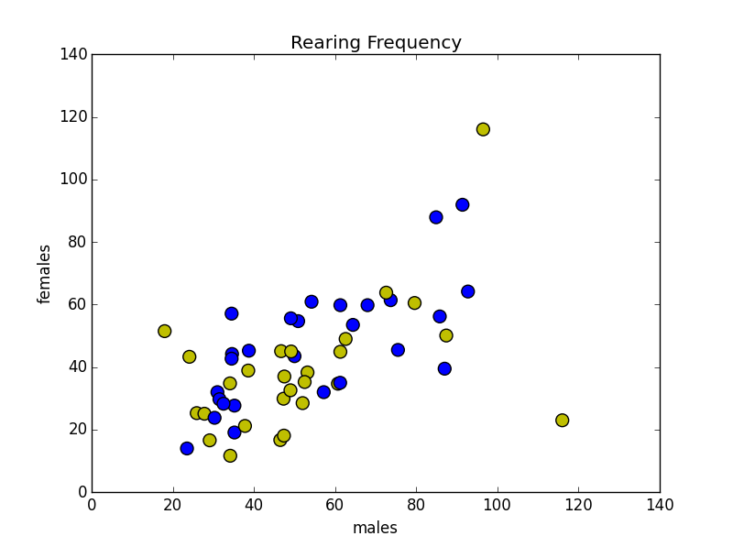
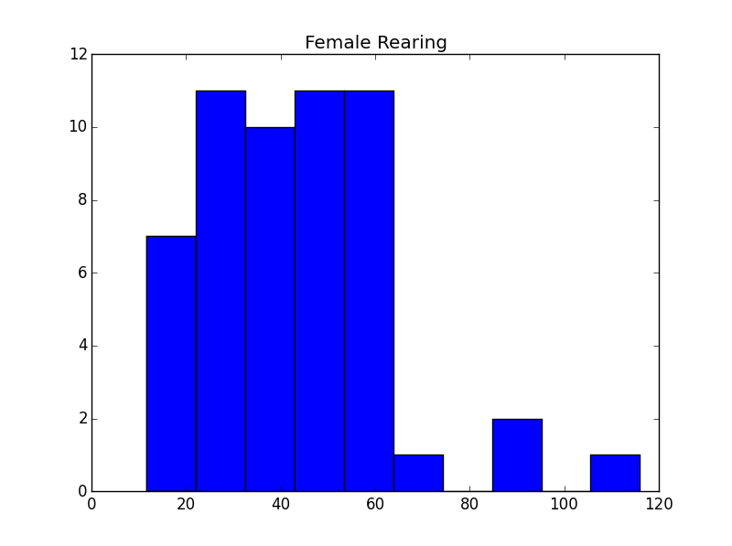
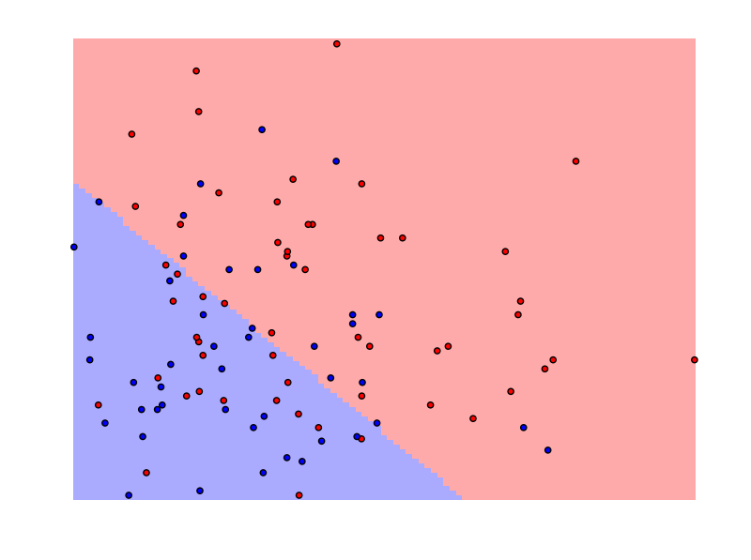
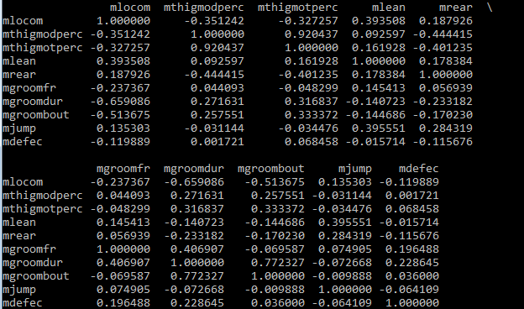
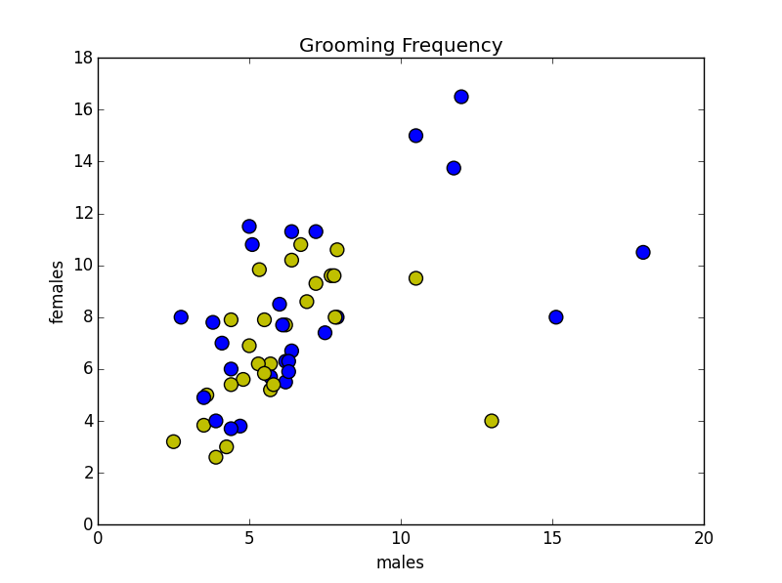
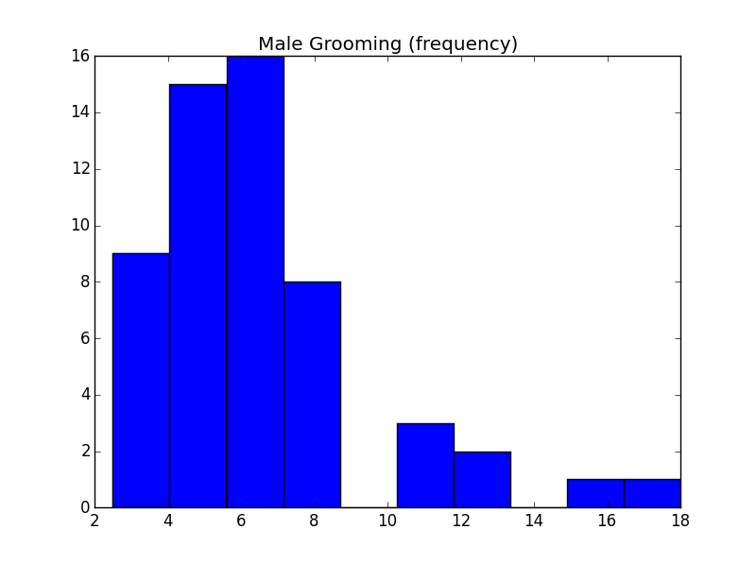
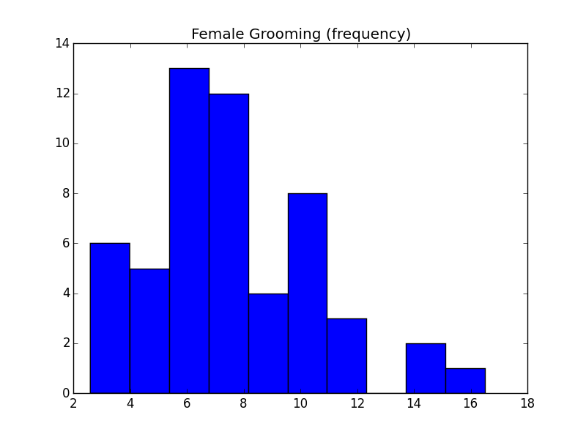
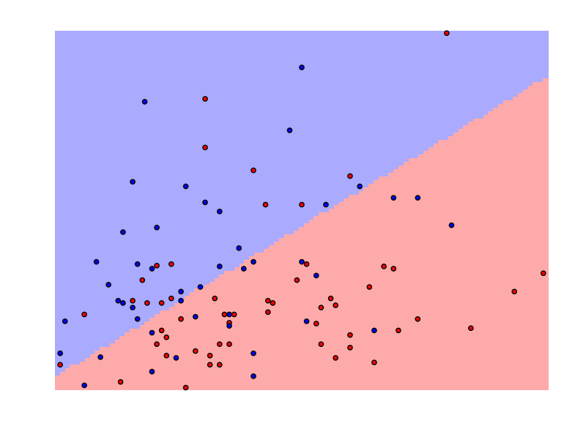
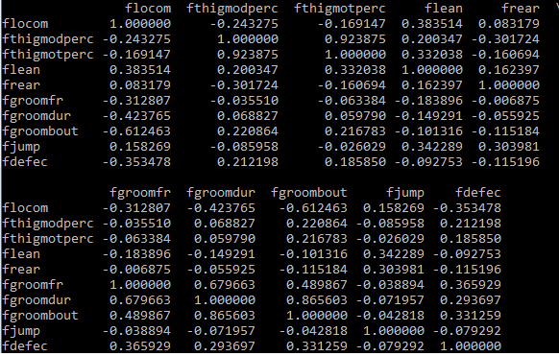
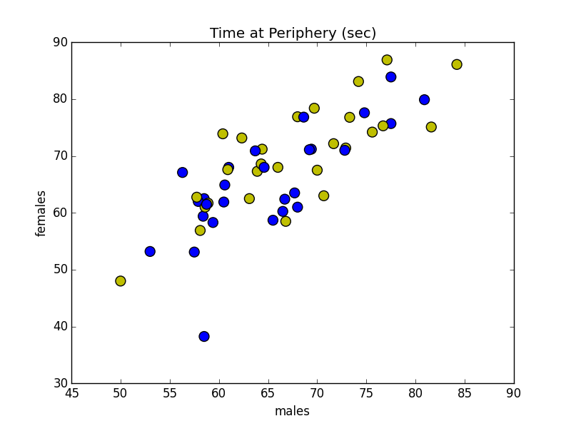
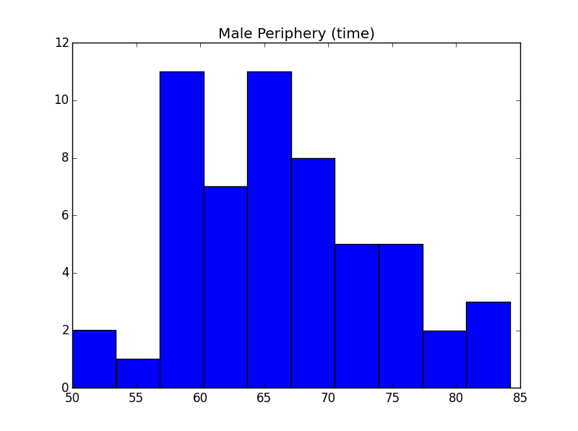
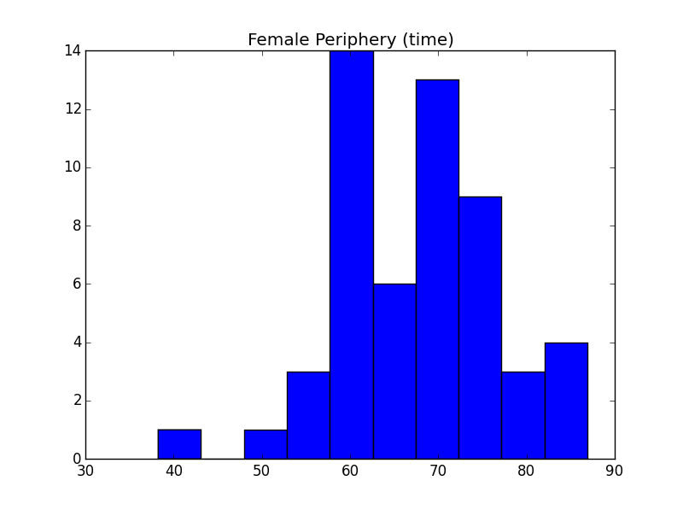
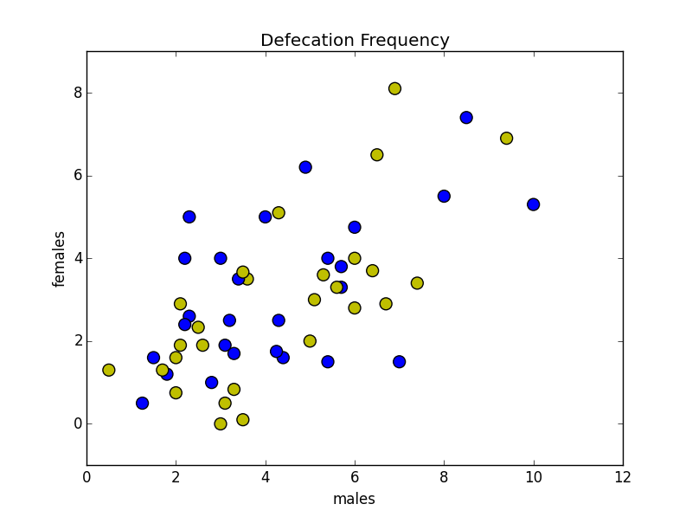
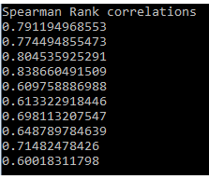

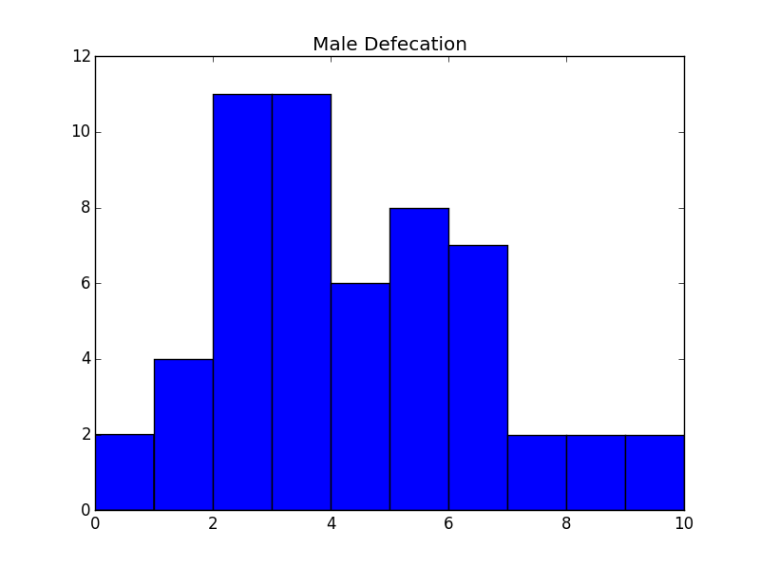
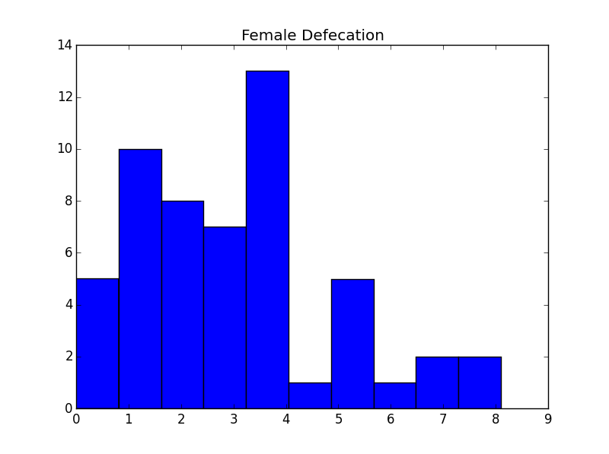

Profiling Sex Differences in Openfield Behavior
^{1,2}Delprato A., ³Erdogan A.,^{1,2} Crusio W.E.
¹Institut de Neurosciences Cognitives et Intégratives d'Aquitaine, Université de Bordeaux and CNRS UMR 5228, Avenue des Facultés, 33405 Talence Cedex, FR
²BioScience Project, Wakefield, MA 01880 ( www.bioscienceproject.org)
³Thinkful, 598 Broadway, New York, NY 10012 (https://www.thinkful.com/)
Background
The openfield is a classic test used to assess exploratory behavior, anxiety, and locomotor activity in rodents.
BXD recombinant inbred mouse strains were tested in the openfield taking into account sex effects exclusively.
Machine learning algorithms were used to classify and predict males/female performance for several openfield related features.
Results
Discussion
Distributions & Correlations
Statistics
SVM Classifier
Overall, male/female performance in the openfield test is highly similar. However for a few features (rearing, grooming frequency, and defecation), differences exist and it may be possible to use these in a classification/prediction scheme.
Two-thirds of the data were classified correctly. Additional data and more homogeneous populations could help to reduce the number of mis-classifications but perhaps not, because there is a great deal of variation in behavioral data in general.
Fine tuning the parameters for the machine learning algorithms may produce a better classification and/or implementing other machine-learning algorithms could be more amenable to profiling this type of data.
A
Locomotor activity
A
B
A
Grooming & Rearing
B
Rearing frequency
B
Figure 2. General statistics for male and female features. Mean, SD, and Range (A), and Variances (B)
Rearing & Defecation
A
Methods
Grooming frequency
The test subjects are monitored continuously throughout the experiment with video tracking software and also by an individual that manually registers the frequencies of certain features. Each experiment lasts 20 minutes. The parameters measured are locomotion total (distance traveled), thigmotaxis (time spent at the periphery zone (surface within 5 cm of the walls), thigmodtaxis (distance from the center), grooming duration, and the frequencies of leaning (standing on hind legs with one or both forepaws against the wall), rearing standing on hind legs with forepaws free), jumping, grooming, and defecation.
53 BXD recombinant inbred strains along with the two parental lines were tested. The values in the data set considered here represent the strain Means. In this study, the data is used to profile sex differences only. Strain effects are not evaluated .
The data were formatted as csv files and read into Python (https://www.python.org) as Pandas dataframes (http://pandas.pydata.org). The general statistical tests: Mean, SD, Variance, Range and Spearman Rank correlations were performed with Pandas.
The histograms and scatter plots were created with Matplotlib (http://matplotlib.org). For the student’s T-test (http://www.scipy.org), Support Vector Machine (SVM) and Gaussian Naive Bayes (NB) analysis, the Pandas dataframes were converted to Numpy arrays (http://www.numpy.org ) prior to further processing.
The SVM and NB analyses were done with Scikit learn (http://scikit-learn.org) using the default parameters (SVM: Linear kernel, C=1) for those algorithms. The SVM results were visualized with methods adapted from https://github.com/jakevdp/sklearn_scipy2013.
C
C
B
Grooming & Defecation
D
Thigmotaxis (% time)
Figure 3. Correlation matrices for feature evaluation. Spearman rank correlations were calculated within male (A) and female datasets (B). Grooming frequency/locomotion and grooming bout/locomotion negatively covaried for both males and females.
Figure 6, A clear separation for many of the points is observed. For each set of features, the number of mis-classified points on either side of the boundary line is about equal (17/18) but is slightly skewed for the rearing and defecation combination which is around 20/16. The total of mis-classified points represents ~1/3 of the data..
Figure 4. Identifying features for classification and prediction. Spearman Rank correlations. between males and females were determined or each feature. All correlations are significant (p≥0.5). Rearing, grooming frequency, and defecation have the lowest values.
A
Naive Bayes Predict
E
Defecation frequency
B
Figure 5. Rearing, grooming frequency, and defecation are statistically different. Student’s t-test was used to determine whether there is a significant difference between males and females for the rearing, grooming frequency, and defecation features. The p-values obtained for each of these variables are smaller than the threshold values of 1%, 5% or 10%. The p-values for the rearing and defecation variables are lowest (t(1) l2.57l, p=0.01 and t(1) l1.90l), p=0.002) whereas, for grooming frequency, the resulting p-value is above the 5% threshold value (t(1) l3.22l, p=0.06).
Figure 7. For the rearing, grooming frequency, and defecation data, parameters could be defined where the NB prediction successfully discriminates between male and female. However, as seen with the SVM analysis ~ 1/3 of the data is mis-classified.
Figure 1. Distribution properties and the relationship between variables for each sex. In general, the data are normally distributed and have relatively the same size tails with some variation. In some cases, there is positive or negative skewing but this is slight. Each of the scatter plots show a positive relationship between males and females for all of the features. The scatter plots in Figure 1, panels A, B, and C have significant clustering whereas, the points in the scatter plot shown in Figure 1 D are disperse and do not exhibit a tight banding pattern.

