Slide 1
MLDS2 · From Notebook to Production · Part 2 of 3
Experiment Tracking and
Model Management
From a reproducible training command to a model an application can retrieve, with MLflow
25 minutes
Lecture: 16 November 2026
1 Train
2 Track
3 Serve
4 Monitor
Notes:
Section opener. Do not stop here: move straight to slide 1 after Presenter 1's handoff question.

Slide 2
We already built a tracker by hand
Part 1's run folders record everything. They do not scale to a team.
OUR OUTPUTS/ FOLDER TODAY
WHAT BREAKS WHEN A TEAM USES IT
2026-11-13_22-13-12Z_ridge_v1_87e9e4/
Search runs across people and machines
Know which runs are comparable
Find last month's run and its exact code
Hand one model to another team
2026-11-13_22-13-27Z_random_forest_…/
manifest.json metrics.json model.pkl
comparison.md (report.py, 200 lines)
… one folder per run, one laptop
Tracking keeps the same records: shared, searchable and linked to the models they produced.
1 Train
2 Track
3 Serve
4 Monitor
2 min
01
Notes:
Timing 0:00-2:00.
Presenter 1 ended with a reproducible command, and every run already leaves a folder: config, metrics, a manifest with the Git commit and data hash, the model. Plus a comparison report that report.py generates, about two hundred lines of our own code.
[Point left] So we have built a small tracker by hand. For one person on one laptop, it works.
[Point right] Now put five people on the project for a month. You cannot search runs on someone else's laptop. You must know which runs are even comparable. You need last month's run and the exact code behind it. And another team needs one model they can load without walking through our folders.
That is the gap experiment tracking fills: the same records, but in a shared, searchable store, linked to the models they produced. Teams use a tool for this rather than growing their own report scripts.
Ask: "Who has kept results in a spreadsheet or a folder of pickles?" Most hands go up.
Transition: "So where does a tool like MLflow fit into the lifecycle?"

Slide 3
Where MLflow fits
Tracking and model management connect reproducible training to application use.
PART 1
MLFLOW TRACKING
MLFLOW MODELS
PART 3
Reproducible training
Experiment tracking
Model management
Application use
Code · data · environment · evaluation
Runs · parameters · metrics · artifacts
Logged models · registry versions · aliases
Serving · monitoring · drift
Boundary: this section ends with a versioned model we can retrieve, not a deployed service.
The same ideas apply to other trackers (e.g. Weights & Biases). We run MLflow locally; a team would share one tracking server.
1 Train
2 Track
3 Serve
4 Monitor
1.5 min
02
Notes:
Timing 2:00-3:30.
Experiment tracking means recording what each execution used, what it measured and what it produced.
[Point to the two green boxes] MLflow covers two parts of the lifecycle. Tracking is an API plus a UI for runs, metrics and files. Model management is a standard model package plus a registry with names and versions.
Presenter 1 owns the left box: correct evaluation and recoverable inputs. Presenter 3 owns the right box: using and monitoring the model. A tracker cannot fix a leaking split. It will faithfully record a misleading score.
[Point to the boundary] My section ends with a model we can identify and load, not with a running service.
MLflow is one concrete tool; Weights & Biases and managed ML platforms implement the same ideas. We run it on a laptop; a team would use a shared tracking server with durable artifact storage.
Transition: "Let us define the objects MLflow organizes."

Slide 4
Experiments, runs and what a run records
An experiment groups related runs and logged models. A run is the record of one execution.
Experiment: electricity-mt158-lecture
Parameters
Metrics
Settings you choose
Outcomes you measure
alpha, max_depth, seed
validation MAE, fold scores
Run
Ridge search
Run
Forest search
Run
Baseline
Artifacts
Tags + datasets
One run can cover a single fit, several CV folds or a whole search. Choose its scope deliberately.
Files you keep
Searchable context
plots, configs, fitted model
purpose, data digest, code version
1 Train
2 Track
3 Serve
4 Monitor
1.5 min
03
Notes:
Timing 3:30-5:00.
In everyday language every attempt is an "experiment". In MLflow, an experiment is a container for one task, here forecasting hourly load for one customer. It groups runs and, in MLflow 3, the logged models they produce.
A run is the record of one execution: an ID, a status, and whatever we log. Note the scope: one run can cover a single fit, three cross-validation folds, or a whole search. Decide that scope on purpose.
[Point to the four cards] Parameters are settings you choose: alpha, tree depth, seed. Metrics are measured outcomes: validation MAE, per-fold scores. Artifacts are files: plots, configs, the fitted model. Tags and dataset inputs add searchable context: purpose, data digest, code version. Parameters are fixed once logged; tags can be updated later.
Ask: "Where would you put a learning rate, an error score and a residual plot?"
Transition: "How are these records created from existing training code?"

Slide 5
Adding MLflow to existing training
Training computes the result. A thin tracking wrapper records it.
1
Open a run
mlflow.set_experiment("electricity-mt158-lecture")
with mlflow.start_run(run_name="forest-depth-10"):
mae = evaluate_cv(pipeline, folds) # compute
pipeline.fit(X_dev, y_dev) # compute
mlflow.log_params({"max_depth": 10, "min_samples_leaf": 3})
mlflow.log_metric("cv_mae_kw", mae)
mlflow.log_artifact("forecast.png")
mlflow.sklearn.log_model(pipeline, name="forecast_pipeline",
input_example=X_dev.head())
A context manager. An exception marks the run FAILED.
2
Compute
The same temporal CV and refit as before.
3
Record
Code version, data identity, config, environment, metrics, files.
4
Package
The fitted pipeline becomes a logged model.
Separate concerns: train.py never imports mlflow. tracking.py wraps it, so training still runs in tests, notebooks and CI without a tracker.
1 Train
2 Track
3 Serve
4 Monitor
2.5 min
04
Notes:
Timing 5:00-7:30.
This is the simplified pattern. The point is where the tracking code lives.
[1] Choose the experiment, then open a run as a context manager. If the code raises an exception, MLflow marks the run FAILED, so a half-finished attempt is never mistaken for a result.
[2] The green lines compute: the same chronological CV and final refit as before.
[3] These lines only record. In a real project, record enough for someone else to investigate the run: the code version, the data identity, the config, the environment, metrics and output files.
[4] The yellow call packages the fitted pipeline as a logged model; that is the bridge to model management.
[Bottom] In our repository, train.py never imports MLflow. A thin wrapper, tracking.py, calls the same training function and logs its result. So the training code still runs in unit tests, in a notebook or in CI without a tracking server. Keep tracking as an adapter around training, not woven through it.
Autologging can record supported libraries automatically; we log manually because only we know which score is the honest validation score.
Transition: "Here is where those records appear."

Slide 6
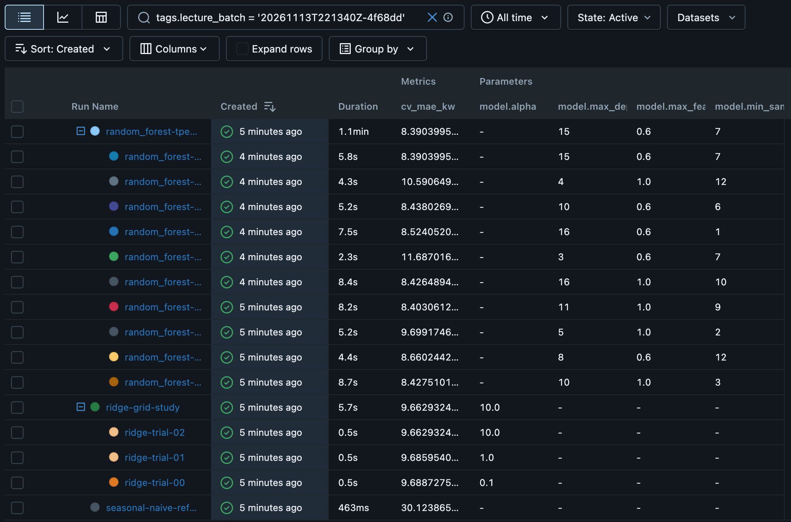
Finding runs in the Tracking UI
Filter by tags, then expand a search into its candidate runs.
1
1
Filter with tags
3
tags.lecture_batch = '…' keeps one batch. Tags find work among hundreds of runs.
2
2
Parent and child runs
A parent is one search; each child is one candidate: 10 forest settings, 3 Ridge alphas.
3
Settings beside outcomes
Parameter and metric columns show what changed and what happened. A run name opens its record.
Actual MLflow 3.18 Runs view of the recorded lecture batch.
1 Train
2 Track
3 Serve
4 Monitor
2 min
05
Notes:
Timing 7:30-9:30.
This is the real Runs view of our recorded batch.
[1] The search box filters on a tag: only runs from one batch. Tags are how you find work among hundreds of runs, by purpose, dataset, author or status.
[2] The search is organized as parent and child runs. The parent is one search for a model family; each child is one candidate configuration: ten forest settings proposed by Optuna, three Ridge alphas. This is the usual way to log a hyperparameter search. Nesting organizes records; it is not nested cross-validation.
[3] Parameters and metrics sit side by side, so you can see which settings changed and what happened. Clicking a run name opens its full record.
Do not read numbers aloud here. The point is navigation: experiment, runs, one run.
Pause and ask: "Which column tells you the tree depth of each candidate?"
Transition: "Tables are one view. MLflow can also chart the same records."

Slide 7
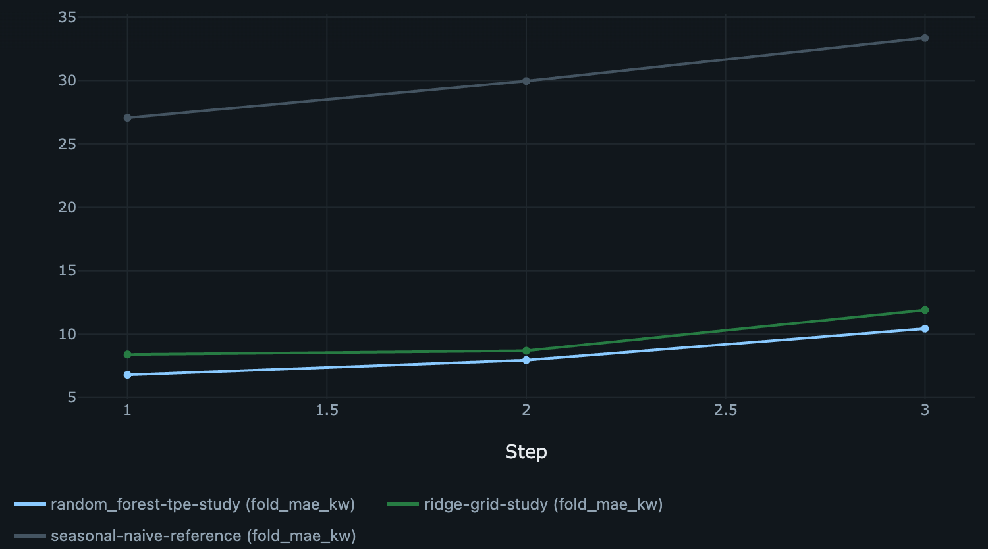
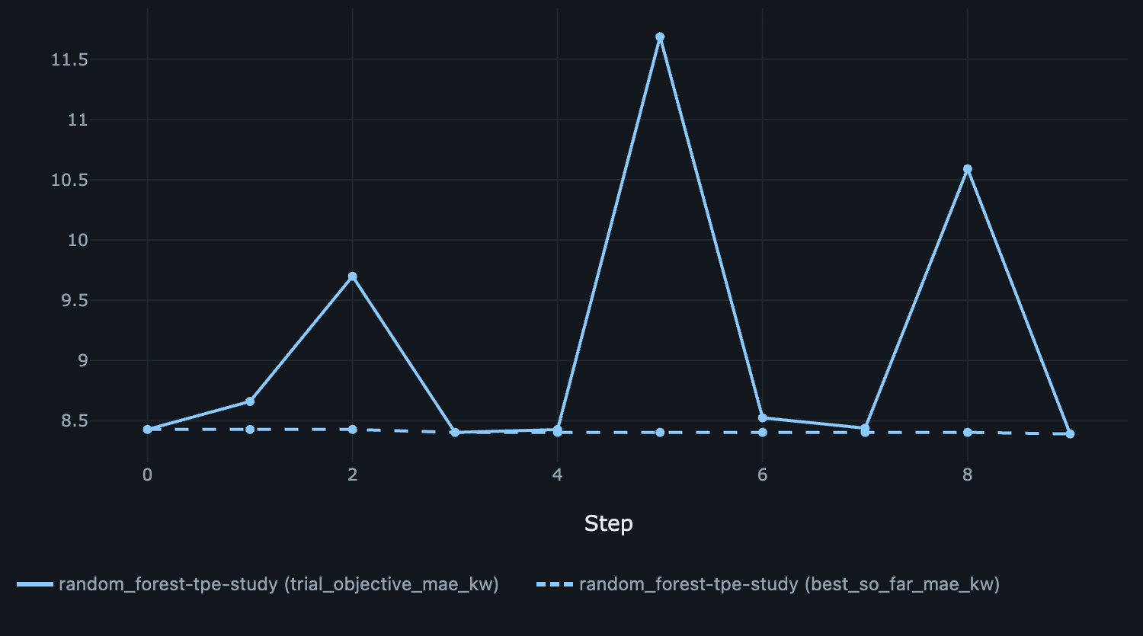
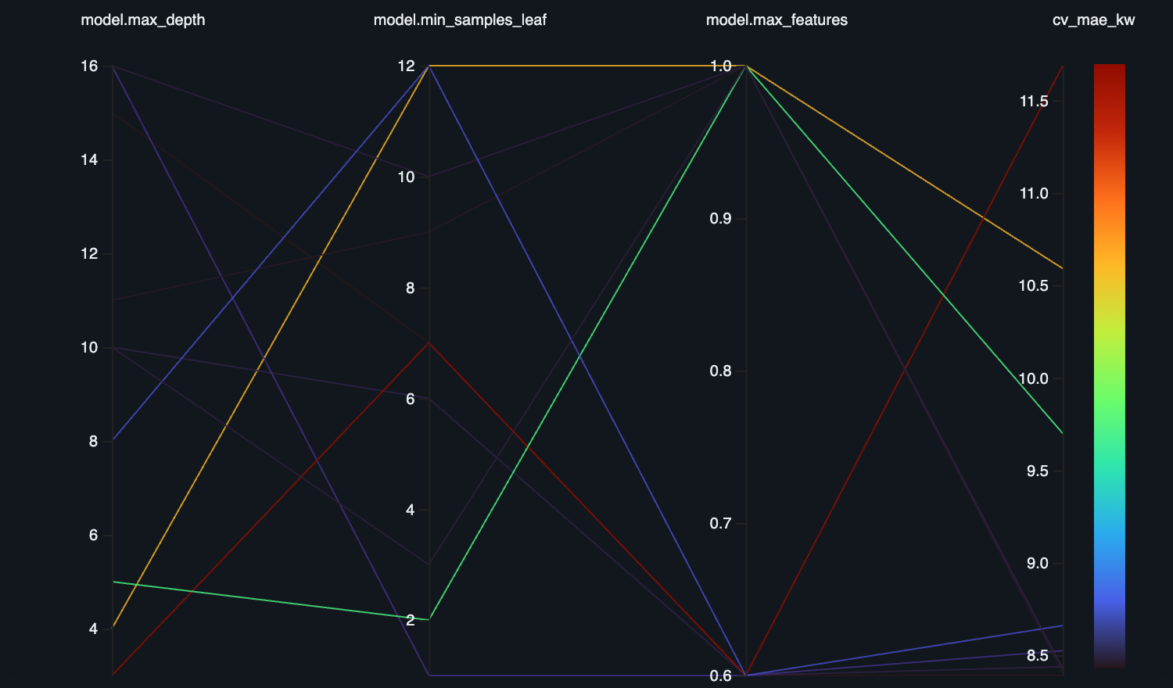
Comparing runs visually
Metrics logged with a step, and parameters per trial, become MLflow charts with no plotting code.
1
Fold error per run
2
Optuna search progress
3
Settings vs error
Step = chronological fold. All runs worsen in fold 3; the baseline stays far above.
Step = trial. Solid: each trial's error. Dashed: best so far; most gain by trial 3, a small gain at trial 9.
One line per forest trial. Shallow trees (depth 3–5) give the three worst errors; depth 10+ all score about 8.4.
Ten trials show search behaviour, not robust parameter importance. Folds are time windows, not epochs.
1 Train
2 Track
3 Serve
4 Monitor
2 min
06
Notes:
Timing 9:30-11:30.
These are MLflow's own charts. We only logged metrics with a step and parameters per trial; the UI draws them, so nobody writes plotting code to compare runs.
[1] Fold error per run. We logged fold_mae_kw with step equal to the fold number. Forest and Ridge stay close and far below the seasonal baseline, and every method gets worse in the third, latest window. That is a reason to look closer, not proof of drift.
[2] The Optuna search on the forest parent run. Step is the trial number. The solid line is each trial's error; the dashed line is the best so far. Most of the gain is made by trial 3, with one small further improvement at trial 9; the spikes are the search exploring poor settings.
[3] Parallel coordinates across the ten forest trials: each line is one trial, coloured by validation error. The three worst trials all use shallow trees, depth 3 to 5. Every trial with depth 10 or more lands around 8.4, whatever its feature fraction, so depth is the one setting that clearly matters here.
[Bottom] Keep the claims modest. Ten trials illustrate search behaviour; they do not prove which parameter matters. And the x-axis in the first chart is time windows, not training epochs.
Transition: "Charts help us investigate. But the decision itself should be code."

Slide 8
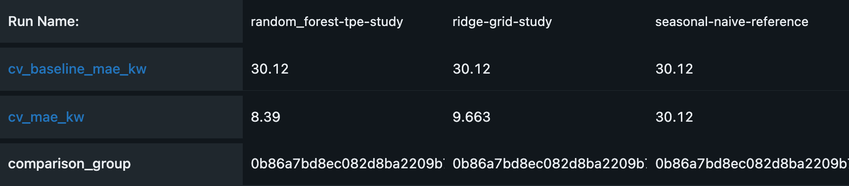
Selecting a model: compare, then decide in code
The UI is for investigating. The decision rule should be code you can rerun.
Select with code
runs = mlflow.search_runs(
experiment_names=["electricity-mt158-lecture"],
filter_string="tags.run_kind = 'study' and "
"attributes.status = 'FINISHED'",
order_by=["metrics.cv_mae_kw ASC"])
best = runs.iloc[0]
assert best["tags.comparison_group"] == group
assert best["metrics.cv_mae_kw"] < baseline_mae
mlflow.register_model(best["tags.model_uri"], name)
Same baseline error and comparison_group = comparable runs
Ranking metric: validation MAE (kW)
RANK ONLY COMPARABLE RUNS
Same data digest, same target hours, same protocol (comparison_group tag), status FINISHED.
Rerunnable, reviewable, CI-ready. Simplified from selection.select_candidate.
1 Train
2 Track
3 Serve
4 Monitor
2 min
07
Notes:
Timing 11:30-13:30.
[Left] MLflow's Compare Runs view for the two search parents and the seasonal baseline. Validation MAE: forest 8.39, Ridge 9.66, baseline 30.12 kilowatts. The amber rows are a quick sanity check: the baseline error and the comparison_group tag are identical in every run. That tag hashes the data, features, evaluation design, code and lockfile, so equal values mean the runs are comparable. MLflow will happily put incomparable numbers side by side, so check data digest, comparison_group and status first.
[Right] The UI is for investigating. The decision itself should be code: search runs with a filter, order by the agreed metric, check comparability and the baseline, then register. Our demo does exactly this in selection.select_candidate. Because it is code, it gives the same answer every time, a colleague can review it, and it can run in CI after every training job instead of someone clicking through a UI.
These are selection scores: the forest search tried ten settings and Ridge three, so they are optimistic. Freeze the choice before any final test.
Transition: "To investigate the selected candidate, we need more than metrics."

Slide 9
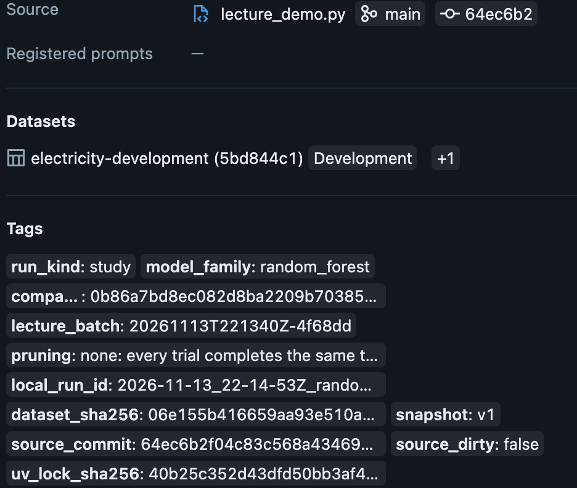
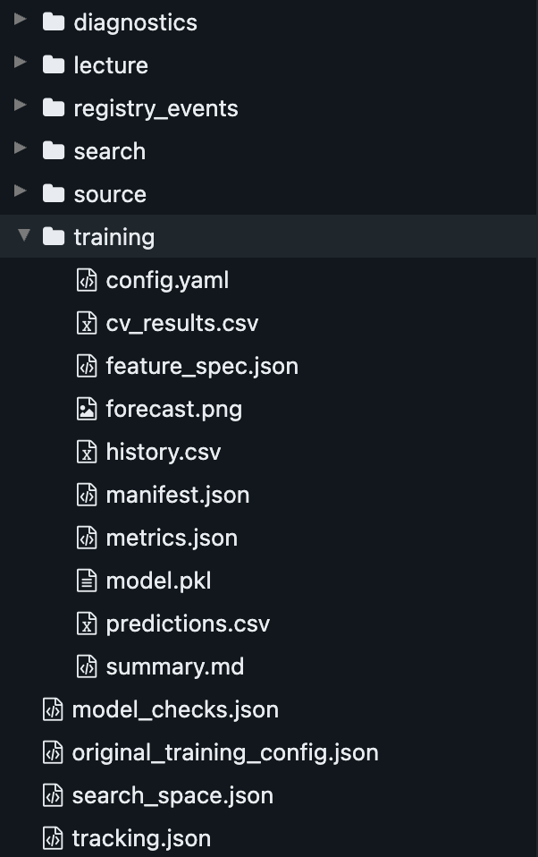
Provenance: where did this result come from?
A run links its result to code, data, environment and outputs.
1
1
Source
Script, branch and Git commit.
2
4
2
Dataset
3
Digest of the data the run used.
3
Tags
Data hash, lockfile hash, commit 64ec6b2 and source_dirty: false.
4
Artifacts
Config, predictions, plots, archived source and uv.lock.
An ID identifies a resource; it does not keep it. Recovery still needs Git, DVC and uv.
1 Train
2 Track
3 Serve
4 Monitor
2 min
08
Notes:
Timing 13:30-15:30.
This is one run's record, the selected forest search.
[1] Source: which script, branch and commit produced it.
[2] Datasets: the digest of the data it used.
[3] Tags: the data hash, the lockfile hash, the exact commit, and source_dirty: false. We committed before running this batch, so anyone can check out commit 64ec6b2 and get exactly this code. Had there been uncommitted changes, the tag would say true, and the commit alone would not describe the code. That is provenance: the origin of a result, recorded honestly.
[4] Artifacts hold the evidence itself: the configuration, predictions, plots, plus archived source files and the uv.lock.
Why it matters: when a result changes, provenance tells you whether the data, the settings or the code changed.
[Bottom] The limit: an ID or a hash identifies something; it does not keep it. A commit hash cannot recover uncommitted code, and a data digest cannot recover deleted data. That is why Presenter 1's Git, DVC and uv still matter. MLflow records evidence; it does not guarantee reproducibility.
Transition: "One artifact is special: the model. Three objects get confused here."

Slide 10
Run, logged model, registered version
Three different objects answer three different questions.
Tracked run
Logged model
Registered version
What was executed and measured?
What exactly was fitted, and how do I load it?
Which model does the team refer to?
random_forest-tpe-study
forecast_pipeline
electricity-mt158-lecture/v2
Registration creates a named, numbered reference. It is not approval and not a deployment.
In our demo the registered model shares the experiment's name. They are still different objects.
1 Train
2 Track
3 Serve
4 Monitor
1.5 min
09
Notes:
Timing 15:30-17:00.
Three objects that are easy to mix up.
[Left] A run answers: what was executed and measured?
[Middle] A logged model answers: what exactly was fitted, and how do I load it? In MLflow 3 it has its own ID and links back to the run that produced it.
[Right] A registered model version answers: which model does the team refer to? It is a numbered entry under a shared name.
Each arrow is a deliberate step. Logging creates the model package; registration gives a selected package a name and a number.
[Bottom] Registration is neither business approval nor deployment. Nothing is being served yet.
One honest detail: in our demo the registered model and the experiment have the same name. They are still different objects. One groups runs, the other groups model versions.
Transition: "Let us open the logged model."

Slide 11
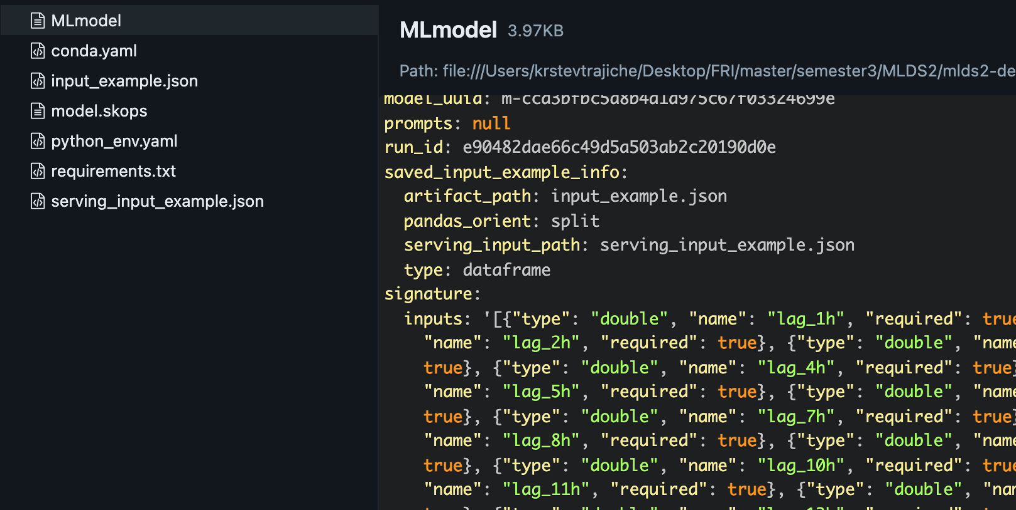
The model contract: what a consumer receives
Another developer gets a reference, an interface and an environment, and must know what is not inside.
HANDED TO THE APPLICATION
Reference
models:/electricity-mt158-lecture/2
Package
Fitted scaling + encoding + estimator
1
2
Input
29 engineered numeric columns
Output
Next-hour load in kW
Environment
requirements.txt (no training tools)
NOT INSIDE THE MODEL: FEATURES BUILT FROM RAW METER HISTORY
Option A · features inside the model
A custom pyfunc wraps the feature code; consumers send raw history.
Option B · shared feature library (our demo)
Consumers call build_next_features, the same feature code training uses.
1 Train
2 Track
3 Serve
4 Monitor
3 min
10
Notes:
Timing 17:00-20:00.
This slide answers the key question of the section: what does another developer or application actually receive?
[Left] A reference to one exact version, a package with the fitted preprocessing and estimator together, an input interface, an output with units, and the environment to load it. [Screenshot 1] Those are the real files of our logged model. [2] The signature lists twenty-nine named double columns. A signature checks names and types; it cannot check that features were computed correctly or were available at prediction time.
[Bottom] The important detail: the model does not receive raw meter readings. Building the twenty-nine lag and rolling features from raw history happens outside it. That is a design decision with two valid answers.
Option A: wrap the feature code inside the model as a custom pyfunc, so consumers send raw history. One artifact, but more model code to maintain.
Option B, our demo: publish the feature code as a shared library. Inference calls build_next_features, which runs the very same feature_table function as training, and a test checks that the two agree. The cost: consumers must install the matching library version.
Either way, write the contract down. For Presenter 3: serving this exact model means sending the twenty-nine features, not raw meter data.
Transition: "With many logged models, how does an application find the selected one, and who decides which one that is?"

Slide 12
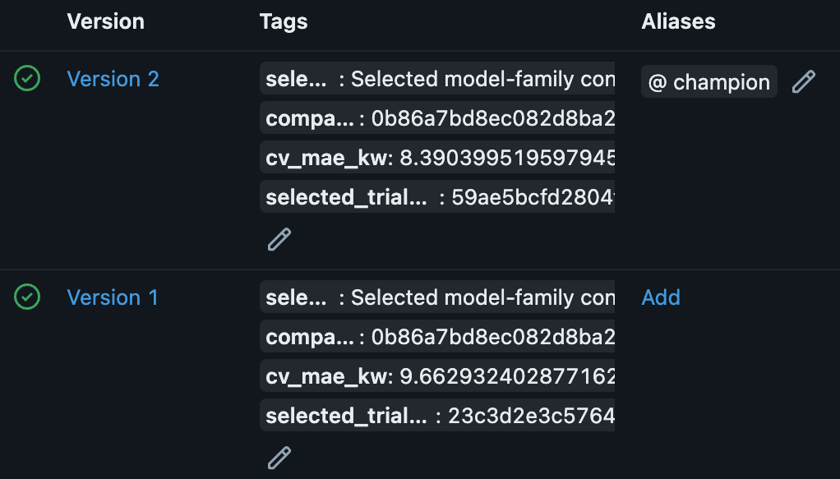
Registry and aliases: the hand-off boundary
Data scientists publish versions; applications load a name the team controls.
1
2
Consumers load by alias
uri = "models:/electricity-mt158-lecture@champion"
model = mlflow.pyfunc.load_model(uri)
v = client.get_model_version_by_alias(
"electricity-mt158-lecture", "champion")
log(v.version) # record what was used
Moving champion is a team decision
3
Tests pass and the selection rule agrees
A second person reviews the change
Old and new version are recorded
1 Numbered versions never change 2 champion → version 2 3 lineage to run and logged model
Moving an alias changes the next load. A running service keeps its model until it reloads.
1 Train
2 Track
3 Serve
4 Monitor
2.5 min
11
Notes:
Timing 20:00-22:30.
The registry is where data science work is handed to the people who run applications.
[1] One registered name groups numbered versions: version 1 is Ridge, version 2 the forest. A number never changes, and a higher number is only a later registration, not a better model.
[2] An alias is a movable name for one version. "champion" is our convention; MLflow does not judge quality. MLflow's old Staging and Production stages are deprecated; aliases and tags replace them.
[3] Each version links back to its source run and logged model, so anyone can see why it was selected.
[Right, top] Applications load by alias, so switching models needs no code change. Resolve and log the version number too, so every prediction stays traceable after the alias moves.
[Right, bottom] Because one alias move changes what production loads, treat it like a code change: the tests pass, the selection rule agrees, a second person reviews it, and the old and new versions are recorded. Our demo records every alias move; in the recorded run we moved champion to version 1 and back.
[Bottom] Moving the alias affects the next load. A batch job picks it up on its next run; a running service keeps its model until it reloads. That is where Presenter 3 continues.
Transition: "So when is a model ready to hand over?"

Slide 13
From a notebook model to a model others can use
Hand a model over only when every item is true.
Training runs headless from a committed revision
Model logged with signature and dependencies
✓
Part 1
✓
MLflow
Environment locked; data version identifiable
Registered version with lineage; alias moved after review
✓
Part 1
✓
MLflow
Tests pass in CI: data contract, parity, reload
Input contract and feature code documented
✓
Part 1
✓
Team
Run tracked: settings, metrics, data identity, files
Known limits stated: nothing monitored yet
✓
MLflow
✓
Part 3
We can identify and retrieve a selected model version. How does an application use it, and how do we know it still works?
1 Train
2 Track
3 Serve
4 Monitor
2.5 min
12
Notes:
Timing 22:30-25:00.
This is the difference between a model that works in a notebook and one another team can rely on.
[Left column] Presenter 1's practices: training runs as one command from a committed revision, the environment is locked and the data version identifiable, and tests that run automatically in CI cover the data contract, training-inference parity and model reload.
[Right column] What we added with MLflow: a tracked run, a logged model with signature and dependencies, and a registered version with lineage whose alias moves only after review. Then the team's part: a written input contract and the feature code consumers need. And an honest statement of limits: nothing is monitored yet.
MLflow covers three of these eight items. The rest is engineering practice; the tool does not provide it.
Handoff to Presenter 3: "We can identify and retrieve a selected model version. How does an application use it, and how do we know it still works?"

Slide 14
Backup: forecasting evaluation details
Development selection CV on identical target hours.
Model | MAE (kW) | RMSE (kW)
Same hour yesterday | 30.124 | 44.606
Ridge (alpha 10) | 9.663 | 13.501
Random forest (depth 15) | 8.390 | 13.146
Every method has its largest error in the last window. That motivates investigation; it does not establish drift. Fold spread is descriptive, not a confidence interval.
1 Train
2 Track
3 Serve
4 Monitor
Backup
A
Notes:
Hidden backup, for questions only.
The reference predicts the same hour's observed load from the previous day. All methods are scored on identical targets, with the same data snapshot, features and folds. Each new observation becomes available before the next one-hour forecast, so a two-week validation block holds advancing one-step forecasts, not one fixed-origin forecast.
These CV predictions come from fold-specific fits; the saved model is a later refit on all development data. That is why the model-linked metrics are called selection_cv_*.
Prompt: "What does the average score hide here?"

Slide 15
Backup: recorded inference contract
Input: at least 168 consecutive observed hours (timestamp, load_kw).
Field | Recorded value
Prediction origin | 2014-11-01 00:00 (last observed hour)
Target | 2014-11-01 01:00
Prediction | 131.984 kW
Resolved model | models:/electricity-mt158-lecture/2 (forest)
Clock | Published Portuguese wall clock, not UTC
Shared features.build_next_features turns observed history into 29 inputs; no future value is supplied. Input validity can be checked immediately; accuracy only once the actual load arrives.
1 Train
2 Track
3 Serve
4 Monitor
Backup
B
Notes:
Hidden backup, for questions only.
The application supplies a table of timestamp and observed load in kW, at least 168 consecutive hours. The shared helper builds the next hour's 29 features, and the loaded pipeline returns one prediction. We know exactly which model produced it: version 2, linked to its source run. When another observation arrives, the next forecast advances by one hour.
For monitoring: data arrival and input validity are known immediately; forecast error only after the actual load is observed.

Slide 16
Backup: validation error by target hour
Selected forest, out-of-fold predictions from the three validation windows.
Diagnostics suggest where to investigate. They do not establish drift, a cause or an alert policy.
1 Train
2 Track
3 Serve
4 Monitor
Backup
C
Notes:
Hidden backup, for questions only.
Every bar comes from validation folds whose pipeline only saw its own training rows. Errors are larger around the evening hours. This tells us where to look; it does not establish drift, a root cause or a production alert policy. The validation-week forecast plot is in assets/random_forest_forecast.png if someone asks what the one-step sequence looks like.

Slide 17
Backup: what the demo shows, and what it does not
Demonstrated
Tracked and nested runs, fair comparison, provenance tags, packaged and reload-verified models, registry versions, alias change and retrieval
Explained conceptually
Serving, application reload, delayed labels and monitoring (Presenter 3)
Not claimed
Shared tracking server, access control, durable artifact store, a tested fresh serving environment
1 Train
2 Track
3 Serve
4 Monitor
Backup
D
Notes:
Hidden backup, for questions only.
If asked about reproducibility across machines: the lock file and model requirements are recorded and local reload is tested, but a fresh, isolated serving environment was not exercised. A team setup would add a shared tracking server, access control and durable artifact storage. Presenter 3 covers the application-facing lifecycle.
Sources: docs/MLFLOW_DEMO.md and docs/MLFLOW_ENHANCED_RESULTS.md.

